Slide 1
Task 2: Paper Review
A Systematic Review on Federated Learning
in Medical Image Analysis
Md Fahimuzzaman Sohan, Anas Basalamah
CSE707: Distributed Computing Systems
Instructor: Annajiat Alim Rasel (AAR)
RA: Md. Sabbir Hossain
ST: Farah Binta Haque
Team: 22
Name: Ahmed Mahir Ruhan
ID: 23366025
‹#›

Slide 2
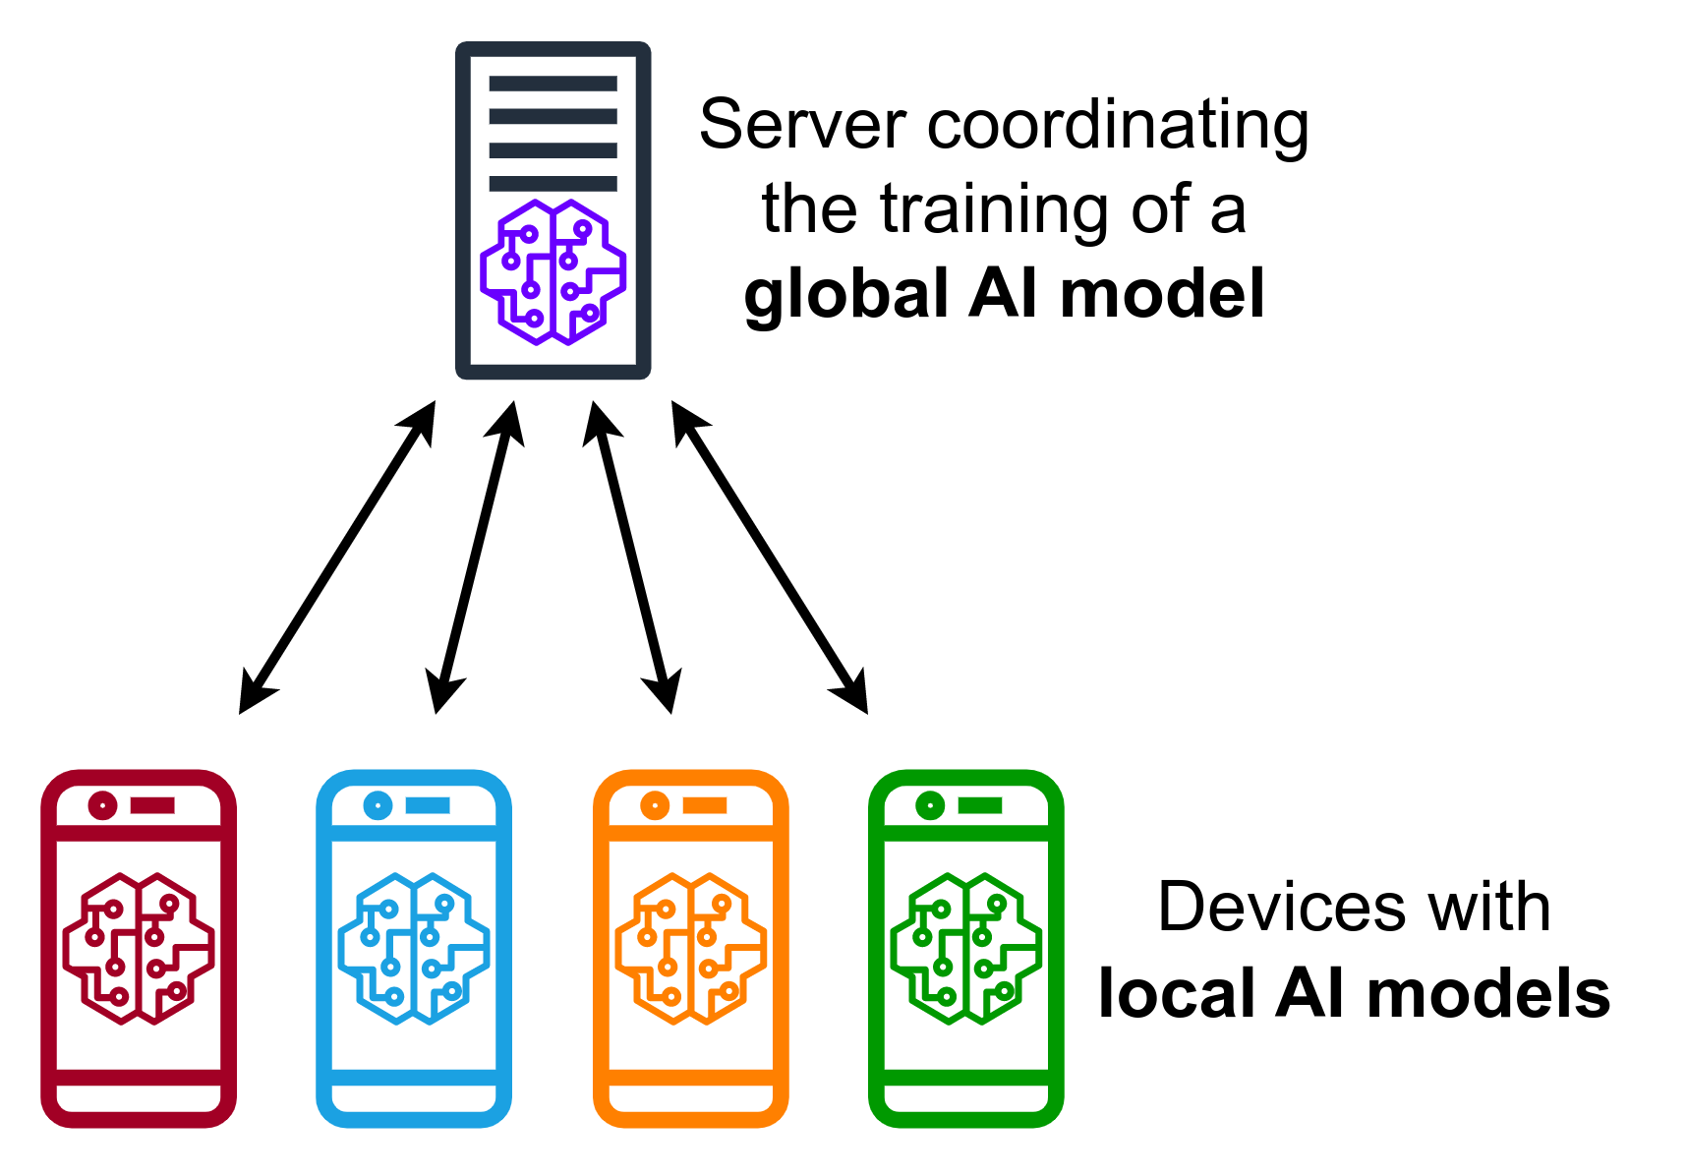
Introduction
Medical data sensitivity
Introduction to federated learning in healthcare
Privacy concerns in medical image analysis
FL's decentralized model training approach

Slide 3
Research Motivation
Addressing privacy concerns in medical data
Importance of decentralized model training
Exploring FL's role in healthcare
Filling the gap in medical image analysis

Slide 4
Research Contribution
Systematic review of FL applications in medical imaging
Highlighting FL's role in critical medical areas
Emphasizing privacy preservation
Addressing challenges and limitations

Slide 5
Methodology
Analysis of diverse medical image datasets
Utilization of CNN architectures
Integration of differential privacy and secure aggregation
Addressing security concerns in FL

Slide 6
FL Method in Datasets
Performance metrics used in FL models
Comparison with traditional ML models
Identification of privacy benefits
Challenges in data heterogeneity and model performance

Slide 7
Conclusion
FL's role in advancing medical data privacy
Comparative analysis of FL and traditional ML models
Importance of FL despite identified challenges
Urgency for practical implementation and resource accessibility

Slide 8
Limitations
Potential exclusion of relevant articles
Limited practical implementation of FL models
Need for more empirical experiments
Accessibility to research materials and code

Slide 9
Synthesis
FL's potential in future medical applications
Role in ensuring data security
Implications for sophisticated analyses
Future scopes in healthcare advancements

Slide 10
References
Sohan, M. F., & Basalamah, A. (2023). A Systematic Review on Federated Learning in Medical Image Analysis. IEEE Access.
https://ieeexplore.ieee.org/abstract/document/10077569/

Slide 11
Thank You!

