Slide 1
Federated Learning via Conditional Mutual Learning for Alzheimer’s Disease Classification on T1w MRI
Task 1: Paper Review
Ya-Lin Huang, Hao-Chun Yang, Chi-Chun Lee
CSE707: Distributed Computing Systems
Instructor: Annajiat Alim Rasel (AAR)
RA: Md. Sabbir Hossain
ST: Farah Binta Haque
Team: 22
Name: Ahmed Mahir Ruhan
ID: 23366025

Slide 2
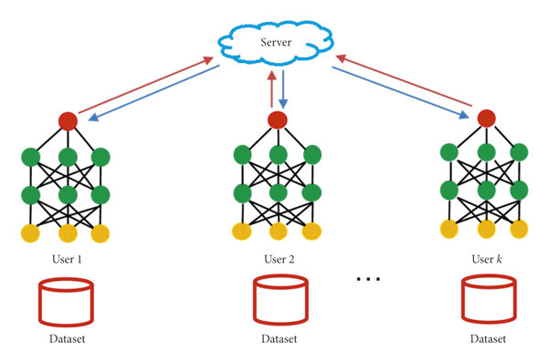
Introduction
Alzheimer's Disease
Most prevalent dementia
urgency for early identification
Federated Learning:
Collaborative model
learning without data sharing

Slide 3
Research Motivation
Non-invasive Alzheimer's detection imperative
Overcoming deep learning limitations in medical realms
Early intervention for improved patient outcomes
Addressing data privacy concerns in medical data sharing

Slide 4
Research Contribution
Introduction of FedCM framework for Alzheimer's classification
Enhancement of federated learning through local performance and data similarity considerations
Preserving data privacy while improving learning efficiency
Overcoming barriers to collaborative medical data analysis

Slide 5
Dataset
Utilization of ADNI, OASIS, AIBL Studies data
Preprocessing via Clinica software platform
Incorporation of diverse MRI data for robust analysis
Ensuring data integrity and reliability across datasets

Slide 6
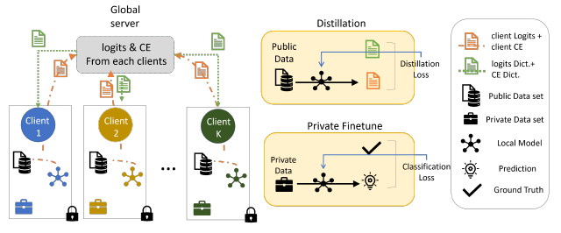
Methodology

Slide 7
Conclusion
FedCM outperforming FedMD & FedAvg in recognition rates
On the AIBL-1 dataset, best accuracy was 93.4% using FedCM (with Entropy Ratio Conditioning and Jensen Shannon Conditioning).
On the AIBL-2, best accuracy was 97.3% using FedCM (with Entropy Ratio Conditioning).
Visualization and relevance ranking of brain ROIs
Demonstrating superiority in Alzheimer's classification
Validating FedCM's effectiveness and potential in medical research

Slide 8
Limitations
MRI data variability: Confounding factors due to diverse scanners and sites
Hindrances in pooling data from different sites due to domain shift
Acknowledgment of limitations for further research
Calls for addressing data variability and domain shift challenges

Slide 9
Synthesis
FedCM's potential in collaborative learning challenges
Future scopes: Overcoming data variability, exploring further investigations
Bridging the gap between medical research and federated learning
Empowering efficient and secure collaborative medical data analysis

Slide 10
References
Huang, Y. L., Yang, H. C., & Lee, C. C. (2021, November). Federated learning via conditional mutual learning for Alzheimer’s disease classification on T1w MRI. In 2021 43rd Annual International Conference of the IEEE Engineering in Medicine & Biology Society (EMBC) (pp. 2427-2432). IEEE.
https://ieeexplore.ieee.org/abstract/document/9630382/

Slide 11
Thank you!

Slide 12
Methodology
FedCM Framework: Utilizing model distillation for improved learning
Incorporating entropy ratio and Jensen Shannon conditioning mechanisms
Leveraging local performance and similarity for knowledge sharing
Ensuring privacy and security in data sharing mechanisms

Slide 13
Methodology (Cont.)
Facilitating effective knowledge exchange among clients
Mitigating privacy risks through selective knowledge transfer
Enabling collaborative learning without direct data sharing
Enhancing model performance by considering diverse client conditions

