Slide 1

YouTube Songs Analysis

Slide 2
Overview
The dataset contains key attributes such as video ID, channel title, title, description, tags, published date, view count, like count, favorite count, comment count, video duration, video definition, and caption details.
The goal is to utilize Power BI to create insightful visualizations and reports that provide a deeper understanding of YouTube songs' performance, popularity, and user engagement.
The analysis aims to uncover trends, preferences, and patterns in the data to aid content creators and stakeholders in optimizing their YouTube song content.

Slide 3
Dataset Description
video_id: Unique identifier for each YouTube video.
channelTitle: Title of the YouTube channel publishing the song.
title: Title of the YouTube song video.
description: Description provided for the YouTube song video.
tags: Tags associated with the YouTube song video.
publishedAt: Date and time when the YouTube song video was published.
viewCount: Number of views received by the YouTube song video.
likeCount: Number of likes received by the YouTube song video.
favoriteCount: Number of times the YouTube song video has been marked as a favorite.
commentCount: Number of comments posted on the YouTube song video.
duration: Duration of the YouTube song video.
definition: Video definition or quality (e.g., HD, SD).
caption: Availability of captions for the YouTube song video.

Slide 4
Project Objectives:
Data Cleaning and Preparation
Exploratory Data Analysis (EDA)
Content and Channel Analysis
Temporal Trends
User Engagement Insights
Recommendation to enhance YouTube song video performance

Slide 5
Data Cleaning and Preparation
Connecting MICROSOFT POWER BI to our dataset
Clean and preprocess the dataset, handling missing values or outliers.
Convert relevant columns to appropriate data types.
Split Columns:
publishedAt to published date, published time
Duration to duration hour, duration minute, duration second

Slide 6
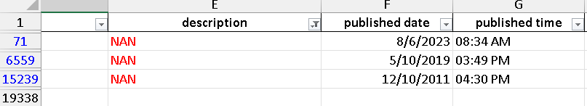
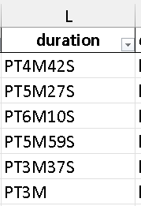
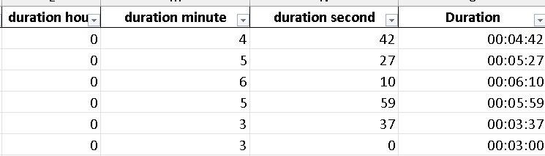
Data Cleaning and Preparation

Slide 7
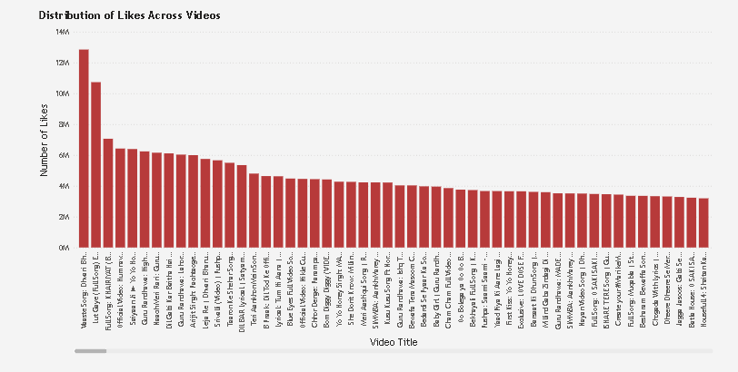
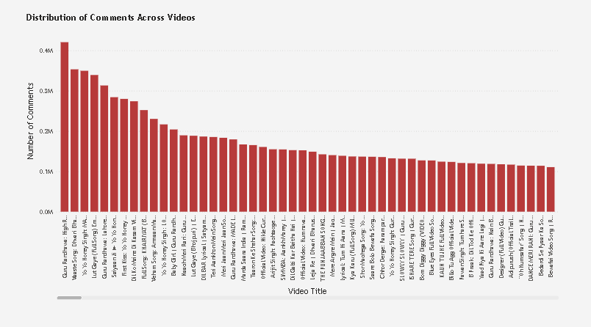
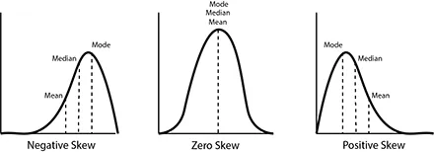
Exploratory Data Analysis (EDA):
Explore patterns and distributions in view counts, like counts, and comments.
Identify trends in the popularity and engagement of YouTube song videos.

Slide 8
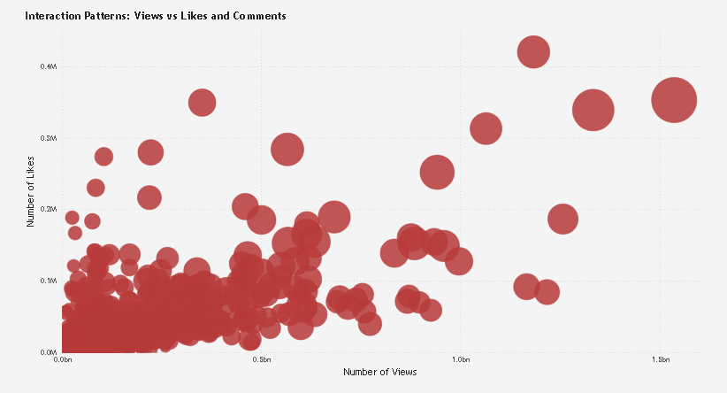
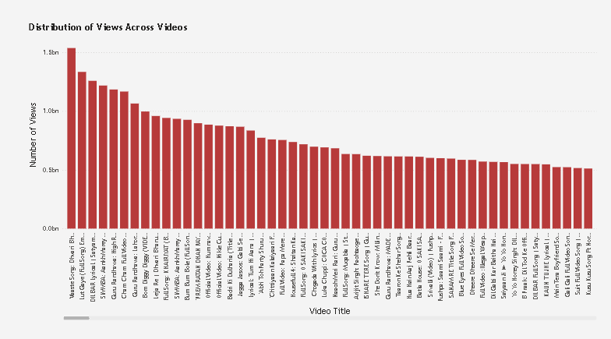
Exploratory Data Analysis (EDA):

Slide 9
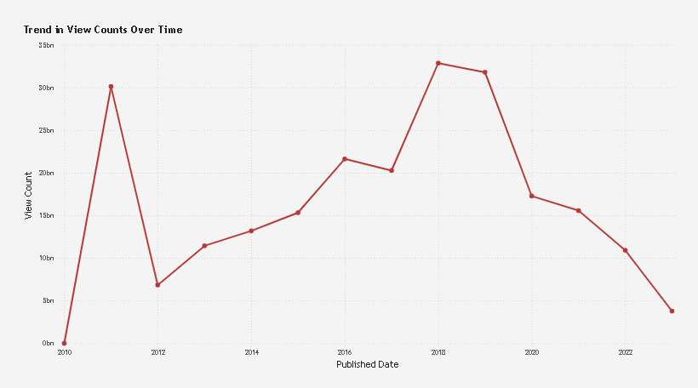
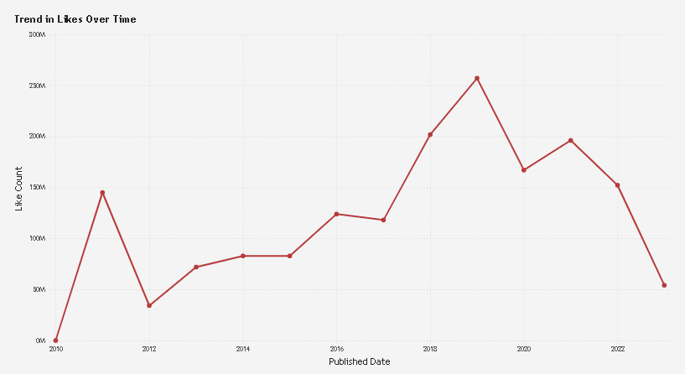
Exploratory Data Analysis (EDA):

Slide 10
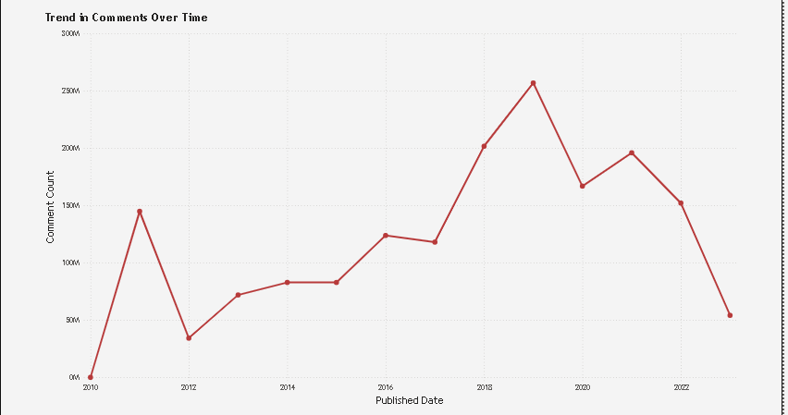
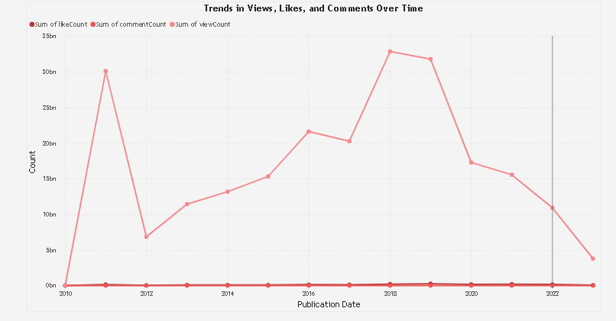
Exploratory Data Analysis (EDA):

Slide 11
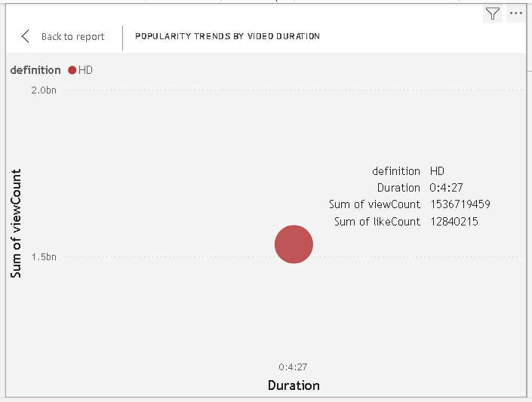
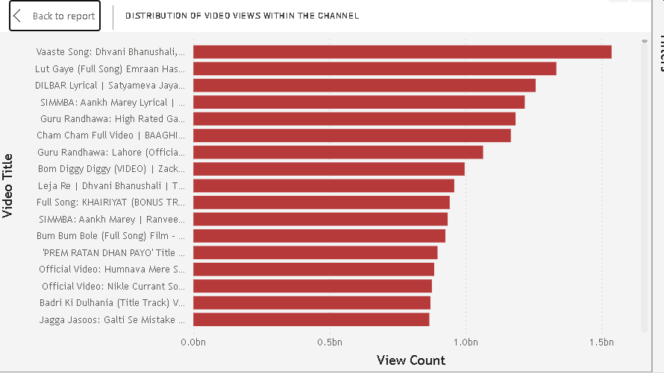
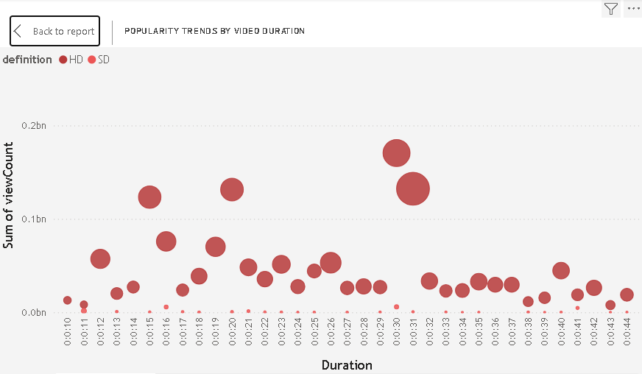
Content and Channel Analysis
Analyze the distribution of videos across different channels.
Identify popular tags and their correlation with view counts.

Slide 12
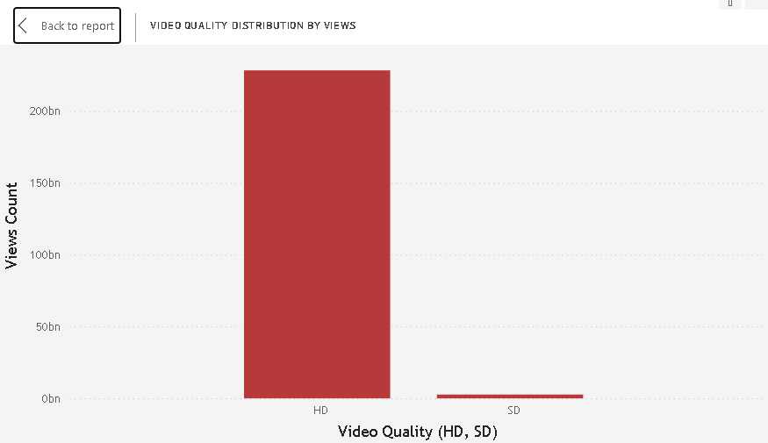
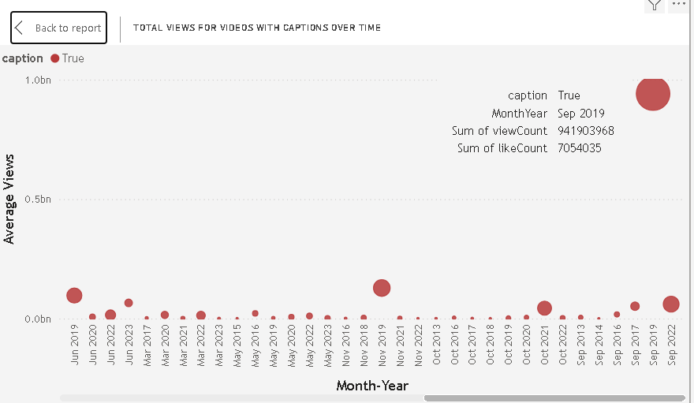
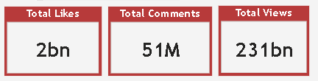
Content and Channel Analysis

Slide 13
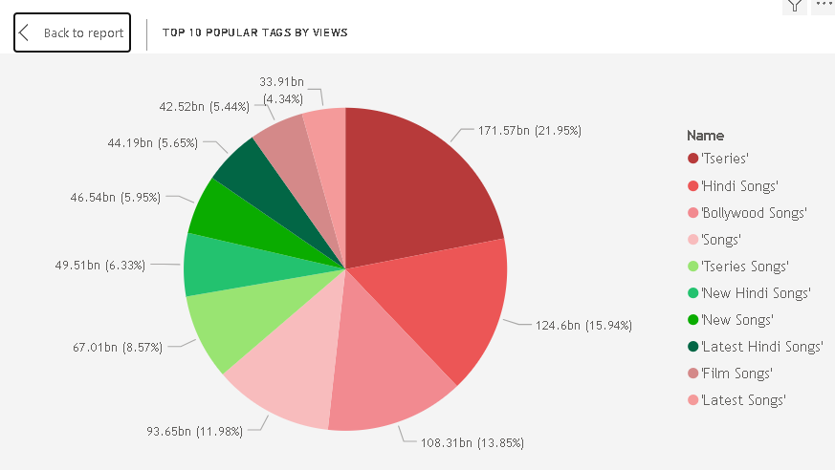
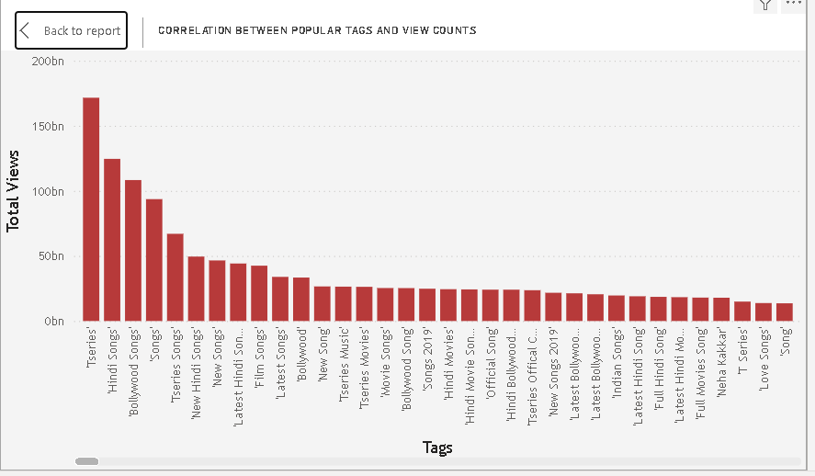

Content and Channel Analysis

Slide 14
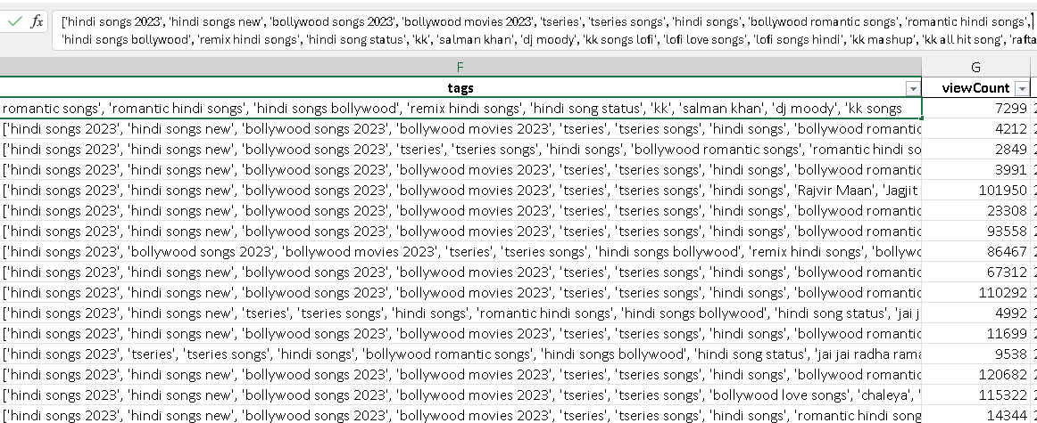
Content and Channel Analysis
'hindi songs 2023’
'hindi songs new' 'bollywood songs 2023' 'bollywood movies 2023' 'tseries’
'tseries songs’
.
.
.
7292
7292
7292
7292
7292
7292

Slide 15
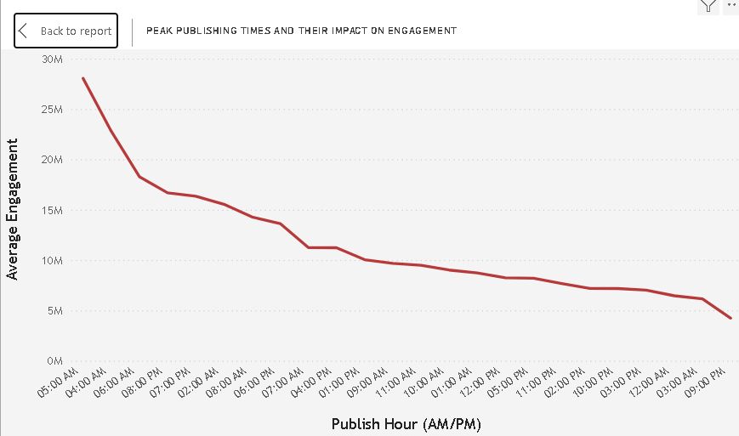
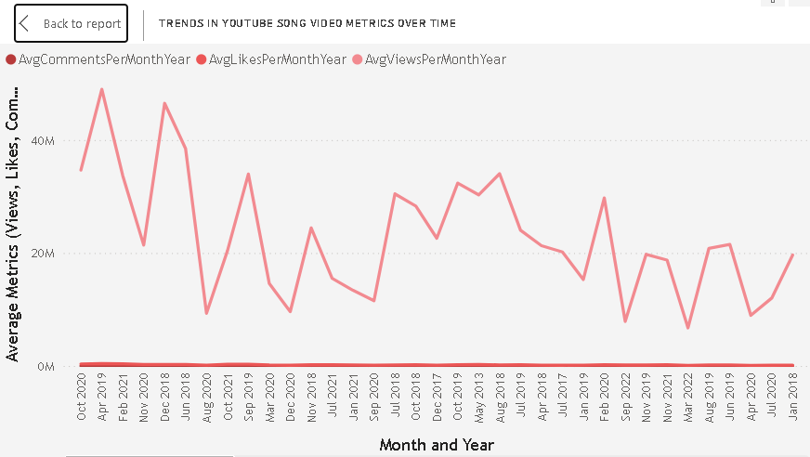
Temporal Trends
Explore how YouTube song video metrics vary over time.
Identify peak publishing times and their impact on engagement.
AvgViewsPerMonthYear = AVERAGEX(
SUMMARIZE(
'YouTube songs data',
'YouTube songs data'[MonthYear],
"AvgViews", AVERAGE('YouTube songs data'[viewCount])
),
[AvgVews])
AvgEngagement = AVERAGE('YouTube songs data'[viewCount])

Slide 16
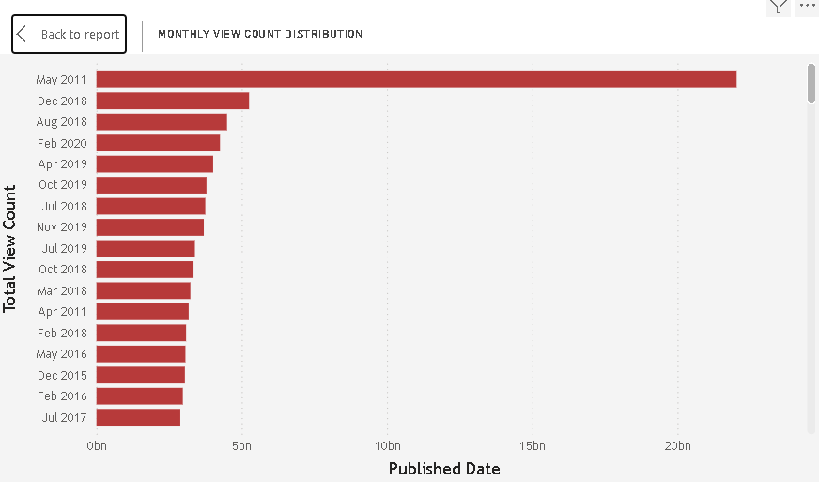
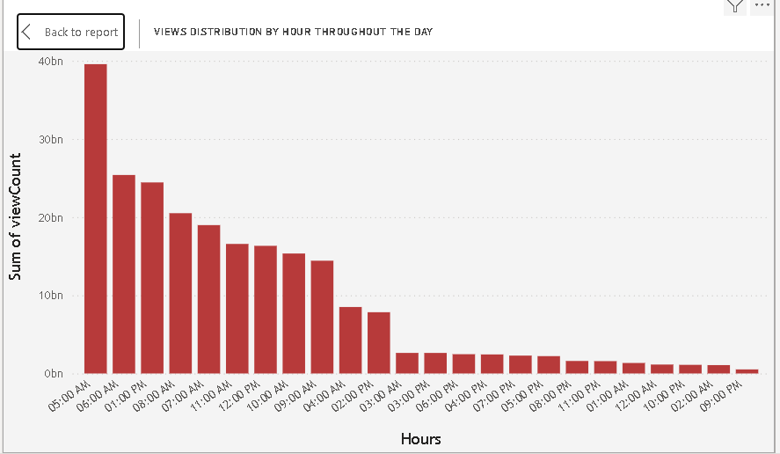
Temporal Trends

Slide 17
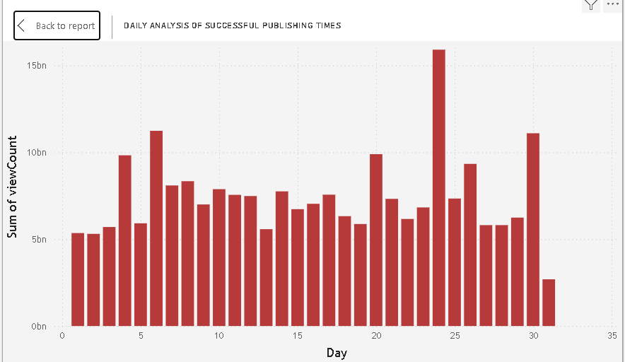
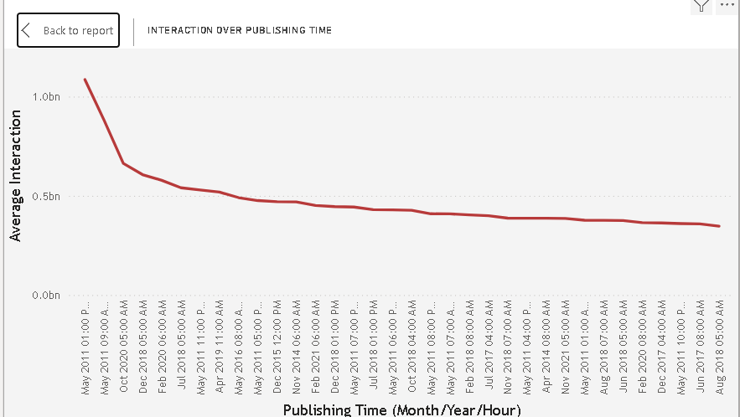
Temporal Trends

Slide 18
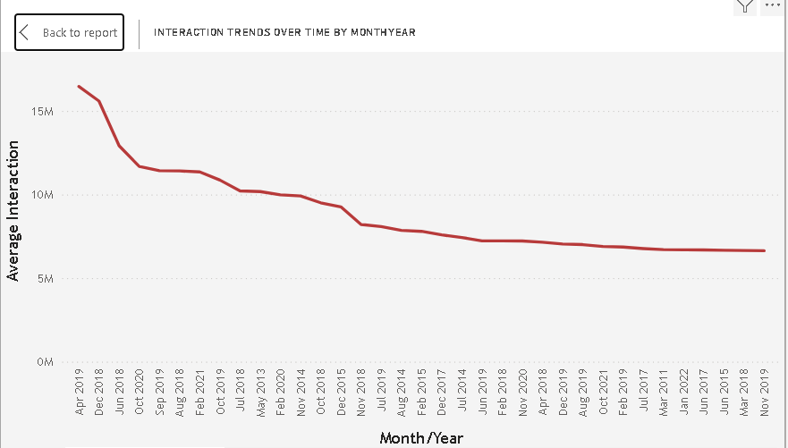
Temporal Trends
AvgInteractionPerMonth = ( [AvgViewsPerMonthYear] + [AvgLikesPerMonthYear] + [AvgCommentsPerMonthYear] ) / 3

Slide 19
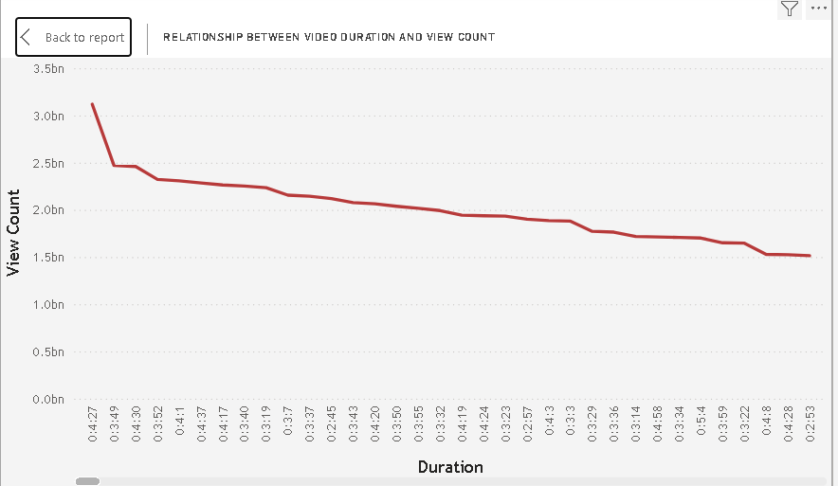
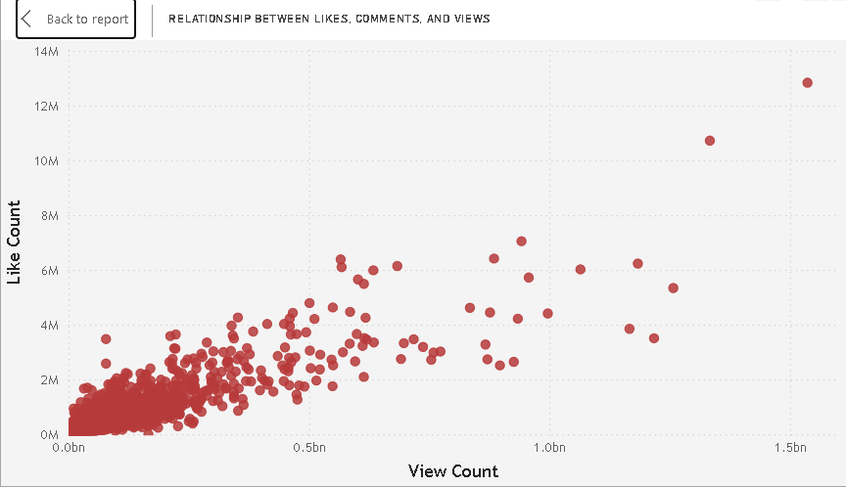
User Engagement Insights
Investigate relationships between likes, comments, and views.
Identify factors influencing user engagement with YouTube song videos.

Slide 20
Recommendation
Optimize Video Titles and Descriptions:
Ensure video titles are clear, engaging, and include relevant keywords.
Use descriptive and compelling descriptions that capture viewer interest and include key information about the video.
Utilize Effective Tags:
Identify popular tags that correlate with higher view counts and engagement.
Use tags that accurately describe the content and appeal to your target audience.
Publishing Time Optimization:
Analyze peak publishing times when engagement (likes, comments, views) tends to be highest.
Schedule video releases during these optimal times to maximize initial engagement.
Engage with Audience Feedback:
Monitor comments and engage with viewers to foster a sense of community.
Respond to feedback and suggestions to build a loyal audience base.
Video Duration and Content Quality:
Analyze viewer retention rates to determine optimal video length.
Ensure high-quality content that provides value to viewers and encourages them to watch until the end.

Slide 21
Recommendation
Promotion and Distribution:
Utilize social media and other platforms to promote videos and increase reach.
Collaborate with influencers or other channels to expand audience reach and engagement.
Data-Driven Decision Making:
Continuously analyze performance metrics (views, likes, comments) to identify trends and patterns.
Use insights to iterate on content strategy and improve future video performance.
SEO and Discovery:
Optimize video metadata (titles, descriptions, tags) for search engines to improve discoverability.
Use analytics tools to understand how viewers find your videos and adjust SEO strategies accordingly.
Experimentation and Innovation:
Test different video formats, topics, and styles to understand what resonates best with your audience.
Innovate and stay updated with trends to keep content fresh and engaging.
Monitor Competitors:
Benchmark performance against competitors to identify gaps and opportunities.
Learn from successful channels and adapt strategies that align with your brand and audience.

Slide 22
Thank’s For Watching

