Slide 1
Customer Sentiment and Trend Analysis
Team Members:
Mahmoud Kamel Salman
Sarah Abdel Hamid Abdel Ghany
Fatma Ahmed Mohamed
Youssef Ashraf Shaaban
Ahmed Mahmoud Abdelaziz

Slide 2
Data Preprocessing and Cleaning for NLP

Slide 3
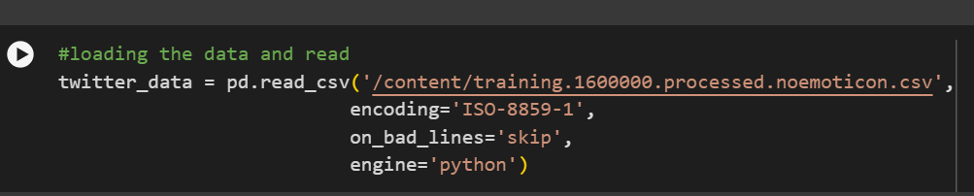
Loading the Data
Done with Pandas, with coding processing and bypassing corrupted rows

Slide 4
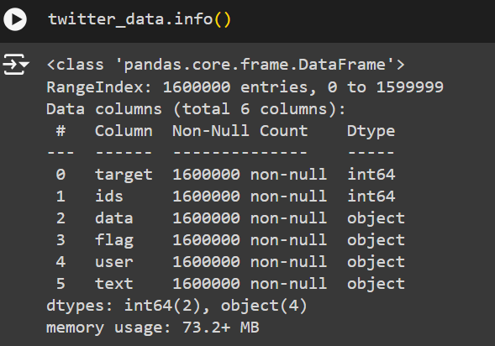

Data exploration and cleaning:
The data was explored to check for duplicates, missing values, and column structure. The categorization column was modified to facilitate binary categorization.

Slide 5
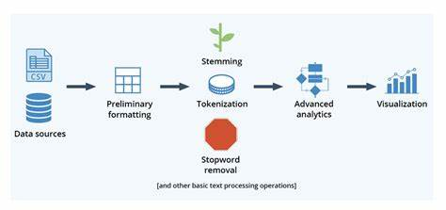
Text processing
A function was created to derive words and clean up tweets by removing non-alphabetic characters, common words, and reducing words to their roots.

Slide 6
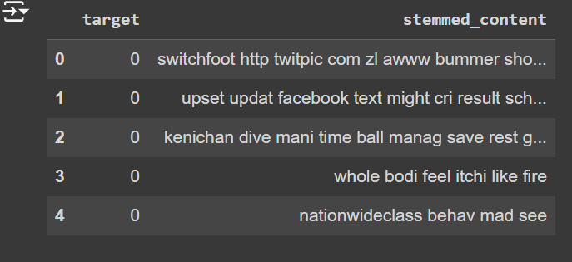
Summary and next step
By the end of these steps, you have a clean and processed dataset containing text ready for analysis, which can be used to build a Sentiment Analysis model using machine learning algorithms.

Slide 7
Exploratory Data Analysis (EDA)

Slide 8
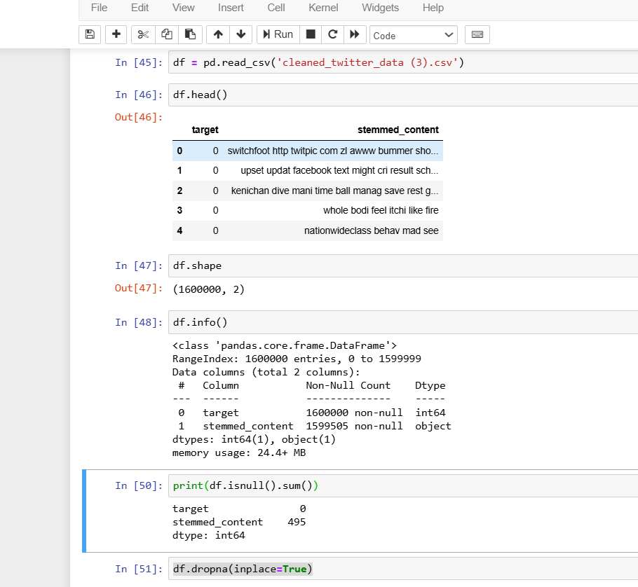
Perform exploratory data analysis (EDA) to understand the dataset.
Dataset Summary:
Number of records and features.
Overview of categorical and numerical variables.
Initial observations on missing data and distributions.
Handling missing values (removal or imputation).

Slide 9
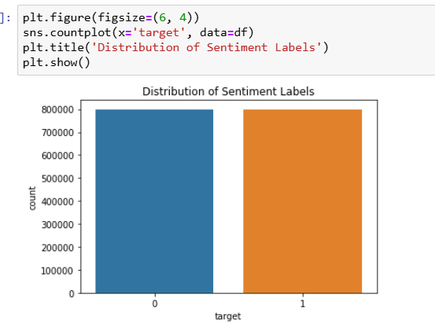
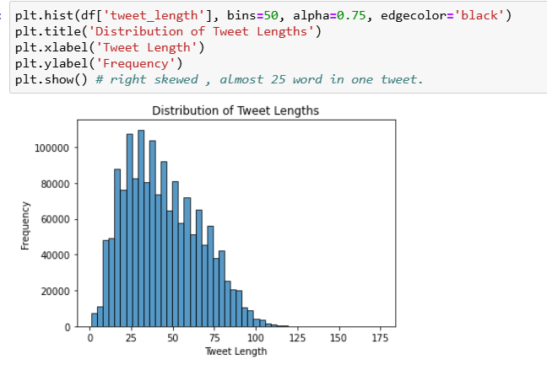
Univariate and Bivariate Analysis Key Features: Distribution of important variables through histograms.

Slide 10
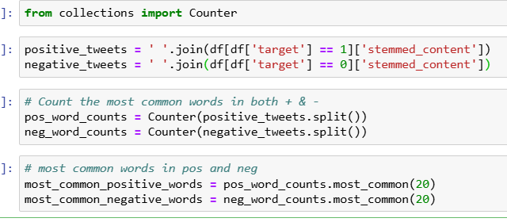
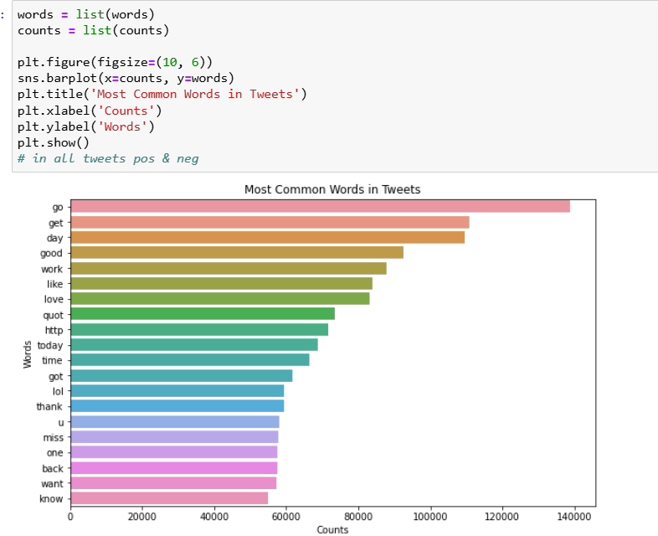
Extracting Most Common Words and Counts Identify and analyze the 20 most common words in positive and negative tweets.

Slide 11
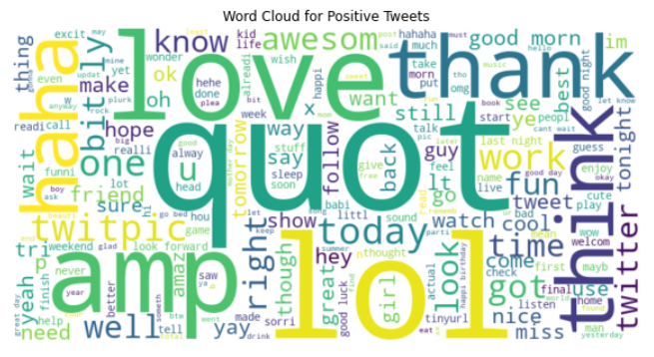
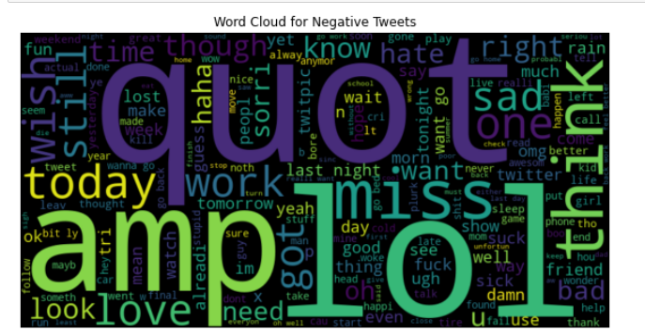
Word clouds for both positive and negative sentiments.

Slide 12
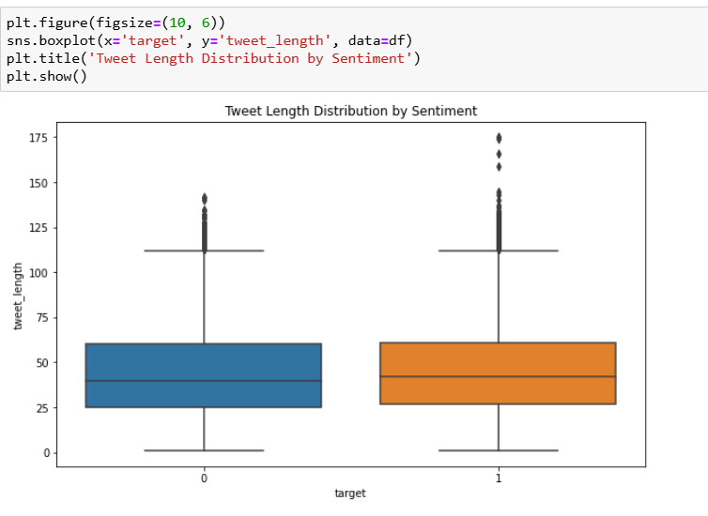
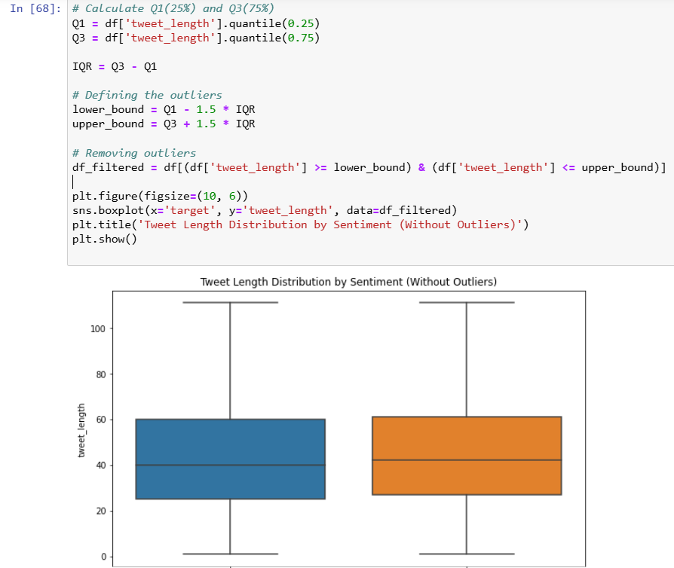
identifying and handling outliers
Identifying outliers
Handling outliers

Slide 13
Mlflow

Slide 14
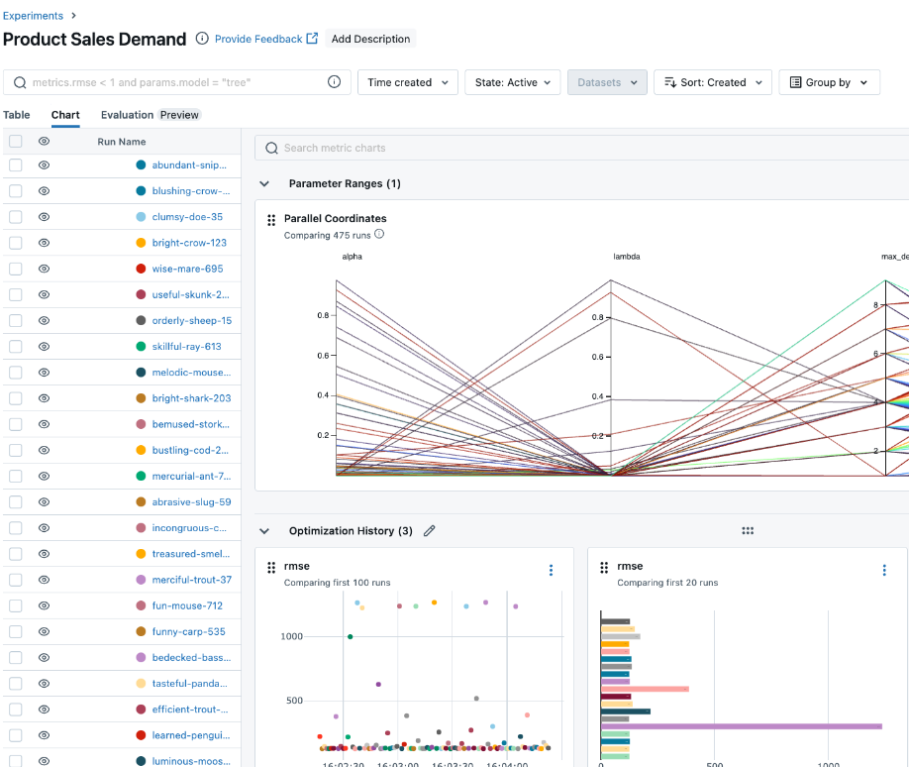
Mlflow
MLflow is an open-source platform designed to manage the machine learning lifecycle, providing tools to help with:
Experiment tracking
Model management
Reproducibility
Deployment

Slide 15
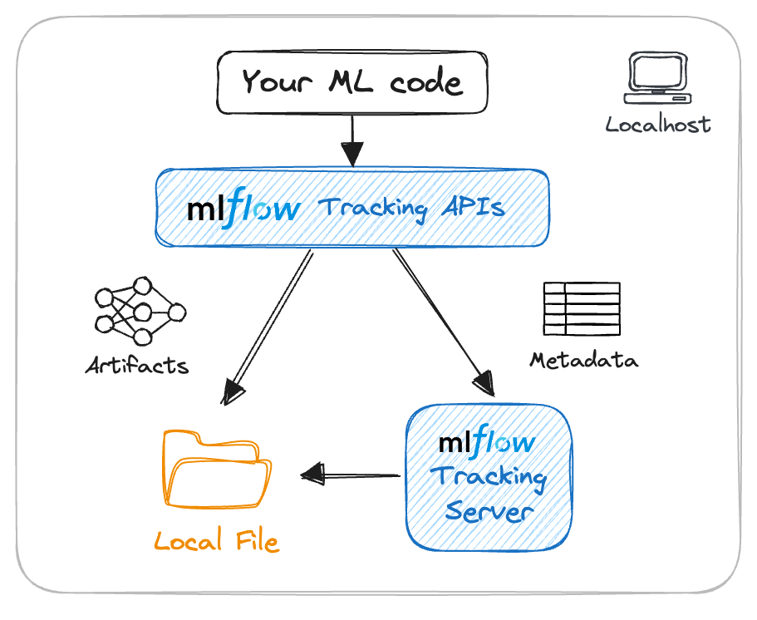
Cloud or Server is Needed for MLflow
By using a cloud-based MLflow server (on platforms like AWS, Google Cloud, or Azure), the entire team can access the system remotely from any location, making it easier for distributed teams to collaborate.

Slide 16
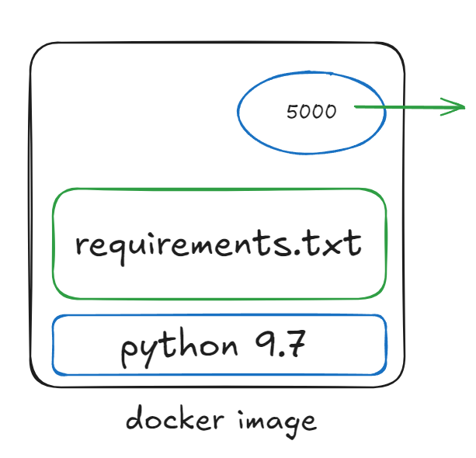
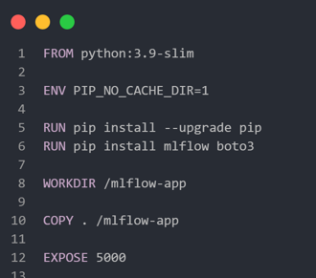
Docker for Team Collaboration
Docker offers:
Docker containers offer a lightweight, consistent environment that can be shared across team members, enabling collaboration without the complexity of setting up individual environments.

Slide 17
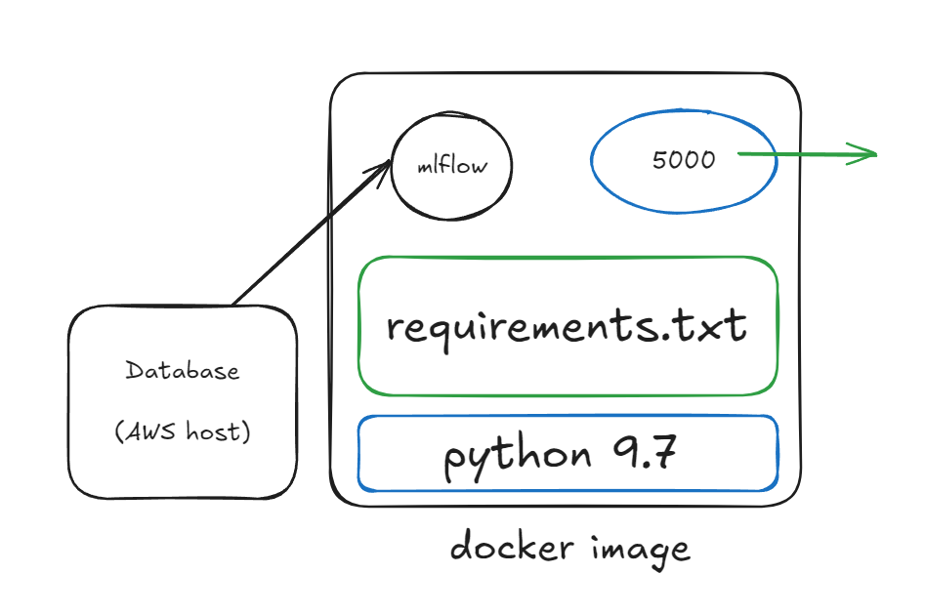
Database Host for Team Collaboration
MLflow with PostgreSQL:
docker-compose to run MLflow along with a PostgreSQL database for logging results, all inside containers.
Small data share:
No need to share the big docker images with a team to work on the same mlflow server with same data.

Slide 18
Train-Test Split
Objective: Split the data to train models and evaluate their performance.
Split Ratio:
80% for training
20% for testing.
The training set teaches the models to recognize patterns.
The testing set helps us evaluate how well the models generalize to new data.
Code Example

Slide 19
Model Training & Evaluation
Models Used:
Logistic Regression: A linear model effective for text-based data.
Random Forest: An ensemble model combining decision trees for better performance.
Metrics Evaluated:
Accuracy Score: Percentage of correct predictions.
Classification Report: Includes precision, recall, and F1-score.
Confusion Matrix: Visualizes true vs. predicted labels.

Slide 20
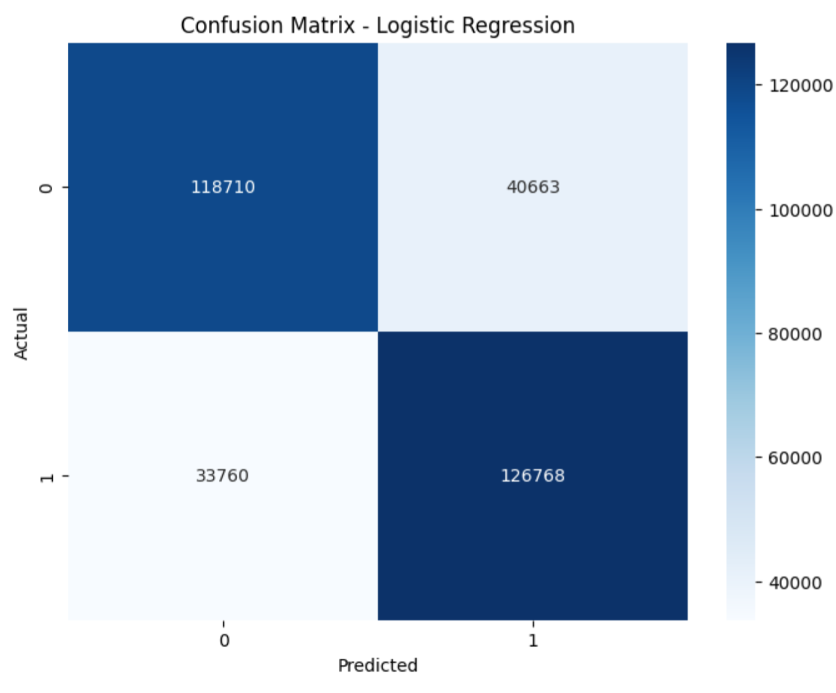
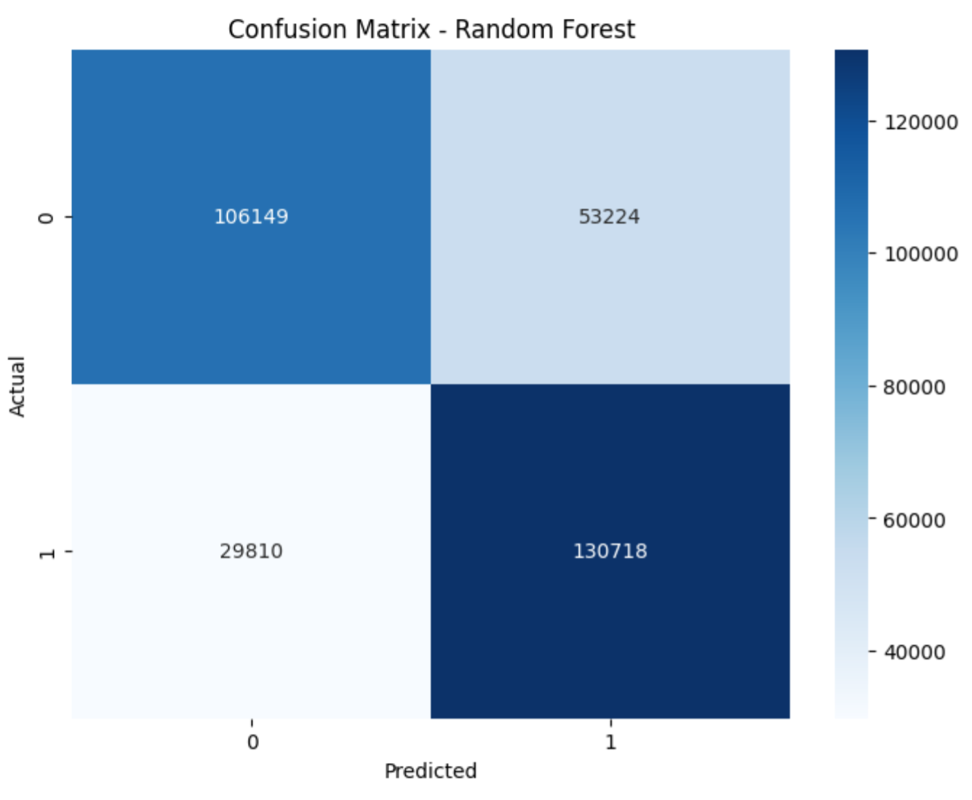
Example Confusion Matrix Plot:

Slide 21
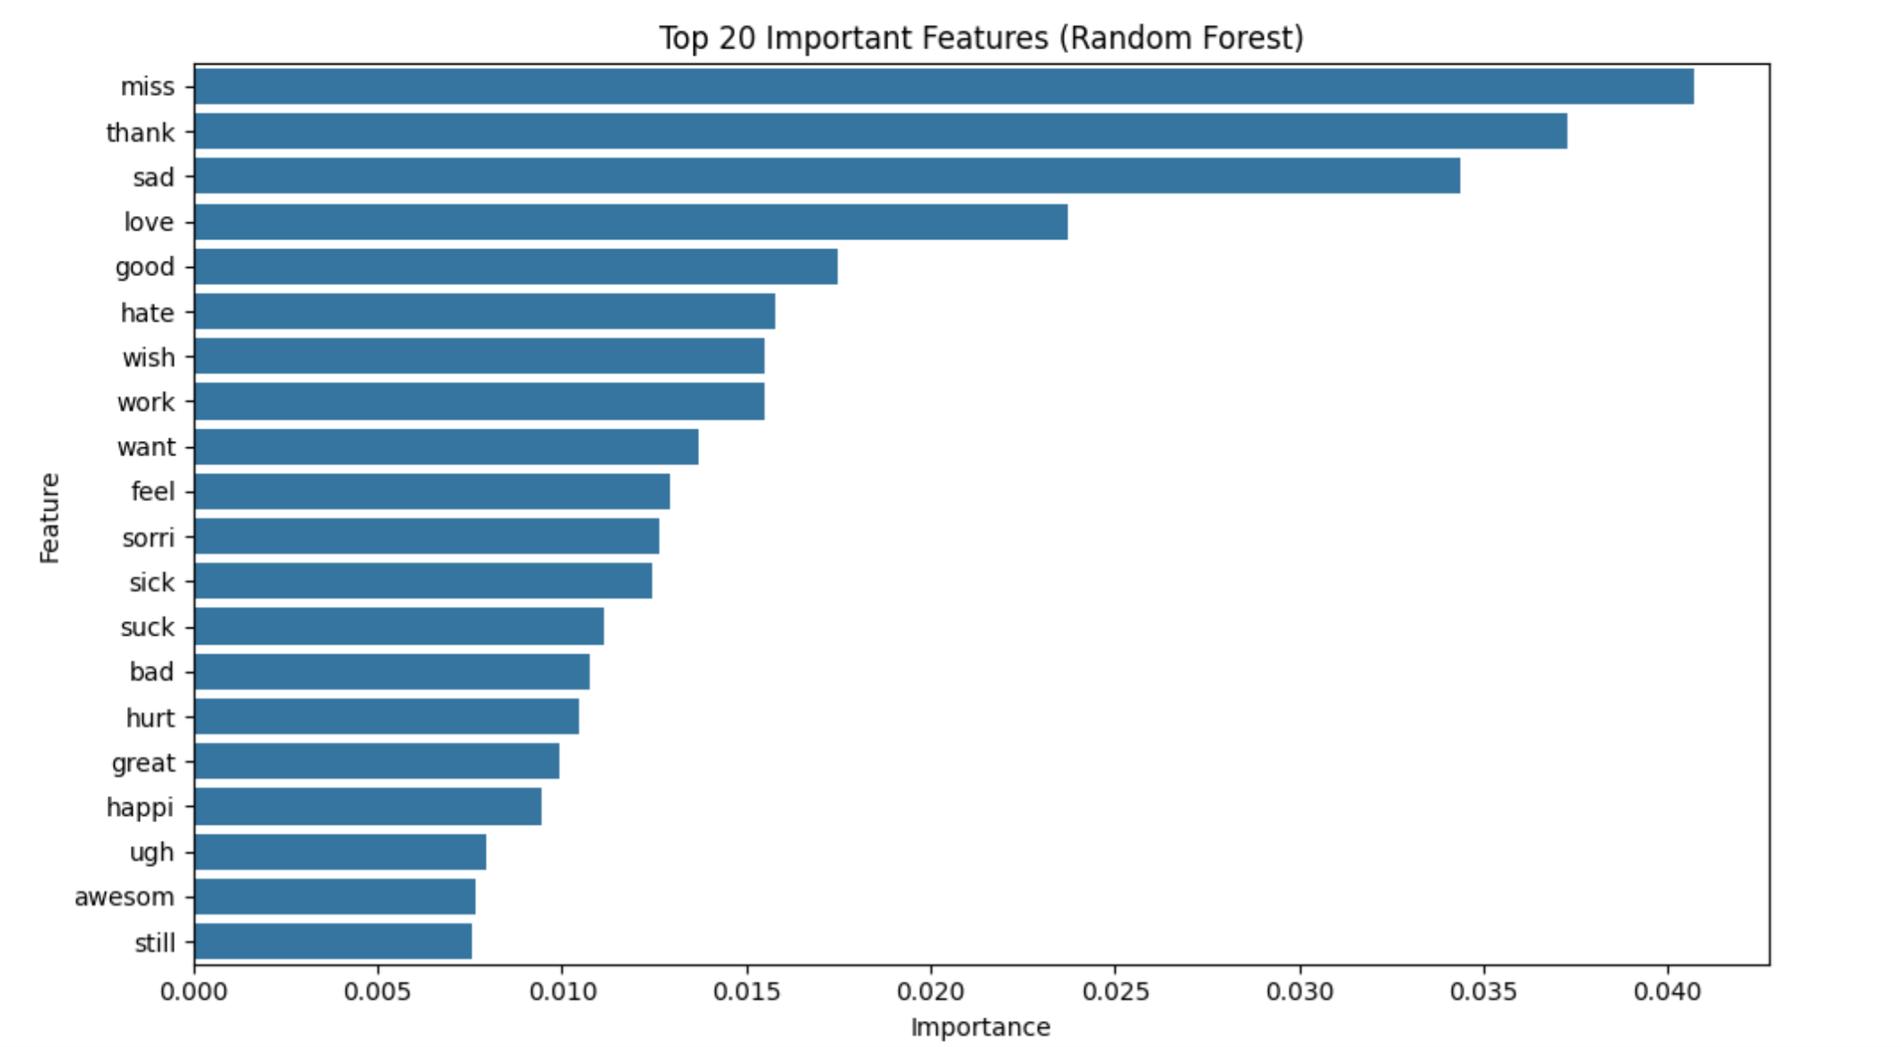
Top Features from Random Forest
What is Feature Importance? It shows which words or phrases contribute most to the model’s decisions.
Steps:
Extract top 20 important features using Random Forest.
Visualize them with a bar plot.

Slide 22
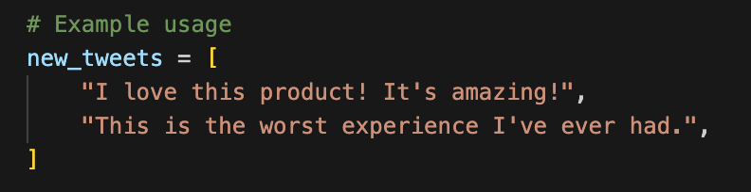
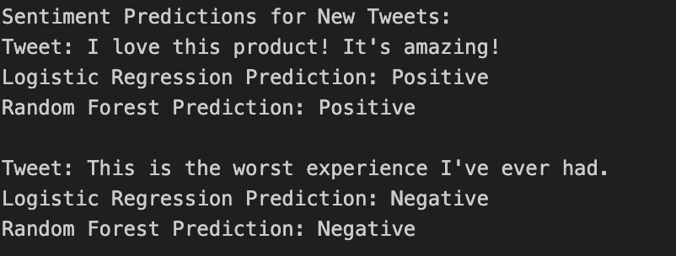
Predicting Sentiment of New Tweets
Purpose: Test the models on new, unseen tweets.
Example Tweets:
“I love this product!” → Positive
“Worst experience ever!” → Negative
Code Example:
Output Example:

Slide 23
Bidirectional Encoder Representations from Transformers (BERT)

Slide 24
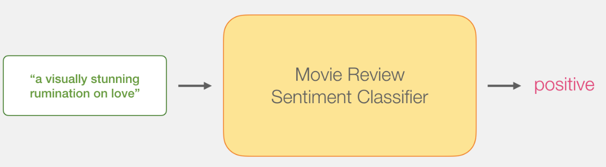
Sentence Sentiment Classification
Our goal is to create a model that takes a sentence (just like the ones in our dataset) and produces either 1 (indicating the sentence carries a positive sentiment) or a 0 (indicating the sentence carries a negative sentiment). We can think of it as looking like this:

Slide 25
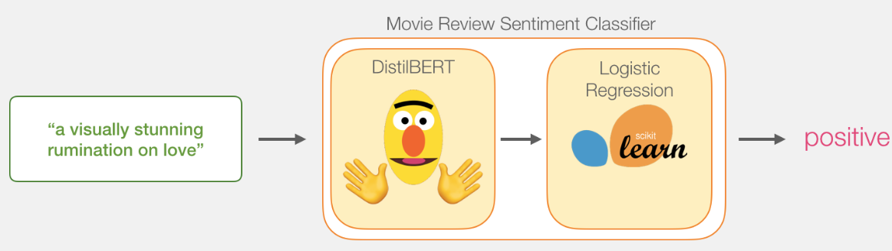
Under the hood, the model is actually made up of two model.
processes the sentence and passes along some information it extracted from it on to the next model. DistilBERT is a smaller version of BERT developed and open sourced by the team at HuggingFace. It’s a lighter and faster version of BERT that roughly matches its performance.
The next model, a basic Logistic Regression model from scikit learn will take in the result of DistilBERT’s processing, and classify the sentence as either positive or negative (1 or 0, respectively).

Slide 26
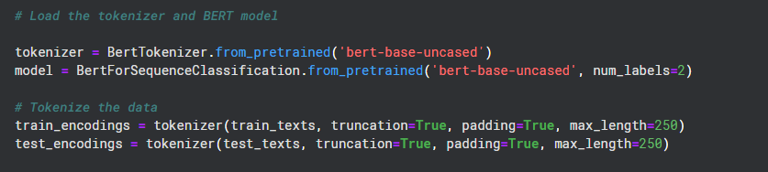
load a BERT tokenizer and model
BERT understands text as a series of token IDs. Without tokenization, the model wouldn't be able to interpret the input.
Tokenization also handles special cases like subwords, punctuation, and unknown tokens, which allows BERT to process a wide variety of text inputs effectively.

Slide 27
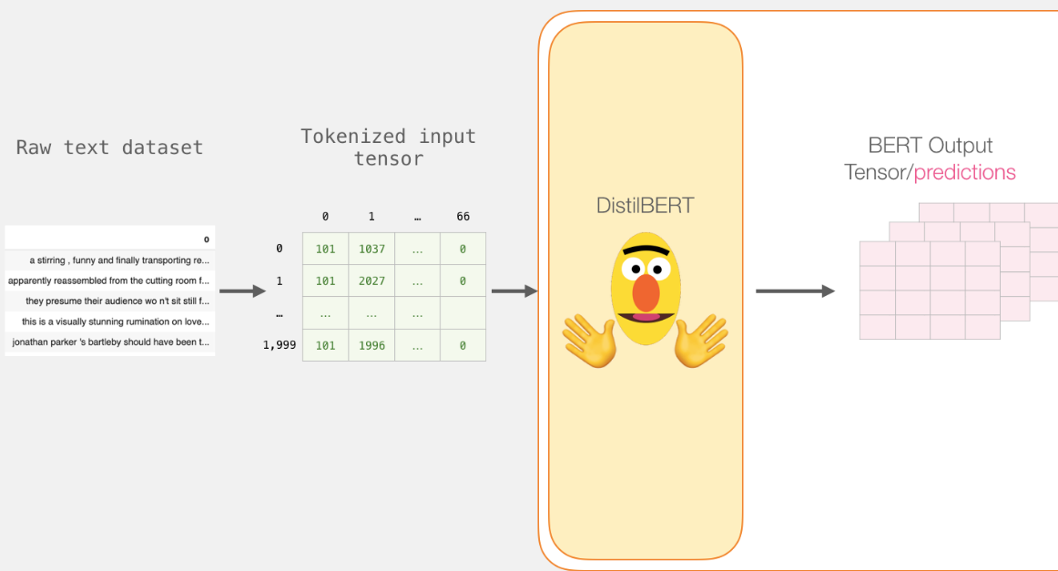

Slide 28
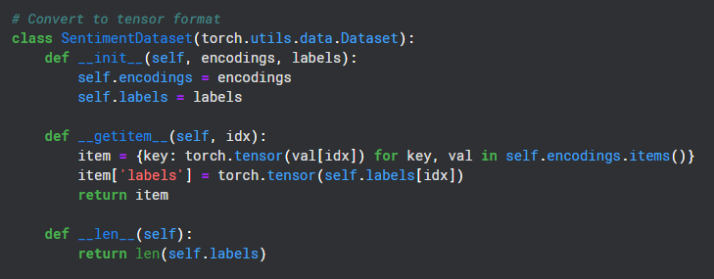
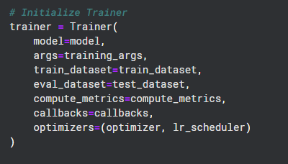
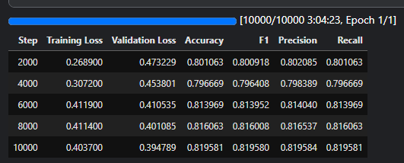
our train

Slide 29
Generative Adversarial network (GAN)

Slide 30
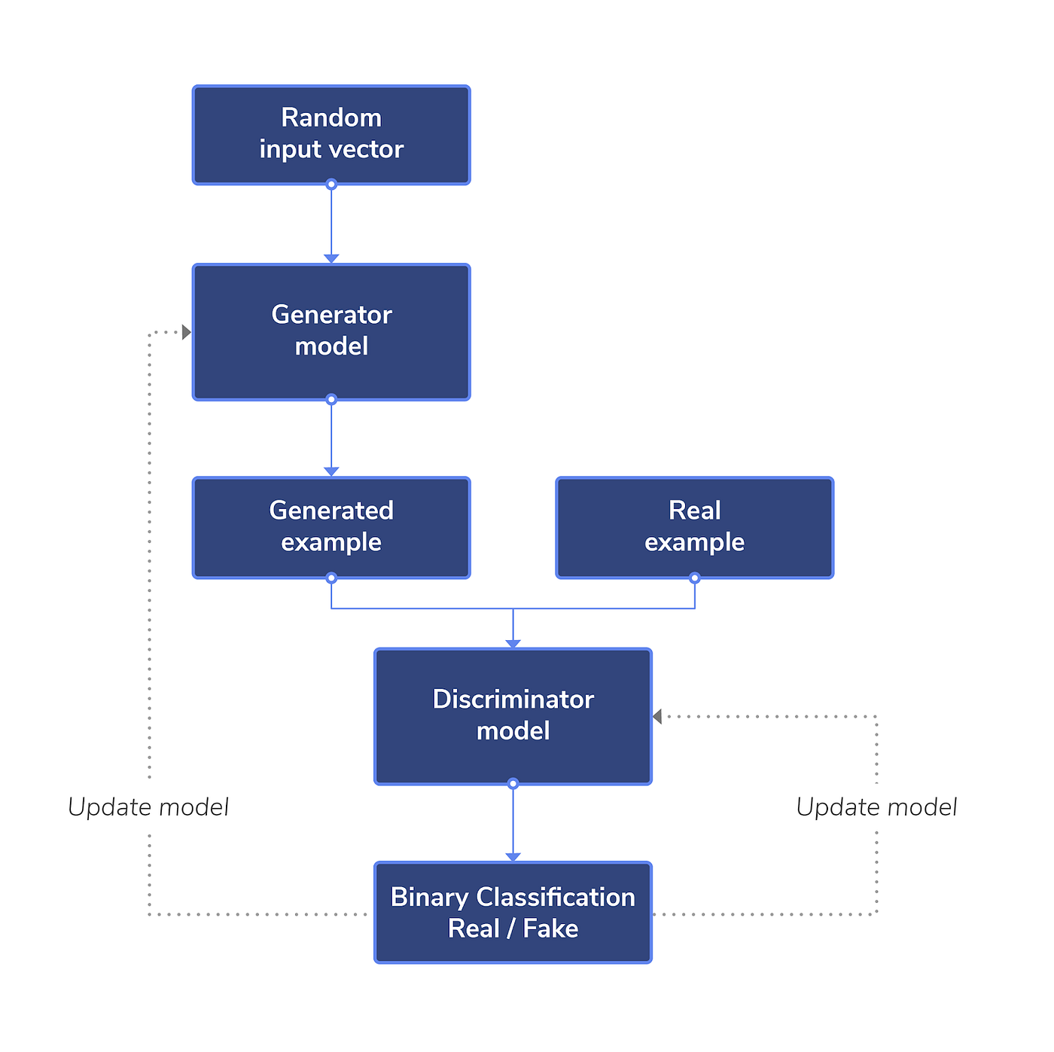
Generative Adversarial network (GAN)
GANs consist of two networks:
Generator (creates synthetic data) :
Its job in a GAN is creates synthetic data by learning to mimic the real data, aiming to fool the discriminator into thinking the generated data is authentic.
Discriminator(evaluates data authenticity).
Its job is to evaluates whether the input data is real (from the dataset) or fake (generated by the generator), guiding the generator's improvement.

Slide 31
GANs revolutionized the field of visual data generation but faced significant challenges when applied to text due to the sequential and discrete nature of language, making it harder for the model to generate coherent and meaningful text.

Slide 32
What are the challenges of using GANs for text generation
Discrete Nature of Text:
Unlike images, where pixel values are continuous, text is composed of discrete tokens (words or characters). This makes it difficult for GANs to calculate gradients effectively during the training process, as backpropagation relies on continuous values.
Others:
Sequential Structure
Mode Collapse
Evaluation Challenges:

Slide 33
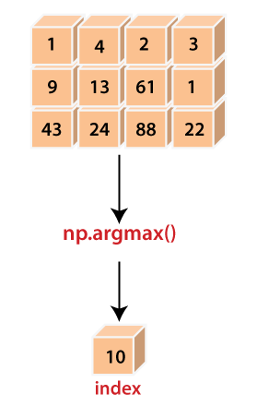
We usually use argmax function to convert the output of the generator into a vector of generated words.
But the problem with argmax function is that it is not differentiable, which obstructs the process of backpropagation in the neural network.
That's what makes using GANs for text a challenge.

Slide 34
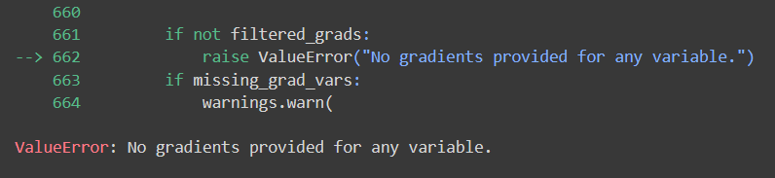
The solution
Gumbel softmax
Reinforcement learning
Variational autoencoder

Slide 35
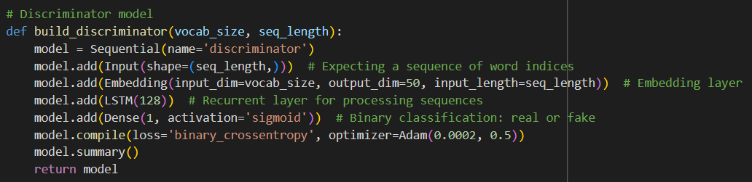
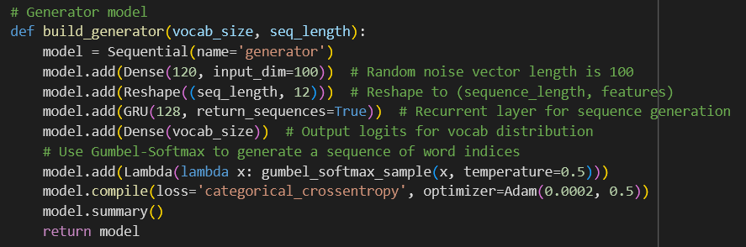
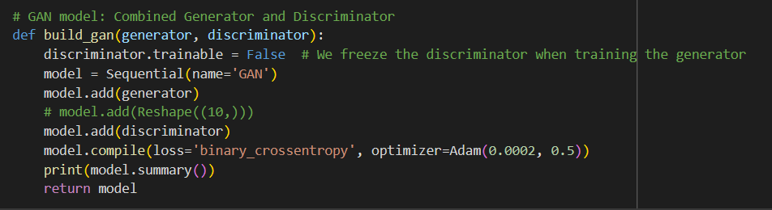
Our simple GAN

Slide 36
Advanced alternative solutions for GANs.
SeqGAN - SeqGAN: Sequence Generative Adversarial Nets with Policy Gradient
LeakGAN - Long Text Generation via Adversarial Training with Leaked Information
SentiGAN - SentiGAN: Generating Sentimental Texts via Mixture Adversarial Networks

Slide 37
Deployment

Slide 38
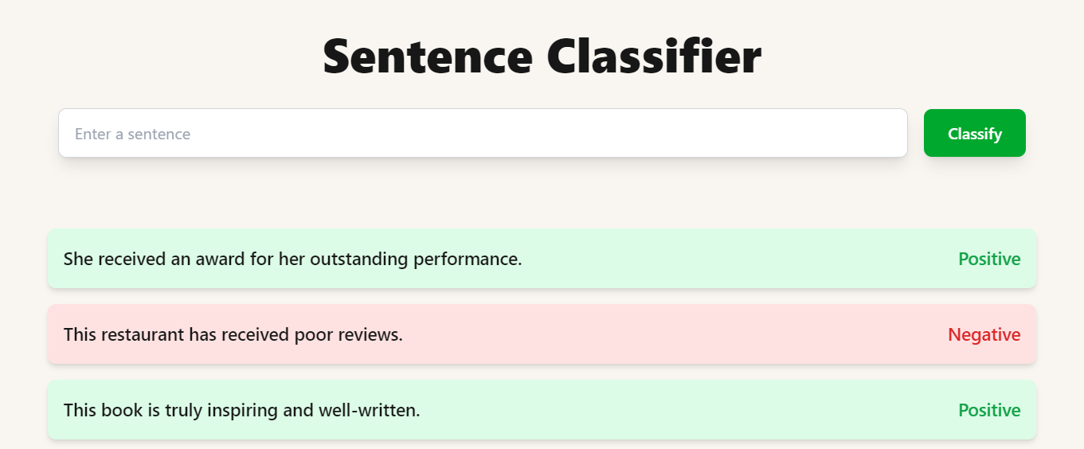
Frontend
We utilize the React framework for the layout and Tailwind for styling and colors, and we deploy our application using Vercel.

Slide 39
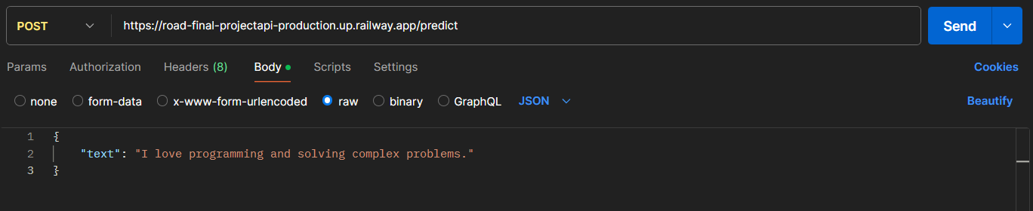
Backend
We use Flask to create our API and deploy the backend with CORS (AWS) on Railway.
This is the final deployment link
https://road-final-project-front.vercel.app/

Slide 40

Thank you

