Slide 1
College Tracking System
Software Requirements Specification
Group - B

Slide 2
TOPICS COVERED
Introduction
General Description
Functional Requirements
Non-Functional Requirements
conclusion

Slide 3
INTRODUCTION
Helping student process is one of the management processes on computer science college and they are working hard to improve it. In the meantime, students have some difficulties on searching for a certain classroom or faculty staff office, as well as searching for an exam’s classroom and time. College tracking system will help college management, staff, student and visitors on the previous difficulties. College tracking system is a standalone mobile application and it will not be associated with other external systems on the computer science college.

Slide 4
GENERAL DESCRIPTION
CTS is a mobile software that will cooperates with GPS system. CTS mobile application will be used to locate and show real-time status of the desired classrooms or offices. Furthermore, our application will connect with the GPS to provide directions for the users to the designated room. CTS mobile application should present the contact information for the faculty staff along with the student's schedule information.

Slide 5
FUNCTIONAL REQUIREMENTS

Slide 6
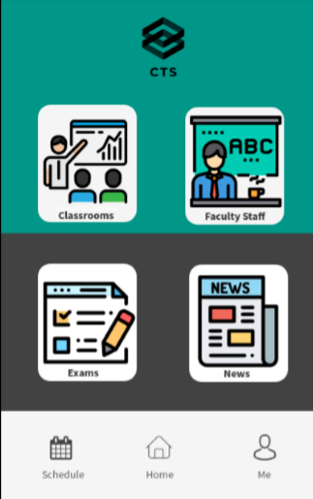
Log in
Log out
Choose role
Sign up
Search for faculty staff
Search for classroom
Add course
Remove course
Search for exam
Add exam
Remove exam
View schedule
Reset password
View news
Edit info
View direction

Slide 7
NON-FUNCTIONAL REQUIREMENTS
High availability: (no frequent down time).
Response time: (less than 3 seconds for responding time).
Ease of use: (simple screens, clear functionality buttons and color presentation).
Secure information: (by encrypting the login information).

Slide 8
CONCLUSION
In this presentation we had a general description about our application which is “college tracking system”. Furthermore, we explained the functional requirements and non-functional requirements.

Slide 9
TEAM MEMBERS
Ahmed majed Alotaibi (438020712) , Coordinator
Fahad abdulaziz Alshaya(439016350)
Ibraheem saleh Altuwayjiri(439013074)
Mohammed khaled Alnasser (439014350)
Khalid abdulaziz Alotaibi(439012737)

