Slide 1
Create the Azure Policy Governance Lab Azure policy used to ensure that resources are compliant with organizational standards
Assign a policy definition which “Require Tag and its value on resources”
Assign the Policy at the Resource Group Level
Creating storage Without any tags to validate policy
Tag is Missing – Policy Validation
Create a New Policy that Allows Tag Inheritance
Test the Policy with a New Storage Account Creation

Slide 2
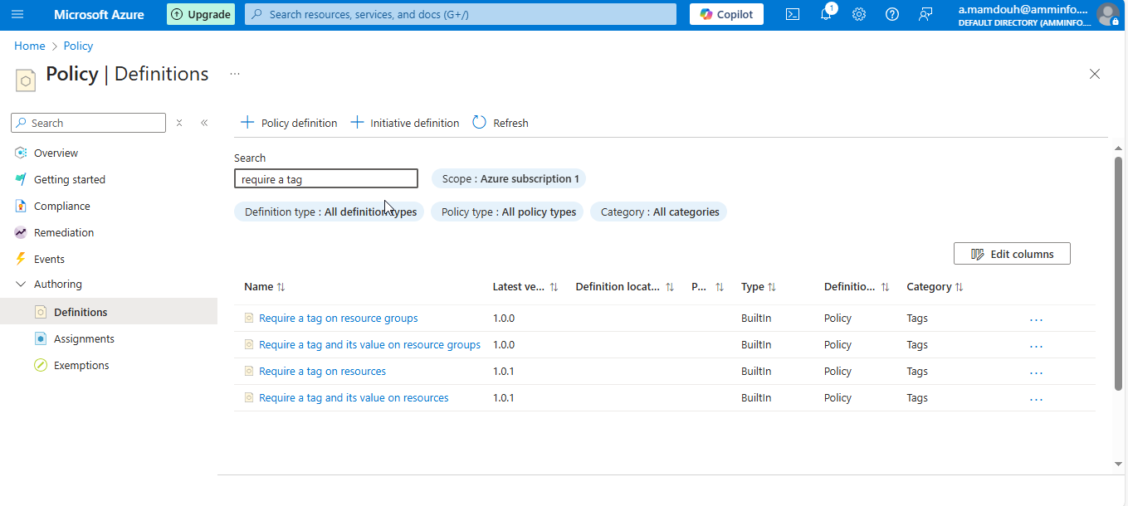
Notes:
Search for policy and select definition -→ policy definition and search for “require a tag and its value on resources”

Slide 3
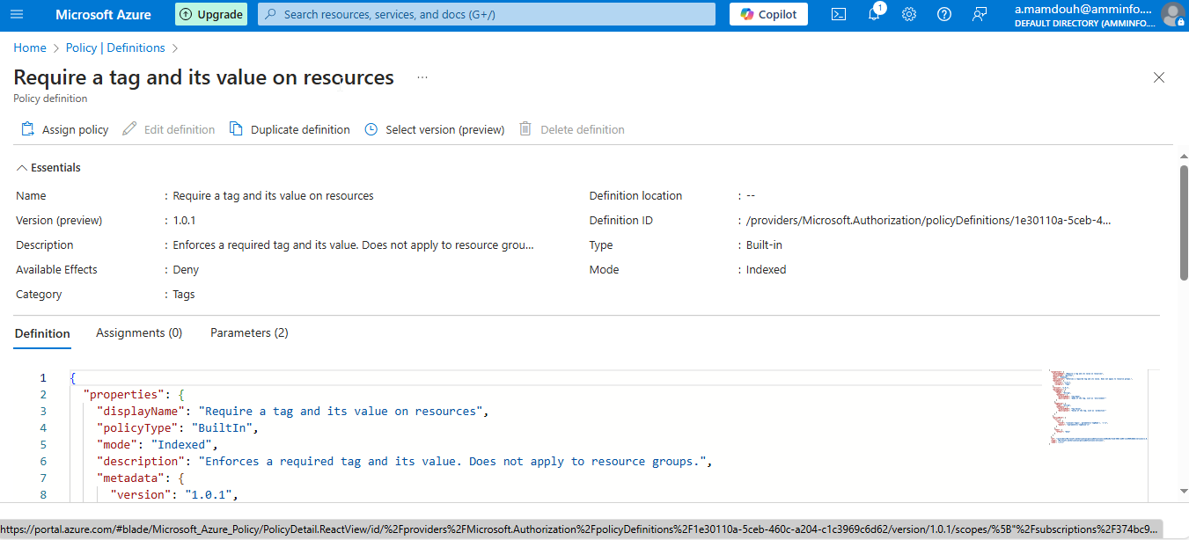

Slide 4
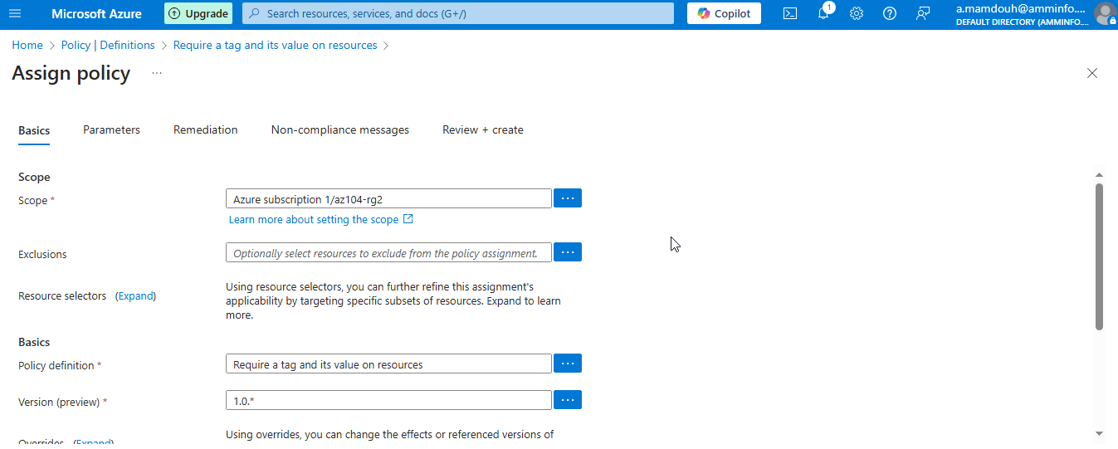
Notes:
Assign policy Select Require Tag on resources as a policy definition

Slide 5
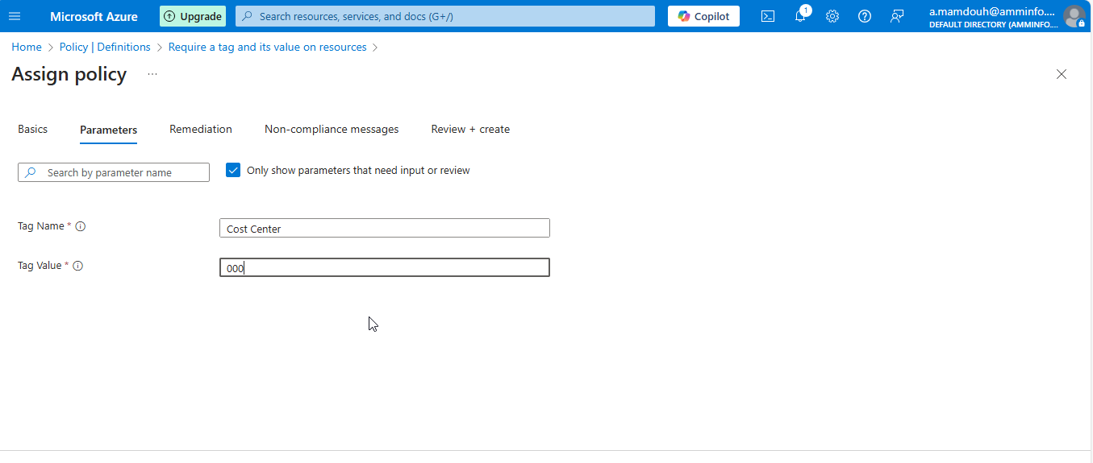
Notes:
Specify Tage name and value

Slide 6
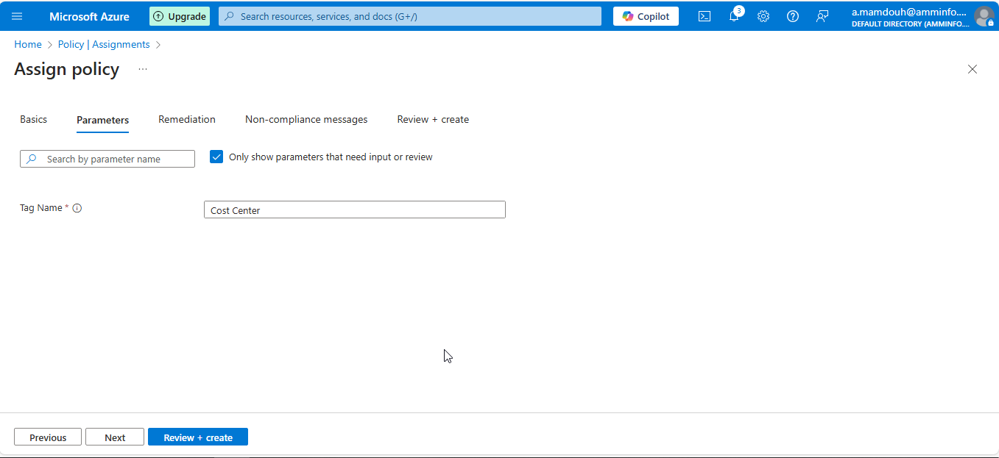
Notes:
Tag Name

Slide 7
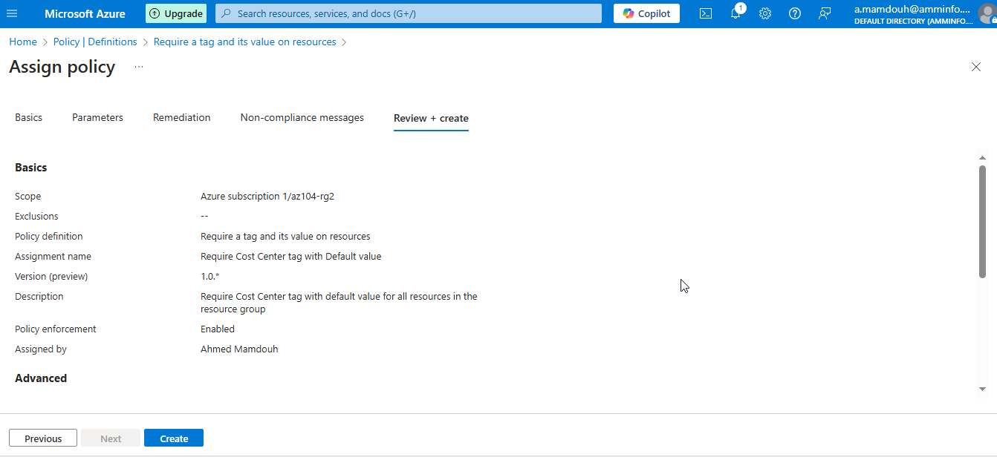
Notes:
Require tag name and value

Slide 8
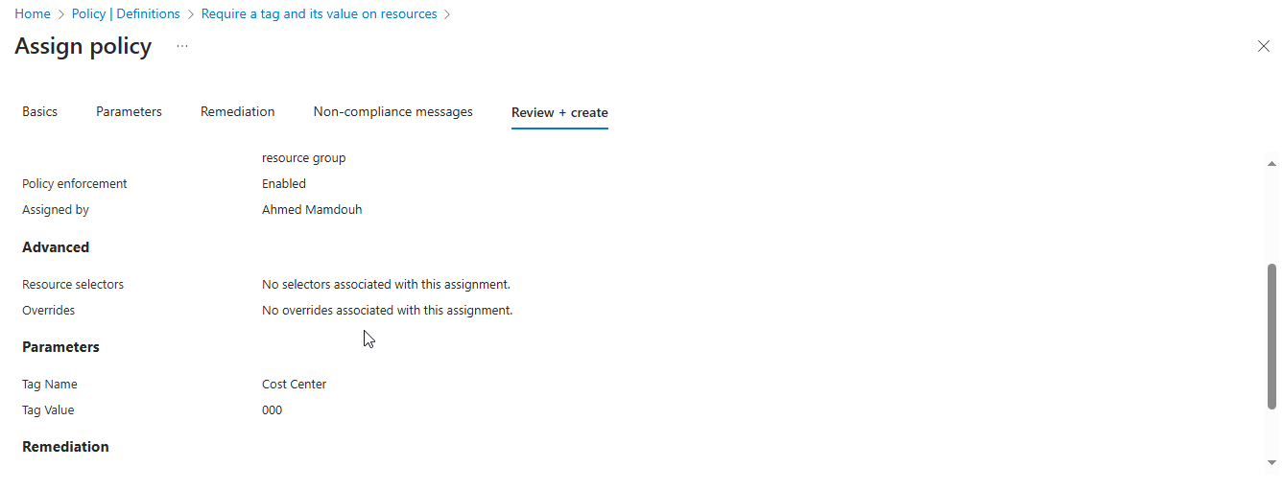

Slide 9
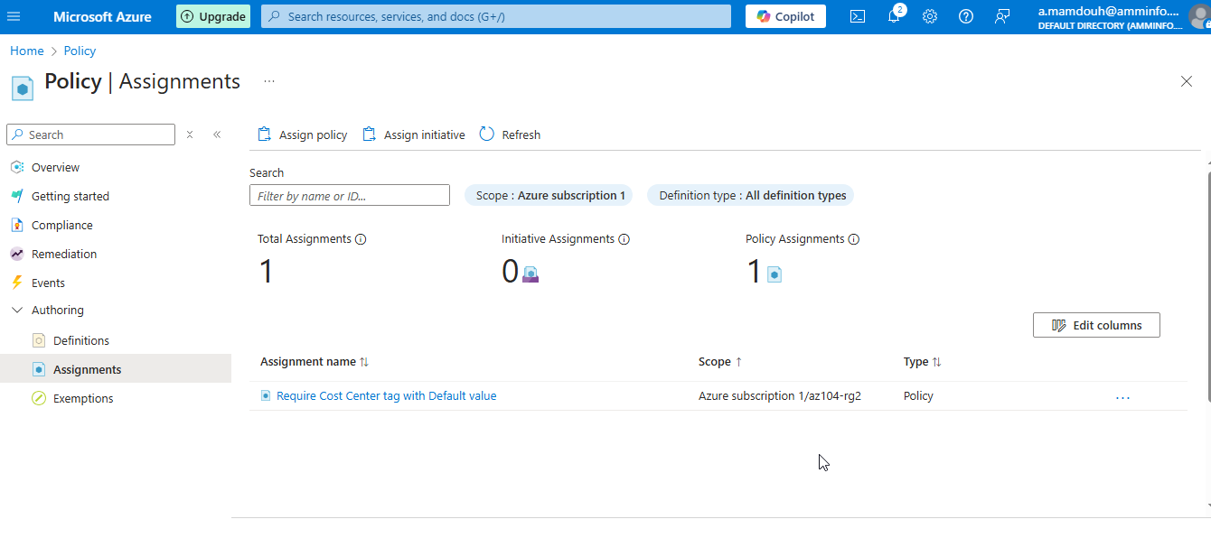
Notes:
Assign policy at RG2 “Level ”

Slide 10
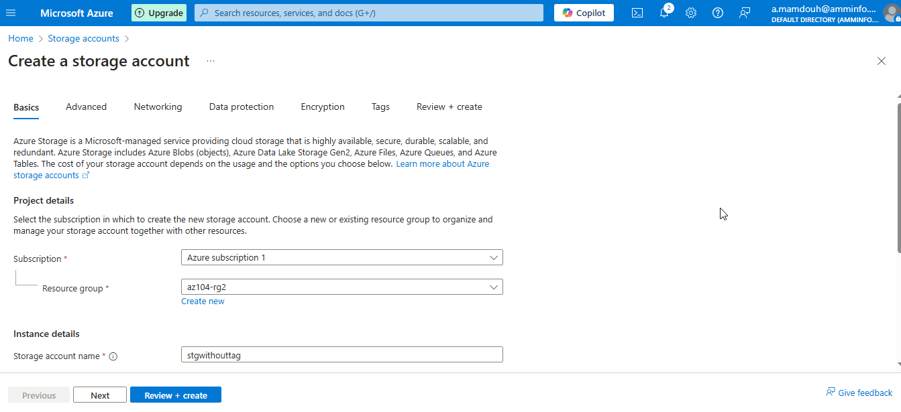
Notes:
Create storage account without any tags to validate policy

Slide 11
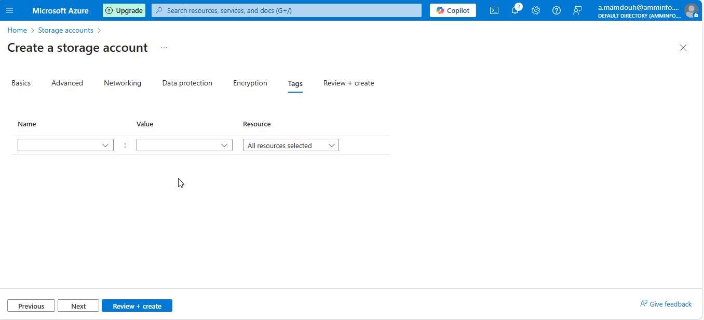
Notes:
Without any tags to validate policy

Slide 12
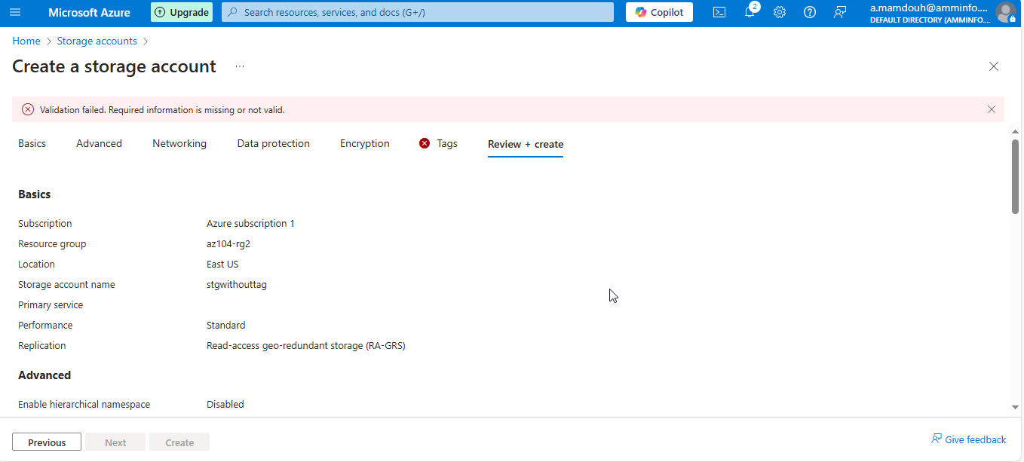
Notes:
Tag is missing

Slide 13
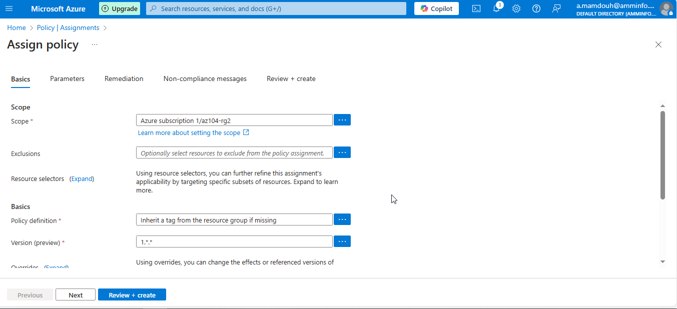
Notes:
Assign new policy definition

Slide 14
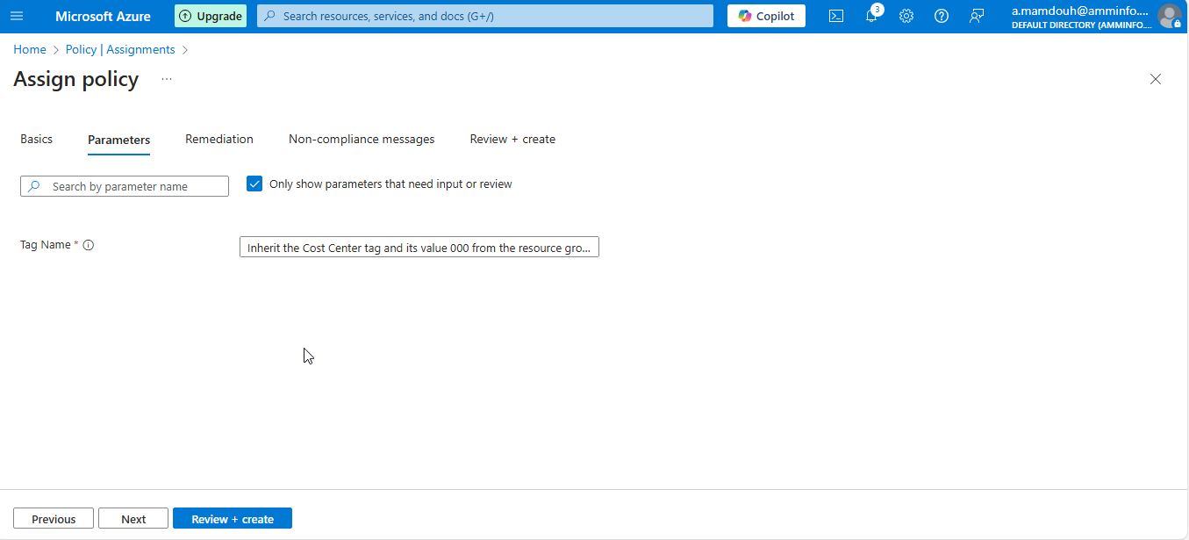
Notes:
Inherit a tag from the resource group

Slide 15
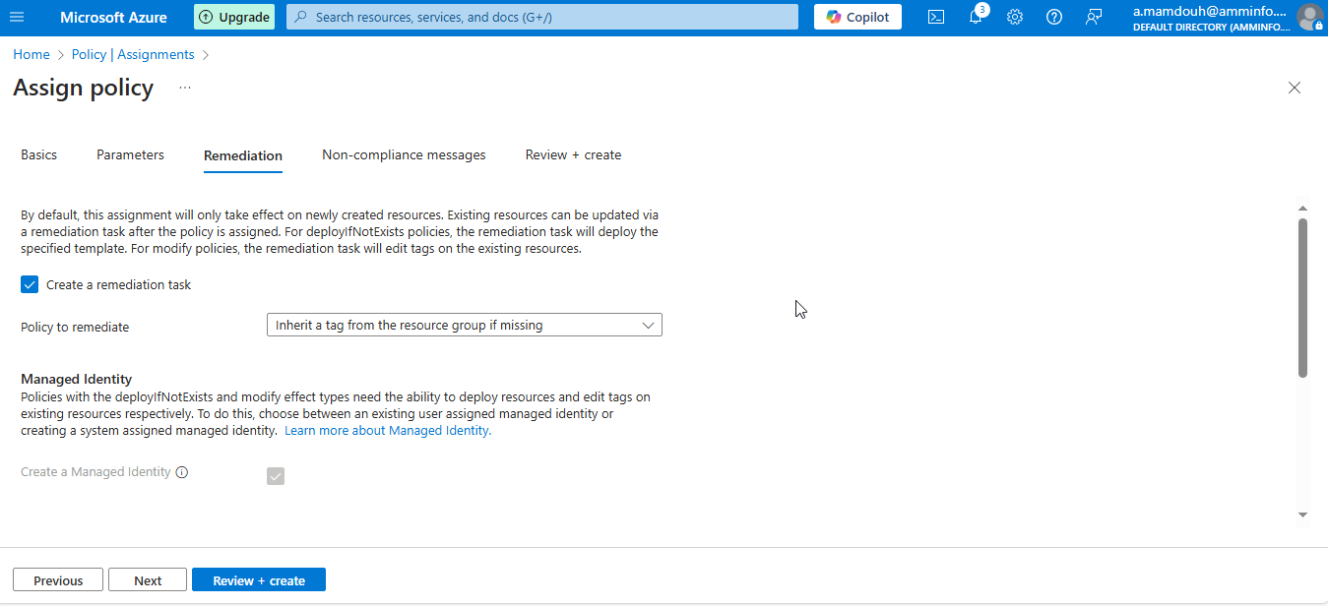

Slide 16
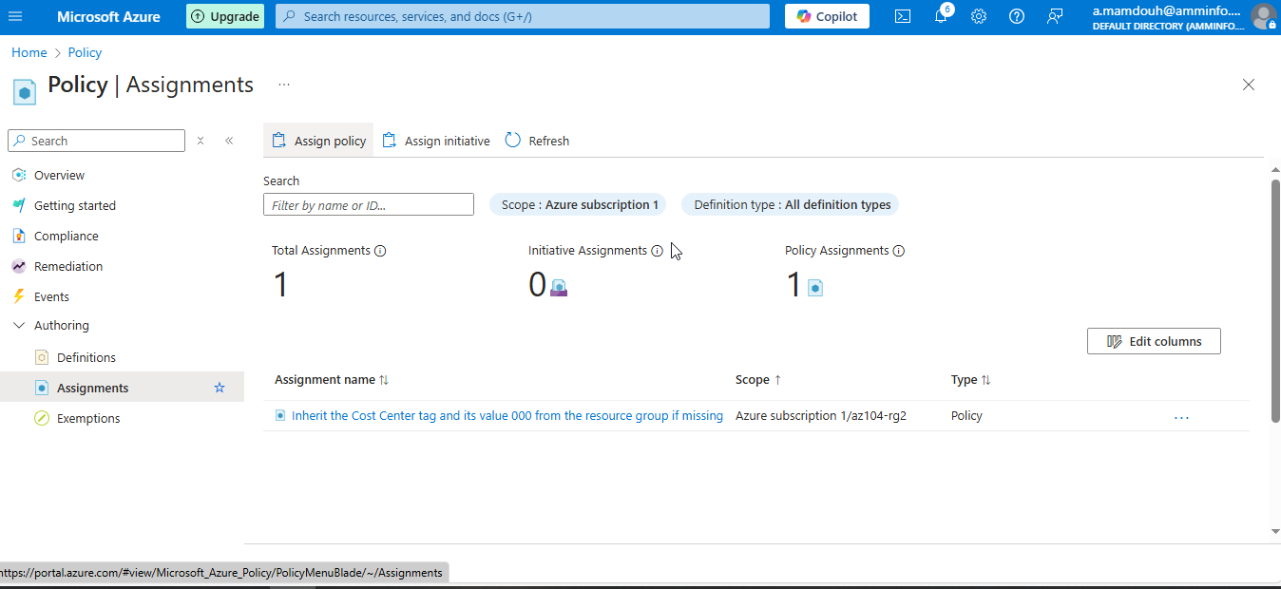
Notes:
Create new policy which allow creation and inherit tag name and value from parent

Slide 17
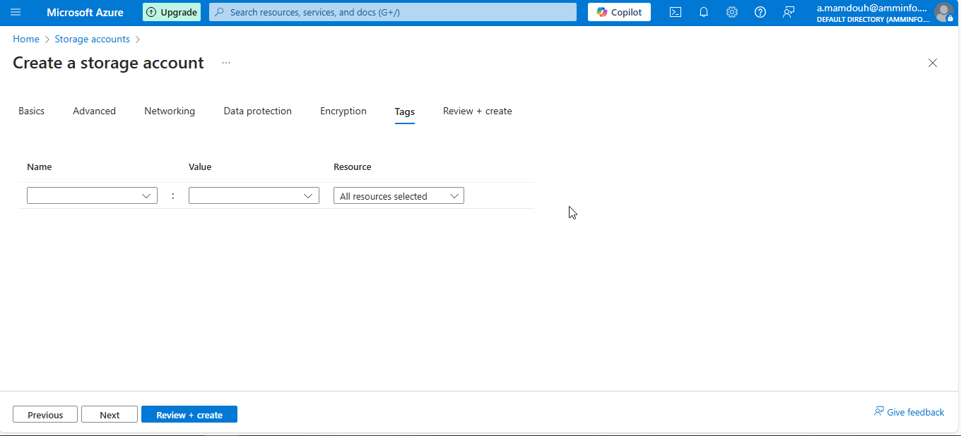
Notes:
Create a new storage account without any tags

Slide 18
