Slide 1
Azure Lab: Implement Azure Policy & Governance
# Objective:- Enforce tagging standards using Azure Policy to ensure resource compliance and enable automatic tag inheritance from the Resource group.
# Resources Required
Azure Policy definitions and assignments
Storage Accounts for Testing
# Tools Used
Azure Portal | Azure Policy | Custom Policy Definition |Azure Resource Manager

Slide 2
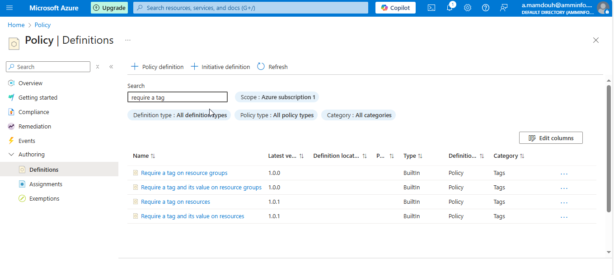
Notes:
Search for policy and select definition -→ policy definition and search for “require a tag and its value on resources”

Slide 3
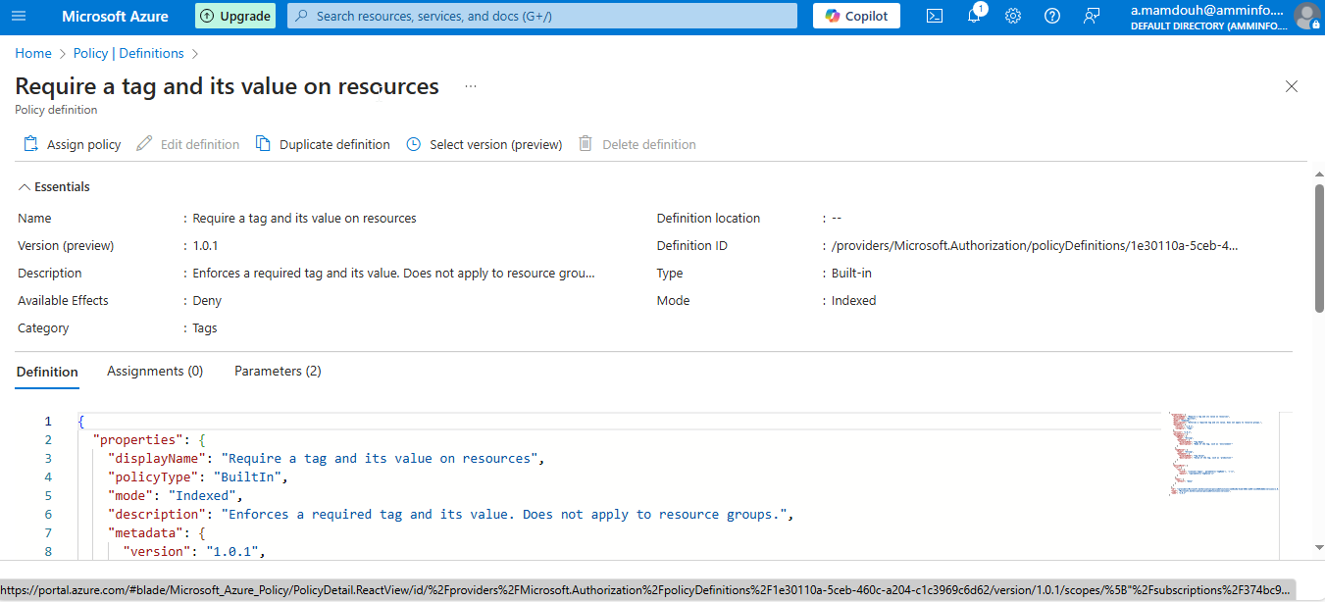

Slide 4
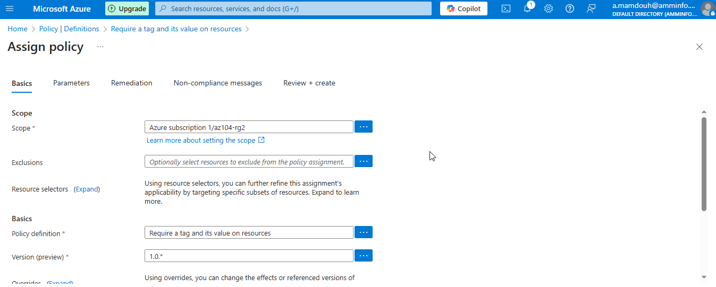
Notes:
Assign policy Select Require Tag on resources as a policy definition

Slide 5
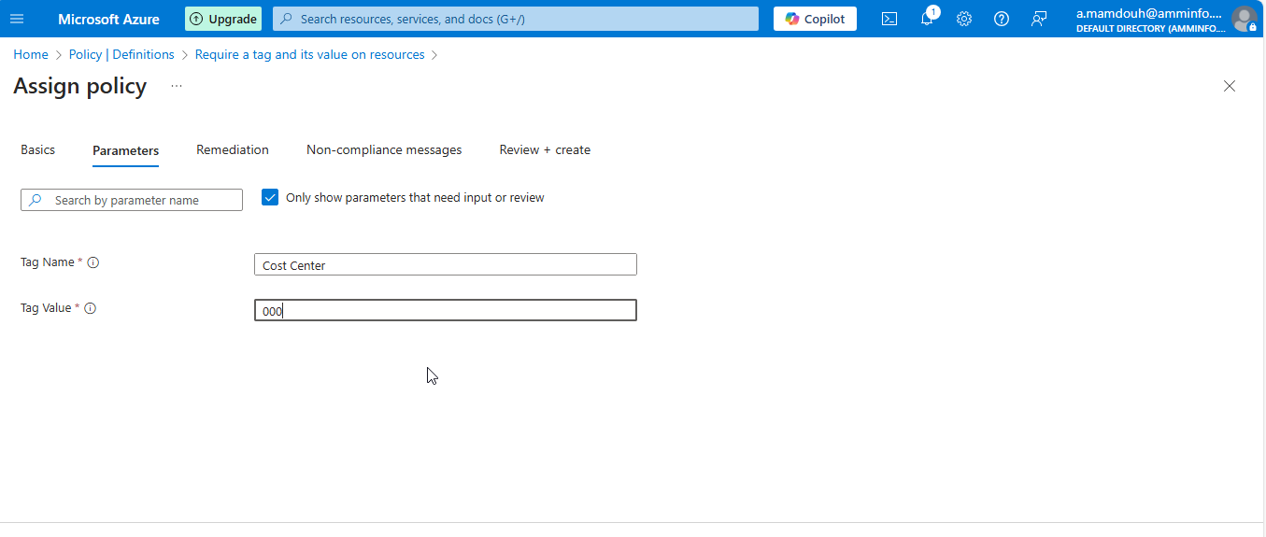
Notes:
Specify Tage name and value

Slide 6
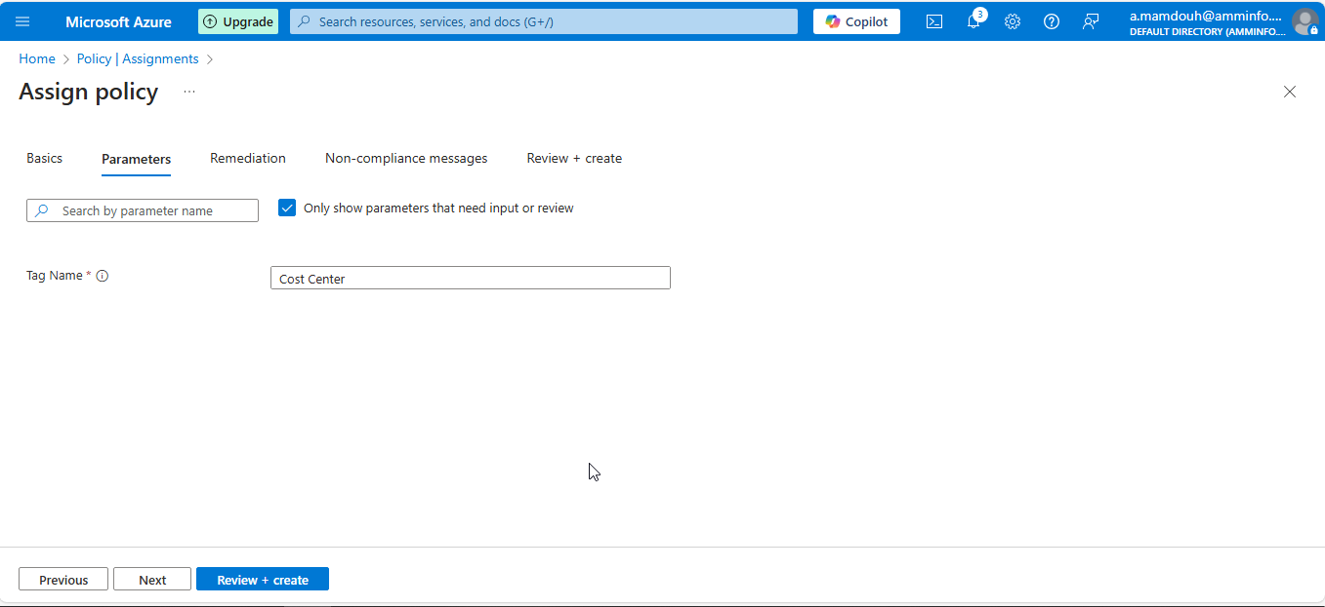
Notes:
Tag Name

Slide 7
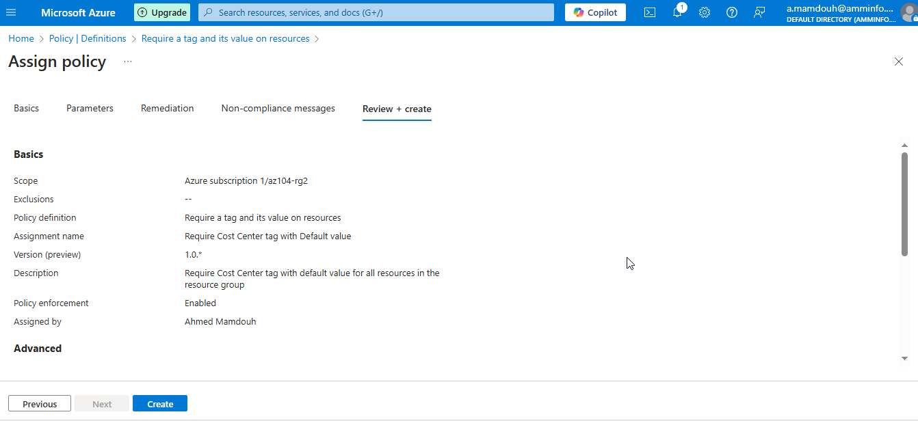
Notes:
Require tag name and value

Slide 8
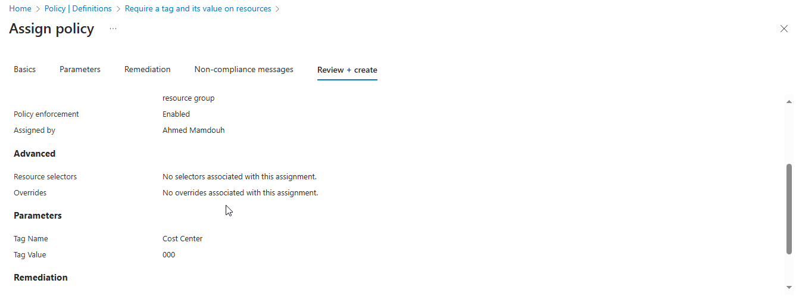

Slide 9
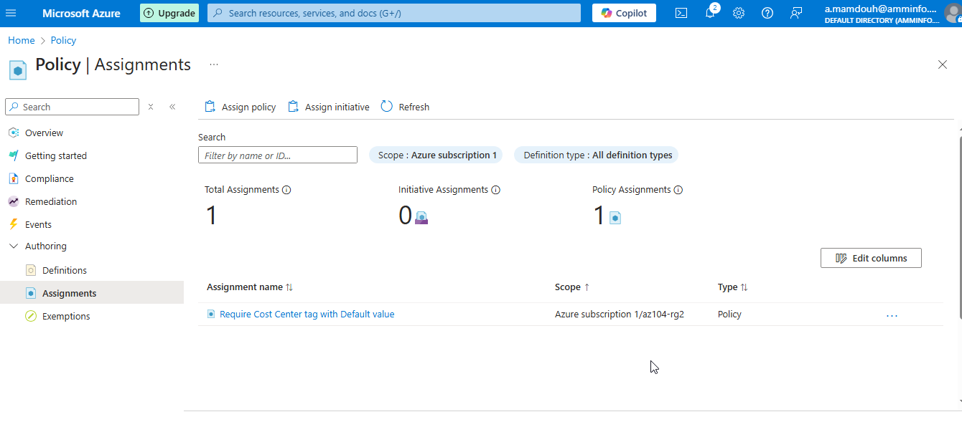
Notes:
Assign policy at RG2 “Level ”

Slide 10
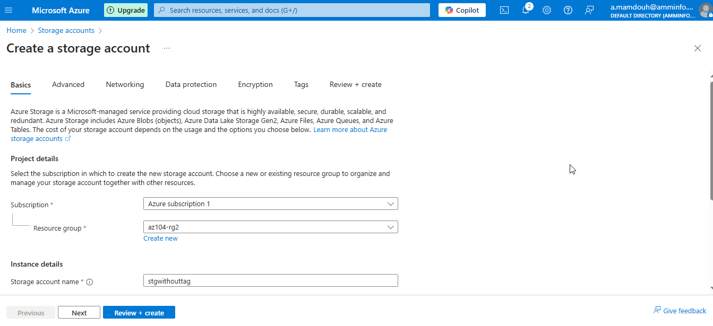
Notes:
Create storage account without any tags to validate policy

Slide 11
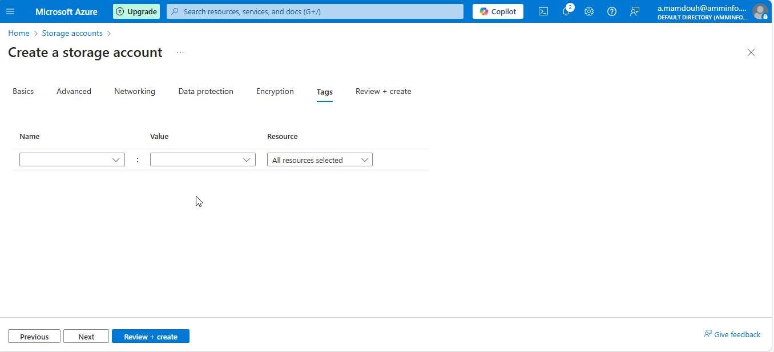
Notes:
Without any tags to validate policy

Slide 12
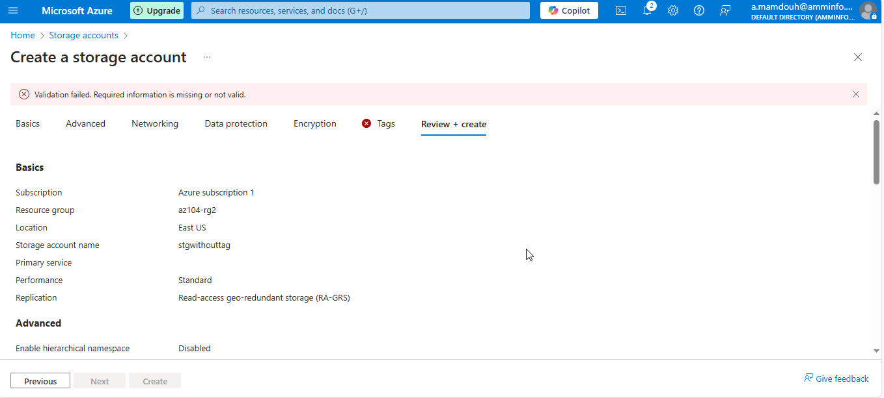
Notes:
Tag is missing

Slide 13
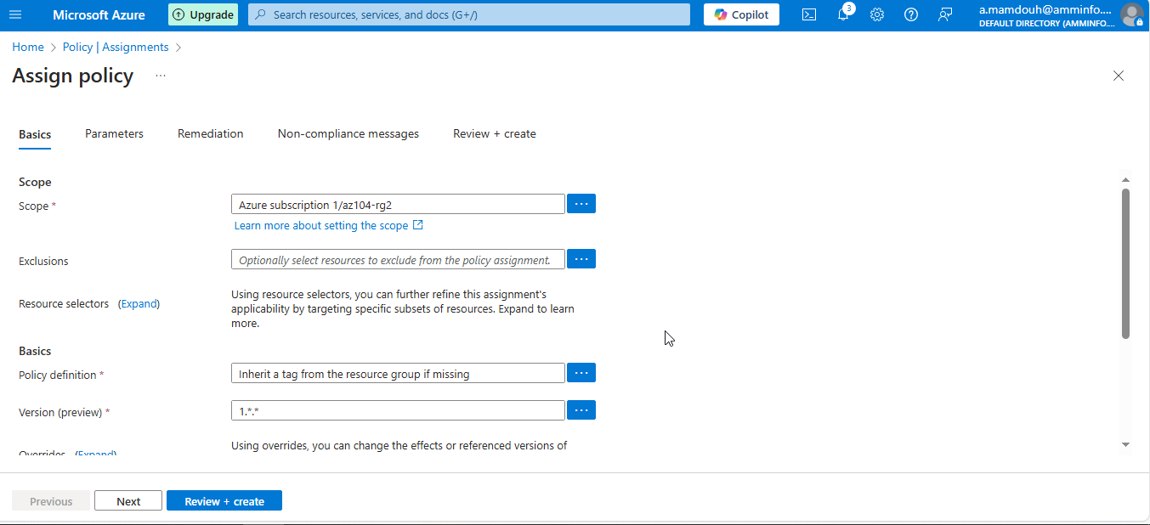
Notes:
Assign new policy definition

Slide 14
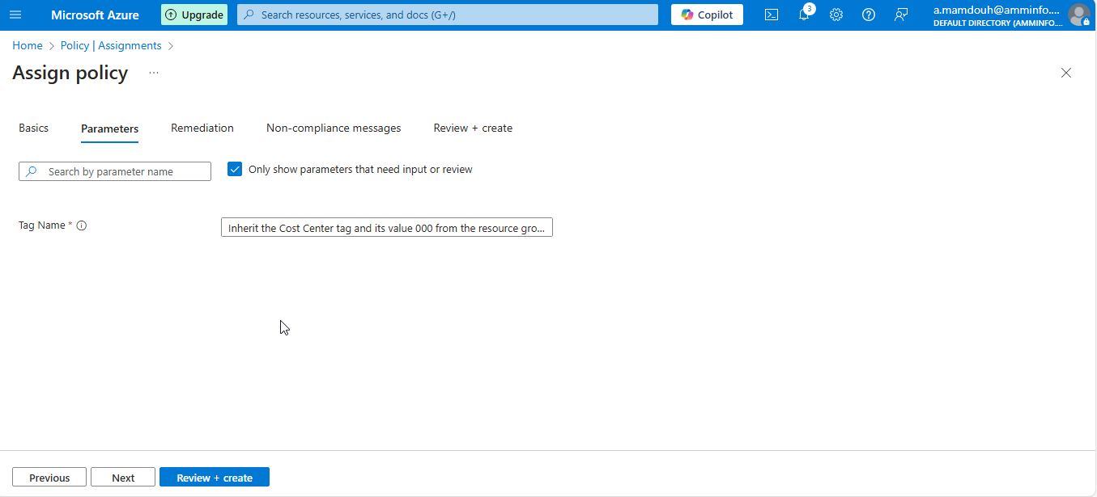
Notes:
Inherit a tag from the resource group

Slide 15
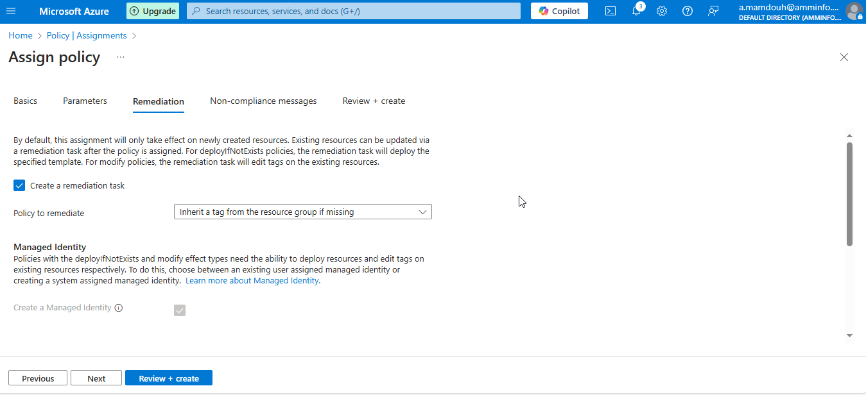

Slide 16
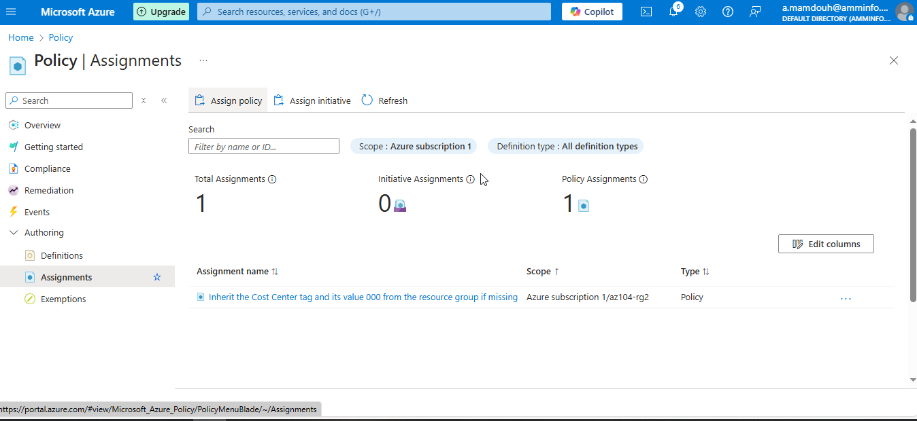
Notes:
Create new policy which allow creation and inherit tag name and value from parent

Slide 17
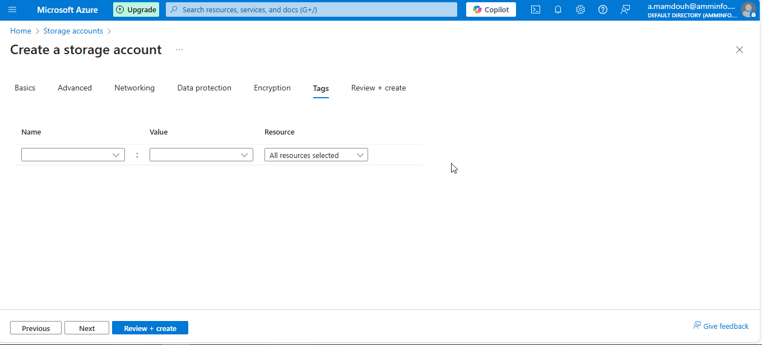
Notes:
Create a new storage account without any tags

Slide 18
