Slide 1
Introduction to NoSQL and MongoDB
<number>

Slide 2
Outline for today
Introduction to NoSQL
Architecture
Sharding
Replica sets
NoSQL Assumptions and the CAP Theorem
Strengths and weaknesses of NoSQL
MongoDB
Functionality
Examples
<number>

Slide 3
What’s NoSQL?
NoSQL DEFINITION: Next Generation Databases mostly addressing some of the points: being non-relational, distributed, open-source and horizontally scalable.
The original intention has been modern web-scale databases. The movement began early 2009 and is growing rapidly.
Often more characteristics apply such as: schema-free, easy replication support, simple API, eventually consistent/BASE (not ACID), a huge amount of data and more.
So the misleading term "nosql“, originally referring to “non SQL” or “non relational” (the community now translates it mostly with "not only sql").
Generally, NoSQL databases are structured in a key-value pair, graph
database, document-oriented or column-oriented structure.

Slide 4

CAP theorem for NoSQL
What the CAP theorem really says:
If you cannot limit the number of faults and requests can be directed to any server and you insist on serving every request you
Eric Brewer 2001
receive then you cannot possibly be consistent
How it is interpreted:
You must always give something up: consistency, availability or tolerance to failure and reconfiguration
<number>

Slide 5
Theory of NOSQL: CAP
GIVEN:
Many nodes
Nodes contain replicas of partitions
of the data
Consistency
All replicas contain the same version of data
Client always has the same view of the data (no matter what node)
Availability
System remains operational on failing nodes
All clients can always read and write
Partition tolerance
multiple entry points
System remains operational on system split (communication malfunction)
System works well across physical
network partitions
C
A P
CAP Theorem: satisfying all three at the same time is impossible
6

Slide 6
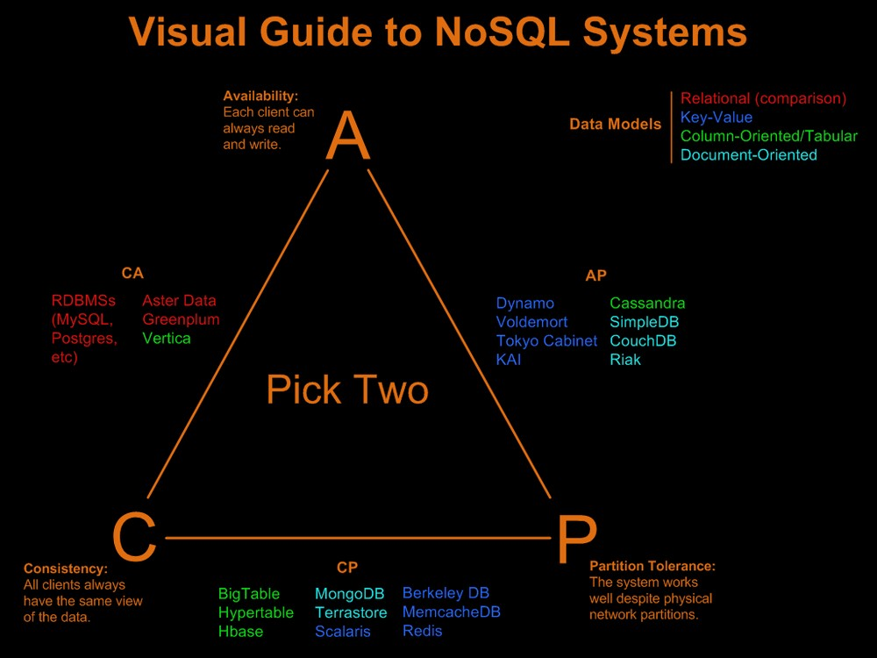
Available, Partition- Tolerant (AP) Systems achieve "eventual consistency" through replication and verification
Consistent, Available (CA) Systems have trouble with partitions
and typically deal with it with replication
Consistent, Partition-Tolerant (CP) Systems have trouble with availability while keeping data consistent across partitioned nodes
7
http://blog.nahurst.com/visual-guide-to-nosql-systems

Slide 7
How does NoSQL vary from RDBMS?
Looser schema definition
Applications written to deal with specific documents/ data
Applications aware of the schema definition as opposed to the data
Designed to handle distributed, large databases
Trade offs:
No strong support for ad hoc queries but designed for speed and growth of database
Query language through the API
Relaxation of the ACID properties
10

Slide 8
Benefits of NoSQL
Elastic Scaling
RDBMS scale up – bigger load , bigger server
NO SQL scale out – distribute data across multiple hosts seamlessly
DBA Specialists
RDMS require highly trained expert to monitor DB
NoSQL require less management, automatic repair and simpler data models
Big Data
Huge increase in data RDMS: capacity and constraints of data volumes at its limits
NoSQL designed for big data
11

Slide 9
Benefits of NoSQL
Flexible data models
Change management to schema for RDMS have to be carefully managed
NoSQL databases more relaxed in structure of data
Database schema changes do not have to be managed as one complicated change unit
Application already written to address an amorphous schema
Economics
RDMS rely on expensive proprietary servers to manage data
No SQL: clusters of cheap commodity servers to manage the data and transaction volumes
Cost per gigabyte or transaction/second for NoSQL can be lower than the cost for a RDBMS
12

Slide 10
Drawbacks of NoSQL
Support
RDBMS vendors provide a high level of support to clients
Stellar reputation
NoSQL – are open source projects with startups supporting them
Reputation not yet established
Maturity
RDMS mature product: means stable and dependable
Also means old no longer cutting edge nor interesting
NoSQL are still implementing their basic feature set
13

Slide 11
Drawbacks of NoSQL
Administration
RDMS administrator well defined role
No SQL’s goal: no administrator necessary however NO SQL still requires effort to maintain
Lack of Expertise
Whole workforce of trained and seasoned RDMS developers
Still recruiting developers to the NoSQL camp
Analytics and Business Intelligence
RDMS designed to
address this niche
NoSQL designed to meet the needs of an Web 2.0 application - not designed for ad hoc query of the data
Tools are being developed to address this need
14

Slide 12








Taxonomy of NoSQL
Key-value
Graph database
Document-oriented
Column family
<number>

Slide 13
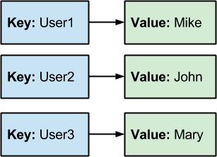
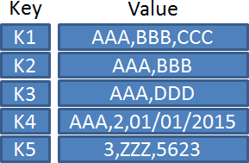
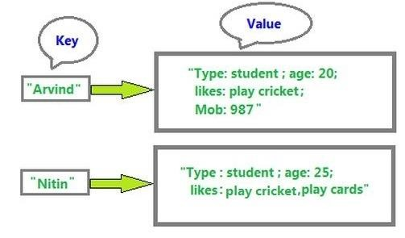
NoSQL Types - Key Value Databases

Slide 14
NoSQL Types - Column Based Databases
Column Based Databases
The column-oriented storage allows data to be stored effectively.
Were created to store and process very large amounts of data distributed over many machines.
There are still keys but they point to multiple columns. The columns are arranged by column family.
Businesses Use Wide Column Databases to Handle:
High volume of data
Extreme write speeds with relatively less velocity reads
Data extraction by columns using row keys.
Like:Sensor Logs [Internet of Things (IOT)], Geographic information, etc.
Examples: Cassandra, HBase.

Slide 15
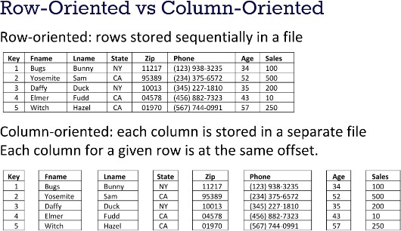
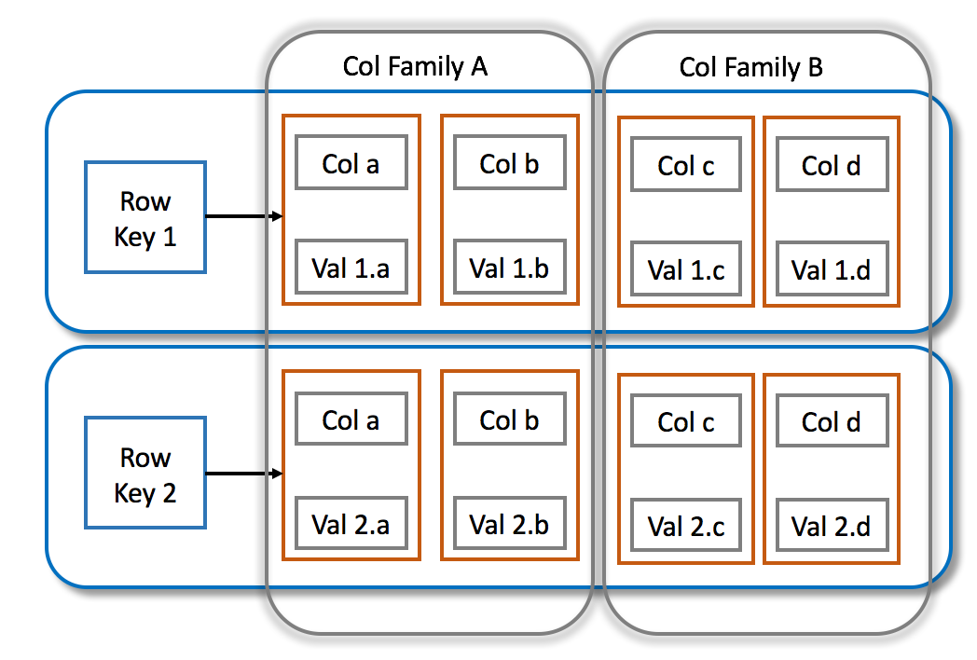
NoSQL Types - Column Based Databases (Cont.)

Slide 16
NoSQL Types - Document Oriented Databases
Document Oriented Databases
These were inspired by Lotus Notes and are similar to key-value
stores.
The model is basically versioned documents that are collections of other key-value collections.
The semi-structured documents are stored in formats like JSON.
Document databases are essentially the next level of Key/value,
allowing nested values associated with each key.
Document databases support querying more efficiently.
Examples: CouchDB, MongoDb.
In fact, MongoDB has become one of the most popular NoSQL
databases.

Slide 17
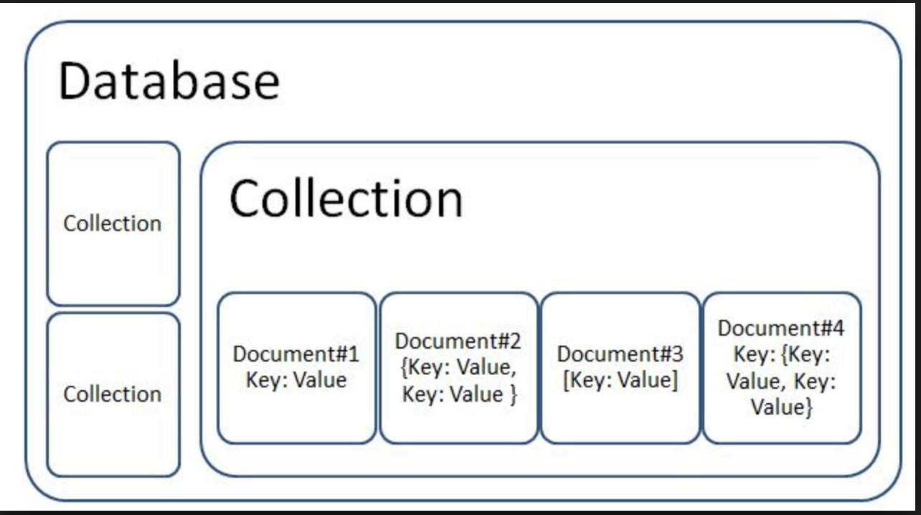
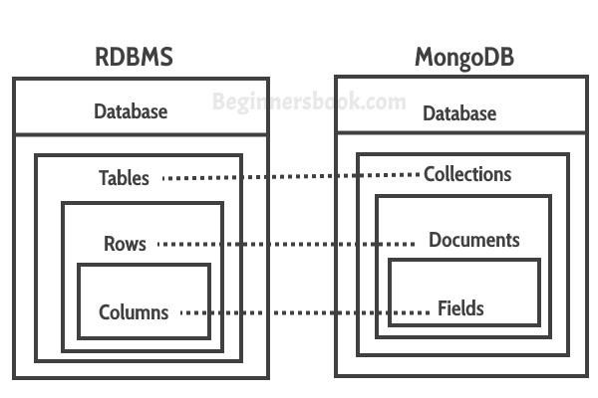
NoSQL Types - Document Oriented Databases (Cont.)

Slide 18
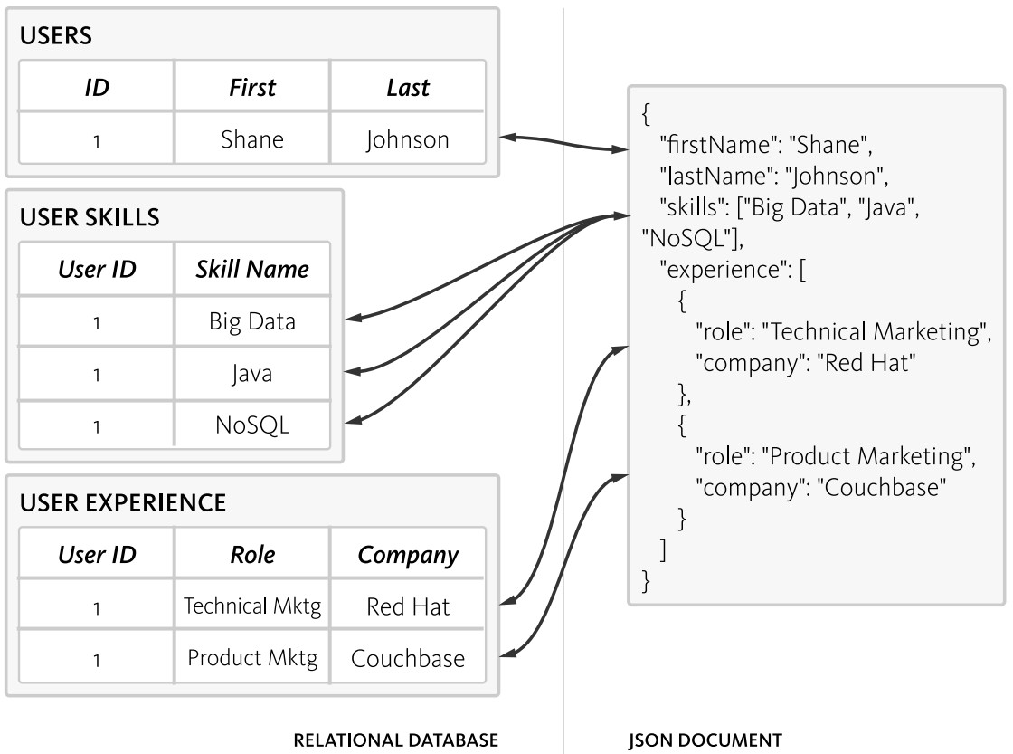
NoSQL Types - Document Oriented Databases (Cont.)

Slide 19
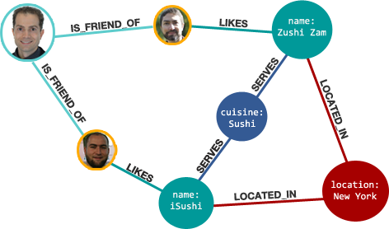
NoSQL Types - Graph Based Databases (Cont.)

Slide 20

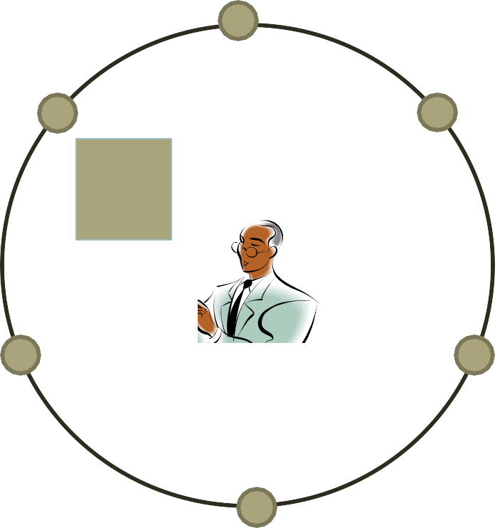
Typical NoSQL architecture
Hashing function maps each key to a server (node)
K
<number>

Slide 21

First example:
16

Slide 22
What is MongoDB?
Developed by 10gen
Founded in 2007
A document-oriented, NoSQL database
Hash-based, schema-less database
No Data Definition Language
In practice, this means you can store hashes with any keys and values that you choose
Keys are a basic data type but in reality stored as strings
Document Identifiers (_id) will be created for each document, field name
reserved by system
Application tracks the schema and mapping
Uses BSON format
Based on JSON – B stands for Binary
Written in C++
Supports APIs (drivers) in many computer languages
JavaScript, Python, Ruby, Perl, Java, Java Scala, C#, C++, Haskell, Erlang
17

Slide 23
Functionality of MongoDB
Dynamic schema
No DDL
Document-based database
Secondary indexes
Query language via an API
Atomic writes and fully-consistent reads
If system configured that way
Master-slave replication with automated failover (replica sets)
Built-in horizontal scaling via automated range-based
partitioning of data (sharding)
No joins nor transactions

Slide 24
Why use MongoDB?
Simple queries
Functionality provided applicable to most web applications
Easy and fast integration of data
No ERD diagram
Not well suited for heavy and complex transactions systems

Slide 25

MongoDB: CAP approach
Focus on Consistency and Partition tolerance
C
Consistency
all replicas contain the same version of the data
Availability
system remains operational on failing nodes
Partition tolarence
multiple entry points
system remains operational on
system split
A P
CAP Theorem:
satisfying all three at the same time is
impossible
20

Slide 26
MongoDB: Hierarchical Objects
A MongoDB instance may have zero or more ‘databases’
A database may have
zero or more ‘collections’.
A collection may have zero or more ‘documents’.
A document may have one or more ‘fields’.
MongoDB ‘Indexes’ function much like their RDBMS counterparts.
0 or more Databases
0 or more Collections
0 or more Documents
0 or more Fields
21

Slide 27
RDB Concepts to NO SQL
RDBMS |  | MongoDB
Database |  | Database
Table, View |  | Collection
Row |  | Document (BSON)
Column |  | Field
Index |  | Index
Join |  | Embedded Document
Foreign Key |  | Reference
Partition |  | Shard
Collection is not strict about what it Stores
Schema-less
Hierarchy is evident in the design
Embedded Document ?
22

Slide 28
MongoDB Processes and configuration
Mongod – Database instance
Mongos - Sharding processes
Analogous to a database router.
Processes all requests
Decides how many and which mongods should receive the query
Mongos collates the results, and sends it back to the client.
Mongo – an interactive shell ( a client)
Fully functional JavaScript environment for use with a MongoDB
You can have one mongos for the whole system no matter
how many mongods you have
OR you can have one local mongos for every client if you wanted to minimize network latency.
23

Slide 29
Choices made for Design of MongoDB
Scale horizontally over commodity hardware
Lots of relatively inexpensive servers
Keep the functionality that works well in RDBMSs
Ad hoc queries
Fully featured indexes
Secondary indexes
What doesn’t distribute well in RDB?
Long running multi-row transactions
Joins
Both artifacts of the relational data model (row x column)

Slide 30
BSON format
Binary-encoded serialization of JSON-like documents
Zero or more key/value pairs are stored as a single entity
Each entry consists of a field name, a data type, and a value
Large elements in a BSON document are prefixed with a
length field to facilitate scanning

Slide 31






Schema Free
MongoDB does not need any pre-defined data schema
Every document in a collection could have different data
Addresses NULL data fields
{name: “will”,
eyes: “blue”,
birthplace: “NY”,
aliases: [“bill”, “la ciacco”],
loc: [32.7, 63.4],
boss: ”ben”}
name: “jeff”,
eyes: “blue”, loc: [40.7, 73.4],
boss: “ben”}
{name: “brendan”,
aliases: [“el diablo”]}
{name: “matt”, pizza: “DiGiorno”, height: 72,
loc: [44.6, 71.3]}
name: “ben”,
hat: ”yes”}

Slide 32
JSON format
Data is in name / value pairs
A name/value pair consists of a field name followed by a colon, followed by a value:
Example: “name”: “R2-D2”
Data is separated by commas
Example: “name”: “R2-D2”, race : “Droid”
Curly braces hold objects
Example: {“name”: “R2-D2”, race : “Droid”, affiliation:
“rebels”}
An array is stored in brackets []
Example [ {“name”: “R2-D2”, race : “Droid”, affiliation: “rebels”},
{“name”: “Yoda”, affiliation: “rebels”} ]

Slide 33
MongoDB Features
Document-Oriented storage
Full Index Support
Replication & High Availability
Auto-Sharding
Querying
Fast In-Place Updates
Map/Reduce functionality
Agile
Scalable
28

Slide 34
Index Functionality
B+ tree indexes
An index is automatically created on the _id field (the primary key)
Users can create other indexes to improve query performance or to enforce Unique values for a particular field
Supports single field index as well as Compound index
Like SQL order of the fields in a compound index matters
If you index a field that holds an array value, MongoDB creates
separate index entries for every element of the array
Sparse property of an index ensures that the index only contain entries for documents that have the indexed field. (so ignore records that do not have the field defined)
If an index is both unique and sparse – then the system will reject records that have a duplicate key value but allow records that do not have the indexed field defined
29

Slide 35
CRUD operations
Create
db.collection.insert( <document> )
db.collection.save( <document> )
db.collection.update( <query>, <update>, { upsert: true } )
Read
db.collection.find( <query>, <projection> )
db.collection.findOne( <query>, <projection> )
Update
db.collection.update( <query>, <update>, <options> )
Delete
db.collection.remove( <query>, <justOne> )
Collection specifies the collection or the ‘table’ to store the document
30

Slide 36
Create Operations
Db.collection specifies the collection or the ‘table’ to store the document
db.collection_name.insert( <document> )
Omit the _id field to have MongoDB generate a unique key
Example db.parts.insert( {{type: “screwdriver”, quantity: 15 } )
db.parts.insert({_id: 10, type: “hammer”, quantity: 1 })
db.collection_name.update( <query>, <update>, { upsert: true } )
Will update 1 or more records in a collection satisfying query
db.collection_name.save( <document> )
Updates an existing record or creates a new record

Slide 37
Read Operations
db.collection.find( <query>, <projection> ).cursor modified
Provides functionality similar to the SELECT command
<query> where condition , <projection> fields in result set
Example: var PartsCursor = db.parts.find({parts: “hammer”}).limit(5)
Has cursors to handle a result set
Can modify the query to impose limits, skips, and sort orders.
Can specify to return the ‘top’ number of records from the result set
db.collection.findOne( <query>, <projection> )

Slide 38
Query Operators
Name | Description
$eq | Matches value that are equal to a specified value
$gt, $gte | Matches values that are greater than (or equal to a specified value
$lt, $lte | Matches values less than or ( equal to ) a specified value
$ne | Matches values that are not equal to a specified value
$in | Matches any of the values specified in an array
$nin | Matches none of the values specified in an array
$or | Joins query clauses with a logical OR returns all
$and | Join query clauses with a loginal AND
$not | Inverts the effect of a query expression
$nor | Join query clauses with a logical NOR
$exists | Matches documents that have a specified field
33
https://docs.mongodb.org/manual/reference/operator/query/

Slide 39
Update Operations
db.collection_name.insert( <document> )
Omit the _id field to have MongoDB generate a unique key
Example db.parts.insert( {{type: “screwdriver”, quantity: 15 } )
db.parts.insert({_id: 10, type: “hammer”, quantity: 1 })
db.collection_name.save( <document> )
Updates an existing record or creates a new record
db.collection_name.update( <query>, <update>, { upsert: true } )
Will update 1 or more records in a collection satisfying query
db.collection_name.findAndModify(<query>, <sort>,
<update>,<new>, <fields>,<upsert>)
Modify existing record(s) – retrieve old or new version of the record

Slide 40
Delete Operations
db.collection_name.remove(<query>, <justone>)
Delete all records from a collection or matching a criterion
<justone> - specifies to delete only 1 record matching the criterion
Example: db.parts.remove(type: /^h/ } ) - remove all parts starting with h
Db.parts.remove() – delete all documents in the parts collections

Slide 41
CRUD examples
db.user.insert({
first: "John",
last : "Doe", age: 39
})
db.user.find ()
{ "_id" : ObjectId("51"), "first" : "John",
"last" : "Doe", "age" : 39
}
db.user.update(
{"_id" : ObjectId(“51")},
{
$set: {
age: 40,
salary: 7000}
}
db.user.remove({ "first": /^J/
})
36
)

Slide 42
SQL vs. Mongo DB entities
My SQL
Mongo DB
db.contacts.save( { userName: “joeblow”,
START TRANSACTION;
INSERT INTO contacts VALUES (NULL, ‘joeblow’);
INSERT INTO contact_emails
VALUES
( NULL, ”joe@blow.com”, LAST_INSERT_ID() ),
( NULL,
“joseph@blow.com”,
LAST_INSERT_ID() ); COMMIT;
emailAddresses: [ “joe@blow.com”,
“joseph@blow.com” ] }
);
Similar to IDS from the 70’s Bachman’s brainchild
DIFFERENCE:
MongoDB separates physical structure
37
from logical structure
Designed to deal with large &distributed

Slide 43
Aggregated functionality
Aggregation framework provides SQL-like aggregation functionality
Pipeline documents from a collection pass through an aggregation pipeline, which transforms these objects as they pass through
Expressions produce output documents based on calculations performed on input documents
Example db.parts.aggregate ( {$group : {_id: type, totalquantity
: { $sum: quanity} } } )

Slide 44
Aggregation (Cont.)
Aggregation expressions:
Expression | Description | Example
$sum | Sums up the defined value from all documents in the collection. | db.mycol.aggregate([{$group : {_id : "$by_user", num_tutorial : {$sum : "$likes"}}}])
$avg | Calculates the average of all given values from all documents in the collection. | db.mycol.aggregate([{$group : {_id : "$by_user", num_tutorial : {$avg : "$likes"}}}])
$min | Gets the minimum of the corresponding values from all documents in the collection. | db.mycol.aggregate([{$group : {_id : "$by_user", num_tutorial : {$min : "$likes"}}}])
$max | Gets the maximum of the corresponding values from all documents in the collection. | db.mycol.aggregate([{$group : {_id : "$by_user", num_tutorial : {$max : "$likes"}}}])
$push | Inserts the value to an array in the resulting document. | db.mycol.aggregate([{$group : {_id : "$by_user", url : {$push: "$url"}}}])
$addToSet | Inserts the value to an array in the resulting document but does not create duplicates. | db.mycol.aggregate([{$group : {_id : "$by_user", url : {$addToSet : "$url"}}}])
$first | Gets the first document from the source documents according to the grouping. Typically this makes only sense together with some previously applied “$sort”-stage. | db.mycol.aggregate([{$group : {_id : "$by_user", first_url : {$first : "$url"}}}])
$last | Gets the last document from the source documents according to the grouping. Typically this makes only sense together with some previously applied “$sort”-stage. | db.mycol.aggregate([{$group : {_id : "$by_user", last_url : {$last : "$url"}}}])

Slide 45
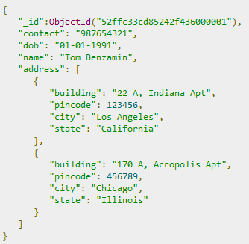
Relationships
Relationships can be modeled via Embedded and Referenced approaches.
Modeling Embedded Relationships:
This approach maintains all the related data in a single document, which makes it easy to retrieve and maintain. The whole document can be retrieved in a single query:
>db.users.findOne({"name":"Tom Benzamin"},{"address":1})
The drawback is that if the embedded document keeps on growing too much in size, it can impact the read/write performance.

Slide 46
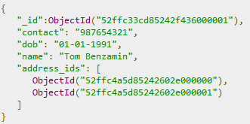
Relationships (Cont.)
Modeling Referenced Relationships:
In this approach, both the user and address documents will be maintained separately but the user document will contain a field that will reference the address document's id field.
With this approach, we will need two queries:
>var result = db.users.findOne({"name":"Tom Benzamin"},{"address_ids":1})
>var addresses = db.address.find({"_id":{"$in":result["address_ids"]}})

Slide 47
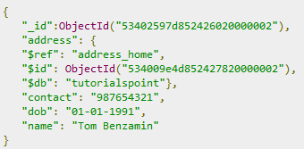

Relationships (Cont.)
Modeling Referenced Relationships using MongoDB DBRefs.
The previous approach is called Manual References in which we manually store the referenced document's id inside other document.
However, in cases where a document contains references from different collections, we
can use MongoDB DBRefs.
Using DBRefs: There are three fields in DBRefs :
$ref − This field specifies the collection of the referenced document
$id − This field specifies the _id field of the referenced document
$db − This is an optional field and contains the name of the database in which the referenced
document lies

Slide 48
Relationships (Cont.)
Modeling Referenced Relationships using MongoDB DBRefs. (Cont.)
The following code dynamically looks in the collection specified by $ref parameter:
>var user = db.users.findOne({"name":"Tom Benzamin"})
>var dbRef = user.address
>db[dbRef.$ref].findOne({"_id":(dbRef.$id)})

Slide 49
Map reduce functionality
Performs complex aggregator functions given a collection of keys, value pairs
Must provide at least a map function, reduction function and a
name of the result set
db.collection.mapReduce( <mapfunction>, <reducefunction>,
{ out: <collection>, query: <document>, sort: <document>, limit: <number>, finalize: <function>, scope: <document>, jsMode: <boolean>, verbose: <boolean> } )
More description of map reduce next lecture

Slide 50
Indexes: High performance read
Typically used for frequently used queries
Necessary when the total size of the documents exceeds the
amount of available RAM.
Defined on the collection level
Can be defined on 1 or more fields
Composite index (SQL) → Compound index (MongoDB)
B-tree index
Only 1 index can be used by the query optimizer when retrieving data
Index covers a query - match the query conditions and return
the results using only the index;
Use index to provide the results.
40

Slide 51
Replication of data
Ensures redundancy, backup, and automatic failover
Recovery manager in the RDMS
Replication occurs through groups of servers known as replica sets
Primary set – set of servers that client tasks direct updates to
Secondary set – set of servers used for duplication of data
At the most can have 12 replica sets
Many different properties can be associated with a secondary set i.e. secondary-only, hidden delayed, arbiters, non-voting
If the primary set fails the secondary sets ‘vote’ to elect the new primary set

Slide 52
Consistency of data
All read operations issued to the primary of a replica set are consistent with the last write operation
Reads to a primary have strict consistency
Reads reflect the latest changes to the data
Reads to a secondary have eventual consistency
Updates propagate gradually
If clients permit reads from secondary sets – then client may read a previous state of the database
Failure occurs before the secondary nodes are updated
System identifies when a rollback needs to occur
Users are responsible for manually applying rollback changes

Slide 53
Summary
NoSQL built to address a distributed database system
Sharding
Replica sets of data
CAP Theorem: consistency, availability and partition tolerant
MongoDB
Document oriented data, schema-less database, supports secondary indexes, provides a query language, consistent reads on primary sets
Lacks transactions, joins

