Slide 1
Blazor (web assembly)
By. Ahmed Mohamed Samir
ahmedmohamedmvp@gmail.com

Slide 2
introduction
BLAZOR: it’s a client-side web framework help developer to build interactive UI using DotNet (C#)
MVC, the server generates(render) HTML views and sends them to the client's browser as static HTML.
Blazor is a technology to make single page application, which serves as the entry point for the application.
The entire application runs within a single HTML page.
Single page application: provide navigation within the application without full page reloads.
Navigation within the application typically involves updating the URL’s
Instead of navigating to different HTML pages to view different content or perform different actions the SPA dynamically updates portions of the page in response to user interactions, data changes, or navigation events, This is achieved using JavaScript to manipulate the Document Object Model (DOM) of the HTML page.
Blazor
Blazor server
Blazor client (web assembly)

Slide 3
Introduction [cont.]
loading process in SPAs:
Initial Load: When a user first opens the SPA in his browser, the browser loads the initial HTML, CSS, and JavaScript files required to render the application's UI
After the initial load, the SPA may make additional requests to the server to fetch data as needed. These requests are typically made asynchronously using AJAX or fetch
When a new data is fetched from the server, the SPA updates the relevant portions of the page without reloading the entire page This approach provides a smoother and faster user experience compared to traditional multi-page web applications, where each user action typically results in a full page reload.
SPAs often implement client-side routing to handle navigation within the application without triggering full page reloads.

Slide 4
How can browser execute C#
The answer is by using WebAssembly
In 2015 cross platform language called WASM is developed to be executed on web browser
WASM is a machine language not human programming, it’s close to [Assembly-binary]
W3C organization make standard to WASM to this language and called WebAssembly
The browser can understand the WebAssembly.
Due to this language close to binary and browser can understand it so most of programming language can compiled into WebAssembly to run on browser.
At core 7 the IL is sent to the browser then browser convert it to web assembly and execute it
At core 8 the IL is converted into WebAssembly on the server to the browser then browser execute it
When user request app created using Blazor the server response with like
app.wasm : The main file responsible for executing a Blazor application in the browser , This file contains the compiled WebAssembly code for the application
blazor.webassembly.js : sets up the execution environment for running your Blazor WebAssembly application within the browser. This includes initializing the .NET runtime, handles the rendering of Blazor components
Blazor WebAssembly applications are powered by the .NET runtime, which is compiled to WebAssembly to run the application within the browser environment.

Slide 5
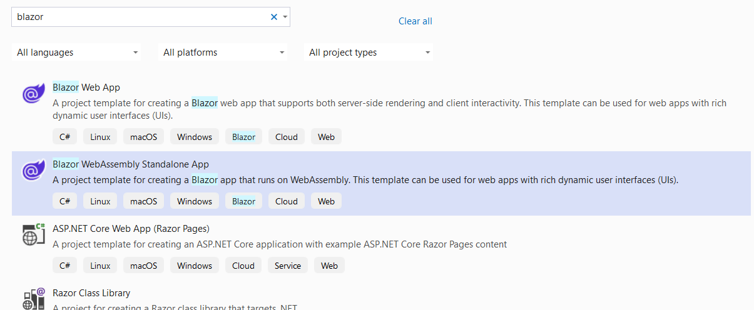
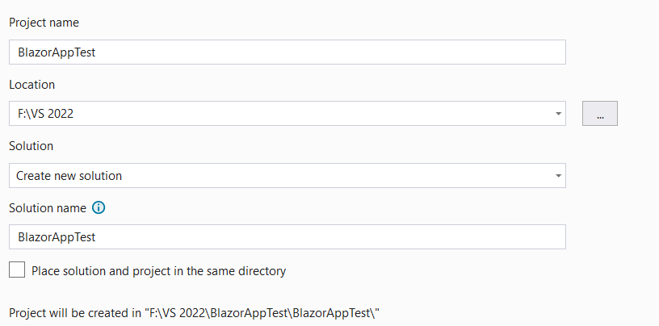
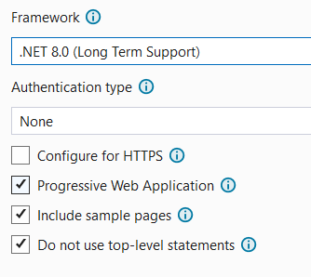
Create new Blazor project
Progressive web application
Offline : can work offline and sync data when become online
standalone: do not need browser to run (can run on desktop)

Slide 6
Solution files
wwwroot: carry css, js images, files, we can create appsetting inside it
index.html the single page application
App.razor is the root component that catch URL and return the component that has the URL if it’s found
Layout folder: components that contains common UI elements such as headers, footers, navigation bars, etc., which are shared across the application.
_Imports.razor: contains all import that component will read
pages folder: custom components with URL
components : you can create it to carry the components with no URL

Slide 7
Blazor page & component
Is a set of component, each component (C#, HTML, CSS)
Component types:
Built-in component
Custom component
Page component (has URL)
Non-page component (has no component) to be used in another component
Component extension is razor
Once you create component class is created on background with the name of component and inherit from ComponentBase class
Layout component inherits from LayoutComponentBase class
MainLayout.razor: inherit from → @inherits LayoutComponentBase that has @Body directive where the content of specific component will be rendered, specific means navigated component
App.razor is the root component that catch URL and return the component that has the URL if it’s found

Slide 8
Component [cont.]
Create Razor component: Component name must start with capital, and it’s better to be followed by Component for example FirstComponent
To set URL to component → @page "/first" , must start with /
To change the title inside component <PageTitle>First component</PageTitle> page title is built in component
NavLink: is a built-in component that active the link if its href matches the URL
<NavLink class="nav-link" href="counter"> // it active the link if its href matched
At any component @code { // enter c# code here that will executed at browser }

Slide 9
General info
<button class="btn btn-success" @onclick="test">Enter </button>
At @code → void test(){Console.WriteLine("hello from test");}
// @onclick="test" == @onclick=test
-----------------------------------------------------------------
<< call function with params >>
<button class="btn btn-success" @onclick='()=>{test("sss");}' >Enter </button>
void test(string msg) => Console.WriteLine(msg);
-----------------------------------------------------------------
To read variable from @code directive in html element (one way binding)
@code {string msg = "Ahmed";} ,
at html <p>@msg</p> <input type="text" value="@msg" />
two-way binding
<input type="text" @bind-value:event="oninput" @bind-value="@msg" />

Slide 10
General info
The @bind directive used with select input
<select @bind="msg" @bind:event="onchange">
<option value="1">alex</option>
<option value="2">cairo</option>
<option value="3">mansoura</option>
</select>
<select class="form form-control"
@foreach (var item in DeptList)
{ <option value="@item.Id">@item.Name</option>}
</select>
<img src="Images/@product.Image" class="card-img-top" alt="@product.Name">
You can separate the component c# code in file → for FirstComponent.razor component you can create class with name FirstComponent.razor.cs and make class partial and delete the @code directive from component

Slide 11
Get parameter from route
@page "/first/{id:int}" // id will pass to component at property named id
<p>@id</p>
[Parameter]
public int id { get; set; } // the name must be similar to route parameter

Slide 12
Pass data between component
From parent to child
At child component
[Parameter]
public string msg { get; set; }
[Parameter] // this means msg property value is gotten from route else if from direct parent component as attribute else default value
At parent component
<ChildComponent msg="hello Ahmed this is my message"></ChildComponent>

Slide 13
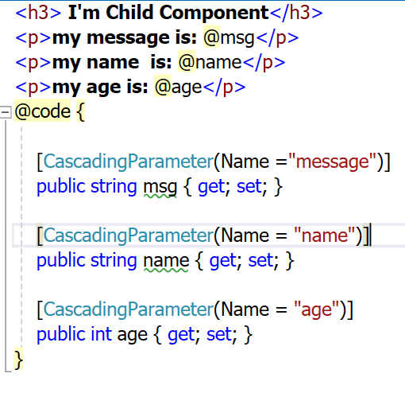
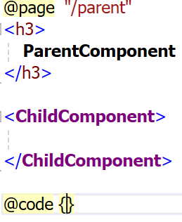
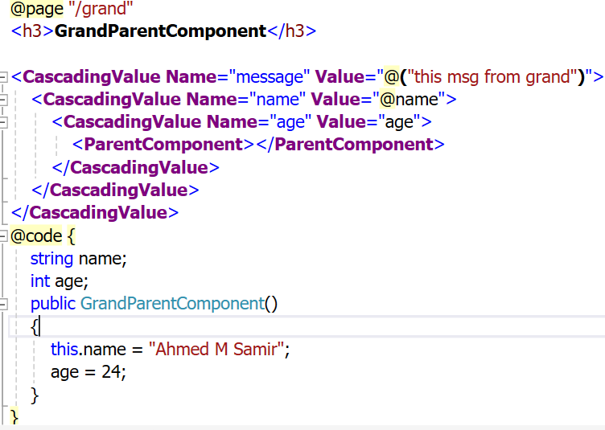
Pass data between component
From GrandParent to Child
At child component at parent at GrandParent
[CascadingParameter means any parent level can pass value to property

Slide 14
Pass data between component
From Child to parent
At child component at parent component
<h3> I'm Child Component</h3>
<button class="btn btn-success"
@onclick="change">change message
</button>
@code {
public string msg { get; set; }
[Parameter]
public EventCallback<string> changeMsgEvent {get; set;}
public void change(){
changeMsgEvent.InvokeAsync("mesg from child");
}
}
@page "/parent"
<h3> ParentComponent</h3>
<p>parent msg is @parentMsg</p>
<ChildComponent changeMsgEvent="changeMsg"></ChildComponent>
@code {
public string parentMsg { get; set; }
void changeMsg(string s)
{ parentMsg = s; }
}

Slide 15

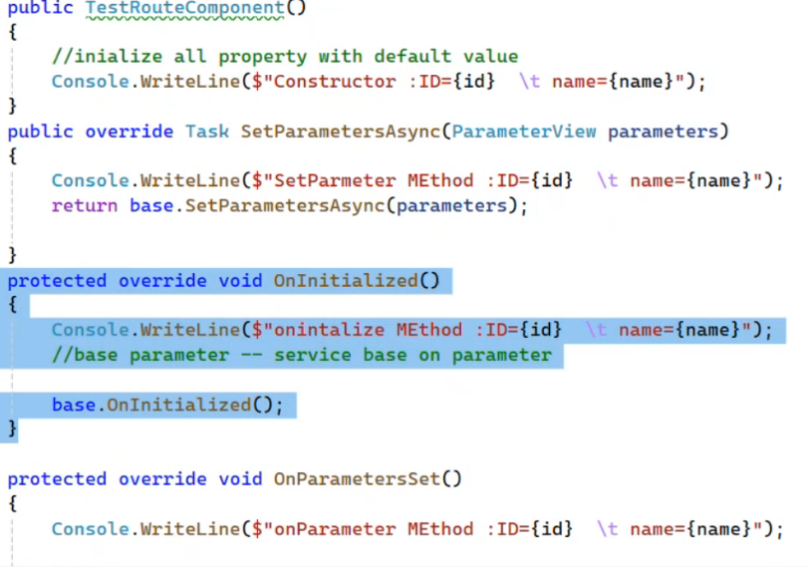
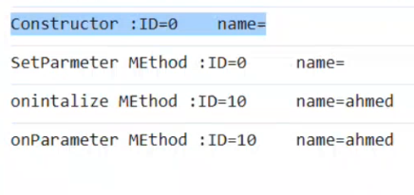
Life Cycle of component
Component is a class and life cycle is
Constructor(): initialized with default value
SetParameter(): set values to properties that has parameter or cascade parameter from route or parent component
oninitialized() // to make instructions based on parameters
OnParameterSet(): called at each changing on parameters properties

Slide 16
Injection at Blazor
@page "/allproducts"
@inject IService<Product> service
<h3>AllProductsComponent</h3>
<div class="container">
<div class="row">
@foreach(Product product in products){
<div class="card" style="width: 18rem; col-sm-3">
<img src="Images/@product.Image"
class="card-img-top" alt="@product.Name">
<div class="card-body">
<h5 class="card-title">@product.Name</h5>
<p class="card-text">price: @product.Price$ </p>
</div>
</div>
}
</div>
</div>
@code {
public List<Product> products;
public AllProductsComponent(IService<Product> service)
{ this.service = service; }
protected override void OnInitialized()
{ products = service.getAll(); base.OnInitialized();}
}
At program.cs
builder.Services.AddScoped<IService<Product>, ProductService>();

Slide 17
Injection at Blazor
@page "/allproducts"
<h3>AllProductsComponent</h3>
<div class="container">
<div class="row">
@foreach(Product product in products){
<div class="card" style="width: 18rem; col-sm-3">
<img src="Images/@product.Image" class="card-img-top" alt="@product.Name">
<div class="card-body">
<h5 class="card-title">@product.Name</h5>
<p class="card-text">price: @product.Price$ </p>
</div>
</div>
}
</div>
</div>
@code {
public List<Product> products;
[Inject] //Created at SetParameter() method
IService<Product> service { get; set; }
public AllProductsComponent(){}
protected override void OnInitialized()
{ products = service.getAll(); base.OnInitialized() }
}
At program.cs
builder.Services.AddScoped<IService<Product>, ProductService>();

Slide 18
Built-in form component
<EditForm Model="obj_name"></EditForm> , <InputText> , <InputNumber>, <InputSelect>
<EditForm Model="product" OnSubmit="Save">
<div>
<label>Name</label>
<InputText class="form form-control" @bind-Value="product.Name"></InputText>
</div>
<div>
<label>Price</label>
<InputNumber class="form form-control" @bind-Value="product.Price"></InputNumber>
</div>
<div>
<label>category</label>
<InputSelect class="form form-control" @bind-Value="product.CatId">
@foreach (var cat in categories)
{ <option value="@cat.Id">@cat.Name</option>}
</InputSelect>
</div>
<button class="btn btn-success">Save changes</button>
</EditForm>

Slide 19
Form validation
using System.ComponentModel.DataAnnotations;
[Required(ErrorMessage = "product name is required")]
[MinLength(3, ErrorMessage ="length must be at least 3")]
[RegularExpression("^[1-9][0-9]*$", ErrorMessage ="choose category"),]
[Range(10, 1000,ErrorMessage ="price must be between 10 and 1000")]
To active the validation feature → inside EditForm Element
<DataAnnotationsValidator></DataAnnotationsValidator> //it show only client message
to show the validation error message
<div>
<label>Name</label>
<InputText class="form form-control" @bind-Value="product.Name"></InputText>
<ValidationMessage For="()=>product.Name"></ValidationMessage>
</div>
Also you can use <ValidationSummary></ValidationSummary> to list the error a the top of the form

Slide 20
navigation

Slide 21
Consume API
Create model its properties names are like returned properties
The API must enable cores to accept requests from outside domains
GetFromJsonAsync<List<Course>> de-serializes the returned json into List<Course>
This is the naïve code let’s make a service and put web api link in app-setting
@code {
public List<Course>? courses;
HttpClient? httpClient;
protected override async Task OnInitializedAsync()
{
httpClient = new HttpClient();
courses = await httpClient.GetFromJsonAsync<List<Course>>("https://localhost:7269/api/Course");
base.OnInitializedAsync();
}
}

Slide 22
Consume API [cont.] (inject HttpClient )
Create appsettings.json at www root folder if not exist
At appsettings.json → "SP": https://localhost:7269/
At program.cs → you will find
Change it to
builder.Services.AddScoped(sp => new HttpClient { BaseAddress = new Uri(builder.HostEnvironment.BaseAddress) });
builder.Services.AddScoped(sp => new HttpClient {
BaseAddress = new Uri(builder.Configuration.GetValue<string>("SP"))
});

Slide 23
Create Service
public interface IGeneralService<T>
{
Task<List<T>> getAll();
Task<T> getById(int id);
Task insert(T entity);
Task update(int id, T entity);
Task delete(int id);
}
public class CourseService : IGeneralService<Course>
{
public readonly HttpClient client;
public CourseService(HttpClient _client) { this.client = _client; }
public async Task delete(int id)
{ await client.DeleteAsync($"api/Course/{id}"); }
public async Task<List<Course>> getAll()
{ return await client.GetFromJsonAsync<List<Course>>("api/Course"); }
public async Task<Course> getById(int id)
{ return await client.GetFromJsonAsync<Course>($"api/Course/{id}"); }
public async Task insert(Course entity)
{ var response = client.PostAsJsonAsync<Course>("api/Course", entity); }
public async Task update(int id, Course entity)
{ await client.PutAsJsonAsync<Course>($"api/Course/{id}", entity); }
}

Slide 24
Create service [cont.]
At program.cs → register the service
builder.Services.AddScoped<IGeneralService<Course>, CourseService>();
@code {
public List<Course>? courses;
[Inject]
public IGeneralService<Course> crsService { get; set; }
protected override async Task OnInitializedAsync()
{
courses = await crsService.getAll();
base.OnInitializedAsync();
}
}

Slide 25

Consume more than 1 API at your application
Install this package →install-package Microsoft.Extensions.Http
At appsetting.json
At program.cs
// it’s registration to service and http client
builder.Services.AddHttpClient<IGeneralService<Course>, CourseService>(
httpclient => httpclient.BaseAddress = new Uri(builder.Configuration.GetValue<string>("SP"))
);
builder.Services.AddHttpClient<IGeneralService<Product>, ProductService>(
httpclient => httpclient.BaseAddress = new Uri(builder.Configuration.GetValue<string>("IP"))
) ;
//builder.Services.AddScoped(sp => new HttpClient
//{
// BaseAddress = new Uri(builder.Configuration.GetValue<string>("SP"))
//});

Slide 26
Global using file

