Slide 1
GRPC
By. Ahmed Mohamed Samir
ahmedmohamedmvp@gmail.com

Slide 2
Info to help
TCP connection is a fundamental concept in computer networking that provides reliable, ordered, and error-checked delivery of data between applications running on hosts communicating over an IP (Internet Protocol) network
Transmission Control Protocol (TCP) is a communications standard that enables application programs and computing devices to exchange messages over a network. It is designed to send packets across the internet and ensure the successful delivery of data and messages over networks.
Frame : the basic unit in HTTP2
HTTP2 divide the message that will be sent from source to destination(server) into frames
Head of line blocking: the first packet in a queue prevents the subsequent packets from moving forward until it is successfully processed and removed from the queue even if there are resources available for those subsequent packets.
HTTP2 support multiplexing that solve head of line blocking
multiplexing: the ability to send more than one request through a single TCP connection, with each request being independent which optimize resources , reduce latency
Latency : the amount of time it takes to send data from source to destination

Slide 3
How do service communicate with each other [service to service communication]
What do need for successful communication
HTTP, WebSocket, Soap, GRPC

Slide 4
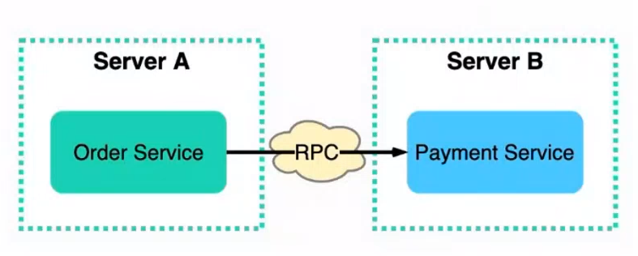
What is RPC
RPC: Remote procedure calling
GRPC: google Remote procedure calling
RPC technique helps you if you have a service and you want to make it communicate with other service
Example on RPCs: GRPC, Java remote method invocation

Slide 5
GRPC
GRPC: google remote procedure call
Developed in 20216 and Based on HTTP2
GRPC: Language agnostic which means does not depend on specific language
High performance dur to it based on http2 that support binary serialization

Slide 6
How does GRPC works
It’s Contract-first-Api development using protocol buffer file, this file shared between the services and by which the communication is performed between services
Protocol buffer file is translated to server language, and client language using GRPC compiler that Generate client stub, server skeleton
Protocol buffer file: language agnostic
Data exchange format : Protocol Buffers proto, Protocol Buffers (proto) format is generally faster and more efficient than XML and JSON for data exchange why ? Protocol Buffers serialize data into a compact binary format, which is much smaller than text-based formats like XML and JSON. This reduces the amount of data that needs to be transmitted over the network, leading to faster data exchange.
At GRPC : data is sent in the form of binary format which leads decrease the latency
Latency : the amount of time it takes to send data from source to destination
It’s better to use GRPC to with microservices
Microservice → each server existed on separate server for example → service 1 on server A, server 2 on server B

Slide 7
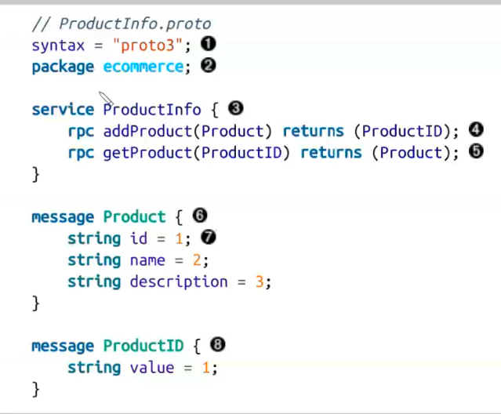
Protocol buffer file example
one of the key reasons why Protocol Buffers (proto) are more efficient for data exchange compared to formats like XML and JSON is that they use numeric tags (field numbers) instead of textual names for variables

Slide 8

Proto file option and package
You use one of them at proto file
Both refer to the namespace of generated code
If both exists, the option override the package
option cshap_namespace for C#
package for all language

Slide 9
Proto file
To make empty response →
To use timestpan →
import "google/protobuf/empty.proto";
// . . . . .
rpc KeepAlive(stream PulseMsg) returns(google.protobuf.Empty);
import "google/protobuf/timestamp.proto";
// . . . . .
google.protobuf.Timestamp DateTime = 2
----------------------------------------------------
To convert from DateTime to timespan
Expiredates=Timestamp.FromDateTime(p.ExpireDate.ToUniversalTime())
------------------------------------------------------
Convert Google protobuf Timestamp to DateTime
ExpireDate = request.Expiredates.ToDateTime()

Slide 10
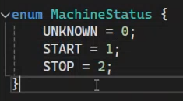

Proto file
To make enum →
Note that number at Enum refers to actual value
To convert from Protobuf enum to C# enum
Category = (ServerAPI.Models.ProductCategory)request.Category,
To convert from C# enum to a Protobuf enum
Category = (GRPS_Test.Protos.ProductCategory) p.Category,

Slide 11
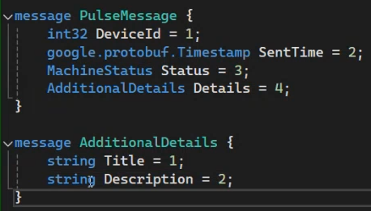
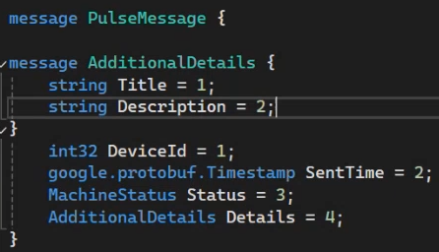
Proto file
To make inner message
OR

Slide 12
Proto file
To ignore the data clint send on specific number
To ignore message property where location is a message
To ignore more than message property →
To ignore

Slide 13
Proto buffer file
Based on HTTP2

Slide 14
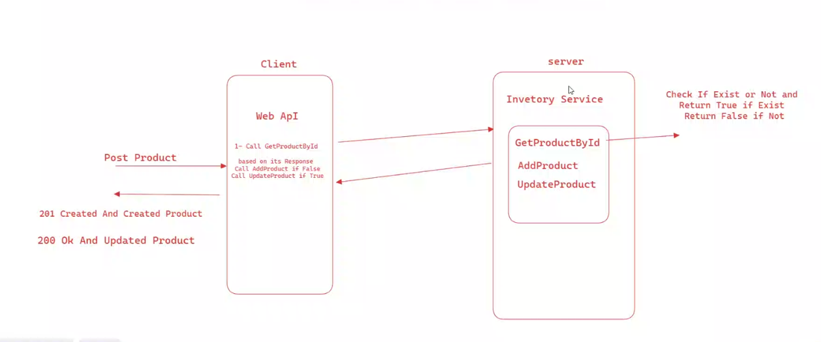
Let’s have more fun and implement our first GRPC project
We will implement this task

Slide 15
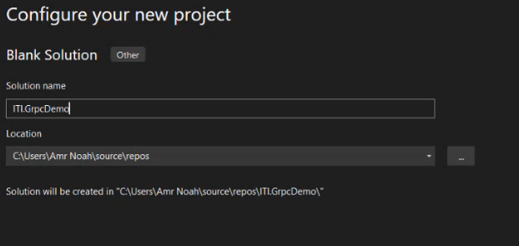
Step 1
At first create Blank solution

Slide 16
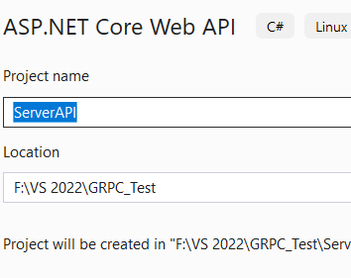
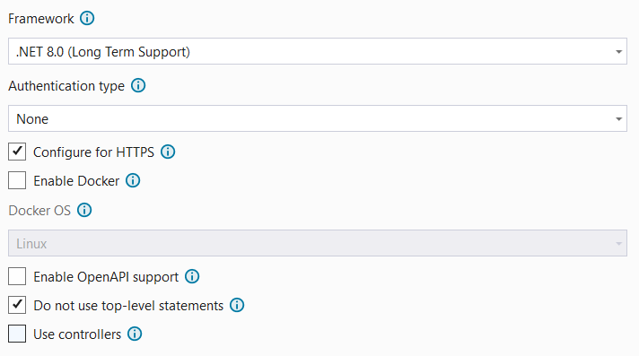
Step 2 create server project → WebAPI project
I do not need swagger because I don’t make restful API, so I uncheck enable OpenAPI support

Slide 17
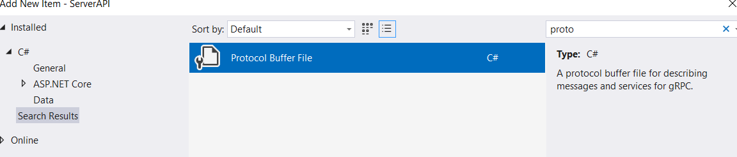
Step 3 create the shared protocol buffer file on server
Create new folder with name Protos
Right click on the Protos folder + add new item + create Proto buffer file
I named it with InventoryService

Slide 18
Protocol buffer Code
syntax = "proto3";
option csharp_namespace = "ServerAPI.Protos";
service InventoryService{
rpc GetProdById(prodIdMsg) returns (ProdExistResponse);
rpc AddProduct(productMsg) returns (productMsg);
rpc UpdateProduct(productMsg) returns (productMsg);
}
message prodIdMsg {
int32 prodId = 1;
}
message productMsg {
int32 prodId = 1;
string name = 2;
string description = 3;
float price = 4;
int32 quantity = 5;
}
message ProdExistResponse { bool exists = 1;}

Slide 19
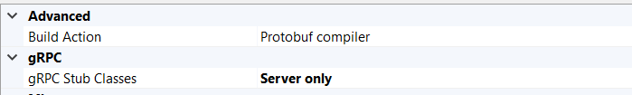
Step 4 install Grpc.AspNetCore package in server project
After implementation of proto buffer file Install-package Grpc.AspNetCore in server project
Grpc.AspNetCore package adds GRPC compiler that generate server code
After installing package go to proto buffer file -> right click -> properties
Right click on server project + build

Slide 20
Step 5 implement service at server project
Create folder services
Create class with name InventoryServiceMessage [name it as you want]
The class generated from proto buffer file is InventoryServiceBase
Inherit from the InventoryServiceBase and override the methods for example

Slide 21
public class InventoryServiceMessage: InventoryServiceBase {
List<Product> products;
public InventoryServiceMessage(){
products = new List<Product>(){new Product(){Id=1,Name="car", Description="this is car", price=45, quantity=14 },
}
public override async Task<ProdExistResponse> GetProdById(prodIdMsg request, ServerCallContext context){
var res = products.FirstOrDefault(x => x.Id == request.ProdId);
if (res != null) { return await Task.FromResult(new ProdExistResponse() { Exists = true });}
return await Task.FromResult(new ProdExistResponse() { Exists = false });
}
public override async Task<productMsg> AddProduct(productMsg request, ServerCallContext context)
{
Product newProd = new Product(){ Id=request.ProdId,Name=request.Name, Description= request.Description,
price = request.Price,quantity = request.Quantity, };
products.Add(newProd);
return await Task.FromResult(request);
}
Note that generated class name is → InventoryServiceBase

Slide 22
Step 6: inject GRPC service
At server program.cs
NOW OUR SERVER IS READY TO RECEIVE REMOTE CALL FOR THIS service
Each call translated to POST Request
builder.Services.AddGrpc();
// . . . . . .
app.MapGrpcService<MessageInventoryService>();

Slide 23
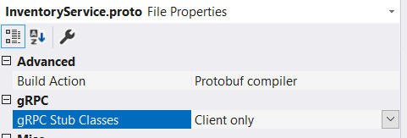
Create client application WebAPI
Make the same proto buffer file
install these 3 packages to generate the client code
Install-package Grpc.Tools
Install-package Grpc.Net.Client
Install-package Google.Protobuf
Install-Package Grpc.Net.ClientFactory // to inject client
After installing packages go to properties of proto buffer file
Build the application

Slide 24
At client project
Make channel with server
The naïve way
Note that generated class name is → InventoryServiceClient
The client can make the calling to remote service methods
public class ProductController : ControllerBase
{
private readonly GrpcChannel channel;
InventoryServiceClient client;
public ProductController()
{
channel = GrpcChannel.ForAddress("https://localhost:7266");
client = new InventoryServiceClient(channel);
}
}

Slide 25
Inject client instead of ask
At program.cs
Ensure that you install this package
Install-Package Grpc.Net.ClientFactory // to inject client
builder.Services.AddGrpcClient<InventoryServiceClient>(o =>
{
o.Address = new Uri("https://localhost:7091");
});
public class ProductController : ControllerBase {
InventoryServiceClient client;
public ProductController(InventoryServiceClient _client)
{
this.client = _client;
}

Slide 26
Call methods of service existed on server using client [InventoryServiceClient]
[HttpPost]
public async Task<ActionResult> Post(Product product){
var req = new prodIdMsg() { ProdId = product.Id };
var res = await client.GetProdByIdAsync(req);
productMsg prod = new productMsg(){
ProdId = product.Id,
Description = product.Description,
Name = product.Name,
Price = product.price,
Quantity = product.quantity,
};
if (res.Exists == true) {
await client.UpdateProductAsync(prod);
return Created("product updated successfully", product);
}
await client.AddProductAsync(prod);
return Ok(product);
}

Slide 27
The difference between JSON & XML & Buffer
feature | JSON | XML | Protobuf
Stands for | JavaScript Object Notation | eXtensible Markup Language | Protocol Buffers
Structure | Based on key-value pairs | Tag-based | Compact binary with schema
Usage | Web APIs, | Enterprise systems | service communication
Pros | Readable | Flexible, extensible | Efficiency (size, speed) language-agnostic high-performance
cons | Limited Data Types | Verbose | not Human-Readable Schema Dependency
Verbose: A verbose format means it includes a lot of additional information, often making it larger in size and potentially harder to read or process quickly.

Slide 28
feature | REST | GraphQL | GRPC
brief | using HTTP as the protocol, Resources are identified by URLs, and operations are performed using standard HTTP methods such as GET, POST, PUT, DELETE, etc. | It allows clients to request exactly the data they need and nothing more. Clients can specify the structure of the response, | It uses Protocol Buffers (Protobuf) for defining service methods and message types, allowing for efficient binary serialization. and can use HTTP/2 for transport,
Use case | Simple CRUD | Mobile and web applications where efficient data retrieval is crucial. | Microservices communication
Pros | Statelessness: Each request must contain all the information needed to understand and process the request. Caching Flexibility: Works well with multiple data formats (JSON, XML) | Flexible Queries: Clients can request exactly the data they need Single Endpoint: All interactions happen through a single endpoint | Cross-language Support: Compatible with multiple programming languages Performance: binary serialization (Protobuf) Streaming
cons | Tight coupling: Changes in the API can require significant client-side updates Over-fetching/Under-fetching: Clients may receive too much or too little data in a single request. | Caching: More complex compared to REST due to dynamic query nature. | Complexity: Requires setup of Protobuf schemas Not Human-readable: Binary format is not human-readable,

Slide 29
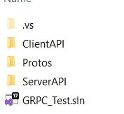
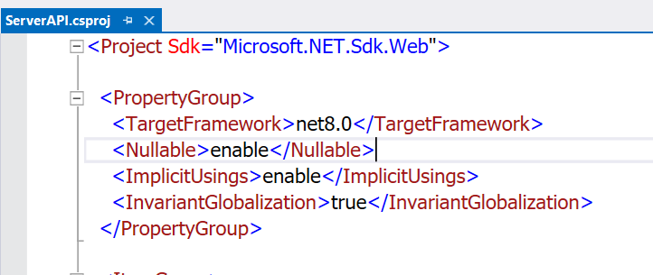
Shared proto file between client and server
It’s better to Make the namespace name of proto buffer file logical
At Directory of file solution explorer create Protos folder and put your proto buffer file inside that folder
On solution explorer double click on server project name to open csproj file , this is the picture of file content
At ItemGroup tag group add
Include: refers to the actual(real, physical) path of the proto file
Link: the proto file will appear as if it located at Protos/InventoryService.proto
GrpcServices: to determine the generated GPRC code Server, or Client or server and client
<Protobuf Include="..\Protos\InventoryService.proto" GrpcServices="Server" Link="Protos/InventoryService.proto"></Protobuf>

Slide 30
Shared proto file between client and server [cont.]
At the client csproj file add
Right click on solution and clean → you’ll finds the Protos folder inside server and client projects
<Protobuf Include="..\Protos\InventoryService.proto" GrpcServices="Client" Link="Protos/InventoryService.proto"></Protobuf>

Slide 31



GRPC communication patterns
UNARY RPCs: where client sends single request to the server and gets single response back
Server streaming RPCs: where clint sends single request to the server and the server respond with more than response (stream of response)
client streaming RPCs : clint sends more than one request to the server and server respond with one response
Bidirectional streaming: clint sends more than one request to the server respond with more than response (stream of response)
Note: stream key word refers to more than

Slide 32
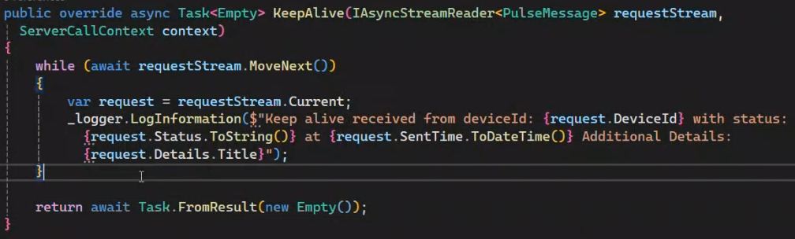
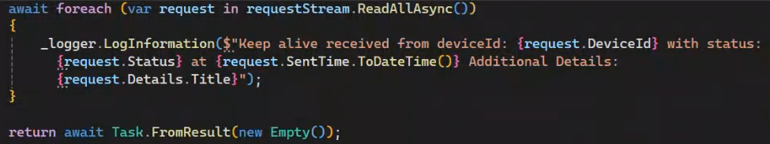
client streaming RPCs exmaple
rpc KeepAlive (stream PulseMsg) returns(google.protobuf.Empty);
Server implementation
Another way to loop on client streams

Slide 33
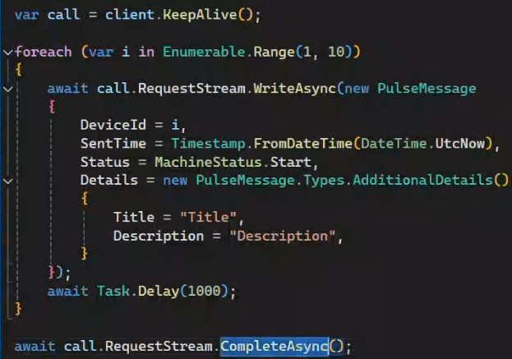
client streaming RPCs example [cont.]
At client application
To inform the server that the client complete sending requests

Slide 34
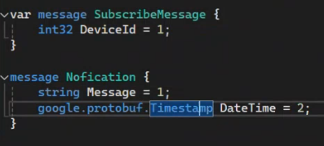
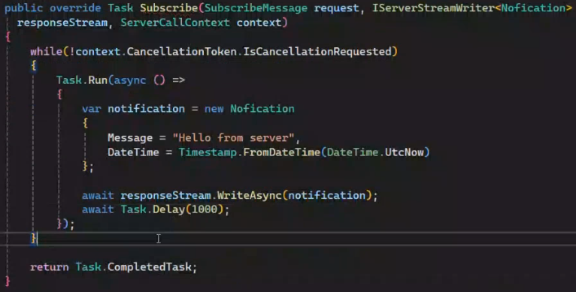
Implement server response with stream
The proto
Server implementation

Slide 35
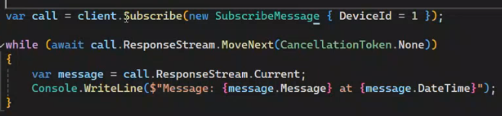
Implement server response with stream
At client project

Slide 36
GRPC service versioning
This case when client and server have two separate proto file not share the same file

Slide 37
Authentication

