Slide 1
MVC Model view controller
By. Ahmed Mohamed Samir
ahmedmoahmedmvp@gmail.com
ahmedmohamedsamir33@gmail.com

Slide 2
info to help
web server: computer with equipped software applications, such as Apache, IIS to handle incoming http requests, web server hosts your application
Web Client : device with applications (browsers) that enable sending send http request to web server
Hosting: Deploying your app on a web server
domain name : Ip-address(host) + port number
the host has many app that has been deployed on it, each app deployed on specific port number, This allows the host to distinguish between different applications and route incoming requests to the appropriate application.
you can absolutely have more than one server running on the same host.
Each server would typically listen on a different port number, allowing them to handle incoming requests independently.
your machine consider local host with more than one server You might have
a web server : Apache
App Sever : Node.js
Database Server : SQL Server

Slide 3
info to help [cont.]
the default web server used in ASP.NET Core is Kestrel
A proxy server acts as bridge between a client (such as a web browser) and web server When a client sends a request to access a resource on the internet, it first goes through the proxy server, which then forwards the request to the destination server. The destination server processes the request and sends the response back to the proxy server, which in turn sends it back to the client.
http://www.example.com:80/path/to/resource?param1=value1&param2=value2
http: protocol
www.example.com : domain (HOST)
80: port number
path/to/resource: Path
param1=value1&param2=value2: Query String

Slide 4
Desktop & web application
Desktop application:
need to setup it by yourself yourself
Need to update it by yourself
locally
Web application:
Need Browser + internet
You always see the latest update

Slide 5
ASP.net core
ASP.net core help us to make
WEB APP
Using MVC
Using Razor page
WEB SERVICE
Web API
SignalR

Slide 6
MVC: stands for model view controller
MVC: it’s a design pattern solves the interdependencies between data access code, business logic code, and presentation code by decoupling them
Models: there is two types of classes exists in Models Folder
class that map on table,
business logic [operations] class
View: HTML, CSS code
Controller: bridge between view, model
Catch request
ask model to get a specific method
Send data to view after that the view is rendered
MVC Cons
Separation data access code, business logic code, and presentation code
Powerful URL mapping instead of we were use routing using folders and page name like this->
file:/web%20developement/26_MVC/lec1/Day1.pdf -> using RESFUL API technology the URL will be → class name/method
Razor engine: write C# code inside html

Slide 7
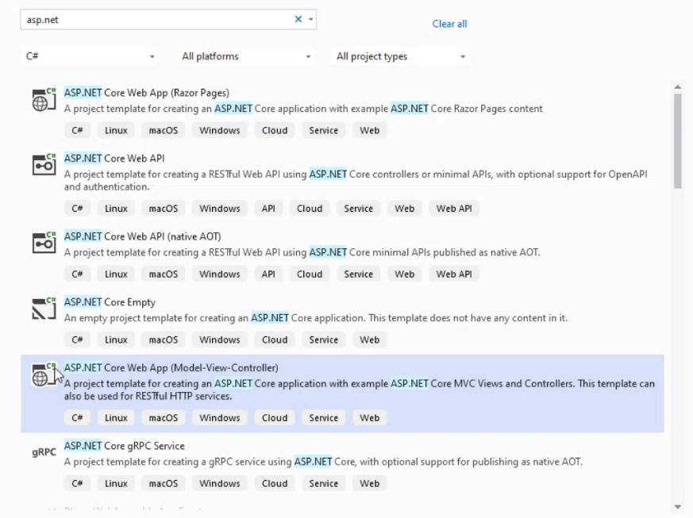
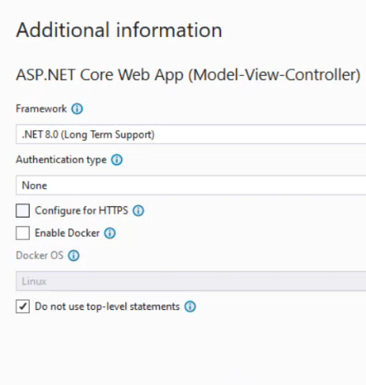
Create new project

Slide 8
Created folders after creating project
Connected Services
Dependencies: include installed packages, referenced projects
properties:
wwwroot: contains any file you includes at your project like JS files, CSS files, images
To include file from it → <img src="~/images/@prod.image">
note : img src like request for example→ http://localhost:5163/images/historya.jpg
appsetting.json file: set setting over application level
Program file : entry point of application
_ViewImports.cshml : has all using for any view
_ViewStart.cshtml :

Slide 9
Controller info
Controller: bridge between view, model
Catch request
ask model to get a specific method
Send data to view then view is rendered
When Action at TestController returns a view the compiler search for this view in Views folder at Test Folder if it doesn’t exist it will search at Shared Folder if it doesn’t exist also, it will returns an error

Slide 10
Controller info [cont.]
Controller Properties
ViewData
ViewBag
HttpContext: It encapsulates all the information about the current HTTP request and response.
Request object:
QueryString object:
Form object:
Method: "GET",
Cookies // same cookies at Response
Path : ‘/Binding/TestBinding’
Response object :
WriteAsync("string")
Cookies: for setting cookies that the server wants the client to store.
Session

Slide 11
Razor page & view
Each view in background is converted into class that inherits from RazorPage built-in class that properties are:
Layout
ViewData

Slide 12
Method (Action)
Method in controller class called Action
What makes method end point
Method need to be public
Can’t be static
Can’t be overloaded it based on the HTTP verb and the URL route
When action

Slide 13
Method (Action) (cont)
Action can return all of the following, each one of them of type IActionResult
View() → return View("view name");
Content() → return Content(String) or return Content ("html code")
Redirect() → return Redirect("http://www.google.com")
return HttpNotFound(); → Error 404
return EmptyResult(); → when action doesn’t need to return any value
File() → return File ("path of file");
Json() → return Json()
RedirectToAction() → RedirectToAction("ActioName", "ContollerOfAction", data (optional)

Slide 14
Passing value to Action parameters
parameters of an action method can be passed in three main ways
As Query string: → controller/action?param_name1=value&param_name2=value2

Slide 15
View (Razor syntax) the inline : designed to outputting values, not for executing statements cannot directly handle complex logic, such as a method that returns void the block : you can call methods that return void
@model My_MVC_APP.Models.Course // inline statement
// block of code
@foreach(Product prod in Model)
{
<div class="card" style="width: 18rem;">
<img src="~/images/@prod.image" class="card-img-top" alt="...">
<div class="card-body">
<h5 class="card-title">@prod.name</h5>
<p class="card-text">price: @prod.price$</p>
<a href="/product/details/@prod.id" class="btn btn-primary">more details</a>
</div>
}

Slide 16
View
When Action at TestController returns a view the compiler search for this view in Views folder at Test Folder if it doesn’t exist it will search at Shared Folder if it doesn’t exist also it will return an error
The view at background is converted to class and this class inherits from built in MVC class RazorPage<T> that has a property Model → public T Model {get; set;}, you can determine the type of T at run-time → View("Test", studentModel), at View @model Student → this means the type of generic class (RazorPage<T>) will be RazorPage<Student> → class TestView: RazorView<Student> , public Student Model {get; set;}
if you do not determine the type of generic class, it will consider as dynamic
At View Folder there is _ViewImports.cshtml file that contains all using that any view can see, and you can add any another using of any class or folder

Slide 17
sending data to view using view model
public IActionResult Test() { var mycourse = new Course() {ID = 1, Name = "MVC"}; return View("resultView",mycourse); // the value Model property will by mycourse }
At View
@model Course; //specifies the type of the Model that the view expects to receive from the controller // This setup ensures that the view is strongly-typed with the Course
<h5 class="card-title">@Model.Name</h5>
<h5 class="card-title">@Model.ID</h5>
@model: specifies the type of the Model that the view expects to receive from the controller.
@Model: This refers to the entire model object that is passed to the view
You can make your custom viewmodel to send it to view Model

Slide 18
sending data to view using viewData
It’s used when I want to send extra info with view model
ViewData is a dictionary <string, object?> → ViewData["msg"] = "hello“
ViewData is a property within class controller
RazorPage class that every view class inherits from has a property ViewData as well
When view is called from controller the viewData of controller will be cloned into viewData of View
ViewData Scope(lifetime) is one request from action to returned View
With each request new object from controller and View are created and they are destroyed after response
ViewData problem is → value object need casting

Slide 19
sending data to view using viewBag
It’s used when I want to send extra info with view model
ViewBag is a property within class controller
ViewBag is set and get from ViewData and return data in the form of dynamic so we do not need casting
ViewBag.salary = 500 is converted to ViewData["salary"]
RazorPage class that every view class inherits from has a property ViewBag as well
ViewBag Scope(lifetime) is one request: from action to returned View
With each request new object from controller and View are created and they are destroyed after response

Slide 20
Middleware
The default web server used in ASP.NET Core is Kestral
How request is handled in asp.net core, the flow of request handling typically goes as follows
Client sends a request: This request is typically an HTTP request sent over the internet.
The request is received by the web server, which in the case of ASP.NET Core is IIS
The web server creates an HttpContext object to encapsulate the request and response, and then passes this object through the middleware pipeline. HttpContext object contains information about the HTTP request such as headers, body, and other metadata).
ASP.NET Core applications use a middleware pipeline to handle requests; This pipeline is configured during application startup. Each middleware component could inspect or modify the HttpContext before passing it to next middleware
Each middleware component processes the request in some way they can perform tasks such as authentication, logging, routing, error handling, etc.
Once the request has passed through all the middleware components, a response is generated. This response is then sent back to the client This response includes an HTTP status code, headers, and optionally a body containing data or HTML content.
middleware Pipeline exists for any application that responsible for handle request and build response using set of middlewares (request delegate)

Slide 21
Middleware [cont.]
Middleware used to handle any http request
Middleware controls the flow of request by terminate it or forward it to next middleware
There is built-in middleware, custom middleware
Types of middlewares
Write on response and call next middleware
Write on response and terminate (short circuit)
Map (URL, Code): execute specific code based on URL
Middleware is an extension method on WebApplication object (app)
Each middleware has a default settings needed to be added to builder before build app

Slide 22
Middleware [cont]
The process briefly:
Client make request,
request arrives at IIS, then forwards the request to the Kestrel server that responsible for handling HTTP traffic.
When the request reaches Kestrel, it creates the HttpContext object, which contains all the information about the request, such as headers, query parameters, and body data and passed through the ASP.NET Core middleware pipeline,
The middleware pipeline is a series of components (middlewares) that process an HTTP request and generate an HTTP response .
Each middleware component in the pipeline can handle the request or pass it on to the next middleware in the pipeline, This pipeline is configured in the program.cs
Once the request has passed through all the middleware components, a response is generated. This response is then sent back to the client This response includes an HTTP status code, headers, and optionally a body containing data or HTML content.

Slide 23
Middleware [cont.]
Middleware extension methods: they are all methods used to add middleware to the application pipeline, extension method on app object, they serve slightly different purposes:
Use: to write on response and call next middleware
is used to add middleware components to the pipeline.
Middleware added using Use will be executed for every request, and it can pass the request(httpcontext) to the next middleware using the next delegate.
run: to Write on response and terminate,
is used to specify terminal middleware in the pipeline.
This method typically comes at the end of the middleware pipeline.
Run does not call the next delegate,
Map: to Map (URL, Code)
The Map method is used to create branches in the middleware pipeline based on the request path.
It allows you to define separate middleware pipelines for different URL prefixes.
It allows you to route requests to different middleware pipelines based on the request path prefix.

Slide 24
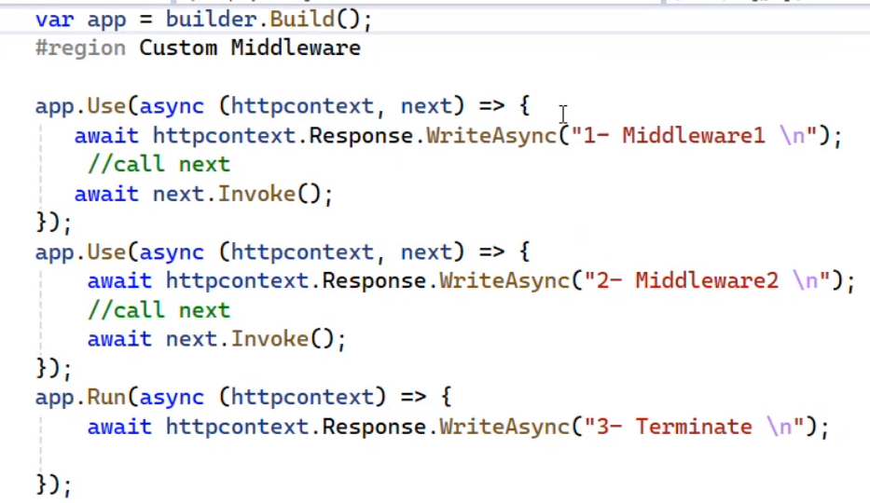
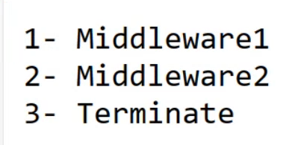
example

Slide 25
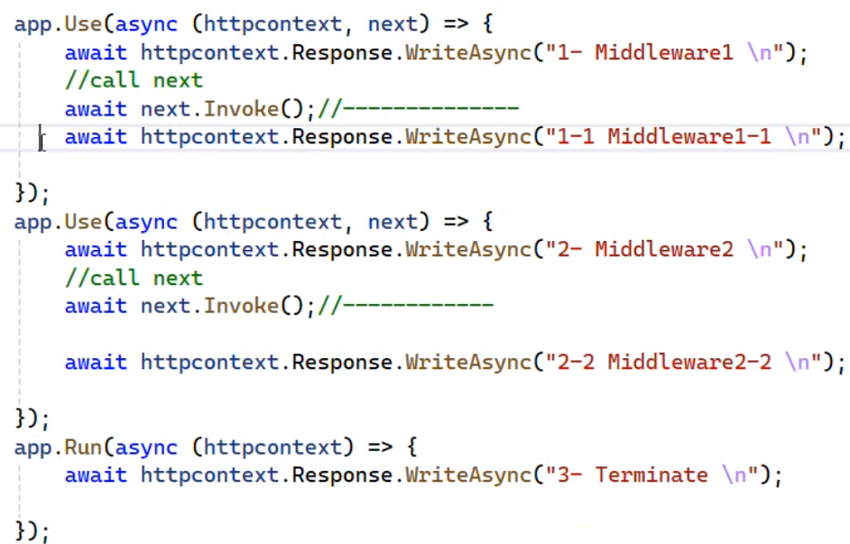
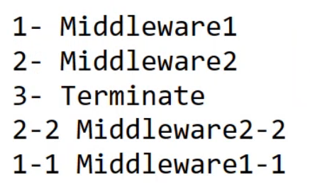
Example[cont.]

Slide 26
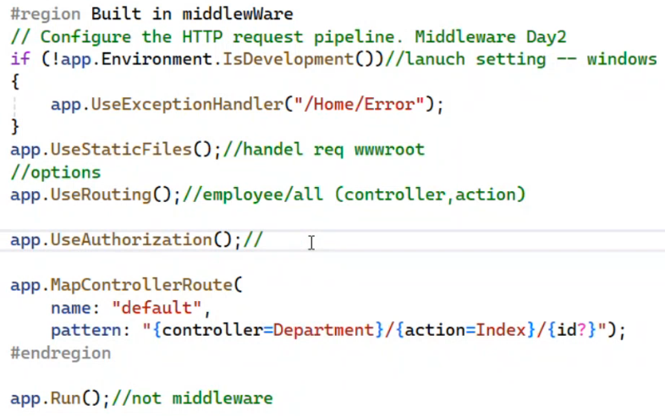
Built-in middleware

Slide 27
State Management
State management means that I want to keep the state of specific variable (store variable)
How server differ client1 from client2 ? if a client make a request for the first-time to server, channel (session) is created between this client and server, every session has a unique Id and saved in browser cookies , when a request is sent it’s sent with cookies to server
If I have sensitive data and I want it to be secured I can store it on session
Cookies is a client side, session is a server side
Data can be stored in
Session : it’s not the session storage existed in browser
Cookies
TempData
HiddenField
QueryString

Slide 28
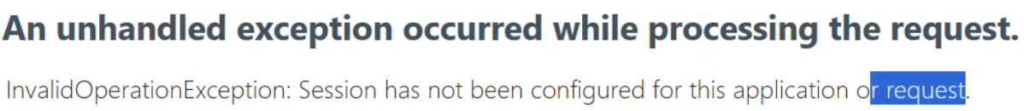
How to use session at your application state management using session(server side)
At program.cs →
Builder.Services.AddSession();
app.UseSession(); // enable session state for application
app.UseSession(options=>{options.IdleTimeout = TimeSpan.FromMinutes(30);});
Storing data in session
Reading data from session

Slide 29



state management using cookies(client side)
Type of Cookies
Session Cookie: ends when Session ends
Persistence cookie: (expiration)
Persistence cookie:

Slide 30
Lecture4 model binding
Model binding means Send data from front to back(C#)
At HTML data is sent to server using Form element
Action = “URL”
Method = “GET” → data is sent in URL → url?name=value&age=val [query string]
Method = “POST” → data is sent at http request body (form data)
At controller action the action parameter name must be the same name of input [case insensitive]
Model binding takes the Action parameter and try to bind its value From
Request.Form object if it is not found
Request.RouteValue if it is not found [the third segment of path is determined as id]
try to get it from QueryString object if not found it will assign the parameter with default value
// Binding/TestPrimitive?name=ahme&age=12 → the order of parameter does not matter
public IActionResult TestPrimitive(int age, string name){
return Content($"{name} \t {age}");
}

Slide 31
Submit at form add inputs names and its values in query string
For example: the if the URL is → http://localhost:5163/test/TestModelBinding
After submit button is clicked the URL will be → http://localhost:5163/test/TestModelBinding?age=22&name=ahmed
If URL is http://localhost:5163/test/TestModelBinding and form-action is <form method="get" action="testModelBinding2"> →if you click the submit button the executed URL is http://localhost:5163/test/testModelBinding2?age=22&name=ahmed // note that that the last URL path segment is removed
If URL is http://localhost:5163/test/TestModelBinding and form-action is <form method="get" action=“/testModelBinding2/try"> → http://localhost:5163/testModelBinding2/try?age=22&name=ahmed // note that the [/] replace the current URL Path
<form method="get">
<input name="age" type="number"/>
<input name="name" />
<input type="submit" value="OK" />
</form>

Slide 32
Send array to action in query string
Binding/TestPrimitive/11?name=ahme&age=12&color=red&color=blue
public IActionResult TestPrimitive(int age,string name,int id, string[] color){}
Binding/TestPrimitive/11?name=ahme&age=12&color[0]=red&color=blue // once you send an element at index 0 the next element will be assigned to index 1 and so on so you
Send dictionary to Action
Binding/TestDic?Phones[Ahmed]=123&Phones[Christen]=456&name=ITI
public IActionResult TestDic(Dictionary<string,string> Phones,string name){}
Passing object to action
Object properties must be the same name pf parameter name
Binding/TestObj?id=1&name=sd&ManagerName=Hala&Emps[0].Salary=5000
public IActionResult TestObj(Department dept)//,int id,string name,string managername){}

Slide 33
Form
Form action default is the current URL
<input type="text" value="@Model.Name" id="Name" name="Name" class="form form-control" />
<select class="form form-control" name="DepartmentId" id="DepartmentId">
@foreach (var deptItem in Model.Departments) {
if(Model.DepartmentId==deptItem.Id)
{ <option value="@deptItem.Id" selected>@deptItem.Name</option> }
else { <option value="@deptItem.Id">@deptItem.Name</option> }
}
</select>

Slide 34
Helpers [HTML helper]
Pure HTML you can send form data from front to back,
HTML Helper : RazorPage<T> that view inherit from has property called HTML
Loosely Type →
@HTML.TextBox(“Salary") → <input type = "text" name="Salary" id = "Salary" value = "ViewData["Salary"] or ViewBag.Salary or @Model.Salary or default "/>
Strong Type → @model Employee
@HTML.TextBoxFor(e=>e.Address); → <input type="text" name=“Address" id = “Address" value ="@Model.Address"
@Html.TextBoxFor(e => e.Address, new { style = "color:red",@class="form form-control"})
@HTML.LabelFor(e=>e.Address); // display the name of property but if you want to display another name for property go to class of property and give it → [Display(Name="Current Address")]
@HTML.EditorFor(e=>e.Address); //Editor determines the type input based on attribute type
You can determine the type class attribute → [DataType(DataType.Password)]
@Html.ActionLink("Back To List Helper","Index","Employee") // Index is action , Employee is controller

Slide 35
Helpers [Tag helper]
Server side attribute
@model Employee
Start with asp-for
asp-for="Salary" → id=Salary, name=Salary, type=number, value="@Model.Salary“
<label asp-for="Address"></label> // display the name of attribute address
<input asp-for="Address">
<a asp-action="Index" asp-controller="Employee"> Back To List Tag Helper</a>
<a asp-action="Details" asp-controller="Employee" asp-route-id="@Model.Id" asp-route-age="30">Details </a>
→ <a href="Employee/Details/2?age=30">details </a>
<form asp-action="SaveNew" asp-controller="Employee" method="post">

Slide 36
Tag Helper [select]
SelectList deptList = new SelectList(ViewBag.Depts,"Id","Name");
<select class="form form-control" asp-for="DepartmentId" asp-items="deptList">
<option value="0">--Select Department--</option>
</select>
asp-items type is IEnumerable<SelectListItem>, SelectList class implement IEnumerable<SelectListItem>
[ValidateAntiForgeryToken] // the request should be internal not external , must use tag helper with the form or HTML helper login post Action takes this attribute
How [ValidateAntiForgeryToken] works : when use tag helper or html helper the form generates hidden input its value tokenKey and based on session id , so it prevent external request

Slide 37
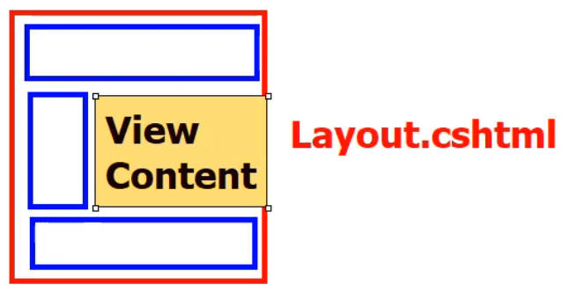
Layout
Include common parts
Existed at shared folder
It has @RenderBody() function that view content replace it
Any View that inherit from Razor page that has Layout property
You can create your own layout → Razor Layout
For any View →Layout = "_Layout"; // due to _ViewStart.cshtml
At any view you want → @ { Layout =_YourLayout }
You can make sections inside layout
At layout → @RenderSection("HeadSection") // this section will be required at view
At View → @section HeadSection { // write your HTML Elements you want }
To make the section not required → @RenderSection("HeadSection“, false)

Slide 38
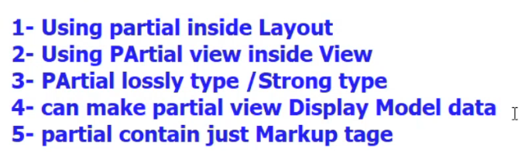
Partial View
Part of View, designed once and reused multiple
View without layout
Created at specific controller view or shared
Type of partial view
The common naming _PartialViewNamePartial
To invoke partialView
@Html.Partial(" _PartialViewNamePartial") // will be deprecated
@await Html.PartialAsync(" _PartialViewNamePartial")
@{ await Html.RenderPartialAsync(" _PartialViewNamePartial ")}
<partial name="_PartialViewNamePartial"/>
Model="Model" is the default
You can make action return partialView → return PartialView("index", empModel);
Index can be partial view or view but in case of view the view doesn't assigned value to Layout
This mean the partial view is like view → you can <partial name="ViewName"/>

Slide 39
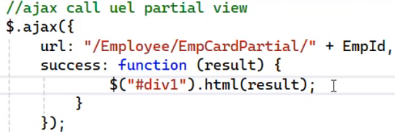
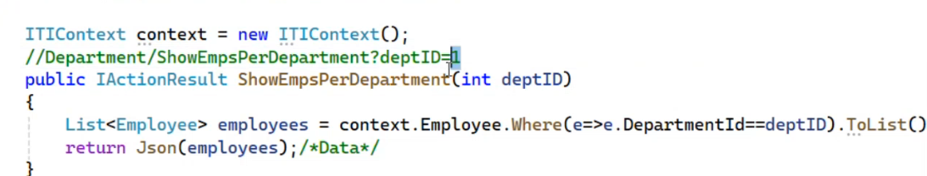
Partial view is used with partial request
Example about Ajax call that returns partial view
Ajax call that returns Data

Slide 40
To install client-side library
Right click on the project name + add + clint-side-library

Slide 41
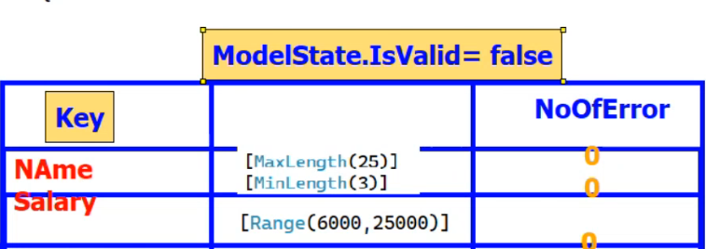
Validation
Client-side , Server-side , SQL- constraints
It needs object parameter not primitive parameter
Not nullable type has attribute required
Built-in attribute validation (server side) → examples
[MaxLenght(25)] , [MinLenght(5)] , [Range(60, 90)] , [Required] , [RegularExpression(“pattern”)]
[DataType(DataType.Password)], [Compare(“PropertyName")]
ModelState object is one of controller properties , provided object parameter
How ModelState checks for validation of object (model) > ModelState is a dictionary its keys are the object attributes
ModelState.IsValid → return Boolean
if total numOfError >0
ModelState.IsValid == false

Slide 42
Validation message Tag Helper
Attribute for span
To custom error message for validation attribute → [MaxLength(5, ErrorMessage="Length must be 3")]
<div>
<label asp-for="Name"></label>
<input class="form form-control" asp-for="Name"/>
<span asp-validation-for="Name" class="text-danger"></span>
</div>

Slide 43
Validation with client side [cont.]
Tag helper with input in addition to creating input with id, name, type, value it also generate data-val="true" , data-val-required="this field is required and so on
So we need to a package that allow tag helper to understand the data-val and it is
Jquery-validation-unobtrustive but it need → Jquery-validation but it need → Jquery , all these libraries existed at wwwroot
<script src="~/lib/jquery/dist/jquery.min.js"></script>
<script src="~/lib/jquery-validation/dist/jquery.validate.min.js"></script>
<script src="~/lib/jquery-validation-unobtrusive/jquery.validate.unobtrusive.min.js"></script>

Slide 44
Custom validation attribute[server side]
Custom validation attribute
It inherits from ValidationAttribute class, override IsValid function, class name preferred to ends with Attribute
IsValid(object? value) // value is the value of attribute
IsValid(object? Value, ValidationContext validationContext) //validationContext is the object itself (like Course)
public class UniqueAttribute : ValidationAttribute {
protected override ValidationResult? IsValid(object? value, ValidationContext validationContext) {
string courseName = value?.ToString(); // the value you want to validate
appContext appContext = new appContext();
// UpdateCourseViewModel viewModel = validationContext.ObjectInstance as UpdateCourseViewModel;
Course course = appContext.Courses.Where(x => x.Name == courseName).FirstOrDefault();
if (course == null)
return ValidationResult.Success;
return new ValidationResult("name already taken");
}
}

Slide 45
Custom validation attribute (cont.)
You can make properties and send their values
At validationClass → public int Number {get; set;}
At property → [validationName(propertyName = value)]
Or you can make constructor and send properties values via it without need to write their name
[validationName(value1, value2)]

Slide 46
Remote Attribute [called using AJAX]
Its server side validation
Your page must configure (unobstrustive validation) to send an ajax call to the website, the invoked action should return JSON indicating the value is valid
Does need submit of the form to execute activated when input is changed
Tag helper also generates data-val-remote-url="/path" and so on
For property → [Remote("Action", "Controller", ErrorMessage = "wrong pass", AdditionalFields="param1,param2")]
Param1, param2 are names of properties
The path will be → /Controller/Action?yourFieldName=value&param1=value1&param2=value2
At Controller →
public IActionResult Actionname(string yourField, string param1, string param2) {
// write your logic and return Json(true) or Json(false)
}

Slide 47
Validation (Exception message)
Send exception message to views
If(ModelState.IsValid==true){
try{
// code;
}catch(Exception ex){
// ModelState.AddModelError(“DepartmentId", “Please Select Department"); // but if we don’t know the cause of exception
ModelState.AddModelError("", ex.Message);
ModelState.AddModelError(“”, ex.InnerException.Message);
}
}
At form
<div asp-validation-summary="All" ></div> // display all model state errors

Slide 49
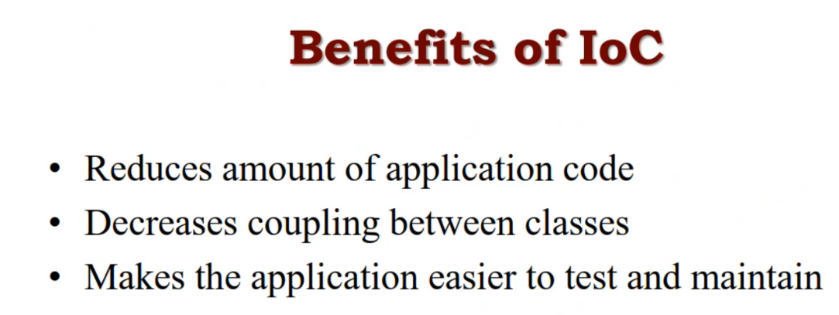
LEC 8 MVC [rename it later]
If you write the business logic code inside the controller you violate the separate of concern that MVC should achieve
IOC (inversion of control): don’t make class depends on other class make them loosely coupled by applying Dependency inversion principle and dependency injection design pattern

Slide 50
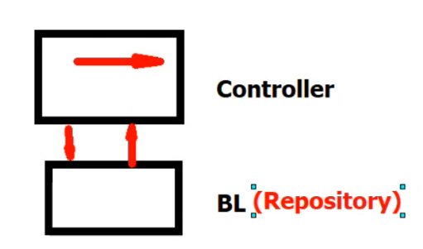
How MVC support dependency injection & IOC
Models: there is two types of classes exists in Models Folder
class that map on table,
business logic [operations] class
We need business logic layer to not write the data access code inside the controller , as if we do that we consider violate one of main target of MVC (separate of concern) and violate DRY principle
We will call Business logic BL as Repository which includes the operations of model, So we will make a repository for each model to achieve the single responsibility
so instead of wring the code in controller you will make repository contains all operations and call it in controller

Slide 51
How MVC support dependency injection & IOC [cont.]
public class EmployeeRepository
{
appContext context;
public CourseRepository()
{ this.context = new appContext(); }
public List<Employee> GetAll()
{ return context.Employees.ToList();}
public Course GetEmployee(int id)
{ return context.Employees.FirstOrDefault(c => c.Employee_id == id); }
public void Insert(Employee employee)
{ context.Add(employee); }
public void Update(Employee employee)
{ context.Update(employee); }
public void Delete(int id)
{ Employee employee = GetEmployee(id); context.Remove(employee); }
public int Save()
{ return context.SaveChanges(); }
}
Here we make Employee repository
That will be used in controller

Slide 52
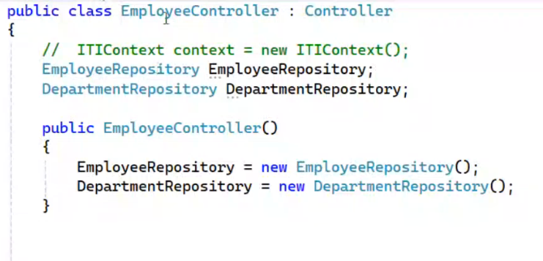
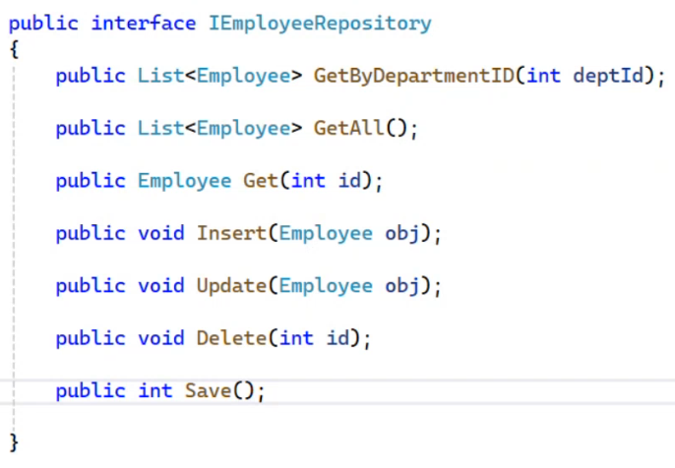
How MVC support dependency injection & IOC [cont.]
Ok we will replace the code inside controller with the methods of repository so we achieve the separation of concern but the dependencies between classes still tight as Employee controller depends on EmployeeRespository and DepartmentRespository so we still need to achieve dependency inversion so we will make this

Slide 53
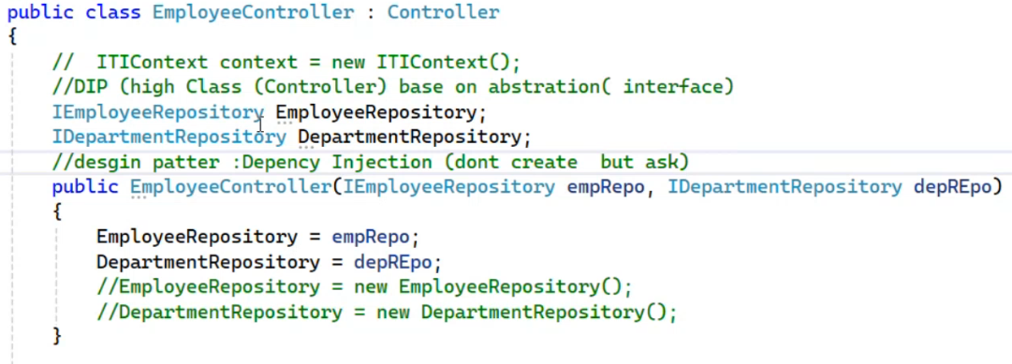
Here in this controller, we achieved the IOC : as we achieved the Dependency injection and dependency inversion (depend on abstract)
public class EmployeeRepository : IEmployeeRepository
{
appContext context;
public CourseRepository()
{ this.context = new appContext(); }
public List<Employee> GetAll()
{ return context.Employees.ToList();}
public Course GetEmployee(int id)
{ return context.Employees.FirstOrDefault(c => c.Employee_id == id); }
public void Insert(Employee employee)
{ context.Add(employee); }
public void Update(Employee employee)
{ context.Update(employee); }
public void Delete(int id)
{ Employee employee = GetEmployee(id); context.Remove(employee); }
public int Save()
{ return context.SaveChanges(); }
}

Slide 54
IOC container
IOC container contains Services
The mechanism of IOC container:
When controller ask for specific(service) object -> it called controller makes inject,
When IOC container creates requested object from specific service → it called resolve (respond with object)
When ask(inject) for specific(service) not exist at IOC container : unable to resolve error
---------------------------------------------------------------------------------------------------------
IOC principle need IOC container to work
IOC container operations
Add service [ Register service inside IOC container]
Create object [resolve]
Dispose [dispose] →
At C# IOC container called ServiceProvider

Slide 55
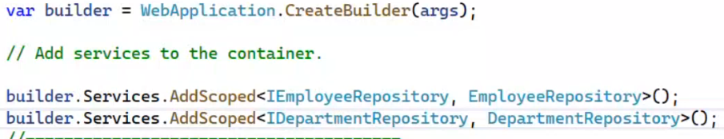
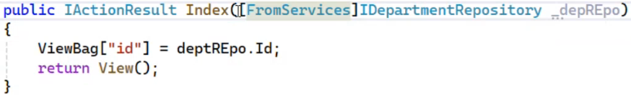
IOC container
IOC container (ServiceProvider) create one object for each inject in the same request (the most common)
IOC container (ServiceProvider) create one object for each inject for all requests (one object on app level)
IOC container (ServiceProvider) create new object for each inject even if it’s at the same request
View Injection, @inject is an indicator for view that IDepartmentRespository comes from IOC container
Method Injection
[FromServices] tells model binding that IDepartmentRespository comes from IOC container

Slide 56
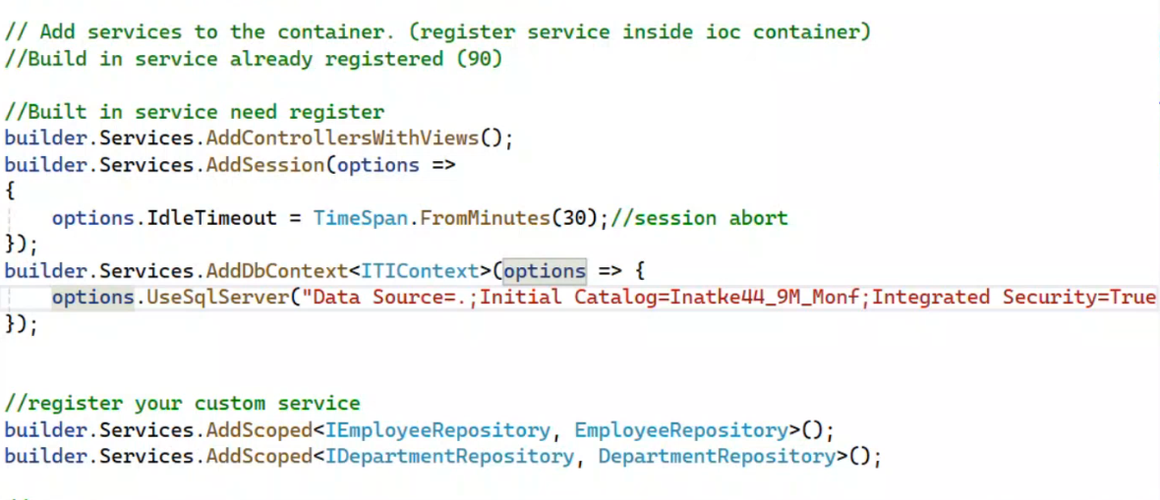
IOC container service types
Built in registered service
Built in service that need register
Custom service, and you register it
When add service we
First: add Built in registered service
Second: add Built in service that need register
Third: add Custom service and you register it

Slide 57
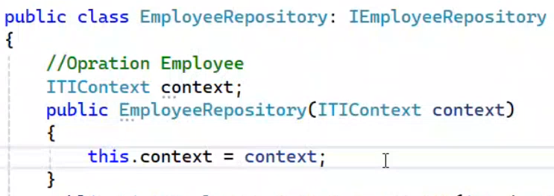

Inject database context to repository
To ask (inject) the context you need at context class constructor with options
public ItiContext():base(){} // the default context constructor without option needs onConfiguring() Method, once you use the parameterized with option you do not need the default one and onConfiguring()
Context is Built in service that need to be registered, so To make IOC container Responds with object of DbContext you need to register it

Slide 58

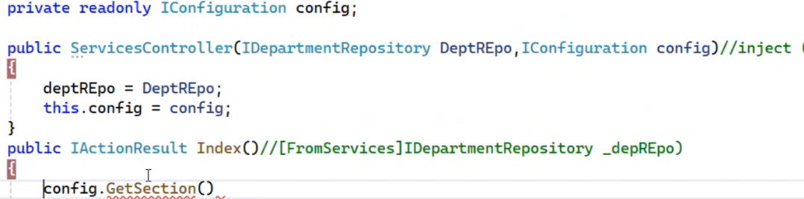
To make connection string at app setting
At appSetting.Json → it’s an configuration file
To read configuration At program.cs
To read configuration at controller, its registered service

Slide 59
To read configuration at view
@inject IConfiguration config

Slide 60
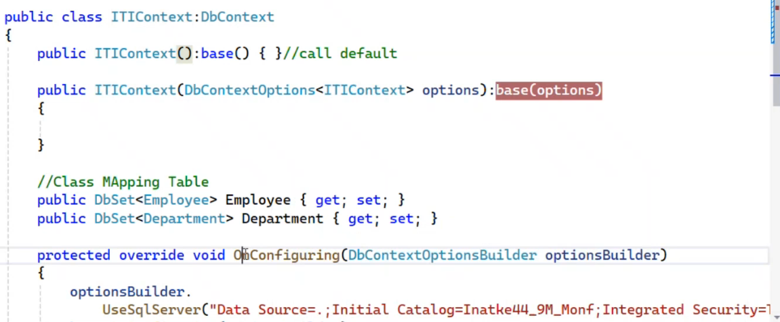
Database context constructors
The default constructor need onConfiguring method to read the connection string
The parameterized contractors for any class inject ITIContext , and ServiceProvider use it when making object from it

Slide 61
Context injection at validator attribute
Validation Attribute class cannot ask IOC container to get object so we can not inject inside it but we can get access the services of ServiceProvider Via valitionContext parameter

Slide 62
To Inject DB Context instead of create
At DBContext file comment the function on configure as there is no need for it, add this parametrized constructor
At appSetting.Json → it’s a configuration file
At program.cs
At controller class or repository class
public WebApiLab1Context(DbContextOptions<WebApiLab1Context> options) : base(options) {} // for inject context
//protected override void OnConfiguring(DbContextOptionsBuilder optionsBuilder) { optionsBuilder.UseSqlServer("Server=.;Database=WebApi;Trusted_Connection=True;TrustServerCertificate=True");
//}
"ConnectionStrings": {
"lab1": "Server=.;Database=WebApiLab1;Trusted_Connection=True;TrustServerCertificate=True;"
}
builder.Services.AddDbContext<WebApiLab1Context>(
op => op.UseSqlServer(builder.Configuration.GetConnectionString("lab1")));
WebApiLab1Context appContext;
public CourseController(WebApiLab1Context appContext){ this.appContext = appContext; }

Slide 63
Lecture 9

Slide 64
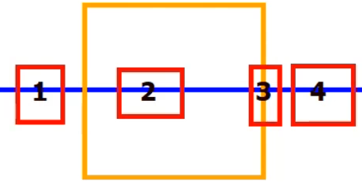
filters
Block of code that executed before, after, or during action execution like [HttpGet], so it’s an attribute
If Attribute placed above the action which means it’s applied on that Action
If attribute place above controller it’s means, it’s applied in every action of controller
if it’s placed on program.cs [global filter] which means it’s applied on every action in application
We have built in filters, custom filter
every filter implements IFilterMetaData
Built-in filters:
Authorize: before request enter the action (num 1 on the image)
Exception: it makes us dispense with try-catch →number 4
Result: to cash the result [num 3]
Action Filter that is used in customized filter , you can override the onExecuted, onExecuting [num 2]
onExecuting: it’s executed before action execution
onExecuted: it’s executed before end of action execution
Notes:
Search on research filter : it’s suitable to deal with image size

Slide 65
filters
Built-in filters:
[AllowAnonymous] // this attribute make Action doesn’t need any restrictions which means any one has the URL will execute the action , any action has it by default
[Authorize] // Restrict Access to Authenticated Users

Slide 66
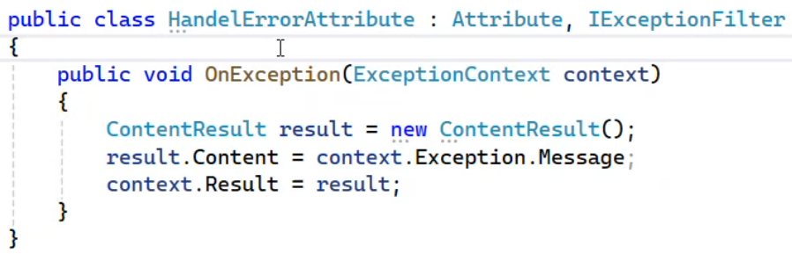
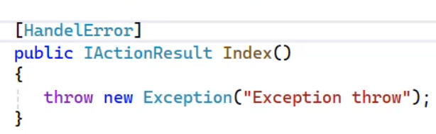
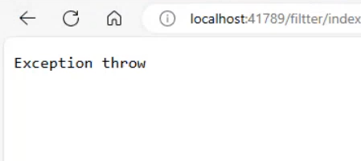
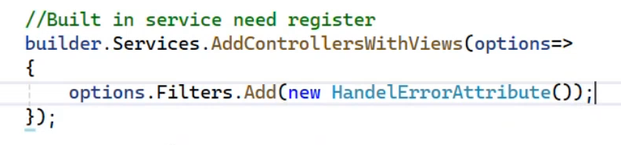
Custom filter example I want to make my handle error filter exception
First inherit from Attribute that implement IFilterMetaData
Implement IException interface
Implement the methos OnException()
Note: context.Result of type IActionResult
To add the filter on all actions of application: go to program.cs

Slide 67
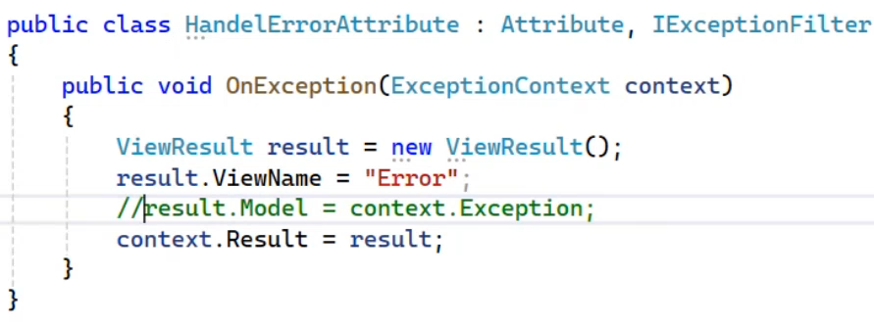
Handle error attribute returns view
// you can access the ModelState→ context.ModelState

Slide 68
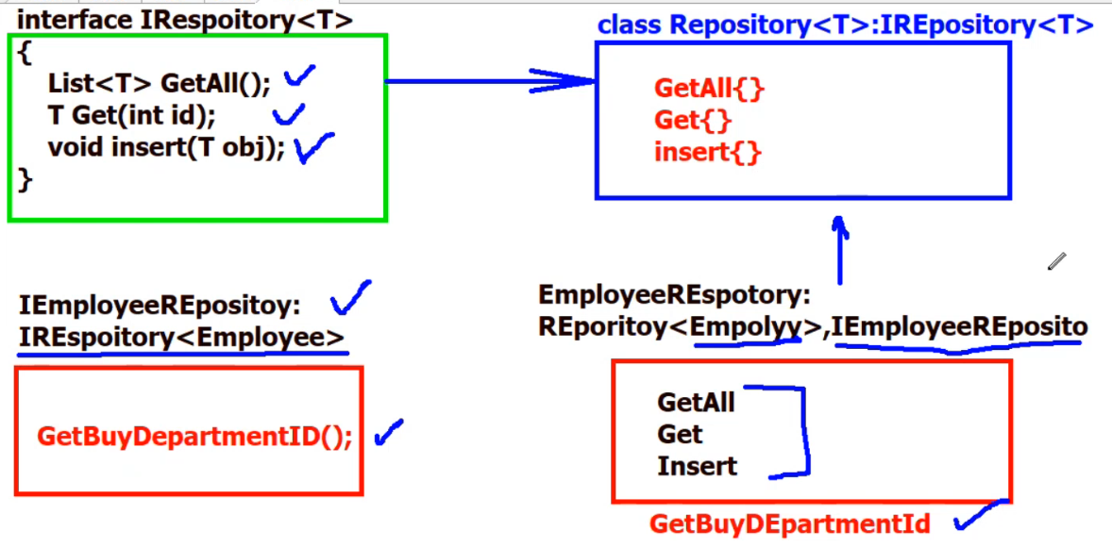
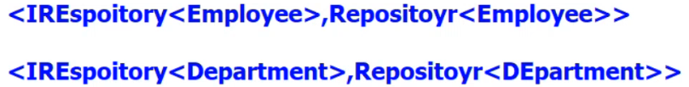

Project modules
Mapping step : get from object into view model
Is mapping performed in controller ?? Some of perspectives say ok, and others say it’s better to make a new layer called service, so let’s make some OOP
Register Service

Slide 69
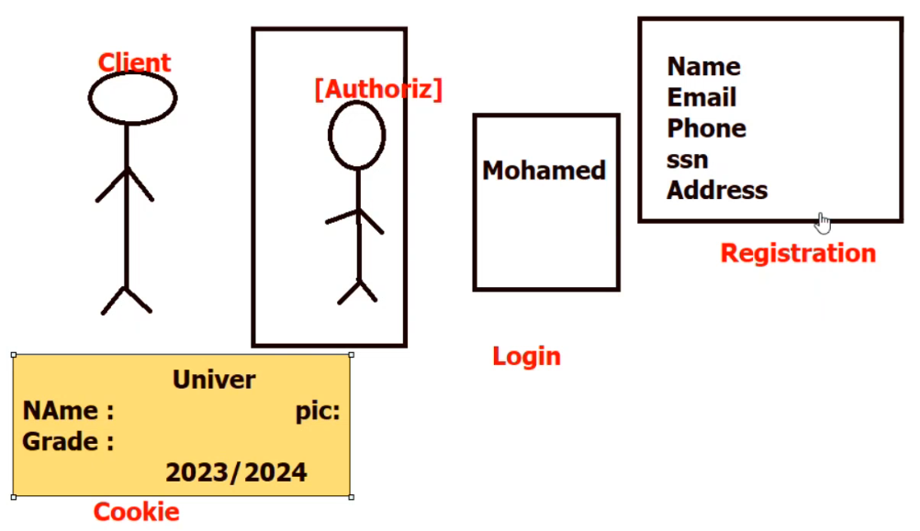
Identity
It’s responsible for security module
Once you login you get a cookies that is used to authorize client instead of going to DB to ensure client

Slide 70
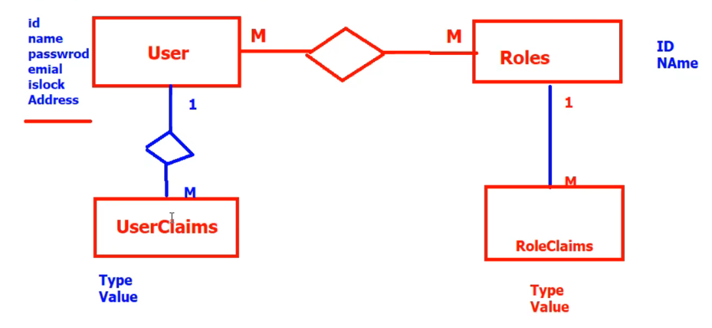
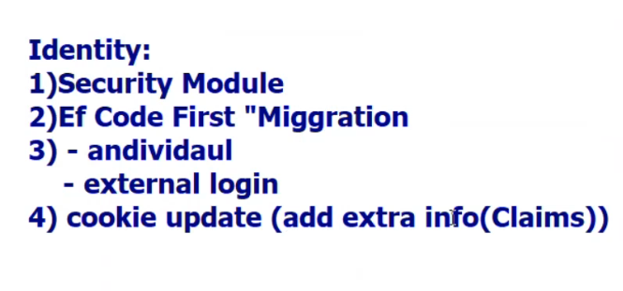
Identity (cont.)
Identity module provide the following
Roles: A role represents a named group of permissions. For example, roles might include Admin, Editor, User, etc.
usage: You assign users to one or more roles and then check their roles to determine what actions they can perform.
User Claims: used to store additional information about a specific user, in the form of key-value pair, can include things like email addresses, names, roles permissions, or any other piece of information
Role Claims: extra info for a specific role , claims that are associated with a role rather than an individual user When a user is assigned to a role, they automatically inherit the claims associated with that role
When a user is assigned to a role, the claims associated with that role are also assigned to the user.

Slide 71
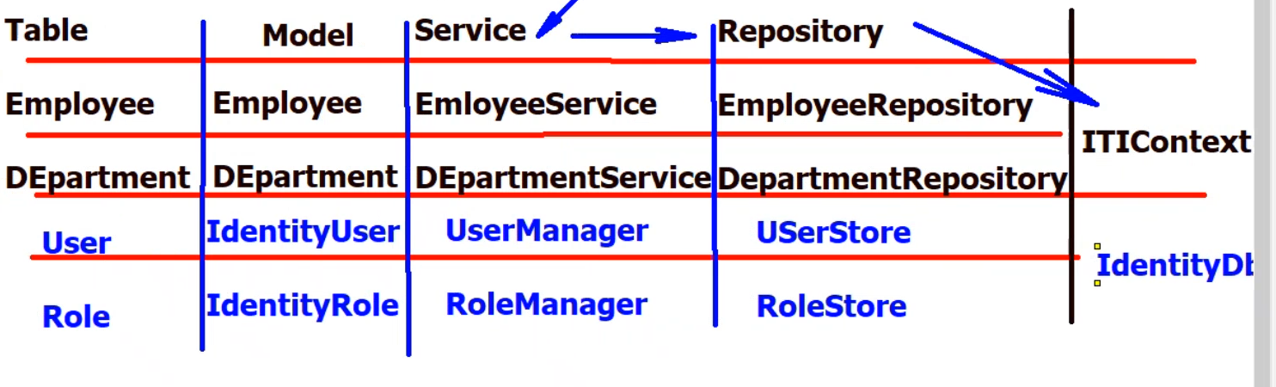
DbContext
Identity is a package
Controller → Service → Repository → Context

Slide 72
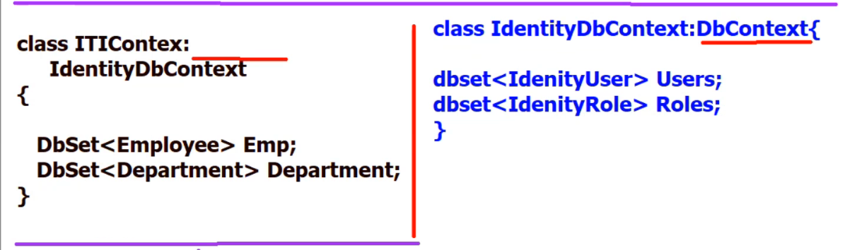
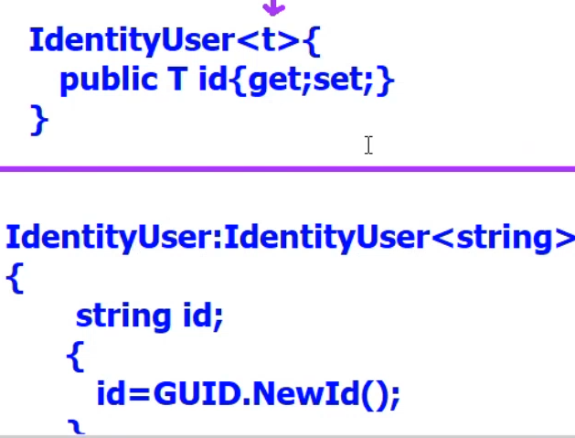
Identity [cont]
After install identity package we want to access the DB sets like IdentityUser, IdemtityRole , so we make databaseContext inherits from IdentityDbContext
The id in any Identity model is not int it’s generic so you can determine the type of id, the default is string

Slide 73
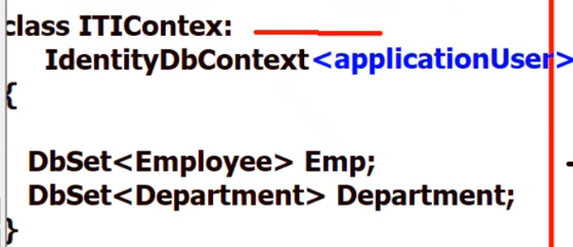
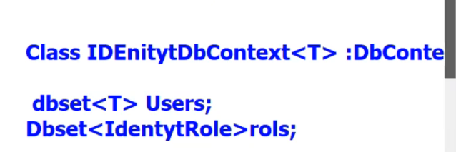
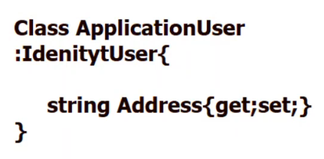
Identity (cont.)
What if we want to add attributes in identity user
Look at the screens shots and understand

Slide 74
Summary [IdentityUser Class]
IdentityUser Class
It contains basic user information such as id, username, password hash, email, ETC., This class is used as the base class for creating user entities.
IdentityUser<T> : is a generic version of IdentityUser it allows you to specify the type of the primary key for the user
IdentityUser<TKey> {
public TKey Id { get; set; }
string UserName {get; set; }
}
IdentityUser class by default inherits from IdentityUser<string>
public class IdentityUser : IdentityUser<string> {}

Slide 75
Identity Role class
public class IdentityRole<TKey>
Public TKey Id {get; set; }
Public string name {get; set;}
IdentityRole class by default inherit from IdentityRole<string>
public class IdentityRole : IdentityRole<string>
public IdentityRole() { Id = Guid.NewGuid().ToString(); }

Slide 76
Summary [IdentityDbContext Class]
public class IdentityDbContext : IdentityDbContext<IdentityUser, IdentityRole, string>
public DbSet< IdentityUser > users
public DbSet< IdentityRole > roles
…………………..
public class IdentityDbContext<TUser> : IdentityDbContext<TUser, IdentityRole, string> where TUser : IdentityUser
public DbSet< TUser > users
public DbSet< IdentityRole > roles
And so on ……………………….

Slide 77
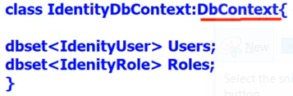
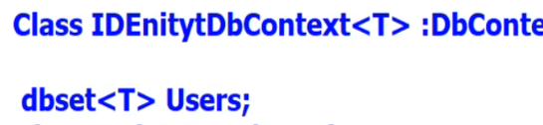
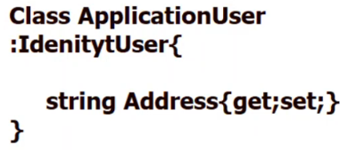
Summary(cont.) Identity
Application User
public class ApplicationUser : IdentityUser {
// Additional custom properties can be added here
public string CustomProperty { get; set; }
}
IdentityDbContext, IdentityDbContext<T>
Most commonly used

Slide 78
Identity steps
Install-Package Microsoft.AspNetCore.Identity.EntityFrameWorkCore
Create ApplicationUser Class that inherits Identity user and add you additional attributes
Make our database context inherit from IdentityDbContext<ApplicationUser>
Add migration, update database
Create controller account
Create register get Action
Create view model (name, pass, address, confirm pass) for registeration
Create register view
Create register post action
Register identity service at program.cs

Slide 79
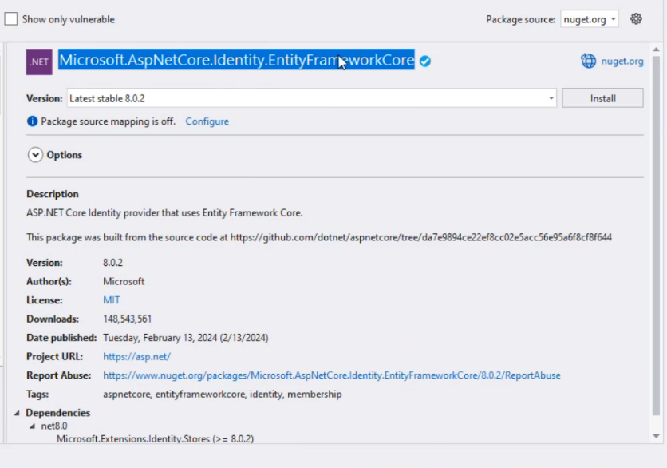
Install Microsoft.AspNetCore.Identity.EntityFrameWorkCore [identity steps]

Slide 80
[identity steps]
2.Create ApplicationUser Class that
3. Make our database context inherit from IdentityDbContext< ApplicationUser>
4. Add migration, update database
5.Create account controller
6. Create register get Action
using Microsoft.AspNetCore.Identity;
public class ApplicationUser: IdentityUser{}

Slide 81
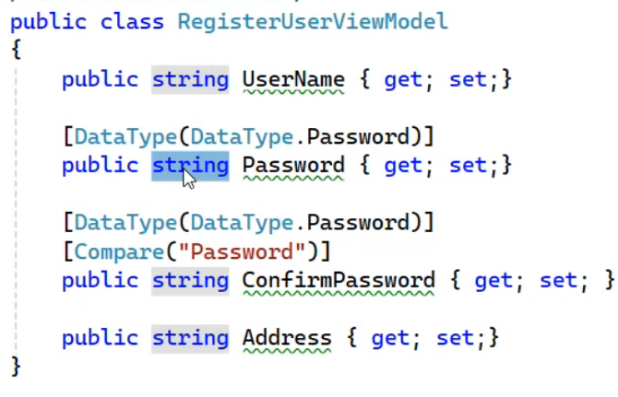
[identity steps]
7. Create view model to register
8. Create registration view

Slide 82
[identity steps]
10.Register identity service at program.cs
builder.Services.AddIdentity<ApplicationUser, IdentityRole>().AddEntityFrameworkStores<App_Context>();

Slide 83
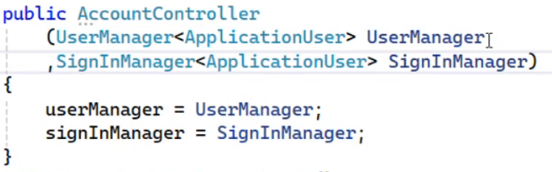
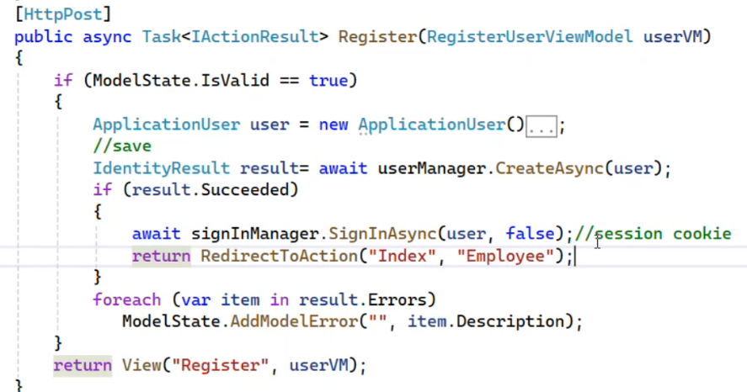
Create register post action
[identity steps]

Slide 84
Hash the password of user when creating it
Instead of
Use

Slide 85
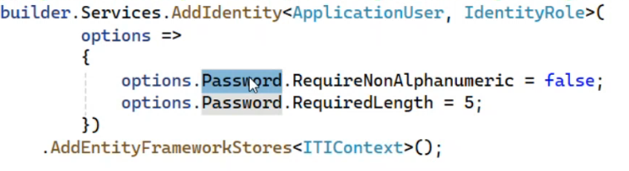
To custom the validation of password

Slide 86
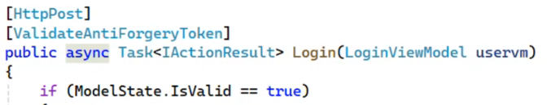

Login
View : email, pass, remember me

Slide 87

logout

Slide 88

Authentication & Authorization
Authentication: check login
Authorization: check on permission (role)
At program.cs
[Authorize] → check if Identity Cookie is existed if found forward the request, not found redirect to login

Slide 89
Authentication & Authorization
ControllerBase class has a User property that provides information about the current authenticated user. This property is of type ClaimsPrincipal its and Properties
Identity: The Identity property is of type ClaimsIdentity and its properties
AuthenticationType: Gets the type of authentication used. Example: "Bearer", "Cookie".
IsAuthenticated: true | false
Name: Gets the name of the user.
Claims: Gets the claims associated with this identity.
NameClaimType: Gets the claim type that is used to retrieve the user name.
RoleClaimType: Gets the claim type that is used to retrieve the role.
[Authorize] // User.Identity.IsAuthenticated

Slide 90
Cookies
There are claims related to cookies different from claims exist at database
Cookie at run consists set of claims
User property Claims
Get the userID
Claims of cookie has id, name , role
If I want to add extra info inside cookie when it is created after login

Slide 91


Role
Add Role to DB
[Authorize(Roles="Admin")] // authenticated, check if cookie has Admin claim
[Authorize(Roles="Admin,Trainee")]
Add role claim to user cookie after success login, userId, RoleId is added to UserRole Table| Admin Role must exist at Role DB table at first

Slide 92


Razor View also has User Object property
So you can display element provided user is authenticated
If user is admin

Slide 93


Routing
Naming Routing
Attribute Routing: once you make attribute routing to action you can not call it using real name of controller it has priority more that naming attribute

Slide 94
Publishing MVC project
Deployment mode → Framework dependent → refer to host has run-time
Deployment mode → Self-contained → publish include with run-time
Visual studio SDK includes run-time
Windows by default support .net application

Slide 95
Basics Method for Identity
Create new User to database
IdentityResult result = await userManager.CreateAsync(AppUser, user.Password);
AppUser: application user
Add Role To DB
IdentityResult result = await roleManager.CreateAsync(new IdentityRole(){Name="User" });
Add Role to User
IdentityResult Result = await userManager.AddToRoleAsync(AppUser, "User");
userId, RoleId is added to UserRole Table
User Role must exist at Role DB table at first
To check if role is existed
if (await roleManager.FindByNameAsync("User") == null)

