Slide 1
SignalR
By. Ahmed Mohamed Samir
ahmedmohamedsamir33@gmail.com

Slide 2
introduction
At stateless app when new data is posted to the server and the client needs to reconcile or receive this new data, it typically involves the client making a new request to the server to get the updated information.
Real time applications: any new data posted to the server will be pushed (broadcasting) to all connected clients
Notes:
Delude : يوهم

Slide 3
History of how real time implemented
Ajax polling: request is sent to server specific time ajax call is sent to server to get data, but it leads to unnecessary load on the server as there is often no new data is posted
Long polling: client send a request and sever is configured to store this request if new data is available the server response, then client sends another request to be stored on the server and so on, the problem of this technique is request(connection) time out due to http specification is 30s
Forever frame:
It based Chunked encoding vulnerability: the server response is sent in the form of divided chunks and server does not know the length of chuncks that will be sent in response
So, the Server is deluded that it is continue in responding all the time and if new data is available, it will be sent as chunks and client is configured to display the received chuncks int iframe element
Problems
This technique works on IE only,
One way: clints need to close the forever frame to post data and then open the forever frame
Chuncks is sent as script and load into iframe so it makes load on the page due to a lot of chunks
Server sent event
Web socket protocol: full duplex connection(channel) is stablished between client and server and they can send and receive data whenever they want, this protocol use http protocol to make handshaking between server and client
Problem: work on technologies of 2012 and after

Slide 4
SignalR
Open-source library that adding real-time functionality to your applications
Used the previous techniques
Layer service: Real time function using C# as a services [hub Layer]
Connection layer that determines the suitable real-time technique that can used whether it [web socket, server sent event, forever frame, long polling]
Client consume server
RPC: it’s a technique allows server to call component existed on client
Scenario as following:

Slide 5
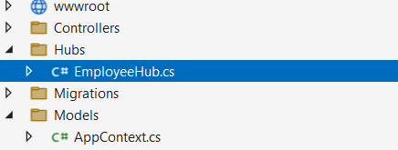
Implement service example
using Microsoft.AspNetCore.SignalR;
public class EmployeeHub : Hub
{
appContext _appContext;
public EmployeeHub(appContext _appContext)
{ this._appContext = _appContext;}
public void addEmployee(Employee employee)
{
_appContext.Employees.Add(employee);
_appContext.SaveChanges();
//broadcasting to all online clients
Clients.All.SendAsync("addemployee", employee);
// you're essentially invoking the addemployee method or // event handler on all connected clients.
}
}
Make folder with name Hubs for classes of SignalR services
Specifiy the URL endpoint at which the SignalR hub will be available In this case, the hub is mapped to the "/employee" URL path. Clients will be able to connect to this endpoint to interact with the EmployeeHub.
builder.Services.AddSignalR(); // Register signalR services
//. . . . .
app.MapHub<EmployeeHub>("/employee");

Slide 6
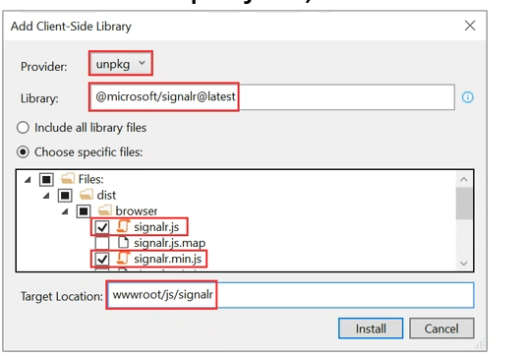
Add signalRclient library → wwroot + right click + add + clirnt side library

Slide 7
at client
@section Scripts {
<script src="~/microsoft/signalr/dist/browser/signalr.js"></script>
<script>
//define connection
con = new signalR.HubConnectionBuilder().withUrl("/employee").build();
//start connection
con.start(); // negotiate between client and server to determine which suitable real-time technique
//define fun to consume service
function addEmp() {
var obj = {
"name": document.getElementById("name").value,
"age": Number(document.getElementById("age").value),
"address": document.getElementById("address").value
}
con.invoke("addEmployee", obj) //addEmployee the function at hub class
}
</script>
}

Slide 8
at client
@section Scripts {
<script src="~/microsoft/signalr/dist/browser/signalr.js"></script>
<script>
//define connection
con = new signalR.HubConnectionBuilder().withUrl("/employee").build();
//start connection
con.start();
// call back function that executed after broadcasting
con.on("addemployee", function (employee) {
$("#tbl-body").append(
`<tr><td>${employee.name}</td><td>${employee.age}</td><td>${employee.address}</td></tr>`
);
})
</script>
}

