Slide 1
NP Explore Graduation Project
Team 2

Slide 2



Our Team
Hana Alaa Mohammed EMAIL : hana.alaa.ha@gmail.com | Ahmed mostafa abd el-fatah EMAIL : ahmedmostafa9908@gmail.com | Khalid ahmed abd el-razek EMAIL : khalidabdelrazik@gmail.com
Yasmeen Mahmoud ali EMAIL : yasmeenmahmoud220@gmail.com | Ahmed Mohamed tawheed EMAIL : ahmedtawheed976@gmail.com | Youseef Mohamed abou el-saad EMAIL : youseefmohamed2022@alexu.edu.eg

Slide 3
Abstract
In this project, we practice interfacing Atmega32 microcontrollers with LCD and a motor. We control the speed of the motor and display this speed on the LCD. we also practice connecting two microcontrollers using the UART.

Slide 4
1
Introduction
2
Project layout
3
Design layout
Agenda
4
Layers
5
Project schematic
6
Conclusion
Notes:
© Copyright PresentationGO.com – The free PowerPoint and Google Slides template library

Slide 5
Introduction
An embedded system can be defined as a device that combines hardware and software methods to perform a single task, which is part of a larger system. Interfacing microcontrollers such as the ATmega 32 with other hardware components allows us to do just that.
In this presentation we illustrate how to interface a microcontroller with a motor and LCD. We also practice the UART technique by connecting two microcontrollers where one works as the transmitter of data and the other receives.

Slide 6
Project Layout
IDEL
IDEL
INT1
INT0
Change Speed(ptr)
Sending Byte Complete
Change Motor Speed
Update
LCD
Sending Byte
Microcontroller 2
UART
Microcontroller 1

Slide 7
Design Layout
External Switch 1
(Increases Motor speed)
Microcontroller 2
Microcontroller 1
Speed
0
10
.
.
90
100
LCD
Speed
UART
External Switch 2
(Decreases Motor speed)
MOTOR

Slide 8
Layers
APPLICATION
HAL
Switch
LCD
Motor
MCAL
DIO
PWM
Timers
USART
HW Register

Slide 9
Application Layer
The application layer includes various application specific software components that are designed to execute specific set of tasks, as per the use-case.
It basically refers to the main.c file that is written for the two microcontrollers.
In this layer we also utilize the driver functions that we implemented.
The next few slides will further explain how we used the Application layer in Microcontrollers 1 and 2.

Slide 10
Microcontroller 2
First, an array is initialized which contains the speeds of the motor differing from 0 to 100.
We then send the data to the other microcontroller, this data is the speed of the motor which we control through two switches.
In the main.c file we created two interrupt ISR functions for (INT0) and (INT1) .
INT0 is responsible for increasing the speed of the motor then sending the new speed to the other microcontroller. It is called when the corresponding Switch 1 is pressed which causes an interrupt flag to be 1 and the ISR of INT0 is executed.

Slide 11
Cont. Microcontroller 2
INT1 has the same functionality as INT0 except it decreases the speed of the motor.
Two switches are initialized in the microcontroller (Switch 1 and Switch 2). The UART is also initialized.
Switch 1 increases the speed of the motor while switch 2 decreases the speed. In both functions of the switches we check for segmentation errors every time the speed changes.
In both functions we use the UART_sendByte(data) function to send the speed decided by the user to the other microcontroller.

Slide 12
Microcontroller 1
In this microcontroller we initialize the UART, TIMER0 and the LCD in the main function using the data we received from the Microcontroller 2 .
Then we print this data to the LCD using the LCD driver functions.
Lastly, we increase or decrease the speed of the motor according to the switch pressed in microcontroller 2.

Slide 13
HAL
A HAL is a hardware abstraction layer which defines a set of routines, protocols and tools for interacting with the hardware components. This layer is extremely useful for developers who work with multiple microcontroller hardware devices and need to port applications from one platform to the next.
This layer helps the communication between microcontrollers and other connected peripherals.
Over the next few slides we discuss how we used the HAL layer(Switch, LCD and Motor).

Slide 14
Switch
SwitchInit(Switch_t *My_Switch)
This is the function where we perform the following:
initialize the switch.
Check if input pin number is within the acceptable range (0-31).
Check the status of the switch, whether it is being set to pull up or floating.
Check if the mode of the switch (INT0, INT1, INT2) is a valid value.

Slide 15
Cont. Switch
Enable_Global_Interrupt()
In this function we enable the global interrupt for the SREG register.
IsPressed(Switch_t* My_Switch, uint8_t* Status)
Check if the button pressed by using DIO_u8GetPinValue().

Slide 16
LCD
Here we used this driver to work with the LCD component in the Proteus and to print our data.
The functions used in our project:
LCD_init()
In this function we initialize the LCD.
LCD_displayString(speed)
In this function we display the current speed the motor is running on.

Slide 17
Cont. LCD
LCD_goToRowColumn(row,column)
In this function we display the current speed the motor is running on.
LCD_integerToString(integer)
In this function we convert the integer type speed to string data type so we could use the function LCD_displayString(speed) to print the speed.
LCD_clearScreen()
In this function we clear the previous speed and display the new increased or decreased

Slide 18
MCAL
MCAL stands for “Microcontroller Abstraction Layer” and it is a software module that directly accesses the on-chip MCU peripheral modules and external devices mapped to the memory. It also makes the upper software layer independent of the MCU.
Here we discuss the drivers used in the project as a whole. And these drivers are the Timer, DIO, UART and PWM.

Slide 19
Timer Driver
We use the Timer driver in microcontroller 2 where we initialize a timer object from the struct (timer0).
We then initialize the elements of the struct (Interrupt_Mode, Timer_Channel, Timer_Mode, Timer_Psc).
Later we call the Timer_Init(timer0) function where the object timer was sent.
Timer_Start(TIMER0,255) is the function where we set the start of the Timer0 channel from 0 to 255.

Slide 20
DIO Driver
In this driver we set all the pins in the ports to 0 or 1 depending on whether they are input or output pins, we set the high/low voltage and the direction of the pin.
This driver is mainly used in the initialization of other drivers such as the Switch and is also used in the Is_pressed() function in the Switch driver to get the pin value.

Slide 21
UART
This driver is used to send and the receive the data form microcontroller 2 to 1.
We create a struct UART object then we initialize the attributes related to the objects in the struct. Afterwards we call the UART_init() function to initialize the UART object.
We use the UART_sendByte(data) function in the ISR(INT0) and ISR(INT1) to transmit the data from microcontroller 2 to microcontroller 1.
The same goes for the microcontroller 1 where we use the receive flag to know whether or not data was received and display this received data on the LCD.

Slide 22
PWM
PWM stands for pulse width modulation and it imitates an analogue signal.
In this project we presented the functionality of the PWM as a software.
we represented the speed of the motor as the duty cycle since it is essential in PWM to work with duty cycles.
This means that instead of representing the speed from 0 to 100, we represent it as duty cycles from 0% to 100%.

Slide 23
Cont. PWM
Meaning that, when the data gets displayed on the LCD, it is actually the percentage of the speed from the max speed of the motor.
The output of the PWM signal is obtained through portB in microcontroller 2.
Afterwards, the data is sent to the motor driver in pin (IN1).
The number of ticks defines the number of time the signal is 1 and 0
So if we want to represent 10% duty cycle so this is 26 ticks out of 255, so the signal is 1 during the 26 ticks and 0 in the remaining 229 ticks.

Slide 24
HW Register Layer
Hardware registers are used in the interfacing between software and peripherals. Software writes these registers to send information to the desired device, it then reads these registers to get information from the device. Some hardware devices also include registers that are not visible to software, for their internal use.
In this layer we add the addresses of the registers in the AVR register file. It is also where we define the PORTs, PINs and DDRs before they are used in the file.h format to be able to use them in the file.c format of each driver.

Slide 25
Cont. HW Layer
We also define the interrupt registers to be used. For example, we enable the SREG global register in the switch.
This layer is also responsible for defining the all-time registers(timer0, timer1, timer2) to use it in the TIMER driver.
The UART registers are also defined to be used in the UART.h and UART.c as well.

Slide 26
Schematic of the Project

Slide 27
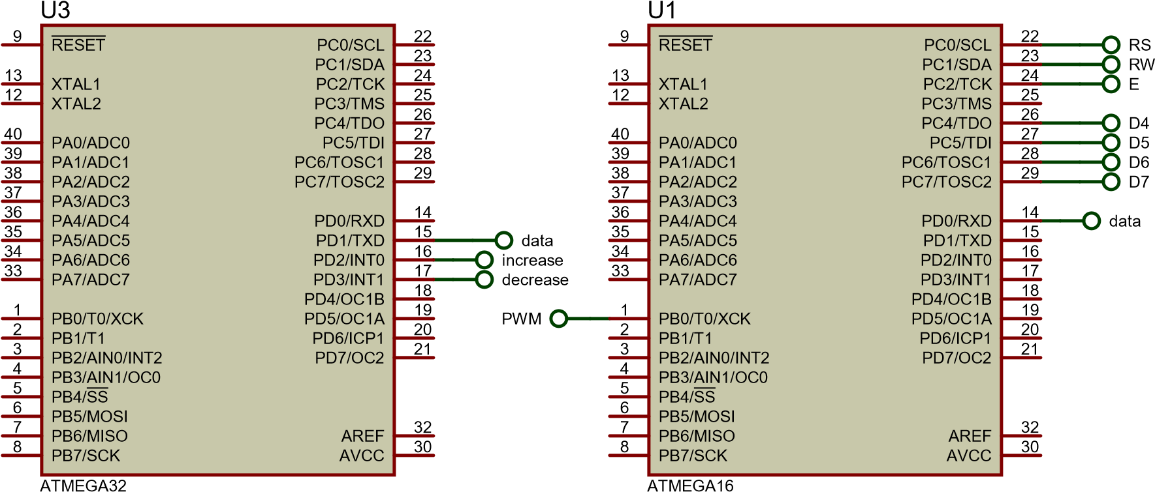
Microcontroller 2
Microcontroller 1
RV1
VDD
2
potentiometer
%
VEE
44
3
1
1
k
VSS
LM016L
U2(VS)
Motor
LCD
VDD
VSS
VEE
RS
RW
E
D0
D1
D2
D3
D4
D5
D6
D7
U2
16
8
1
2
3
4
5
6
7
8
9
10
11
12
13
14
PWM
2
IN1
VSS
VS
OUT1
3
7
IN2
OUT2
6
+88.8
1
EN1
AC Volts
VSS
VEE
RS
RW
E
VDD
D4
D5
D6
D7
9
EN2
10
IN3
OUT3
11
External Switch 1
15
IN4
GND
GND
OUT4
14
Increase
L293D
External Switch 2
decrease
L293D
Motor driver

Slide 28
Conclusion
Embedded systems are rapidly making a highly significant change in the computing, data communications, industrial control and telecommunications sectors In this project we learned about interfacing microcontrollers with Hardware devices and also connecting multiple ones using UART.
In this project we have covered the usage of all the layers starting form the hardware register layer leading up to the application layer and how each layer communicates with it’s higher level until finally establishing the final design.
Through this course we were able to interface microcontrollers with other hardware devices to achieve a specific task using Proteus.

Slide 29
Any Questions?

