Slide 1

Disease Prediction System
Supervised by
Dr. Hesham Ahmed Hassan
TA. Sabah
Implemented by
Cairo University
Faculty of Computers and Information
Department of Computer Sciences
20150037 | Ahmed Mohamed Abbas
20150032 | Ahmed Mohamed Ahmed
20150003 | Ibrahim Mohamed Ibrahim
20150013 | Ahmed Samir Mohamed
Graduation Project
Academic Year 2018-2019
Midyear Short presentation

Slide 2

Disease Prediction System [Doc-bot]

Slide 3
Project idea Medical diagnosis is the process of determining the disease that explains a person's symptoms.

Slide 4
Problem significance
What is the problem you are going to solve?
Why and how?
What are the previous solutions to the problem, if they exist, and what are their advantages/disadvantage?

Slide 5

Project specifications
Functional Requirements
Non-functional Requirements
Use-case Diagram
Architecture Design
Class Diagram
Sequence Diagram
Entity Relationship Diagram (ERD) for your Database (if any)

Slide 6
Functional Requirements
User Register
User login
Select gender (if not logged in)
Select Symptoms
Answer questions related to your condition
Disease prediction
Suggesting medical tips
Suggesting to see specialist
Find nearby hospitals
Add disease
Find the Symptoms of specific disease
Logout

Slide 7
Non-Functional Requirements
Modifiability
Portability
Reliability
Usability
Security

Slide 8
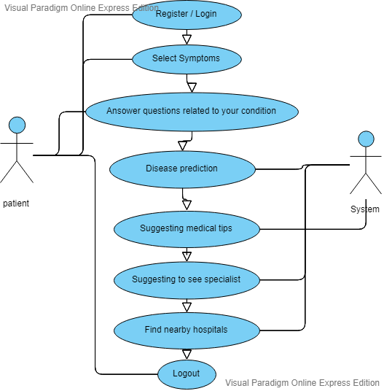
Use Case Diagram

Slide 9
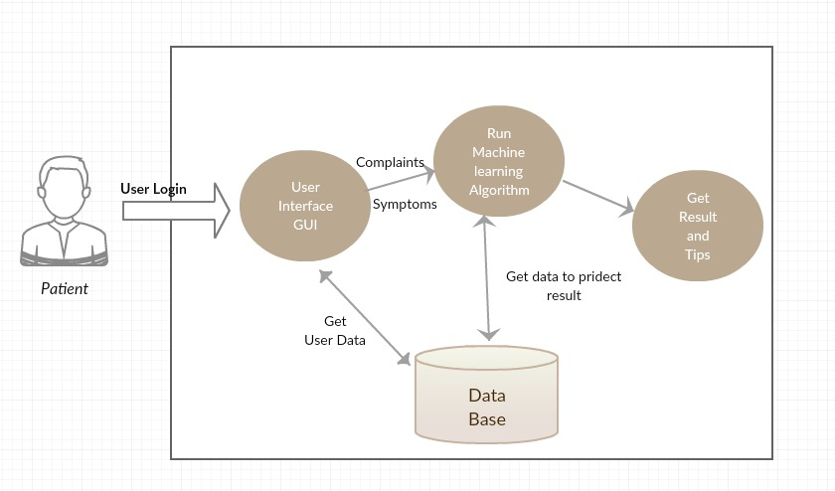
Architecture Design

Slide 10
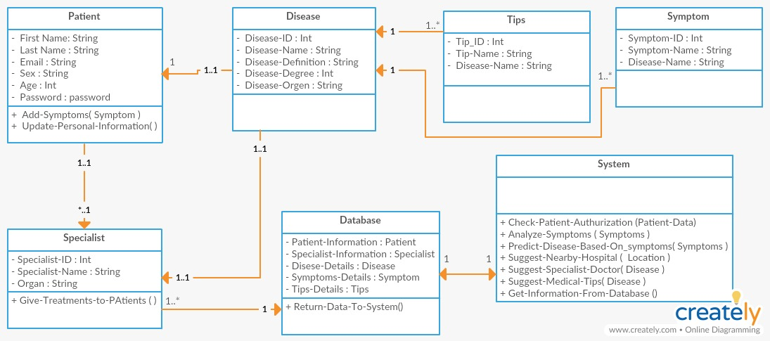
Class Diagram

Slide 11
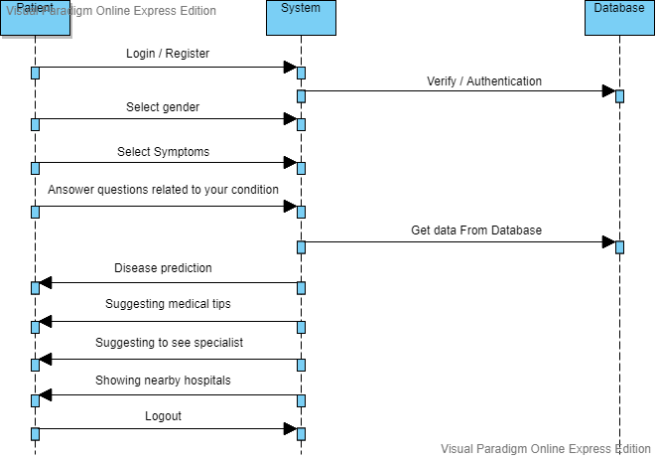
Sequence Diagram

Slide 12
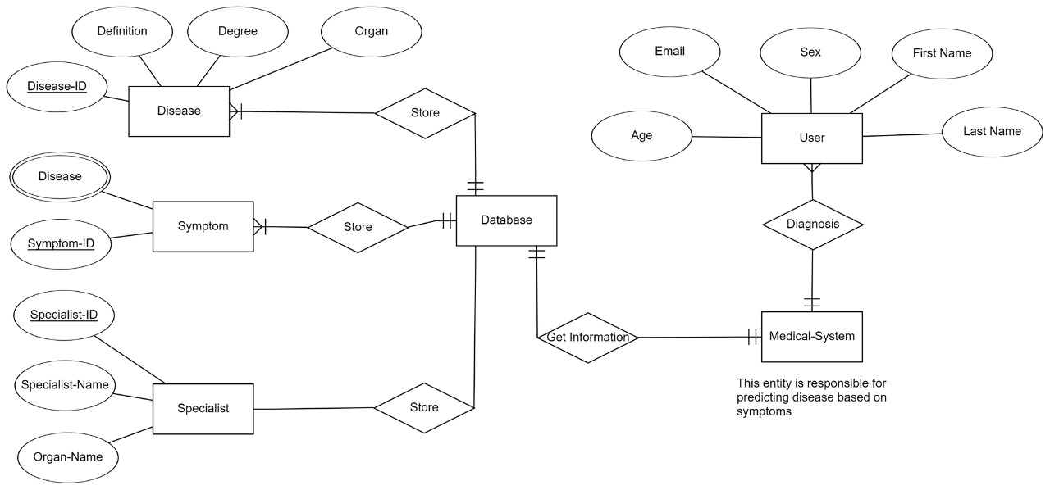
Entity Relationship Diagram (ERD)

Slide 13
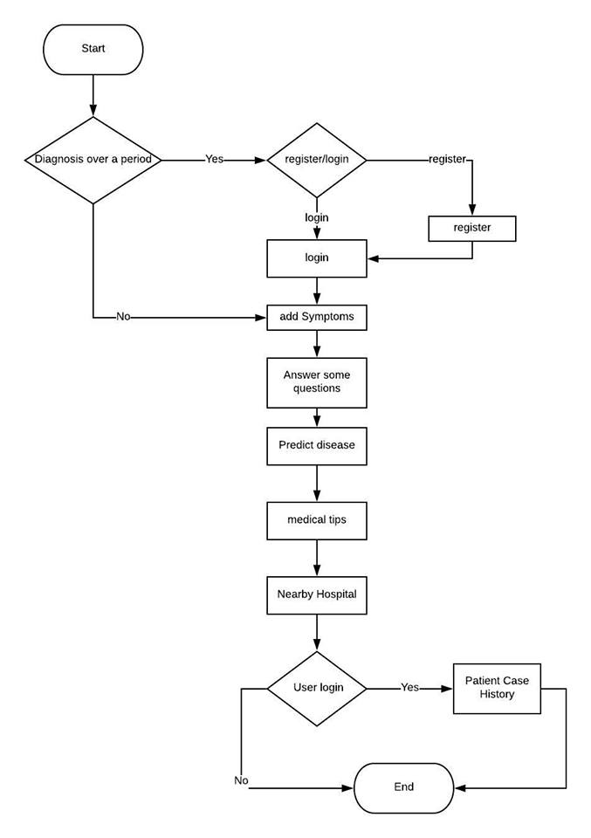
Flow Chart

Slide 14
Challenges! -data cleaning

Slide 15
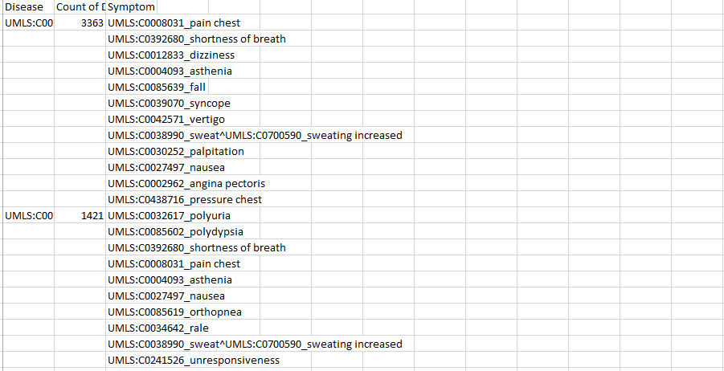
Row Data

Slide 16
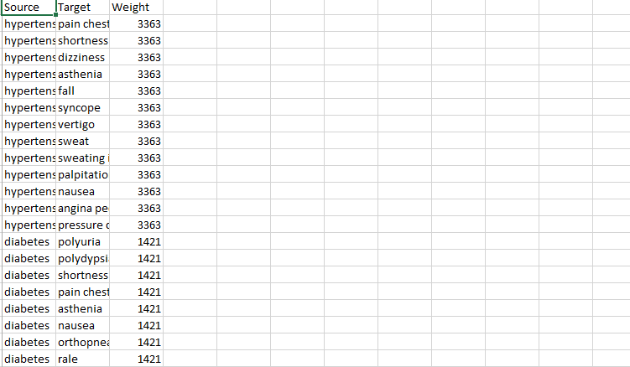
Information

Slide 17
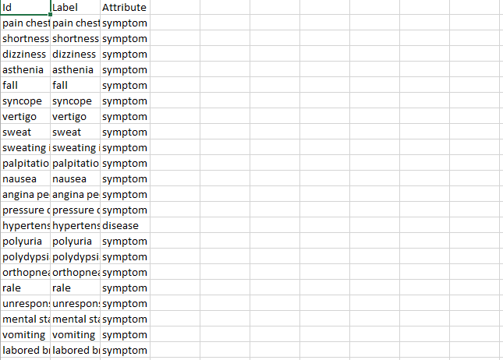
Information

Slide 18
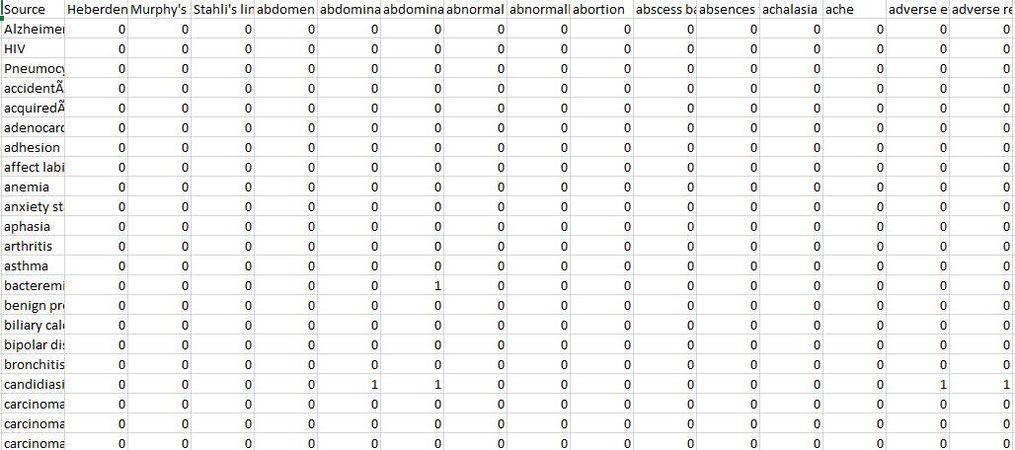
Knowledge

Slide 19

Demo

Slide 20

Conclusion

Slide 21
THANKS!
Any questions?

