Slide 1
E-Commerce Customer & Sales Analysis
Presented by Ahmed Mousa

Slide 2
1.Data source:-
-https://www.kaggle.com/datasets/shriyashjagtap/e-commerce-customer-for-behavior-analysis

Slide 3
Introduction
I’ll be presenting an analysis of customer behavior based on a large e-commerce dataset. In this project, we explore detailed customer data to uncover patterns and trends that can help improve marketing strategies, increase customer retention, and boost overall business performance.
This dataset includes various attributes such as customer demographics, order history, product preferences, and interaction patterns. By leveraging this information, we aim to gain a deeper understanding of customer segments, identify high-value customers, and detect potential areas of improvement in the customer journey.
Our goal is to turn raw data into actionable insights that can support data-driven decisions for optimizing the customer experience and enhancing revenue growth

Slide 4
3-Data Cleaning & Preparation:-
Dropping Unnecessary Features
Columns Removed:
1. Customer Name
Reason: Personal identifier with no analytical value
Impact: Reduces dimensionality without losing insights
Privacy: Removes personally identifiable information
2. Customer Age
Reason: duplicates and standardize column naming
Decision: Based on analysis requirements
Impact: Simplifies dataset structure
Missing Value Treatment
Problem: Missing values (NaN) in Returns column
Solution: Replace missing values with 0
Logic:
No return record = No returns made
Zero is the logical default value
Maintains data integrity
Why Zero Makes Sense:
Business logic: No record = No returns
Prevents data loss
Maintains numerical consistency

Slide 5
Exploratory Data Analysis

Slide 6
1-Customer Demographics Analysis

Slide 7
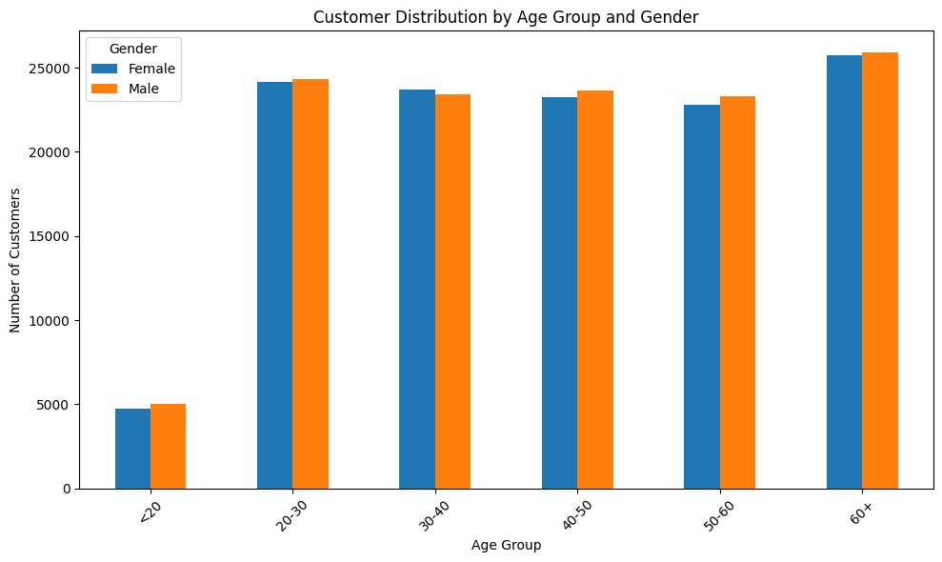
Customer Distribution by Age and Gender
This bar chart shows the distribution of customers across different age groups, broken down by gender. As we can see, the largest customer segments are in the 60+ and 20–30 age ranges, followed closely by those in their 30s and 40s.
Interestingly, there's a relatively even split between male and female customers across all age groups, with only minor variations. This suggests our customer base is demographically balanced in terms of gender, which is valuable for inclusive marketing strategies.
The younger segment under 20 is noticeably smaller, indicating a potential growth opportunity or simply a lower engagement rate among that age group."

Slide 8
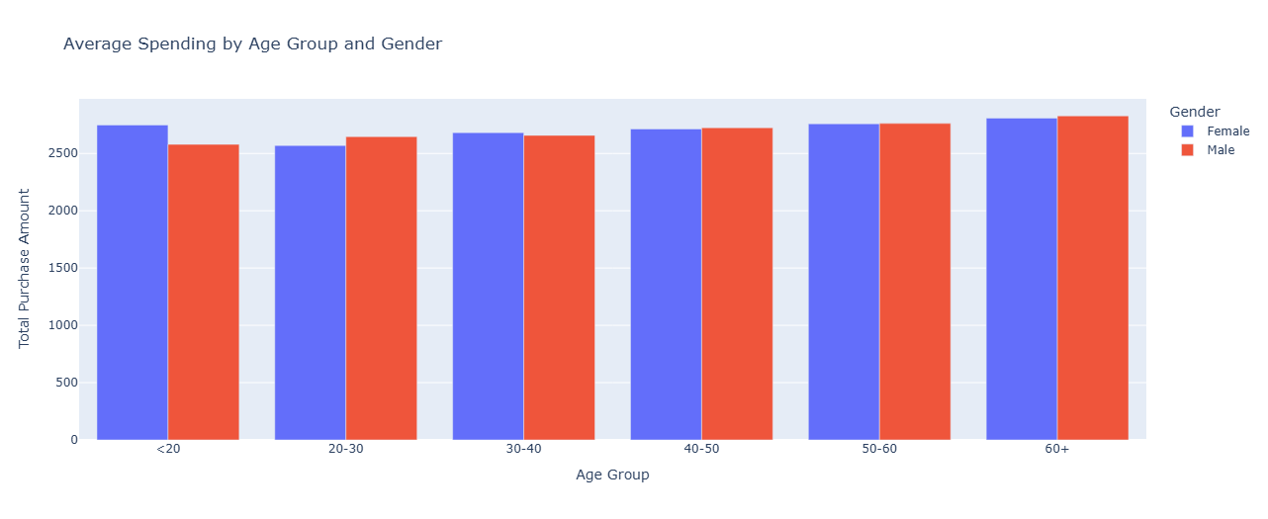
Average Spending by Age & Gender
Average spending increases with age
Highest spenders:age group 60+
Gender differences in spending are minimal
Older customers are valuable high-value segments

Slide 9
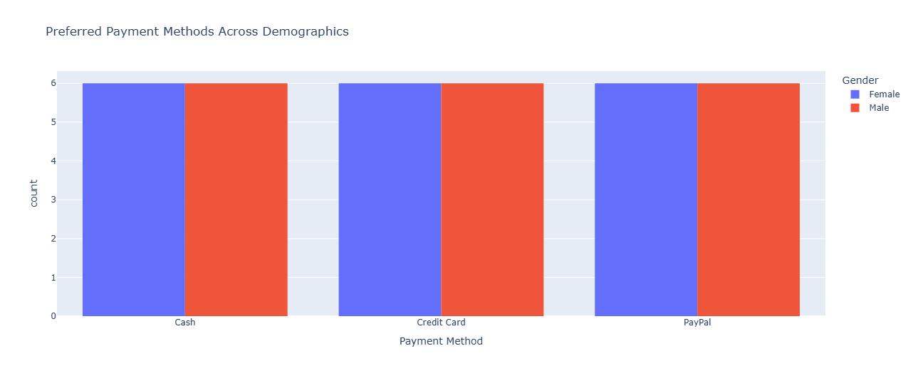
Preferred Payment Methods Across Demographics
Equal usage across Cash, Credit Card, and PayPal
No gender-based payment preferences
High digital payment adoption

Slide 10
2-Sales Performance Analysis

Slide 11
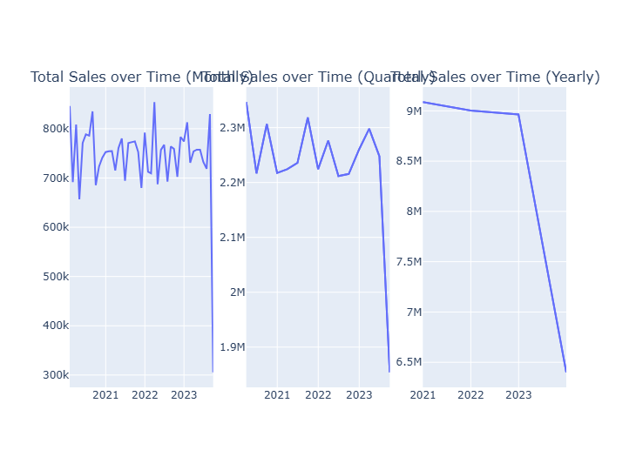
Total sales and number of purchases over time (monthly/quarterly/yearly
Monthly: Volatile but stable until 2023 collapse
Quarterly: Steady performance until sharp Q3 2023 decline to 2M
Yearly: Dramatic drop from 9M (2022) to 6.5M (2023) revenue loss
Strategic Recommendations:
Crisis Response: Implement immediate revenue recovery plan to address
Trend Analysis: Investigate what changed in mid-2023 causing the sharp downturn
Market Recovery: Launch aggressive campaigns to restore quarterly performance to 2.2M baseline
Financial Planning: Adjust 2024 budgets and forecasts based on new performance.

Slide 12
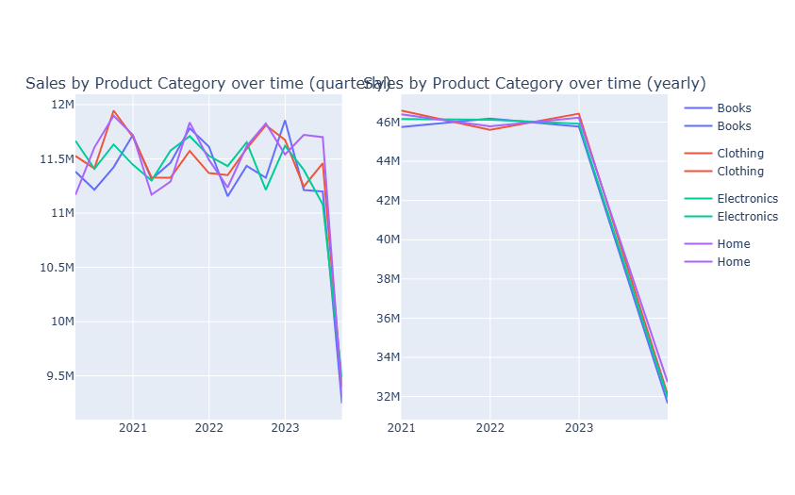
Sales by Product Category Over Time
-All categories stable at (2021-2022)
-Universal 30% decline to 32M in 2023 across all product lines
-Synchronized drop suggests external market factors
*Strategic Recommendations
1-Root Cause Analysis: Investigate market-wide factors causing universal decline
2-Category Recovery: Launch targeted campaigns to restore 46M baseline performance
3-Portfolio Expansion: Add new product categories to reduce risk concentration

Slide 13
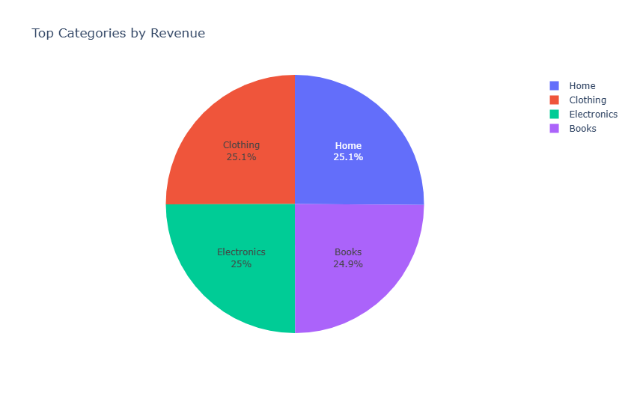
Top Categories by Revenue
-Nearly perfect balance: Home (25.1%), Clothing (25.1%), Electronics (25%), Books (24.9%)
-Only 0.2% difference between highest and lowest performers
-Extremely well-diversified revenue portfolio

Slide 14
3-Return Behavior Analysis

Slide 15
Return Rate Analysis
Critical Issue: 40.59% overall return rate is extremely high
Universal Problem: All categories show similar rates (40.4% - 40.8%)
Systemic Issue: Minimal variance suggests company-wide problem
Strategic Recommendations
Urgent Action: Investigate root cause of 40%+ return rate immediately
Quality Control: Implement stricter standards across all categories
Accuracy Review: Audit product descriptions and marketing materials
Process Audit: Examine packaging, shipping, and fulfillment operations

Slide 16
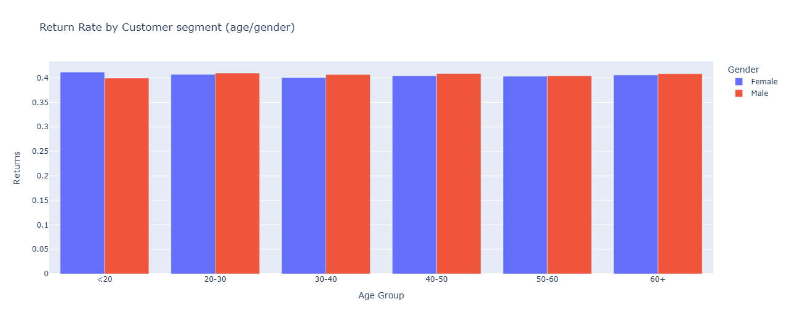
Return Rate by Customer Segment (Age/Gender)
-All demographics show identical ~40% return rate
-No variation across age groups or genders
-Confirms systemic company-wide issue, not customer-specific behavior

Slide 17
4-Customer Purchase Behavior

Slide 18
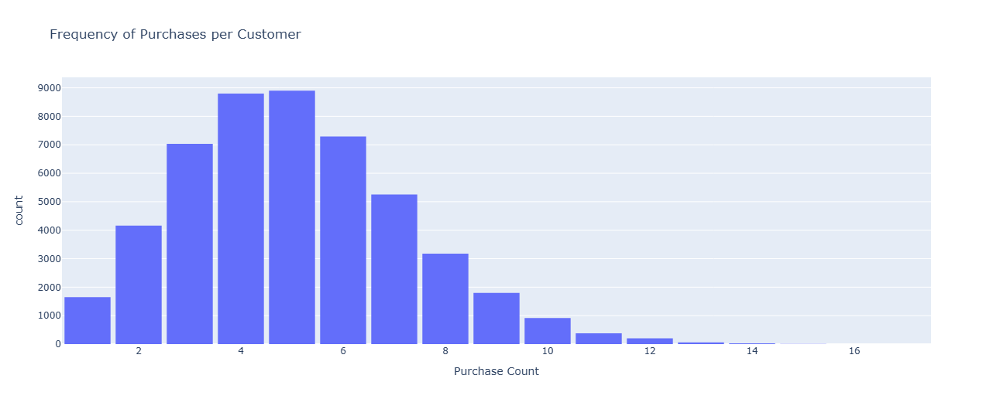
Frequency of Purchases per Customer
Most customers make 4-5 purchases (peak at ~8,800 customers each)
Sharp drop-off after 6 purchases indicates retention issues
Few customers reach 10+ purchases showing limited loyalty
Strategic Recommendations
Retention Focus: Target customers with 4-6 purchases to increase frequency
Loyalty Programs: Develop incentives to push beyond 6-purchase barrier
Returns: 40% return rate likely impacting repeat purchase behavior

Slide 19
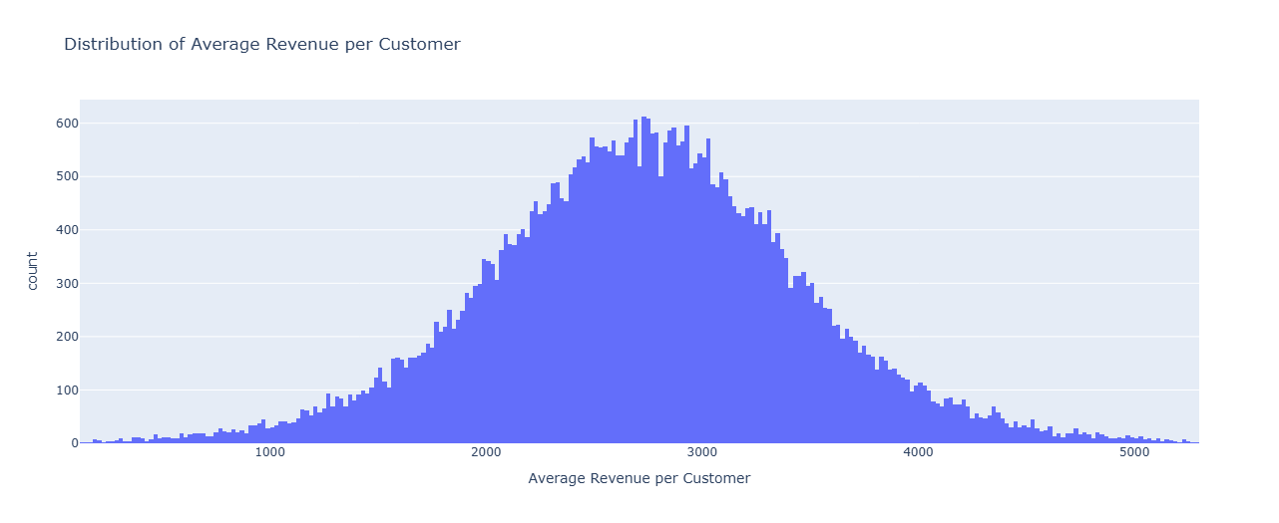
Distribution of Average Revenue per Customer
Normal distribution centered around $2,500-3,000 per customer
Most customers fall in $2,000-3,500 lifetime value range
Few extreme low or high-value customers
Strategic Recommendations:
Upsell Focus: Move $2,000-2,500 customers to $3,000+ tier
VIP Programs: Retain high-value customers above $3,500Low-Value Recovery: Re-engage customers below $1,500

Slide 20


