Slide 1
Hotel Management system
It is a system for managing and saving all hotel data

Slide 2
Team(12) Team Member
Ahmed Abd Elrahiem Mohamed (CS 3)
Ahmed Nabil Mohamed Kamel (IS 3)
Ahmed Naser Mohamed Aboud (IS 1)
Omar Gamal Fathy (CS 3)
Mostafa Hussien Amin (CS 3)

Slide 3
Project Description
It contains 6 forms. The basic form contains two options to enter as an employee and as an admin, and this can be done through a user name and password.
When entering as a admin, he has access to reservations, rooms, guests and the employee, where he can access all forms and deal with them.
When entering as an employee, he has access with SSN and First name to reservations, rooms and guests only, as he cannot enter the employee's form and deal with it.
The second form contains the basic data of the hotel, through which it is possible to change the password and exit the program.
GitHub_link:
https://l.facebook.com/l.php?u=https%3A%2F%2Fgithub.com%2Fmustafa7ussien%2FHotel-Manaegment-System%3Ffbclid%3DIwAR0D6lwNGYsDo-B8uY1-UGWazlxb6ehjfyjSwMQZchfHwL7r_uf-41VN8s0&h=AT2Bb3_E05LFi1AWMtgCVFeOOFTNOighLA-yKu3bT4lf7ldcjfvakVLtUceSFXSH7EF5ZreaQpDbYXrcx494oM5-AT8eUxDLUEuiusqrhsVj8pLpZFBUITq0fLSKZNim1SZA

Slide 4
Project Forms
Main form requires name and password.
The second form contains the basic data of the hotel, through which one can enter the other forms according to the admin or employee.
Employees
Rooms
Guest
Booking

Slide 5
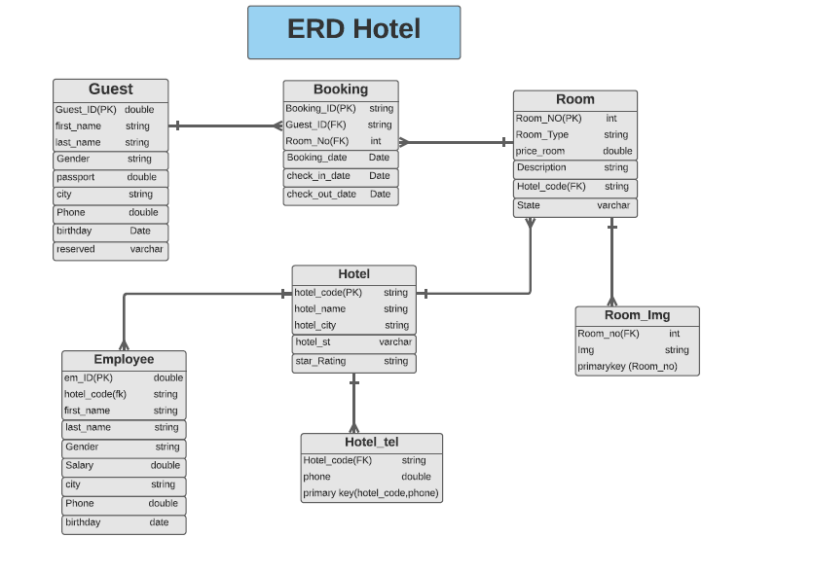
Project erd
The normalization was achieved by the presence of more than one picture of the room, so we made a special table for it and also more than one number to contact, so we made a special table for it.
.

Slide 6

Employees form
Which contains the data of all employees: identification number, first and last name, date of birth, gender, salary, city, phone number and hotel code.
Through which the Admin can search for an employee, view all employees, add, delete and modify the data of any employee.

Slide 7

Room form
Which contains the data of all rooms: room number, room type, room price, room description and hotel code.
Through which it is possible to search for a room, view all rooms, and add, delete and modify the data of any room. It also contains pictures of all rooms and the ability to modify it.

Slide 8

Guest Form
Which contains the data of all guests: identification number, first and last name, date of birth, gender, password number, city and phone number.
Through it, it is possible to search for a guest, view all guests, and add, delete and modify the data of any guest.

Slide 9
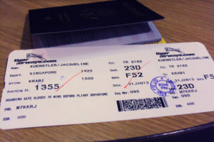
Booking form
Which contains all the ticket data: ticket identification number, guest identification number, room number, reservation date, entry date and exit date.
Through it is possible to search for a ticket, view all tickets, add, delete and modify the data of any ticket.
Notes:
e

