Slide 1

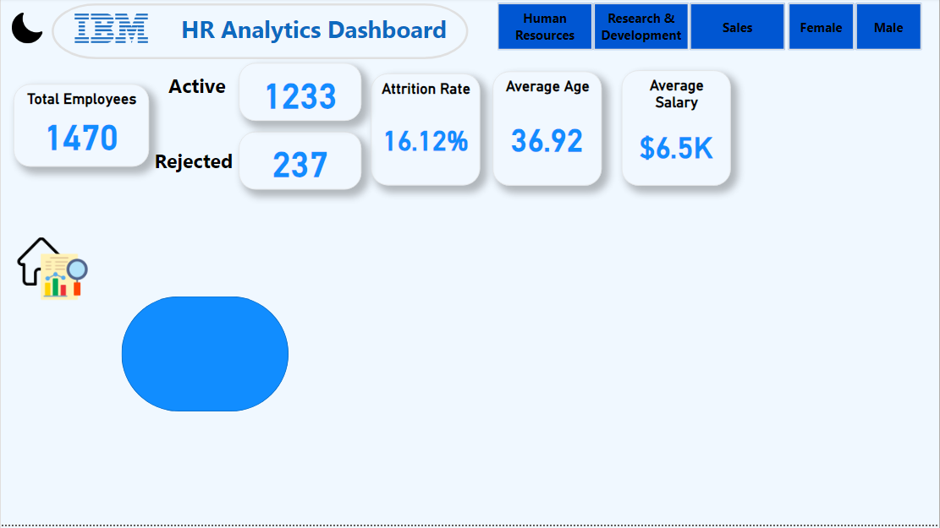


HR Analytics Dashboard

Slide 6
HR Analytics Dashboard

