Slide 1
HR Analytics Dashboard for IBM
Analysis of Employee Attrition, Distribution, and Performance
By : AHMED NABIL Mohamed Kamel

Slide 2
Objective of the Analysis
1- Understand employee attrition :
Determine the rate of employee attrition
Identify key factors contributing to employee turnover
Provide actionable insights to reduce attrition and improve employee retention
2- Analyze employee distribution:
Use these insights to optimize departmental structures and resource allocation.
Analyze the age and gender distribution of the workforce.
Provide recommendations to foster a more inclusive and diverse workplace.

Slide 3
Project Steps
Step 1-Data Cleaning & Transformation
Using Power BI Query to Ensuring data accuracy and consistency was crucial. We cleaned and transformed the data, Deleting Columns “EmployeeCount” Because each Row represent One Employee and The All Values are (1) that’s Normal thing , ” Over18” Because each Employees age more then or equal (18) , ” StandardHours” Because each Rows have the same value (80) . This phase was all about improving data quality and reliability.
Step 2 -Data Modeling
Designing a star schema to structure the data for optimal performance and ease of analysis was key. This modeling set the stage for effective and efficient reporting.
Step 3 -Data 𝗩𝗶𝘀𝘂𝗮𝗹𝗶𝘇𝗮𝘁𝗶𝗼𝗻 & 𝗥𝗲𝗽𝗼𝗿𝘁𝗶𝗻𝗴
I create interactive dashboards and reports to visualize key metrics and provide actionable insights We focused on Attrition analysis.

Slide 4
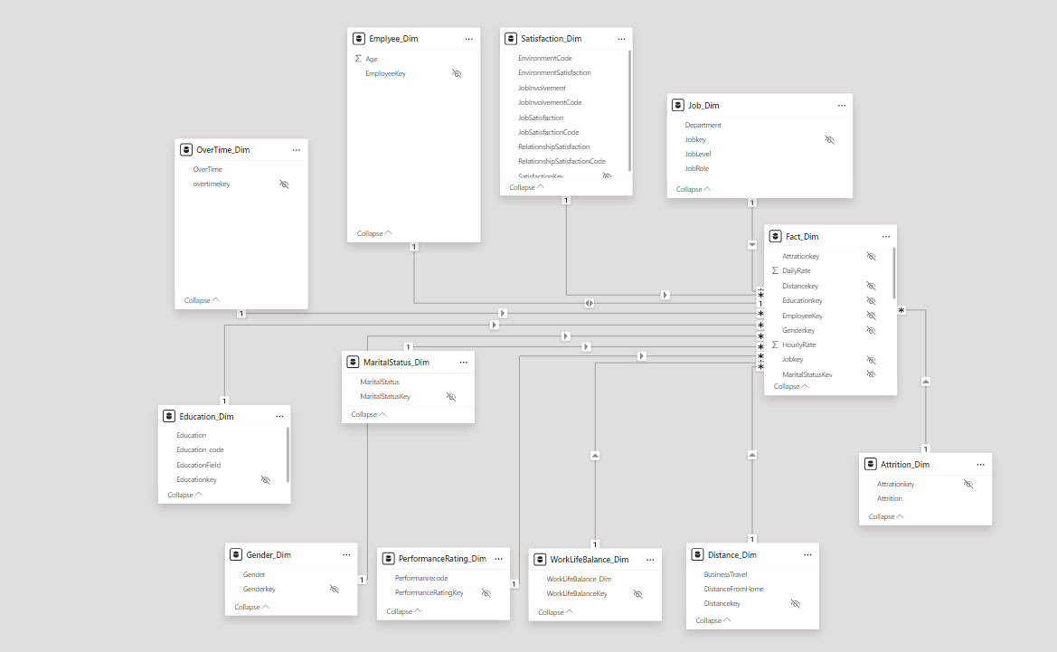
Modeling
Make the dataset into a star schema
.

Slide 5
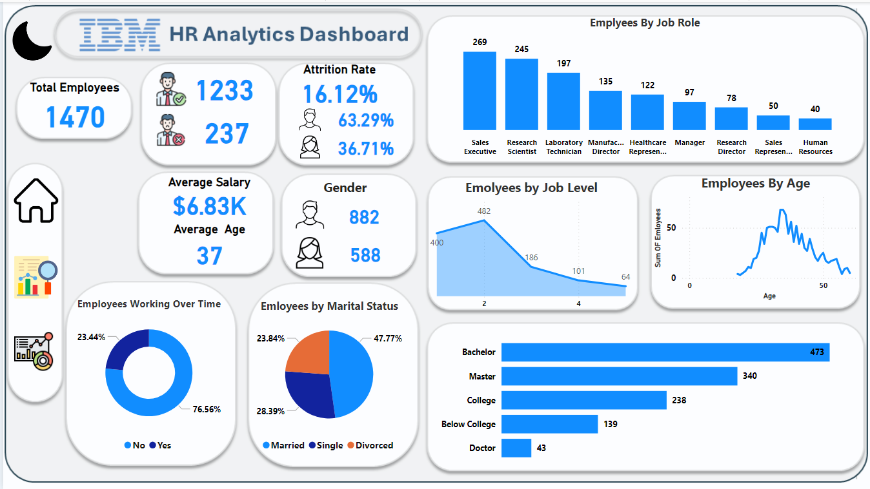
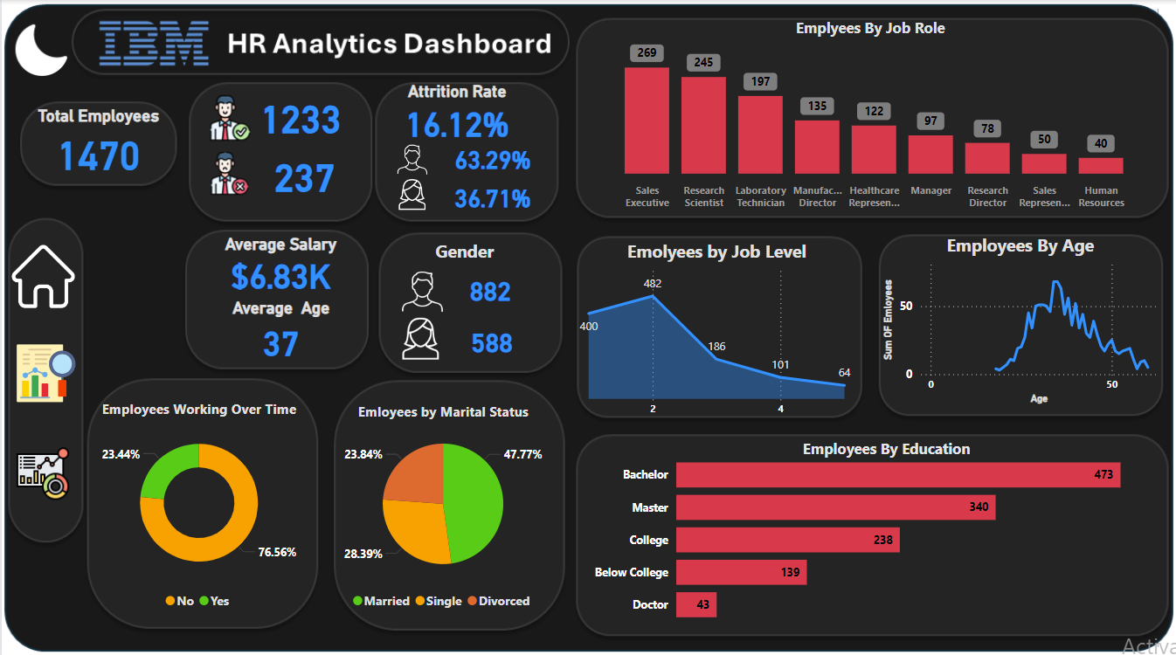
Home Page
The Home dashboard for HR Analytics at IBM is designed to provide a comprehensive overview of key HR metrics and insights in an intuitive and visually appealing format

Slide 6
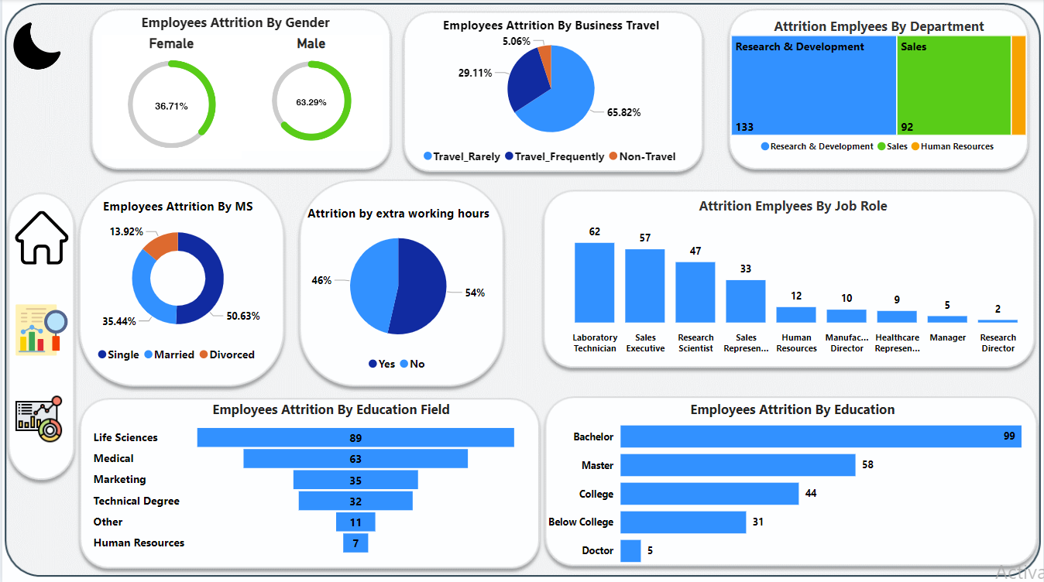
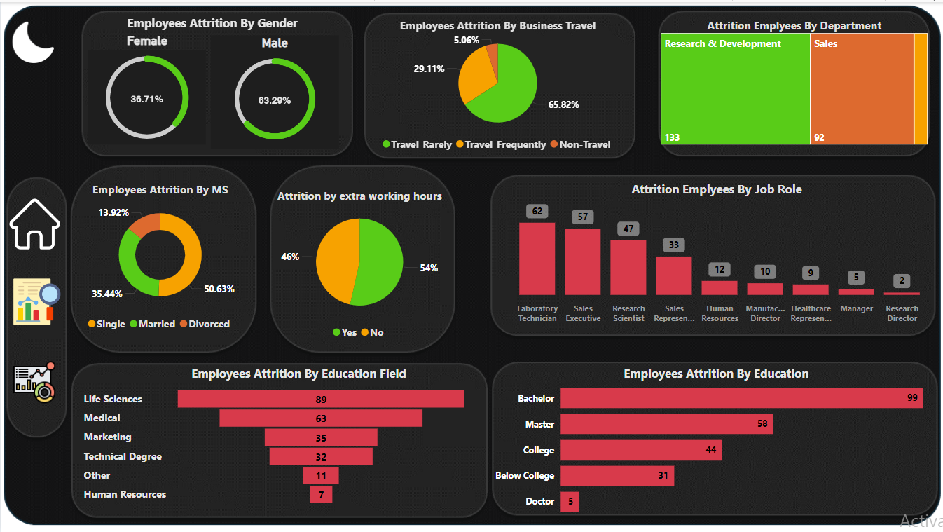
Outliers page one
The Outliers Dashboard is designed to identify and analyze atypical data points within the HR dataset at IBM

Slide 7
Outliers page one Overview
Chart of the Attrition rate of Employees whose education level is below college is the highest and the attrition rate of employees whose education level is doctor is lowest .
Chart of Attrition Employees By Job Role Show the percentage of attrition is highest amongst sales representatives and lowest amongst managers, manufacturing directors, and healthcare representatives.
Chart of Attrition Employees By Department Show Attrition percentage Is highest in the sales department at 20.63% where 92 employees out of 446 went through attrition and the lowest in the research and development department at 13.84% where 133 employees went through attrition out of 961 .
Chart of Attrition Employees By Marital Status Show Single employees are the most likely to attrition with approximately 1 in 4 single employees likely to attrition. This is followed by married employees (12.5%), with divorced employees least likely to attrition.

Slide 8
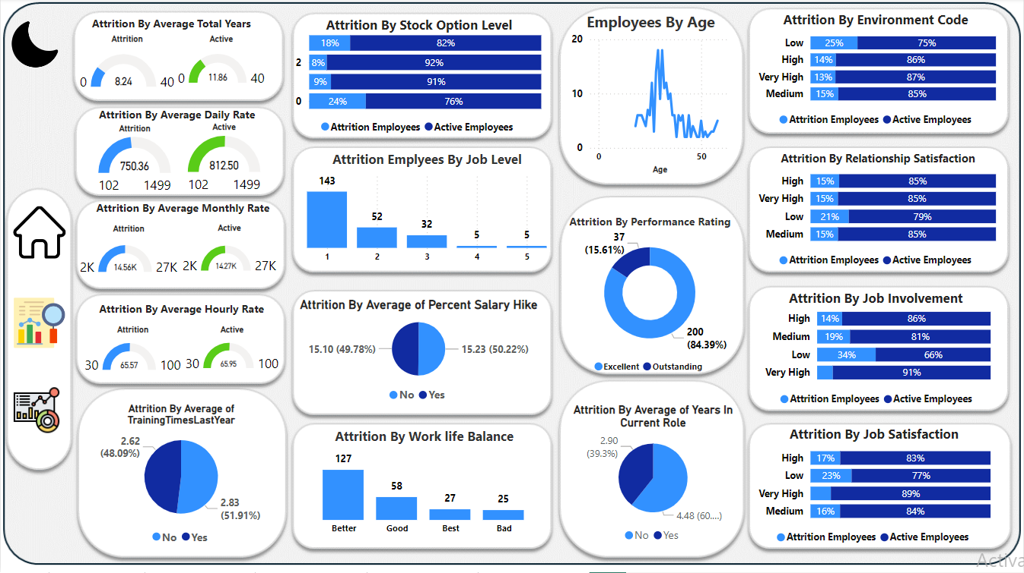
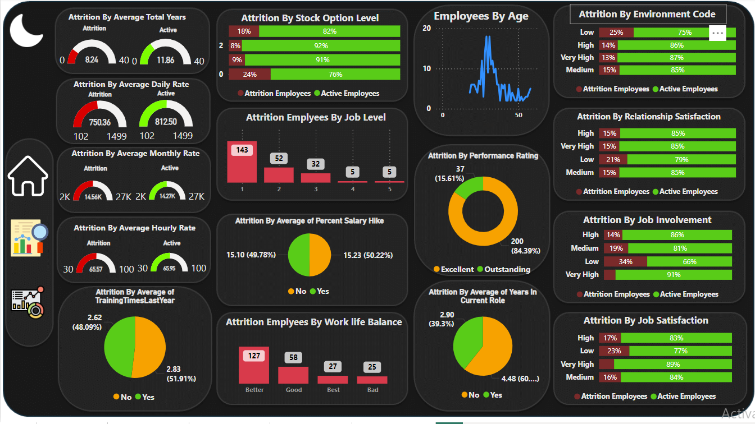
Outliers page Two
The Outliers Dashboard is designed to identify and analyze atypical data points within the HR dataset at IBM

Slide 9
Outliers page Two Overview
Chart of the Attrition By Job Involvement shows that when the job involvement rate is very high, the attrition rate is lowest and when the job involvement rate is very low, the attrition rate is highest.
Chart of Attrition By Work life Balance Shows when employees can’t balance work and life well, the attrition rate is high .
Chart of Attrition Relationship Satisfaction Show It’s expected that employees with the lowest relationship satisfaction with IBM are the most likely to attrition; 1 in 5 employees with a low score attrition.
Chart of Attrition By Job Satisfaction Show As it can be observed from the above graph, employees with the lowest job satisfaction score are the most likely to attrition when compared to the other scores, with an attrition percentage of 23%.

Slide 10
Recommendations
Hire more highly educated employees in order to reduce attrition rate
Implement retention strategies tailored to employees around 40 years old.
Address attrition issues within the Research & Development department.
Give employees training in how to balance work and life in order to reduce attrition rate.
Enhance compensation and benefits for employees in lower salary ranges.
Develop engagement initiatives for early career employees.
Offer career growth opportunities aligned with educational backgrounds.
Promote diversity and inclusion to mitigate gender-based attrition disparities.
Implement department-specific strategies to reduce attrition in high-risk areas.
Regularly review and adjust salary ranges to remain competitive in the market.
help employees to get more involved in the job to reduce attrition rate .

Slide 11
Links
Data Set : https://www.kaggle.com/datasets/pavansubhasht/ibm-hr-analytics-attrition-dataset
Power BI Service Link : https://app.powerbi.com/links/XBchG9HLFt?ctid=25ce0261-bbd6-49cd-a1e2-54260886d159&pbi_source=linkShare
Notes:
e

