Slide 1
1- Team members
1-سعد صفوت سعد الدين محمد (2)
2-احمد نبيل محمد كامل احمد (3)
3-احمد أبو السعود عبد الراضي (3)
4-احمد خالد خلف محمد (3)
5-محمد ايمن محمد عبد المطلب (3)
6-إسماعيل عوني علي مخلوف (1)

Slide 2
2-Link to of dataset
https://www.kaggle.com/altadata/covid19

Slide 3
Describe of dataset
(Frist column)-Reported Date (reported_date) : Covid-19 Report Date
(second column)- CountryRegion (countryregion) : Country, region or sovereignty name
(third column)- Population (population) : Country populations as per United Nations Population Division
(fourth column)- Confirmed Case (confirmed) : Confirmed cases include presumptive positive cases and probable cases
(fifth column)- Active cases (active) : Active cases = total confirmed - total recovered - total deaths
(sixth column)- Deaths (deaths) : Death cases counts
(seventh column)- Recovered (recovered) : Recovered cases counts
(eighth column)- Mortality Rate (mortality_rate) : Number of recorded deaths * 100 / Number of confirmed cases
(ninth column)- Incident Rate (incident_rate) : Confirmed cases per 100,000 persons
-Number of records after cleaning : (31432) -Number of attributes after cleaning :(9)

Slide 4
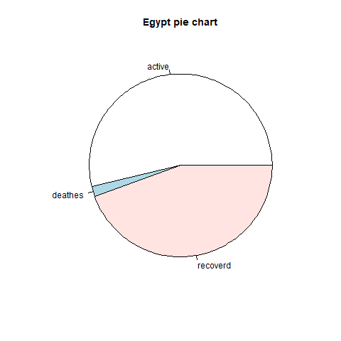
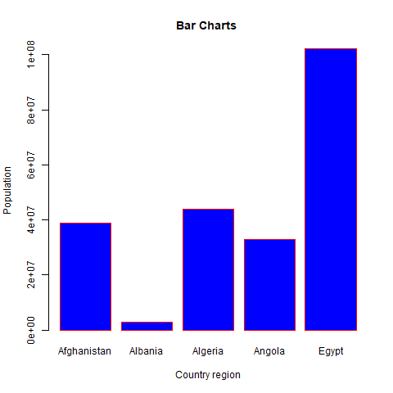
Results of visualization
-Bar Chart in R Programming is handy to compare the data visually. By seeing this R bar chart, One can understand, Which country is have large population compared to others.
-Using the pie charts, patterns in the data can be understood easily

Slide 5
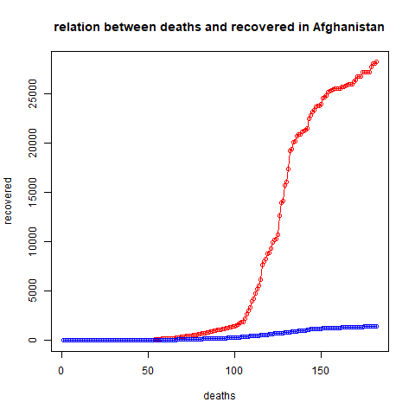
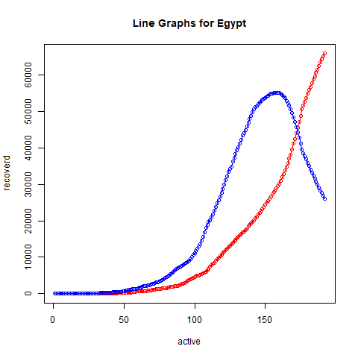
Results of visualization
-because A line chart is a graph that connects a series of points by drawing line segments between them.
Notes:
e

Slide 6
Semantic data integration
-Serious critical
Critical cases give us big predictions about the possibility of an increase in mortality and that the survival rate is very low
-Total tests
It allows us to know how many people took the test from the total population and based on that we can conclude the infection rate, mortality rate and recovery rate
Through these tests, we can deduce the rate of people who did not take the test
-take the vaccine
We use this data about taking the vaccine to find out the statistic of the number of people who took the vaccine, and through this we can put another statistic, which is
-The probability of infection with the virus again
here is the measure of the effect of the vaccine on preventing infection with this virus

