Slide 1
AI-Powered Assistive System for
Alzheimer’s Patients
Team Members
Ahmed Nada Ahmed 22101167
Omar ibrahim suliman 22100974
Ahmed Fathy Ahmed 22101981
Aya Abdelmaged Kamel 22100953
Negma Abderhman Ali 22101242
Rokia Islam Elsayed 22101084
Dr. Mahmoud Saber

Slide 2

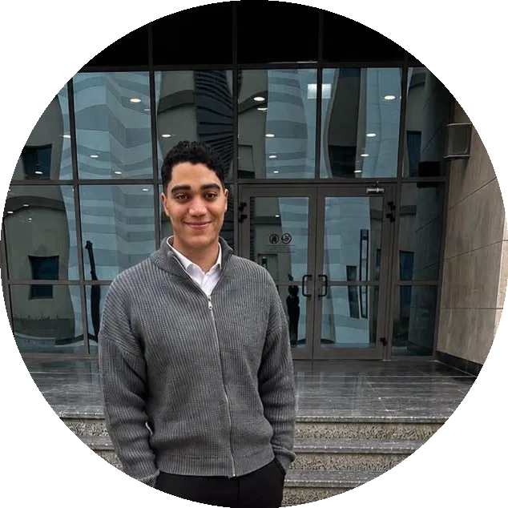

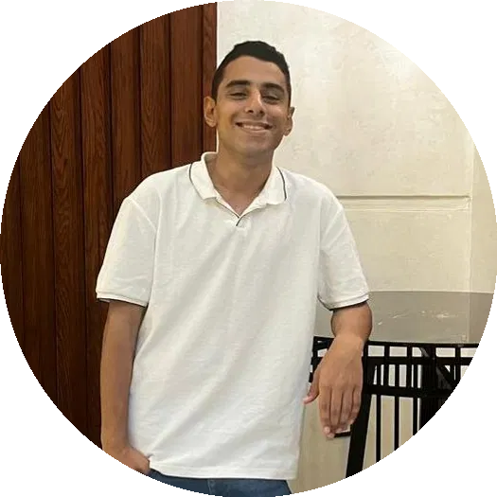


Agenda
Ahmed Nada
Introduction & Motivation, Cognitive Exercises
Omar
Software Development & System Integration
Aya
Chatbot (RAG-Based Assistant)
Ahmed Fathy
Location Tracking
Rokia
Medication Reminder & Daily Plan Management
Negma
AI Mood Detection System

Slide 3

Introduction
ALZCare:
AI-Powered Assistive System for Alzheimer’s Patients
Purpose:
An intelligent web-based system that supports Alzheimer’s patients in managing daily life, while enabling doctors and families to monitor and assist them effectively.

Slide 4
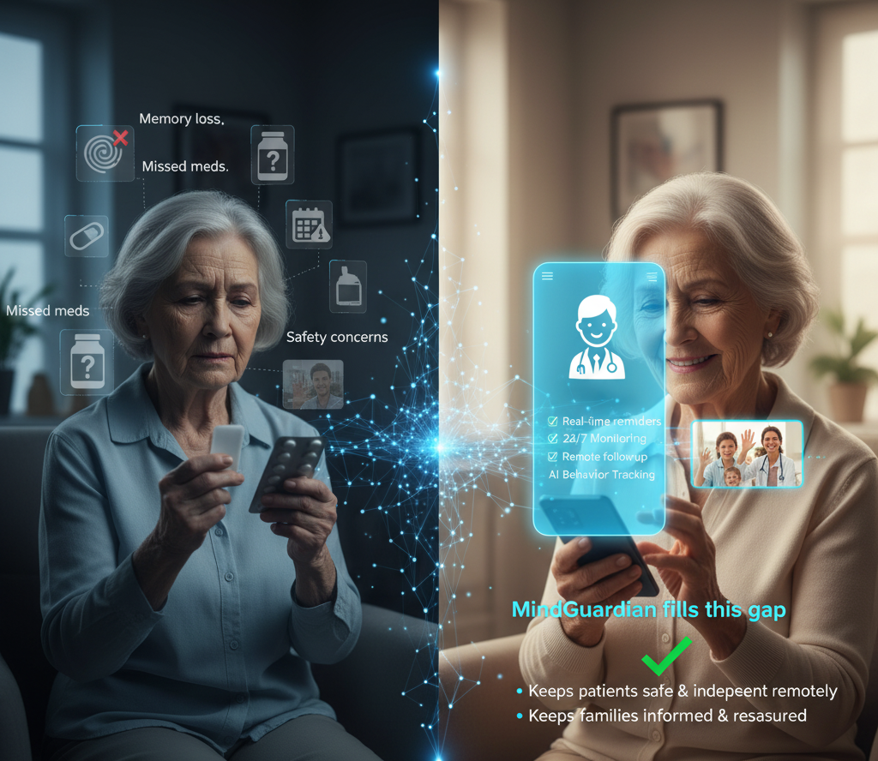
Motivation / Why ALZCare
Motivation / Why ALZCare
• 55M+ patients worldwide → 139M by 2050 • Egyptian families face daily issues: memory loss & missed meds
Current systems lack:
• Real-time reminders + 24/7 monitoring • Remote doctor follow-up + AI emotion tracking
ALZCare solves this:
• Enhances safety & independence • Supports doctor monitoring + keeps families reassured

Slide 5
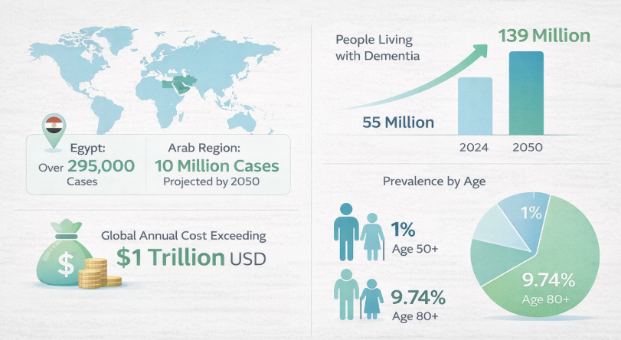
International & Local Numbers

Slide 6
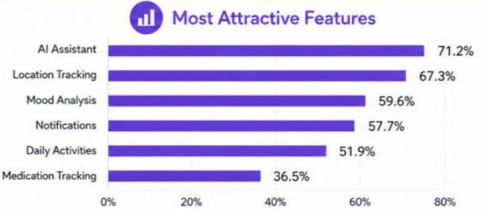
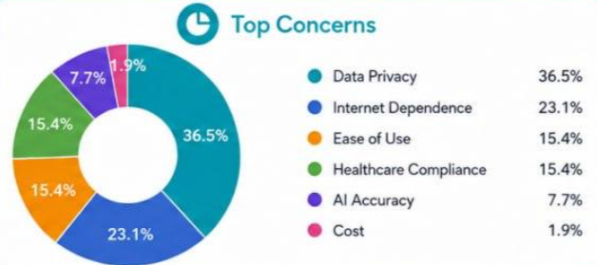
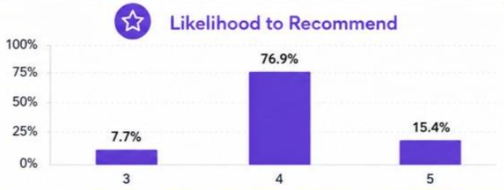
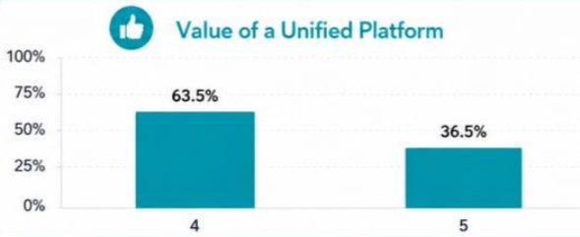
Survey Insights
The survey results show that users see strong value in a unified Alzheimer’s care platform.
The most attractive features were the AI assistant, location tracking, mood analysis, and notifications.
The main concerns were data privacy, internet dependence, ease of use, healthcare compliance, and AI accuracy.
Overall, users have a positive impression of the system, but trust, security, and simplicity should be prioritized.

Slide 7
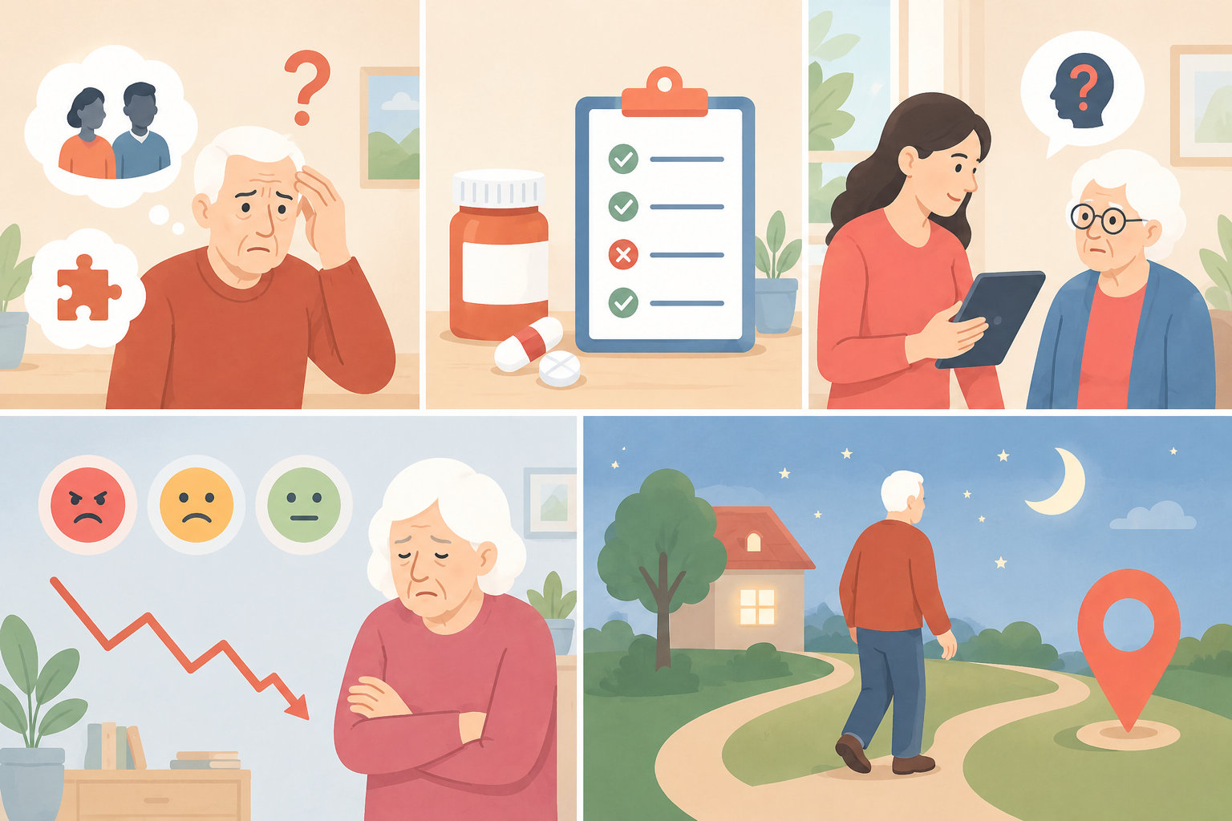
Problems
Patients forget important people and memories.
Patients miss medications and daily tasks.
Caregivers need personalized answers to patient-related questions.
Emotional changes are difficult to monitor.
Patients may wander beyond safe areas.

Slide 8
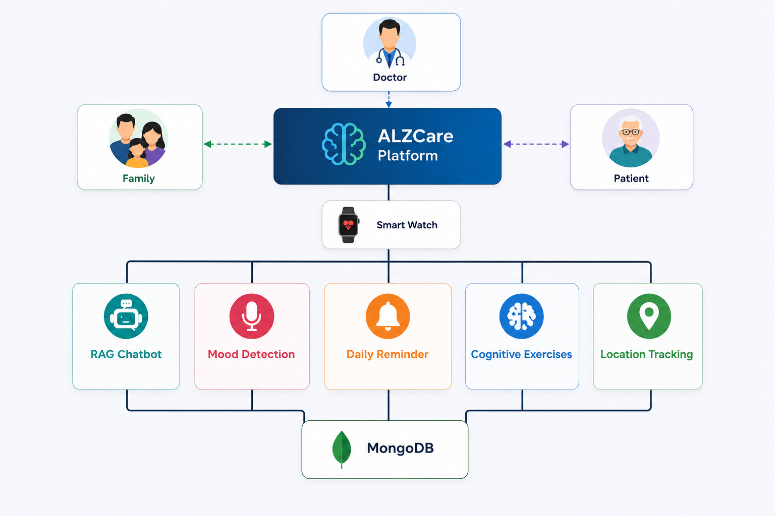
Components
Key Components
Smart Watch Integration
RAG-based Medical Chatbot
Mood Detection System
Daily Reminder Service
Cognitive Exercise Module
Location Tracking
Centralized MongoDB Database

Slide 9
Available Solutions
Existing Solution | Medication Reminder | Family Alerts | GPS | Emotion Detection (Voice) | Direct Chat | Cognitive Exercises | Central System
MindMate | ✔ | ❌ | ❌ | ❌ | ❌ | ❌ | ❌
AngelSense | ❌ | ❌ | ✔ | ❌ | ❌ | ❌ | ❌
Earkick | ❌ | ❌ | ❌ | ✔ | ❌ | ❌ | ❌
CaringBridge | ❌ | ❌ | ❌ | ❌ | ✔ | ❌ | ❌

Slide 10
Functional Requirements​
​
ID | Requirement
FR-01 | Three independent authentication flows (doctor/family/patient), each with its own signed token and role middleware.
FR-02 | Doctors manage full patient profiles with unique auto-generated identifiers (ALZ-XXXXXX) and create permission-scoped family accounts.
FR-03 | Medication prescribing with flexible schedules; auditable intake logging; automatic adherence statistics.
FR-04 | Structured mood entries (label, 1–10 score, behaviors); scores ≤3 or abnormal behaviors auto-flagged with a notification.
FR-05 | Families build daily plans of typed, timed events triggered automatically and pushed to the patient device in real time.
FR-06 | Patients answer events by voice; every response resolves to a definite status with an audit trail and a medical risk level; medication events synchronize into the medication log.
FR-07 | Periodic GPS reporting with throttled writes, a rolling history, and a live family map.
FR-08 | One circular safety zone per patient (radius 50–5,000 m); an inside→outside transition raises one urgent real-time alert.
FR-09 | Family-enrolled persons (≤20 photos each) recognized live on the patient's camera with a name/relation overlay.
FR-10 | Memory albums feed five cognitive exercise types with server-side scoring and longitudinal analytics.
FR-11 | An AI assistant answers all roles, grounded in the live patient record or a curated knowledge base, with role-adapted tone.
FR-12 | Categorized, prioritized notifications (11 types, 4 priorities) persisted and delivered in real time.
FR-13 | An acoustic model estimates the patient's mood (six classes) and arousal (low/high) from check-in voice audio, reporting calibrated probabilities and abstaining when confidence is low so uncertain cases escalate to a human.

Slide 11
Non-Functional Requirements​​
Non-Functional Requirements:
Non-functional requirements define quality attributes of the system.
NFR-1 Usability
The system shall provide a simple, elderly-friendly interface.
The system shall minimize user interaction complexity.
The system shall support voice-based navigation.
NFR-2 Performance
The system shall respond to user actions within acceptable time limits.
Face and emotion recognition shall execute in near real-time.
Alerts shall be delivered instantly during emergencies.
NFR-3 Security
The system shall use authentication and authorization mechanisms.
Sensitive patient data shall be encrypted during storage and transmission.
Access shall be role-based (patient, family, doctor, admin).
NFR-4 Reliability and Availability
The system shall operate continuously with minimal downtime.
The system shall recover gracefully from failures.
Monitoring services shall be available 24/7.
NFR-5 Scalability
The system shall support multiple patients and caregivers.
The architecture shall allow future integration with wearable devices.

Slide 12
User Requirements​​​​​
User Requirements:​
User requirements describe expectations from each user group.​
​
Patient Requirements​
Easy-to-use interface with voice assistance.​
Clear reminders for medications and appointments.​
Immediate help during emergencies.​
Family Requirements​
Real-time alerts and patient location tracking.​
Emotional and behavioral summaries.​
Communication and reassurance tools.​
Doctor Requirements​
Accurate and structured patient reports.​
Early warnings for abnormal behavior.​
Secure access to patient data.​
Administrator Requirements​
User and system management tools.​
Monitoring and logging capabilities.​
Security and compliance enforcement.​
​

Slide 13
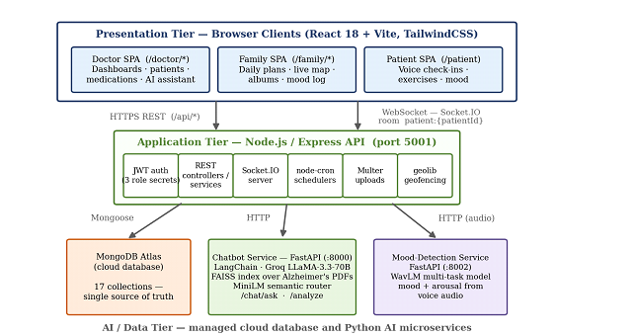
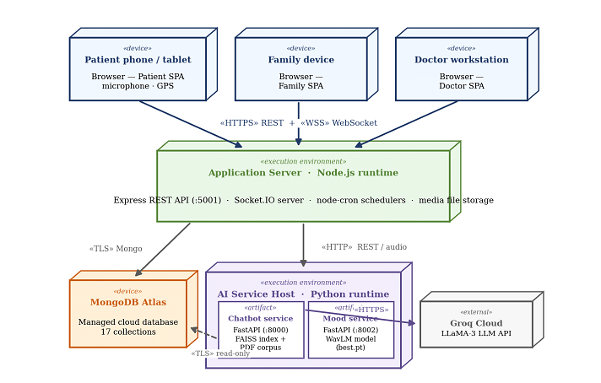
Design Requirement

Slide 14
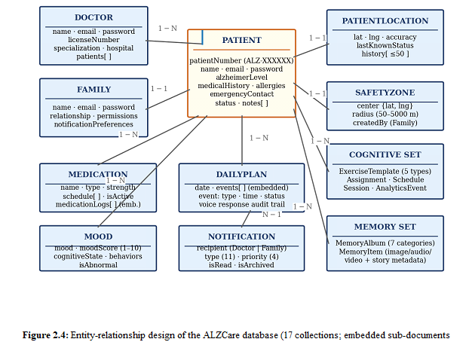
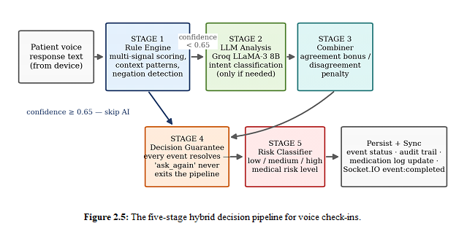
Design Requirement

Slide 15
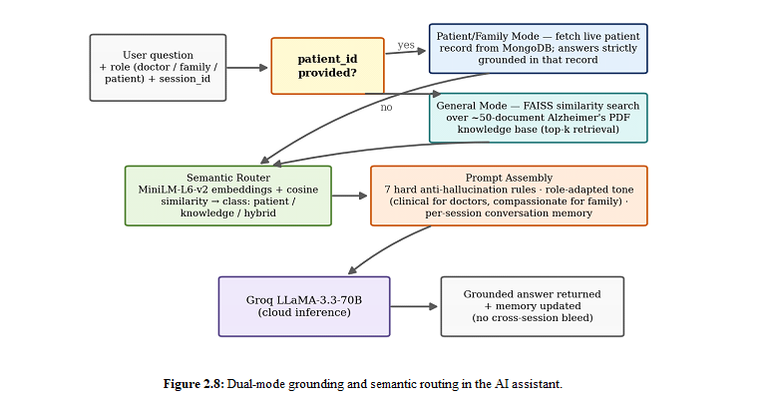
Design Requirement

Slide 16
Design Requirement
Show how you refined your design after trying out different approaches???
Initially, we designed a basic monitoring system, but during development we refined the design using an
Agile approach. We improved the system by integrating AI modules such as mood detection and anomaly detection,
and we enhanced usability by simplifying the patient interface and adding voice interaction.

Slide 17
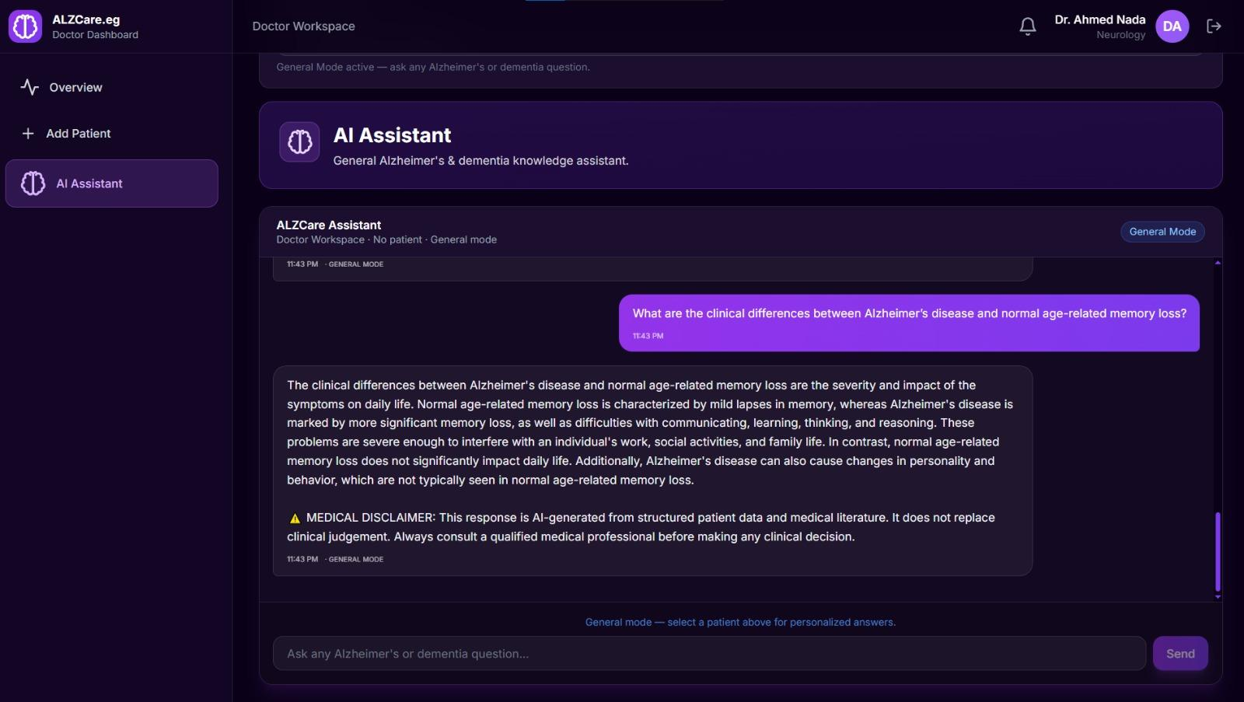
Methodology
Chatbot RAG System
Used RAG approach (Patient Data + Medical Knowledge)
Applied anti-hallucination rules to improve response reliability.
Data collected from PDFs, trusted websites, MongoDB
Uses FAISS + embeddings + prompt engineering
Tools Used:
React, Node.js, FastAPI
LLM: LLaMA-3 (via Groq API)

Slide 18
Dataset
Chatbot RAG System
Dataset Type
Hybrid dataset:
Structured (MongoDB patient records)
Unstructured (PDFs + web data)
Size & Source
~100 PDF documents
Trusted medical websites
Real-time patient database

Slide 19
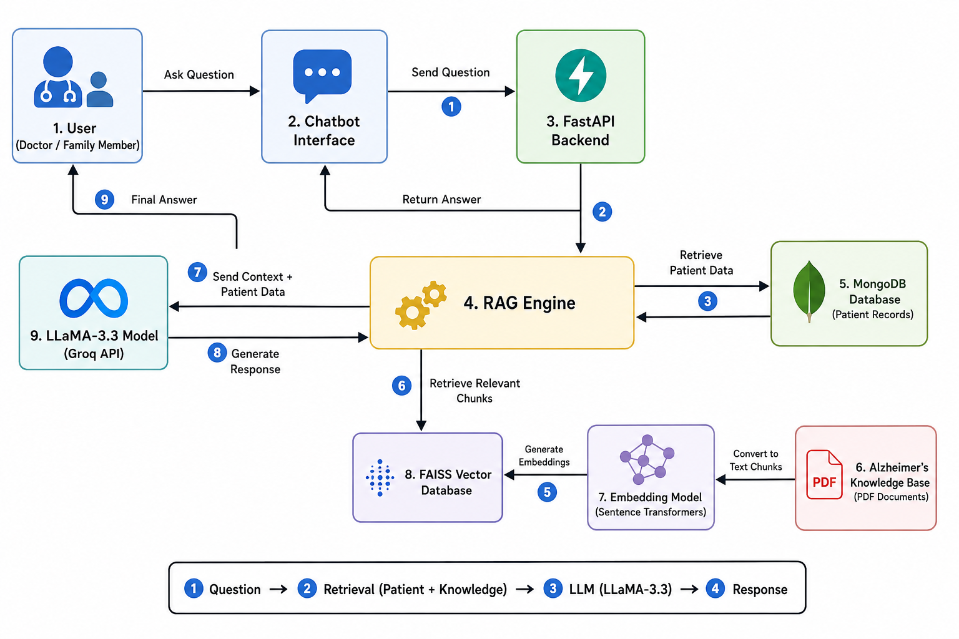
Implementation
Chatbot RAG System
Collected and preprocessed medical and patient data.
Built a FAISS vector database for semantic retrieval.
Developed the RAG chatbot pipeline.
Integrated the chatbot with backend and frontend systems.
Applied prompt engineering and safety rules to improve response quality.

Slide 20
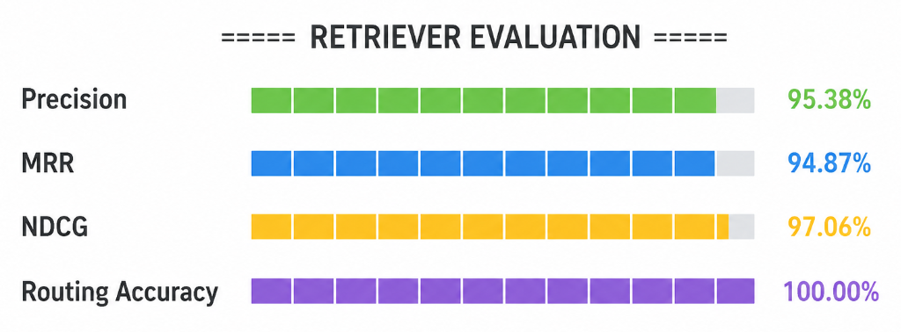
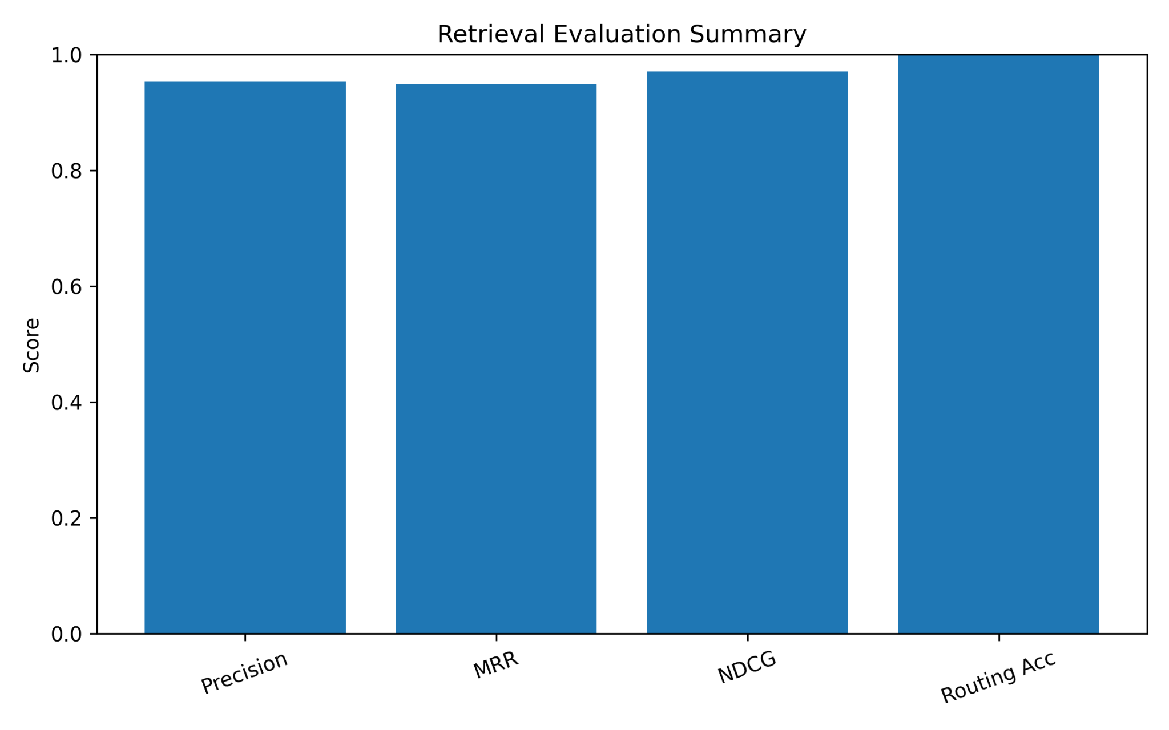
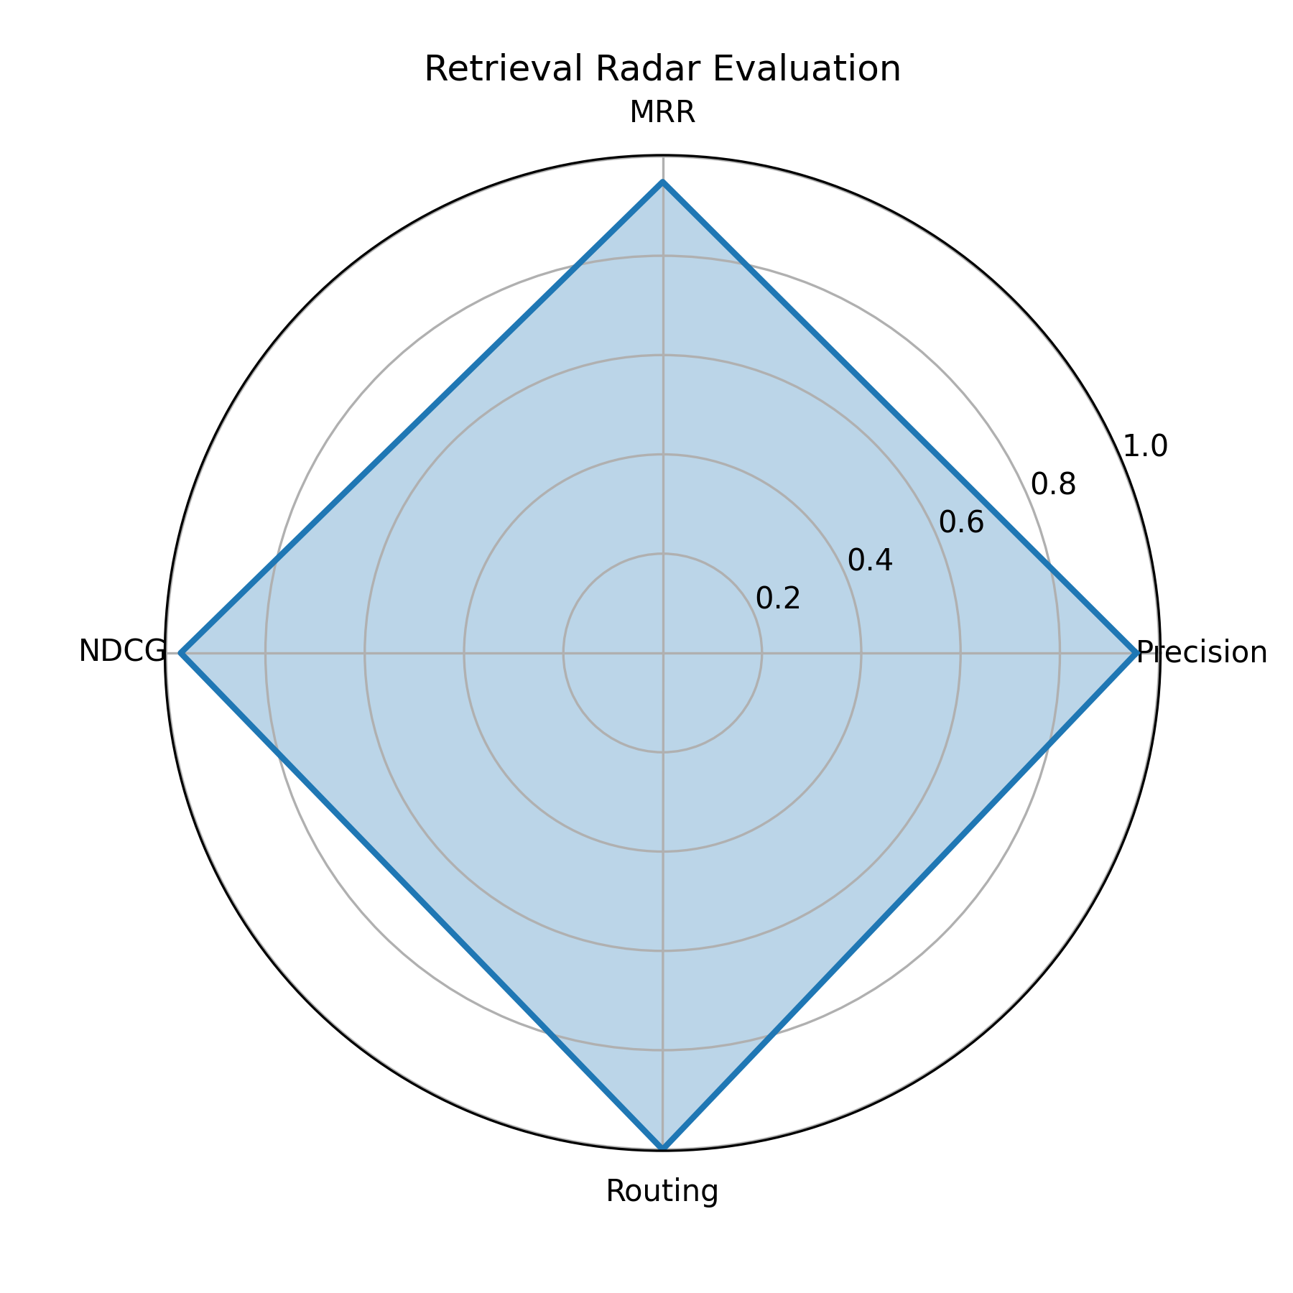
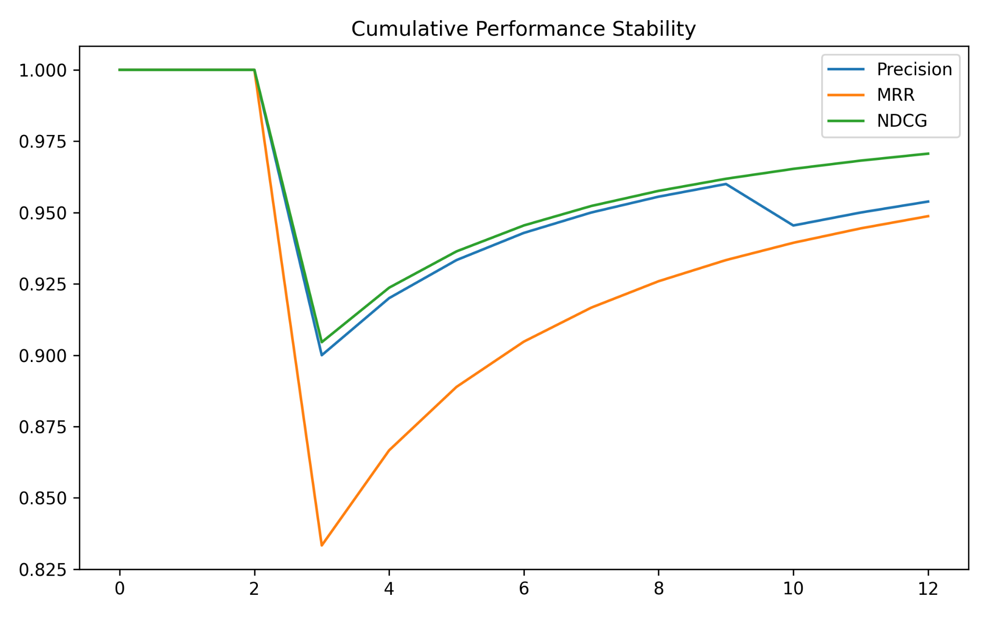
Evaluation Plan
Chatbot RAG System
Evaluated based on accuracy, relevance, safety
Tested using real user scenarios

Slide 21
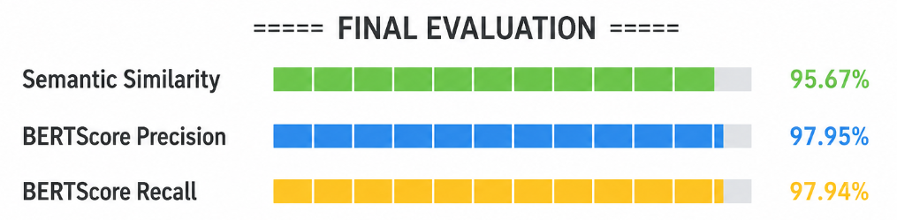
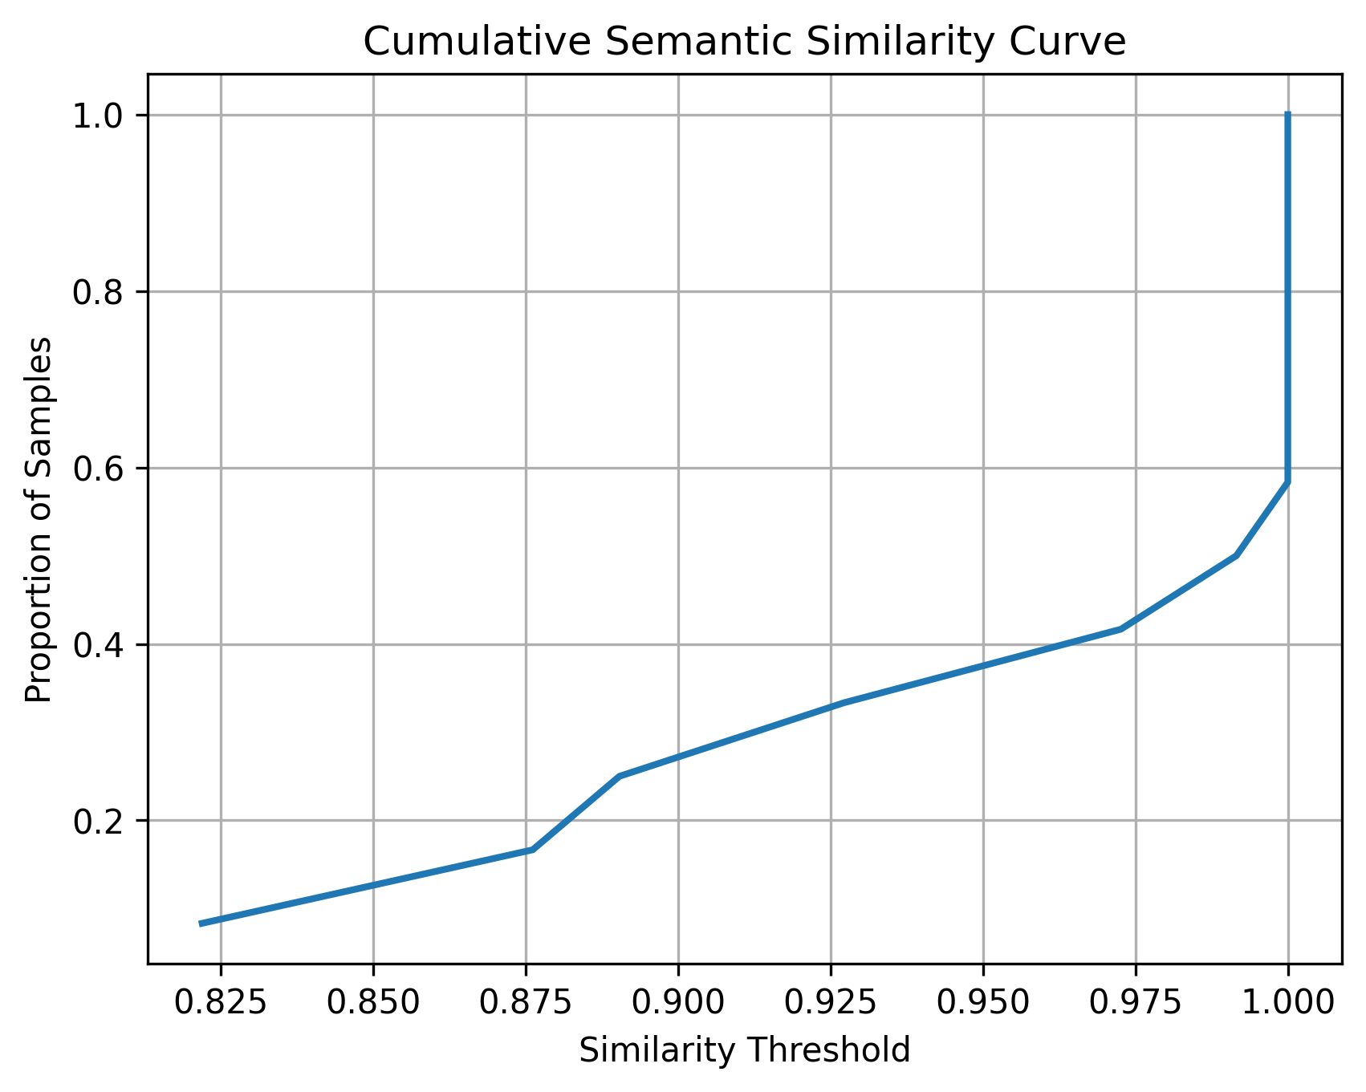
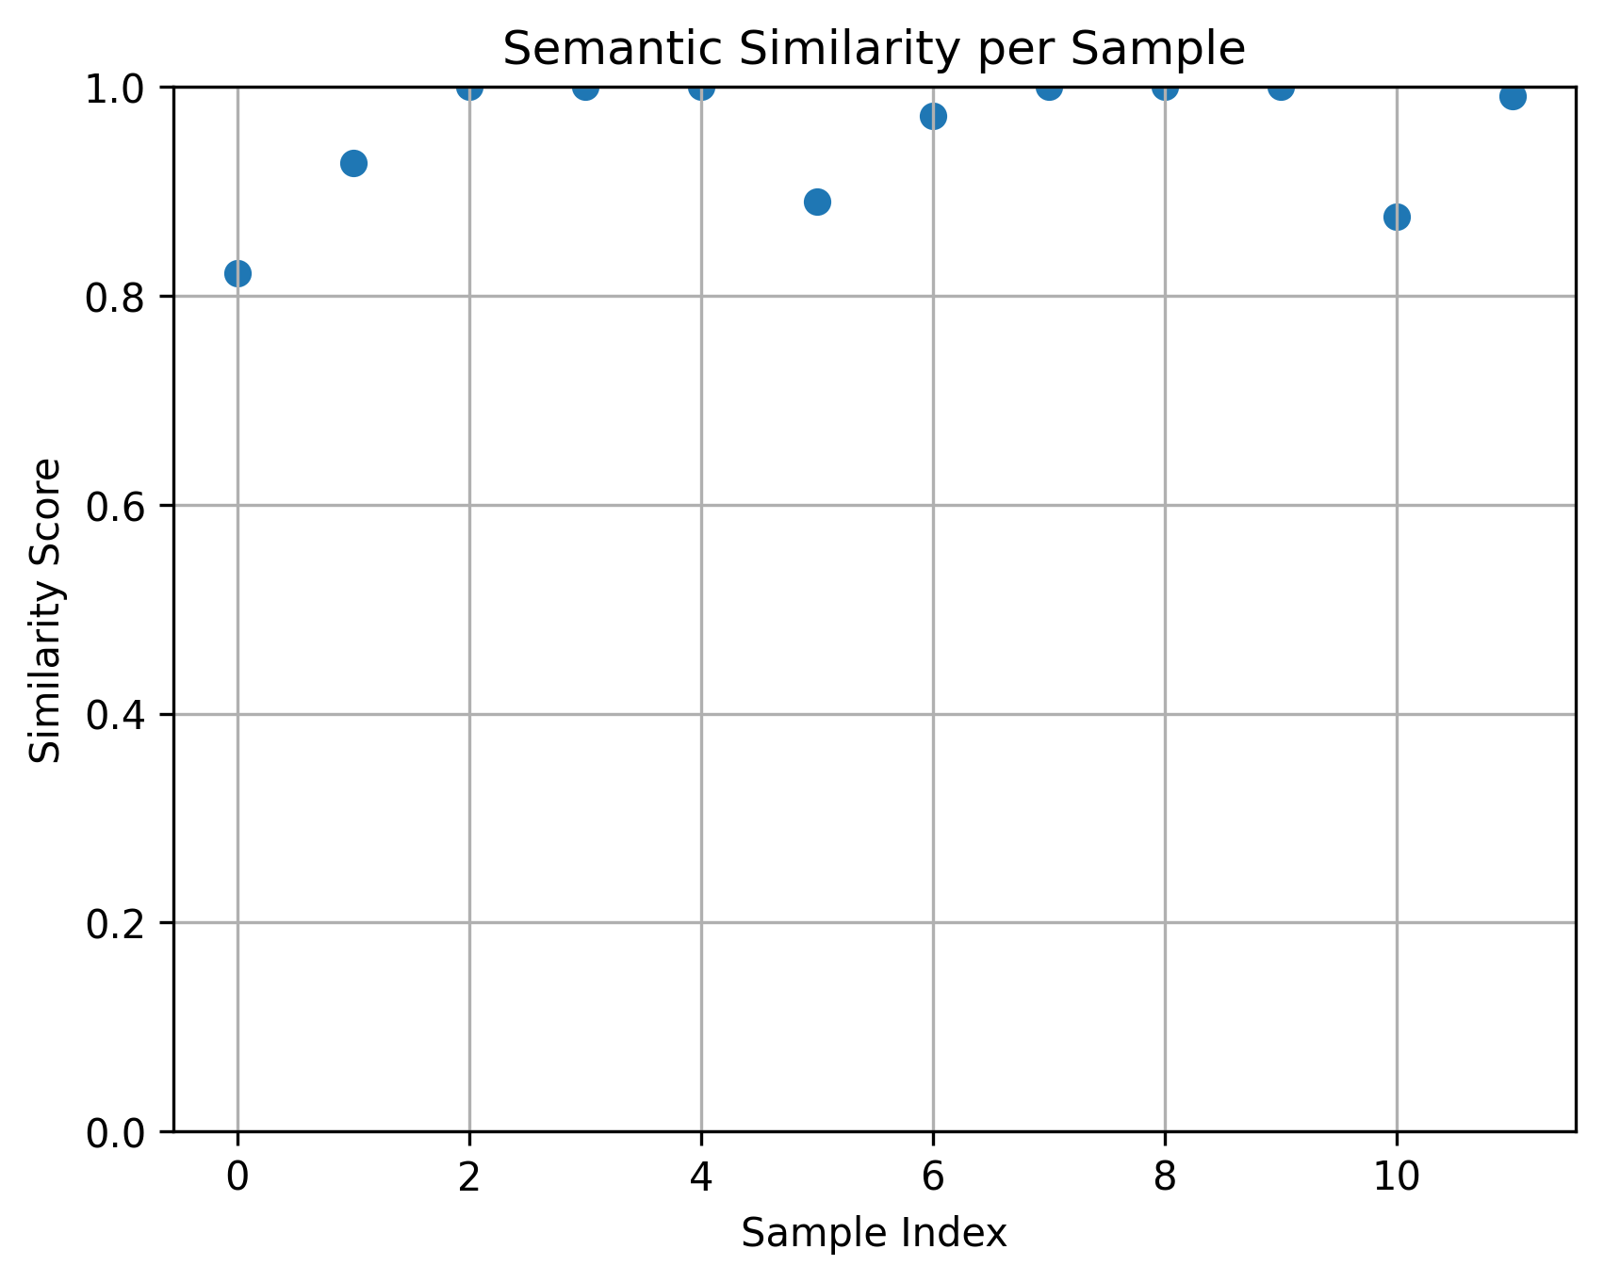
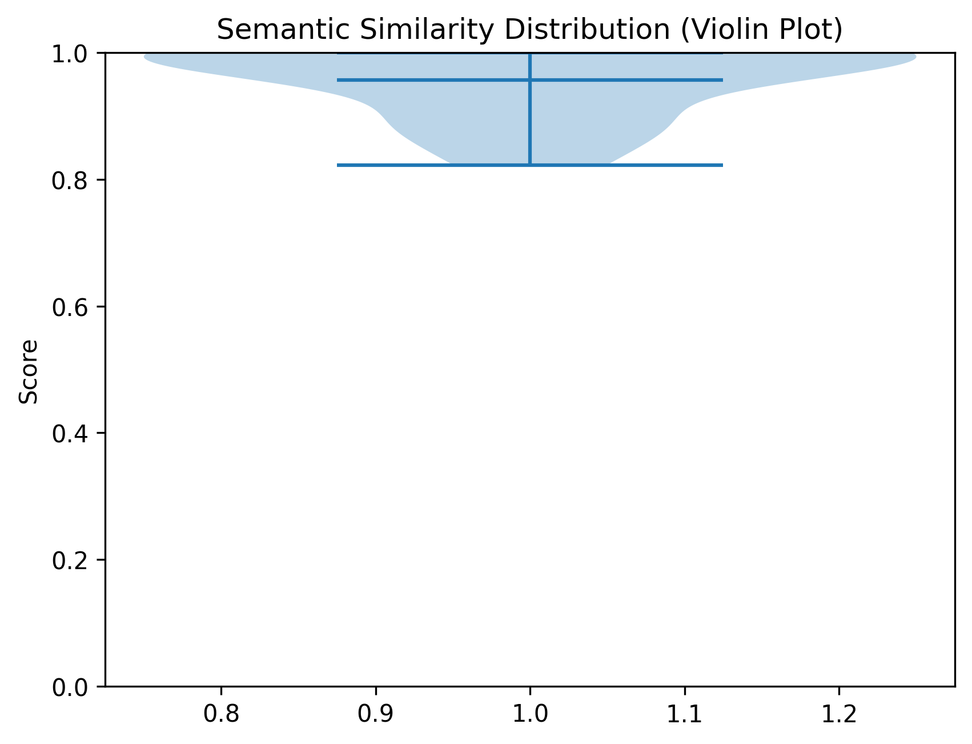
Evaluation Plan
Chatbot RAG System
Evaluated based on accuracy, relevance, safety
Tested using real user scenarios

Slide 22
Results & Challenges
Chatbot RAG System
Results
Accurate integration of:
Patient data + medical knowledge
Reduced hallucination significantly
Stable multi-mode chatbot (patient / general)
Challenges
Hallucination of patient data
Irrelevant retrieval results
Current Status
Chatbot working

Slide 23
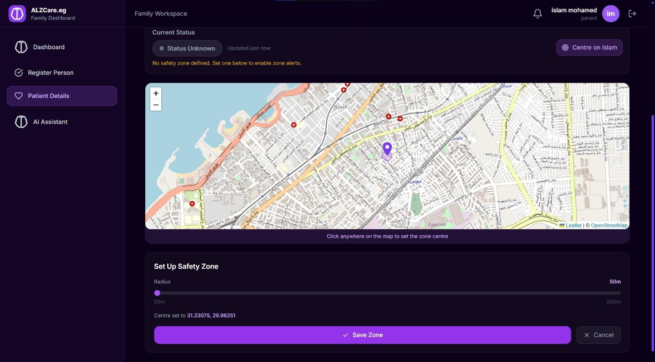
Methodology
Location Tracking
Collects patient GPS coordinates using the Geolocation API.
Stores location data in MongoDB.
Uses Geolib to monitor the patient's safety zone.
Sends real-time location updates and alerts to caregivers via Socket.IO.
Tools Used:
React + Leaflet (map visualization)
Nodes.js / Express (API) + Socket.IO.

Slide 24
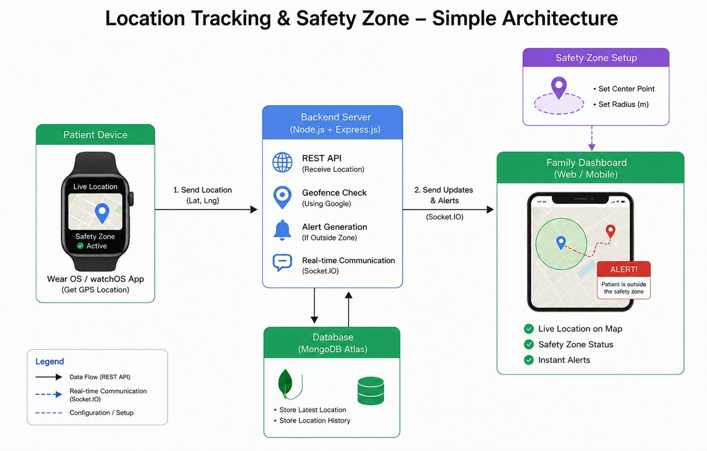
Implementation
Location Tracking
Applied real-time GPS tracking for patient monitoring.
Created a configurable safety zone around the patient.
Continuously checks whether the patient remains within the safe area.
Generates automatic alerts when the patient leaves the safety zone.
Provides caregivers with real-time notifications and monitoring.

Slide 25
Results & Challenges
Location Tracking
Results:
Functional real-time tracking system
Accurate safety zone alerts
Reliable location monitoring
Challenges:
GPS accuracy variations
Maintaining stable real-time updates
Contribution to Goal:
Enhances patient safety
Provides reliable monitoring for caregivers

Slide 26
Evaluation Plan
Location Tracking
Tested location tracking under different movement scenarios
Verified geofence alert generation
Evaluated real-time update performance
Impact of Evaluation:
Improved tracking reliability
Enhanced system stability

Slide 27
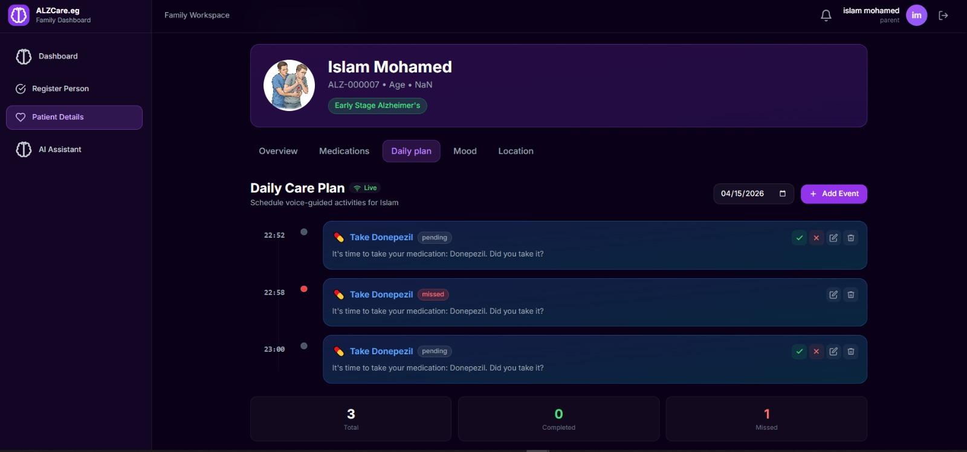
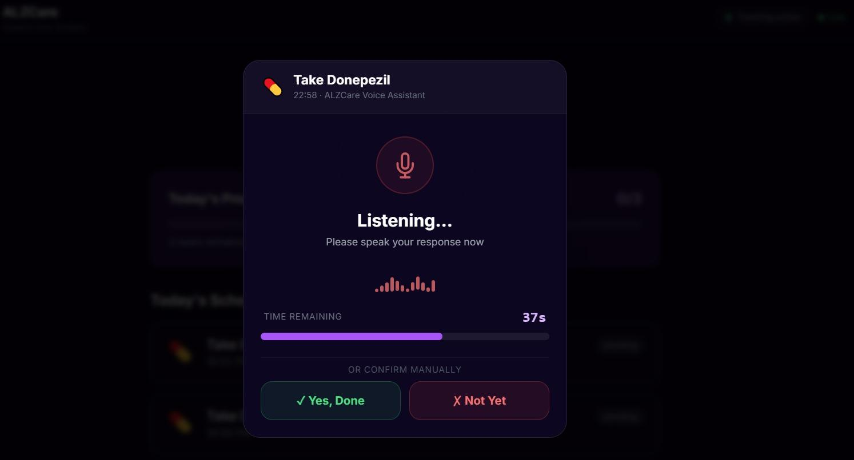
Methodology
Medication reminder & Daily Plan
Voice-based medication reminder system.
Uses Speech-to-Text (STT) for patient responses.
Hybrid approach: Rule-Based Logic + LLaMA-3 AI.
Pipeline: Voice → Analysis → Decision → Action.
Designed for reliable and safe decision-making.
Tools Used:
React, Node.js, FastAPI,Socket.IO

Slide 28
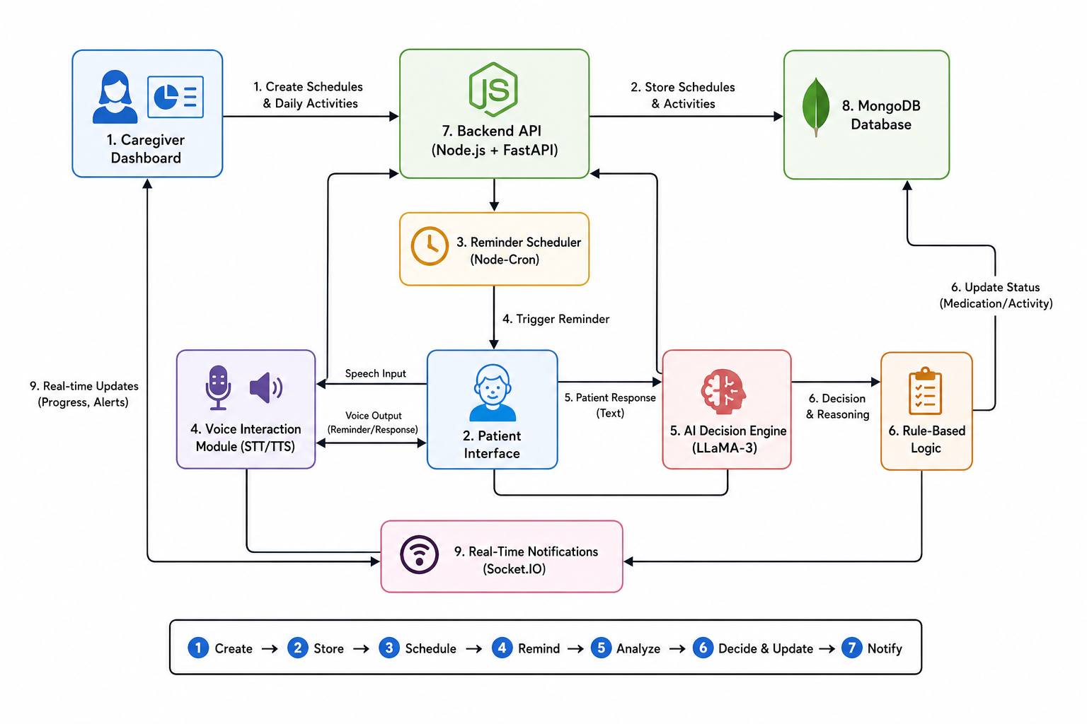
Implementation
Medication reminder & Daily Plan
Family schedules medication reminders and daily events.
Patients respond using voice interaction.
Responses are converted to text and analyzed.
Rule engine handles most decisions.
LLaMA-3 supports intent detection when needed.
Results are updated and shared in real time.

Slide 29
Results & Challenges
Medication reminder & Daily Plan
Results
Accurate voice-to-action processing.
Reliable intent detection.
Real-time synchronization between users.
Challenges
STT (speech recognition) errors
Ambiguous patient responses
Current Status
System is fully functional and integrated

Slide 30
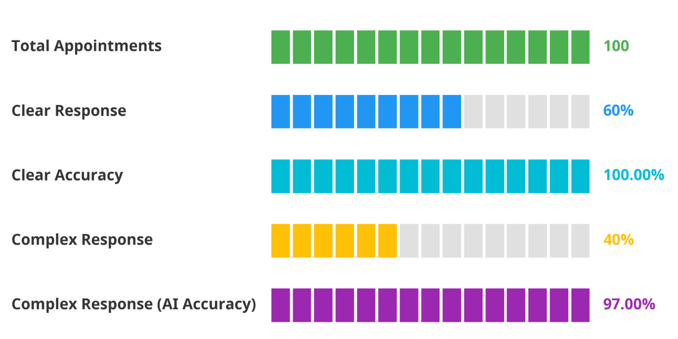
Evaluation Plan
Medication reminder & Daily Plan
Tested with real voice interaction scenarios.
Evaluated confirm, deny, and unclear responses.
Compared system decisions with expected outcomes.
Improved accuracy and reliability through testing.

Slide 31
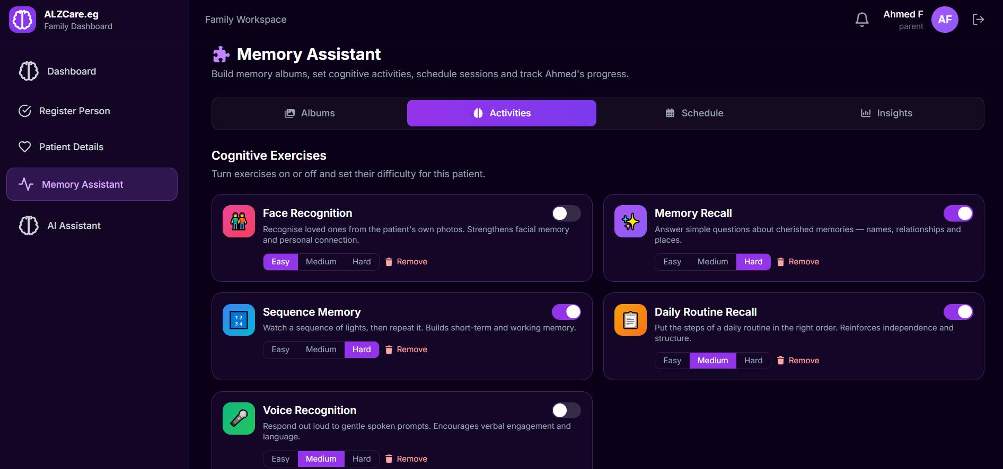
Methodology
Cognitive Exercises
Applied cognitive stimulation techniques for Alzheimer’s patients.
Used Memory Albums to reinforce recognition of familiar people and memories.
Provided personalized exercises for memory, attention, and daily routine skills.
Adapted exercise difficulty and tracked progress based on patient performance.
Tools Used:
React, Node.js, MongoDB, and FastAPI

Slide 32
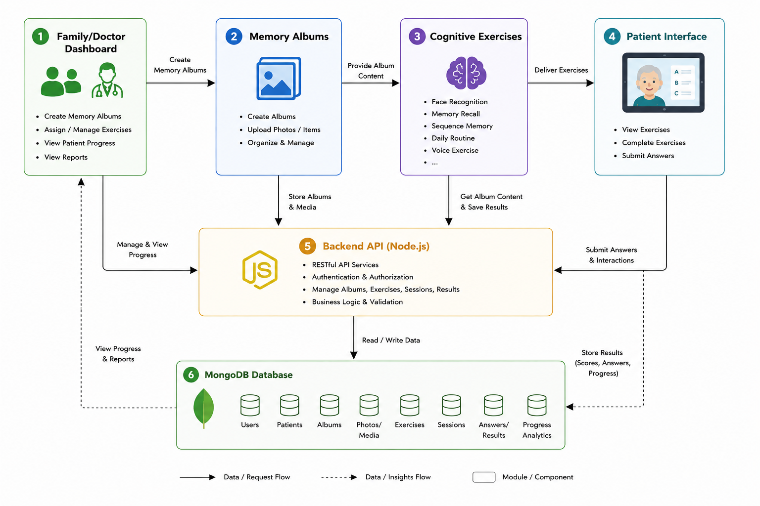
Implementation
Cognitive Exercises
Applied cognitive stimulation therapy to support memory and thinking skills.
Used Memory Albums to help patients recall familiar people and past experiences.
Included personalized exercises for memory recall, sequence memory, daily routines, and voice recognition.
Monitored performance and adapted activities based on patient progress.

Slide 33
Results & Challenges
Cognitive Exercises
Results
Improved patient engagement and participation.
Enhanced memory training with personalized exercises.
Enabled continuous tracking of cognitive performance and progress..
Challenges
Supporting different cognitive levels.
Maintaining patient engagement.
Adjusting exercise difficulty.
Current Status
System is fully functional and integrated

Slide 34
Evaluation Plan
Cognitive Exercises
Evaluated completed exercise sessions.
Measured scores, completion rates, and mistakes.
Tracked patient progress over time.
Used analytics to assess engagement and cognitive performance.

Slide 35
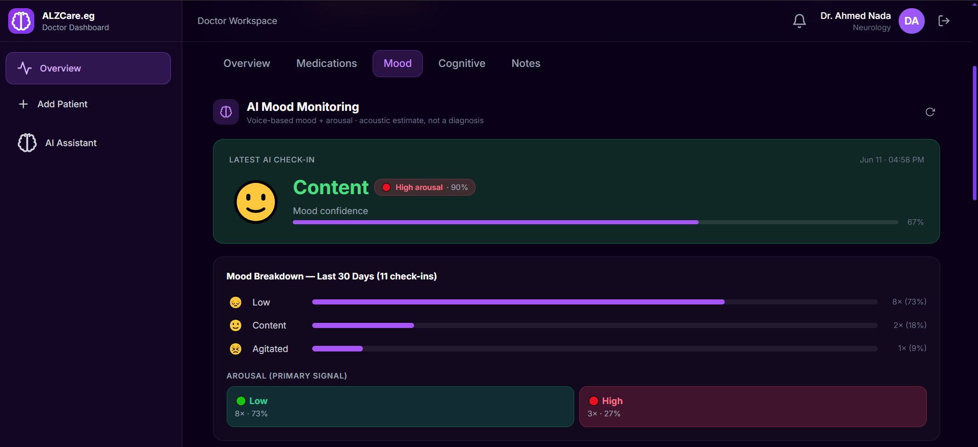
Methodology
Mood Detection
Applied cognitive stimulation techniques for Alzheimer's patients.
Used Memory Albums to reinforce memory recall and recognition.
Included exercises for memory, attention, and daily routine skills.
Tracked patient performance and progress over time.
Tools Used:
Python, PyTorch, WavLM, Hugging Face

Slide 36
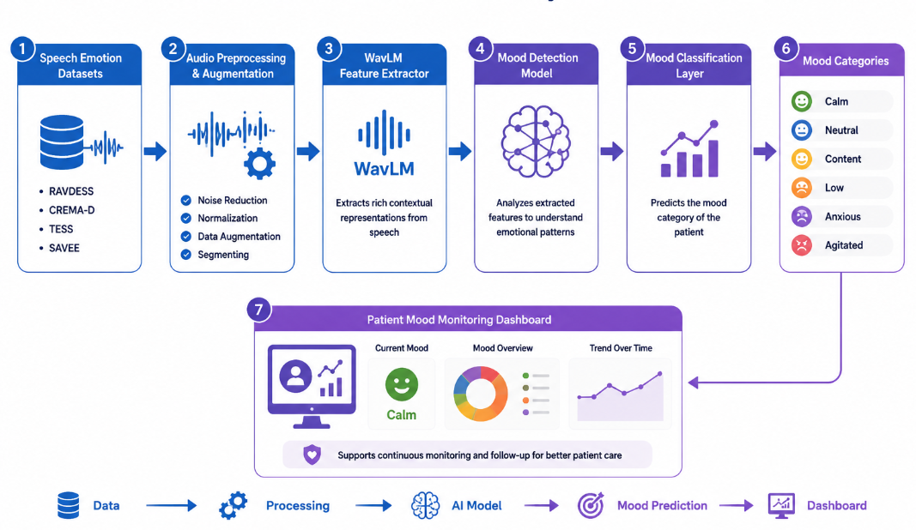
Implementation
Mood Detection
Processed patient speech recordings.
Classified moods into Calm, Neutral, Low, Content, Anxious, and Agitated.
Applied data augmentation to improve performance.
Added confidence-based prediction for reliable results.

Slide 37
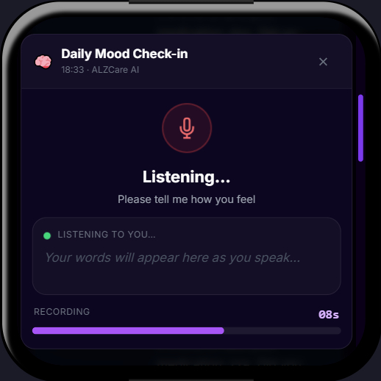
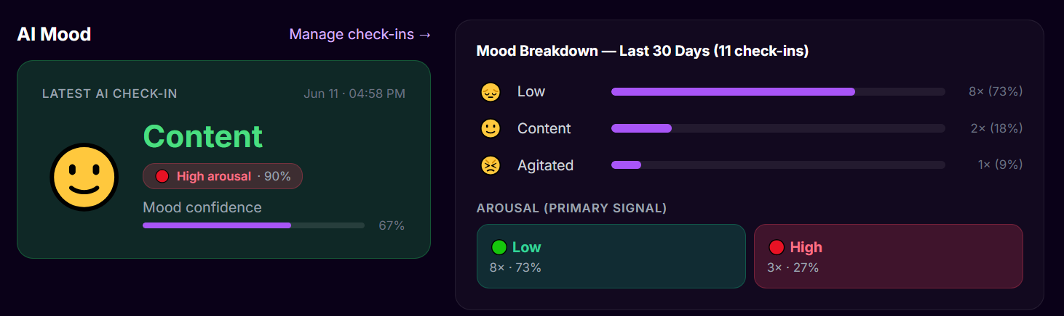
Results & Challenges
Mood Detection
Results
Successfully detected mood from speech.
Improved prediction accuracy using WavLM.
Enabled automatic mood monitoring.
Challenges
Different speech qualities and accents.
Class imbalance in datasets.
Handling uncertain predictions.
Current Status
System is fully functional and integrated.

Slide 38
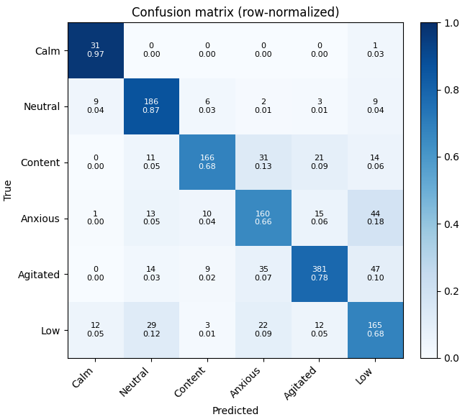
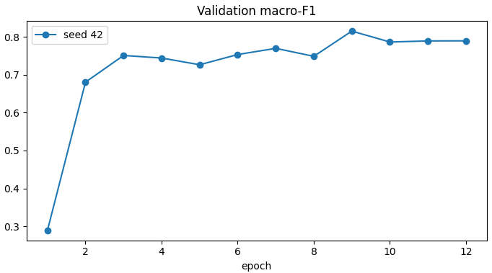
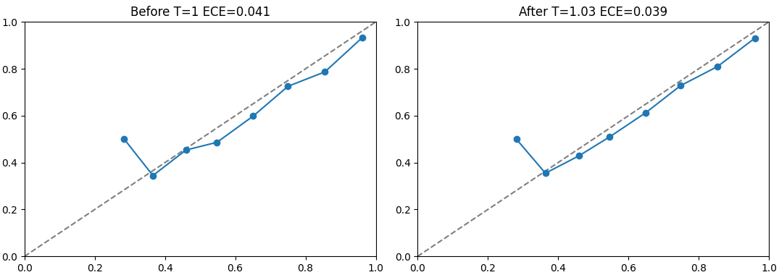
Evaluation Plan
Mood Detection
Evaluated model performance using classification metrics.
Measured Accuracy, Precision, Recall, and F1-Score.
Used Confusion Matrix for prediction analysis.
Assessed prediction confidence and reliability.

Slide 39
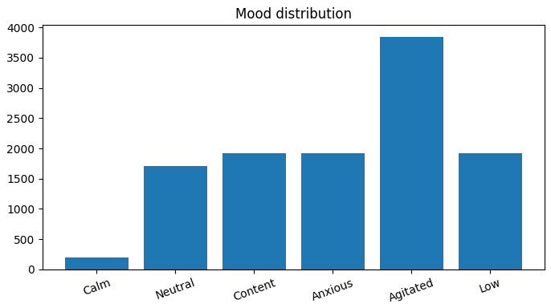
Dataset
Emotion Detection System
Dataset Source
RAVDESS, CREMA-D, TESS, SAVEE
Dataset Type
Labeled speech emotion recordings
Audio Processing
WavLM feature extraction
Audio preprocessing & augmentation

Slide 40
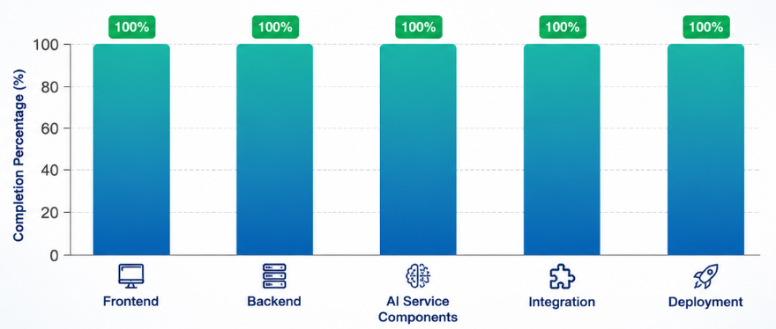
Project Component

Slide 41
References
https://arxiv.org/abs/2006.11477
https://journals.plos.org/plosone/article?id=10.1371/journal.pone.0196391
https://sail.usc.edu/iemocap/
https://huggingface.co/superb

Slide 42
Thank you

