Slide 1
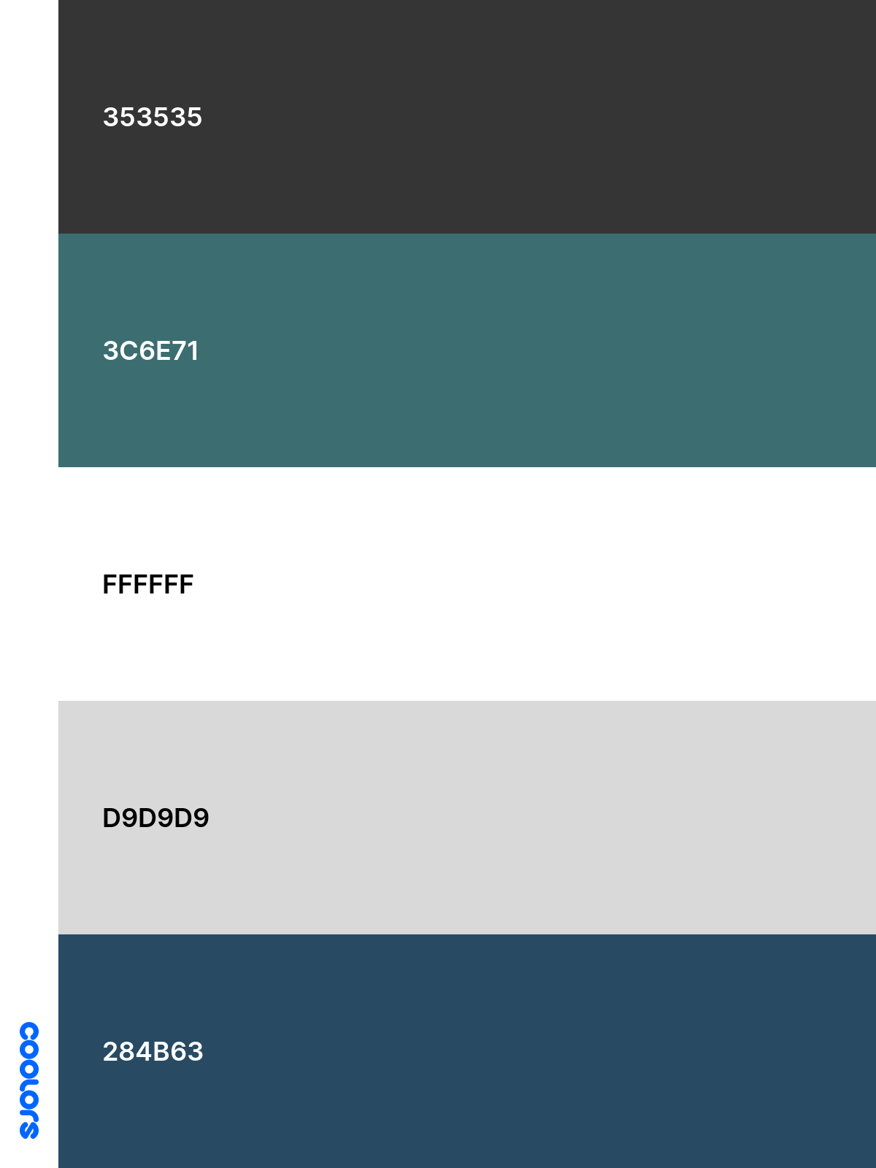
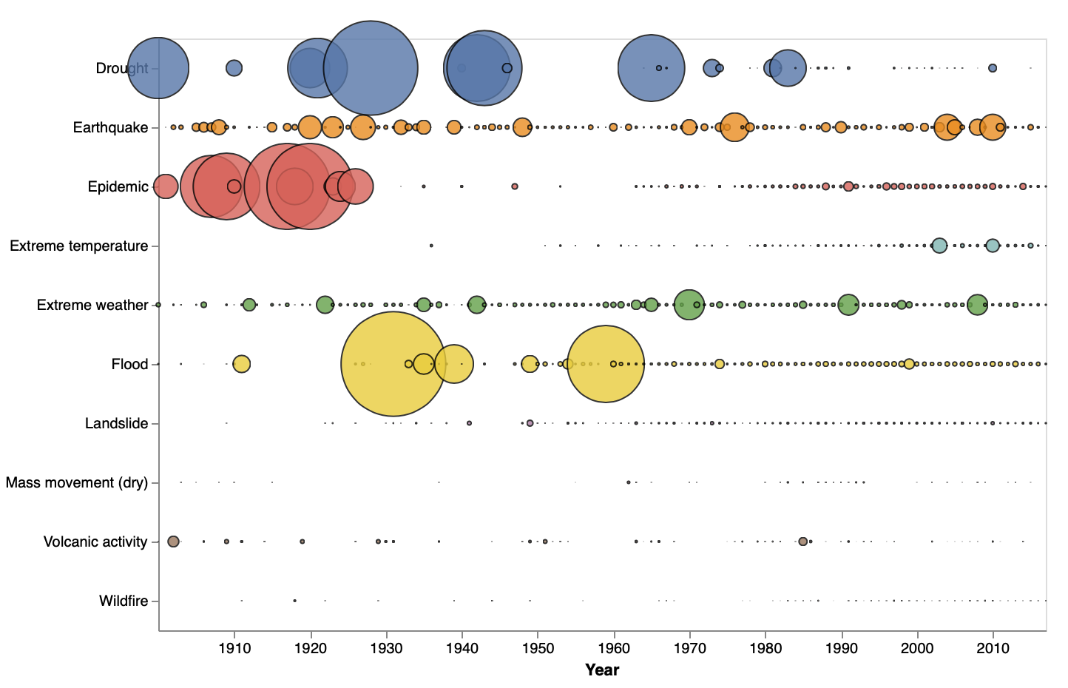
Natural Disasters and Their Effects
Body Body Body Body Body Body Body Body Body Body Body Body Body Body Body Body Body Body Body Body
Body Body Body Body Body Body Body Body Body Body Body Body Body Body Body Body Body Body Body Body
Body Body Body Body Body Body Body Body Body Body Body Body Body Body Body Body Body Body Body Body,
Occurrences of Natural Disasters
Radial chart (count of disasters per continent)
WORLD MAP OF ALL NATURAL DISASTERS
WORLD MAP OF HYDROLOGEICAL NATURAL DISASTERS
WORLD MAP OF GEOLOGICAL NATURAL DISASTERS
Body Body Body Body Body Body Body Body Body Body Body Body Body Body Body Body Body Body Body Body
Body Body Body Body Body Body Body Body Body Body Body Body Body Body Body Body Body Body Body Body
Body Body Body Body Body Body Body Body Body Body Body Body Body Body Body Body Body Body Body Body,
Effect of Natural Disasters
Proportional Global Map of deaths per country
Deaths caused by the top 4 occurring subgroups of natural disasters
Financial Damage caused by the top 4 occurring subgroups of natural disasters
Body Body Body Body Body Body Body Body Body Body Body Body Body Body Body Body Body Body Body Body Body Body Body Body Body Body Body
Body Body Body Body Body Body Body Body Body Body Body Body Body Body Body Body Body Body Body Body Body Body Body Body Body Body Body
Observable Patterns
Subgroup vs Year Vs Deaths
(Bubble Plot)
CPI vs Number of Deaths
(Scatter plot)
Body Body Body Body Body Body Body Body Body Body Body Body Body Body Body Body Body Body Body Body Body Body Body Body Body Body Body
Body Body Body Body Body Body Body Body Body Body Body Body Body Body Body Body Body Body Body Body Body Body Body Body Body Body Body

