Slide 1
Multiprogramming Concepts in Algorithm Analysis
Thread Safety, Bugs, and Solutions in ctrlSortingComparisson
Generated Presentation

Slide 2
Problem Definition
Goal: Analyze the thread safety of the 'Compare' button in ctrlSortingComparisson.
Issue: Concurrent execution of sorting algorithms using Task.Run causes bugs.
- Both threads share a static global 'OnSwap' event.
- Cross-thread operations update WinForms UI controls directly.
- Tasks continue executing even after the control is closed (Back Button Bug).

Slide 3
Current Architecture & Components
Components:
1. UI Layer (ctrlSortingComparisson): Starts 2 tasks, hosts 2 visualizers.
2. Tasks (Task.Run): Parallel threads running sorting algorithms.
3. Logic Layer (Sorting.cs): Static class holding the sorting logic.
4. Shared Resource: Static event 'OnSwap'.
Flaw: The static event acts as a bottleneck and shared mutable state. Both threads invoke the exact same multicast delegate, causing them to execute UI updates meant for the other thread.

Slide 4
Dry Run: The Current Bugs
Step 1: User clicks Compare. Two Tasks start sorting concurrently.
Step 2: Thread A and Thread B both subscribe to static Sorting.OnSwap.
Step 3: Thread A performs a swap and invokes Sorting.OnSwap.
Step 4: Both visualizers receive the event. Thread A executes UI update for Visualizer 2 (Cross-thread Exception).
Step 5: User clicks 'Back'. UserControl is disposed.
Step 6: Tasks keep running, invoke OnSwap, try to update disposed Visualizers -> FATAL CRASH.

Slide 5
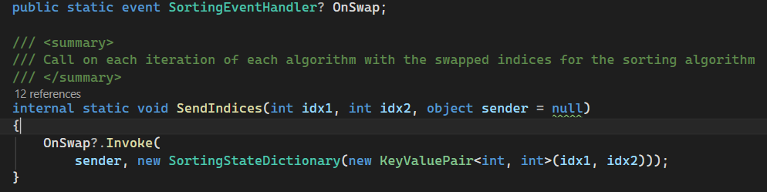
Bug Demonstration 1
Diagram/Explanation:
Bug 1: Thread A starts sorting. The UI freezes because UI updates aren't marshalled.
This happens because the static OnSwap event does not isolate thread contexts, and UI updates lack proper thread synchronization (no Invoke/lock).

Slide 6
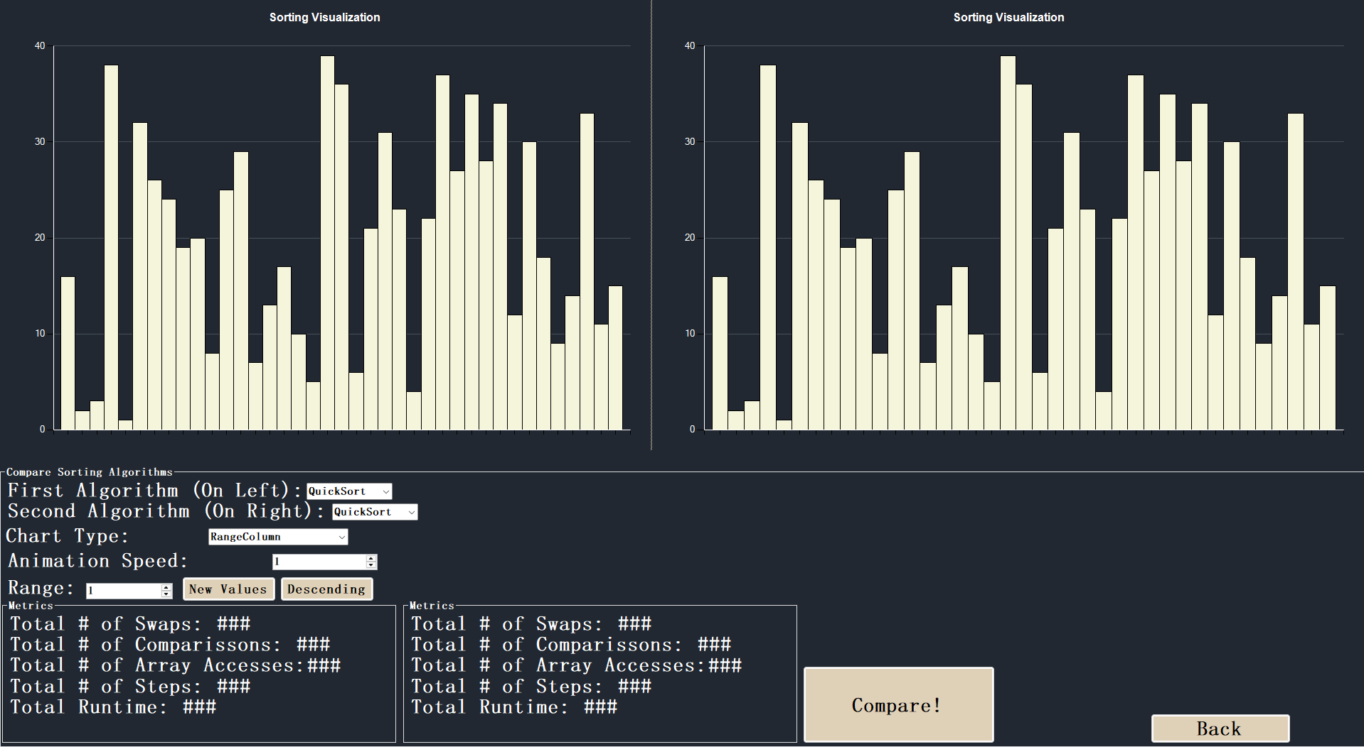
Bug Demonstration 2
Diagram/Explanation:
Bug 2: Thread B fires OnSwap. Static event sends incorrect 'sender'.
This happens because the static OnSwap event does not isolate thread contexts, and UI updates lack proper thread synchronization (no Invoke/lock).

Slide 7
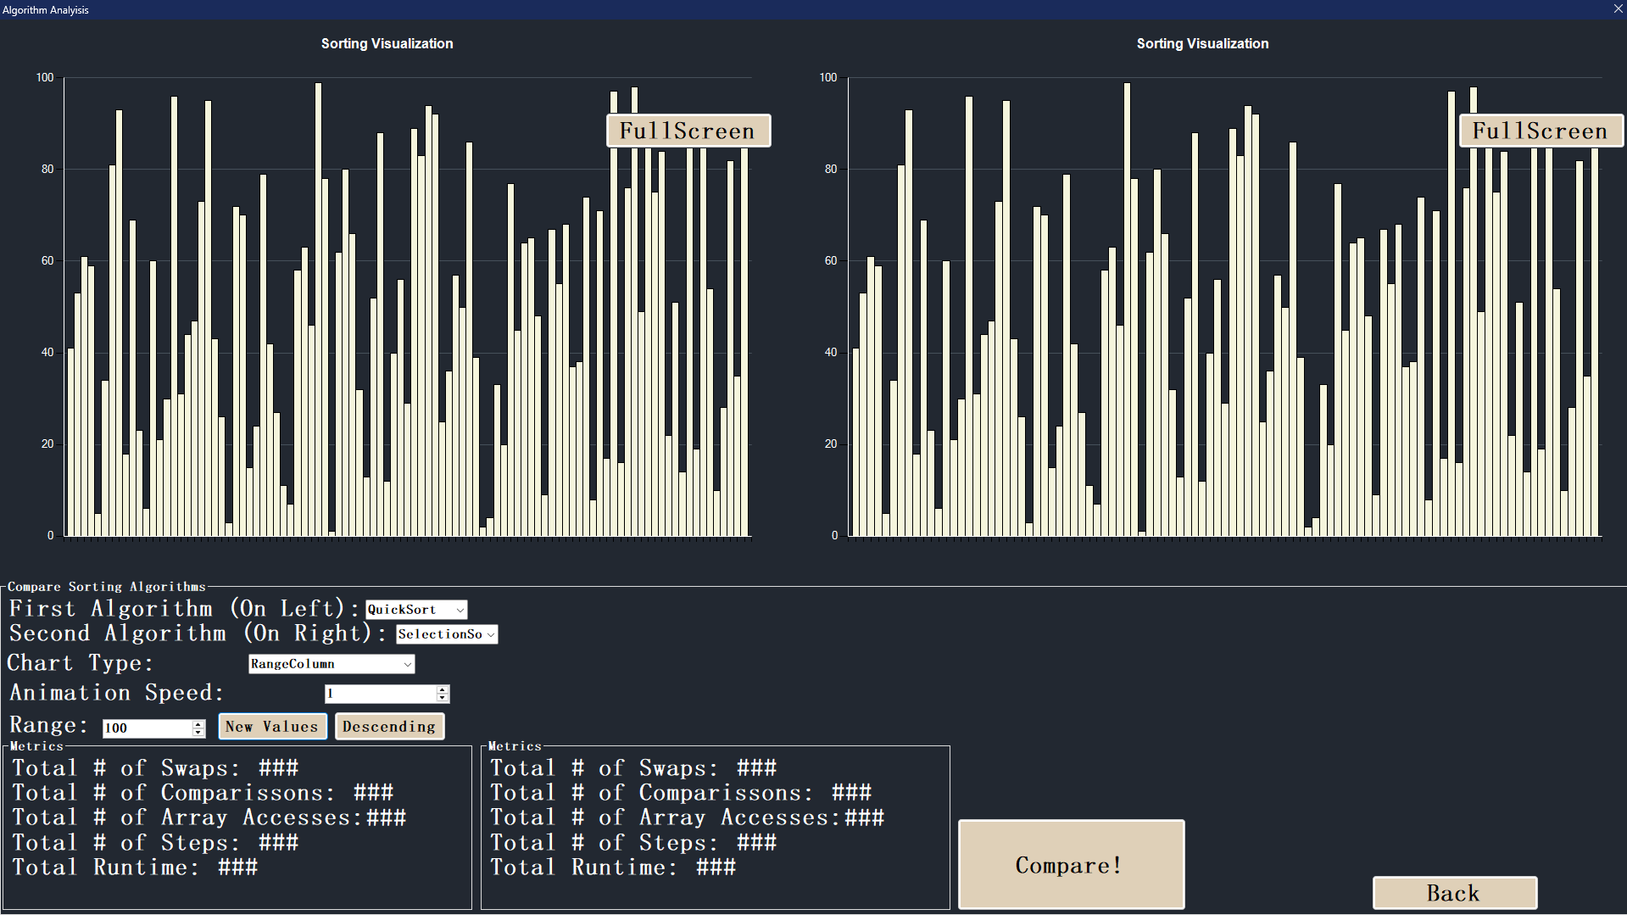
Bug Demonstration 3
Diagram/Explanation:
Bug 3: Visualizer 1 updates with Thread B's data (Data Corruption).
This happens because the static OnSwap event does not isolate thread contexts, and UI updates lack proper thread synchronization (no Invoke/lock).

Slide 8
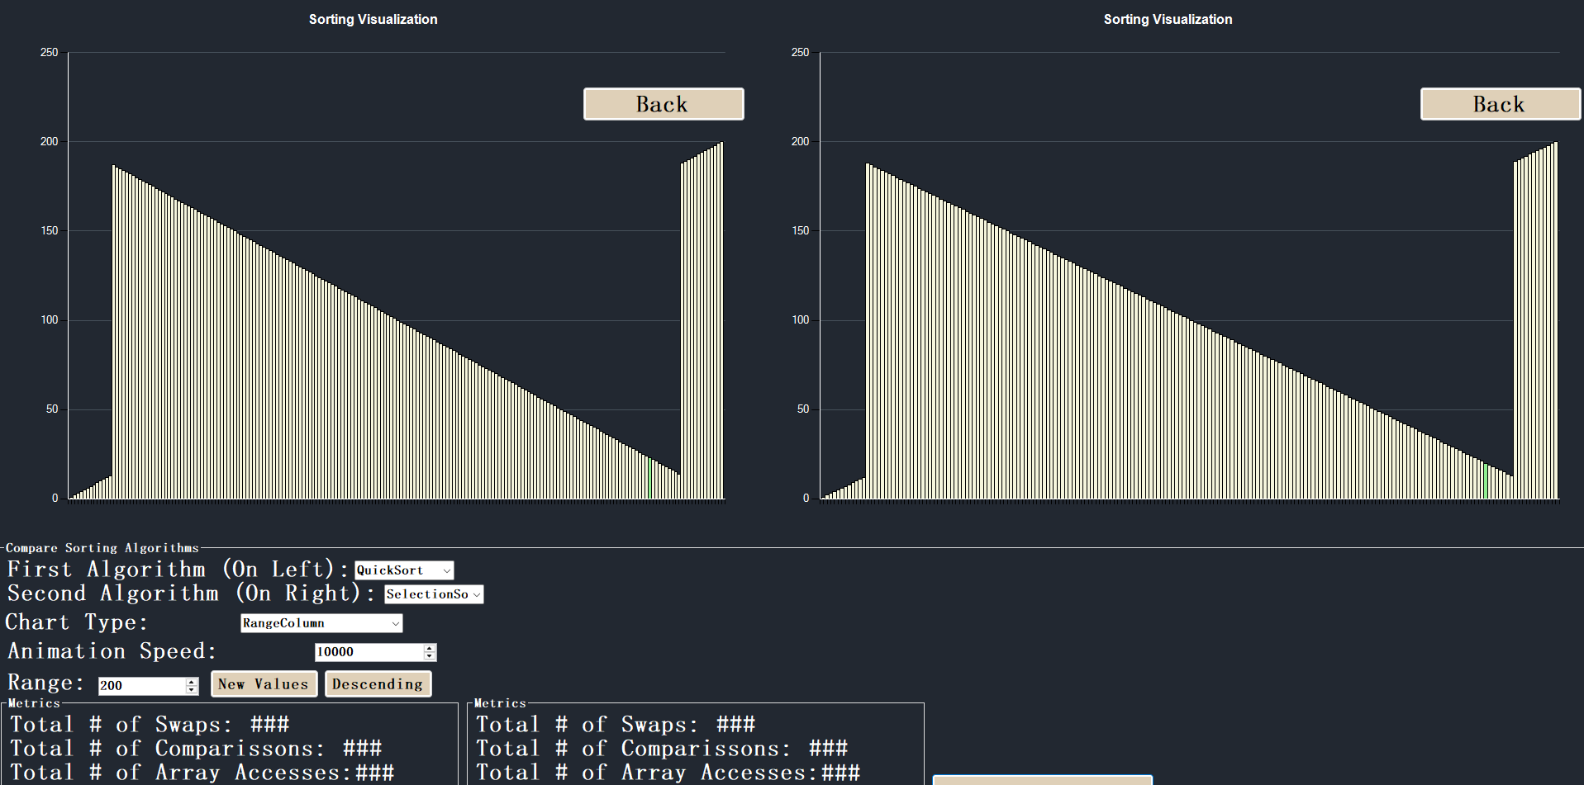
Bug Demonstration 4
Diagram/Explanation:
Bug 4: Cross-thread operation exception thrown by WinForms.
This happens because the static OnSwap event does not isolate thread contexts, and UI updates lack proper thread synchronization (no Invoke/lock).

Slide 9
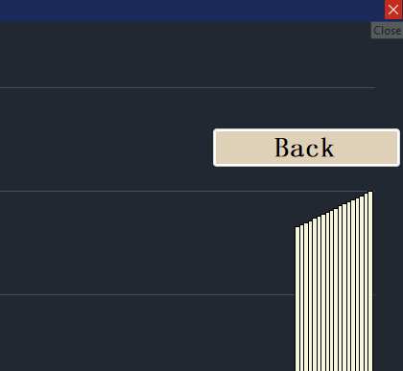
Bug Demonstration 5
Diagram/Explanation:
Bug 5: The Red-X Rendering Error on the Chart due to concurrent modification.
This happens because the static OnSwap event does not isolate thread contexts, and UI updates lack proper thread synchronization (no Invoke/lock).

Slide 10
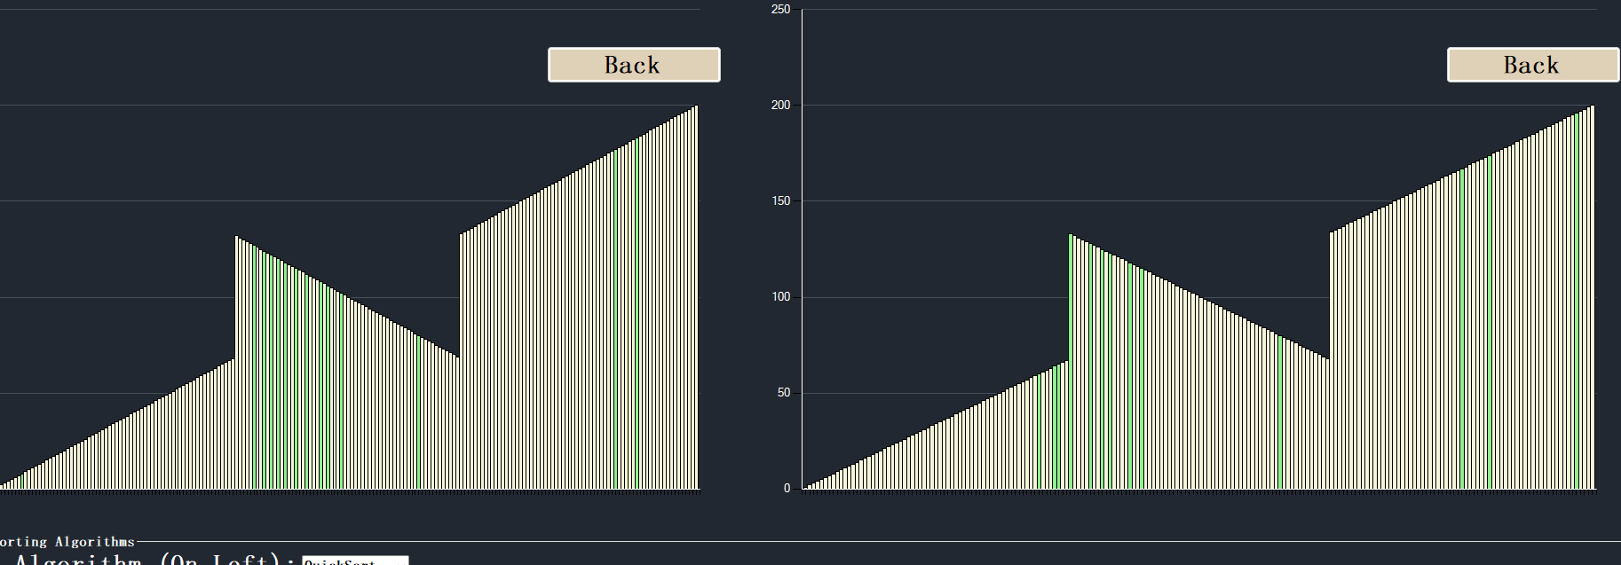
Bug Demonstration 6
Diagram/Explanation:
Bug 6: User attempts to navigate away while sorting is active.
This happens because the static OnSwap event does not isolate thread contexts, and UI updates lack proper thread synchronization (no Invoke/lock).

Slide 11
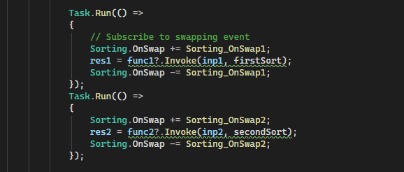
Bug Demonstration 7
Diagram/Explanation:
Bug 7: 'Back' button clicked. UI Control starts disposing.
This happens because the static OnSwap event does not isolate thread contexts, and UI updates lack proper thread synchronization (no Invoke/lock).

Slide 12
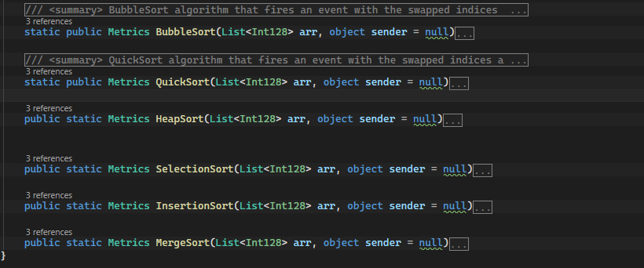
Bug Demonstration 8
Diagram/Explanation:
Bug 8: Background Task A performs a swap.
This happens because the static OnSwap event does not isolate thread contexts, and UI updates lack proper thread synchronization (no Invoke/lock).

Slide 13
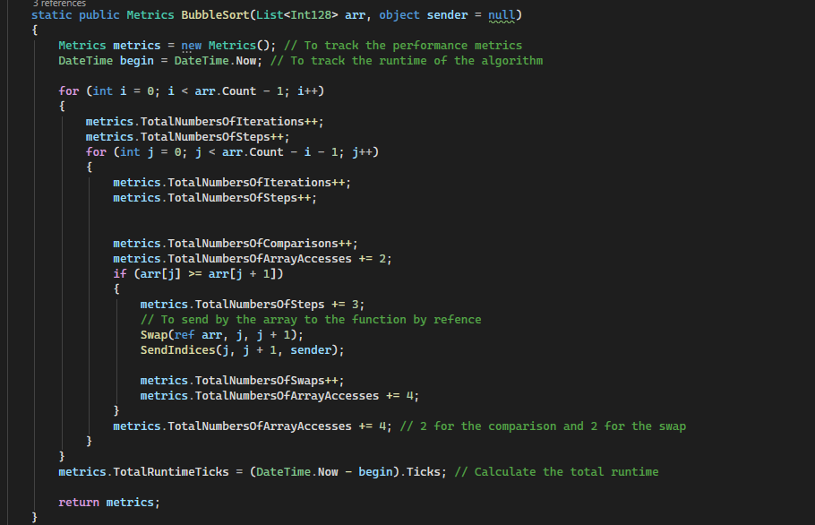
Bug Demonstration 9
Diagram/Explanation:
Bug 9: Task A invokes OnSwap event on disposed Visualizer 1.
This happens because the static OnSwap event does not isolate thread contexts, and UI updates lack proper thread synchronization (no Invoke/lock).

Slide 14
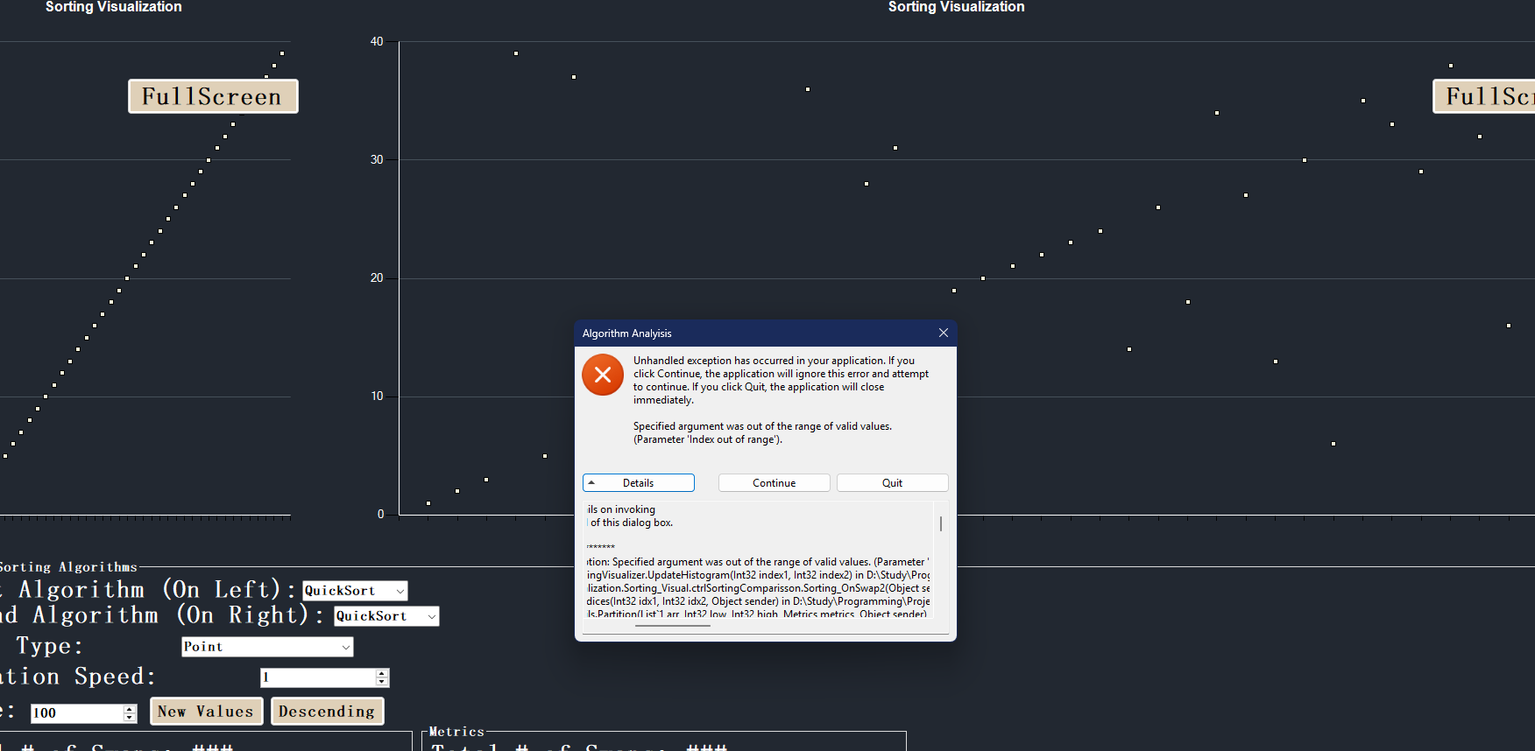
Bug Demonstration 10
Diagram/Explanation:
Bug 10: NullReferenceException or ObjectDisposedException.
This happens because the static OnSwap event does not isolate thread contexts, and UI updates lack proper thread synchronization (no Invoke/lock).

Slide 15
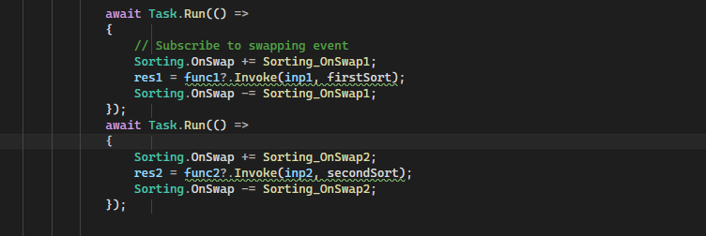
Bug Demonstration 11
Diagram/Explanation:
Bug 11: Application completely crashes.
This happens because the static OnSwap event does not isolate thread contexts, and UI updates lack proper thread synchronization (no Invoke/lock).

Slide 16
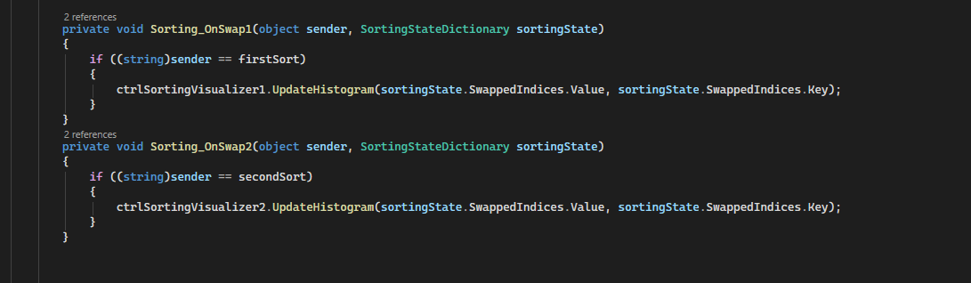
Bug Demonstration 12
Diagram/Explanation:
Bug 12: Stack trace confirming the cross-thread violation in OnSwap.
This happens because the static OnSwap event does not isolate thread contexts, and UI updates lack proper thread synchronization (no Invoke/lock).

Slide 17
Solution 1: Multiple Publisher Objects
Concept: Eliminate static shared state.
Implementation:
- Instead of a static Sorting class, instantiate a new SortingVisualizerPublisher for each thread.
- Thread 1 subscribes to Publisher1.OnSwap.
- Thread 2 subscribes to Publisher2.OnSwap.
Result: Zero cross-talk. No need to filter by 'sender'. Events are cleanly isolated per thread.

Slide 18
Dry Run: Solution 1 Flow
Step 1: User clicks Compare. UI instantiates Publisher1 and Publisher2.
Step 2: Task A uses Publisher1; Task B uses Publisher2.
Step 3: Task A performs a swap and invokes Publisher1.OnSwap.
Step 4: Only Visualizer 1 receives the event (Isolated Context).
Step 5: No cross-thread interference. UI must still use 'Invoke' for safety.

Slide 19
Solution 2: Sync Using Await & IProgress
Concept: Modern async/await pattern with synchronization contexts.
Implementation:
- Make the click handler 'async void'.
- Use Task.Run internally but pass an IProgress<T> object.
- Sorting algorithms call progress.Report(swapData).
- Await Task.WhenAll(sort1, sort2).
Result: IProgress automatically marshals the UI update back to the Main Thread! Solves cross-thread exceptions inherently. Allows passing a CancellationToken to fix the Back Button bug.

Slide 20
Dry Run: Solution 2 Flow
Step 1: User clicks Compare. UI creates CancellationTokenSource and IProgress.
Step 2: Task A and B start with await Task.Run.
Step 3: Task A performs swap -> progress.Report(indices).
Step 4: IProgress posts the update to the Main UI Thread safely.
Step 5: User clicks Back -> CancellationToken.Cancel() is called.
Step 6: Tasks cleanly abort. No disposed object exceptions!

