Slide 1
BFCAI LIBRARY
TEAM MEMBERS:
1. Ahmed Nasser Emam 4.Eslam Ahmed Lotfy
2. Eslam Hany Zoghla 5.Esraa Mohamed Salem
3. Ashraf Hamed Abdallah 6. Alaa Abdelmaksoud Mohamed

Slide 2
PROJEC OVERVIEW
This system helps the librarian in managing the library and converting it to the digital system. It provides some features, for example, adding books to the database and modifying them, or searching for a book request from the student, controlling and managing students and adding them to the database.

Slide 3
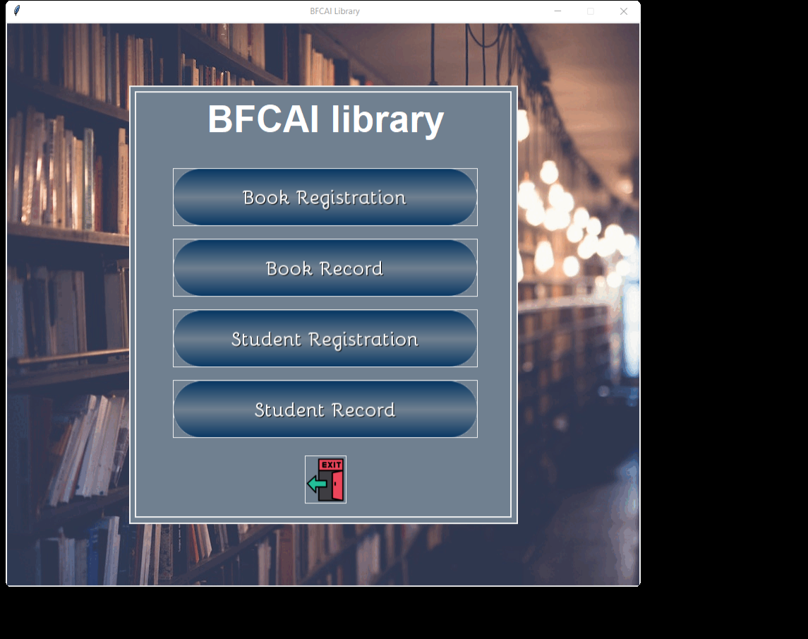
This is first frame of a project
Its content 4 buttons each button leads to his screen
And finally Exit button

Slide 4
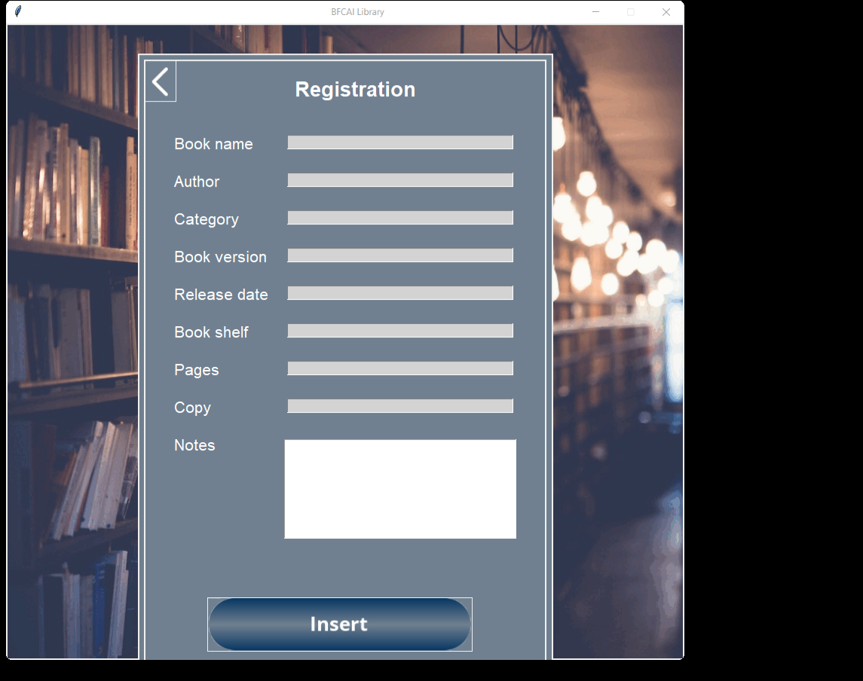
This frame gather information about the book ,and added it to database by click ‘Insert’

Slide 5
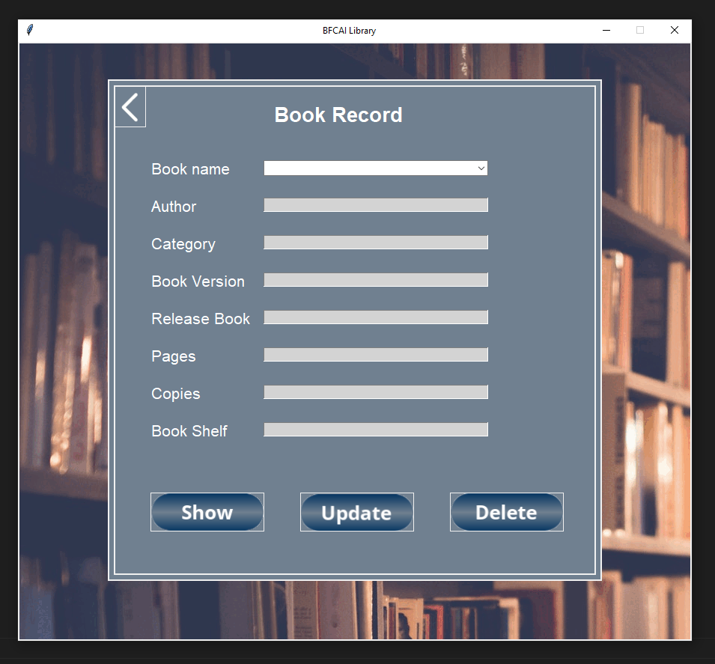
This frame used when i need to show, search, update or delete specific book from database

Slide 6
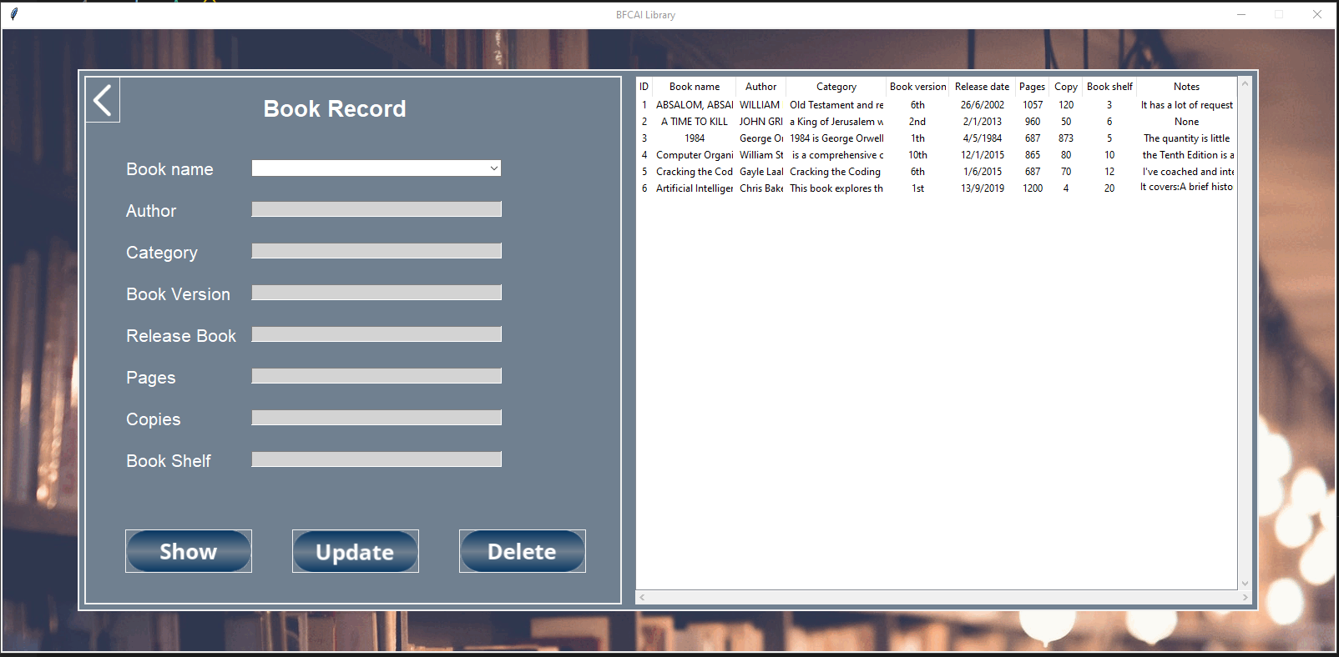

Slide 7
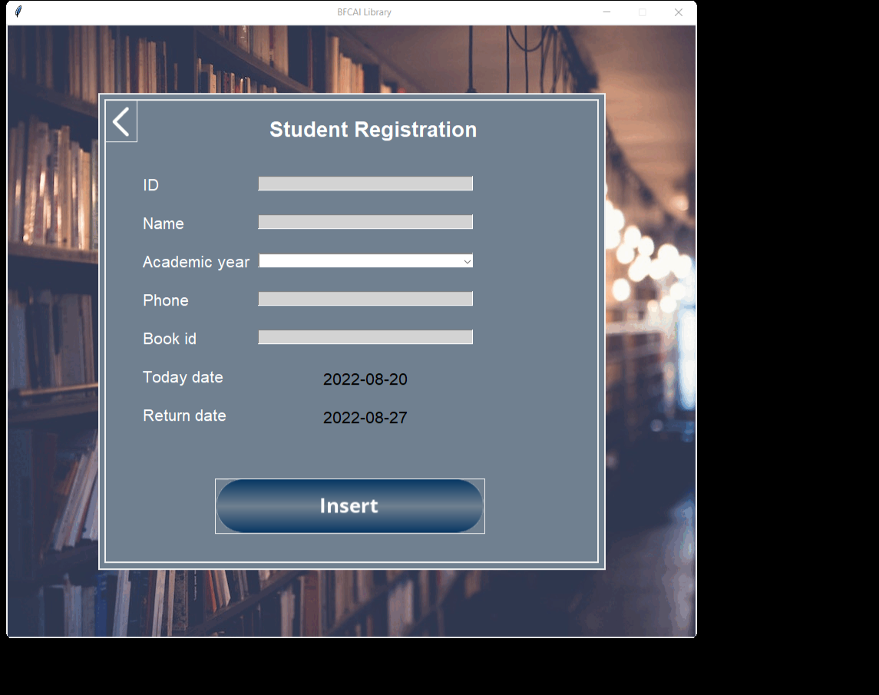
This frame gather information about student ,and added it to database by click ‘Insert’
Registration date and return date added by default

Slide 8
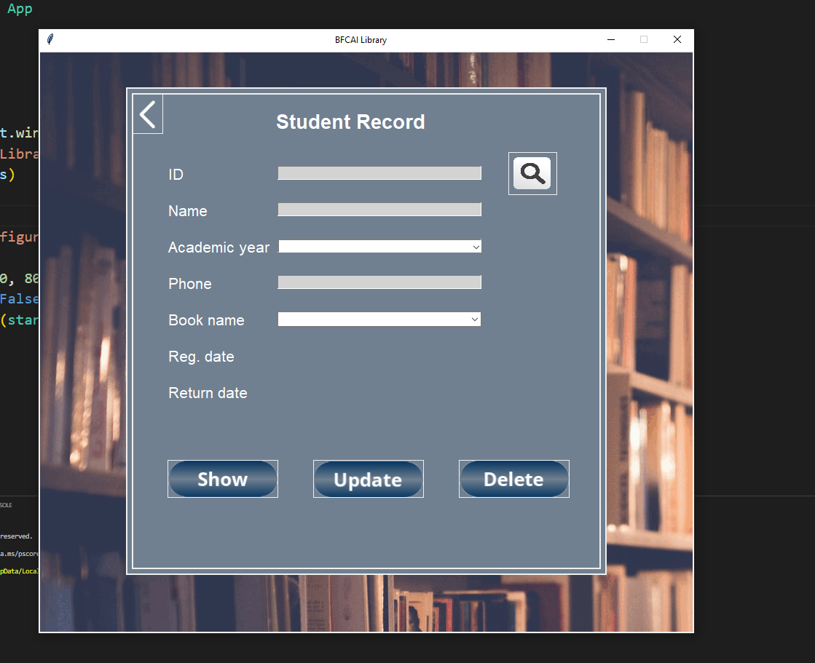
This frame used when i need to show, search, update or delete specific student from database

Slide 9
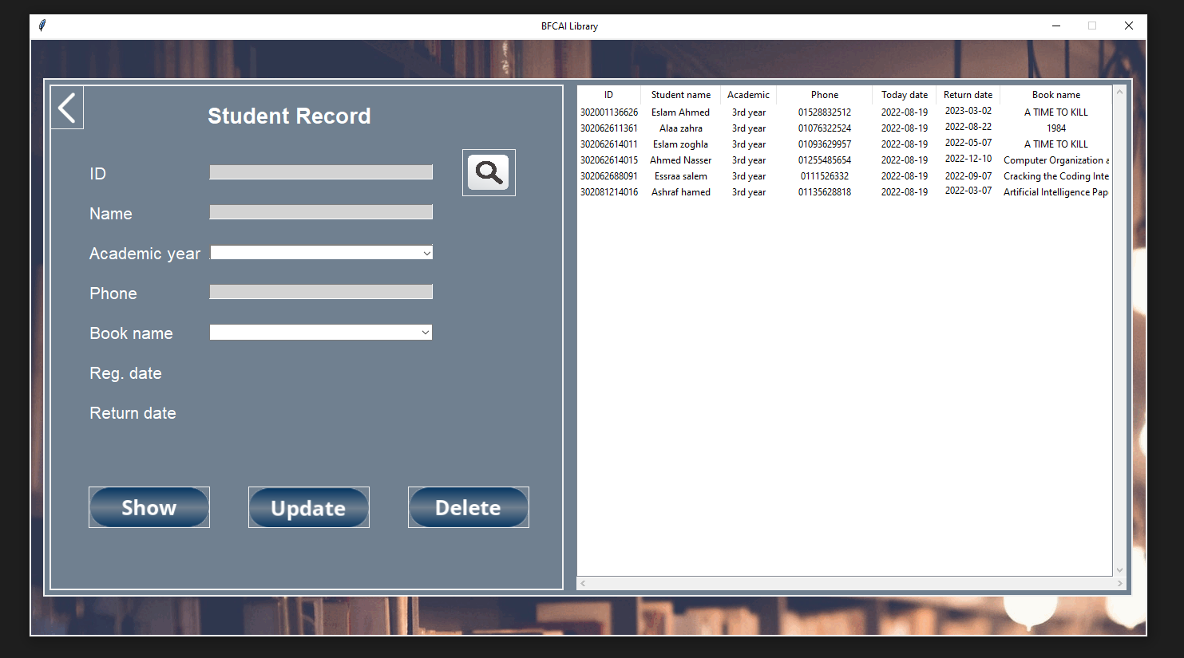

Slide 10
Thank You

