Slide 1
Fantasy Premier league
April 24, 2020

Slide 2
Overview
With over 6 million players
Fantasy Premier League is the biggest Fantasy Football game in the world.
It’s FREE to play and you can win great prizes!

Slide 3
Understanding the problem
Rules
Challenges
Constraints
How to win?
Problem statement
Why?
*v *

Slide 4
Progress

Slide 5
Adding new features
In the previous milestone we have trained our model using two groups of features which describing :
The current form of the player.
The difficulty of the current gameweek.

Slide 6
Adding new features
In this milestone we have trained our model using another two groups of features which describing :
The performance of the player in general.
The difficulty of the future 3 gameweeks for this player.

Slide 7
Train more data
In the previous milestone we have trained our model using 2016-2017 season only.
Number of training examples = 1176

Slide 8
Train more data
In this milestone we have trained our model using 3 seasons (2016-17,2017-18,2018-19)
Number of training examples = 3798

Slide 9
Tuning
In the previous milestone we have trained our model using initial number of hidden layers and initial number of units.
3 hidden layers
With (24,36,64) units

Slide 10
Tuning
In this milestone we have tried to tune the number of hidden layers and the number of units as much as possible.
4 hidden layers
With (10,10,10,10) units

Slide 11
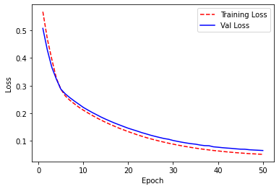
Tuning
Lr = 1e-4

Slide 12
Plots and graphs

Slide 13
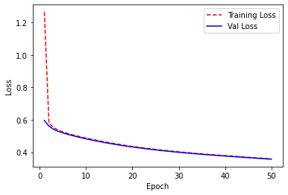
Graphs
Using logarithmic mean square error

Slide 14
Graphs
Using mean square error

Slide 15
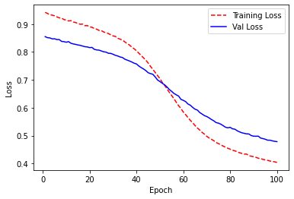
Graphs
Using mean absolute percentage error

Slide 16
Next steps

Slide 17
Next
Step 1
We will try to modify the calculate score function which we use to get the ground truth.
details:
We can build a NN to get the score function.
But we need to look about users who get high ranks every gameweek.
Step 2
Testing our model against the current season to check our model performance
details:
We have 2019-2020 saeson data till the last played gameweek.
We will compare our top 5 players which are produced from our model to the top players in each week the user can transfer them without violating any constraints.

Slide 18
Split Data
In this milestone we have split our training data into the 4 main positions (Goalkeeper, Defence, Midfield, Attack) to make 4 models one for each position trying to capture better pattern for each position.

Slide 19
Proposed deliverables
Deliverable 1
Initial model, no tuning
Small training data
Deliverable 2
Hyper parameter tuning
More data to train.
Deliverable 3
Try to modify the score function.
Testing the model.

Slide 20
Thanks!

