Slide 1

Final Report: Fantasy Premier League
Ahmed Nasser Abdelkareem
(9)
| |
|----------- -----------|
| |
| |
Abdelrahman Ahmed Mohamed Abdelfattah Omran
(36)

Slide 2

Where machines and humans team up to win at FPL
We want to suggest the best substitutions for the user’s team.

Slide 3
Original model from literature
Note
There is no model from literature.
There is no related work the same as us.

Slide 4
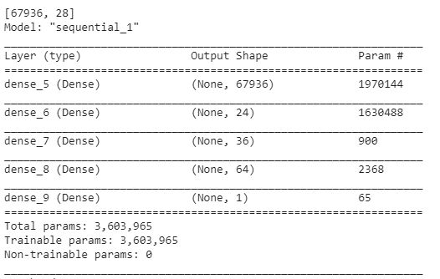
Proposed model architecture
Note
One model for all players.
With random hidden layers and random number of units.

Slide 5
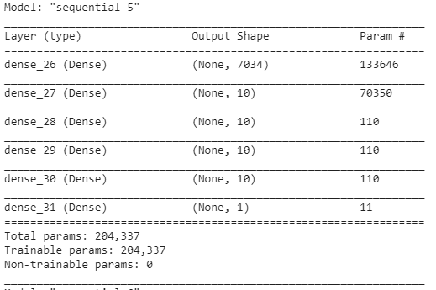
Final model architecture
Note
Goalkeeper Model

Slide 6
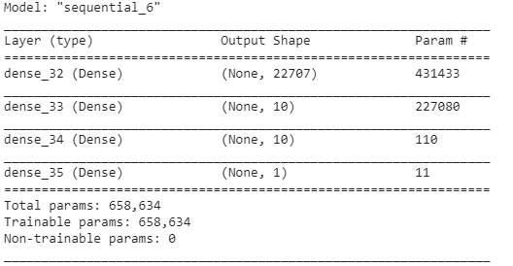
Final model architecture
Note
Defender Model

Slide 7
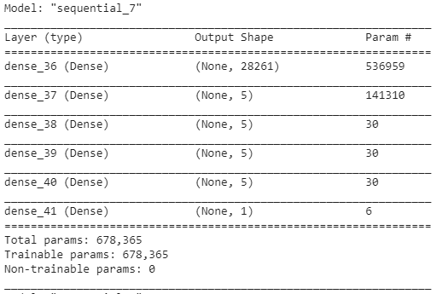
Final model architecture
Note
Midfield Model

Slide 8
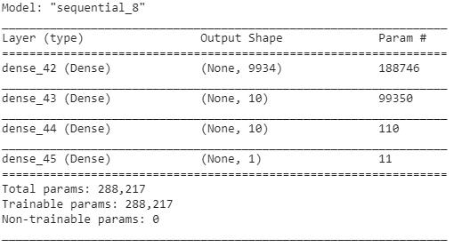
Final model architecture
Note
Stricker Model

Slide 9
Graphs and plots
Optimizer
Adam
Learnin_rate = 0.0001
Loss Function
Mean absolute error

Slide 10
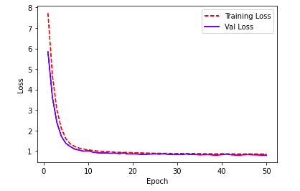
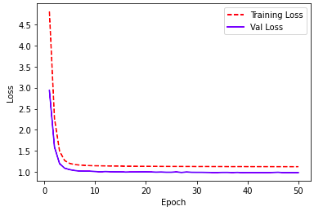
Graphs and plots
GK Model
DF Model

Slide 11
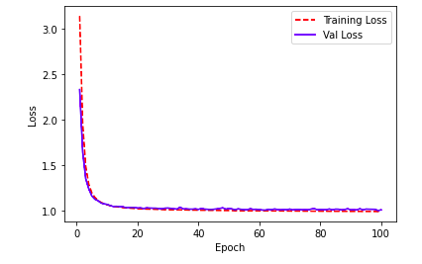
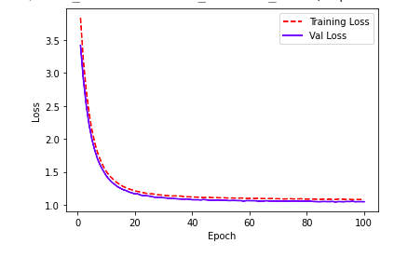
Graphs and plots
MD Model
ST Model

Slide 12
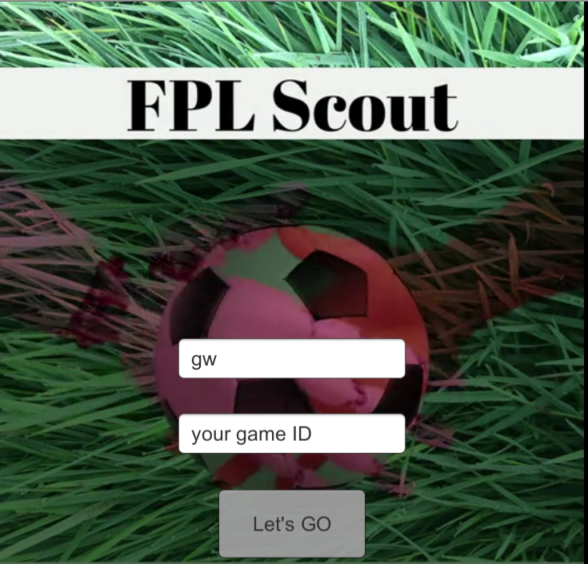

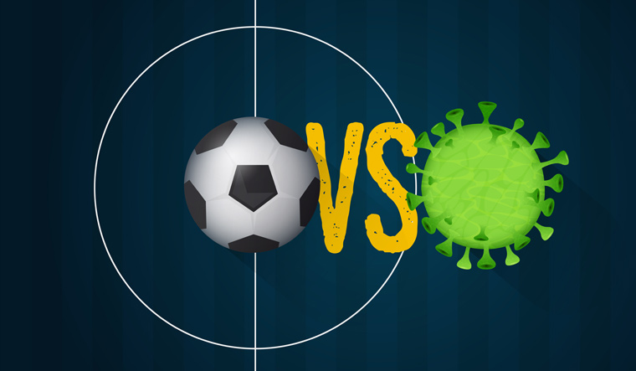
Live Demo
Game !
Completing the process till the end.
Unity game to be published when the PL returns .

Slide 13
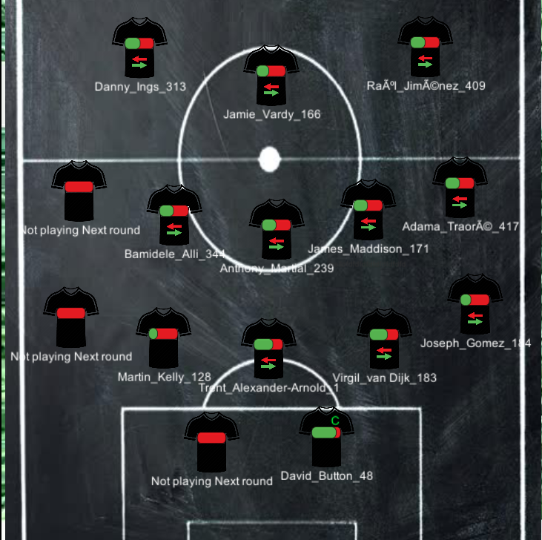
Live Demo
Game !
We get the score of each player in the league .
We send the user the best substitution for each player in team.

Slide 14
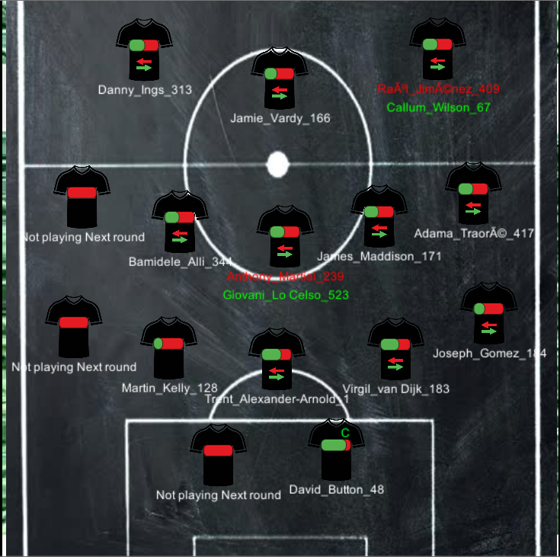
Live Demo
Game !
3. We calculate the ratio between the players in the team and their substitutions :
R = score of the best substitute/the score of the player (the ratio is the green bar)

Slide 15
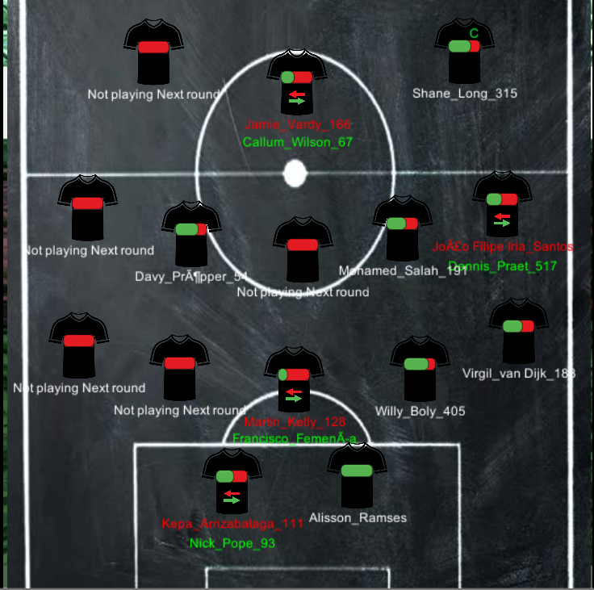
Live Demo
Game !
4. Then we suggest to substitute the highest n ratios
5. Finally we suggest to captain the player with the highest score in the team.

Slide 16
Members contribution
Abdelrahman Omran
Feature extraction.
Creating the base model
Parameter Tuning.
Creating client side part for the game.
Ahmed Nasser
Data preprocessing.
Parameter tuning.
creating to model for each line.
Building the server for the game.

Slide 17
Future Work
Technical
Study the weights of each feature to determine the best Input for each model per position.
Non-Technical
Publish The game.

Slide 18
Conclusion
Lesson 1
Check if the train and test data have the same shape and from the same distribution.
Lesson 2
Study the importance of each features well.

Slide 19
Thanks

