Slide 1

Machine Learning Project
Supervised By: Dr: Ali Hamza Eng. Ahmed Nousir

Slide 2

Agenda :
Introduction.
Projects & tasks.
Data Information, Preparation & Data Cleaning.
Model Building.
Model Evaluation.
Summary.

Slide 3
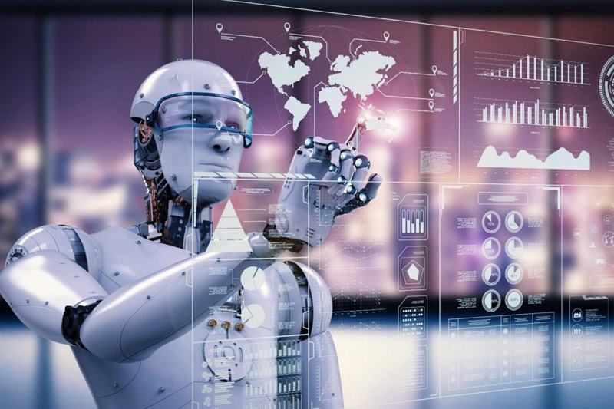
Introduction
Welcome to the exciting world of machine learning! In this presentation, we will explore the journey of a machine learning project, from problem statement to model evaluation and predictions Here we start with understanding the importance of machine learning in the digital age today. We will explore their machine-learning techniques and algorithms and how to apply them in each project.

Slide 4
1
First Project
Projects
Supervised Learning Regression Problem (Structured Dataset)
In this project, your team will work on a structured dataset and apply supervised learning techniques to solve a regression problem.
Second Project
2
Supervised Learning Classification Problem (Structured Dataset) In this project, we worked on a structured dataset and applied supervised learning techniques to solve a Classification problem.
3
Third Project
Unsupervised Learning (Structured Dataset) In this project, we worked on a structured dataset and apply unsupervised learning techniques to solve problem.
Fourth Project
4
Supervised Learning Classification Problem (Unstructured Dataset - Image Dataset) In this project, we worked on an unstructured dataset - image dataset and applied supervised learning techniques to solve a classification problem.

Slide 5
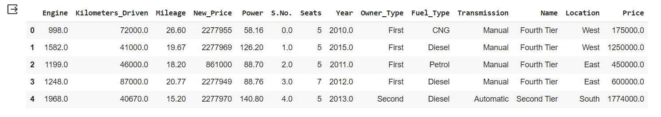
First Project
Supervised Learning Regression Problem (Structured Dataset):
In this project, we worked on a structured dataset and applied supervised learning techniques to solve a Regression problem in this Data.
Definition of the problem:
- The dataset contains information about cars that are distributed into 13 columns.
- The target is to predict the car’s Horsepower value (Power Column) using this information (Columns).

Slide 6
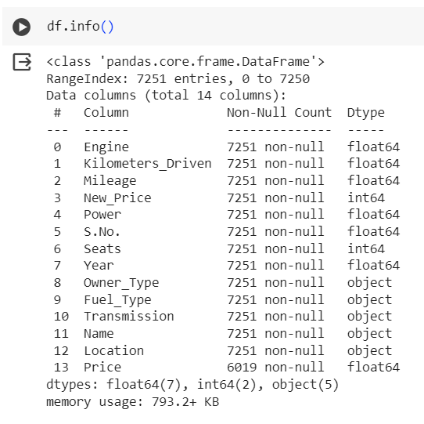
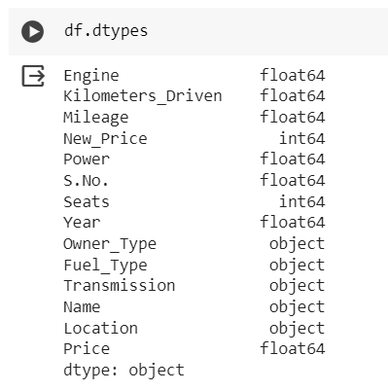
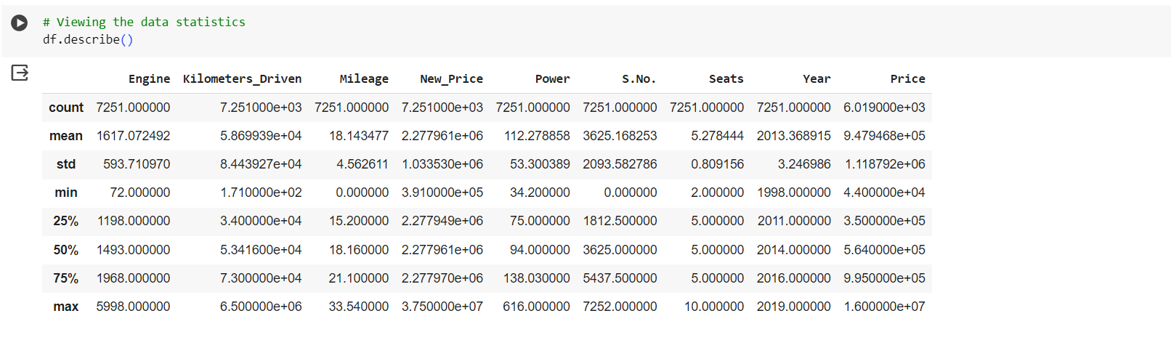
Data Information & Description :

Slide 7
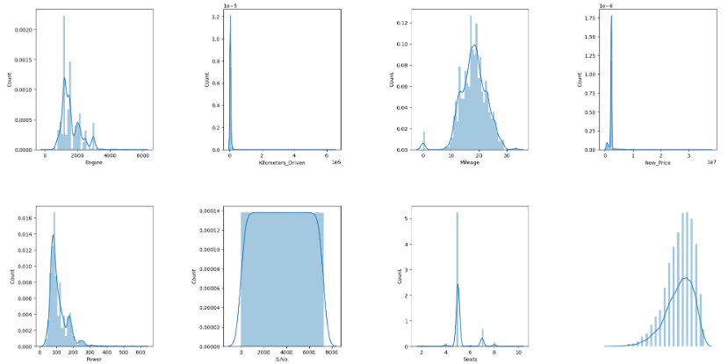
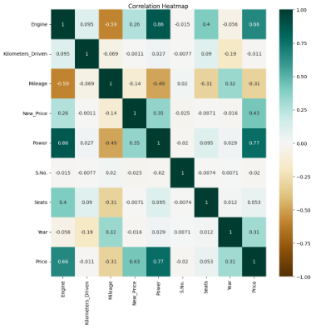
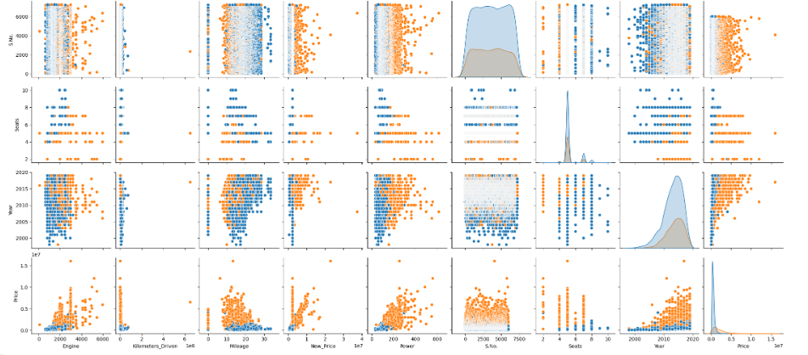
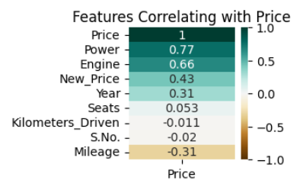
Data Visualizations :

Slide 8
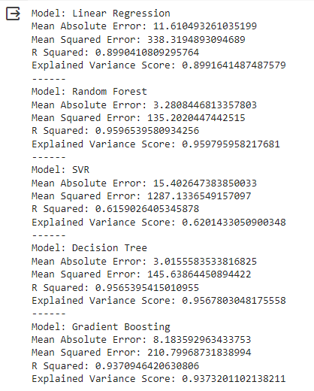
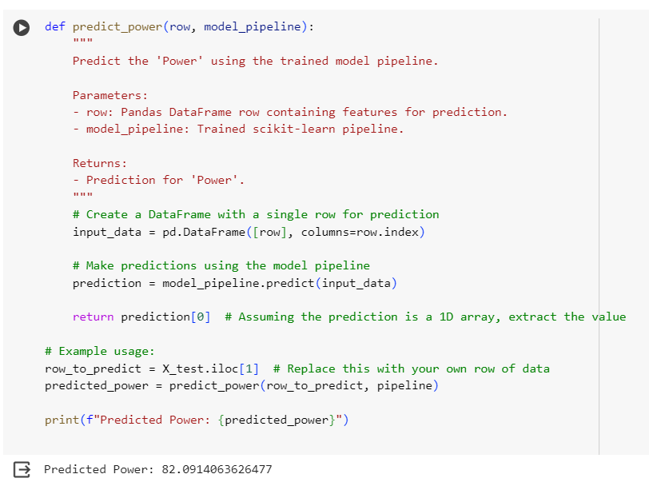
Model Result & Prediction :

Slide 9
Second Project
Supervised Learning Classification Problem (Structured Dataset) :
In this project, we worked on a structured dataset and applied supervised learning techniques to solve a Classification problem.
Definition of the problem:
- The dataset contains information about Diabetes that is distributed into 9 columns.
- The target is to classify if an individual has diabetes or not (diabetes Column) using this information (Columns).
9

Slide 10
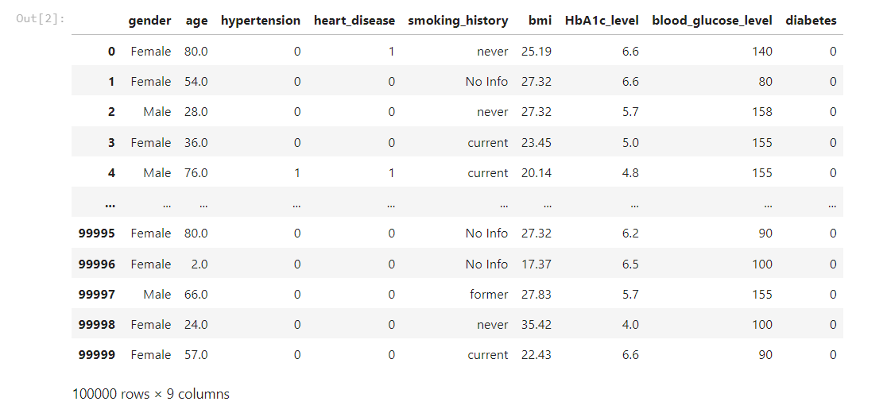
Data Information :

Slide 11
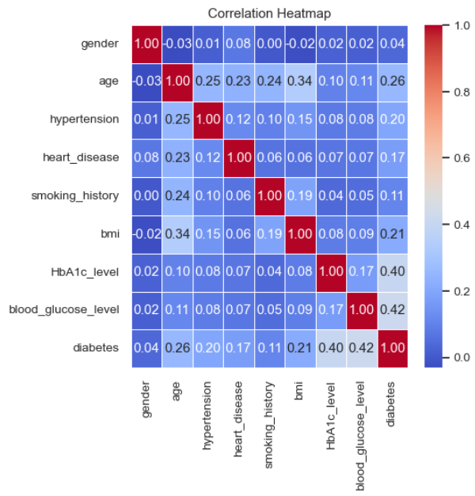
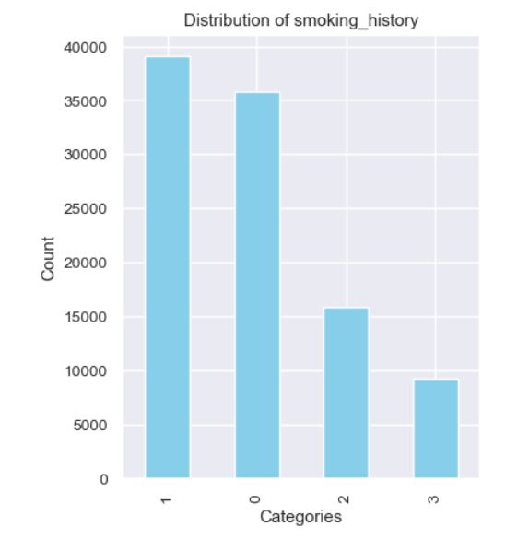
Data Visualizations :
11

Slide 12
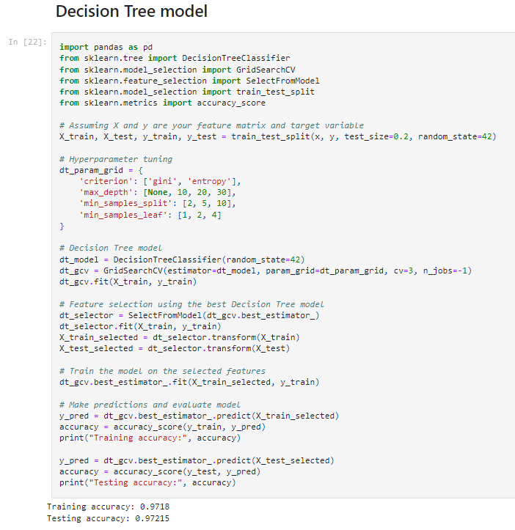
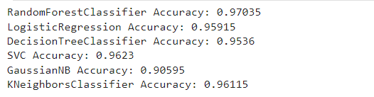
Model Result & Prediction :

Slide 13
Third Project
Unsupervised Learning (Structured Dataset):
In this project, we worked on a structured dataset and applied unsupervised learning techniques to solve problems.
Definition of the problem:
- The dataset contains information about data scientist job salary that is distributed into 11 columns.
- The target is to use K-Mean as the main and only clustering algorithm.
13
13

Slide 14
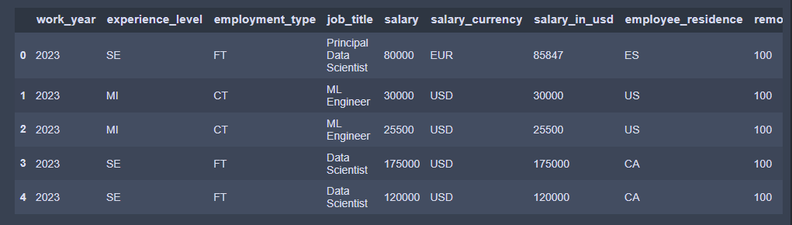
Data Information :
14

Slide 15
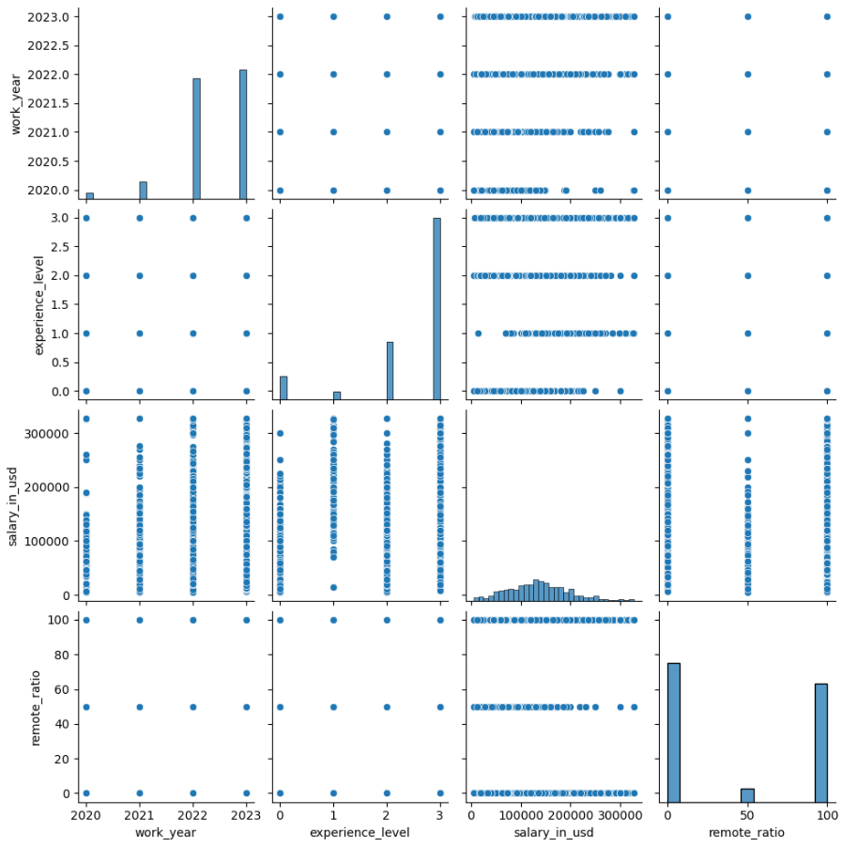
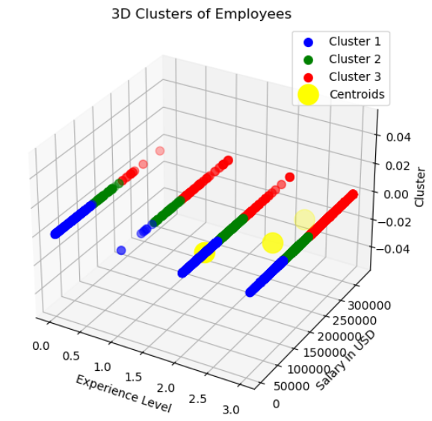
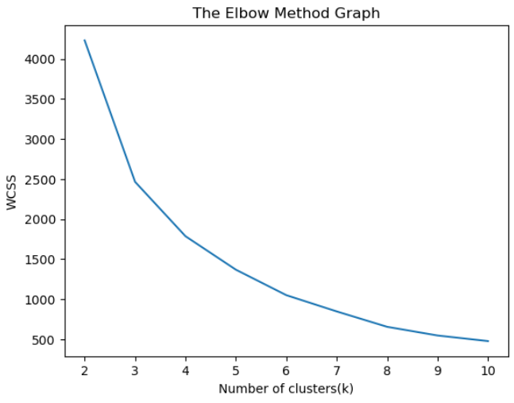
Data Visualizations :
15
15

Slide 16
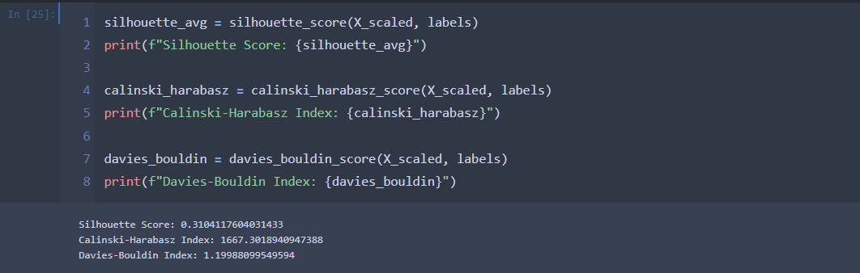
Model Result & Prediction :
16

Slide 17
Fourth Project
Supervised Learning Classification Problem (Unstructured Dataset - Image Dataset):
In this project, we worked on an unstructured dataset-image dataset and applied supervised learning techniques to solve a classification problem.
Definition of the problem:
- The dataset contains X-Ray chest images that are distributed into 3 classes.
- The three classes are divided into training images and testing images.
- The target is to classify if the individual is a normal, pneumonia patient or covid-19 patient using the available images.
17
17
17

Slide 18
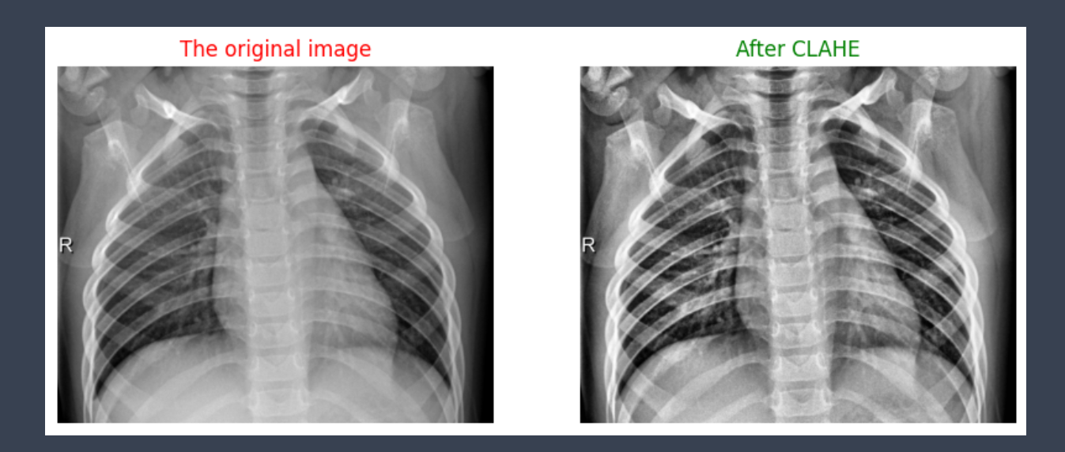
Data Preprocessing :

Slide 19
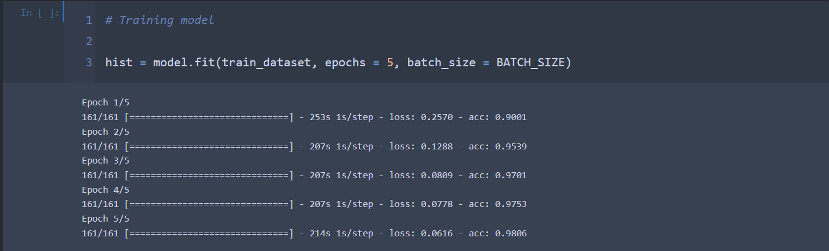
Data Training Process:

Slide 20
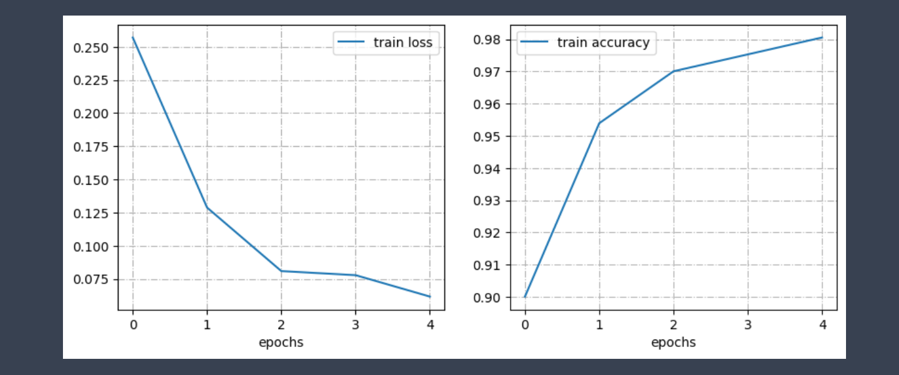
Data Training Evaluation :

Slide 21
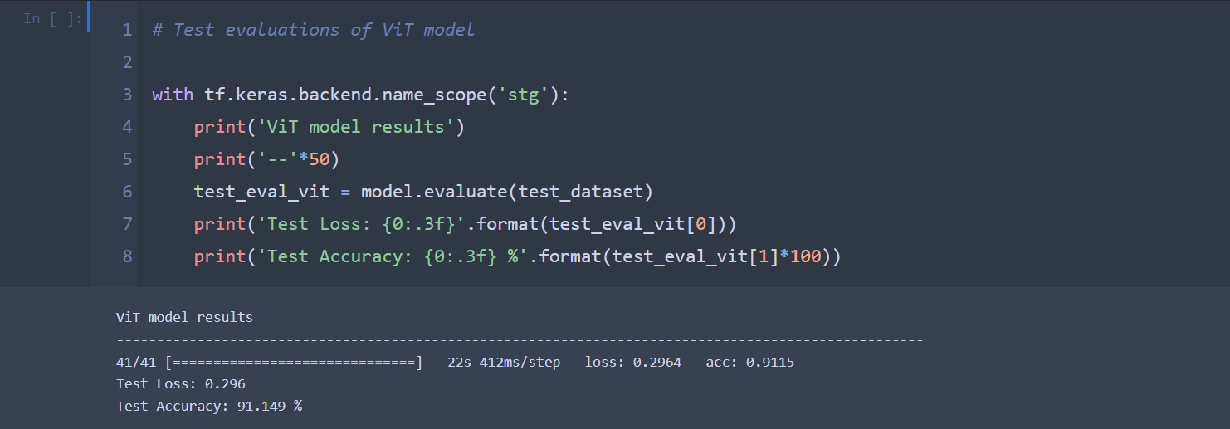
Data Testing Process:

Slide 22
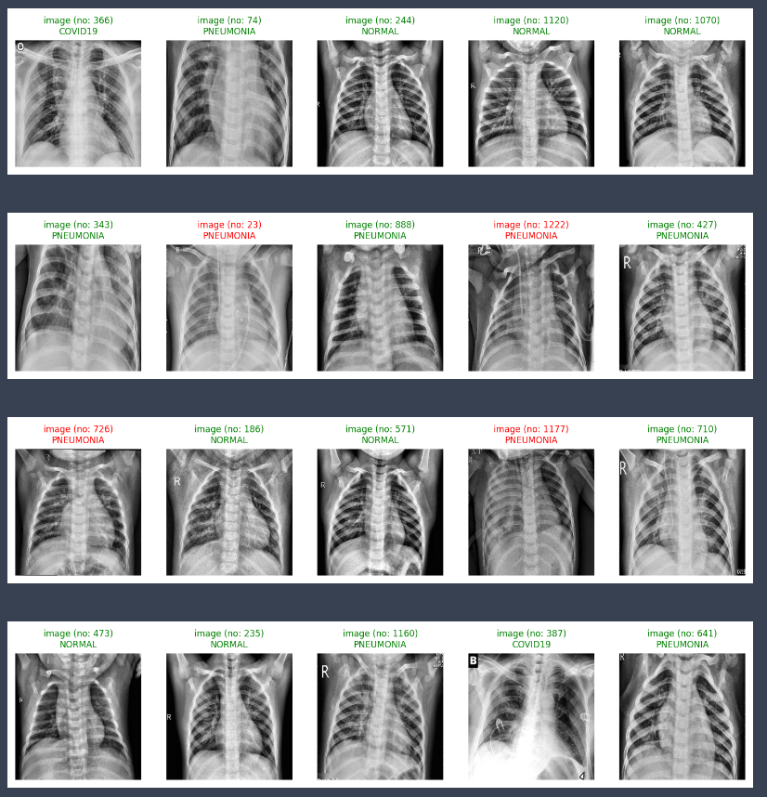
Data Testing Evaluation:

Slide 23
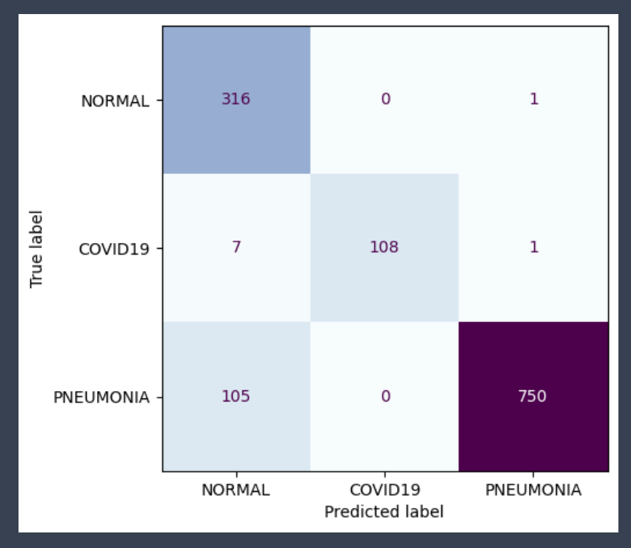
Data Visualizations :

Slide 24
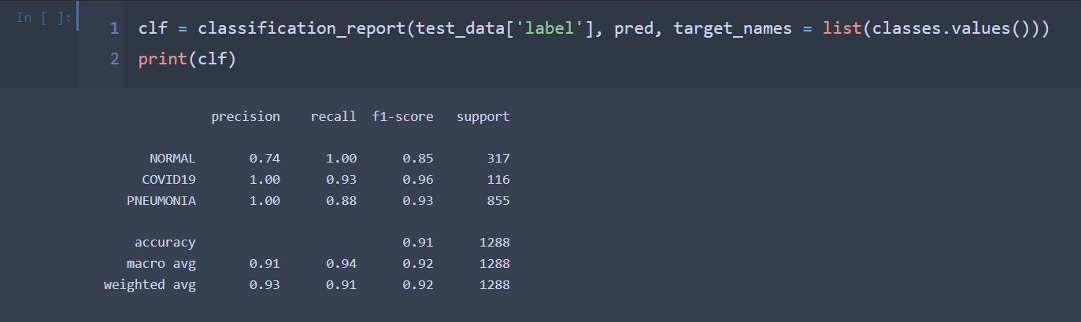
Classification Model Report & Result :

Slide 25
Summary & Deployment :
Finally, we deployed this project and built a user interface for all the bonds and interactions with the user, and we were also able to use all the best sources to build these codes to get the highest possible accuracy

Slide 26
Team Member :
Names: ID:
Ahmed Nehad - 42010704
Seif Elnemr - 42010551
Ali Hussien - 42010308
Ebada Hamdy - 42010494
Ola Rashad - 42010314
Abdulrahman Ayman - 42010392

Slide 27

Thanks :Eng/Ahmed Nousir

