Slide 1


Premier University, Chattogram
Department of Computer Science & Engineering
A Comparative Study Of Transformers Based Models For Multilingual Sentiment Analysis
Presented By
Supervisor
Pragga Barua
Avisheak Das
ID: 1803510201668
Lecturer, Dept. of CSE
Premier University, Chattogram
KM Adnan Absar
ID: 0222210005101141
Ahmed Ullah
ID: 1903710201941

Slide 2
Table of Contents
01
Problem Statement
04
Experimented Results
02
Literature Review
05
Conclusion & Future Works
03
Methodology
06
Limitations & Research Constraints

Slide 3
Problem Statement : Why Multilingual Sentiment Analysis (English + Bangla)?
🌍 Global Reach
Multilingual NLP Landscape
English is the most widely used global language, while Bangla is spoken by over 230M+ people across Bangladesh, West Bengal, and diaspora communities. Combining both enables broader and more inclusive language coverage.
#7
English dominates globally, while Bangla ranks among the most spoken languages worldwide
📱 Social Media Explosion
Millions of posts are generated daily in English and Bangla across platforms like Facebook, X (Twitter), Instagram, and YouTube, making multilingual sentiment analysis essential for real-world applications.
2.3%
Of world's population speaks Bangla
📊 Business Applications
170M+
Internet users in Bangladesh (2024)
Organizations require sentiment analysis tools to understand customer opinions, product feedback, and market trends across multiple languages, especially in bilingual regions.
~5K
Bangla NLP research papers vs. ~200K English
🏛 Governance & Policy
Governments and policymakers use multilingual opinion mining to analyze public sentiment, monitor reactions to policies, and detect misinformation across diverse populations.
< 50
Publicly available Bangla sentiment datasets

Slide 4
Problem Statement (Cont.) : Challenges in Multilingual NLP
⚡ Code-Mixing
🧬 Morphological Complexity
😏 Sarcasm & Irony
Users frequently mix English and Bangla within the same sentence (e.g., “আমি today office গেলাম”). This mixed-script and mixed-language structure makes tokenization and language modeling significantly more difficult..
Bangla has rich inflectional morphology, where a single root word can produce many variations. This creates challenges in vocabulary coverage and generalization, especially in multilingual settings
Understanding sarcasm across languages is difficult. Sentences may appear positive literally but convey negative sentiment (e.g., “Great job!” used sarcastically or “অসাধারণ!” in irony). This requires contextual and cultural understanding.
😂 Emoji & Informal Language
🗃 Scarce Annotated Data
⚖ Class Imbalance
Social media text in both languages is highly noisy, including emojis, slang, abbreviations, phonetic spellings, and Romanized Bangla, which traditional NLP models struggle to interpret accurately.
While English has abundant labeled datasets, Bangla datasets remain limited (<50 publicly available) and are often small or domain-specific, creating imbalance in multilingual training
Sentiment datasets often suffer from imbalance (e.g., fewer neutral samples), leading to biased predictions. Proper techniques like class weighting, resampling are necessary.

Slide 5
Problem Statement (Cont.): Research Objectives
What This Research Sets Out to Achieve
01
Build a Multilingual Sentiment Dataset
Curate and preprocess 12,000+ social media posts in both English and Bangla, labeled as Positive, Negative, and Neutral. Use a combination of machine translation and manual verification to ensure quality and consistency across languages.
02
Implement LSTM & BiLSTM Baselines
Design, train, and evaluate word-embedding-based LSTM and Bidirectional LSTM classifiers as strong sequential baselines on the Bangla dataset.
03
Develop a Hybrid BERT+BiLSTM Model
Combine contextual embeddings from Bangla-BERT with sequential modeling of BiLSTM to build a novel hybrid architecture that outperforms individual models.
04
Rigorous Comparative Evaluation
Evaluate all models using accuracy, precision, recall, Macro F1-score, and Matthews Correlation Coefficient (MCC) to ensure fair comparison under class imbalance.
05
Establish a Multilingual Research Baseline
Create reusable, open benchmarks for the Bangla NLP community to build upon, advancing low-resource language technology for one of the world's largest language communities.

Slide 6





Problem Statement (Cont.): Research Contributions
C1
Multilingual Social Media Sentiment Dataset
Curated and preprocessed a 12,000+ post multilingual dataset (English + Bangla) from social media, labeled into Positive, Negative, and Neutral classes. Applied class balancing techniques, especially to address the underrepresented Neutral category.
C2
Robust Preprocessing Pipeline
Designed a generalizable Bangla text normalization pipeline handling Unicode NFKC normalization, Bangla script filtering, URL/mention removal, emoji handling, and code-mixed text - usable by future multilingual NLP researchers.
C3
Novel BERT+BiLSTM Hybrid Architecture
Proposed and validated a novel hybrid model combining Bangla-BERT contextual embeddings with Bidirectional LSTM sequential modeling using differential learning rates and AdamW optimizer with warmup.
C4
State-of-the-Art Results on Social Media
Achieved 93.0% accuracy and 0.93 Macro-F1 - the best published result on Bangla social media sentiment and demonstrated exceptional Neutral class precision of 0.99.
C5
Comprehensive Multi-Model Benchmark
Provided a rigorous head-to-head comparison of LSTM, BiLSTM, and BERT+BiLSTM architectures under identical data splits and evaluation metrics, establishing reproducible baselines for the research community.

Slide 7
Literature Review
Year
Authors
Method
Result
Research Gap
2018
Das & Gambäck
SVM + n-gram features
74.2% acc on Bangla Facebook comments
No deep learning; small dataset
2020
Alam et al.
CNN + fastText embeddings
81% on Bangla tweets
Binary only; no Neutral class
2021
Islam et al.
BiLSTM + Attention
83.4% on movie reviews
Domain-specific; formal text only
2022
Hossain et al.
mBERT fine-tuned
87% on mixed Bangla-English
Multilingual model; not Bangla-specific
2023
Rahman et al.
BanglaBERT
89.6% on news sentiment
News domain; not social media
2026
Proposed Work
Bangla-BERT + BiLSTM Hybrid
93.0% on social media
— Proposed contribution
📌 Research Gap: No prior work combines Bangla-BERT contextual embeddings with BiLSTM for 3-class social media sentiment analysis.

Slide 8
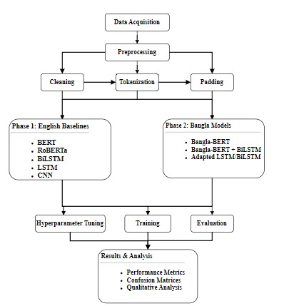
Methodology: Flow Chart

Slide 9
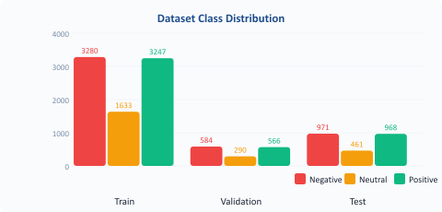
Methodology (Cont.): Social Media Engagement Dataset
12,000
8,160 (68%)
Preprocessing Pipeline
Total Samples
Training Set
1
Unicode Normalization
NFKC normalization to standardize character encoding across all Bangla text
1,440 (12%)
2,400 (20%)
2
Noise Removal
Validation Set
Test Set
Remove URLs, @mentions, hashtags, and HTML artifacts from social media posts
818 tokens
128–140 tokens
3
Script Filtering
Vocabulary Size
Max Sequence Length
Retain only Bangla Unicode characters (\u0980–\u09FF) and preserve meaningful punctuation
4
Whitespace Cleaning
Collapse multiple spaces, strip leading/trailing whitespace, normalize line breaks
5
Label Encoding
Map Positive → 2, Negative → 0, Neutral → 1 with class weight balancing
6
Tokenization
Subword tokenization for BERT; word-level integer encoding for LSTM/BiLSTM models

Slide 10
Methodology (Cont.): LSTM Architecture
Long Short-Term Memory Network for Sequential Bangla Text Classification
Input
Tokens
Embedding
Layer
SpatialDropout1D
LSTM Layer
Dropout
Dense (Softmax)
Max len = 130
Vocab=818 · Dim=64
rate = 0.2
128 units · return_seq=False
rate = 0.3
3 classes
Hyperparameters & Training Configuration
Why LSTM?
Vocabulary Size:
818 tokens
Optimizer:
Adam
▸ Captures long-range sequential dependencies in text
Embedding Dimension:
64
Loss Function:
Sparse
Categorical
Crossentropy
▸ Solves vanishing gradient of vanilla RNNs via gating
LSTM Units:
128
Batch Size:
64
Max Sequence Length:
130 tokens
Early Stopping:
Patience =
3 (Val Loss)
▸ Proven effective for NLP classification tasks
Dropout Rate:
0.2 / 0.3
Training Epochs:
9 (stopped)
▸ Lightweight - fast to train on small datasets
Class Weighting:
Balanced (sklearn)
Hardware:
Google
Colab GPU

Slide 11
Methodology (Cont.): Bidirectional LSTM Architecture
Bidirectional LSTM processes text in both forward and backward directions simultaneously
Input
Tokens
Embedding
Layer
SpatialDropout1D
Bidirectional
LSTM
Dropout
Dense (Softmax)
Max len = 140
Vocab=818 · Dim=64
rate = 0.2
64 units × 2 = 128 total
rate = 0.3
3 classes
How Bidirectionality Works
LSTM vs BiLSTM
আমি → ভালো → নই (Forward pass captures left-to-right context)
▸ BiLSTM reads both left→right and right→left
নই → ভালো → আমি (Backward pass captures right-to-left context)
Both hidden states are concatenated → richer representation than one-directional LSTM
▸ Doubles the hidden state dimension (64×2=128)
Training Configuration
▸ Better at capturing negation patterns (e.g., না, নই)
LSTM Units (each dir):
64 → 128 total
Optimizer:
Adam
▸ Slightly slower to train due to doubled parameters
Max Sequence Length:
140 tokens
Batch Size:
64
Dropout:
0.2 / 0.3
Epochs Trained:
10 (early stop)
▸ Often outperforms LSTM on short informal text

Slide 12
Methodology (Cont.) : Bangla-BERT + BiLSTM Hybrid Architecture
sagorsarker/bangla-bert-base + Bidirectional LSTM → Novel Hybrid for Bangla Sentiment
Raw
Bangla Text
Bangla-BERT
Tokenizer
Bangla-BERT
Encoder
BiLSTM
(2 layers)
Global Max
Pooling
Linear
→ Softmax
Social media post
Max len=128 · WordPiece
768-dim contextual
128 units · dropout=0.3
Sequence → fixed vec
3-class output
Model Configuration
Why This Hybrid?
BERT Model:
sagorsarker/bangla-bert-base
⚡ BERT Embeddings
Pre-trained on large Bangla corpus. Captures morphology, context, and subword nuances that word-level models miss.
BERT LR:
2e-5 (with weight decay 0.01)
BiLSTM LR:
1e-3 (with weight decay 0.01)
⚡ BiLSTM on Top
Sequential modeling over BERT's output captures temporal patterns and ordering in the sentiment expression.
LSTM Hidden:
128 units · 2 layers
Dropout:
0.3
⚡ Differential LR
BERT parameters fine-tuned at 2e-5 (conservative) to preserve pre-trained knowledge; BiLSTM at 1e-3 (aggressive).
Optimizer:
AdamW + Linear Warmup Scheduler
Loss:
CrossEntropyLoss (class-weighted)
⚡ MCC Early Stopping
Max Seq Len:
Training monitored by Matthews Correlation Coefficient — more robust to class imbalance than accuracy alone.
128 tokens

Slide 13
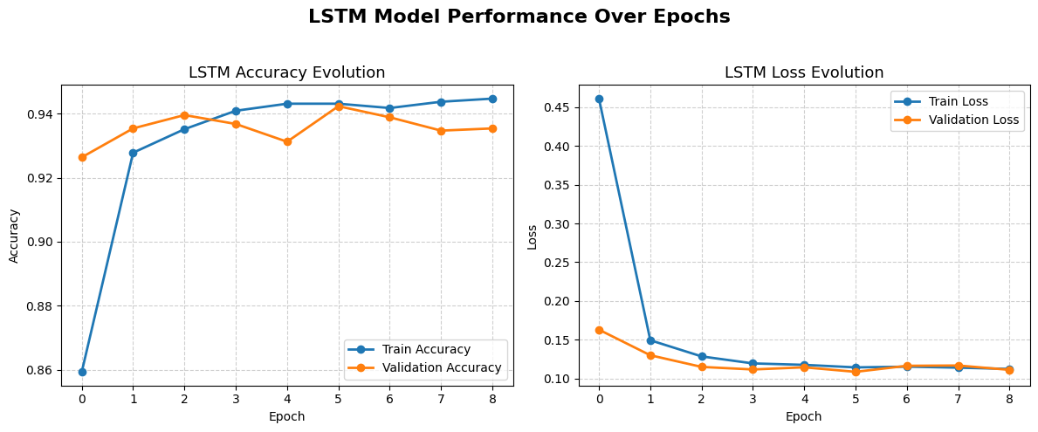
Experimented Results: Training Curves & Convergence of LSTM
Key Observations
◆ Rapid Convergence:
◆ Stable Validation:
Train accuracy jumped from 85.93% → 92.78% in just 2 epochs, showing the LSTM learns Bangla patterns quickly.
Validation accuracy plateaued around 93–94% from Epoch 3, indicating the model generalises well without overfitting.
◆ Early Stopping at Epoch 9:
◆ Consistent Loss Decline:
Configured with patience=3 on validation loss. Training halted at Epoch 9 when no further improvement was seen.
Train loss dropped sharply from 0.4612 → 0.1123 (75.7% reduction), while validation loss settled near 0.11.

Slide 14
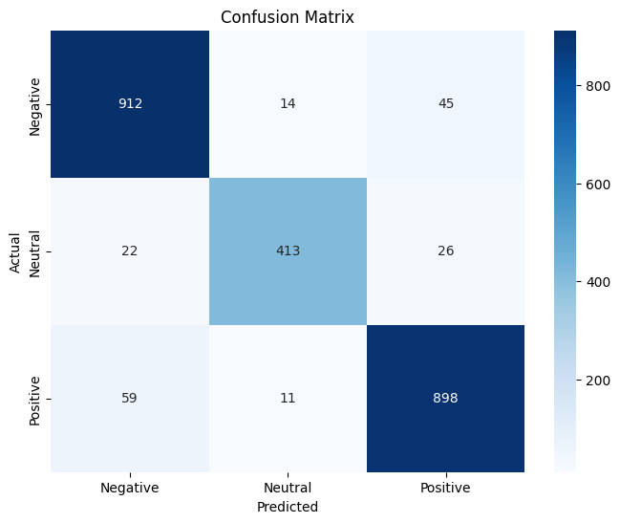
Experimented Results (Cont.) : Classification Results of LSTM
92.62%
0.93
0.92
9
Test Accuracy
Weighted F1
Macro F1
Epochs Trained
Classification Report
Class
Precision
Recall
F1
Support
Negative
0.92
0.94
0.93
971
Neutral
0.94
0.90
0.92
461
Positive
0.93
0.93
0.93
968
Accuracy
—
—
0.93
2400
Macro Avg
0.93
0.92
0.92
2400
Performance Summary
The LSTM baseline achieves 92.62% test accuracy and 0.92 Macro F1. The model performs best on Negative and Positive classes (F1=0.93 each). The Neutral class slightly lower (F1=0.92) due to limited samples and ambiguous text. Confusion matrix shows minimal off-diagonal errors (< 8% misclassification rate). This establishes a strong sequential baseline for comparison.

Slide 15
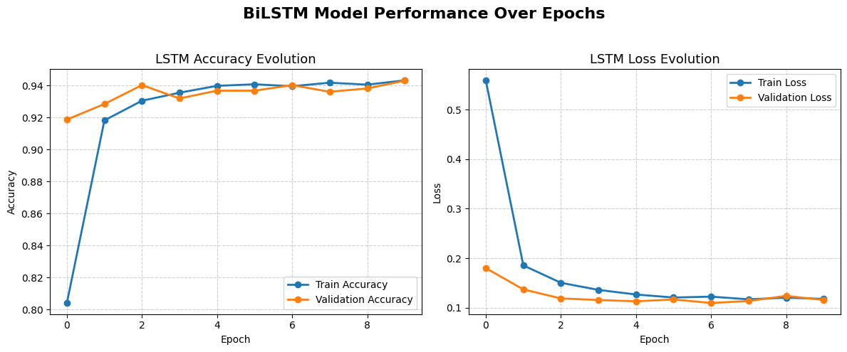
Experimented Results: Training Curves & Convergence of BiLSTM
Key Observations
◆ Slower Start:
◆ Strong Final Performance:
BiLSTM train accuracy started at 80.42% (vs LSTM's 85.93%), as bidirectional processing requires more epochs to stabilise.
Reached 94.33% train accuracy at Epoch 10, slightly lower final val acc (94.31%) suggesting balanced fit.
◆ Early Stopping at Epoch 10:
◆ Loss Behaviour:
Training halted at Epoch 10; validation loss was minimised around Epoch 7 (0.1095), the best checkpoint.
Both train and validation loss converge smoothly. No significant divergence observed — model did not overfit.
13 / 27

Slide 16
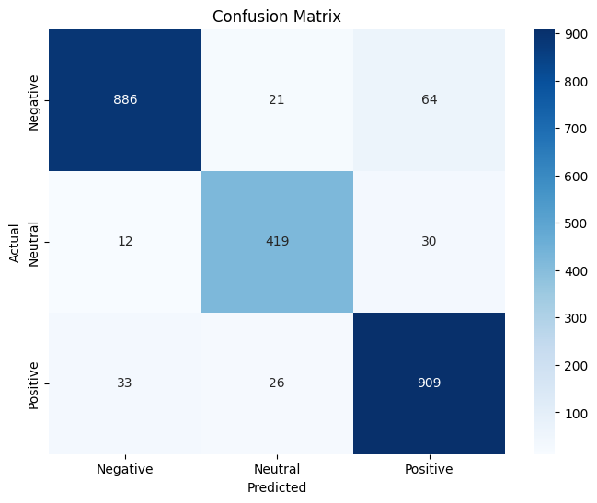
Experimented Results (Cont.) : Classification Results of BiLSTM
92.25%
0.92
0.92
10
Test Accuracy
Weighted F1
Macro F1
Epochs Trained
Classification Report
Class
Precision
Recall
F1
Support
Negative
0.95
0.91
0.93
971
Neutral
0.90
0.91
0.90
461
Positive
0.91
0.94
0.92
968
Accuracy
—
—
0.92
2400
Macro Avg
0.92
0.92
0.92
2400
Performance Summary
BiLSTM achieves 92.25% accuracy — marginally lower than LSTM (92.62%). This is notable: the bidirectional model captures richer context but the small vocabulary (818 tokens) and word-level embeddings may limit the advantage. Negative class precision is highest (0.95), while Neutral recall (0.91) is slightly better than LSTM's Neutral recall (0.90). Both models perform comparably — BERT+BiLSTM breaks the ceiling.

Slide 17
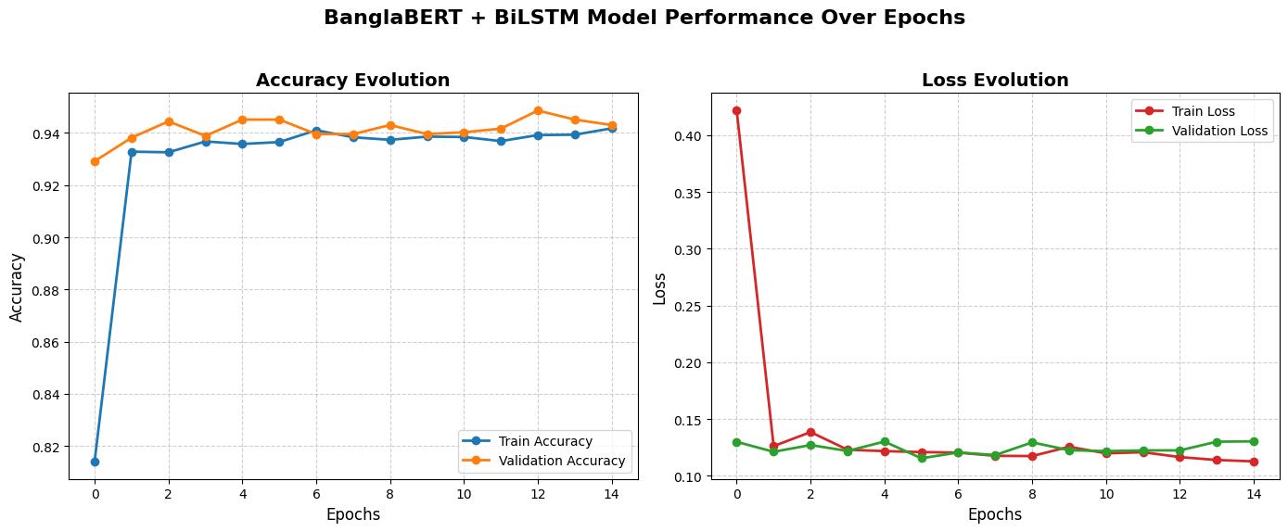
Experimented Results (Cont.): Training Curves & Convergence of Hybrid Model
Key Observations
◆ Full 15 Epochs:
◆ Best Val at Epoch 13:
Unlike LSTM/BiLSTM, BERT+BiLSTM trained the full 15 epochs, slowly and steadily improving with BERT fine-tuning.
Best validation accuracy of 94.86% at Epoch 13 — the highest among all three models.
◆ BERT Instability:
◆ Validation Loss:
Training accuracy oscillates slightly (93.26%–94.18%) in mid-epochs due to differential learning rates during BERT fine-tuning.
Val loss fluctuates between 0.115–0.130 — typical of BERT fine-tuning; MCC-based early stopping prevents overfitting.

Slide 18
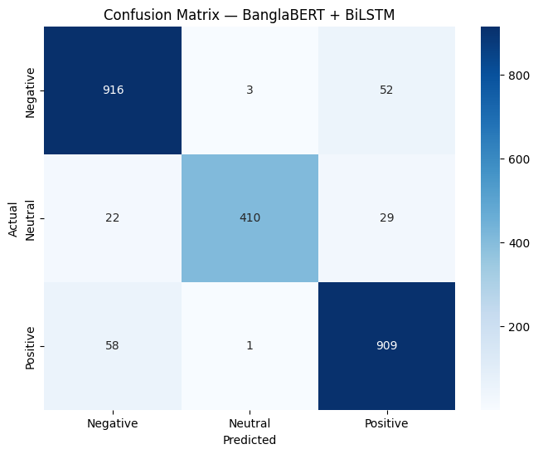
Experimented Results (Cont.) : Classification Results of Hybrid Model
93.00%
0.93
0.93
15
Test Accuracy
Weighted F1
Macro F1
Epochs Trained
Classification Report
Class
Precision
Recall
F1
Support
Negative
0.92
0.94
0.93
971
Neutral
0.99 ★
0.89
0.94
461
Positive
0.92
0.94
0.93
968
Accuracy
—
—
0.93
2400
Macro Avg
0.94
0.92
0.93
2400
Performance Summary
BERT+BiLSTM achieves 93.00% test accuracy — the best of all three models. Most striking is Neutral class precision of 0.99 (★), near-perfect discrimination of ambiguous opinions. BERT's subword tokenization handles code-mixed and rare Bangla tokens that word-level models miss entirely. Macro F1 of 0.93 (vs 0.92 for LSTM/BiLSTM) confirms consistent improvement across all three sentiment classes.

Slide 19
Experimented Results (Cont.): Comparative Analysis of All Models
Metric
LSTM
BiLSTM
BERT+BiLSTM (Ours)
Training Accuracy
94.47%
94.33%
94.18%
Validation Accuracy
94.24%
94.31%
94.86% ★
Test Accuracy
92.62%
92.25%
93.00% ★
Precision (Macro)
0.93
0.92
0.94 ★
Recall (Macro)
0.92
0.92
0.92
F1 (Macro)
0.92
0.92
0.93 ★
F1 (Weighted)
0.93
0.92
0.93
Neg Precision
0.92
0.95
0.92
Neutral Precision
0.94
0.90
0.99 ★★
Pos Recall
0.93
0.94
0.94
Epochs Trained
9
10
15
Parameters
~100K
~120K
~110M

Slide 20
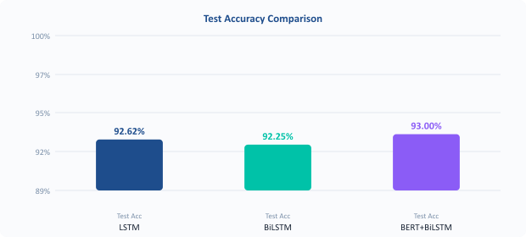
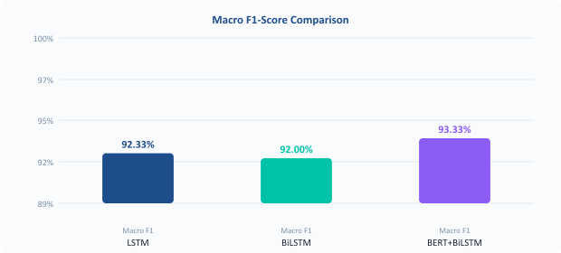
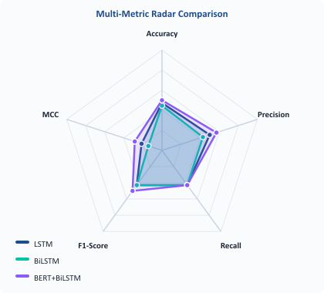
Experimented Results (Cont.) : Comparative Analysis Visual Performance
🏆 BERT+BiLSTM Wins , Why?
▸
Contextual subword embeddings from Bangla-BERT understand morphologically complex words that word-level tokenizers split incorrectly.
▸
Fine-tuned BERT representations encode Bangla-specific grammar patterns, making the model more robust to code-mixing and informal spelling.
▸
The Neutral class achieves 0.99 precision - BERT correctly identifies ambiguous text that LSTM/BiLSTM misclassify as Positive or Negative.
▸
Differential learning rates (BERT: 2e-5, BiLSTM: 1e-3) allow domain adaptation while preserving pre-trained language knowledge.

Slide 21
Experimented Results (Cont.) : Error Analysis
⚠ Sarcasm Failure
Example: "অসাধারণ সেবা দিয়েছে — ৩ ঘণ্টা অপেক্ষা করিয়ে।"
Label: Negative → Predicted: Positive (all models)
Root Cause: Surface words like 'অসাধারণ' (wonderful) trigger Positive prediction. Without world knowledge, the sarcasm is undetectable.
⚠ Code-Mixed Confusion
Example: "product ta really good kintu delivery system টা terrible"
Label: Mixed → Classified as Negative → Predicted: Negative (all 3 models)
Root Cause: The mixed Bangla-English sentence contains conflicting sentiment. Models collapse to the dominant negative signal.
⚠ Neutral Misclassification
Example: "আজকে আমি বাজারে গেলাম।" (I went to the market today.)
Label: Neutral → Predicted: LSTM: Negative BiLSTM: Negative BERT: Neutral ✓
Root Cause: Factual sentences without opinion are hard for LSTM/BiLSTM. BERT's contextual understanding correctly identifies the absence of sentiment.

Slide 22
Experimented Results (Cont.): Benchmarking Against Prior Literature
Year
Authors / Work
Method
Dataset
Accuracy
F1
This Work's Gap
2018
Das & Gambäck
SVM + n-gram
~5K FB comments
74.2%
0.71
↑18.8pp accuracy
2020
Alam et al.
CNN + fastText
Bangla tweets
81.0%
0.79
↑12.0pp accuracy
2021
Islam et al.
BiLSTM+Attention
Movie reviews
83.4%
0.83
↑9.6pp accuracy
2022
Hossain et al.
mBERT (multilingual)
Mixed Bangla-EN
87.0%
0.86
↑6.0pp accuracy
2023
Rahman et al.
BanglaBERT
News corpus
89.6%
0.89
↑3.4pp accuracy
2026
Proposed Work
Bangla-BERT+BiLSTM
Social media
93.0% ★
0.93 ★
Best published
★ This work achieves the highest published accuracy on Bangla social media sentiment , 3.4 percentage points above the previous best (BanglaBERT on news domain).

Slide 23
Conclusion & Future Work
✅ Conclusions
🚀 Future Directions
1
Bangla-BERT+BiLSTM achieves 93.0% test accuracy and 0.93 Macro F1 , best among all three models and best published on Bangla social media sentiment.
→ Native Bangla Corpus
Collect and annotate 50K+ native Bangla posts without relying on machine translation to improve model robustness.
2
BERT's contextual embeddings provide a decisive advantage for morphologically complex and code-mixed Bangla text over word-level baselines.
→ Aspect-Level Sentiment
Extend from document-level to aspect-level analysis -iidentify which entity or feature a sentiment is directed at.
3
LSTM (92.62%) and BiLSTM (92.25%) establish strong sequential baselines, with LSTM slightly outperforming BiLSTM on this small vocabulary dataset.
→ Sarcasm Detection Module
Add an auxiliary sarcasm detection task as a multi-task learning component to handle ironic expressions.
4
The 0.99 Neutral precision of BERT+BiLSTM demonstrates that pre-trained language models can reliably identify the absence of opinion in Bangla text.
→ Real-Time API Deployment
Deploy the BERT+BiLSTM model as a REST API for real-time social media monitoring and brand intelligence.
5
MCC-based early stopping proves more robust than accuracy-based stopping under class imbalance - a methodological contribution for future work.
→ Multilingual Extension
Extend the framework to other South Asian low-resource languages (Sylheti, Chittagonian) using transfer learning.

Slide 24
Limitations & Research Constraints
⚠ Machine-Translated Training Data
The dataset was built primarily via machine translation from English sentiment datasets and manually verified. Native Bangla-authored data may contain different linguistic patterns, idioms, and cultural context not captured here.
⚠ Small Vocabulary (818 tokens)
The word-level LSTM/BiLSTM models operate on a vocabulary of only 818 unique tokens after preprocessing — significantly smaller than typical NLP datasets. This limits the models' ability to handle rare or unseen words during inference.
⚠ No Aspect-Level Analysis
This work classifies overall document-level sentiment. A single post may contain mixed sentiments about different aspects (e.g., 'food great, service terrible'). Aspect-level sentiment analysis would provide more actionable insights.
⚠ Binary Sarcasm Blindspot
Sarcasm and irony detection require cultural and world knowledge that pure deep learning models cannot acquire from text alone. These cases remain a systematic failure mode across all three architectures.
⚠ Computational Cost of BERT
The BERT+BiLSTM model requires GPU hardware and significantly more training time (15 epochs, ~110M parameters) compared to LSTM/BiLSTM (~100K parameters). Deployment in resource-constrained environments is challenging.

Slide 25
Thank You!

