Slide 1
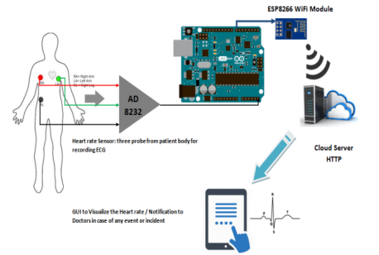
Smart Healthcare System using Internet of Things (IoT)

Slide 2
Abstract
Continuous data monitoring with IoT will be a platform for the healthcare industry, which will enable doctors with quicker, smarter and effective methods of diagnosis. Statistical Analysis of Real time monitoring of patients and feeding the monitored data to the internet is going to be one of the big things in future. IoT Healthcare can be used for critical patients needs to be under continuous observation; especially in the absence or unavailability of medical doctor. Early detection of diseases is possible with IoT Healthcare applications and the doctor can be notified immediately. IoT healthcare has a wide range of applications like Heart-rate monitoring, ECG monitoring, blood pressure monitoring, etc. Here we will be discussing about ECG monitoring with IoT and the methodology of its implementation. This paper has proposed and implemented a Smart healthcare application using a IoT system based on AD8232 heart rate sensor interfaced with Arduino UNO and further connected to Cloud using an ESP8266 Wireless LAN Module.

Slide 3
INTRODUCTION
IoT or Internet of Things refers to the phenomenon of interconnection of people, computers, machines, etc. through the internet for continuous process and exchange of data which can be identified according to a particular trait, with the help of sensors for real time monitoring, tracking and management of data.

Slide 4
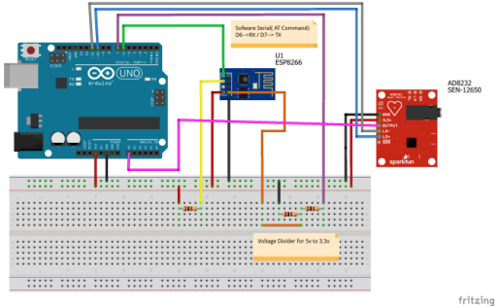
PCB Design

Slide 5

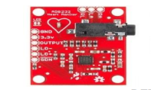
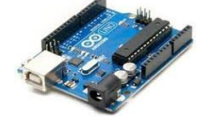
Modules used
ECG Sensor AD8232
Heart rate Sensor
WIFI Module ESP8266
ATmega328 Microcontroller
LCD

Slide 6
ECG, AD8232 Heart rate Sensor
monitored using the serial monitor or can be sent directly to the cloud with the help of a microcontroller. It collects the data and sends it serially to the Arduino for further actions. Table.1 shows the pin connection for interfacing of AD8232 with Arduino UNO.
WLAN Module ESP8266
The circuit, consisting of Arduino Uno, W-LAN module and the ECG sensor was well connected. Then, the ECG leads are placed on the patient’s body as per the color coding. Now, with the switching on of the circuit, heart rate gets monitored constantly and the ECG waveform is generated. The voltage values of the ECG are received by the serial monitor at certain intervals of time. The ECG curve is generated in the serial plotter of Arduino Uno and with the help of ESP 8266, the data is sent over the internet to a specific webpage and can be accessed by the respective doctor in any part of the world. If there is some abnormality in the ECG waveform, (i.e. the QRS complex is not welldefined, inversion of T-waves, very low amplitude level, etc.) then the physician is immediately notified using SMTP that there is a problem with this particular patient. Then the physician can log on to the webpage and can see the ECG graph and then can take necessary actions to improve the condition of the patient.

Slide 7
ATmega328 Microcontroller: Arduino Uno
Data Processing Data of the sensor network is processed with the help of the microcontroller Arduino Uno . The sensor network is connected to the Arduino board, which displays the data value or the graphical value on the serial plotter. Arduino has also connections with ESP8266 which through a series of AT commands sends the data to the internet.

Slide 8
CONCLUSIONS
Integration of healthcare with IoT has opened up a vast arena of development. It will not only facilitate healthcare but will also find out new measures to prevent diseases by processing data and by analyzing global trends. Moreover, a vast future lies entirely on automation of hospitals and treatment mechanisms which can help the doctors understand diseases through artificial intelligence and IoT. However, we should take a step at a time and not rush in into this field, since it deals with human health and safety and security needs to be the top agenda. On a large scale, this can also lead to cheaper treatments and cheaper nursing costs of patients. If technology and health goes hand in hand, we can reach the goal of cheap, safe and efficient disease preventions and treatment.

