Slide 1
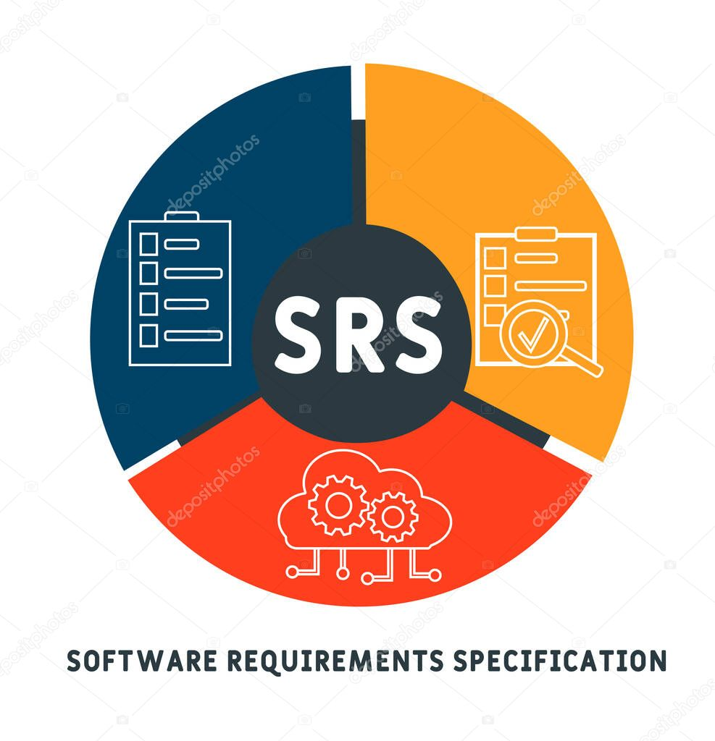

Presented by: Marwan Elkhateeb Ahmed Osama
Principal Component Analysis
(PCA)

Slide 2
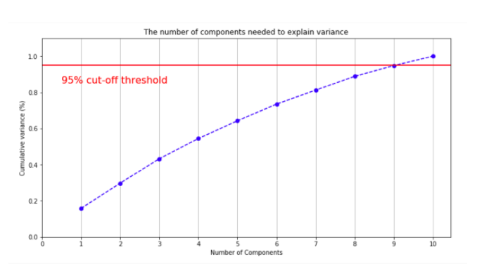
Principal Component Analysis (PCA)
The goal: Find another basis of the vector space, which treats variations of data better.
Don’t choose the number of components manually. Instead of that, use the option that allows you to set the variance of the input that is supposed to be explained by the generated components.

Slide 3
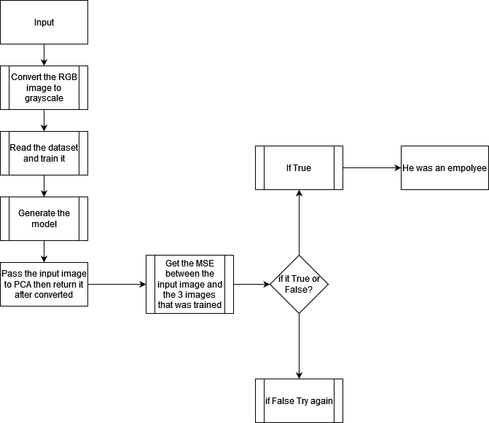
The Block Diagram

Slide 4
Software Requirement Specification
Function Requirements.
Non-Function Requirements.

Slide 5
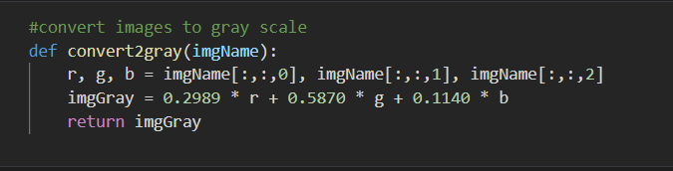
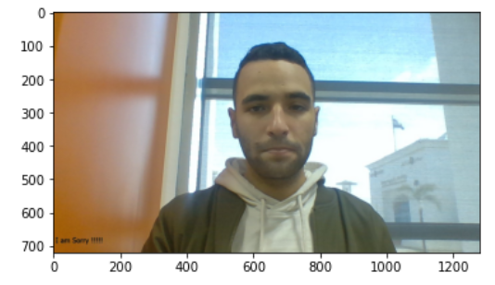
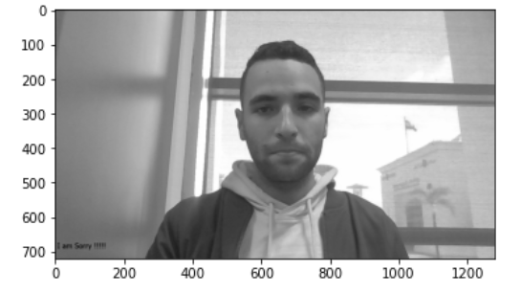
Function Requirements
First Function:
Convert the RGB image
to Grayscale image
(Black and white)

Slide 6
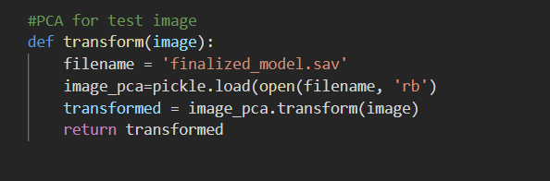
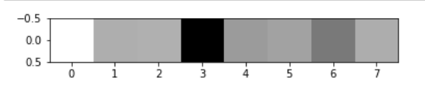
Function Requirements
Second Function:
After generating model
Pass the input image to
PCA function to transform it.

Slide 7
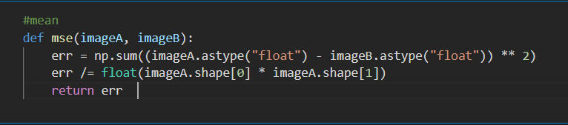
Function Requirements
Third Function:
Get the MSE between every two images and return the error

Slide 8
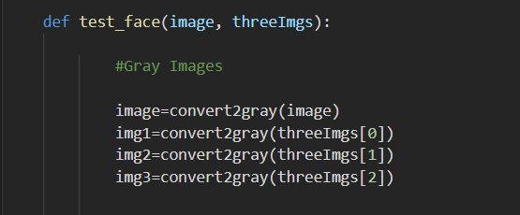
Function Requirements
Forth Function:
We take 4 images from user
One test and 3 for check.
First, we will convert the 4
Images to Grayscale.

Slide 9
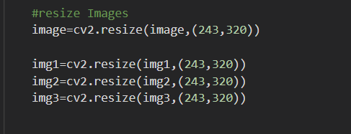
Function Requirements
Then we will resize our images

Slide 10
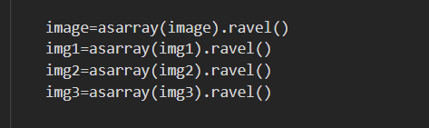
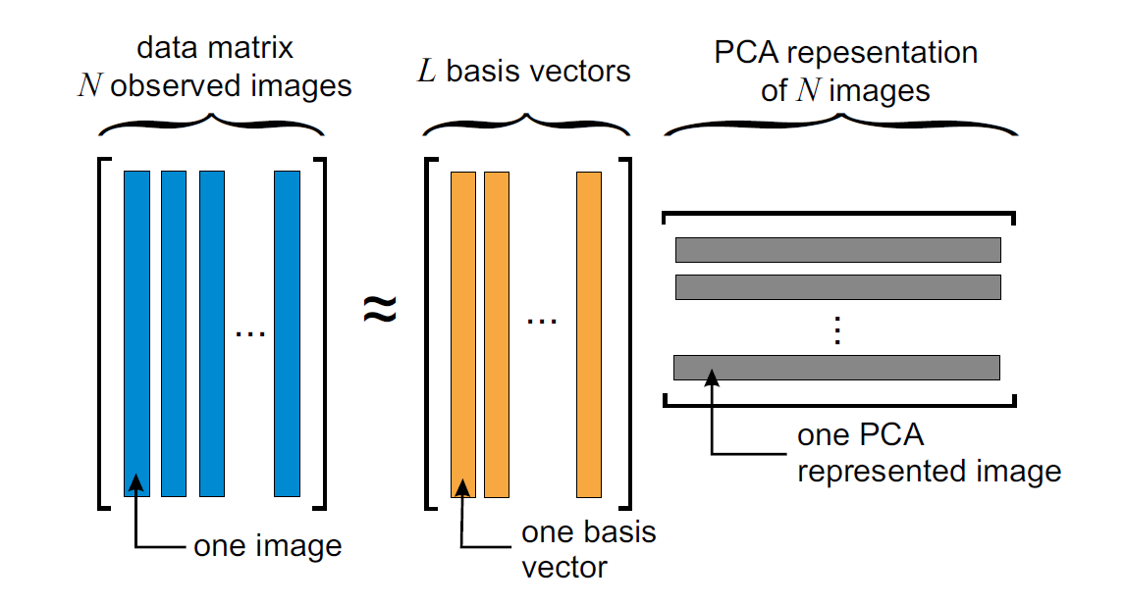
Function Requirements
This step for vectorize each image as a vector(array)

Slide 11
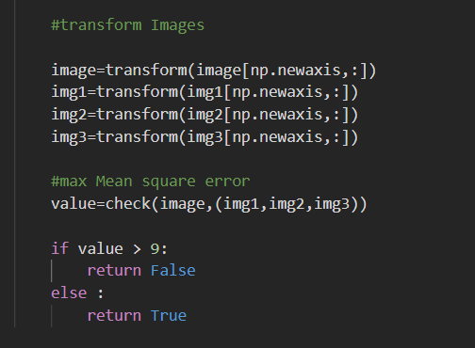
Function Requirements
Transform 4 images and check their MSE between the input image and others

Slide 12
Non-Function Requirements
Security
Usability

Slide 13
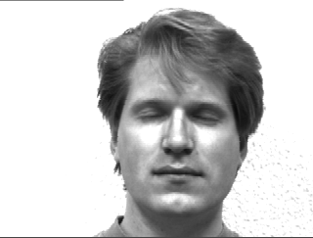
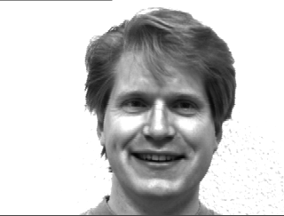
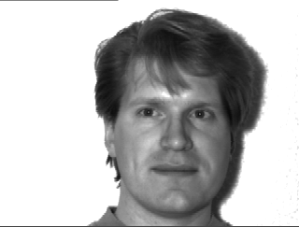
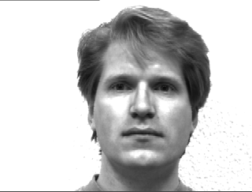
Non-Function Requirements
Security
The image size 100 * 100
The image size 50 * 50

Slide 14
Non-Function Requirements
To secure our camera data If someone was hack the camera to take the images of the employees

Slide 15
Non-Function Requirements
Usability:
PCA image can be enhance with some filters due to the noise that occur after the transform.
Filters like: Median Filter – Lee Filter – Gaussian Filter…

Slide 16
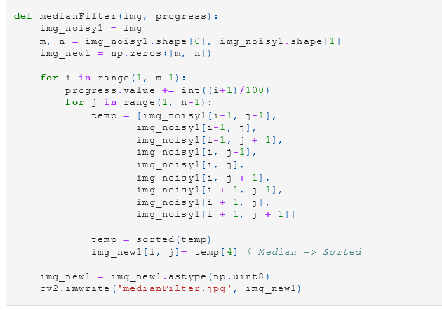
Non-Function Requirements
Median Filter:

Slide 17
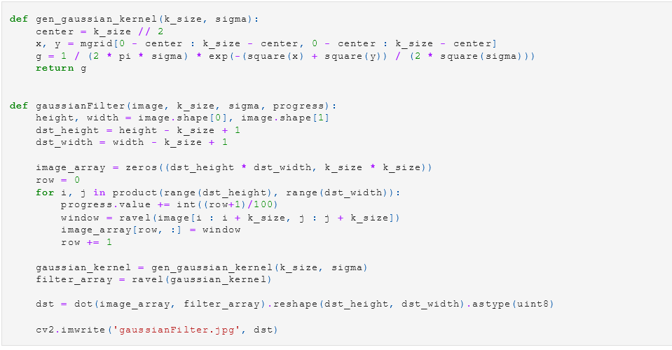
Non-Function Requirements
Gaussian Filter:

Slide 18
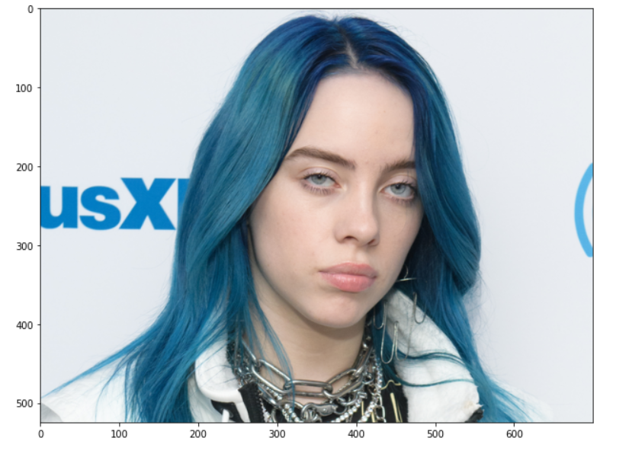
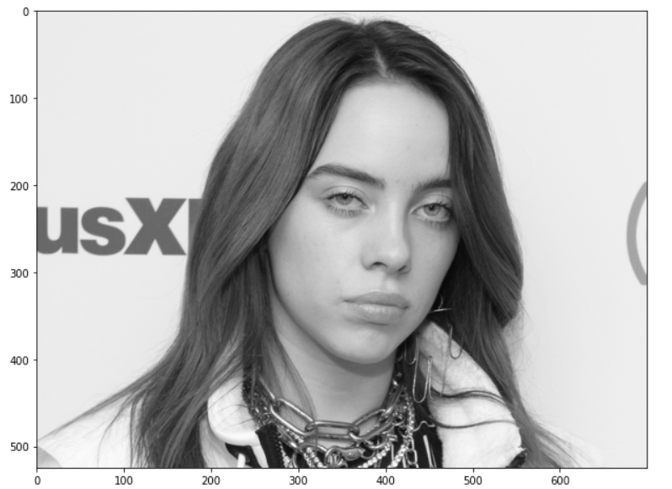
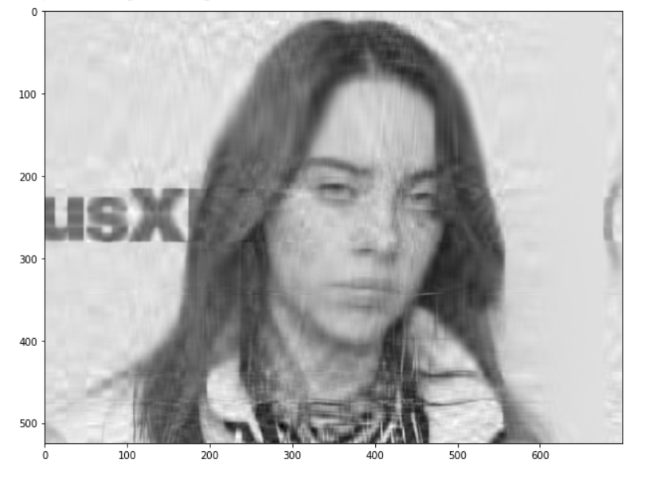
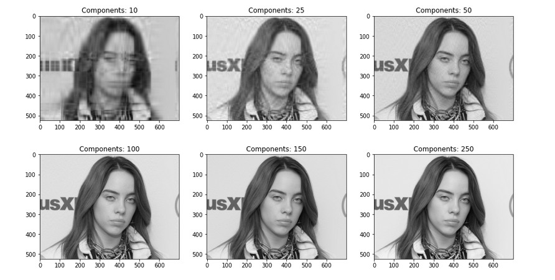
Non-Function Requirements

Slide 19
Thank You

