Slide 1
Unit 7: Synchronization and Matched Filtering
EL-GY 6013: Digital communications
Prof. Sundeep rangan

Slide 2
Learning Objectives
Describe the synchronization mechanisms in common commercial standards
Formulate binary decision tasks as hypothesis testing problems
Compute the LRT detector for a hypothesis testing problem
Compute error probabilities and optimize the threshold
Formulate signal detection as a hypothesis test
Describe and analyze the matched filter detector
Analyze various non-idealities including clock offset, auto-correlation and multi-path
Simulate the MF detector for real systems

Slide 3
This Unit
Channel coding
Symbol mapping
TX filter DAC
Upconversion
Info bits
Coded bits
IQ symbols
Analog baseband
RF
Passband
Channel
Sync
“Noise”
Channel decoding
Symbol demod
Equalization
RX filter and ADC
Down-conversion

Slide 4
Outline
Detection and Synchronization Problem
Hypothesis Testing
Match Filtering for Detection at a Known Delay
Match Filter SNR and Error Probabilities
Match Filtering Convolution with an Unknown Signal Delay
Automatic Gain Control (AGC)
Appendix 1. Error Probability Calculation Details
Appendix 2. Matched Filtering as a Generalized Likelihood Ratio Test

Slide 5


Synchronization and Detection Problem
Two key problems in most communication receivers:
Detect if a transmitter is present
Synchronize to the transmitter
Basic first step in any communication process
Assumes the transmitter broadcasts a signal
Receiver must detect and synchronize to it
This Photo by Unknown Author is licensed under CC BY-SA

Slide 6
Ex 1: 802.11g Transmission
Preamble
Frame
MAC PDU
PLCP header
All data is transmitted in frames
Frames may arrive at any time
Each frame begins with known preamble
Common to all frames
RX station listens for preamble to detect:
Presence of frame.
If frame is present, determines timing delay of the remaining frame

Slide 7
802.11g PLCP Header Details
PLCP header
MAC PDU
Preamble
(16 us)
Rate
(4bits)
Length
(12 bits)
Service
(16 bits)
MAC header
Payload
(MAC SDU)
FCS
Coded at lowest rate
Rate indicated in PLCP header
PLCP header details:
Preamble: Used for initial detection, synchronization, channel estimation
Rate: Signals MCS for service bits & MAC PDU
Length: Number of OFDM symbols in frame
Service: Scrambler sync
MAC header: Contains MAC layer control info
Segmentation, MAC addresses, …
MAC FCS: frame check sum (used to detect errors)

Slide 8
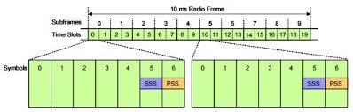
Ex 2: LTE Downlink Primary Sync Signal (PSS)
Frequency
Each cell transmits periodically PSS
Narrowband, short (71.4 us x 1.08 MHz)
One of 3 PSS signals
Once PSS is detected, mobile (UE) knows frame timing
Decodes subsequent signals SSS, broadcast, …

Slide 9
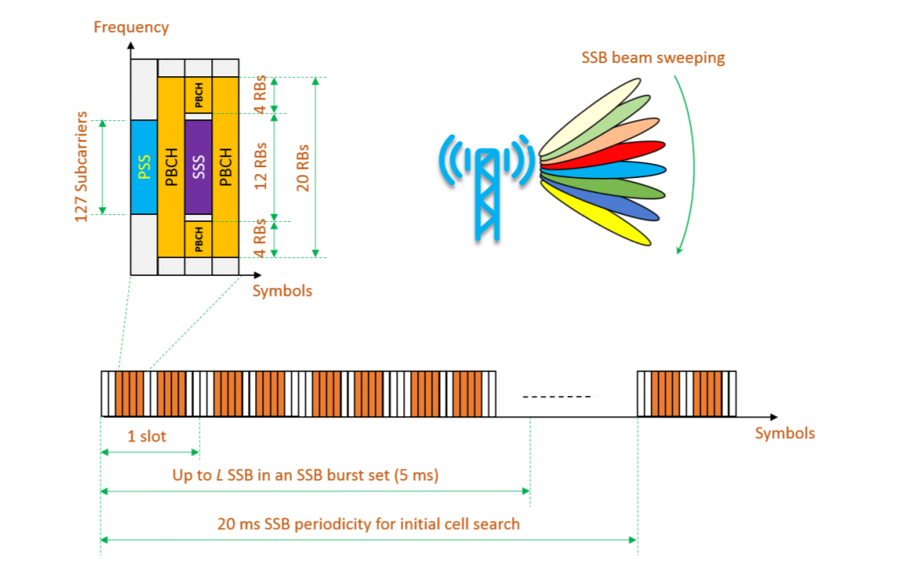
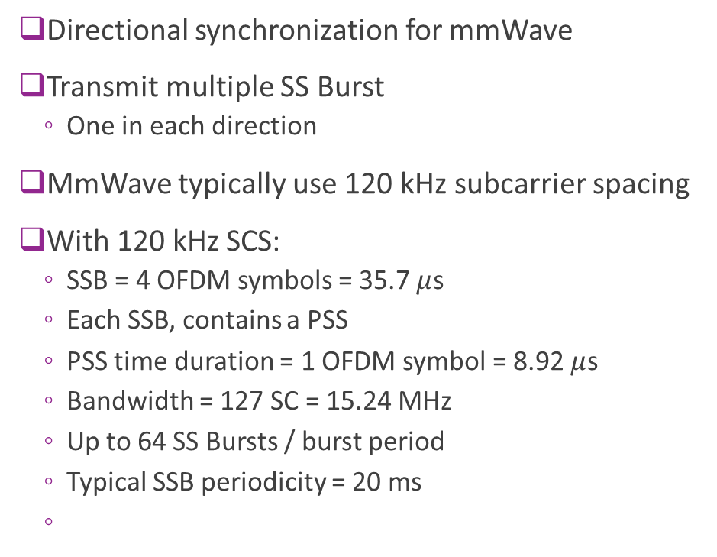
Ex. 3. 5G New Radio Beam Sweeping
Directional synchronization for mmWave
Transmit multiple SS Burst
One in each direction
MmWave typically use 120 kHz subcarrier spacing
With 120 kHz SCS:
SSB = 4 OFDM symbols = 35.7 $μ$s
Each SSB, contains a PSS
PSS time duration = 1 OFDM symbol = 8.92 $μ$s
Bandwidth = 127 SC = 15.24 MHz
Up to 64 SS Bursts / burst period
Typical SSB periodicity = 20 ms

Slide 10

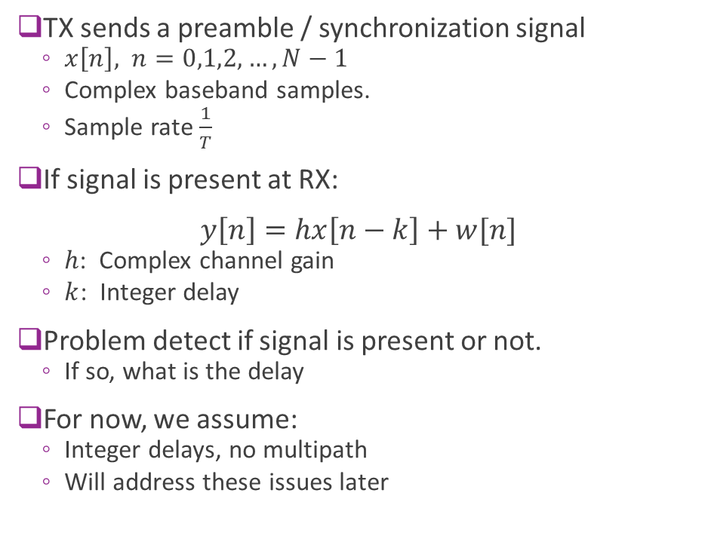


Simple Synchronization Model
TX sends a preamble / synchronization signal
$x\left[n\right],$ $n=0,1,2,…,N−1$
Complex baseband samples.
Sample rate $\frac{1}{T}$
If signal is present at RX: $y\left[n\right]=hx\left[n−k\right]+w[n]$
$h$: Complex channel gain
$k$: Integer delay
Problem detect if signal is present or not.
If so, what is the delay
For now, we assume:
Integer delays, no multipath
Will address these issues later
$$x[n]$$
TX
$$hx[n−k]$$
RX
Delay=$kT$

Slide 11
Outline
Detection and Synchronization Problem
Hypothesis Testing
Match Filtering for Detection at a Known Delay
Match Filter SNR and Error Probabilities
Match Filtering Convolution with an Unknown Signal Delay
Automatic Gain Control (AGC)
Appendix 1. Error Probability Calculation Details
Appendix 2. Matched Filtering as a Generalized Likelihood Ratio Test

Slide 12
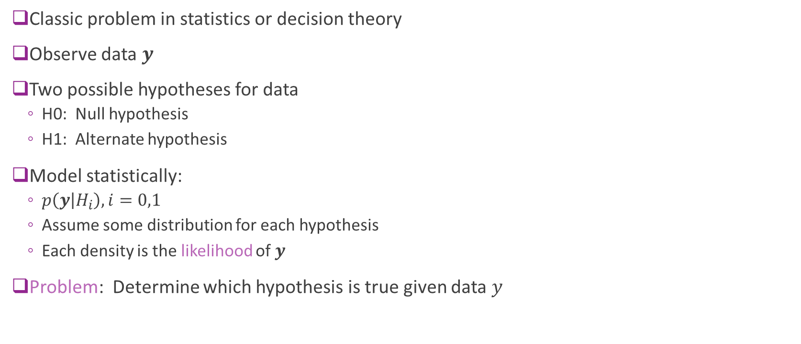
Hypothesis Testing
Classic problem in statistics or decision theory
Observe data $y$
Two possible hypotheses for data
H0: Null hypothesis
H1: Alternate hypothesis
Model statistically:
$p\left(y | H_{i}\right), i=0,1$
Assume some distribution for each hypothesis
Each density is the likelihood of $y$
Problem: Determine which hypothesis is true given data $y$

Slide 13
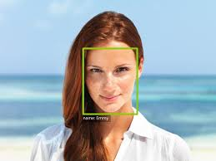
Applications
Many applications
Pattern recognition:
Does this image contain a face or not?
Is this person X?
Detection:
Is the transmitted bit 0 or 1?
This lecture: Is a signal present or not?

Slide 14
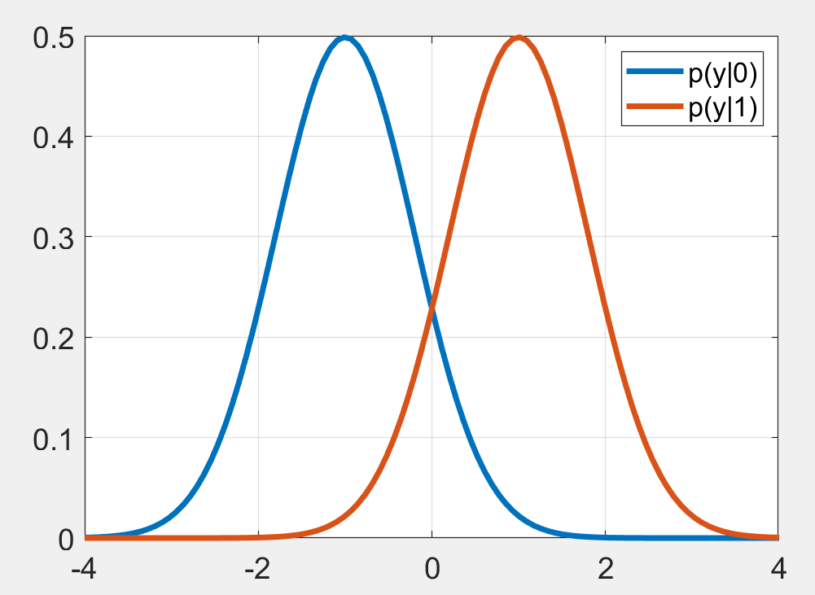

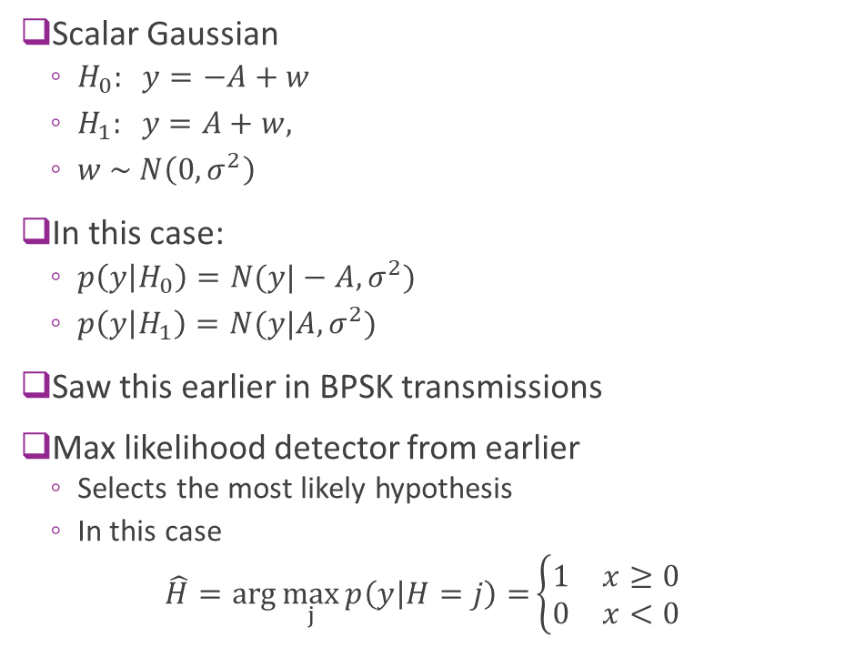

Simple Example
Scalar Gaussian
$H_{0}: y=−A+w$
$H_{1}: y=A+w,$
$w \sim N\left(0,σ^{2}\right)$
In this case:
$p\left(y | H_{0}\right)=N(y|−A,σ^{2})$
$p\left(y | H_{1}\right)=N(y|A,σ^{2})$
Saw this earlier in BPSK transmissions
Max likelihood detector from earlier
Selects the most likely hypothesis
In this case
$$\hat{H}=\arg{\max_{j}{p\left(y | H=j\right)=}}\left\{\begin{matrix}1 & x≥0 \\ 0 & x<0\end{matrix}\right.$$
$$\hat{H}=0$$
$$\hat{H}=1$$

Slide 15
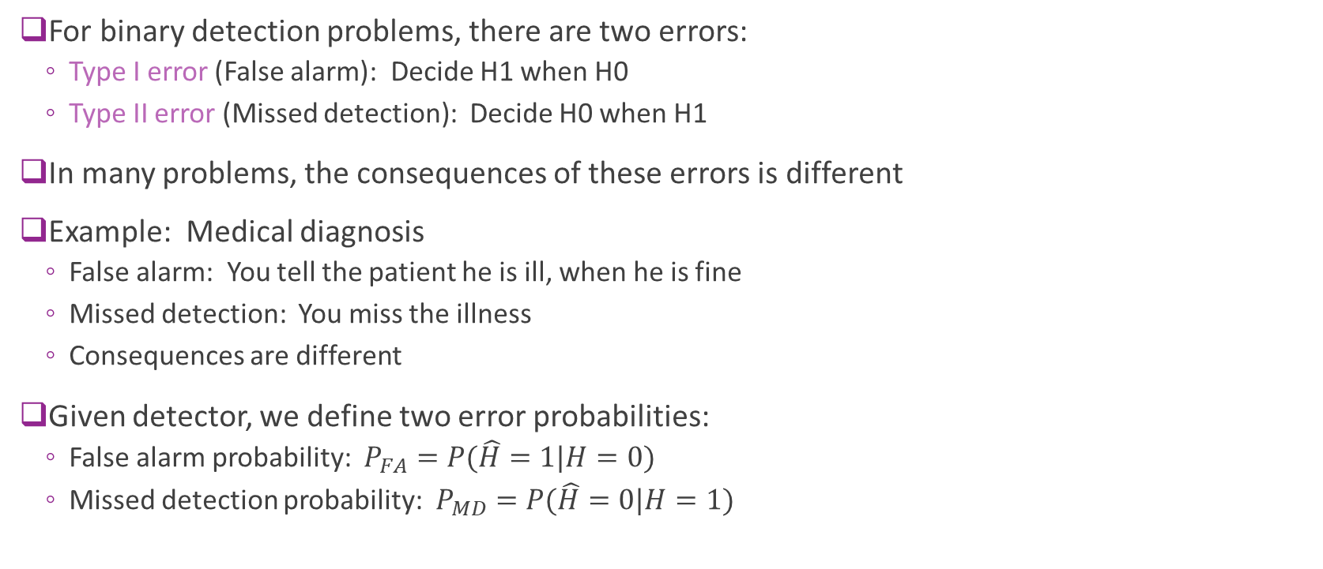
Types of Errors
For binary detection problems, there are two errors:
Type I error (False alarm): Decide H1 when H0
Type II error (Missed detection): Decide H0 when H1
In many problems, the consequences of these errors is different
Example: Medical diagnosis
False alarm: You tell the patient he is ill, when he is fine
Missed detection: You miss the illness
Consequences are different
Given detector, we define two error probabilities:
False alarm probability: $P_{FA}=P(\hat{H}=1|H=0)$
Missed detection probability: $P_{MD}=P(\hat{H}=0|H=1)$

Slide 16
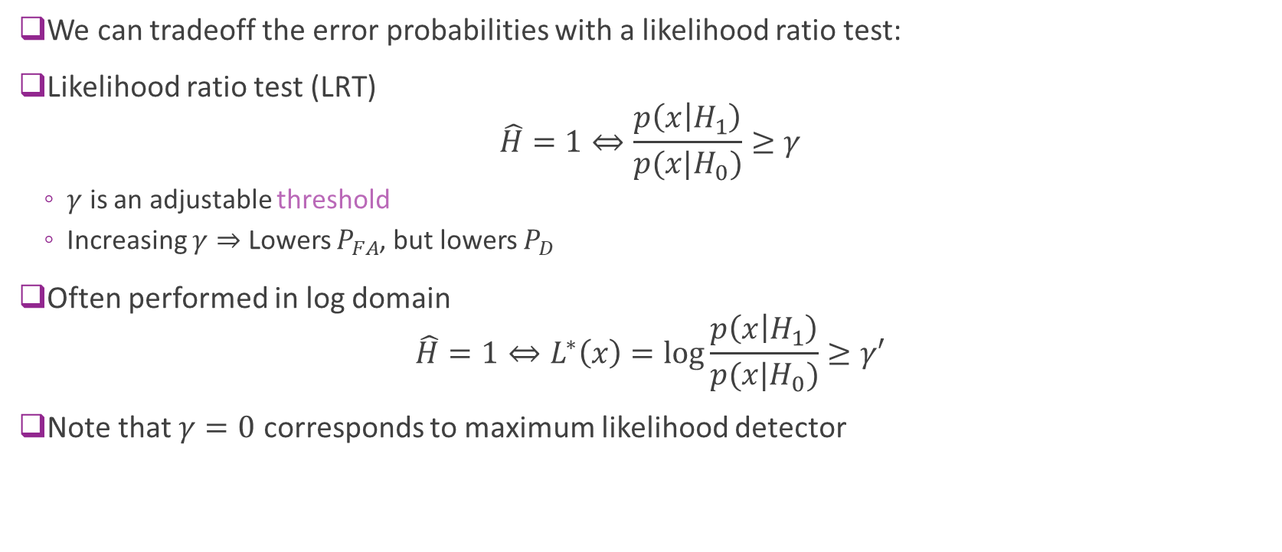
Likelihood Ratio Test
We can tradeoff the error probabilities with a likelihood ratio test:
Likelihood ratio test (LRT) $\hat{H}=1⇔\frac{p\left(x | H_{1}\right)}{p(x|H_{0})}≥γ$
$γ$ is an adjustable threshold
Increasing $γ⇒$ Lowers $P_{FA}$, but lowers $P_{D}$
Often performed in log domain $\hat{H}=1⇔L^{∗}\left(x\right)=\log{\frac{p\left(x | H_{1}\right)}{p(x|H_{0})}}≥γ′$
Note that $γ=0$ corresponds to maximum likelihood detector

Slide 17
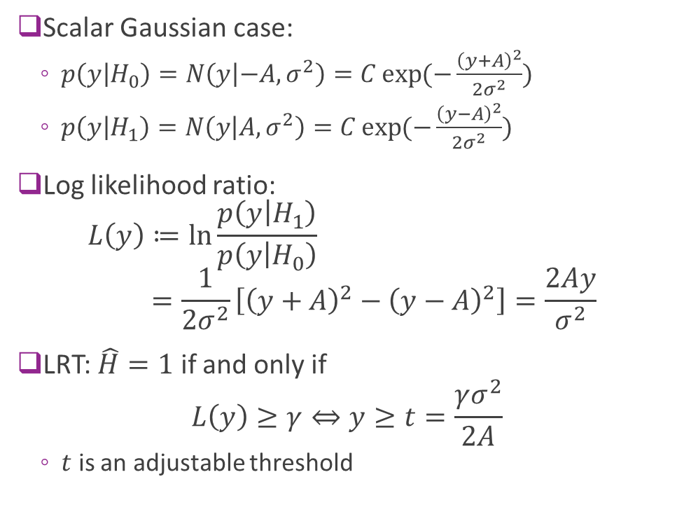


Gaussian Example
Scalar Gaussian case:
$p\left(y | H_{0}\right)=N\left(y | −A,σ^{2}\right)=C\exp{(−\frac{{\left(y+A\right)}^{2}}{2σ^{2}}})$
$p\left(y | H_{1}\right)=N\left(y | A,σ^{2}\right)=C\exp{(−\frac{{\left(y−A\right)}^{2}}{2σ^{2}}})$
Log likelihood ratio: $L\left(y\right)≔\ln{\frac{p\left(y | H_{1}\right)}{p\left(y | H_{0}\right)}}$ $=\frac{1}{2σ^{2}}\left[{\left(y+A\right)}^{2}−{\left(y−A\right)}^{2}\right]=\frac{2Ay}{σ^{2}}$
LRT: $\hat{H}=1$ if and only if $L\left(y\right)≥γ⇔y≥t=\frac{γσ^{2}}{2A}$
$t$ is an adjustable threshold
$$\hat{H}=0$$
$$\hat{H}=1$$

Slide 18
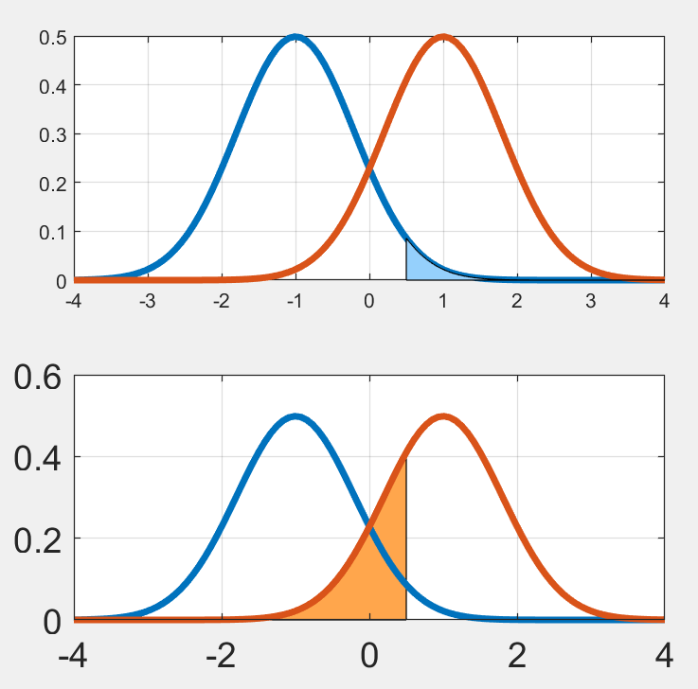
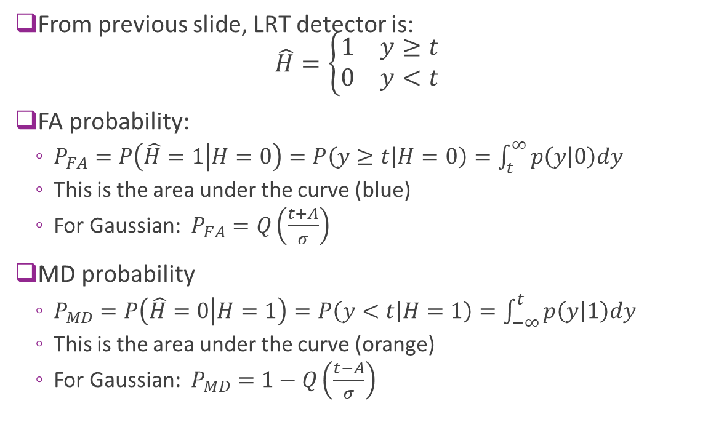
Computing Error Probabilities
From previous slide, LRT detector is: $\hat{H}=\left\{\begin{matrix}1 & y≥t \\ 0 & y<t\end{matrix}\right.$
FA probability:
$P_{FA}=P\left(\hat{H}=1 | H=0\right)=P\left(y≥t | H=0\right)=\int_{t}^{∞}{p\left(y | 0\right)dy}$
This is the area under the curve (blue)
For Gaussian: $P_{FA}=Q\left(\frac{t+A}{σ}\right)$
MD probability
$P_{MD}=P\left(\hat{H}=0 | H=1\right)=P\left(y<t | H=1\right)=\int_{−∞}^{t}{p\left(y | 1\right)dy}$
This is the area under the curve (orange)
For Gaussian: $P_{MD}=1−Q\left(\frac{t−A}{σ}\right)$

Slide 19
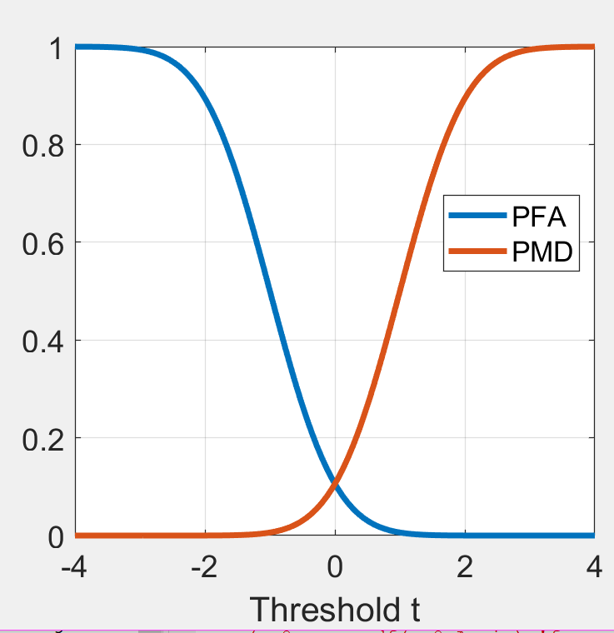
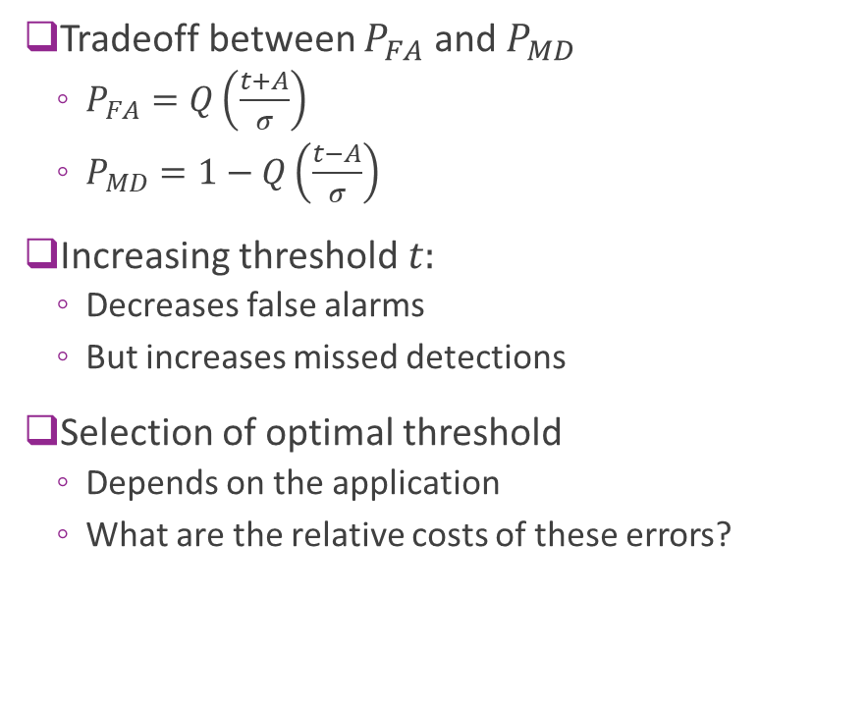
Tradeoff
Tradeoff between $P_{FA}$ and $P_{MD}$
$P_{FA}=Q\left(\frac{t+A}{σ}\right)$
$P_{MD}=1−Q\left(\frac{t−A}{σ}\right)$
Increasing threshold $t:$
Decreases false alarms
But increases missed detections
Selection of optimal threshold
Depends on the application
What are the relative costs of these errors?

Slide 20
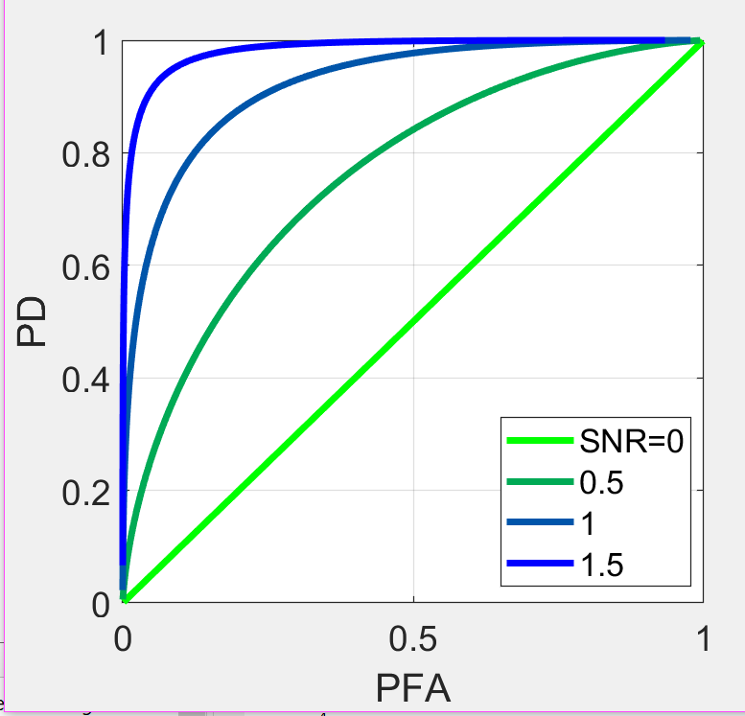
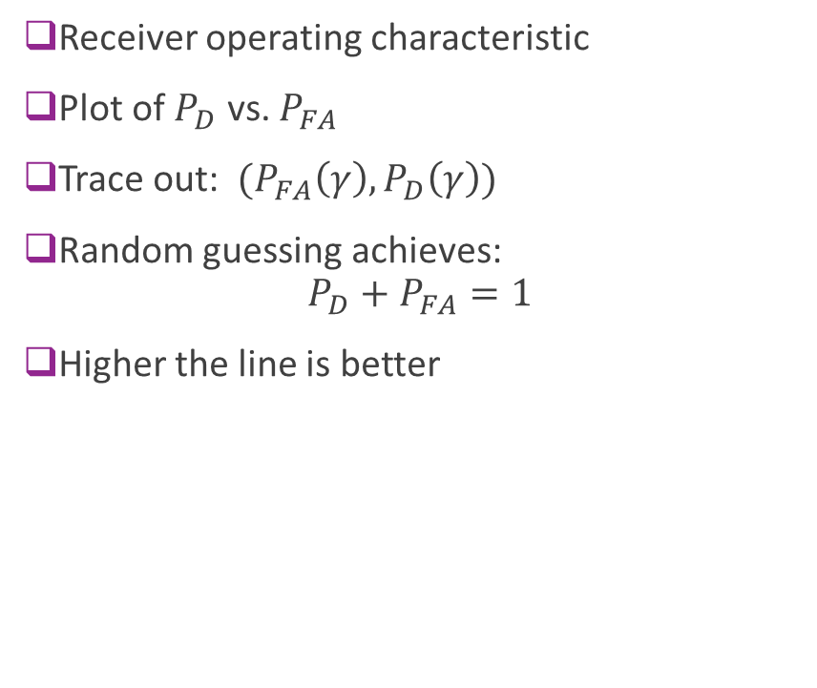
ROC Curve
Receiver operating characteristic
Plot of $P_{D}$ vs. $P_{FA}$
Trace out: $(P_{FA}\left(γ\right),P_{D}\left(γ\right))$
Random guessing achieves: $P_{D}+P_{FA}=1$
Higher the line is better

Slide 21

Neyman-Pearson Theorem
Theorem: Suppose that an LRT obtains $P_{FA}=α$. Then any other test with $P_{FA}$ will have a $P_{D}$ less than or equal to the LRT.
LRT is the most powerful test
Obtains best $P_{FA}$ vs. $P_{D}$ performance

Slide 22
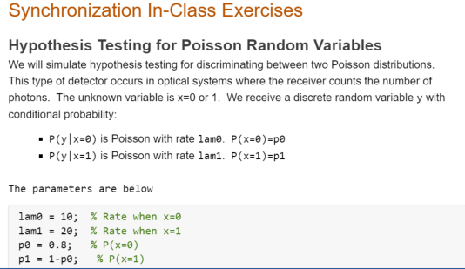
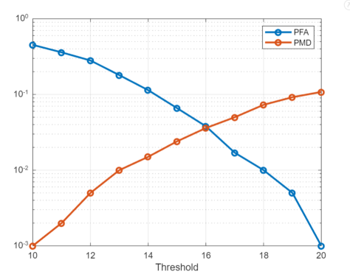
In Class Exercise

Slide 23
Outline
Detection and Synchronization Problem
Hypothesis Testing
Match Filtering for Detection at a Known Delay
Match Filter SNR and Error Probabilities
Match Filtering Convolution with an Unknown Signal Delay
Automatic Gain Control (AGC)
Appendix 1. Error Probability Calculation Details
Appendix 2. Matched Filtering as a Generalized Likelihood Ratio Test

Slide 24
Simple Synchronization Model
TX sends a preamble / synchronization signal
$x\left[n\right],$ $n=0,1,2,…,N−1$
Complex baseband samples.
Sample rate $\frac{1}{T}$
If signal is present at RX: $y\left[n\right]=hx\left[n−k\right]+w[n]$
$h$: Complex channel gain
$k$: Integer delay
Problem detect if signal is present or not.
If so, what is the delay
For now, we assume:
Integer delays, no multipath
Will address these issues later
$$x[n]$$
TX
$$hx[n−k]$$
RX
Delay=$kT$

Slide 25

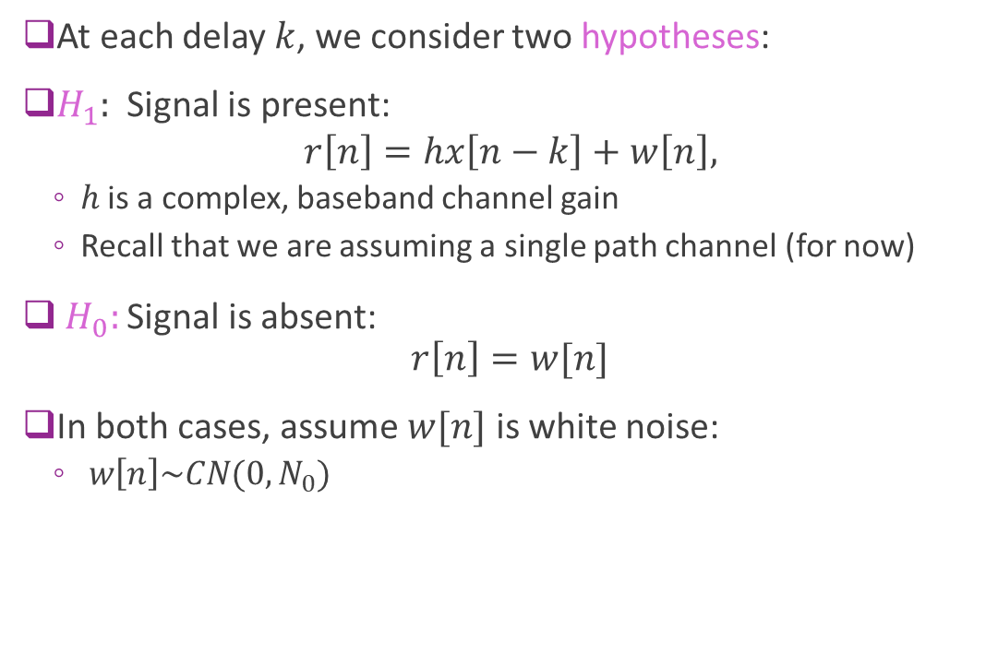

Detect as a Hypothesis Test
At each delay $k$, we consider two hypotheses:
$H_{1}:$ Signal is present:
$$r\left[n\right]=hx\left[n−k\right]+w\left[n\right],$$
$h$ is a complex, baseband channel gain
Recall that we are assuming a single path channel (for now)
$H_{0}:$ Signal is absent: $r\left[n\right]=w[n]$
In both cases, assume $w[n]$ is white noise:
$w\left[n\right]\sim CN(0,N_{0})$
$$hx[n−k]$$
Delay=$kT$

Slide 26
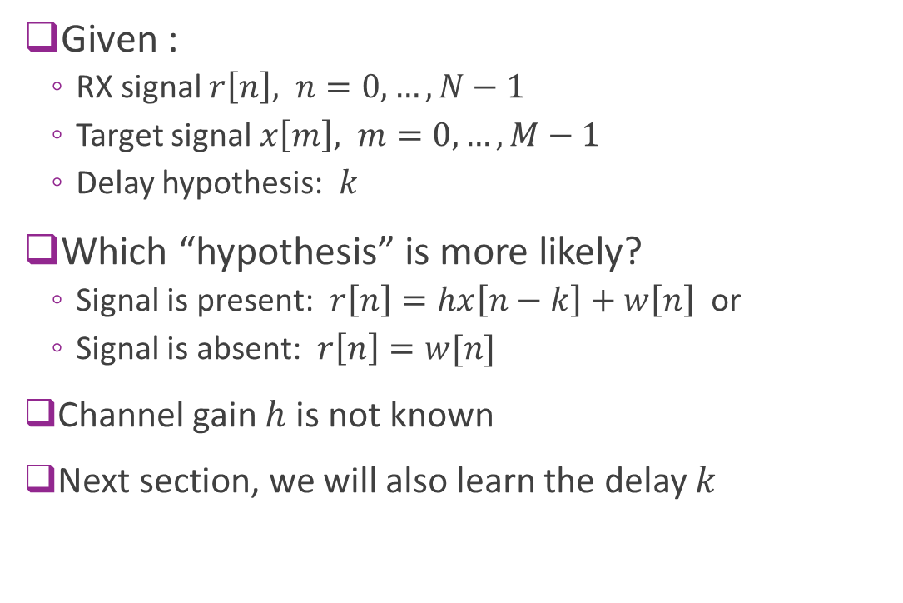
Detection Problem with a Known Delay
Given :
RX signal $r\left[n\right], n=0,…,N−1$
Target signal $x\left[m\right], m=0,…,M−1$
Delay hypothesis: $k$
Which “hypothesis” is more likely?
Signal is present: $r\left[n\right]=hx\left[n−k\right]+w\left[n\right]$ or
Signal is absent: $r\left[n\right]=w[n]$
Channel gain $h$ is not known
Next section, we will also learn the delay $k$
$$hx[n−k]$$
Delay=$kT$

Slide 27
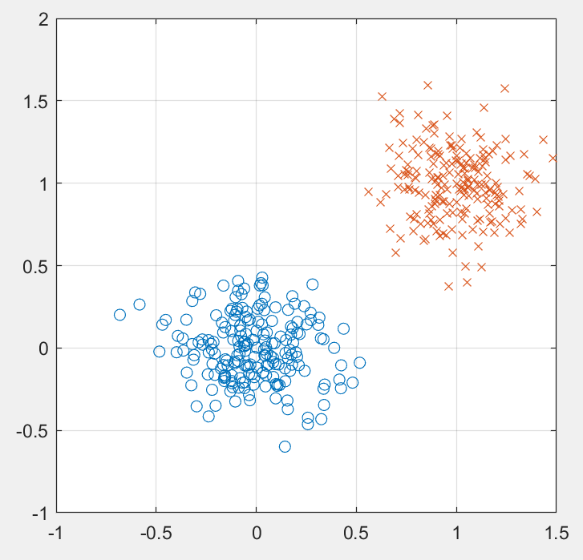
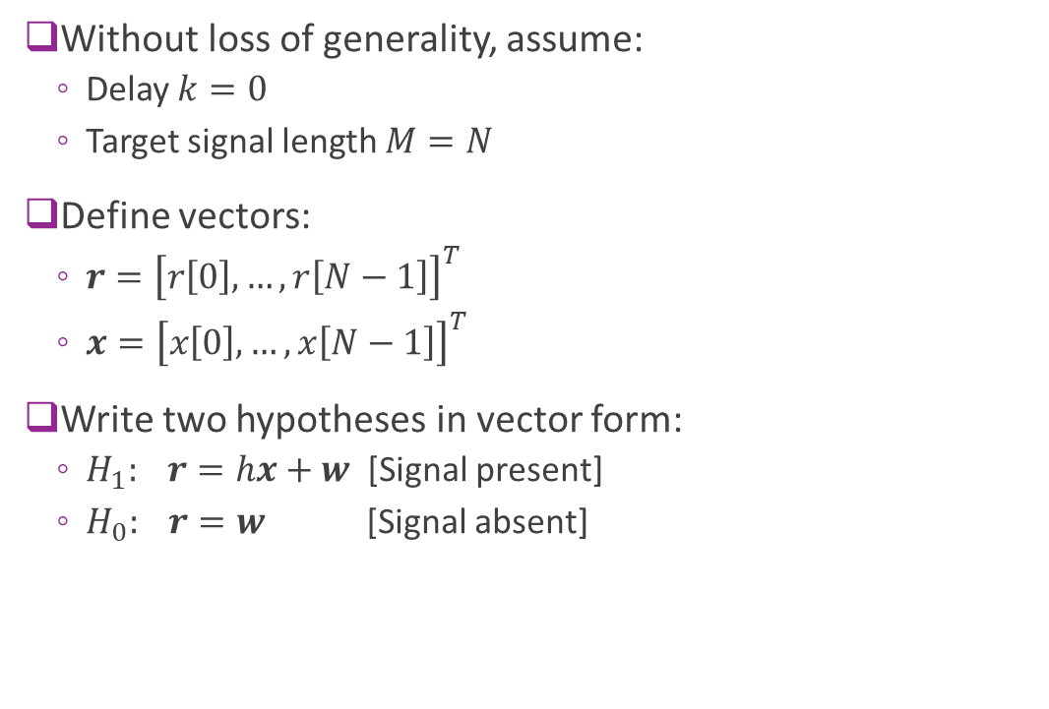

Hypothesis Test in Vector Form
Without loss of generality, assume:
Delay $k=0$
Target signal length $M=N$
Define vectors:
$r={\left[r\left[0\right],…,r\left[N−1\right]\right]}^{T}$
$x={\left[x\left[0\right],…,x\left[N−1\right]\right]}^{T}$
Write two hypotheses in vector form:
$H_{1}: r=hx+w$ [Signal present]
$H_{0}: r=w$ [Signal absent]
$$hx$$

Slide 28

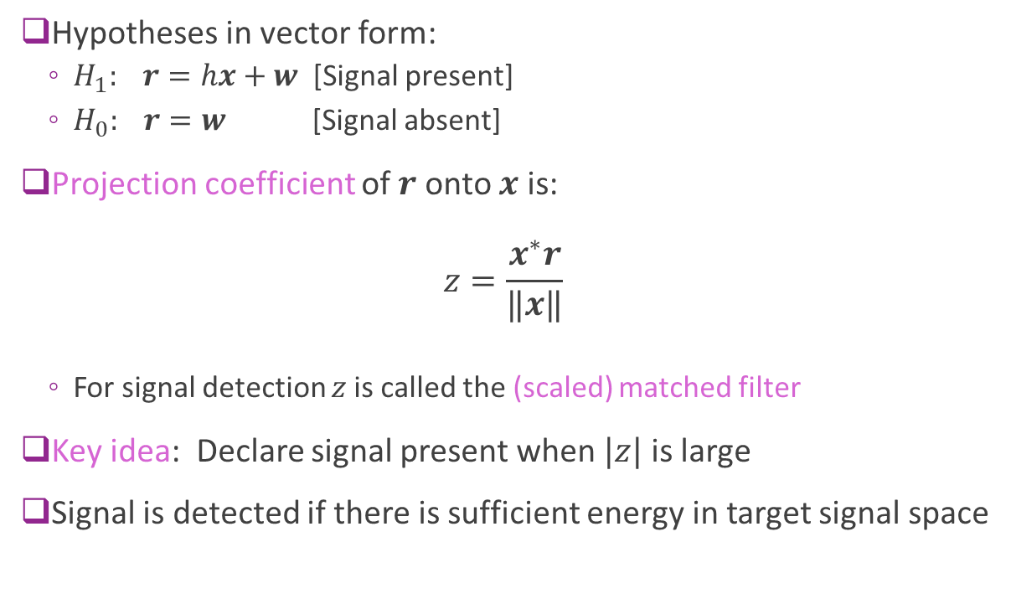


Projection
Hypotheses in vector form:
$H_{1}: r=hx+w$ [Signal present]
$H_{0}: r=w$ [Signal absent]
Projection coefficient of $r$ onto $x$ is: $z=\frac{x^{∗}r}{‖x‖}$
For signal detection $z$is called the (scaled) matched filter
Key idea: Declare signal present when $|z|$ is large
Signal is detected if there is sufficient energy in target signal space
$$r$$
$$z=\frac{x^{∗}r}{‖x‖}$$
$$x$$

Slide 29

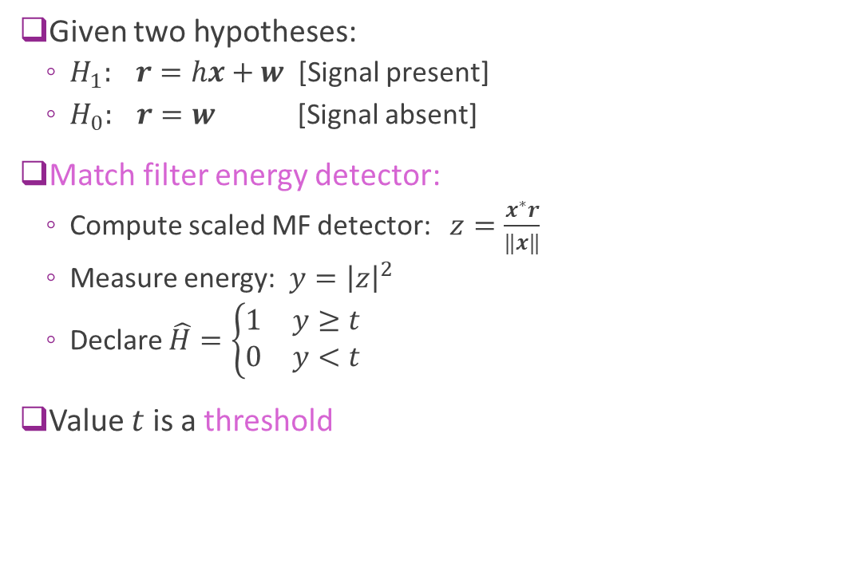


Match Filter Detector
Given two hypotheses:
$H_{1}: r=hx+w$ [Signal present]
$H_{0}: r=w$ [Signal absent]
Match filter energy detector:
Compute scaled MF detector: $z=\frac{x^{∗}r}{‖x‖}$
Measure energy: $y={\left|z\right|}^{2}$
Declare $\hat{H}=\left\{\begin{matrix}1 & y≥t \\ 0 & y<t\end{matrix}\right.$
Value $t$ is a threshold
$$r$$
$$z=\frac{x^{∗}r}{‖x‖}$$
$$x$$

Slide 30
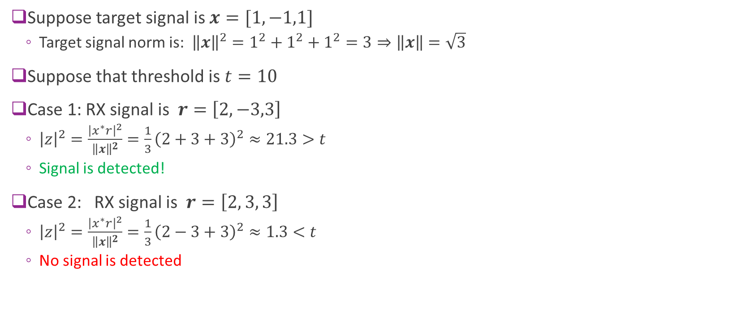
MF Example
Suppose target signal is $x=[1,−1,1]$
Target signal norm is: ${\left\|x\right\|}^{2}=1^{2}+1^{2}+1^{2}=3⇒\left\|x\right\|=\sqrt{3}$
Suppose that threshold is $t=10$
Case 1: RX signal is $r=\left[2,−3,3\right]$
${\left|z\right|}^{2}=\frac{{\left|x^{∗}r\right|}^{2}}{{\left\|x\right\|}^{2}}=\frac{1}{3}{\left(2+3+3\right)}^{2}≈21.3>t$
Signal is detected!
Case 2: RX signal is $r=\left[2, 3, 3\right]$
${\left|z\right|}^{2}=\frac{{\left|x^{∗}r\right|}^{2}}{{\left\|x\right\|}^{2}}=\frac{1}{3}{\left(2−3+3\right)}^{2}≈1.3<t$
No signal is detected

Slide 31

MF Normalization
Up to now, we have used the scaled or normalized MF: $z=\frac{x^{∗}r}{\left\|x\right\|}$
Often, we will use the un-normalized MF: $z=x^{∗}r$
Detection method is the same, just the threshold changes: $\frac{|x^{∗}r|}{\left\|x\right\|}≥t⟺|x^{∗}r|≥t\left\|x\right\|$

Slide 32
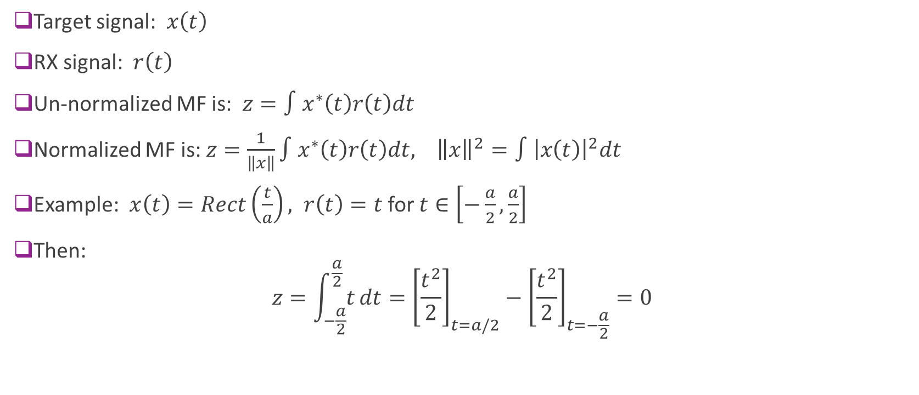
MF in Continuous-Time
Target signal: $x\left(t\right)$
RX signal: $r\left(t\right)$
Un-normalized MF is: $z=∫x^{∗}\left(t\right)r\left(t\right)dt$
Normalized MF is: $z=\frac{1}{\left\|x\right\|}∫x^{∗}\left(t\right)r\left(t\right)dt, {\left\|x\right\|}^{2}=∫{\left|x\left(t\right)\right|}^{2}dt$
Example: $x\left(t\right)=Rect\left(\frac{t}{a}\right), r\left(t\right)=t$ for $t∈\left[−\frac{a}{2},\frac{a}{2}\right]$
Then: $z=\int_{−\frac{a}{2}}^{\frac{a}{2}}{t}dt={\left[\frac{t^{2}}{2}\right]}_{t=a/2}−{\left[\frac{t^{2}}{2}\right]}_{t=−\frac{a}{2}}=0$

Slide 33
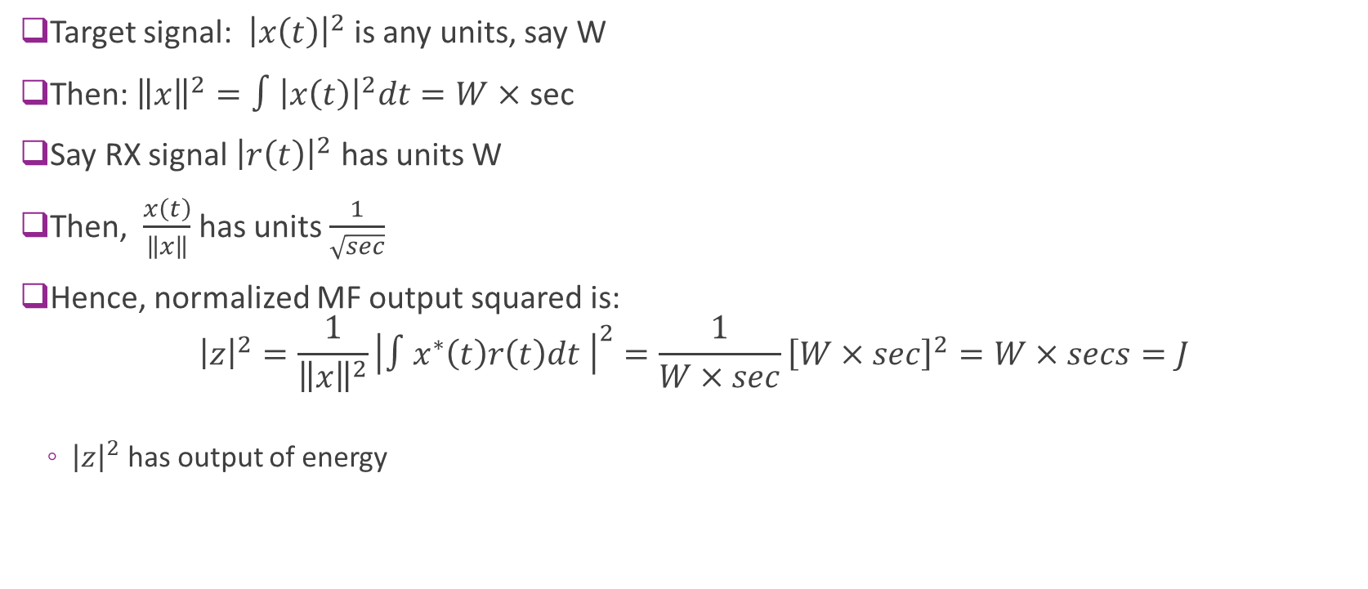
Units
Target signal: ${\left|x\left(t\right)\right|}^{2}$ is any units, say W
Then: ${\left\|x\right\|}^{2}=∫{\left|x\left(t\right)\right|}^{2}dt=W×$ sec
Say RX signal ${\left|r\left(t\right)\right|}^{2}$ has units W
Then, $\frac{x\left(t\right)}{\left\|x\right\|}$ has units $\frac{1}{\sqrt{sec}}$
Hence, normalized MF output squared is: ${\left|z\right|}^{2}=\frac{1}{{\left\|x\right\|}^{2}}{\left|∫x^{∗}\left(t\right)r\left(t\right)dt \right|}^{2}=\frac{1}{W×sec}{\left[W×sec\right]}^{2}=W×secs=J$
${\left|z\right|}^{2}$ has output of energy

Slide 34
Outline
Detection and Synchronization Problem
Hypothesis Testing
Match Filtering for Detection at a Known Delay
Match Filter SNR and Error Probabilities
Match Filtering Convolution with an Unknown Signal Delay
Automatic Gain Control (AGC)
Appendix 1. Error Probability Calculation Details
Appendix 2. Matched Filtering as a Generalized Likelihood Ratio Test

Slide 35
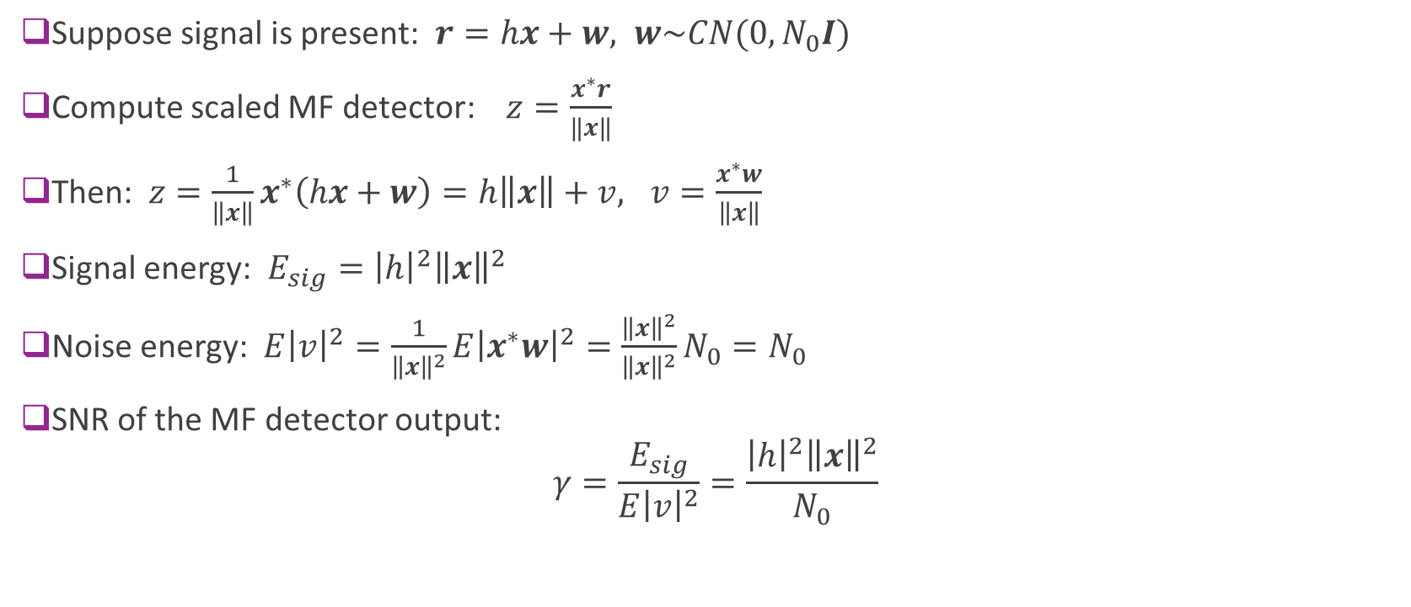
SNR of the MF Detector
Suppose signal is present: $r=hx+w, w\sim CN(0,N_{0}I)$
Compute scaled MF detector: $z=\frac{x^{∗}r}{‖x‖}$
Then: $z=\frac{1}{\left\|x\right\|}x^{∗}\left(hx+w\right)=h\left\|x\right\|+v, v=\frac{x^{∗}w}{\left\|x\right\|}$
Signal energy: $E_{sig}={\left|h\right|}^{2}{\left\|x\right\|}^{2}$
Noise energy: $E{\left|v\right|}^{2}=\frac{1}{{\left\|x\right\|}^{2}}E{\left|x^{∗}w\right|}^{2}=\frac{{\left\|x\right\|}^{2}}{{\left\|x\right\|}^{2}}N_{0}=N_{0}$
SNR of the MF detector output: $γ=\frac{E_{sig}}{E{\left|v\right|}^{2}}=\frac{{\left|h\right|}^{2}{\left\|x\right\|}^{2}}{N_{0}}$

Slide 36
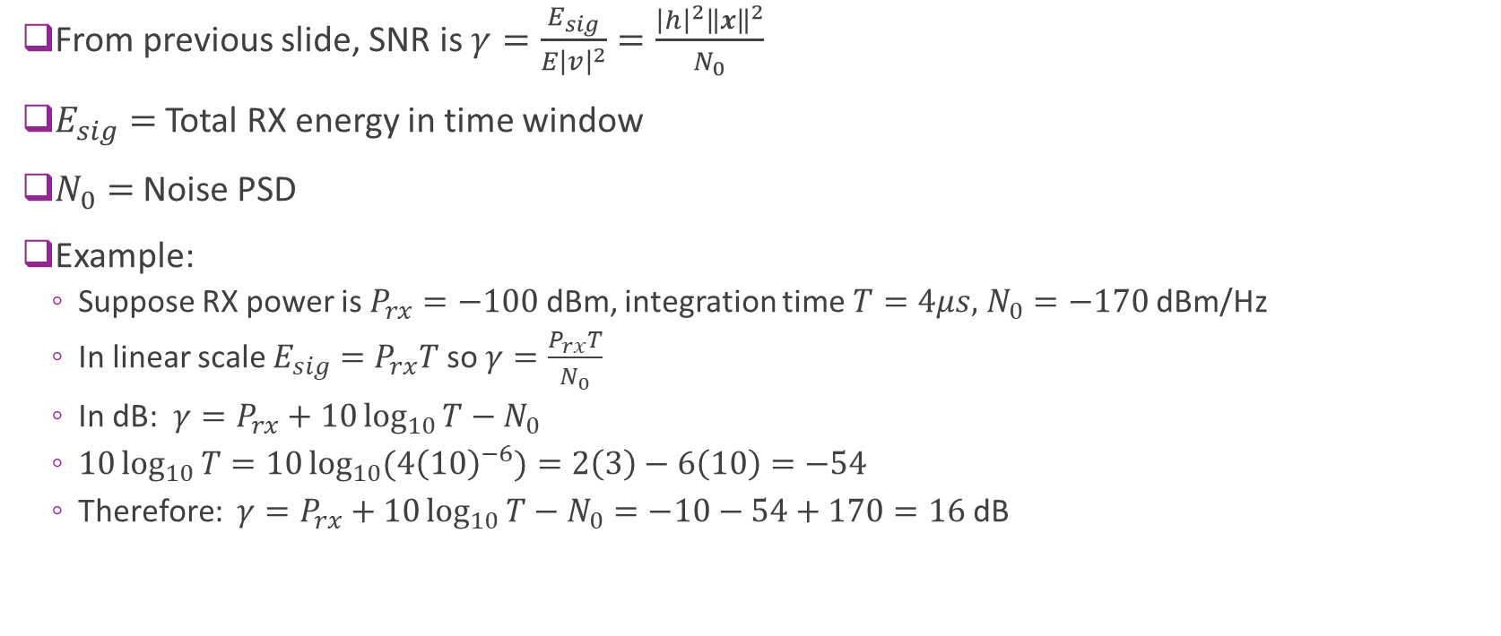
SNR and RX Power
From previous slide, SNR is $γ=\frac{E_{sig}}{E{\left|v\right|}^{2}}=\frac{{\left|h\right|}^{2}{\left\|x\right\|}^{2}}{N_{0}}$
$E_{sig}=$ Total RX energy in time window
$N_{0}=$ Noise PSD
Example:
Suppose RX power is $P_{rx}=−100$ dBm, integration time $T=4μs,$ $N_{0}=−170$ dBm/Hz
In linear scale $E_{sig}=P_{rx}T$ so $γ=\frac{P_{rx}T}{N_{0}}$
In dB: $γ=P_{rx}+10\log_{10}{T}−N_{0}$
$10\log_{10}{T}=10\log_{10}{(4{\left(10\right)}^{−6})}=2\left(3\right)−6\left(10\right)=−54$
Therefore: $γ=P_{rx}+10\log_{10}{T}−N_{0}=−10−54+170=16$dB

Slide 37
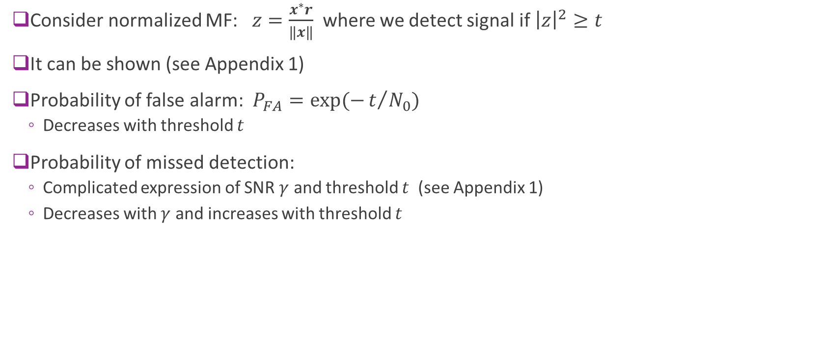
Error Probabilities
Consider normalized MF: $z=\frac{x^{∗}r}{‖x‖}$ where we detect signal if ${\left|z\right|}^{2}≥t$
It can be shown (see Appendix 1)
Probability of false alarm: $P_{FA}=exp(−t/{N_{0}})$
Decreases with threshold $t$
Probability of missed detection:
Complicated expression of SNR $γ$ and threshold $t$ (see Appendix 1)
Decreases with $γ$ and increases with threshold $t$

Slide 38
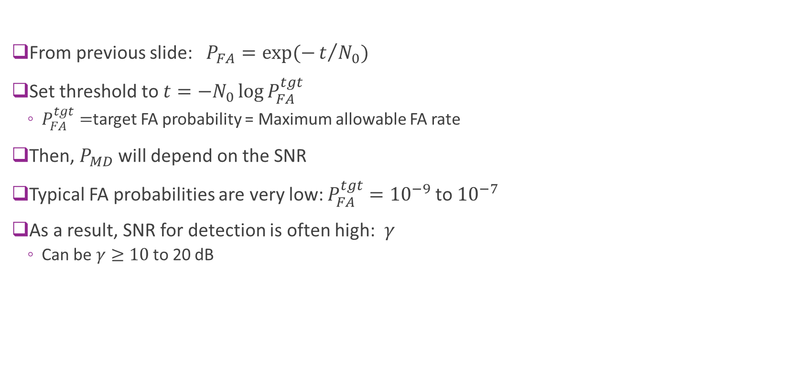
Selecting the Threshold
From previous slide: $P_{FA}=exp(−t/{N_{0}})$
Set threshold to $t=−N_{0}\log{P_{FA}^{tgt}}$
$P_{FA}^{tgt}=$target FA probability = Maximum allowable FA rate
Then, $P_{MD}$ will depend on the SNR
Typical FA probabilities are very low: $P_{FA}^{tgt}={10}^{−9}$to ${10}^{−7}$
As a result, SNR for detection is often high: $γ$
Can be $γ≥10$ to 20 dB

Slide 39
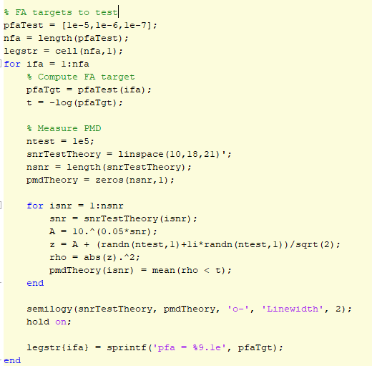
Simulation
Theoretically calculated threshold based on PFA target
Simulate PMD based on SNR

Slide 40

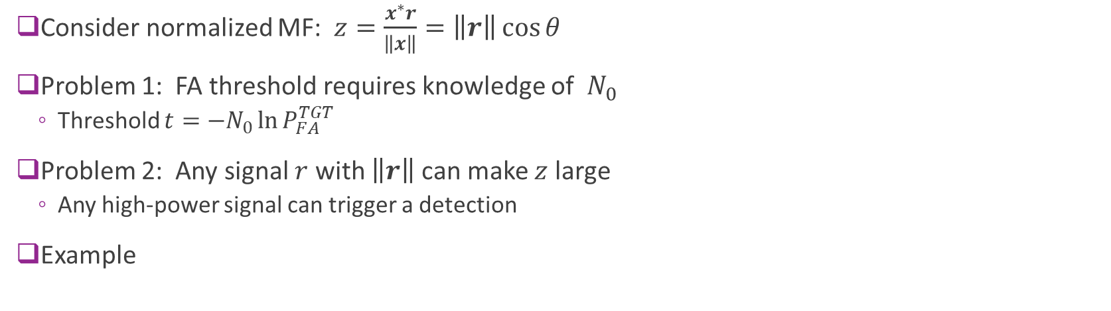
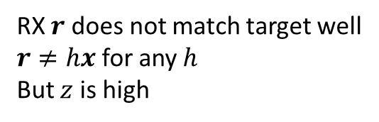
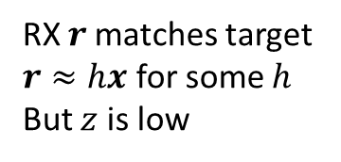
Problems with MF
Consider normalized MF: $z=\frac{x^{∗}r}{\left\|x\right\|}=\left\|r\right\|\cos{θ}$
Problem 1: FA threshold requires knowledge of $N_{0}$
Threshold $t={−N}_{0}\ln{P_{FA}^{TGT}}$
Problem 2: Any signal $r$ with $\left\|r\right\|$ can make $z$ large
Any high-power signal can trigger a detection
Example
Target $x$
RX $r$matches target $r≈hx$ for some $h$
But $z$ is low
RX $r$ does not match target well
$r≠hx$ for any $h$
But $z$ is high

Slide 41



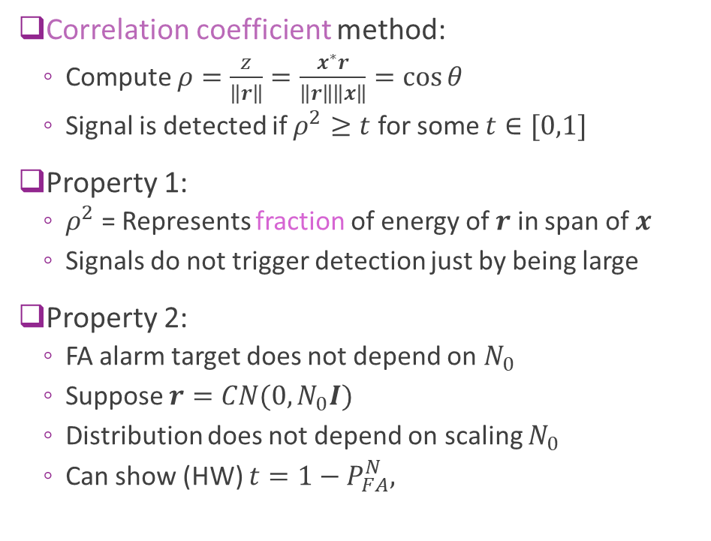


Correlation Coefficient Method
Correlation coefficient method:
Compute $ρ=\frac{z}{\left\|r\right\|}=\frac{x^{∗}r}{\left\|r\right\|\left\|x\right\|}=\cos{θ}$
Signal is detected if $ρ^{2}≥t$ for some $t∈[0,1]$
Property 1:
$ρ^{2}$= Represents fraction of energy of $r$ in span of $x$
Signals do not trigger detection just by being large
Property 2:
FA alarm target does not depend on $N_{0}$
Suppose $r=CN(0,N_{0}I)$
Distribution does not depend on scaling $N_{0}$
Can show (HW) $t=1−P_{FA}^{N},$
$$d$$
$$r$$
$$z=\frac{x^{∗}r}{‖x‖}$$
$$θ$$
$$x$$

Slide 42
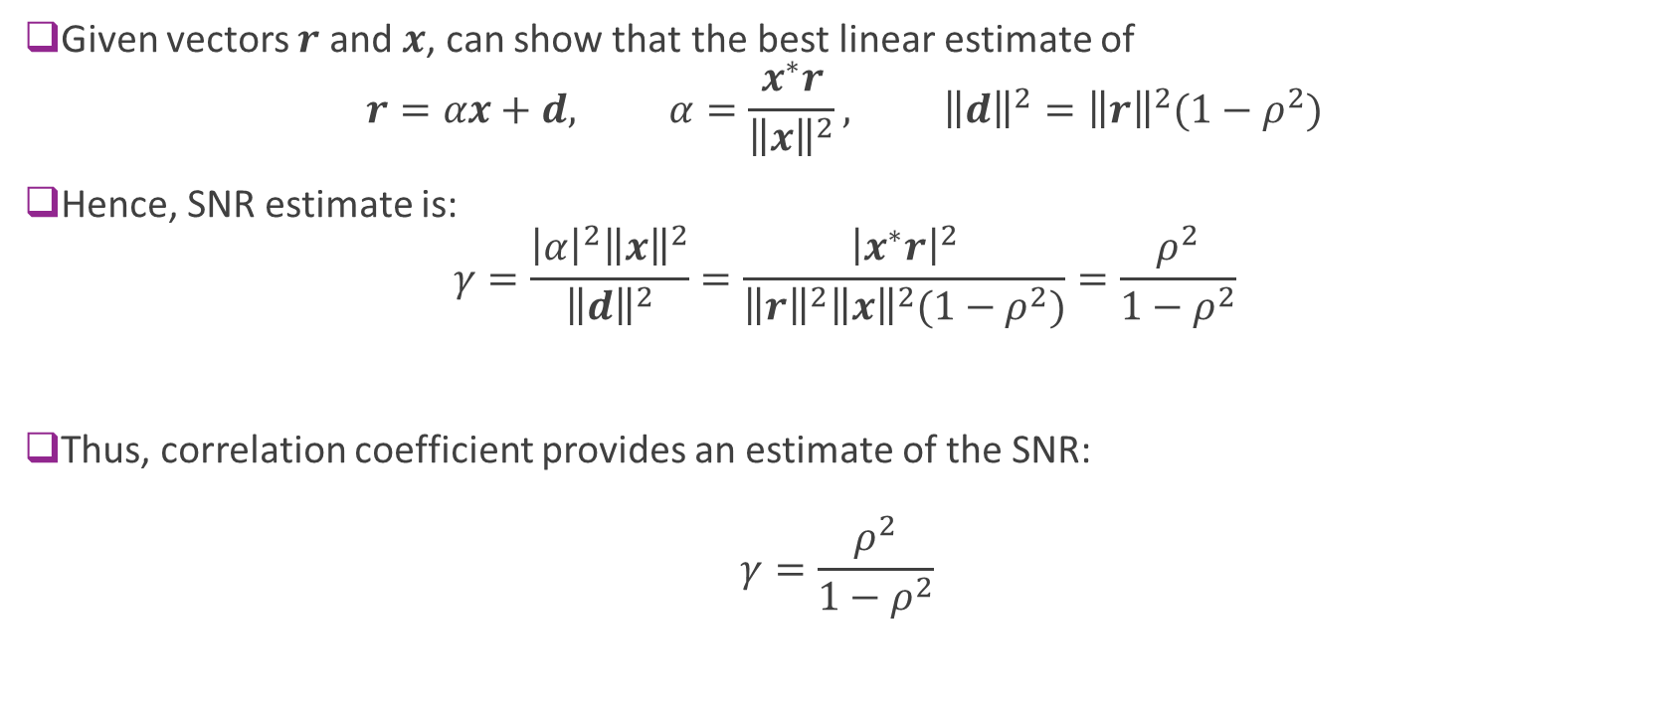
SNR Estimate
Given vectors $r$ and $x$, can show that the best linear estimate of $r=αx+d, α=\frac{x^{∗}r}{{\left\|x\right\|}^{2}}, {\left\|d\right\|}^{2}={\left\|r\right\|}^{2}(1−ρ^{2})$
Hence, SNR estimate is: $γ=\frac{{\left|α\right|}^{2}{\left\|x\right\|}^{2}}{{\left\|d\right\|}^{2}}=\frac{{\left|x^{∗}r\right|}^{2}}{{\left\|r\right\|}^{2}{\left\|x\right\|}^{2}(1−ρ^{2})}=\frac{ρ^{2}}{1−ρ^{2}}$
Thus, correlation coefficient provides an estimate of the SNR: $γ=\frac{ρ^{2}}{1−ρ^{2}}$

Slide 43
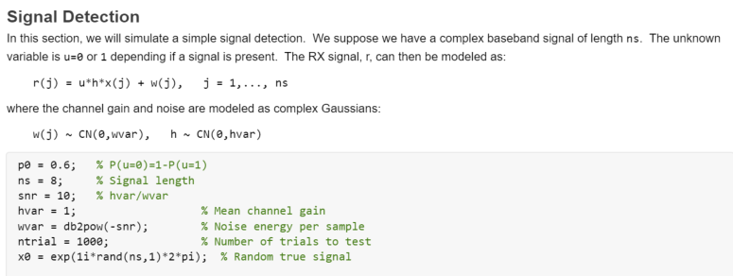
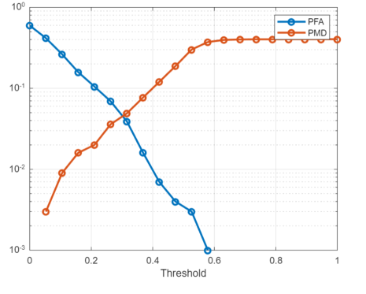
In Class Exercise

Slide 44
Outline
Detection and Synchronization Problem
Hypothesis Testing
Match Filtering for Detection at a Known Delay
Match Filter SNR and Error Probabilities
Match Filtering Convolution with an Unknown Signal Delay
Automatic Gain Control (AGC)
Appendix 1. Error Probability Calculation Details
Appendix 2. Matched Filtering as a Generalized Likelihood Ratio Test

Slide 45
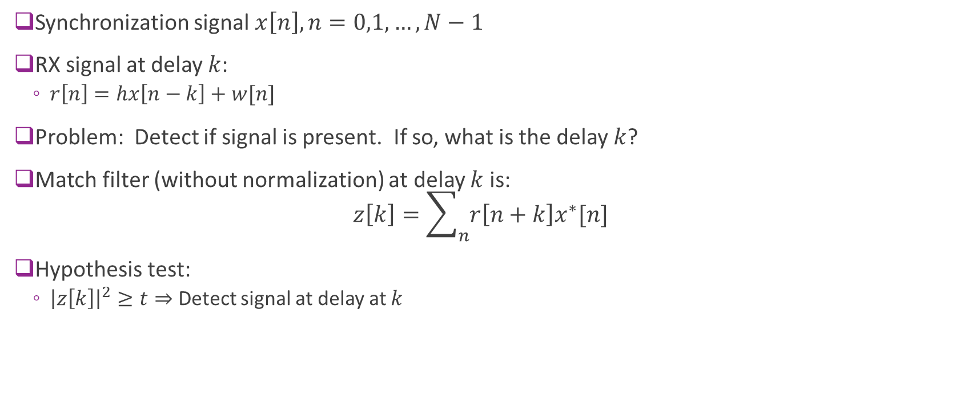
Match Filtering with Unknown Delay
Synchronization signal $x\left[n\right], n=0,1,…,N−1$
RX signal at delay $k$:
$r\left[n\right]=hx\left[n−k\right]+w[n]$
Problem: Detect if signal is present. If so, what is the delay $k$?
Match filter (without normalization) at delay $k$ is: $z\left[k\right]=\sum_{n}{r\left[n+k\right]x^{∗}[n]}$
Hypothesis test:
${\left|z\left[k\right]\right|}^{2}≥t⇒$ Detect signal at delay at $k$

Slide 46
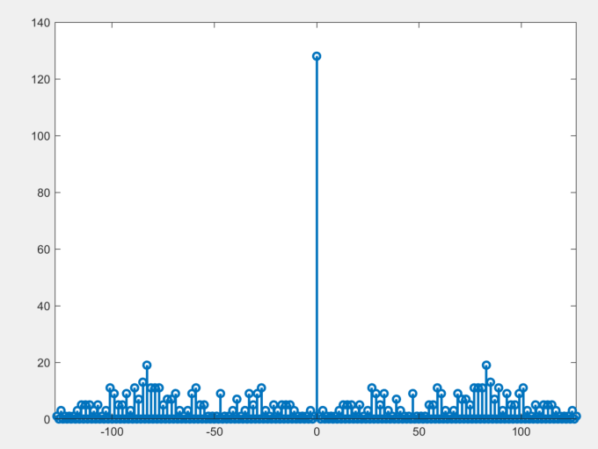

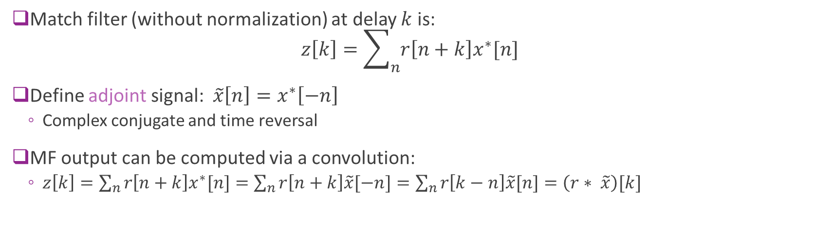


Match Filtering as a Convolution
Match filter (without normalization) at delay $k$ is: $z\left[k\right]=\sum_{n}{r\left[n+k\right]x^{∗}[n]}$
Define adjoint signal: $\tilde{x}\left[n\right]=x^{∗}\left[−n\right]$
Complex conjugate and time reversal
MF output can be computed via a convolution:
$z\left[k\right]=\sum_{n}{r\left[n+k\right]x^{∗}[n]}=\sum_{n}{r\left[n+k\right]\tilde{x}[−n]}=\sum_{n}{r\left[k−n\right]\tilde{x}[n]}=\left(r∗ \tilde{x}\right)[k]$
$$r[n]$$
$$z\left[n\right]$$
Detected signal locations
Filter with $\tilde{x}\left[n\right]$
Peak detection

Slide 47



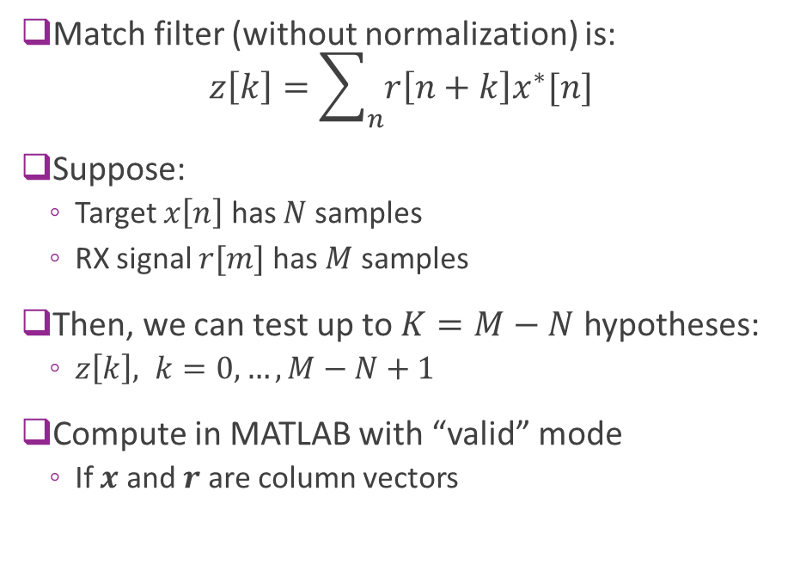



Boundary Conditions
Match filter (without normalization) is: $z\left[k\right]=\sum_{n}{r\left[n+k\right]x^{∗}[n]}$
Suppose:
Target $x\left[n\right]$ has $N$ samples
RX signal $r[m]$ has $M$ samples
Then, we can test up to $K=M−N$ hypotheses:
$z\left[k\right], k=0,…,M−N+1$
Compute in MATLAB with “valid” mode
If $x$ and $r$ are column vectors
$$N$$
Min delay
$$x$$
$$M−N$$
Max delay
$$r$$
$$M$$

Slide 48
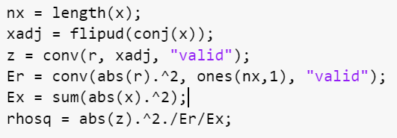

Correlation Coefficient Method
To compute correlation coefficient:
Compute un-normalized MF: $z\left[k\right]=\sum_{n=0}^{N−1}{r\left[n+k\right]x^{∗}[n]}$
Moving average RX energy: $E_{r}\left[k\right]=\sum_{n=0}^{N−1}{{\left|r\left[n+k\right]\right|}^{2}}$
Signal energy: $E_{x}=\sum_{n=0}^{N−1}{{\left|x\left[n\right]\right|}^{2}}$
Then, correlation coefficient squared is: $ρ^{2}\left[k\right]=\frac{{\left|z\left[k\right]\right|}^{2}}{E_{r}\left[k\right] E_{x}}$
Can be perform with two parallel convolutions

Slide 49
Further Analysis Details
We need to examine three key practical issues that degrade performance
Preamble auto-correlation
Multi-path
Carrier offset

Slide 50

Signal Auto-Correlation
Consider what happens with no noise:
$r\left[n\right]=hx\left[n−k_{0}\right]$, $k_{0}=$ “True” delay
Run match filter: $z\left[k\right]=\left(r∗ \tilde{x}\right)[k]$
Can show output is: $z\left[k\right]=hR_{x}[k−k_{0}]$
$R_{x}\left[ℓ\right]=$autocorrelation of transmitted signal
$R_{x}\left[ℓ\right]=\sum_{n}{x\left[n\right]x^{∗}[n−ℓ]}$
Since we want $z\left[k\right]$ small for $k≠k_{0},$ we want: $R_{x}\left[ℓ\right]≈0$ for $ℓ≠0$
Many sequences with low auto-correlation
Golay, Walsh, ….
Auto-correlation of Golay 128 sequence
Used in 802.11ad preamle

Slide 51





Multipath
Up to now we have assumed that there is a single path: $r\left[n\right]=hx\left[n−k_{0}\right]$
But, in reality there is often multipath: $r\left[n\right]=\sum_{k}{h\left[k\right]x[n−k]}$
Due to multi-path in channel and pulse shape filtering
Match filter has delayed copies of auto-correlation: $z\left[n\right]=∑h\left[k\right]R_{x}\left[n−k\right]$
One peak in MF output for each path
Ex: Two path channel
$$h\left[n\right]=sinc\left(n−0.5\right)$$ $+0.5sinc(n−10.2)$
Path at $k=0.5$
Path at $k=10.2$

Slide 52

Frequency Offsets
When initially searching for a preamble, there may be a significant carrier offset
Causes a phase rotation in samples: $r\left[n\right]=e^{iθn}hx\left[n−k\right]+w\left[n\right]$
$θ$ is the phase rotation per sample
$θ=Δf T$, $Δf=$frequency error, $T=$sampling rate
Must integrate over range where phase does not change significantly
Pre-amble length must be $N≪\frac{1}{ΔfT }$
Example: Suppose the carrier offset =10 ppm, $f_{c}=60$GHz and $\frac{1}{T}=1.76$ Gs/s
$ΔfT=\frac{{\left(10\right)}^{−5}\left(60\right){\left(10\right)}^{9}}{1.76{\left(10\right)}^{9}}=3.4{\left(10\right)}^{−4}⇒\frac{1}{Δf T}≈2.9{\left(10\right)}^{3}$ samples
In time duration, this is $\frac{1}{Δf}=1.67$us
A very short time before the signal is completely rotated

Slide 53




Detailed Simulation Example
$$r[n]$$
$$z\left[n\right]$$
Detected signal locations
Filter with $\tilde{x}\left[n\right]$
Peak detection
Transmit 128 length Golay pre-amble
Filter through channel with single (possibly fractional) delay
$r\left[n\right]=h\left[n\right]∗x\left[n\right]+w\left[n\right], h\left[n\right]=sinc(n−\frac{τ}{T})$
Set threshold for FA target of ${10}^{−3}$ per 1000 samples
Measure MD probability as a function of the SNR

Slide 54


Calibration
Need to calibrate the FA probability and delay offset
Estimated Delay
PFA
True Delay
Threshold

Slide 55


Missed Detection
Loss of about 3dB with fractional delay offset
Signal energy is split in two samples
Need to use over-sampling to compensate
See lab

Slide 56
Outline
Detection and Synchronization Problem
Hypothesis Testing
Match Filtering for Detection at a Known Delay
Match Filter SNR and Error Probabilities
Match Filtering Convolution with an Unknown Signal Delay
Automatic Gain Control (AGC)
Appendix 1. Error Probability Calculation Details
Appendix 2. Matched Filtering as a Generalized Likelihood Ratio Test

Slide 57

Automatic Gain Control
AGC goal: Bring RX signal to “correct” level
Tradeoff of two factors
Want high gain: Overcome noise after AMP
But gain too high $⇒$ saturates RX
AGC finds optimal level
RF front end
Digital baseband
Variable gain AMP
Gain
control

Slide 58








Mathematical Model
Digital baseband
RF front-end
Linear gain with noise:
$$u_{1}\left(t\right)=\sqrt{G}r\left(t\right)+w_{1}\left(t\right)$$
Noise after AMP $u_{2}\left(t\right)=u_{1}\left(t\right)+w_{2}\left(t\right)$
Memoryless nonlinearity: $y\left(t\right)=φ(u_{2}\left(t\right))$
$w_{1}(t)$ and $w_{2}(t)$ have PSD $N_{1}$ and $N_{2}$
Digital baseband
Measures RX power or SNR
Controls gain $G$
RF front end
$$w_{1}$$
$$w_{2}$$
Variable gain AMP
$$r$$
$$u_{1}$$
$$u_{2}$$
$$y$$
+
+
$$G$$
Gain
control

Slide 59



Analysis with No Nonlinearity
With no nonlinearity:
$y=\sqrt{G}\left(r+w_{1}\right)+w_{2}=\sqrt{G}r+v$
$v=\sqrt{G}w_{1}+w_{2}$
PSD of signal component $\sqrt{G}r$ in output: $GS_{r}$
PSD of noise in output: $S_{v}=GN_{1}+N_{2}$
Output SNR: $γ_{out}=\frac{GS_{R}}{GN_{1}+N_{2}}=\frac{γ_{1}}{1+\frac{γ_{1}}{Gγ_{2}}}$
$γ_{1}=\frac{S_{r}}{N_{1}}, γ_{2}=\frac{S_{r}}{N_{2}}$
$$w_{1}$$
$$w_{2}$$
Variable gain AMP
$$r$$
$$u_{1}$$
$$y$$
+
+
$$G$$

Slide 60


Analysis with No Nonlinearity Example
$$w_{1}$$
$$w_{2}$$
Output SNR from previous slide:$γ_{out}=\frac{γ_{1}}{1+\frac{γ_{1}}{Gγ_{2}}}$
Fig to left: $γ_{1}=30$dB, $γ_{2}=10$ dB
Observations with no nonlinearity:
Increasing gain always improve output SNR
Saturates at $γ_{out }→γ_{1}$ as $G→∞$
Design principle:
Have high SNR (low noise) in first stage
Increase gain to overcome noise in later stage
Typical RF design starts with a low noise amplifier (LNA)
Variable gain AMP
$$r$$
$$u_{1}$$
$$y$$
+
+
$$G$$

Slide 61





Example with Saturation Nonlinearity
$$w_{1}$$
$$w_{2}$$
With high gain $G$ :
Signal $u_{1}$ becomes large
May saturate component $⇒$ distortion
Saturation occurs in many RF components
E.g., mixer, LNA
Example:
$γ_{1}=\frac{E{\left|r\right|}^{2}}{E{\left|w_{1}\right|}^{2}}=$ 30 dB, $, γ_{2}=\frac{E{\left|r\right|}^{2}}{E{\left|w_{2}\right|}^{2}}=$ 10 dB
Nonlinearity is a saturation: Clips at $±A$
Saturation level $\frac{{\left|A\right|}^{2}}{E{\left|w_{1}\right|}^{2}}=$ 50 dB
We see ideal gain trades off gain and NL distortion
$$r$$
$$u_{1}$$
$$u_{2}$$
$$y$$
+
+
$$G$$
No NL
With NL
Gain too low Signal too small relative to $w_{2}$
Gain too high NL distortion
Ideal gain

Slide 62






Example with ADC
$$w_{1}$$
Example ADC:
Similar to quantization + saturation
Saturates at $y∈[−2^{b−1},2^{b−1}−1]$ with $b$ bits
With finite bit width
Set gain to not overflow ADC
$$r$$
ADC
$$u_{1}$$
$$u_{1}$$
$$y$$
+
$$G$$
$$b=∞$$
$$b=8$$
Gain too low Signal too small relative to $w_{2}$
Gain too high NL distortion
Ideal gain

Slide 63

Practical Gain Control
Measure RX power
$E_{rx}[n]=\sum_{i=0}^{L−1}{{\left|y\left[n−i\right]\right|}^{2}}$
RX power over last $L$ symbols
Adjust gain:
$E_{rx}\left[n\right]>t⇒$ Decrease gain
$E_{rx}\left[n\right]≤t⇒$ Increase gain
Threshold $t$
Set to ensure signal is not saturating
Digital baseband
RF front end
Variable gain AMP
$$r$$
$$y$$
+
+
$$G$$
Gain
control

Slide 64


Gain Control in 802.11
WLAN systems require very fast AGCs
STF (short training field). Duration is $8 μ$s
Used for detection and AGC
Typically set AGC in first ~2 $μs$
Perform detection in remaining $6 μs$
Cannot detect STF until AGC has run
Otherwise, signal will be too low in SNR or too distorted
AGC is implemented in hardware

Slide 65

The 9361 Integrated Circuit
RX
Gain performed in at least three stages
LNA gain control at RF
TIA (transimpedance AMP) gain at IF
Digital gain during digital filtering
Single gain setting selects all three gains
Ensure all intermediate points do not overflow
TX

Slide 66


AGC in the Pluto
MATLAB interface gain control
AGC Fast Attack
AGC automatically performed in HW
Ideal for WLAN with fast gain
But host has no visibility to gain selected
Manual
User can manually select gain
We will use this in lab
But it is very slow
Just for education

Slide 67


SDR Lab
https://github.com/sdrangan/sdrlab/tree/main/lab05_gain

Slide 68
Outline
Detection and Synchronization Problem
Hypothesis Testing
Match Filtering for Detection at a Known Delay
Match Filter SNR and Error Probabilities
Match Filtering Convolution with an Unknown Signal Delay
Automatic Gain Control (AGC)
Appendix 1. Error Probability Calculation Details
Appendix 2. Matched Filtering as a Generalized Likelihood Ratio Test

Slide 69


False Alarm
False alarm
Under $H_{0}:$ $r=w, w\sim CN(0,N_{0}I)$
Statistic $z=\frac{x^{∗}r}{‖x‖}=\frac{x^{∗}w}{‖x‖}$
This is a linear function of a Gaussian
$E\left(z\right)=\frac{x^{∗}E(w)}{‖x‖}=0,$
$E{\left|z\right|}^{2}=\frac{x^{∗}E\left(ww^{∗}\right)x}{{\left\|x\right\|}^{2}}=N_{0}\frac{x^{∗}x}{{\left\|x\right\|}^{2}}=N_{0}$
Hence, $z\sim CN(0,N_{0})$
Hence $y={\left|z\right|}^{2}$ is exponential with $E\left(y\right)=N_{0}$
$P_{FA}=P\left(y≥t\right)=e^{−t/N_{0}}$

Slide 70


Missed Detection
Under $H_{1}:$ $r=hx+w, w\sim CN(0,N_{0}I)$
Statistic $z=\frac{x^{∗}r}{‖x‖}=A+\frac{x^{∗}w}{‖x‖},A=h‖x‖$
Similar to FA calculation: $z\sim CN\left(A,N_{0}\right),$
Can show: $y={\left|z\right|}^{2}\sim \frac{N_{0}}{2}v$
$v$is a non-central chi squared with $2$ degrees of freedom
Non-centrality parameter $λ=\frac{2{\left|h\right|}^{2}{\left\|x\right\|}^{2}}{N_{0}}=2 SNR$

Slide 71
Outline
Detection and Synchronization Problem
Hypothesis Testing
Match Filtering for Detection at a Known Delay
Match Filter SNR and Error Probabilities
Match Filtering Convolution with an Unknown Signal Delay
Automatic Gain Control (AGC)
Appendix 1. Error Probability Calculation Details
Appendix 2. Matched Filtering as a Generalized Likelihood Ratio Test

Slide 72

Likelihood Ratio Test
In vector form:
$H_{1}: r=hx+w$ [Signal present]
$H_{0}: r=w$ [Signal absent]
Likelihoods:
$p\left(r | H_{0},σ^{2}\right)=\frac{C}{σ^{2N}}\exp\left(−\frac{{\left\|r\right\|}^{2}}{σ^{2}}\right)$,
$p\left(r | H_{1},,σ^{2},h\right)=\frac{C}{σ^{2N}}\exp\left(−\frac{{\left\|r−hx\right\|}^{2}}{σ^{2}}\right)$
Cannot apply regular LRT since parameters are unknown
GLRT
$Λ_{0}\left(r,σ^{2}\right)≔−\frac{1}{N}\ln{p\left(r | H_{0}\right)}=\frac{1}{N}\ln{σ^{2}}+\frac{{\left\|r\right\|}^{2}}{Nσ^{2}}$

Slide 73

Generalized Likelihood Ratio Test
Null hypothesis
$Λ_{0}\left(r,σ^{2}\right)≔−\frac{1}{N}\ln{p\left(r | H_{0}\right)}=\frac{1}{N}\ln{σ^{2}}+\frac{{\left\|r\right\|}^{2}}{Nσ^{2}}$
${\overline{Λ}}_{0}\left(r\right)≔\min_{σ^{2}}{\frac{1}{N}\ln{σ^{2}}+\frac{{\left\|r\right\|}^{2}}{Nσ^{2}}}=\frac{1}{N}\ln{\frac{{\left\|r\right\|}^{2}}{N}}+1$
Present hypothesis:
$Λ_{1}\left(r,σ^{2},h\right)≔−\frac{1}{N}\ln{p\left(r | H_{1}\right)}=\frac{1}{N}\ln{σ^{2}}+\frac{{\left\|r−hx\right\|}^{2}}{Nσ^{2}}$
Minimize over $h$: $\min_{h}{\left\|r−hx\right\|}^{2}={\left\|r\right\|}^{2}−\frac{{\left|x^{∗}r\right|}^{2}}{{\left\|x\right\|}^{2}}$
${\overline{Λ}}_{1}\left(r\right)≔\min_{σ^{2},h}{\ln{p\left(r | H_{1}\right)}}=\frac{1}{N}\ln{\frac{1}{N}}\left[{\left\|r\right\|}^{2}−\frac{{\left|x^{∗}h\right|}^{2}}{{\left\|x\right\|}^{2}}\right]+1$
GLRT: $L\left(r\right)≔{\overline{Λ}}_{1}\left(r\right)−{\overline{Λ}}_{0}\left(r\right)=−\ln\left[1−ρ\right], ρ=\frac{{\left|x^{∗}h\right|}^{2}}{{\left\|x\right\|}^{2}{\left\|r\right\|}^{2}}$
Details in class

