Slide 1
Unit 10: Convolutional Codes
EL-GY 6013: Digital communications
Prof. Sundeep rangan

Slide 2
Learning Objectives
Encode data using a convolutional code for given a generator polynomial
Compute the rate of the code including tail bits
Represent the code via a trellis diagram and finite state machine
Compute the branch metrics of a code for a memoryless channel
Decode the code via the Viterbi algorithm

Slide 3
This Unit
Channel coding
Symbol mapping
TX filter DAC
Upconversion
Info bits
Coded bits
IQ symbols
Analog baseband
RF
Passband
Channel
Sync
“Noise”
Channel decoding
Symbol demod
Equalization
RX filter and ADC
Down-conversion

Slide 4
Outline
Convolutional codes: encoding and representations
Tree, trellis and state diagrams
Decoding with branch metrics
Viterbi decoding

Slide 5
Convolutional Codes History
Generates a stream of coded bits from uncoded bits
Block codes form by terminating the stream
Output stream created by binary FIR filters
Developed originally by Elias (1955)
Key challenge was decoders. Much study in 1960s.
Practical, optimal decoders developed by Viterbi,1967.
Can perform within 2-3 dB of Shannon limit.
Instrumental in Pioneer Space program (along with RS codes)
Most widely-used code in industry today: WiFi, cellular
In the mid 1990s, longer block length cellular codes were replaced with Turbo codes,
But, these use convolutional codes as basis

Slide 6
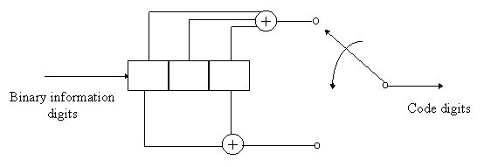

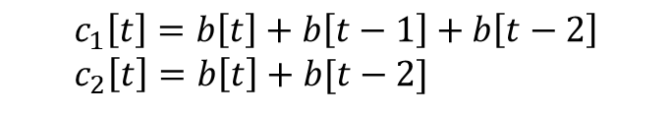
Convolutional Codes
Encode data through parallel binary (usu. FIR) filters
Example convolutional code:
Rate = ½ (two output bits ($c_{1}\left[t\right],c_{2}[t]$) for each input bit b[t].
Constraint length K=3 (size of shift register)
c₁[t]
b[t]
z⁻¹
z⁻¹
z⁻¹
$$c_{1}\left[t\right]=b\left[t\right]+b\left[t−1\right]+b\left[t−2\right] \\ c_{2}\left[t\right]=b\left[t\right]+b[t−2]$$
c₂[t]

Slide 7
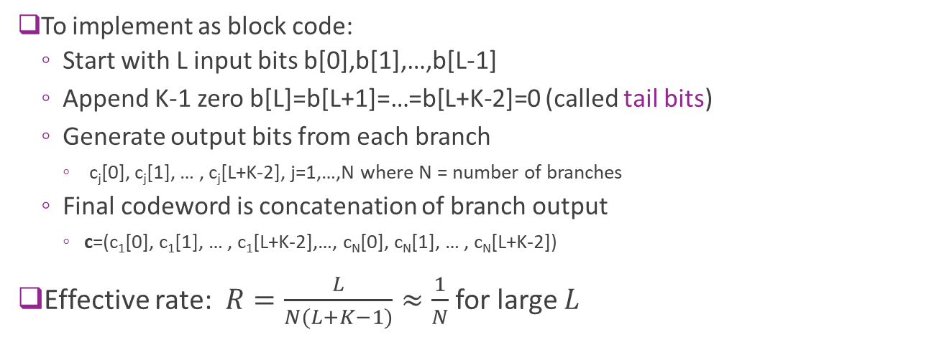
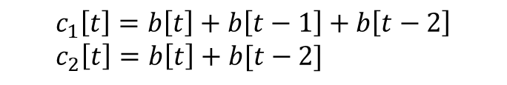
Convolutional Codes Block Implementation
c₁[t]
b[t]
$$c_{1}\left[t\right]=b\left[t\right]+b\left[t−1\right]+b\left[t−2\right] \\ c_{2}\left[t\right]=b\left[t\right]+b[t−2]$$
z⁻¹
z⁻¹
z⁻¹
c₂[t]
To implement as block code:
Start with L input bits b[0],b[1],…,b[L-1]
Append K-1 zero b[L]=b[L+1]=…=b[L+K-2]=0 (called tail bits)
Generate output bits from each branch
c_{j}[0], c_{j}[1], … , c_{j}[L+K-2], j=1,…,N where N = number of branches
Final codeword is concatenation of branch output
c=(c₁[0], c₁[1], … , c₁[L+K-2],…, c_{N}[0], c_{N}[1], … , c_{N}[L+K-2])
Effective rate: $R=\frac{L}{N(L+K−1)}≈\frac{1}{N}$ for large $L$

Slide 8
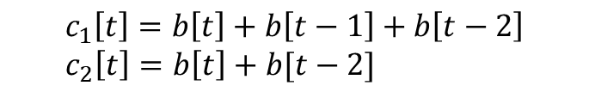
Convolutional Codes Encoding Example
Encode message b = [1 0 1]
Branch outputs c1=[11011] c2=[11001]
Final output c=[11,10,00,10,11] (interleaved)
Rate = 3/10
$$c_{1}\left[t\right]=b\left[t\right]+b\left[t−1\right]+b\left[t−2\right] \\ c_{2}\left[t\right]=b\left[t\right]+b[t−2]$$
t | b[t] | c1[t] | c2[t]
0 | 1 | 1 | 1
1 | 0 | 1 | 0
2 | 1 | 0 | 0
3 | 0 | 1 | 0
4 | 0 | 1 | 1
c₁[t]
b[t]
z⁻¹
z⁻¹
z⁻¹
Tail bits
c₂[t]

Slide 9
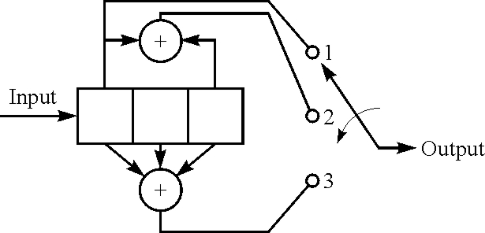
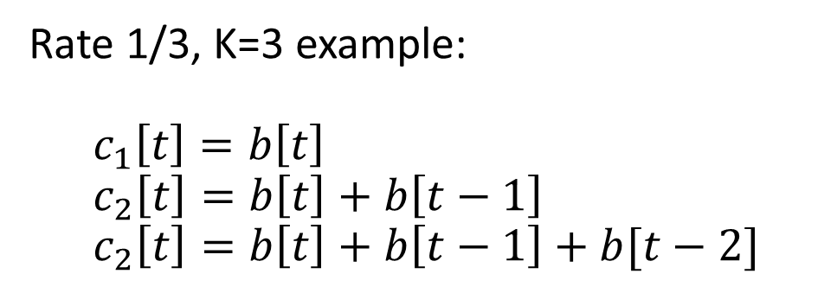
Generator Polynomials: Binary Form
Rate 1/3, K=3 example: $$c_{1}\left[t\right]=b\left[t\right] \\ c_{2}\left[t\right]=b\left[t\right]+b\left[t−1\right] \\ c_{2}\left[t\right]=b\left[t\right]+b\left[t−1\right]+b[t−2]$$
Code polynomials: Binary vector of filter coefficients

Slide 10
Generator Polynomials: Octal Form
For large constraint lengths (large K), binary form is inefficient
Engineers often use octal form
Base 8, each digit 0…7
Each digit represents three bits
Example:
Binary
Octal

Slide 11
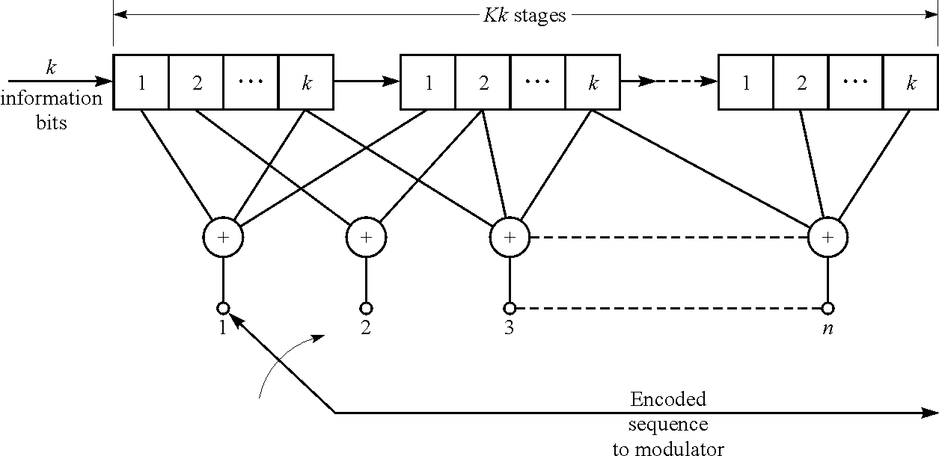
Multiple Inputs
Examples up to now are R=1/n
Can extend to rate R=k/n
Add k bits at a time

Slide 12
Outline
Convolutional codes: encoding and representations
Tree, trellis and state diagrams
Decoding with branch metrics
Viterbi decoding

Slide 13
Convolutional Codes as State Machines
Convolutional codes have memory
Stored in contents of shift registers
Each input bit changes memory contents
Output bits are a function of memory and input
Three common ways to represent evolution of the memory:
Tree diagram
Trellis diagram
State diagram

Slide 14

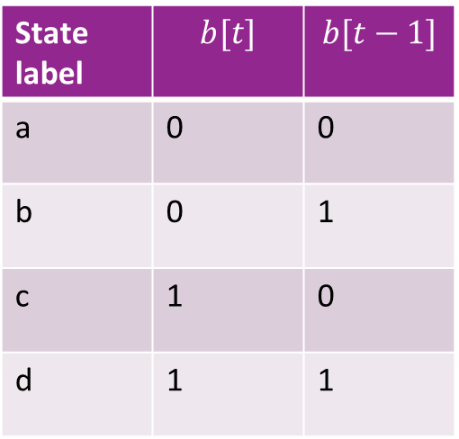
Encoder States
State of the encoder determined by contents of shift register
Only need to look at most recent K-1 bits
Last bit will be shifted out
There are $2^{K−1}$ states
State label | $$b[t]$$ | $$b[t−1]$$
a | 0 | 0
b | 0 | 1
c | 1 | 0
d | 1 | 1
b[t] b[t-1]

Slide 15
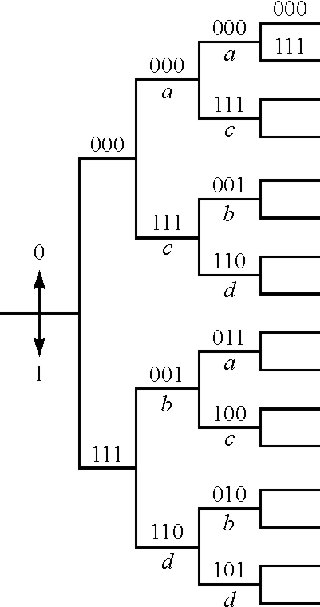
Tree Diagram
Two branches for each input bit 0 or 1.
Branches labeled by output bits (n bits)
Difficult to use since branches infinitely grow

Slide 16
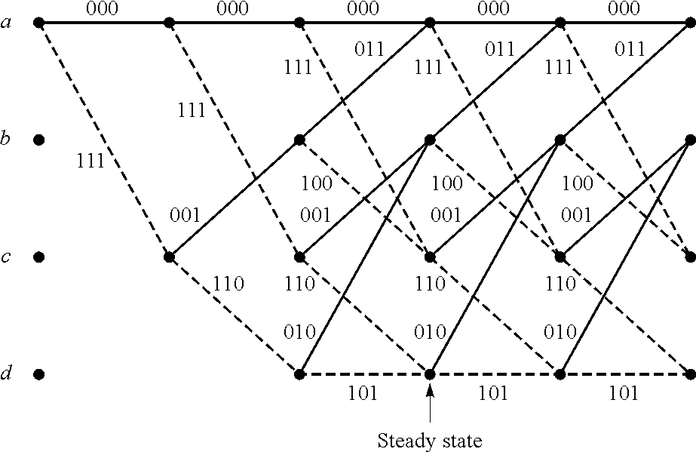
Trellis Diagram
Show trajectory through the states
Solid lines: paths with b[t]=0, Dash lines: b[t]=1
Labels are the outputs along each path

Slide 17
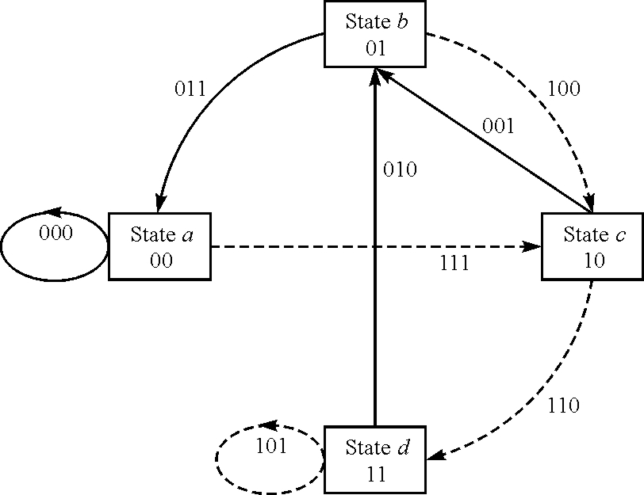
State Diagram
One node per state
Solid lines:
Transitions with b[t]=0
Dashed lines:
Transitions with b[t]=1
Labels indicate outputs on each state

Slide 18

State Machine Functional Description
Finite state machine:
$x[t]$: Sequence of states, $x\left[t\right]∈\{0,…,2^{K−1}−1\}$
$b[t]$: Input sequence
$c[t]$: Output sequence
Iterative generating sequence: $x\left[t+1\right]=f\left(x\left[t\right], b\left[t\right]\right)$ $c\left[t\right]=h(x\left[t\right], b\left[t\right])$
Initial condition: $x[0]$
State function
Output function

Slide 19
Outline
Convolutional codes: encoding and representations
Tree, trellis and state diagrams
Decoding with branch metrics
Viterbi decoding

Slide 20
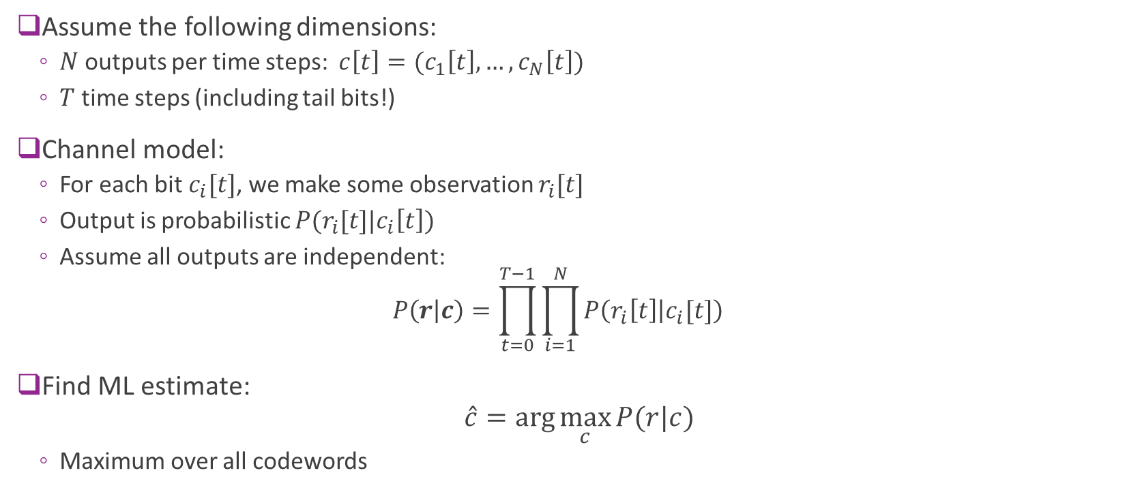
ML Estimation
Assume the following dimensions:
$N$ outputs per time steps: $c\left[t\right]=(c_{1}\left[t\right],…,c_{N}\left[t\right])$
$T$ time steps (including tail bits!)
Channel model:
For each bit $c_{i}[t]$, we make some observation $r_{i}[t]$
Output is probabilistic $P(r_{i}[t]|c_{i}\left[t\right])$
Assume all outputs are independent: $P\left(r | c\right)=\prod_{t=0}^{T−1}{\prod_{i=1}^{N}{P\left(r_{i}\left[t\right] | c_{i}[t]\right)}}$
Find ML estimate: $\hat{c}=\arg{\max_{c}{P(r|c)}}$
Maximum over all codewords

Slide 21
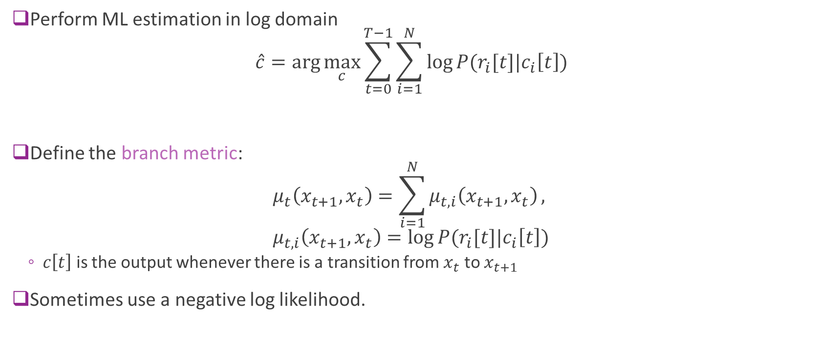
Branch Metrics
Perform ML estimation in log domain $\hat{c}=\arg{\max_{c}{\sum_{t=0}^{T−1}{\sum_{i=1}^{N}{\log{P(r_{i}[t]|c_{i}\left[t\right])}}}}}$
Define the branch metric: $μ_{t}\left(x_{t+1},x_{t}\right)=\sum_{i=1}^{N}{μ_{t,i}\left(x_{t+1},x_{t}\right)},$ $μ_{t,i}\left(x_{t+1},x_{t}\right)=log{P(r_{i}[t]|c_{i}\left[t\right])}$
$c\left[t\right]$ is the output whenever there is a transition from $x_{t}$ to $x_{t+1}$
Sometimes use a negative log likelihood.

Slide 22
Trellis Diagram Interpretation
t=0 1 2 3 4 5
The ML estimate is the shortest path on the trellis diagram.
Each branch labeled with the metric

Slide 23
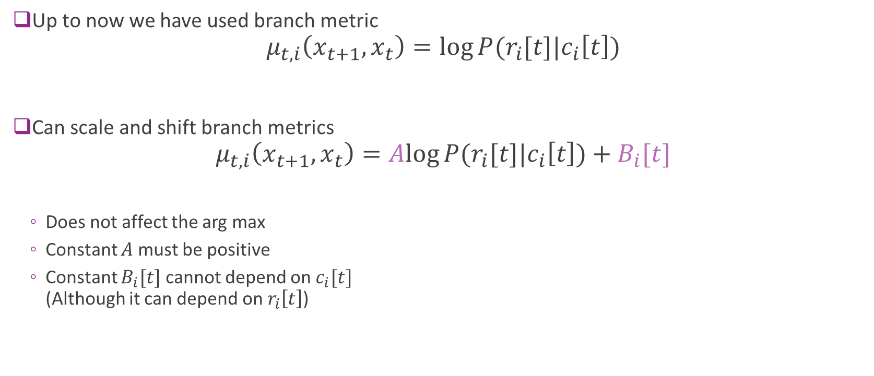
Scaling and Shifting Branch Metrics
Up to now we have used branch metric $μ_{t,i}\left(x_{t+1},x_{t}\right)=log{P(r_{i}[t]|c_{i}\left[t\right])}$
Can scale and shift branch metrics $μ_{t,i}\left(x_{t+1},x_{t}\right)=Alog{P(r_{i}[t]|c_{i}\left[t\right])}+B_{i}[t]$
Does not affect the arg max
Constant $A$ must be positive
Constant $B_{i}[t]$ cannot depend on $c_{i}[t]$ (Although it can depend on $r_{i}\left[t\right]$)

Slide 24
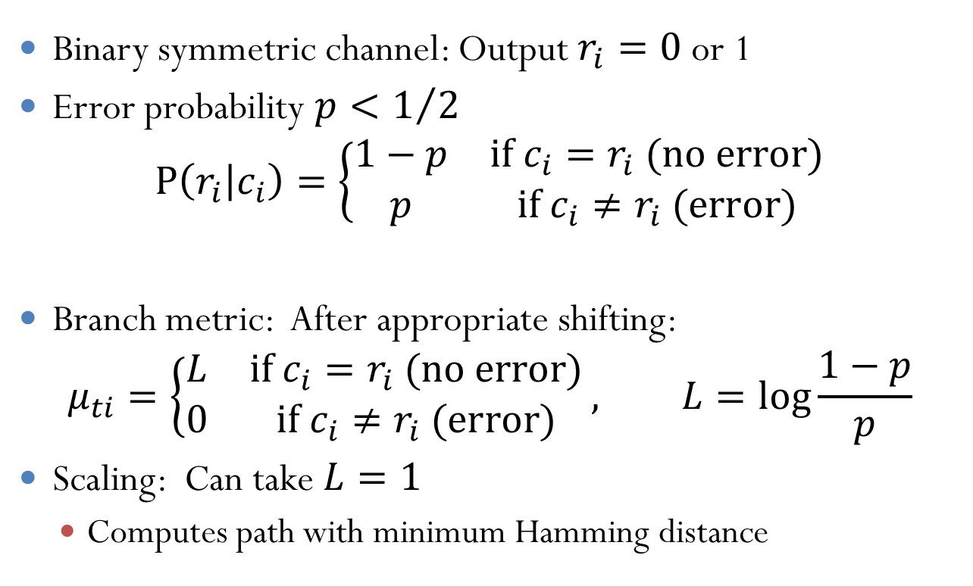
Example 1: Binary Symmetric Channel
Binary symmetric channel: Output $r_{i}=0$ or 1
Error probability $p<1/2$ $P\left(r_{i} | c_{i}\right)=\left\{\begin{matrix}1−p & \text{if} c_{i}=r_{i} \text{(}\text{no} \text{error}\text{)} \\ p & \text{if} c_{i}≠r_{i} \text{(}\text{error}\text{)}\end{matrix}\right.$
Branch metric: After appropriate shifting: $μ_{ti}=\left\{\begin{matrix}L & \text{if} c_{i}=r_{i} \text{(}\text{no} \text{error}\text{)} \\ 0 & \text{if} c_{i}≠r_{i} \text{(}\text{error}\text{)}\end{matrix}\right., L=\log{\frac{1−p}{p}}$
Scaling: Can take $L=1$
Computes path with minimum Hamming distance

Slide 25
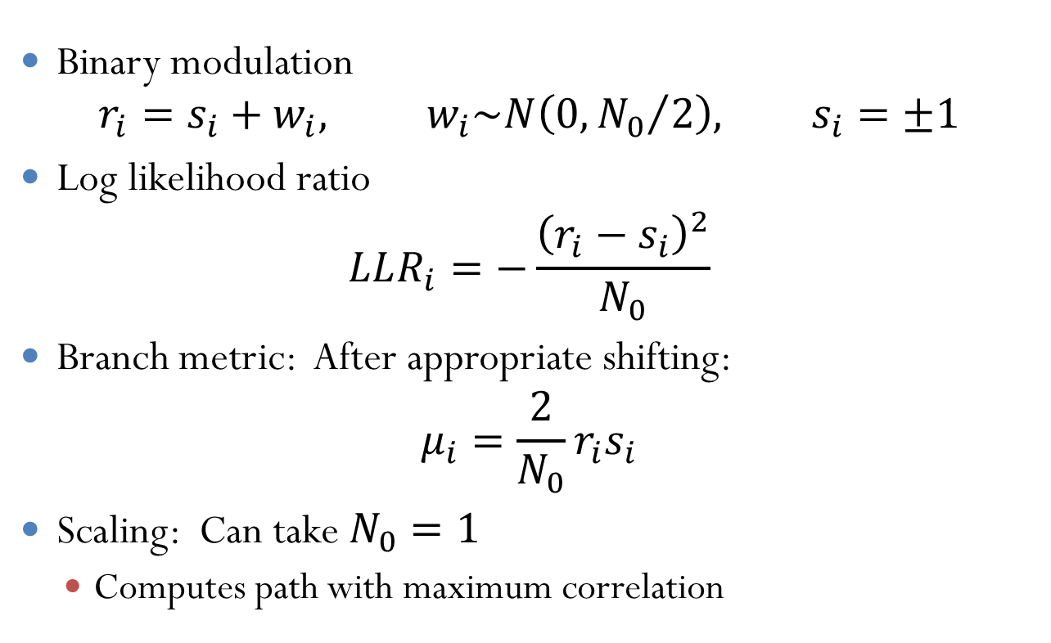
Example 2: AWGN Channel
Binary modulation $r_{i}=s_{i}+w_{i}, w_{i}\sim N\left(0,{N_{0}}/2\right), s_{i}=±1$
Log likelihood ratio $LLR_{i}=−\frac{{\left(r_{i}−s_{i}\right)}^{2}}{N_{0}}$
Branch metric: After appropriate shifting: $μ_{i}={\frac{2}{N_{0}}r}_{i}s_{i}$
Scaling: Can take $N_{0}=1$
Computes path with maximum correlation

Slide 26
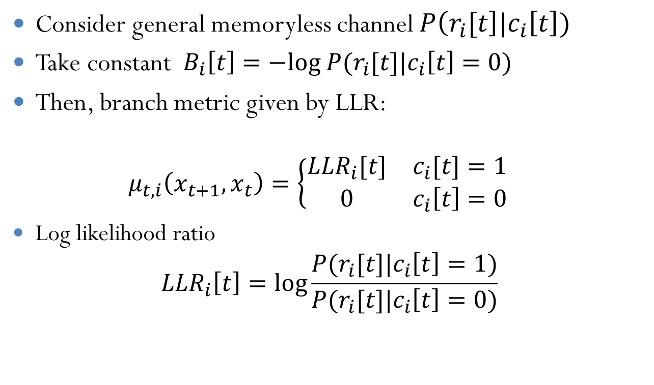
Example 3: General LLRs
Consider general memoryless channel $P\left(r_{i}[t\right]|c_{i}\left[t\right])$
Take constant $B_{i}\left[t\right]=−log P(r_{i}[t]|c_{i}\left[t\right]=0)$
Then, branch metric given by LLR: $μ_{t,i}\left(x_{t+1},x_{t}\right)=\left\{\begin{matrix}LLR_{i}[t] & c_{i}[t]=1 \\ 0 & c_{i}\left[t\right]=0\end{matrix}\right.$
Log likelihood ratio $LLR_{i}\left[t\right]=\log{\frac{P(r_{i}[t]|c_{i}\left[t\right]=1)}{P(r_{i}[t]|c_{i}\left[t\right]=0)}}$

Slide 27
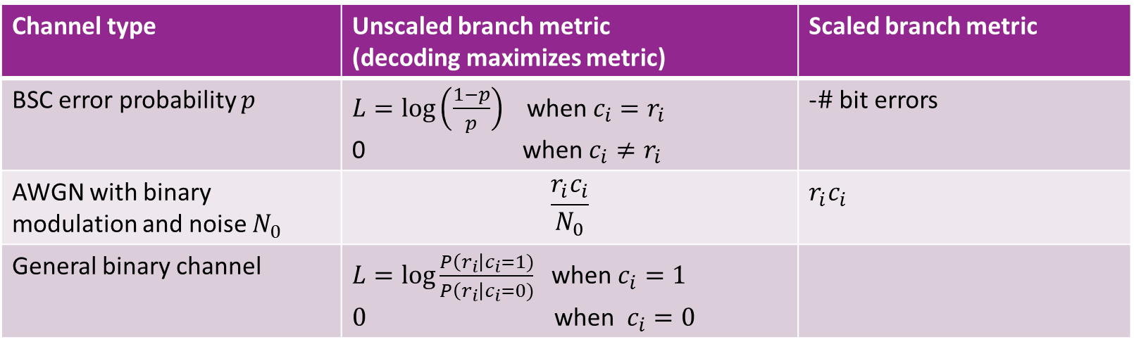
Summary
Channel type | Unscaled branch metric (decoding maximizes metric) | Scaled branch metric
BSC error probability $p$ | $L=\log\left(\frac{1−p}{p}\right)$ when $c_{i}=r_{i}$ 0 when $c_{i}≠r_{i}$ | -$\#$ bit errors
AWGN with binary modulation and noise $N_{0}$ | $$\frac{r_{i}c_{i}}{N_{0}}$$ | $r_{i}c_{i}$
General binary channel | $L=\log{\frac{P\left(r_{i}\right|c_{i}=1)}{P\left(r_{i}\right|c_{i}=0)}}$ when $c_{i}=1$ $0$ when $c_{i}=0$

Slide 28
Examples
Simple two state problem on board.

Slide 29
Outline
Convolutional codes: encoding and representations
Tree, trellis and state diagrams
Decoding with branch metrics
Viterbi decoding
Practical considerations

Slide 30
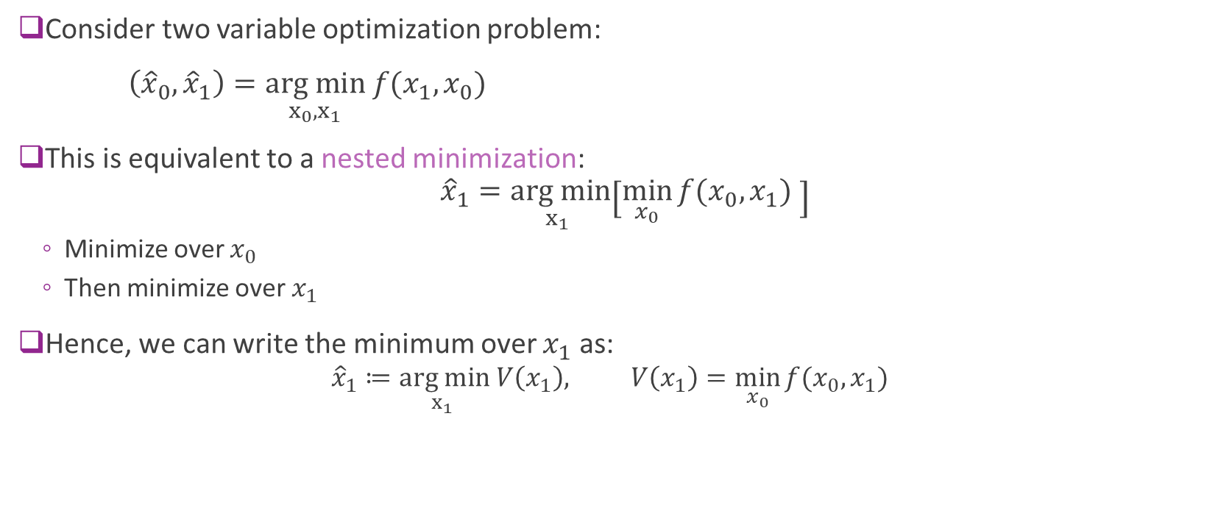
Two Variable Optimization (1)
Consider two variable optimization problem:
$\left({\hat{x}}_{0},{\hat{x}}_{1}\right)=\underset{x_{0},x_{1}}{arg min} f(x_{1},x_{0})$
This is equivalent to a nested minimization: ${\hat{x}}_{1}=\underset{x_{1} }{arg min}\left[\min_{x_{0}}{f(x_{0},x_{1}) }\right]$
Minimize over $x_{0}$
Then minimize over $x_{1}$
Hence, we can write the minimum over $x_{1}$ as:
$${\hat{x}}_{1}≔\underset{x_{1} }{arg min} V\left(x_{1}\right), V\left(x_{1}\right)=\min_{x_{0}}{f(x_{0},x_{1}) }$$

Slide 31
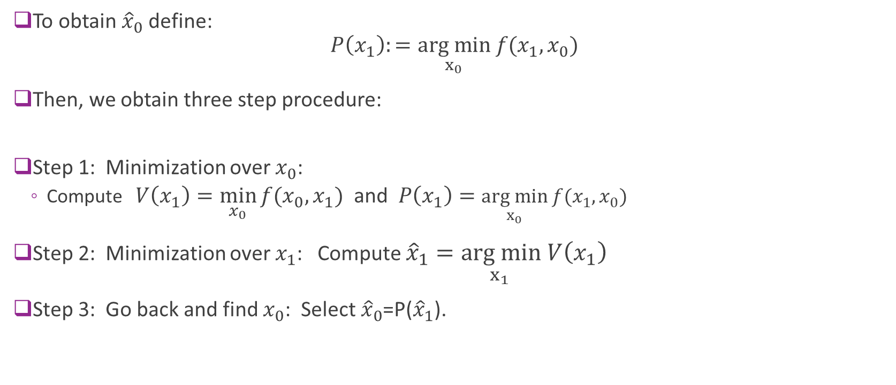
Two Variable Optimization (2)
To obtain${\hat{x}}_{0}$ define: $P\left(x_{1}\right):=\underset{x_{0}}{arg min} f(x_{1},x_{0})$
Then, we obtain three step procedure:
Step 1: Minimization over $x_{0}$:
Compute $V\left(x_{1}\right)=\min_{x_{0}}{f(x_{0},x_{1}) }$ and $P\left(x_{1}\right)=\underset{x_{0}}{arg min} f(x_{1},x_{0})$
Step 2: Minimization over $x_{1}$: Compute ${\hat{x}}_{1}=\underset{x_{1} }{arg min} V\left(x_{1}\right)$
Step 3: Go back and find $x_{0}$: Select ${\hat{x}}_{0}$=P(${\hat{x}}_{1}$).

Slide 32
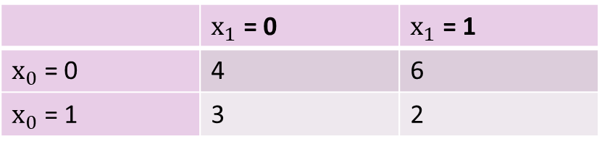
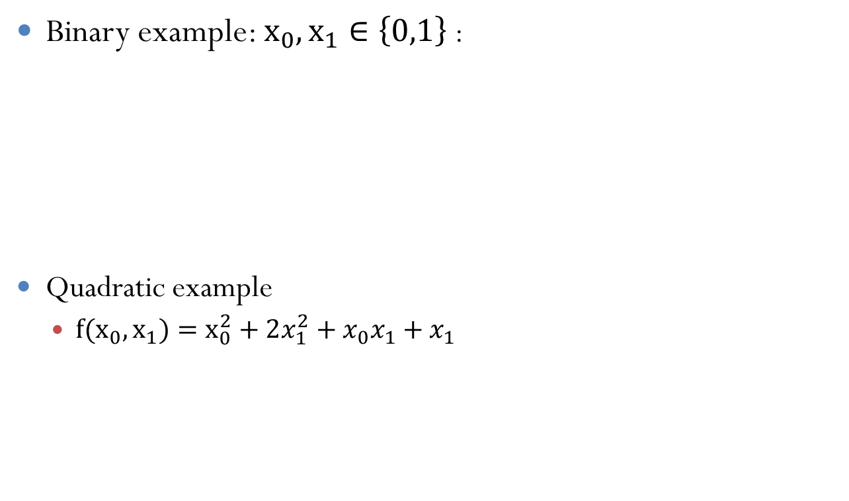
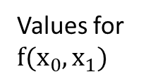
Example (Calculations on Board)
Binary example: ${x_{0}, x}_{1}∈\left\{0,1\right\}$ :
Quadratic example
${{f(x}_{0}, x}_{1})=x_{0}^{2}+2x_{1}^{2}+x_{0}x_{1}+x_{1}$
 | $x_{1}$ = 0 | $x_{1}$ = 1
$x_{0}$ = 0 | 4 | 6
$x_{0}$ = 1 | 3 | 2
Values for $f({x_{0}, x}_{1})$

Slide 33
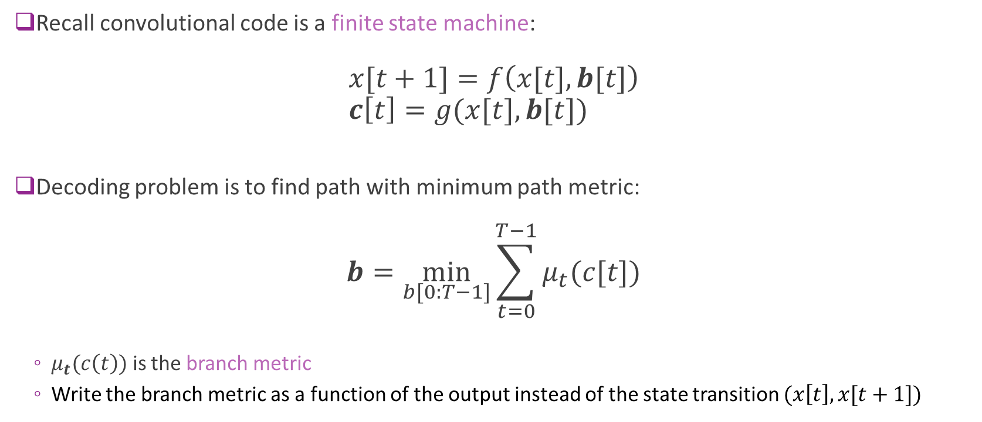
Convolutional Decoding Problem
Recall convolutional code is a finite state machine: $x[t+1]=f\left(x[t],b[t]\right)$ $c\left[t\right]=g(x[t],b[t])$
Decoding problem is to find path with minimum path metric: $b=\min_{b[0:T−1]}{\sum_{t=0}^{T−1}{μ_{t}(c[t])}}$
$μ_{t}(c\left(t\right))$ is the branch metric
Write the branch metric as a function of the output instead of the state transition $(x\left[t\right],x[t+1])$
State update
Output

Slide 34
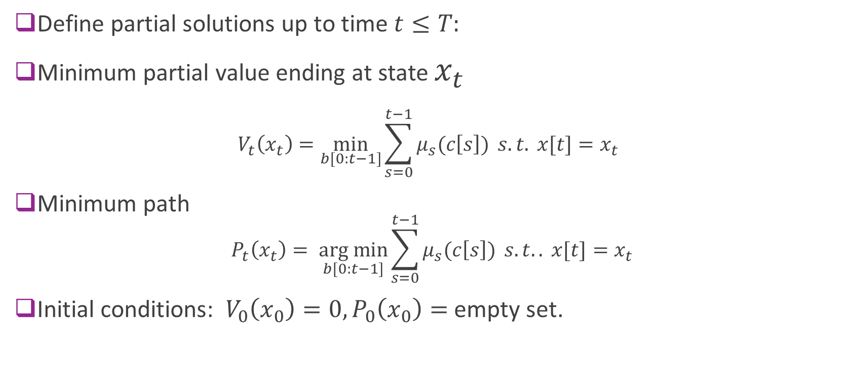
Iterative Solution
Define partial solutions up to time $t≤T:$
Minimum partial value ending at state $x_{t}$ $V_{t}\left(x_{t}\right)=\min_{b[0:t−1]}{\sum_{s=0}^{t−1}{μ_{s}(c\left[s\right])} s.t. x[t]=x_{t}}$
Minimum path $P_{t}\left(x_{t}\right)= \underset{b[0:t−1]}{arg min}{\sum_{s=0}^{t−1}{μ_{s}(c\left[s\right])} }s.t.. x[t]=x_{t}$
Initial conditions: $V_{0}\left(x_{0}\right)=0, P_{0}\left(x_{0}\right)=$ empty set.

Slide 35
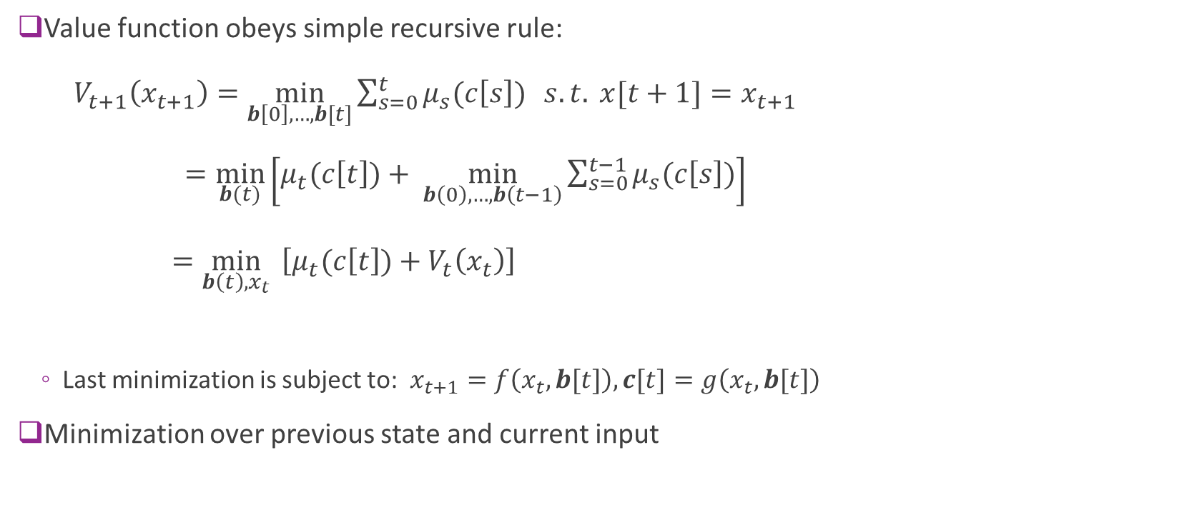
Value Function Recursion
Value function obeys simple recursive rule: $V_{t+1}\left(x_{t+1}\right)=\min_{b\left[0\right],…,b[t]}{\sum_{s=0}^{t}{μ_{s}(c\left[s\right])}}{ s.t. x[t+1]=x_{t+1}}$ $=\min_{b(t)}\left[μ_{t}(c\left[t\right])+ \min_{b\left(0\right),…,b\left(t−1\right)}\sum_{s=0}^{t−1}{μ_{s}(c\left[s\right])}\right]$ $=\min_{b\left(t\right),x_{t}}{ \left[μ_{t}(c\left[t\right])+V_{t}\left(x_{t}\right)\right]}$
Last minimization is subject to: $x_{t+1}=f\left(x_{t},b[t]\right), c[t]=g\left(x_{t},b[t]\right)$
Minimization over previous state and current input

Slide 36
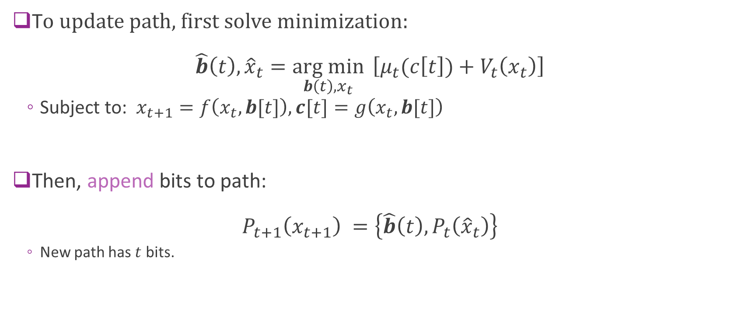
Path Recursion
T$o update$path, first solve minimization: $\hat{b}\left(t\right),{\hat{x}}_{t}=\underset{b\left(t\right),x_{t}}{arg min}{ \left[μ_{t}(c\left[t\right])+V_{t}\left(x_{t}\right)\right]}$
Subject to: $x_{t+1}=f\left(x_{t},b[t]\right), c[t]=g\left(x_{t},b[t]\right)$
Then, append bits to path: $P_{t+1}\left(x_{t+1}\right) =\left\{\hat{b}\left(t\right),P_{t}\left({\hat{x}}_{t}\right)\right\}$
New path has $t$ bits.

Slide 37

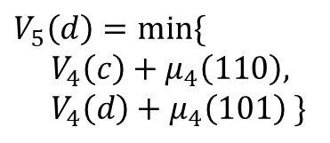


Trellis Diagram Interpretation
Value function and path associated with each node.
Minimum value and path to get to that node.
Updated left to right from inputs
t=0 1 2 3 4 5
Consider example node
Take min path from two possible incoming nodes
$$V_{5}\left(d\right)=min⁡\{$$ $V_{4}\left(c\right)+μ_{4}\left(110\right),$ $$V_{4}\left(d\right)+μ_{4}\left(101\right) \}$$
$$V_{4}(c)$$
$$V_{5}(d)$$
$$V_{4}(d)$$

Slide 38
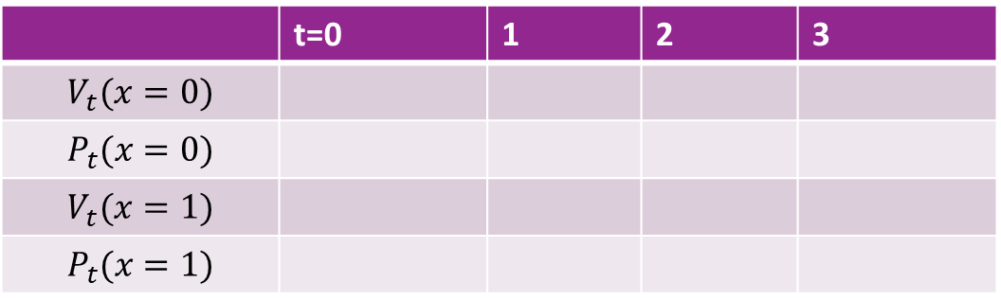
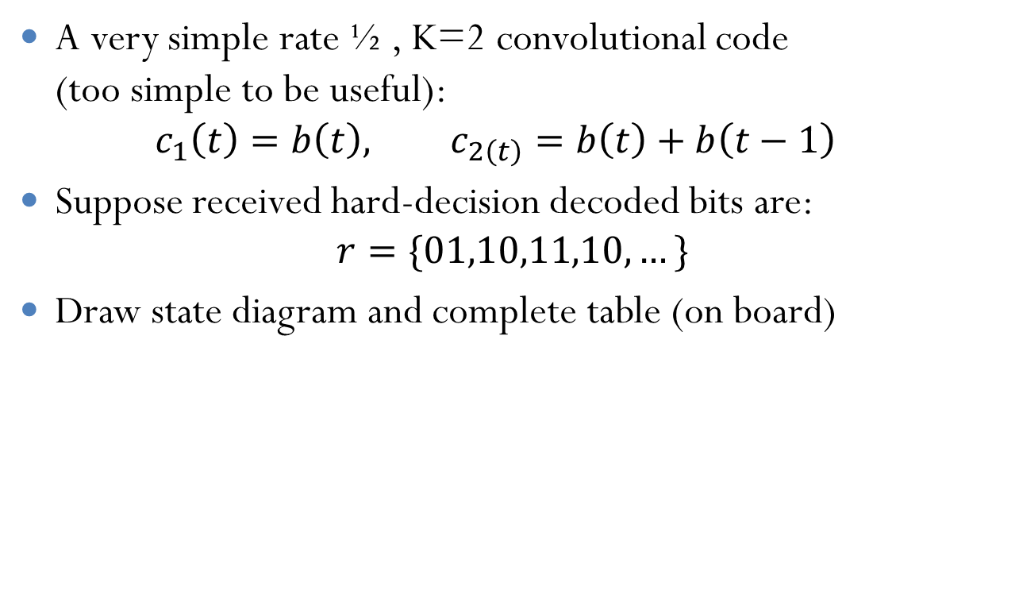
Example 1: HD Decoding
A very simple rate ½ , K=2 convolutional code (too simple to be useful): $c_{1}\left(t\right)=b\left(t\right), c_{2\left(t\right)}=b\left(t\right)+b\left(t−1\right)$
Suppose received hard-decision decoded bits are: $r=\{01,10,11,10, …\}$
Draw state diagram and complete table (on board)
 | t=0 | 1 | 2 | 3
$$V_{t}(x=0)$$
$$P_{t}(x=0)$$
$$V_{t}(x=1)$$
$$P_{t}(x=1)$$

Slide 39
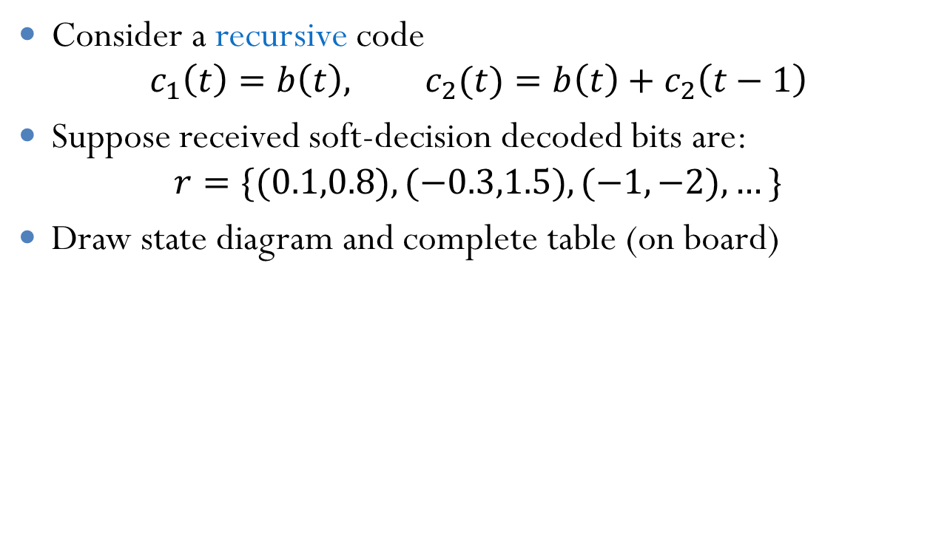
Example 2: SD Decoding
Consider a recursive code $c_{1}\left(t\right)=b\left(t\right), c_{2}(t)=b\left(t\right)+c_{2}\left(t−1\right)$
Suppose received soft-decision decoded bits are: $r=\{(0.1,0.8),(−0.3,1.5),(−1,−2), …\}$
Draw state diagram and complete table (on board)
 | t=0 | 1 | 2 | 3
$$V_{t}(x=0)$$
$$P_{t}(x=0)$$
$$V_{t}(x=1)$$
$$P_{t}(x=1)$$

Slide 40
Outline
Convolutional codes: encoding and representations
Tree, trellis and state diagrams
Decoding with branch metrics
Viterbi decoding
Practical considerations

Slide 41
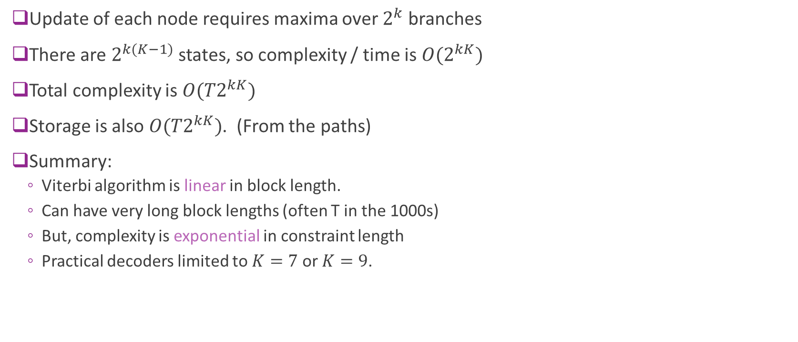
Complexity
Update of each node requires maxima over $2^{k}$ branches
There are $2^{k(K−1)}$ states, so complexity / time is ${O(2}^{kK})$
Total complexity is ${O(T2}^{kK})$
Storage is also ${O(T2}^{kK})$. (From the paths)
Summary:
Viterbi algorithm is linear in block length.
Can have very long block lengths (often T in the 1000s)
But, complexity is exponential in constraint length
Practical decoders limited to $K=7$or $K=9$.

Slide 42
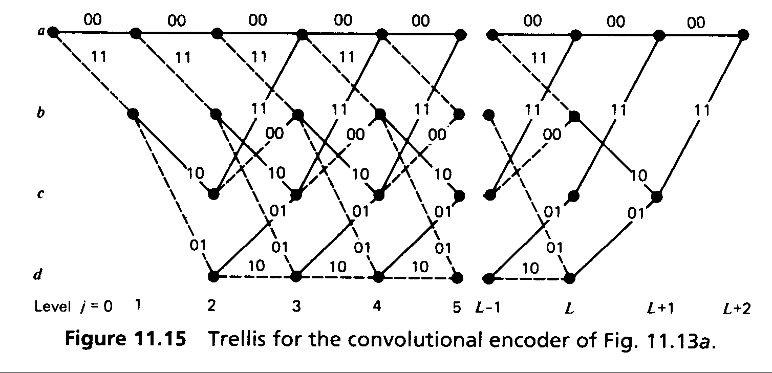
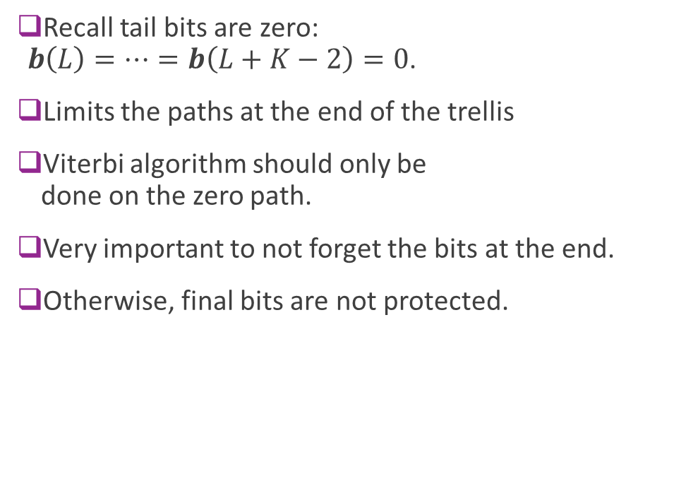
Terminating the Trellis
Recall tail bits are zero: $b\left(L\right)=…=b\left(L+K−2\right)=0$.
Limits the paths at the end of the trellis
Viterbi algorithm should only be done on the zero path.
Very important to not forget the bits at the end.
Otherwise, final bits are not protected.
During tail bits only paths with zero bit inputs.

Slide 43
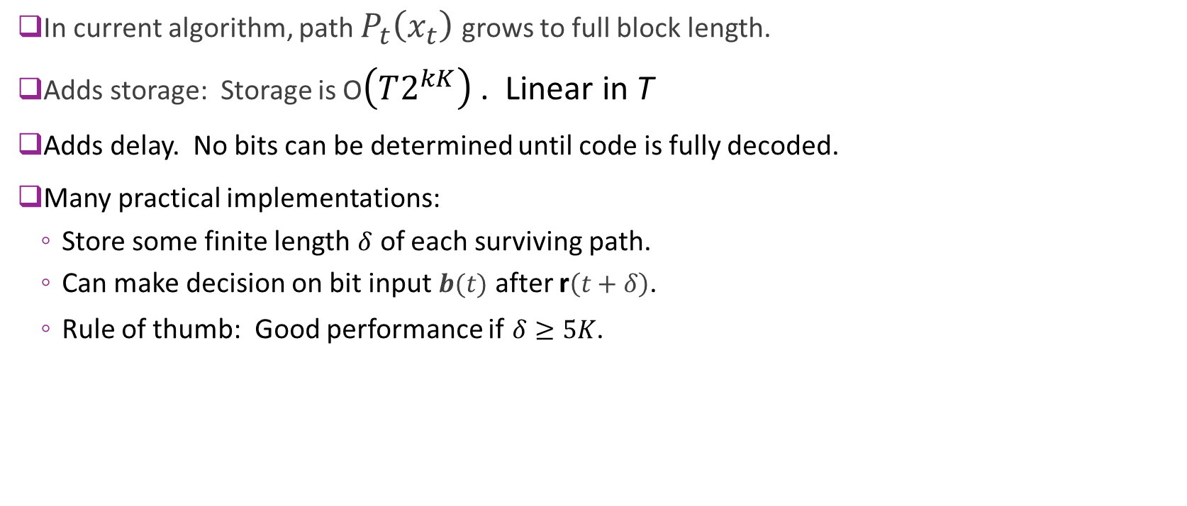
Pruning the Path Memory
In current algorithm, path $P_{t}\left(x_{t}\right)$ grows to full block length.
Adds storage: Storage is O$\left(T2^{kK}\right)$ . Linear in T
Adds delay. No bits can be determined until code is fully decoded.
Many practical implementations:
Store some finite length $δ$ of each surviving path.
Can make decision on bit input $b(t)$ after r$\left(t+δ\right)$.
Rule of thumb: Good performance if $δ≥5K$.

Slide 44
Rate Matching Convolutional Codes
Convolutional codes have limited rates, usu. ½ or 1/3.
Obtain other rates through
Puncturing: Remove coded bits to increase rate
Repetition: Repeat coded bits to decrease rate
Puncture / repeat pattern is important (see Proakis)
Try to spread out modified bits
For punctured bits, set corresponding LLRs to zero
Viterbi decoder just ignores those bits
For repeated bits, add the corresponding LLRs
Viterbi decoder will increase confidence on that branch

Slide 45

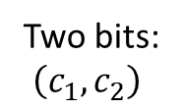

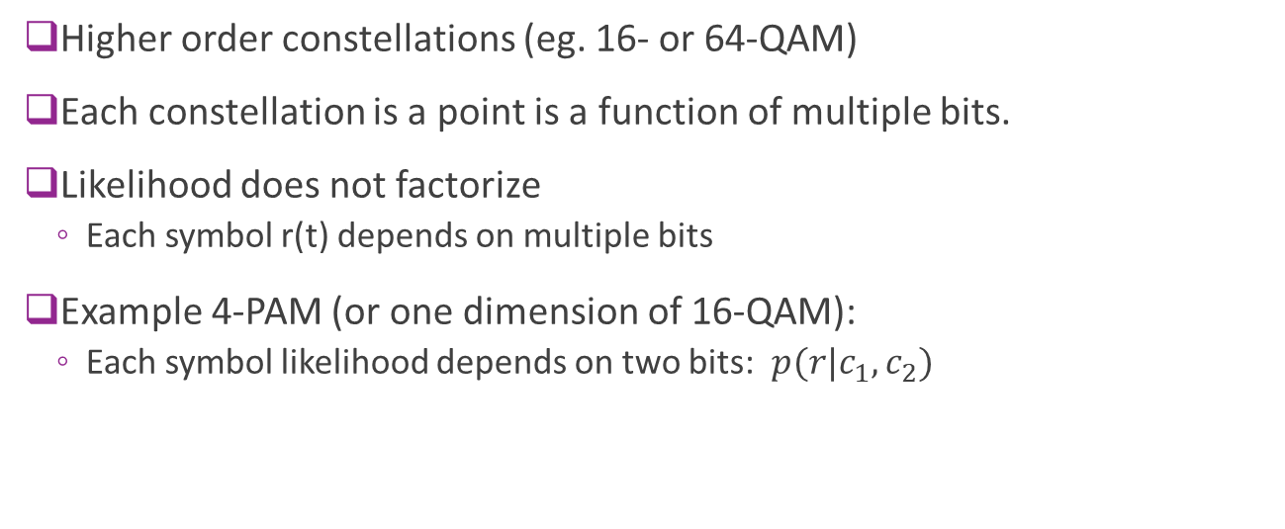



High Order Constellations
Higher order constellations (eg. 16- or 64-QAM)
Each constellation is a point is a function of multiple bits.
Likelihood does not factorize
Each symbol r(t) depends on multiple bits
Example 4-PAM (or one dimension of 16-QAM):
Each symbol likelihood depends on two bits: $p(r|c_{1},c_{2})$
$s_{00}$
$$s_{10}$$
$$s_{11}$$
$s_{01}$
$r=s+n$
Two bits: $\left(c_{1},c_{2}\right)$

Slide 46

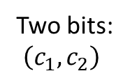

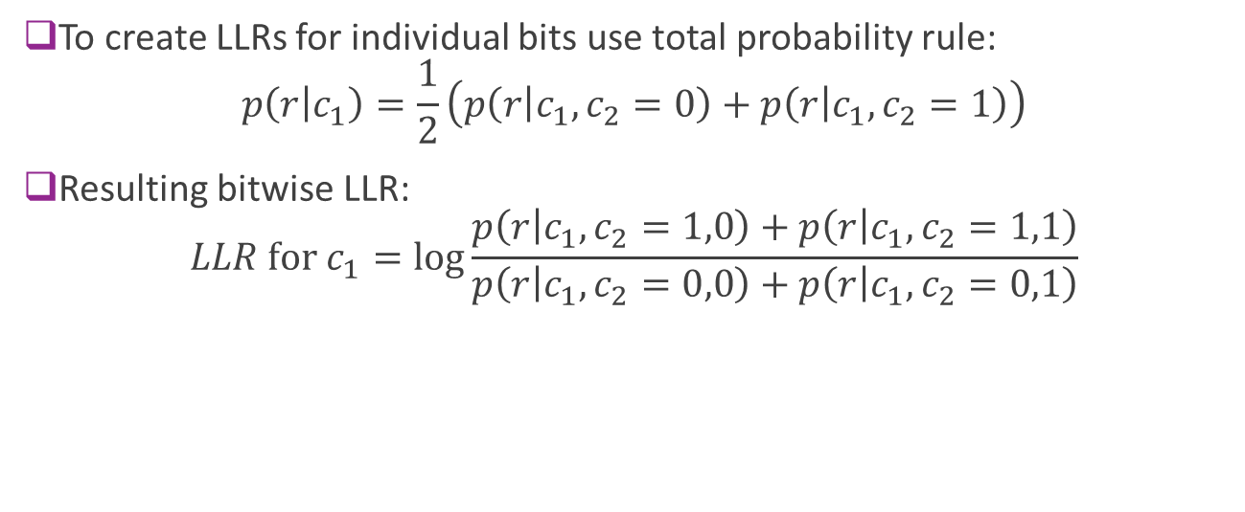



High Order Constellations
$s_{00}$
$$s_{10}$$
$$s_{11}$$
$s_{01}$
$r=s+n$
Two bits: $\left(c_{1},c_{2}\right)$
To create LLRs for individual bits use total probability rule: $p\left(r | c_{1}\right)=\frac{1}{2}\left(p\left(r | c_{1},c_{2}=0\right)+p\left(r | c_{1},c_{2}=1\right)\right)$
Resulting bitwise LLR: $LLR \text{for} c_{1}=\log{\frac{p\left(r | c_{1},c_{2}=1,0\right)+p\left(r | c_{1},c_{2}=1,1\right)}{p\left(r | c_{1},c_{2}=0,0\right)+p\left(r | c_{1},c_{2}=0,1\right)}}$

Slide 47
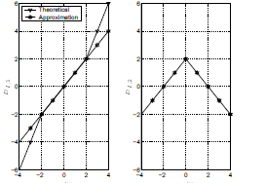


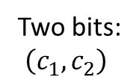



High Order Constellations
$s_{00}$
$$s_{10}$$
$$s_{11}$$
$s_{01}$
$r=s+n$
Two bits: $\left(c_{1},c_{2}\right)$
LLR for c2 LLR for c1
LLRs can have irregular shapes
Not simple linear function as in BPSK / QPSK case
Often use approximations
More info: Caire, Taricco and Biglieri, “Bit-Interleaved Coded Modulation," 1998.

Slide 48
Convolutional Codes in WiFi
802.11 uses R=1/2 K=7 code.
Length adjusted to packet size
Higher rates (R=2/3 and ¾) achieved through puncturing
Enables decoding as data arrives for ACK fast turnaround
Preamble
Data symbols
Turnaround time (<= SIFS = 10us)
Channel est / sync
Viterbi decoding
Check CRC & form ACK
ACK

Slide 49
Convolutional Codes in LTE
Convolutional codes in LTE used for:
Control channels (payload typ 20-40 bits +CRC), and
Short (< 128 bit) data frames
Larger payloads encoded with turbo codes (discussed later)
Uses rate=1/3 base convolutional code with K=7.
Higher rates achieved via puncturing
Control channels use a sophisticated technique called tail biting to reduce loss on the tail bits

Slide 50
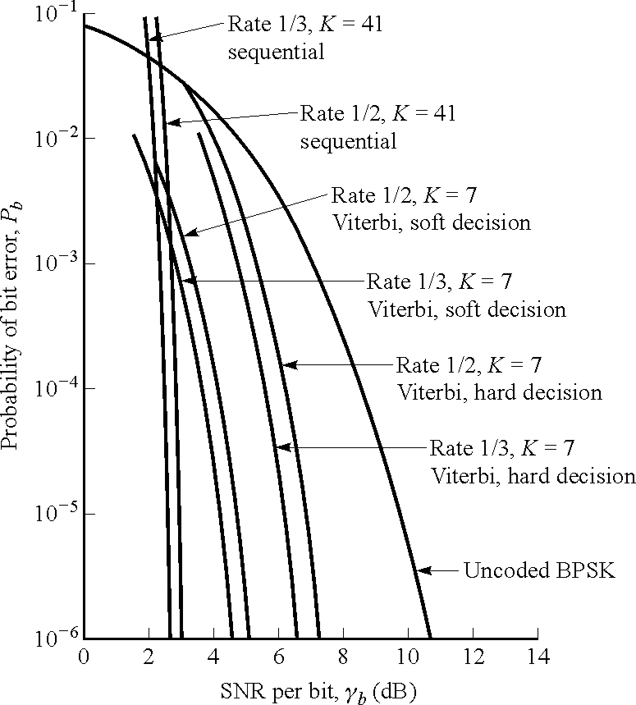
Decoding Performance
Hard decision loses approximately 1.5 to 2 dB
Constraint length K=7 is sufficient for very sharp error performance

Slide 51
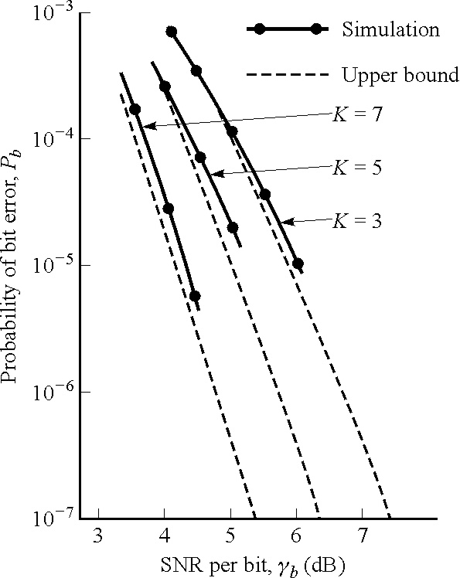
Different Constraint Lengths
Approximate 1 dB improvement between K=3, 5 and 7
Higher constraint lengths become computationally intractable
Recall decoding complexity is exponential in K

Slide 52
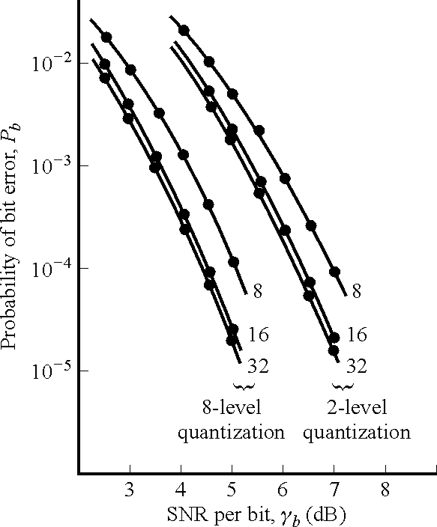
LLR Quantization
Minimal gains after 16 bit quantization of branch metrics
Recall HD is equivalent to 1 bit quantization
Most commercial implementations use 6-bit LLRs

