Slide 1
Unit 4: Signal Space Theory
EL-GY 6013: Digital communications
Prof. Sundeep rangan

Slide 2
Learning Objectives
Determine if a set is a vector space or not
Find the dimension for a vector space or subspace. Find a basis
Find a signal space for a set of signals.
Compute the degrees of freedom and rate for signal set in a signal space
Find the representation of a signal in signal space for a given basis
Find the number of DoF per second of a band-limited signal
Determine if vector or signals are orthogonal
Find an orthonormal basis.
Compute representations of signals in an orthonormal basis
Find the energy per DoF in an orthonormal basis

Slide 3
Outline
Motivation for the signal space model
Vector spaces, bases and dimension
Signal spaces, rate and degrees of freedom
Nyquist Theorem and degrees of freedom in band-limited signals
Inner products and orthogonality
Orthonormal bases and energy per degree of freedom

Slide 4
Algorithmic Model of a Typical Transmitter
Symbol mapping
TX filter DAC
IQ symbols
Analog baseband
Input bits
Output signals
(baseband or RF)
Up to now, we have considered a standard transmitter with three steps
Symbol mapping
TX filtering
Upconversion

Slide 5
Abstract Signal Space Model of a Transmitter
Symbol mapping
TX filter DAC
IQ symbols
Analog baseband
Input bits
Output signals
(baseband or RF)
=
Input bits
Output signals
(in a vector space)
Maps bits to signals
Signals belong to a vector space

Slide 6
Why Use the Signal Space Model?
Input bits
Output signals
(in a vector space)
Analysis is not limited to a specific TX architecture
Applies to any communication system
Describes fundamental parameters of the system
Rate and degrees of freedom
In next unit, we will also introduce a third parameter which is SNR
Some calculations are easier in the transformed space
Provides a geometric model to understand communication

Slide 7
Outline
Motivation for the signal space model
Vector spaces, bases and dimension
Signal spaces, rate and degrees of freedom
Nyquist Theorem and degrees of freedom in band-limited signals
Inner products and orthogonality
Orthonormal bases and energy per degree of freedom

Slide 8
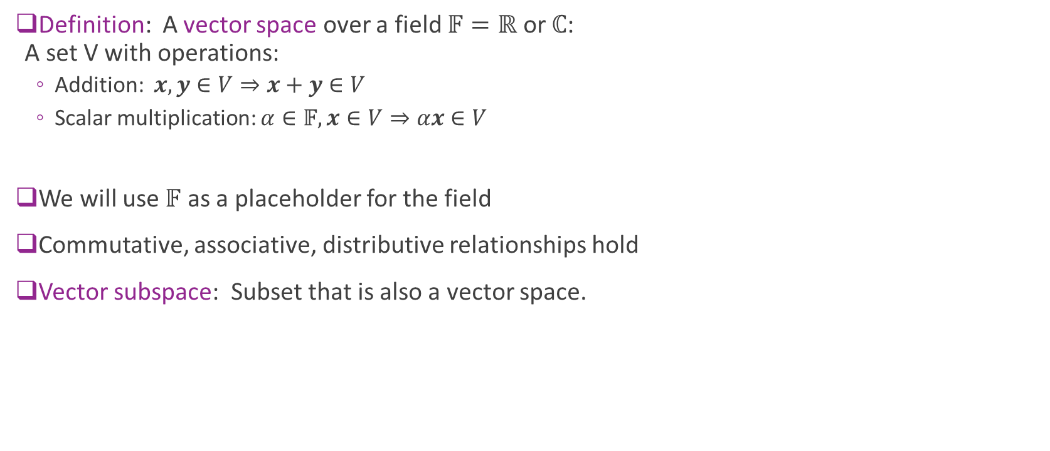
Vector Spaces
Definition: A vector space over a field $𝔽=ℝ$ or $ℂ$: A set V with operations:
Addition: $x,y∈V⇒x+y∈V$
Scalar multiplication: $α∈𝔽, x∈V⇒αx∈V$
We will use $𝔽$ as a placeholder for the field
Commutative, associative, distributive relationships hold
Vector subspace: Subset that is also a vector space.

Slide 9
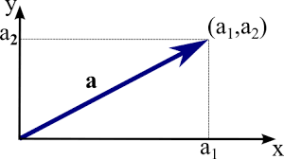
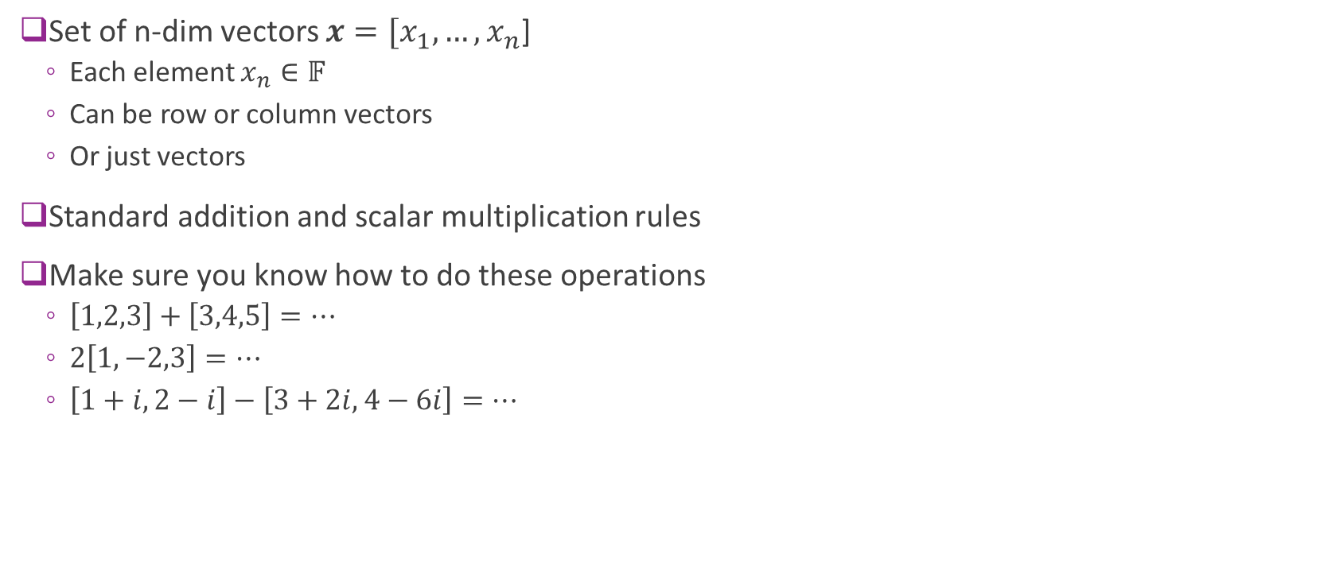

Vector Space $𝔽^{N}$
Set of n-dim vectors $x=[x_{1}, …,x_{n}$]
Each element $x_{n}∈𝔽$
Can be row or column vectors
Or just vectors
Standard addition and scalar multiplication rules
Make sure you know how to do these operations
$\left[1,2,3\right]+\left[3,4,5\right]=…$
$2\left[1,−2,3\right]=…$
$\left[1+i,2−i\right]−\left[3+2i,4−6i\right]=…$

Slide 10
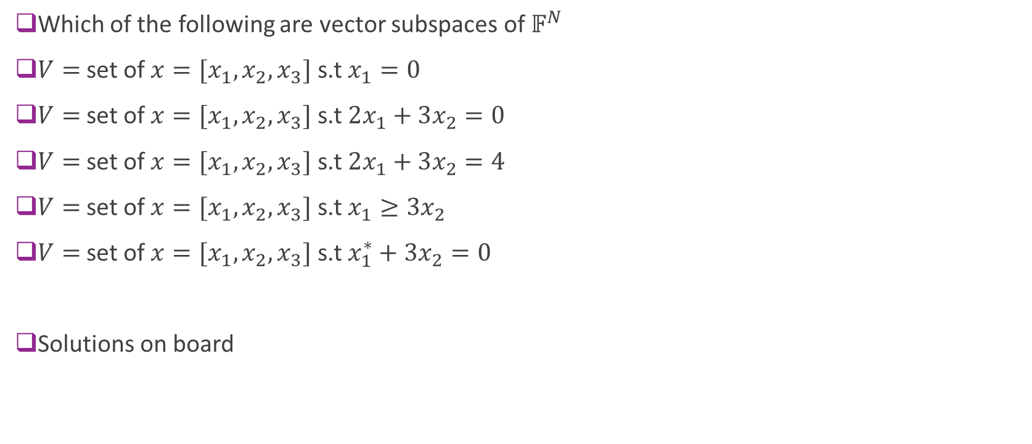
Example Problem
Which of the following are vector subspaces of $𝔽^{N}$
$V=$set of $x=[x_{1},x_{2},x_{3}]$ s.t $x_{1}=0$
$V=$set of $x=[x_{1},x_{2},x_{3}]$ s.t $2x_{1}+3x_{2}=0$
$V=$set of $x=[x_{1},x_{2},x_{3}]$ s.t $2x_{1}+3x_{2}=4$
$V=$set of $x=[x_{1},x_{2},x_{3}]$ s.t $x_{1}≥3x_{2}$
$V=$set of $x=[x_{1},x_{2},x_{3}]$ s.t $x_{1}^{∗}+3x_{2}=0$
Solutions on board

Slide 11
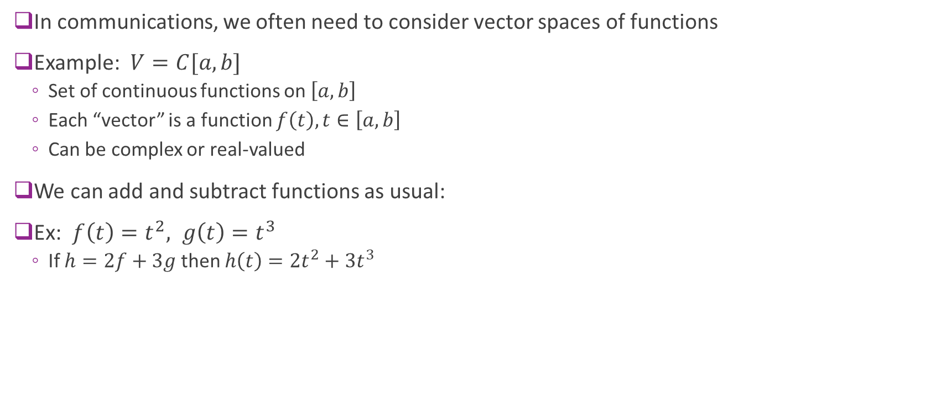
Vector Spaces of Functions
In communications, we often need to consider vector spaces of functions
Example: $V=C[a,b]$
Set of continuous functions on $\left[a,b\right]$
Each “vector” is a function $f\left(t\right), t∈\left[a,b\right]$
Can be complex or real-valued
We can add and subtract functions as usual:
Ex: $f\left(t\right)=t^{2}, g\left(t\right)=t^{3}$
If $h=2f+3g$ then $h\left(t\right)=2t^{2}+3t^{3}$

Slide 12
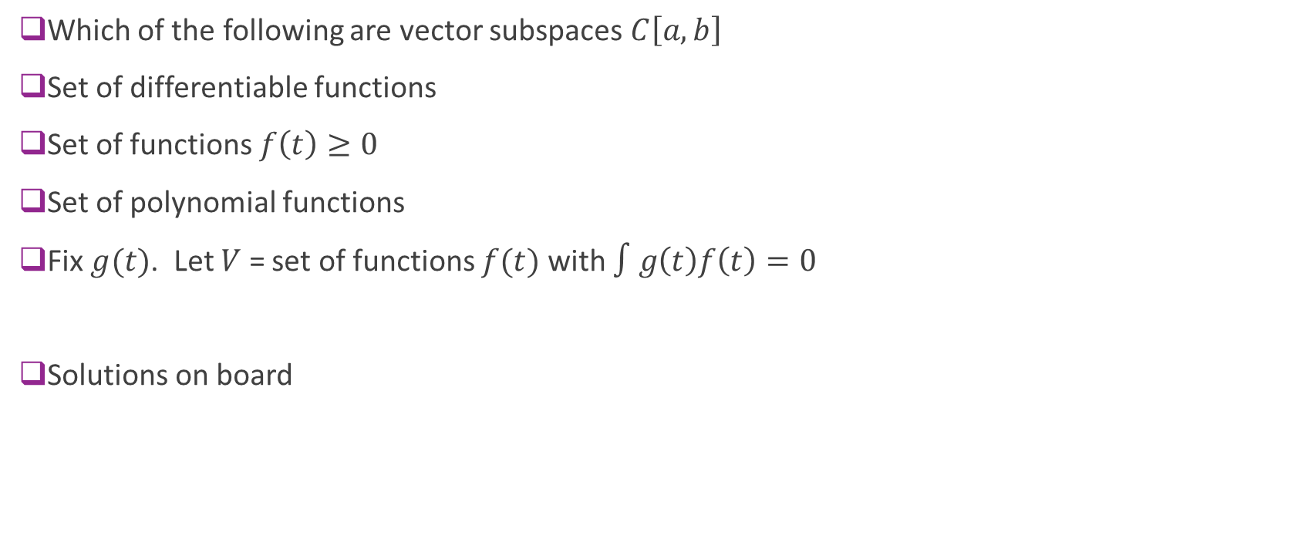
Example Problem
Which of the following are vector subspaces $C\left[a,b\right]$
Set of differentiable functions
Set of functions $f\left(t\right)≥0$
Set of polynomial functions
Fix $g(t)$. Let $V$ = set of functions $f(t)$ with $∫g\left(t\right)f\left(t\right)=0$
Solutions on board

Slide 13
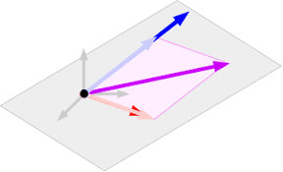
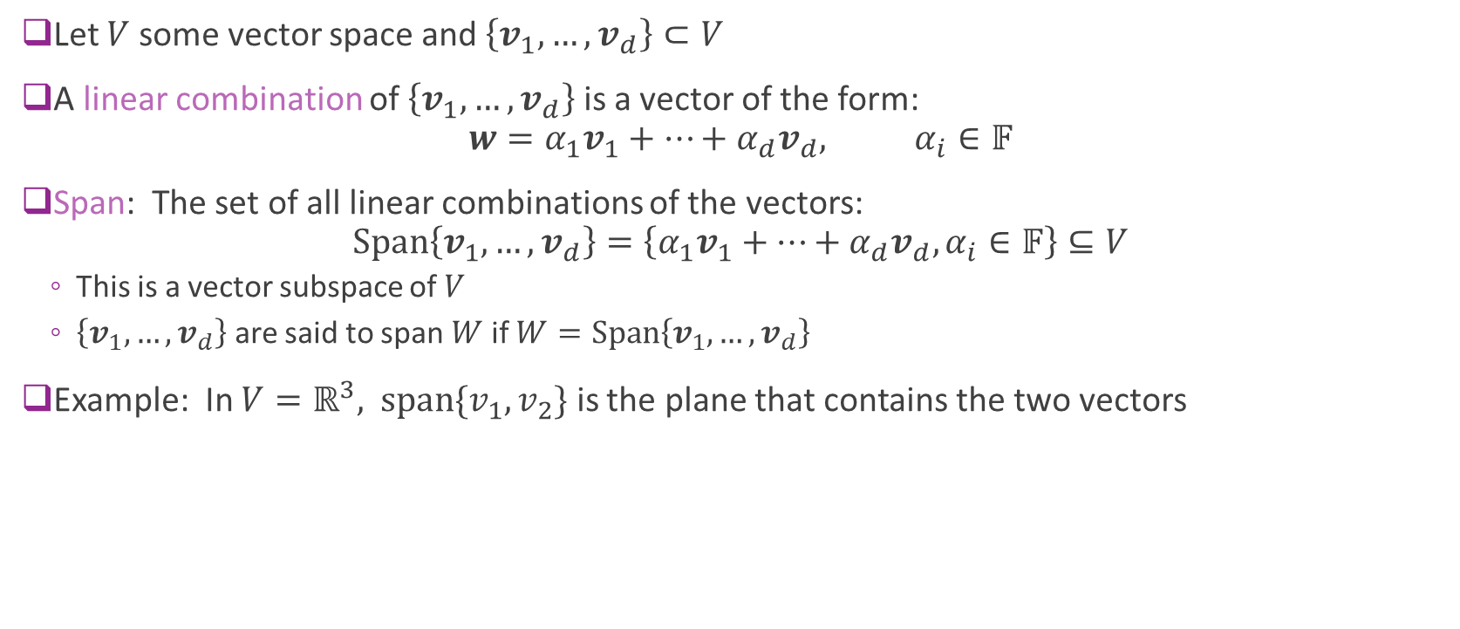



Linear Span
Let $V$ some vector space and $\left\{v_{1},…,v_{d}\right\}⊂V$
A linear combination of $\left\{v_{1},…,v_{d}\right\}$ is a vector of the form: $w=α_{1}v_{1}+⋯+α_{d}v_{d}, α_{i}∈𝔽$
Span: The set of all linear combinations of the vectors: $\text{S}\text{pan}\left\{v_{1},…,v_{d}\right\}=\left\{α_{1}v_{1}+⋯+α_{d}v_{d}, α_{i}∈𝔽\right\}⊆V$
This is a vector subspace of $V$
$\left\{v_{1},…,v_{d}\right\}$ are said to span $W$ if $W=\text{Span}\left\{v_{1},…,v_{d}\right\}$
Example: In $V=ℝ^{3},$ $\text{span}\{v_{1},v_{2}\}$ is the plane that contains the two vectors
$$v_{2}$$
$${w=α_{1}v_{1}+α_{2}v}_{2}$$
$$v_{1}$$

Slide 14

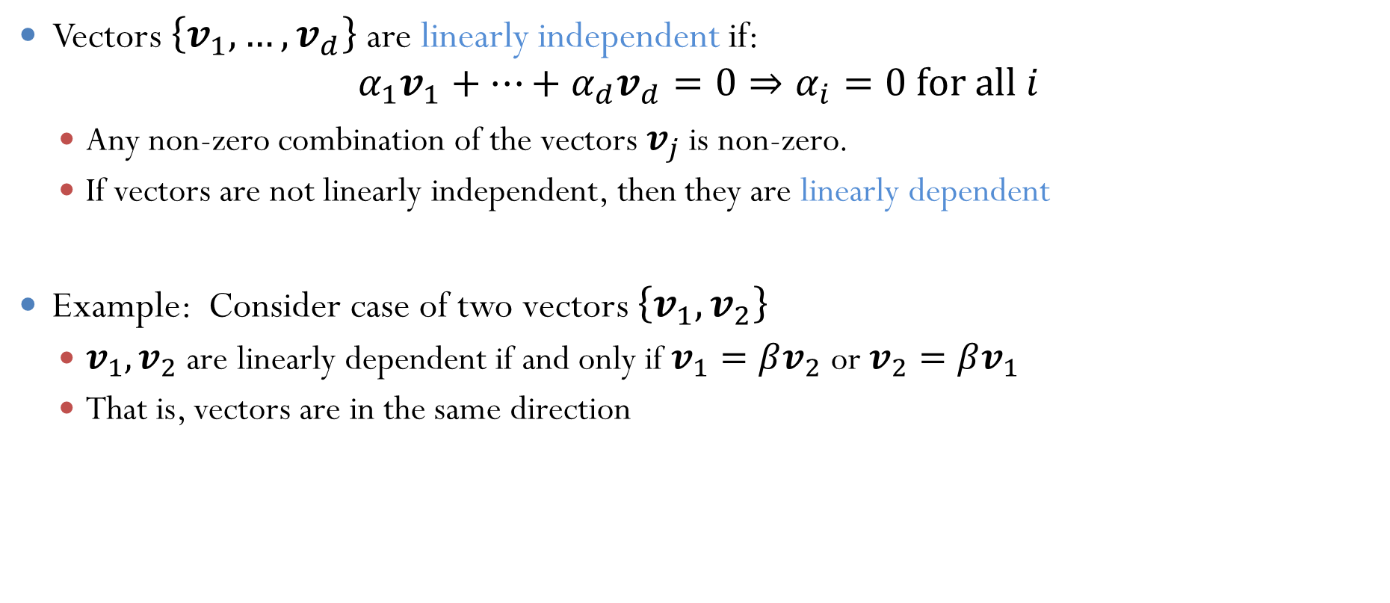

Linear Independence
Vectors $\left\{v_{1},…,v_{d}\right\}$are linearly independent if: $α_{1}v_{1}+⋯+α_{d}v_{d}=0⇒α_{i}=0 \text{for} \text{all} i$
Any non-zero combination of the vectors $v_{j}$ is non-zero.
If vectors are not linearly independent, then they are linearly dependent
Example: Consider case of two vectors $\left\{v_{1},v_{2}\right\}$
$v_{1},v_{2}$ are linearly dependent if and only if $v_{1}=βv_{2}$ or $v_{2}=βv_{1}$
That is, vectors are in the same direction
$$v_{2}$$
$$v_{1}$$

Slide 15
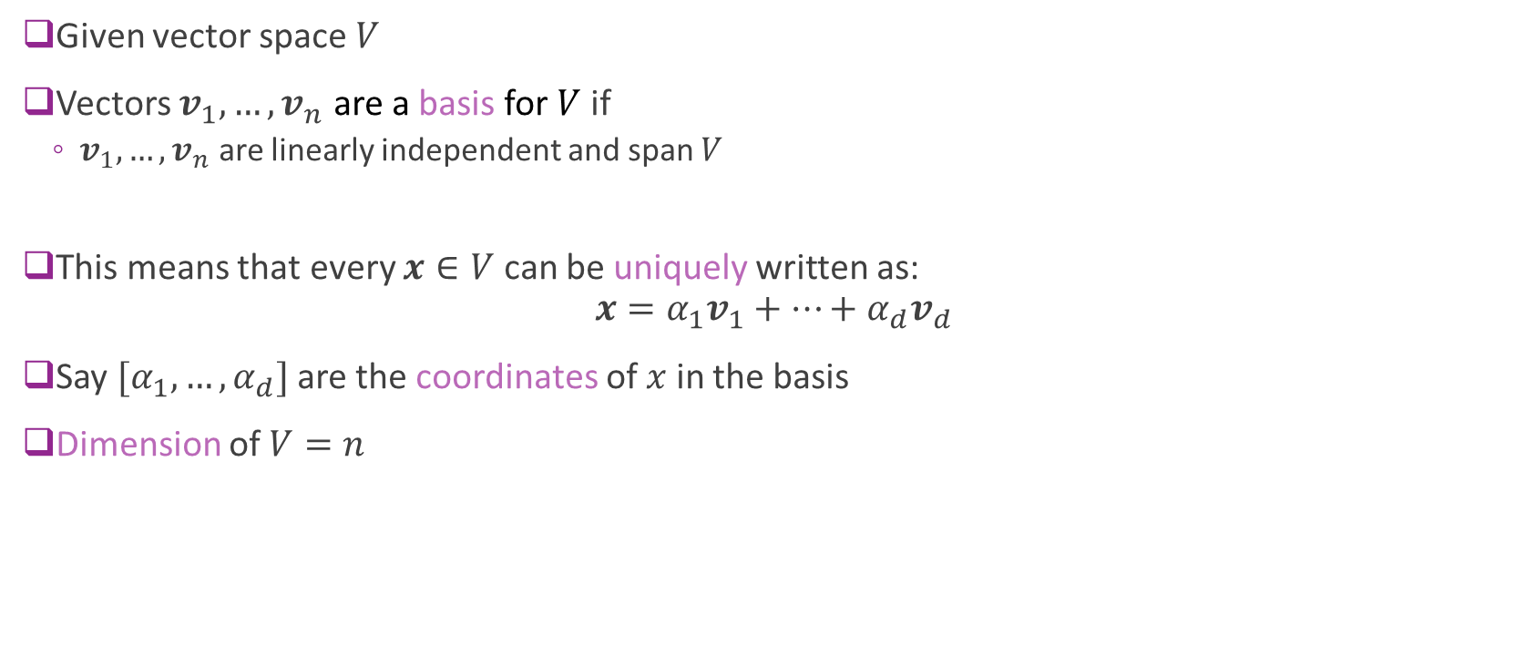
Basis and Dimension
Given vector space $V$
Vectors $v_{1},…,v_{n}$ are a basis for $V$ if
$v_{1},…,v_{n}$ are linearly independent and span $V$
This means that every $x∈V$ can be uniquely written as: $x=α_{1}v_{1}+⋯+α_{d}v_{d}$
Say $[α_{1},…,α_{d}]$ are the coordinates of $x$ in the basis
Dimension of $V=n$

Slide 16
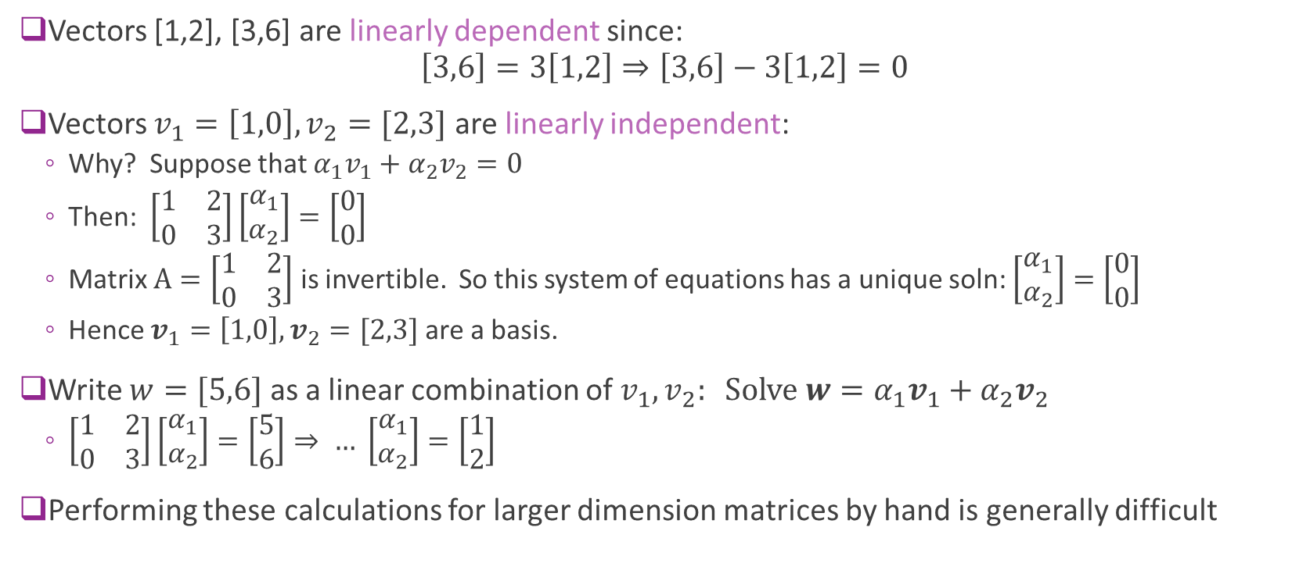
Simple Vector Example
Vectors [1,2], [3,6] are linearly dependent since: $\left[3,6\right]=3\left[1,2\right]⇒\left[3,6\right]−3\left[1,2\right]=0$
Vectors $v_{1}=\left[1,0\right], v_{2}=[2,3]$ are linearly independent:
Why? Suppose that $α_{1}v_{1}+α_{2}v_{2}=0$
Then: $\left[\begin{matrix}1 & 2 \\ 0 & 3\end{matrix}\right]\left[\begin{matrix}α_{1} \\ α_{2}\end{matrix}\right]=\left[\begin{matrix}0 \\ 0\end{matrix}\right]$
Matrix $A=\left[\begin{matrix}1 & 2 \\ 0 & 3\end{matrix}\right]$ is invertible. So this system of equations has a unique soln: $\left[\begin{matrix}α_{1} \\ α_{2}\end{matrix}\right]=\left[\begin{matrix}0 \\ 0\end{matrix}\right]$
Hence $v_{1}=\left[1,0\right], v_{2}=[2,3]$ are a basis.
Write $w=[5,6]$ as a linear combination of $v_{1},v_{2}: Solve w=α_{1}v_{1}+α_{2}v_{2}$
$\left[\begin{matrix}1 & 2 \\ 0 & 3\end{matrix}\right]\left[\begin{matrix}α_{1} \\ α_{2}\end{matrix}\right]=\left[\begin{matrix}5 \\ 6\end{matrix}\right]⇒ … \left[\begin{matrix}α_{1} \\ α_{2}\end{matrix}\right]=\left[\begin{matrix}1 \\ 2\end{matrix}\right]$
Performing these calculations for larger dimension matrices by hand is generally difficult

Slide 17

Standard Basis and Change of Basis
Standard basis of $𝔽^{N}$: $e_{1},…,e_{N}$
$e_{i}=\left[0,…,0,1,0,…0\right].$ A “1” in position $i$
Any vector $x=\left[x_{1},…,x_{N}\right]=\sum_{i}{x_{i}e_{i}}$
Hence $\left[x_{1},…,x_{N}\right]$ are the coordinates in the standard basis
Change of basis:
Suppose $v_{1},…,v_{N}$ is another basis
Want to find coordinates $x=\sum_{i}{α_{i}v_{i}}$

Slide 18









Example
$$x_{2}$$
Suppose $v_{1}=\left[1,2\right], v_{2}=[3,2]$
$x=[7,10]$ in the standard basis
Find coefficients of $x$ in $v_{1},v_{2}$ basis
Solution:
Solve $\left[\begin{matrix}1 & 3 \\ 2 & 2\end{matrix}\right]\left[\begin{matrix}α_{1} \\ α_{2}\end{matrix}\right]=\left[\begin{matrix}7 \\ 10\end{matrix}\right]$
Get $\left[\begin{matrix}α_{1} \\ α_{2}\end{matrix}\right]=\left[\begin{matrix}4 \\ 1\end{matrix}\right]$
$$[7,10]$$
Standard basis
$$v_{1}$$
$$v_{2}$$
$$x_{1}$$
$$α_{2}$$
New basis
$$[4,1]$$
$$α_{1}$$

Slide 19
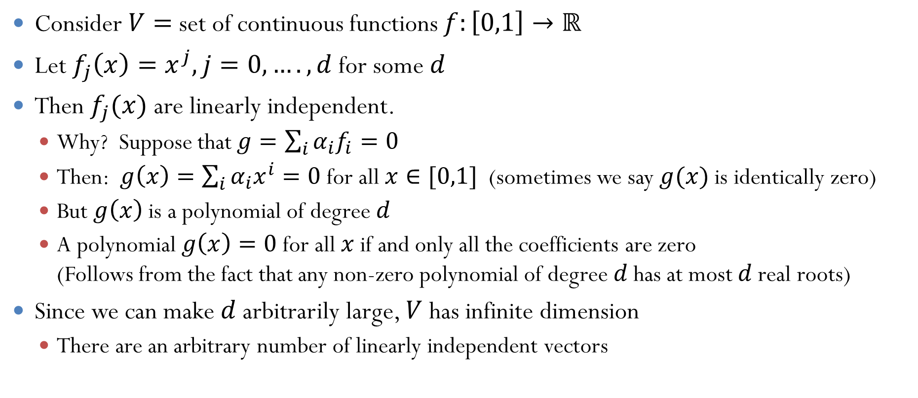
Function Example
Consider $V=$ set of continuous functions $f:\left[0,1\right]→ℝ$
Let $f_{j}\left(x\right)=x^{j}, j=0,….,d$ for some $d$
Then $f_{j}(x)$ are linearly independent.
Why? Suppose that $g=\sum_{i}{α_{i}f_{i}}=0$
Then: $g\left(x\right)=\sum_{i}{α_{i}x^{i}}=0$ for all $x∈[0,1]$ (sometimes we say $g(x)$ is identically zero)
But $g\left(x\right)$ is a polynomial of degree $d$
A polynomial $g\left(x\right)=0$ for all $x$if and only all the coefficients are zero (Follows from the fact that any non-zero polynomial of degree $d$ has at most $d$ real roots)
Since we can make $d$ arbitrarily large, $V$ has infinite dimension
There are an arbitrary number of linearly independent vectors

Slide 20
Outline
Motivation for the signal space model
Vector spaces, bases and dimension
Signal spaces, rate and degrees of freedom
Nyquist Theorem and degrees of freedom in band-limited signals
Inner products and orthogonality
Orthonormal bases and energy per degree of freedom

Slide 21
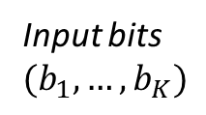
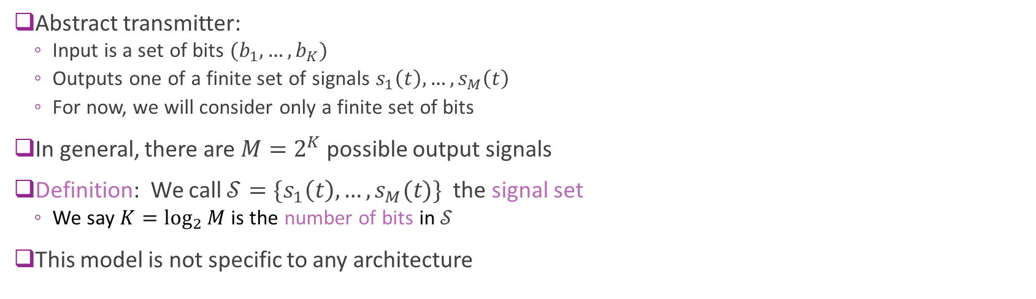
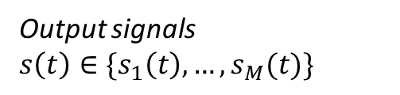
Abstract Transmitter and the Signal Set
Input bits $$(b_{1},…,b_{K})$$
Output signals $s\left(t\right)∈\{s_{1}\left(t\right),…,s_{M}(t)\}$
Abstract transmitter:
Input is a set of bits $(b_{1},…,b_{K})$
Outputs one of a finite set of signals $s_{1}\left(t\right),…,s_{M}\left(t\right)$
For now, we will consider only a finite set of bits
In general, there are $M=2^{K}$ possible output signals
Definition: We call $𝒮=\{s_{1}\left(t\right),…,s_{M}(t)\}$ the signal set
We say $K=\log_{2}{M}$ is the number of bits in $𝒮$
This model is not specific to any architecture

Slide 22
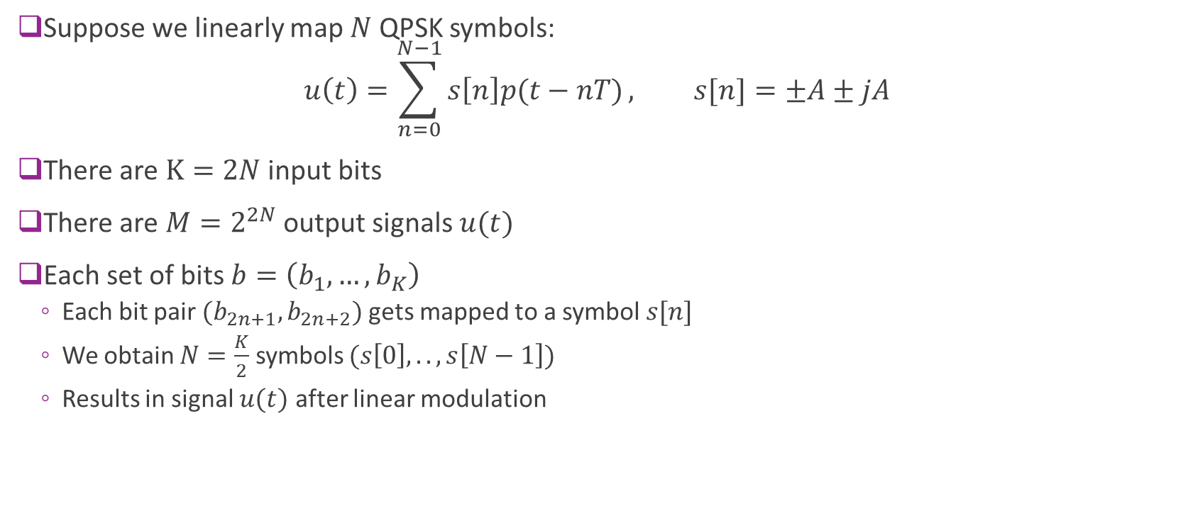
Example
Suppose we linearly map $N$ QPSK symbols: $u\left(t\right)=\sum_{n=0}^{N−1}{s\left[n\right]p(t−nT)}, s[n]=±A±jA$
There are $K=2N$ input bits
There are $M=2^{2N}$ output signals $u(t)$
Each set of bits $b=\left(b_{1},…,b_{K}\right)$
Each bit pair $(b_{2n+1},b_{2n+2})$ gets mapped to a symbol $s[n]$
We obtain $N=\frac{K}{2}$ symbols $(s\left[0\right], ..,s\left[N−1\right])$
Results in signal $u(t)$ after linear modulation

Slide 23
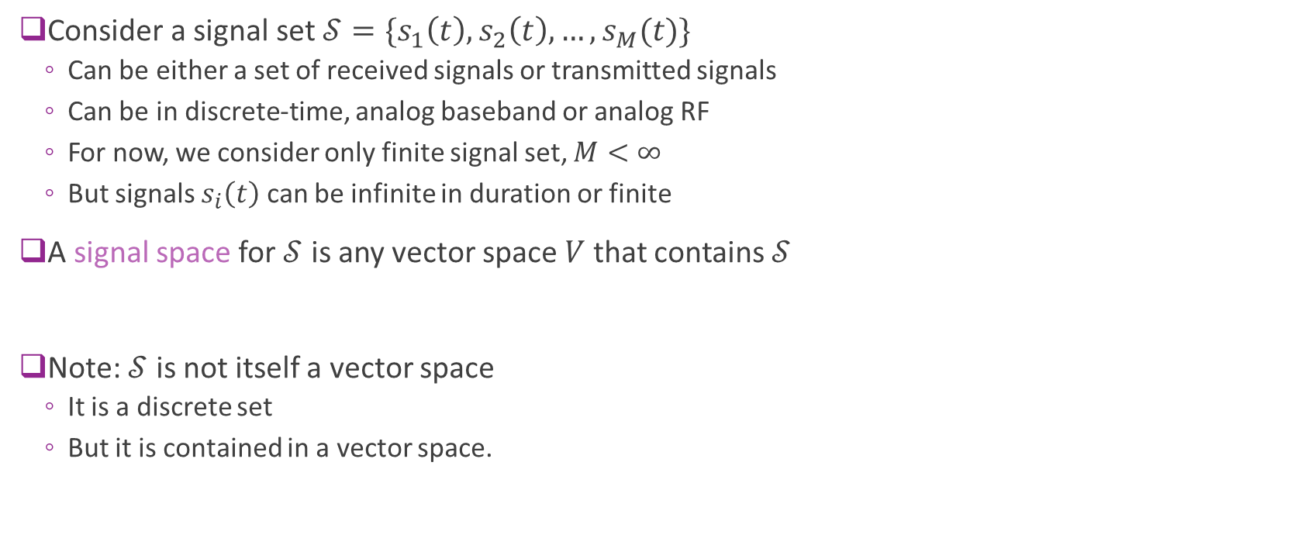
Signal Space
Consider a signal set $𝒮=\{s_{1}\left(t\right),s_{2}\left(t\right), …,s_{M}(t)\}$
Can be either a set of received signals or transmitted signals
Can be in discrete-time, analog baseband or analog RF
For now, we consider only finite signal set, $M<∞$
But signals $s_{i}\left(t\right)$ can be infinite in duration or finite
A signal space for $𝒮$ is any vector space $V$ that contains $𝒮$
Note: $𝒮$ is not itself a vector space
It is a discrete set
But it is contained in a vector space.

Slide 24
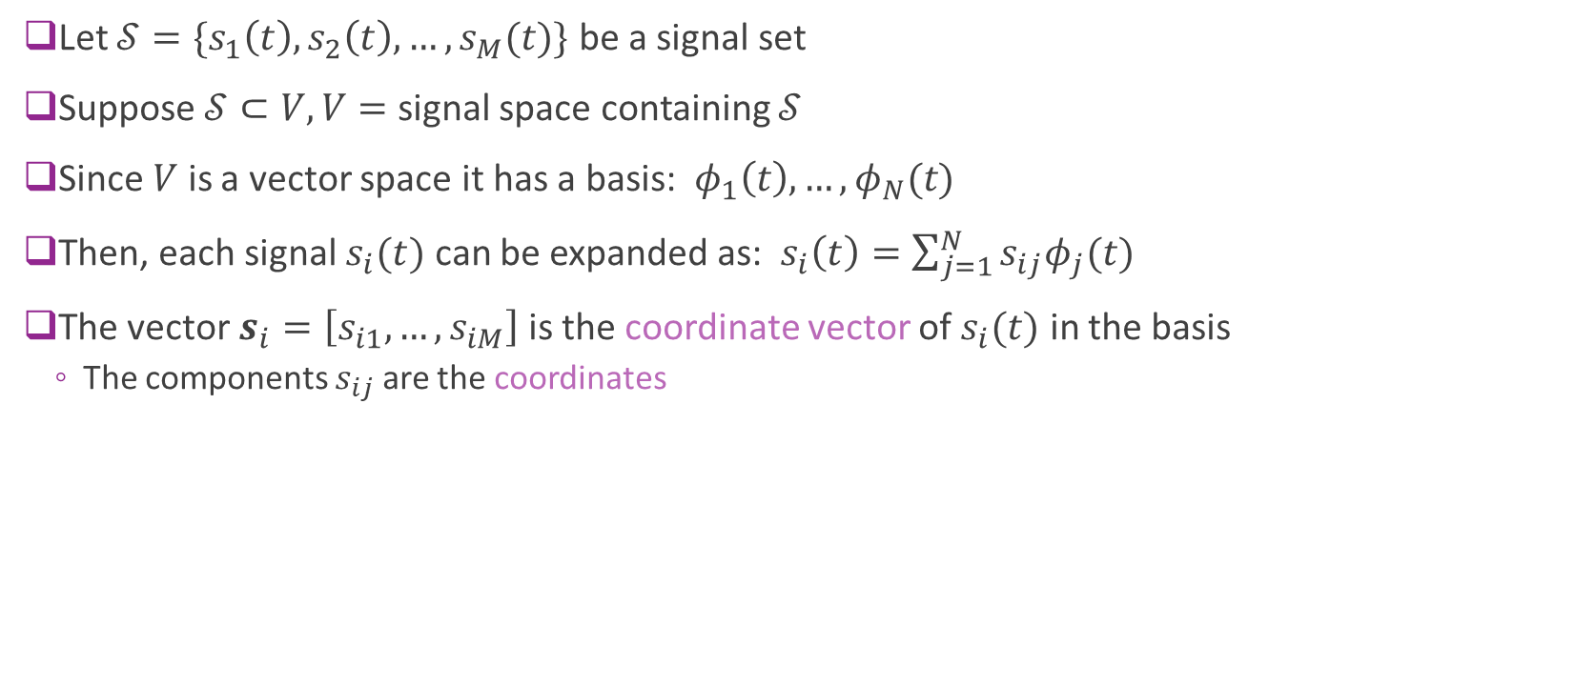
Signal Space Bases
Let $𝒮=\{s_{1}\left(t\right),s_{2}\left(t\right), …,s_{M}(t)\}$ be a signal set
Suppose $𝒮⊂V, V=$ signal space containing $𝒮$
Since $V$ is a vector space it has a basis: $φ_{1}\left(t\right),…,φ_{N}(t)$
Then, each signal $s_{i}(t)$ can be expanded as: $s_{i}\left(t\right)=\sum_{j=1}^{N}{s_{ij}φ_{j}(t)}$
The vector $s_{i}=\left[s_{i1},…,s_{iM}\right]$ is the coordinate vector of $s_{i}(t)$ in the basis
The components $s_{ij}$ are the coordinates

Slide 25
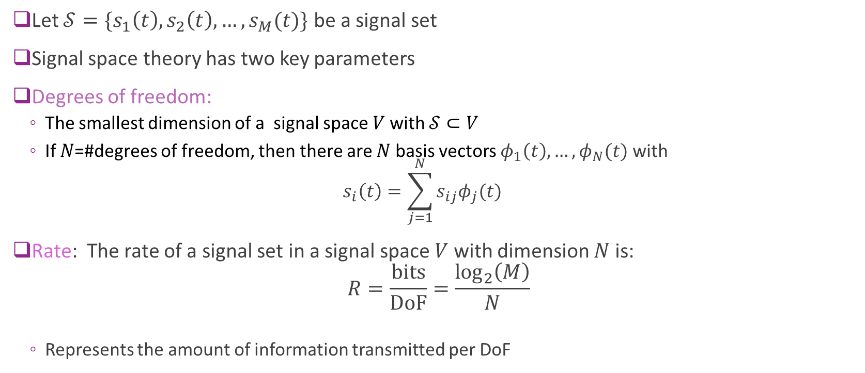
Degrees of Freedom and Rate
Let $𝒮=\{s_{1}\left(t\right),s_{2}\left(t\right), …,s_{M}(t)\}$ be a signal set
Signal space theory has two key parameters
Degrees of freedom:
The smallest dimension of a signal space $V$with $𝒮⊂V$
If $N$=#degrees of freedom, then there are $N$ basis vectors $φ_{1}\left(t\right),…,φ_{N}(t)$ with $s_{i}\left(t\right)=\sum_{j=1}^{N}{s_{ij}φ_{j}(t)}$
Rate: The rate of a signal set in a signal space $V$ with dimension $N$ is: $R=\frac{\text{bits}}{\text{DoF}}=\frac{\log_{2}\left(M\right)}{N}$
Represents the amount of information transmitted per DoF

Slide 26
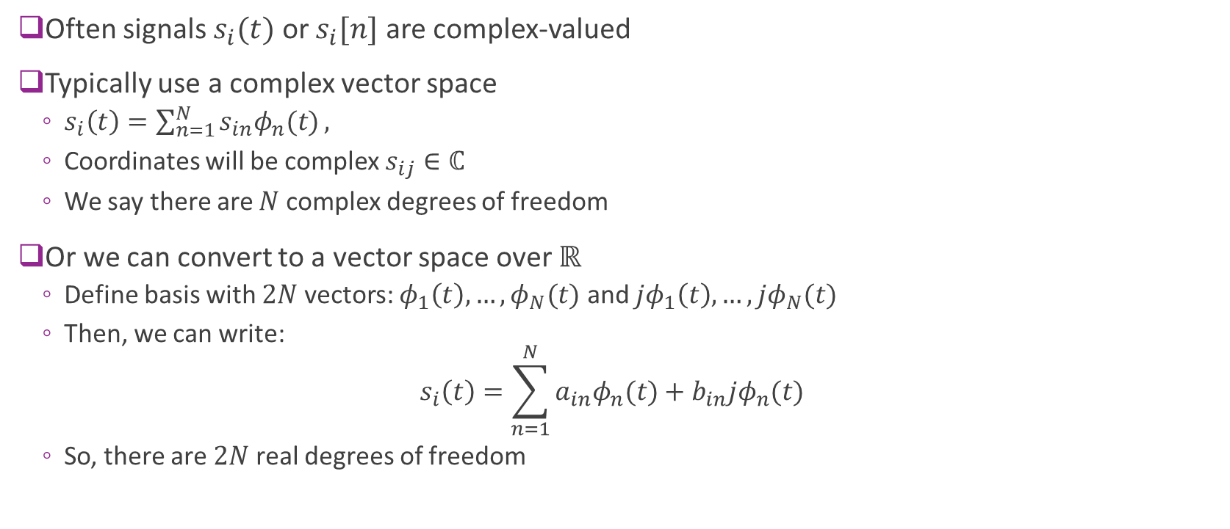
Complex vs. Real DoF
Often signals $s_{i}(t)$ or $s_{i}[n]$ are complex-valued
Typically use a complex vector space
$s_{i}\left(t\right)=\sum_{n=1}^{N}{s_{in}φ_{n}(t)},$
Coordinates will be complex $s_{ij}∈ℂ$
We say there are $N$ complex degrees of freedom
Or we can convert to a vector space over $ℝ$
Define basis with $2N$ vectors: $φ_{1}\left(t\right),…,φ_{N}(t)$ and $jφ_{1}\left(t\right),…,jφ_{N}(t)$
Then, we can write: $s_{i}\left(t\right)=\sum_{n=1}^{N}{a_{in}φ_{n}(t)}+b_{in}jφ_{n}(t)$
So, there are $2N$ real degrees of freedom

Slide 27








Example
Consider the four functions shown to the right
Find $N=$degrees of freedom of $𝒮$
Find a signal space $V$ for $𝒮$ with dimension $N$
Find a basis for $V$
Find the coordinate vector of each $s_{i}(t)$ in the basis
2
$$s_{1}(t)$$
Time $t$
0
1
-2
$$s_{2}(t)$$
3
$$s_{3}(t)$$
Slope=-2
Time $t$
0
1
$$s_{4}(t)$$
1
Slope=1
Time $t$
0
1

Slide 28

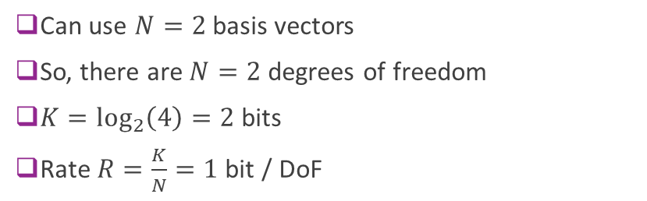
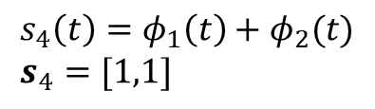
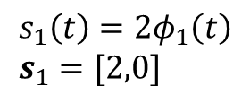
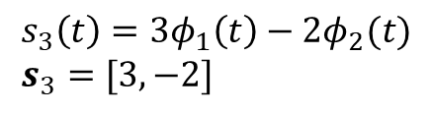

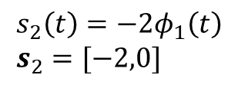


Example Solution
$$φ_{1}\left(t\right)=1$$
2
$$s_{1}(t)$$
$$s_{1}\left(t\right)=2φ_{1}\left(t\right) \\ s_{1}=[2,0]$$
1
0
1
-2
$$s_{2}\left(t\right)=−2φ_{1}\left(t\right) \\ s_{2}=[−2,0]$$
0
1
$$s_{2}(t)$$
Slope=1
$$φ_{2}\left(t\right)=max⁡(0,t−1)$$
3
Slope=-2
$$s_{3}\left(t\right)=3φ_{1}\left(t\right)−2φ_{2}(t) \\ s_{3}=[3,−2]$$
0
1
0
1
Can use $N=2$basis vectors
So, there are $N=2$ degrees of freedom
$K=\log_{2}\left(4\right)=2$bits
Rate $R=\frac{K}{N}=1$ bit / DoF
1
Slope=1
$$s_{4}\left(t\right)=φ_{1}\left(t\right)+φ_{2}(t) \\ s_{4}=[1,1]$$
0
1

Slide 29
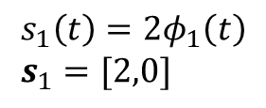
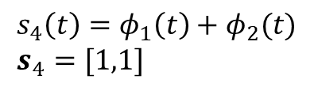

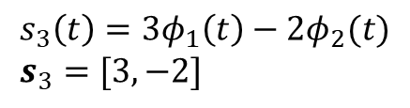

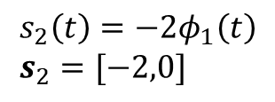




Visualizing the Coordinate Vectors
2
$$s_{1}(t)$$
$$s_{1}\left(t\right)=2φ_{1}\left(t\right) \\ s_{1}=[2,0]$$
0
1
$$s_{4}=[1,1]$$
-2
$$s_{2}\left(t\right)=−2φ_{1}\left(t\right) \\ s_{2}=[−2,0]$$
$$s_{2}(t)$$
3
$$s_{3}\left(t\right)=3φ_{1}\left(t\right)−2φ_{2}(t) \\ s_{3}=[3,−2]$$
Slope=-2
$$s_{2}=[−2,0]$$
$$s_{1}=[2,0]$$
0
1
$$s_{3}=[3,−2]$$
Slope=1
$$s_{4}\left(t\right)=φ_{1}\left(t\right)+φ_{2}(t) \\ s_{4}=[1,1]$$
1
0
1

Slide 30
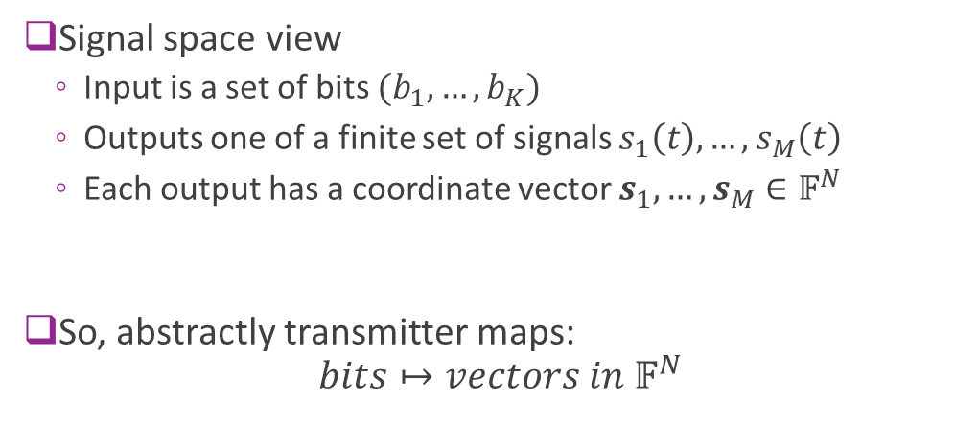
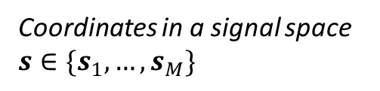
Signal Space View of Transmitter
Input bits $$(b_{1},…,b_{K})$$
Coordinates in a signal space $s∈\{s_{1},…,s_{M}\}$
Signal space view
Input is a set of bits $(b_{1},…,b_{K})$
Outputs one of a finite set of signals $s_{1}\left(t\right),…,s_{M}\left(t\right)$
Each output has a coordinate vector $s_{1},…,s_{M}∈𝔽^{N}$
So, abstractly transmitter maps: $bits↦vectors in 𝔽^{N}$

Slide 31
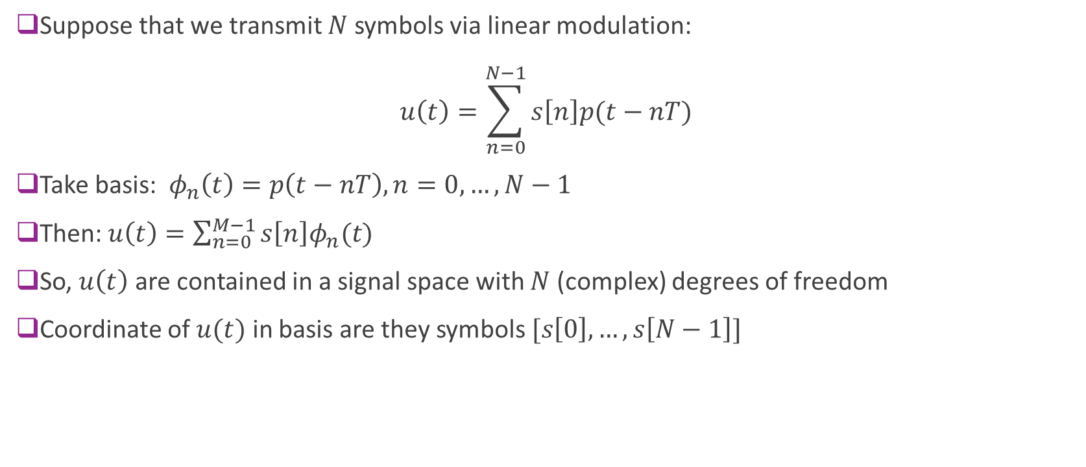
Signal Space for Pulse Shaping
Suppose that we transmit $N$ symbols via linear modulation: $u\left(t\right)=\sum_{n=0}^{N−1}{s\left[n\right]p(t−nT)}$
Take basis: $φ_{n}\left(t\right)=p\left(t−nT\right), n=0,…,N−1$
Then: $u\left(t\right)=\sum_{n=0}^{M−1}{s\left[n\right]φ_{n}(t)}$
So, $u\left(t\right)$ are contained in a signal space with $N$ (complex) degrees of freedom
Coordinate of $u(t)$ in basis are they symbols $[s\left[0\right],…,s\left[N−1\right]]$

Slide 32
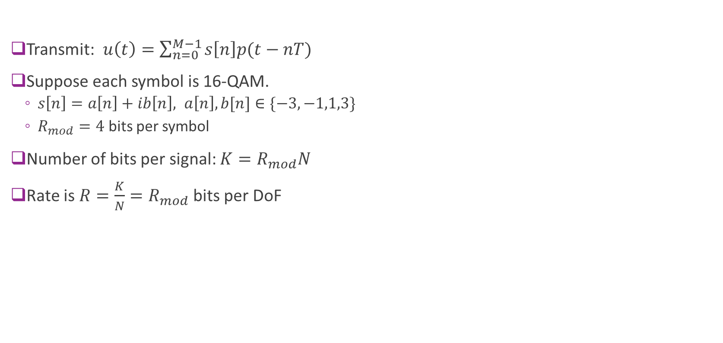
Example for 16-QAM
Transmit: $u\left(t\right)=\sum_{n=0}^{M−1}{s\left[n\right]p(t−nT)}$
Suppose each symbol is 16-QAM.
$s\left[n\right]=a\left[n\right]+ib\left[n\right], a\left[n\right], b[n]∈\{−3,−1,1,3\}$
$R_{mod}=4$ bits per symbol
Number of bits per signal: $K=R_{mod}N$
Rate is $R=\frac{K}{N}=R_{mod}$ bits per DoF

Slide 33
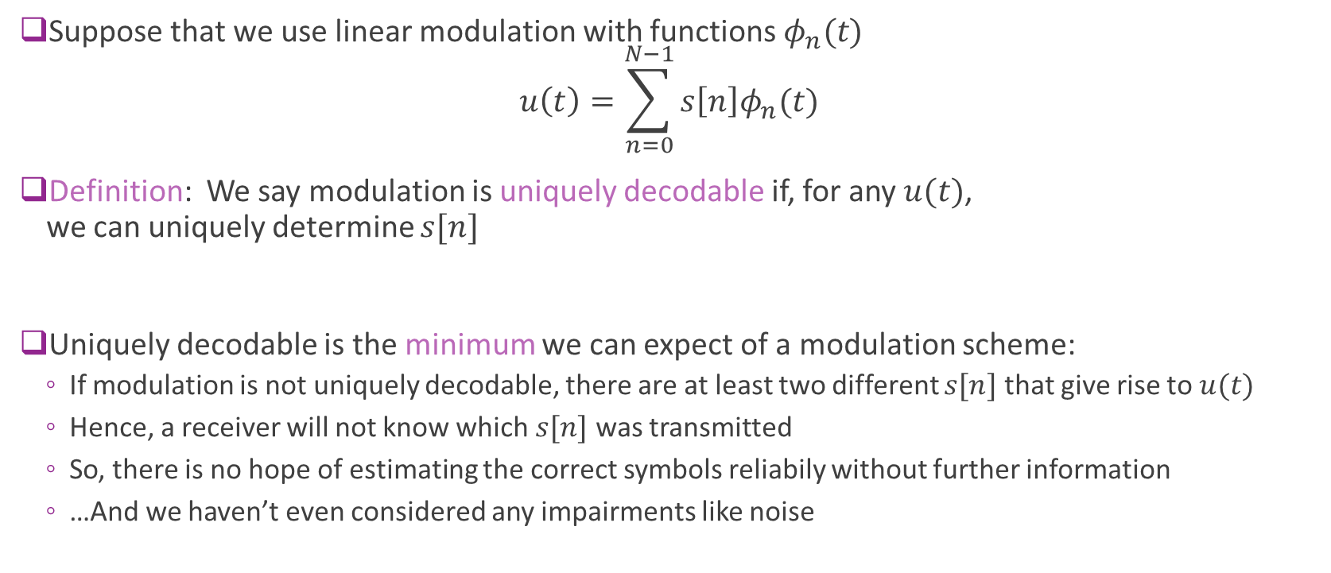
Unique Decodability
Suppose that we use linear modulation with functions $φ_{n}(t)$ $u\left(t\right)=\sum_{n=0}^{N−1}{s\left[n\right]φ_{n}(t)}$
Definition: We say modulation is uniquely decodable if, for any $u(t)$, we can uniquely determine $s[n]$
Uniquely decodable is the minimum we can expect of a modulation scheme:
If modulation is not uniquely decodable, there are at least two different $s[n]$ that give rise to $u(t)$
Hence, a receiver will not know which $s[n]$ was transmitted
So, there is no hope of estimating the correct symbols reliabily without further information
…And we haven’t even considered any impairments like noise

Slide 34
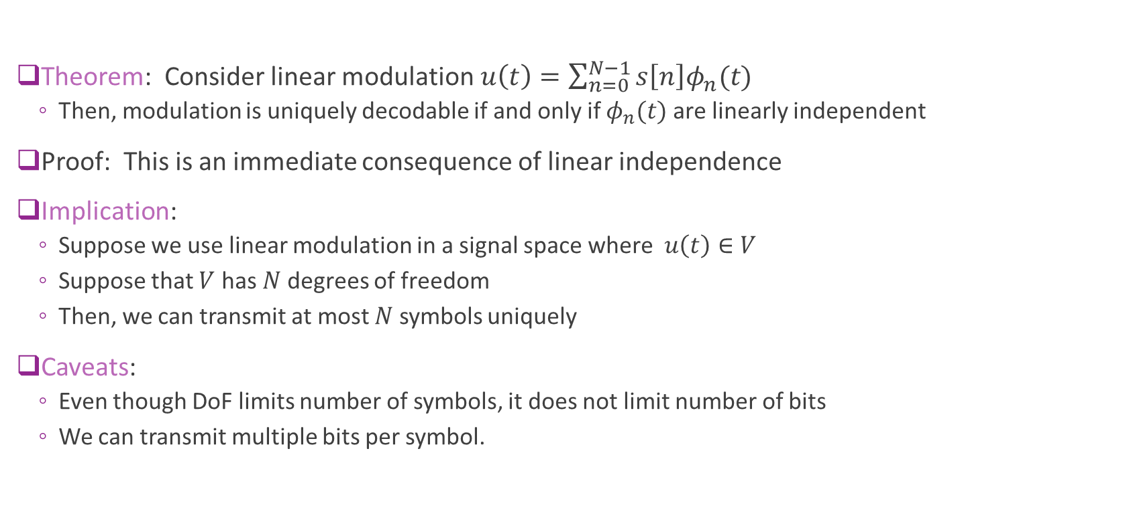
Unique Decodability and Degrees of Freedom
Theorem: Consider linear modulation$u\left(t\right)=\sum_{n=0}^{N−1}{s\left[n\right]φ_{n}(t)}$
Then, modulation is uniquely decodable if and only if $φ_{n}(t)$ are linearly independent
Proof: This is an immediate consequence of linear independence
Implication:
Suppose we use linear modulation in a signal space where $u\left(t\right)∈V$
Suppose that $V$ has $N$ degrees of freedom
Then, we can transmit at most $N$ symbols uniquely
Caveats:
Even though DoF limits number of symbols, it does not limit number of bits
We can transmit multiple bits per symbol.

Slide 35
Outline
Motivation for the signal space model
Vector spaces, bases and dimension
Signal spaces, rate and degrees of freedom
Nyquist Theorem and degrees of freedom in band-limited signals
Inner products and orthogonality
Orthonormal bases and energy per degree of freedom

Slide 36
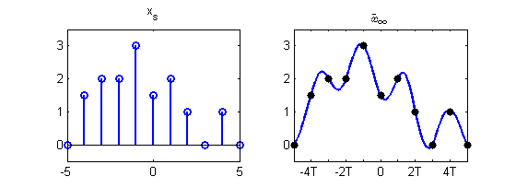




Reconstructing a Signal from Samples
Sampling
Let $x(t)$ be a continuous-time signal
Suppose we are given samples $x\left[n\right]=x\left(nT\right)$
Reconstruction problem:
Estimate $x(t)$ from sample $x[n]$
A classic problem in signal processing
$$x(t)$$
$$x\left[n\right]$$
Ideal A/D
Reconstruction

Slide 37

Nyquist Theorem
Suppose $x(t)$ is band-limited: $X\left(f\right)=0$ for $\left|f\right|>\frac{W}{2}$
$\frac{W}{2}$ is the single-sided bandwidth
We are given samples $x_{d}\left[n\right]=x\left(nT\right)$
Nyquist theorem: If $W<\frac{1}{T}$ then, we can reconstruct $x\left(t\right)$ by: $x\left(t\right)=\sum_{n=−∞}^{∞}{x_{d}\left[n\right] \text{sinc}\left(\frac{t−nT}{T}\right)}$

Slide 38

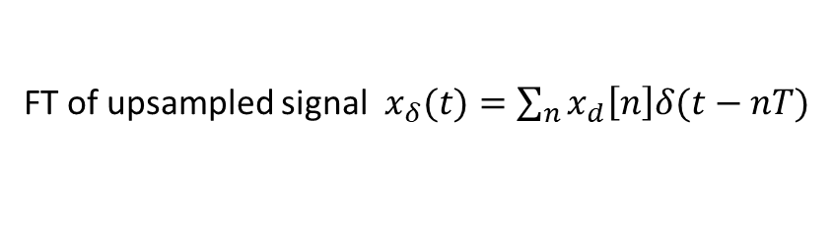









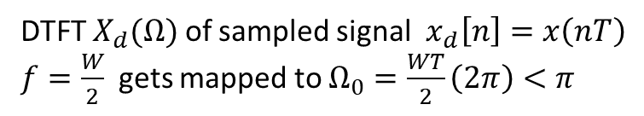





Nyquist Theorem Proof
A simple picture proof in frequency-domain
$$c$$
FT $X(f)$ of original bandlimited $x(t)$
$$−\frac{W}{2}$$
$$\frac{W}{2}$$
$$\frac{c}{T}$$
DTFT $X_{d}(Ω)$ of sampled signal $x_{d}\left[n\right]=x\left(nT\right)$
$f=\frac{W}{2}$ gets mapped to $Ω_{0}=\frac{WT}{2}\left(2π\right)<π$
$$−π$$
$$−Ω_{0}$$
$$Ω_{0}$$
$$π$$
3$π$
$$\frac{c}{T}$$
FT of upsampled signal $x_{δ}(t)=\sum_{n}{x_{d}\left[n\right]δ(t−nT)}$
$$−\frac{1}{2T}$$
$$−\frac{W}{2}$$
$$\frac{W}{2}$$
$$\frac{1}{2T}$$
$$\frac{3}{2T}$$

Slide 39



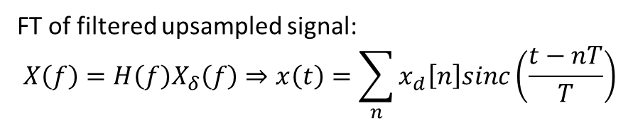




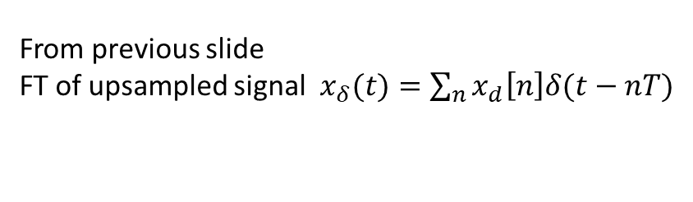

Nyquist Theorem Proof
$$\frac{c}{T}$$
From previous slide
FT of upsampled signal $x_{δ}(t)=\sum_{n}{x_{d}\left[n\right]δ(t−nT)}$
$$−\frac{1}{2T}$$
$$−\frac{W}{2}$$
$$\frac{W}{2}$$
$$\frac{1}{2T}$$
$$\frac{3}{2T}$$
$$T$$
Sinc filter $h\left(t\right)=sinc\left(\frac{t}{T}\right)⇒H\left(f\right)=TRect(fT)$
$$−\frac{1}{2T}$$
$$\frac{1}{2T}$$
$$c$$
FT of filtered upsampled signal: $$X\left(f\right)=H\left(f\right)X_{δ}\left(f\right)⇒x\left(t\right)=\sum_{n}{x_{d}\left[n\right]sinc\left(\frac{t−nT}{T}\right)}$$
$$−\frac{W}{2}$$
$$\frac{W}{2}$$

Slide 40
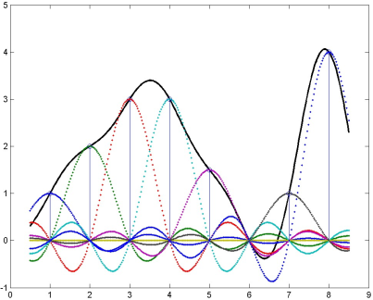
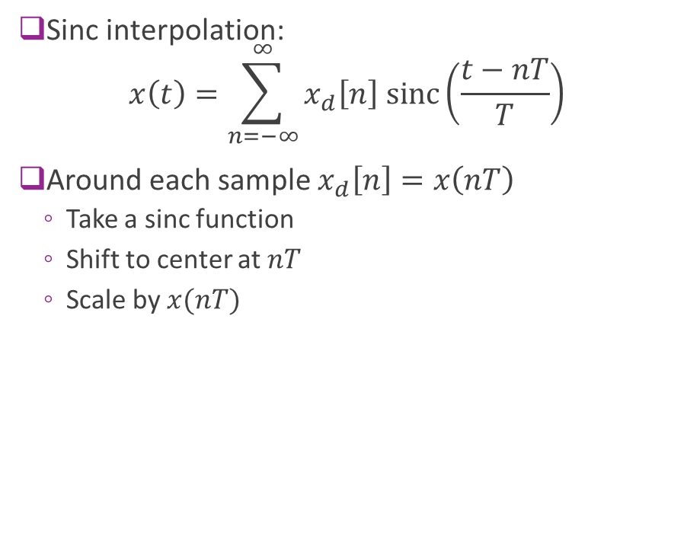
Sinc Interpolation Visualized
Sinc interpolation: $x\left(t\right)=\sum_{n=−∞}^{∞}{x_{d}\left[n\right] \text{sinc}\left(\frac{t−nT}{T}\right)}$
Around each sample $x_{d}\left[n\right]=x\left(nT\right)$
Take a sinc function
Shift to center at $nT$
Scale by $x(nT)$

Slide 41
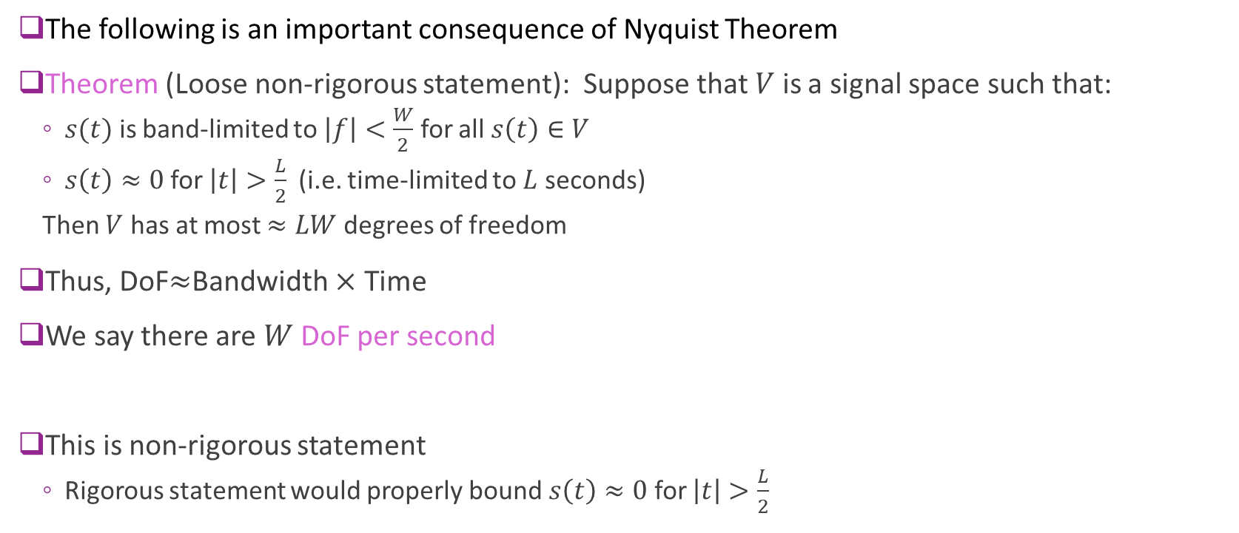
DoF for Bandlimited Signals
The following is an important consequence of Nyquist Theorem
Theorem (Loose non-rigorous statement): Suppose that $V$ is a signal space such that:
$s(t)$ is band-limited to $\left|f\right|<\frac{W}{2}$ for all $s\left(t\right)∈V$
$s\left(t\right)≈0$ for $\left|t\right|>\frac{L}{2}$ (i.e. time-limited to $L$ seconds)
Then $V$ has at most $≈LW$ degrees of freedom
Thus, DoF$≈$Bandwidth $×$ Time
We say there are $W$ DoF per second
This is non-rigorous statement
Rigorous statement would properly bound $s\left(t\right)≈0$ for $\left|t\right|>\frac{L}{2}$

Slide 42
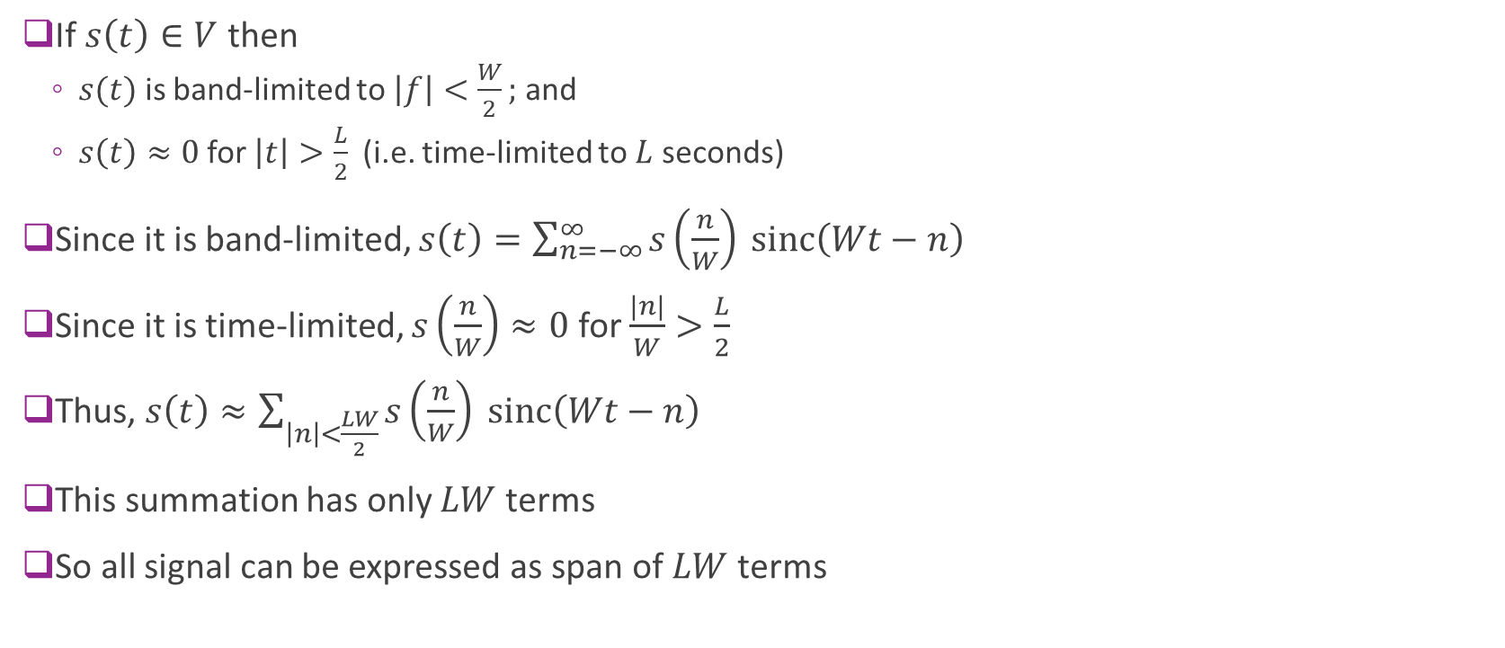
“Proof” of DoF Statement
If $s\left(t\right)∈V$ then
$s(t)$ is band-limited to $\left|f\right|<\frac{W}{2};$ and
$s\left(t\right)≈0$ for $\left|t\right|>\frac{L}{2}$ (i.e. time-limited to $L$ seconds)
Since it is band-limited, $s\left(t\right)=\sum_{n=−∞}^{∞}{s\left(\frac{n}{W}\right) \text{sinc}\left(Wt−n\right)}$
Since it is time-limited, $s\left(\frac{n}{W}\right)≈0$ for $\frac{|n|}{W}>\frac{L}{2}$
Thus, $s\left(t\right)≈\sum_{\left|n\right|<\frac{LW}{2}}{s\left(\frac{n}{W}\right) \text{sinc}\left(Wt−n\right)}$
This summation has only $LW$ terms
So all signal can be expressed as span of $LW$ terms

Slide 43
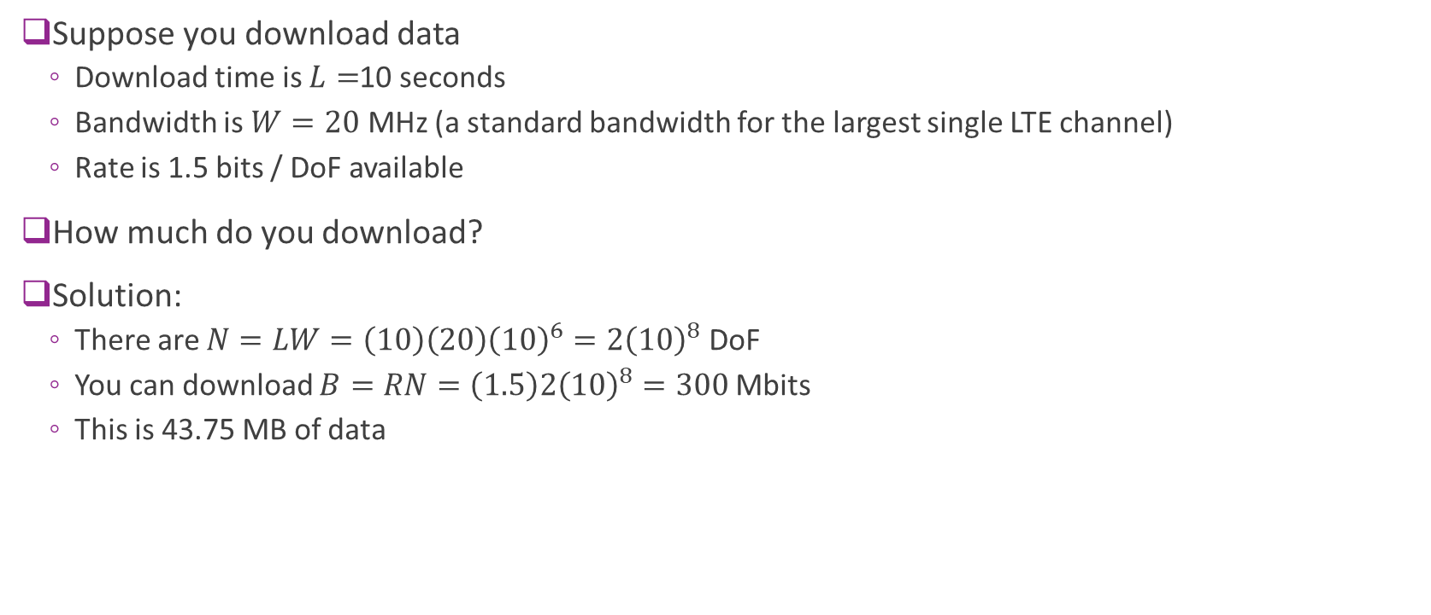
Example
Suppose you download data
Download time is $L=$10 seconds
Bandwidth is $W=20$ MHz (a standard bandwidth for the largest single LTE channel)
Rate is 1.5 bits / DoF available
How much do you download?
Solution:
There are $N=LW=\left(10\right)\left(20\right){\left(10\right)}^{6}=2{\left(10\right)}^{8}$ DoF
You can download $B=RN=\left(1.5\right)2{\left(10\right)}^{8}=300$Mbits
This is 43.75 MB of data

Slide 44
Outline
Motivation for the signal space model
Vector spaces, bases and dimension
Signal spaces, rate and degrees of freedom
Nyquist Theorem and degrees of freedom in band-limited signals
Inner products and orthogonality
Orthonormal bases and energy per degree of freedom

Slide 45


Inner Product in $𝔽^{n}$
Inner product in $𝔽^{n}$: $\left\langle x,y\right\rangle ≔\sum_{i=1}^{n}{{\overline{x}}_{i}y_{i}}$
${\overline{x}}_{i}$= complex conjugate of $x_{i}$
Note: Some texts use $\left\langle x,y\right\rangle ≔\sum_{i=1}^{n}{x_{i}{\overline{y}}_{i}}$
If $x$ and $y$ are column vectors, then $\left\langle x,y\right\rangle =\left[{\overline{x}}_{1},⋯,{\overline{x}}_{n}\right]\left[\begin{matrix}y_{1} \\ ⋮ \\ y_{n}\end{matrix}\right]=x^{∗}y$
Examples:
$x=[1,2]$ and $y=\left[3,4\right]⇒\left\langle x,y\right\rangle =1\left(3\right)+2\left(4\right)=11$
$x=[1+2i,3+4i]$ and $y=\left[5,6+7i\right]$ $⇒\left\langle x,y\right\rangle =\left(1−2i\right)5+\left(3−4i\right)\left(6+7i\right)=5−10i+18+28−24i+21i$

Slide 46

Inner Product on a General Vector Space
Suppose $V$ is a vector space over $𝔽$
Definition: An inner product on $V$ is a function $\left\langle x,y\right\rangle ↦𝔽$ such that:
Conjugate symmetry: $\left\langle x,y\right\rangle =\overline{\left\langle y,x\right\rangle }$
Linearity in the second argument: $\left\langle x,α_{1}y_{1}+α_{2}y_{2}\right\rangle =α_{1}\left\langle x, y_{1}\right\rangle +α_{2}\left\langle x, y_{2}\right\rangle$
Positive definiteness: $\left\langle x,x\right\rangle ≥0$ and $\left\langle x,x\right\rangle =0⟺x=0$
A vector space with an inner product is called an inner product space
Regular inner product in $𝔽^{n}$ satisfies the above properties
Derived property: Conjugate linearity in the first argument: $\left\langle α_{1}x_{1}+α_{2}x_{2},y\right\rangle =\overline{\left\langle y,α_{1}x_{1}+α_{2}x_{2}\right\rangle }$ $={\overline{α}}_{1}\overline{\left\langle y, x_{1}\right\rangle }+{\overline{α}}_{2}\overline{\left\langle y, x_{2}\right\rangle } ={\overline{α}}_{1}\left\langle x_{1}, y\right\rangle +{\overline{α}}_{2}\left\langle x_{2}, y\right\rangle$

Slide 47


Inner Product Geometry
Any inner product induces a norm: $\left\|x\right\|=\sqrt{\left\langle x,x\right\rangle }$
Note $\left\langle x,x\right\rangle ≥0$ so the square root can be taken
Easy to verify that it is satisfies the required norm properties
For $x∈𝔽^{n}$, this is the standard 2-norm: ${\left\|x\right\|}^{2}=\left\langle x,x\right\rangle =\sum_{i}{{\left|x_{i}\right|}^{2}}$
Triangle inequality: $\left\|x+y\right\|≤\left\|x\right\|+\left\|y\right\|$
Cauchy-Schwartz inequality: $\left|\left\langle x,y\right\rangle \right|≤\left\|x\right\|\left\|y\right\|$
Write: $\left\langle x,y\right\rangle =\left\|x\right\|\left\|y\right\|cos(θ)$
$θ=$angle between vectors
Represents “similarity” between vectors
For real vetors, $x^{T}y=\left\langle x,y\right\rangle =\left\|x\right\|\left\|y\right\|cos(θ)$

Slide 48

Inner Products on Functions
Let $f\left(t\right),g(t)$ be two functions on $\left[a,b\right]$
Possibly complex-valued
Define inner product: $\left\langle f,g\right\rangle =∫f{\left(t\right)}^{∗}g\left(t\right)dt$
Same as inner product in $𝔽^{n}$ with sum replaced by integral
Norm squared is the energy:
$ℰ={\left\|f\right\|}^{2}=∫{\left|f\left(t\right)\right|}^{2}dt$ Signal energy
Parseval’s theorem
$\left\langle x(t),y(t)\right\rangle =\left\langle X(f),Y(f)\right\rangle$
$E_{x}=\left\langle x(t),y(t)\right\rangle =\left\langle X(f),Y(f)\right\rangle$
The space $L_{2}[a,b]$ = set of $f(t)$ with finite energy ${\left\|f\right\|}^{2}$

Slide 49

Example Problem
Let $f_{i}\left(t\right)=e^{−α_{i}t}, t≥0, i=1,2,…$
Assume $α_{i}≥0$
Find $\left\langle f_{i},f_{j}\right\rangle$
Find $\left\|f_{i}\right\|$
Solution:
$\left\langle f_{i},f_{j}\right\rangle =\int_{0}^{∞}{f_{i}\left(t\right)f_{j}\left(t\right)dt}=\int_{0}^{∞}{e^{−\left(α_{1}+α_{2}\right)t}dt}=\frac{1}{α_{1}+α_{2}}$
${\left\|f_{i}\right\|}^{2}=\left\langle f_{i},f_{i}\right\rangle =\frac{1}{2α_{i}}$
$\left\|f_{i}\right\|=\frac{1}{\sqrt{2α_{i}}}$

Slide 50


Orthogonality
Orthogonal vectors: $\left\langle x,y\right\rangle =0$
Pythagoras Theorem: ${\left\|x+y\right\|}^{2}=$ ${\left\|x\right\|}^{2}$+${\left\|y\right\|}^{2}$
Write $x⊥y$.
For $x,y∈𝔽^{n}:$
$x⊥y⇔x,y$ are right angles to one another
If $f,g∈L_{2}\left[a,b\right]$, the signals are orthogonal if:
$\left\langle f,g\right\rangle =∫f{\left(t\right)}^{∗}g\left(t\right)dt=0$
A set of vectors $x_{1},x_{2},…$is orthonormal if:
Pairwise orthogonal: $x_{i}⊥x_{j}$ when $i≠j$
Unit energy: $\left\|x_{i}\right\|=1$
Could be a finite or infinite set

Slide 51

Examples of Orthogonal Vectors and Signals
In $V=ℝ^{2}$
$x=\left[1,3\right], y=[−6,2]$
$x^{∗}y=\left(1\right)\left(−6\right)+3\left(2\right)=0$
In $L_{2}[a,b]$: Any two signals $f\left(t\right),g(t)$ that have non-overlapping support
Complex exponentials: $f_{k}\left(t\right)=e^{2πjkt/T}$ for $t∈[0,T]$
Sinc functions: $φ_{k}\left(t\right)=\frac{1}{\sqrt{T}}sinc\left(\frac{t−nT}{T}\right)$
We showed these are orthogonal last unit

Slide 52
Outline
Motivation for the signal space model
Vector spaces, bases and dimension
Signal spaces, rate and degrees of freedom
Nyquist Theorem and degrees of freedom in band-limited signals
Inner products and orthogonality
Orthonormal bases and energy per degree of freedom

Slide 53


Orthonormal Basis
Let $V$ be any vector space
Definition: A set $v_{1},v_{2}…$ is orthonormal if:
$\left\|v\right\|=1$ for all $n$ (all vectors have unit energy)
$\left\langle v_{n},v_{m}\right\rangle =0$ for all $n≠m$ (different vectors are orthogonal)
Orthonormal $⇒$linearly independent.
Why? Suppose that $\sum_{i}{α_{i}v_{i}}=0$
Multiplying by $v_{j}^{∗}$ we get $0=\sum_{i}{α_{i}v_{j}^{∗}v_{i}}=α_{j}$ for all $j$ (since $v_{j}^{∗}v_{i}=δ_{ij}$)
Consequence: if $v_{1},…,v_{N}∈𝔽^{N}$ are orthonormal, then they are a basis for $𝔽^{N}$
Called an orthonormal basis

Slide 54

Example
Show the vectors are orthonormal: $v_{1}=\frac{1}{\sqrt{11}}\left[\begin{matrix}3 \\ 1 \\ 1\end{matrix}\right], v_{2}=\frac{1}{\sqrt{6}}\left[\begin{matrix}−1 \\ 2 \\ 1\end{matrix}\right], v_{3}=\frac{1}{\sqrt{66}}\left[\begin{matrix}−1 \\ −4 \\ 7\end{matrix}\right]$
Solution:
$v_{1}^{T}v_{2}=\frac{1}{\sqrt{66}}\left(−3+2+1\right)=0$
$v_{1}^{T}v_{3}=\frac{1}{\sqrt{66(11)}}\left(−3−4+7\right)=0$
$v_{2}^{T}v_{3}=\frac{1}{\sqrt{66(6)}}\left(1−8+7\right)=0$
${\left\|v_{1}\right\|}^{2}=\frac{1}{11}\left(9+1+1\right)=1, {\left\|v_{2}\right\|}^{2}=\frac{1}{6}\left(1+4+1\right)=1,$
${\left\|v_{3}\right\|}^{2}=\frac{1}{66}\left(1+16+49\right)=1,$

Slide 55

Unitary Matrices
A matrix $U∈ℂ^{N×N}$ is unitary if $U^{∗}U=I$
$U$called orthogonal if it is real-valued (i.e. $U∈ℝ^{N×N}$ and $U^{T}U=I$)
$U$ is unitary/orthogonal if and only if one of the following equivalent properties are true:
$U^{∗}=U^{−1}$
The rows of $U$ are an orthonormal set
The columns of $U$ are an orthonormal set
${\left\|Ux\right\|}^{2}={\left\|x\right\|}^{2}$ for all $x∈𝔽^{N}$
$\left\langle Ux,Uy\right\rangle =\left\langle x,y\right\rangle$ for all $x,y∈𝔽^{N}$

Slide 56

Proof of the Unitary Matrix Properties
$U$ unitary $⟺U^{−1}=U^{∗}$: Follows from the definition $UU^{∗}=U^{∗}U=I$
$U$ unitary $⟺$ columns of $U$ are orthonormal
Write $U=[u_{1},…,u_{N}]$ where $u_{i}$ is the $i$-th column
Then: ${\left(U^{∗}U\right)}_{ij}=u_{i}^{∗}u_{j}$
Since $U^{∗}U=I,$ $u_{i}^{∗}u_{j}=δ_{ij}=\left\{\begin{matrix}0 & i≠j \\ 1 & i=j\end{matrix}\right.$
Hence:$u_{i}^{∗}u_{j}=0$ for $i≠j$ and ${\left\|u_{i}\right\|}^{2}=u_{i}^{∗}u_{i}=1$ for all $i$
$U$ unitary $⟺$ row of $U$ are orthonormal. Same proof as previous but use $UU^{∗}=I$
$U$ unitary $⇒{\left\|Ux\right\|}^{2}={\left\|x\right\|}^{2}:$ ${\left\|Ux\right\|}^{2}=x^{∗}U^{∗}Ux=x^{∗}x={\left\|x\right\|}^{2}$

Slide 57

Coefficients in an Orthonormal Basis
Let$v_{1},…,v_{N}∈𝔽^{N}$ be an orthonormal basis
Theorem: Given any $x∈𝔽^{N}$, $x=\sum_{j}{z_{j}v_{j}}$where $z_{j}=\left\langle v_{j},x\right\rangle$
Consequence: Find coefficients of $x$ in an orthonormal basis is easy
Just take inner products $z_{j}=\left\langle v_{j},x\right\rangle$.
NO matrix inverse
Proof of theorem
Since $v_{1},…,v_{N}$ is orthonormal, $V=[v_{1},…,v_{N}]$ is unitary
Since $z_{j}=\left\langle v_{j},x\right\rangle$ we can write $z=V^{∗}x$
But then $\sum_{j}{z_{j}v_{j}}=Vz=VV^{∗}x=x$

Slide 58











Orthogonal Matrix Transformations
Coefficient in standard basis
$$x=[x_{1},…,x_{N}]$$
Coefficients in orthonormal basis
$$z=[z_{1},…,z_{N}]$$
$$z=V^{∗}x$$
$$x_{3}$$
$$z_{3}$$
$$z_{2}$$
$$z_{1}$$
$$x_{2}$$
$$x_{1}$$
$$x=Vz$$

Slide 59

Example
Consider the orthonormal set from before: $v_{1}=\frac{1}{\sqrt{11}}\left[\begin{matrix}3 \\ 1 \\ 1\end{matrix}\right], v_{2}=\frac{1}{\sqrt{6}}\left[\begin{matrix}−1 \\ 2 \\ 1\end{matrix}\right], v_{3}=\frac{1}{\sqrt{66}}\left[\begin{matrix}−1 \\ −4 \\ 7\end{matrix}\right]$
Let $x={\left[0,1,2\right]}^{T}$. Find the coefficient expansion in the orthonormal bases
Solution:
$z_{1}=v_{1}^{∗}x=\frac{1}{\sqrt{11}}\left(1+2\right)=\frac{3}{\sqrt{11}}$
$z_{2}=v_{2}^{∗}x=\frac{1}{\sqrt{6}}\left(2+2\right)=\frac{4}{\sqrt{6}}$
$z_{3}=v_{2}^{∗}x=\frac{1}{\sqrt{66}}\left(−4+14\right)=\frac{10}{\sqrt{66}}$
Then $x=z_{1}v_{1}+z_{2}v_{2}+z_{3}v_{3}$

Slide 60

Finding an orthonormal basis: Gram Schmidt
Let $v_{1},..,v_{K}$ be linearly independent
There exists an orthonormal set $u_{1},..,u_{K}$ such that $span\left\{v_{1},..,v_{K}\right\}=span\left\{u_{1},..,u_{K}\right\}$
Conclusion: Every subspace has an orthonormal basis
Gram-Schmidt Procedure for finding $u_{1},..,u_{K}$
$u_{1}={v_{1}}/{‖v_{1}‖}$
$w_{2}=v_{2}−\left\langle u_{1},v_{2}\right\rangle u_{1}, u_{2}={w_{2}}/{\left\|w_{2}\right\|}$
$⋯$
$w_{k}=v_{k}−\sum_{i=1}^{k−1}{\left\langle u_{i},v_{k}\right\rangle u_{i}}, u_{k}={w_{k}}/{\left\|w_{k}\right\|}$
$⋯$

Slide 61

Gram Schmidt Example
$v_{1}=\left[\begin{matrix}3 \\ 1\end{matrix}\right], v_{2}=\left[\begin{matrix}2 \\ 2\end{matrix}\right]$
$u_{1}=\frac{v_{1}}{\left\|v_{1}\right\|}=\frac{1}{\sqrt{10}}\left[\begin{matrix}3 \\ 1\end{matrix}\right]$
$w_{2}=v_{2}−\left\langle u_{1},v_{1}\right\rangle u_{1}=\left[\begin{matrix}2 \\ 2\end{matrix}\right]−\frac{1}{10}\left(6+2\right)\left[\begin{matrix}3 \\ 1\end{matrix}\right]=\frac{1}{5}\left[\begin{matrix}−2 \\ 6\end{matrix}\right]$
$u_{2}=\frac{1}{\sqrt{4+36}}\left[\begin{matrix}−2 \\ 6\end{matrix}\right]=\frac{1}{\sqrt{40}}\left[\begin{matrix}−2 \\ 6\end{matrix}\right]=\frac{1}{\sqrt{10}}\left[\begin{matrix}−1 \\ 3\end{matrix}\right]$

Slide 62

QR Factorization
Gram-Schmidt is mostly done on a computer
Use the QR factorization.
Given matrix $A=\left[a_{1},…,a_{K}\right], a_{i}∈𝔽^{N}$
Columns are the vectors that we want to apply the GS procedure to
QR factorization: $A=QR$
$Q=[q_{1},…,q_{K}]∈𝔽^{N×K}, q_{i}$ orthonormal set from the GS procedure
$R=$ lower triangular matrix has coefficients of vectors $a_{j}$ in terms of $q_{i}$: $a_{j}=\sum_{i=1}^{j}{q_{i}R_{ij}}$
LU is another factorization

Slide 63

Orthonormal Basis of Functions
Up to now, we have defined orthonormal bases for finite-dimensional spaces
Let $φ_{k}\left(t\right), k=0,1,…$ be a set of functions in $L_{2}(a,b)$
Could be indexed from $k=…,−1,0,1,…$ also
$(a,b)$ could be a bounded or infinite interval
Definition: We say $\{φ_{k}\left(t\right)\}$ is an orthonormal basis if:
$φ_{k}\left(t\right), k=0,1,…$ is an orthonormal set
For any $f\left(t\right)∈L_{2}(a,b)$ $\lim_{k→∞}\left\|f−\sum_{j=0}^{k}{\left\langle φ_{j},f\right\rangle φ_{j}}\right\|=0$
This means the approximation $f\left(t\right)≈\sum_{j=0}^{k}{α_{j}φ_{j}\left(t\right)}, α_{j}=\left\langle φ_{j},f\right\rangle$ is asymptotically exact

Slide 64

Common Orthonormal Sets and Bases
Set of complex exponentials $φ_{k}\left(t\right)=\frac{1}{\sqrt{T}}e^{2πjkt/T}$
This is a basis of $L_{2}[0,T]$
Set of sinc’s: $φ_{k}\left(t\right)=\frac{1}{\sqrt{T}}Sinc\left(\frac{t−nT}{T}\right)$
This is a basis of the set of signals band-limited to $\left|f\right|<\frac{1}{2T}$
Set of rectangles: $f_{k}\left(t\right)=\frac{1}{\sqrt{T}}Rect\left(\frac{t−nT}{T}\right)$
This is an orthonormal set but not a basis

Slide 65

Energy and an Orthonormal Basis
Suppose $V$ is a signal space with $N$ DoFs
We can find an orthonormal basis $φ_{1}\left(t\right),…,φ_{N}\left(t\right)$
Given any $s\left(t\right)∈V$, we can write $s\left(t\right)=\sum_{j=1}^{N}{z_{j}φ_{j}(t)}, z_{j}=\left\langle φ_{j},s\right\rangle$
Signal energy is ${\left\|s\right\|}^{2}=∫{\left|s\left(t\right)\right|}^{2}dt$
Parseval’s Theorem: ${\left\|s\right\|}^{2}={\left\|z\right\|}^{2}=\sum_{j=1}^{N}{{\left|z_{j}\right|}^{2}}$
Proof: On board
In an orthonormal basis, we can compute energy in the coefficients
Call ${\left|z_{j}\right|}^{2}$ the energy in the $j$ th degree of freedom

Slide 66

Example Problem
Suppose that $s(t)$ has a coefficient representation $s\left(t\right)=∑z_{j}φ_{j}(t)$ in an o.n. basis
Suppose coefficients are $z=\left[3+i, 2−i,1\right]\sqrt{A}$
What is $A$ if the signal energy is -150 dBmJ?
Solution:
Signal energy is ${\left\|s\right\|}^{2}=∫{\left|s\left(t\right)\right|}^{2}dt={10}^{−15}$ mJ
By Parseval’s theorem ${\left\|s\right\|}^{2}={\left\|z\right\|}^{2}=\sum_{j=1}^{N}{{\left|z_{j}\right|}^{2}}=A\left[\left(9+1\right)+\left(4+1\right)+1\right]=A\left(16\right)$
Hence $A=\frac{{10}^{−15}}{16}$ mJ / DoF

