Slide 1
Unit 11: Information Theory and Capacity
EL-GY 6013: Digital communications
Prof. Sundeep rangan

Slide 2
Learning Objectives
Define and compute the Shannon capacity for simple memoryless channels
Identify power-limited and bandwidth-limited regimes of operation
Describe difficulties in achieving the Shannon capacity for practical systems
Mathematically describe the performance of a system relative to the Shannon limit
Define and compute the constellation-constrained capacity

Slide 3
Outline
Information theory basics
Shannon capacity
Modeling capacity of practical systems
Constellation constrained capacity
Proof of the Shannon Theorem

Slide 4
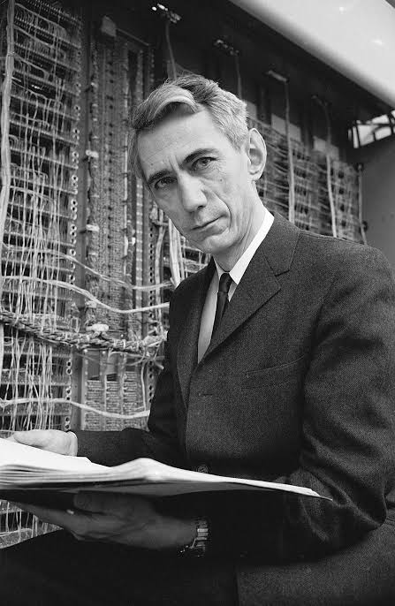
What is Information Theory?
There are many ways to design communication systems
Two basic questions:
How do we measure the performance?
What is the best we can expect to do?
Information theory provides:
Simple metrics to evaluate system performance
Fundamental bounds that can be achieved by any system
Apply to any communication system
No constraint in computation / delay
Can be used as a benchmark for practical systems
Claude Shannon Founder of IT

Slide 5
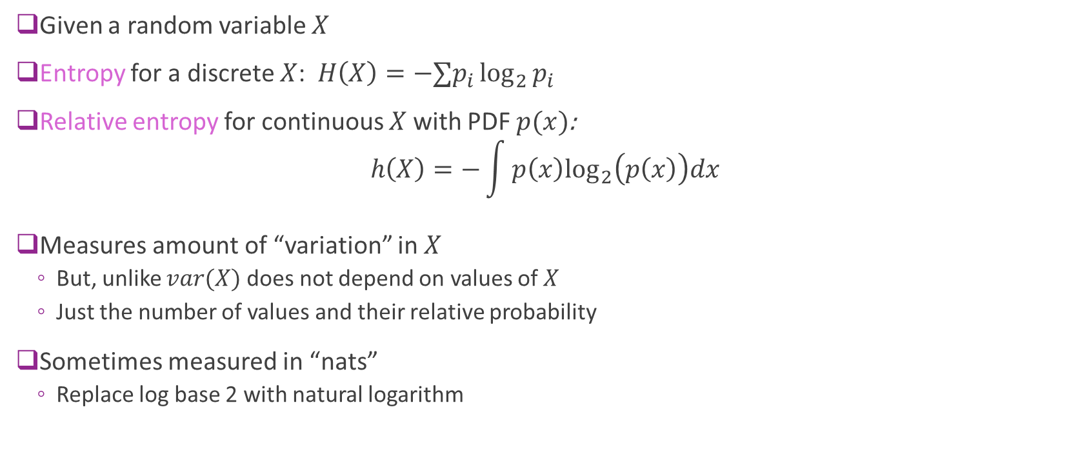
Entropy
Given a random variable $X$
Entropy for a discrete $X$: $H\left(X\right)=−∑p_{i}\log_{2}{p_{i}}$
Relative entropy for continuous $X$ with PDF $p(x)$: $h\left(X\right)=−\int{p\left(x\right)\log_{2}\left(p\left(x\right)\right)dx }$
Measures amount of “variation” in $X$
But, unlike $var(X)$ does not depend on values of $X$
Just the number of values and their relative probability
Sometimes measured in “nats”
Replace log base 2 with natural logarithm

Slide 6
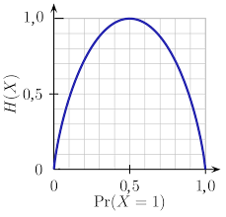
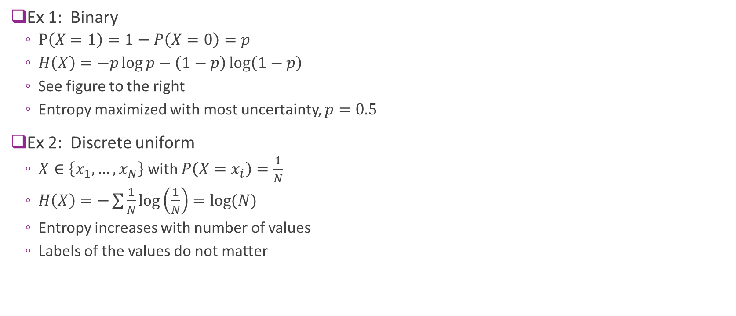
Discrete Examples
Ex 1: Binary
$P\left(X=1\right)=1−P\left(X=0\right)=p$
$H\left(X\right)=−p\log{p}−\left(1−p\right)\log\left(1−p\right)$
See figure to the right
Entropy maximized with most uncertainty, $p=0.5$
Ex 2: Discrete uniform
$X∈\left\{x_{1},…,x_{N}\right\}$ with $P\left(X=x_{i}\right)=\frac{1}{N}$
$H\left(X\right)=−\sum{\frac{1}{N}}\log\left(\frac{1}{N}\right)=\log{(N)}$
Entropy increases with number of values
Labels of the values do not matter

Slide 7
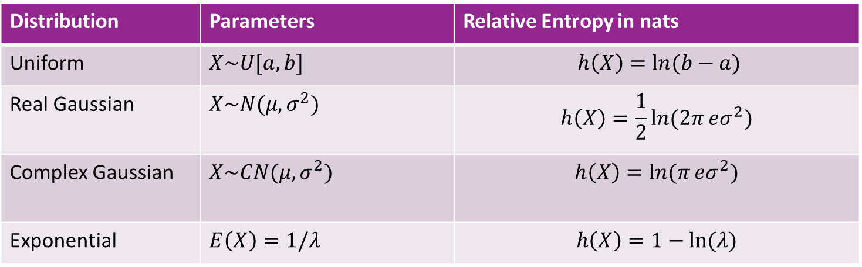
Continuous Examples
Distribution | Parameters | Relative Entropy in nats
Uniform | $X\sim U[a,b]$ | $$h\left(X\right)=\ln{(b−a)}$$
Real Gaussian | $X\sim N(μ,σ^{2})$ | $$h\left(X\right)=\frac{1}{2}\ln{(2π}eσ^{2})$$
Complex Gaussian | $X\sim CN(μ,σ^{2})$ | $$h\left(X\right)=\ln{(π}eσ^{2})$$
Exponential | $E\left(X\right)=1/λ$ | $$h\left(X\right)=1−\ln{(λ)}$$
Entropy increases with variance
Entropy does not change with mean

Slide 8




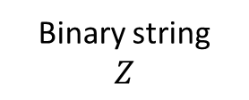
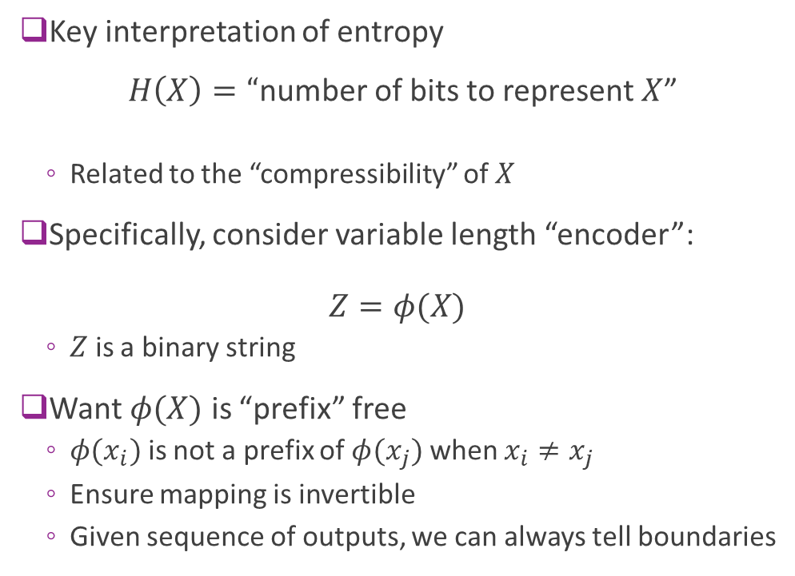
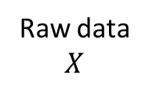
Compression and Entropy
Key interpretation of entropy
$H\left(X\right)=“$number of bits to represent $X$”
Related to the “compressibility” of $X$
Specifically, consider variable length “encoder”: $Z=φ(X)$
$Z$ is a binary string
Want $φ(X)$ is “prefix” free
$φ(x_{i})$ is not a prefix of $φ(x_{j})$ when $x_{i}≠x_{j}$
Ensure mapping is invertible
Given sequence of outputs, we can always tell boundaries
Raw data $$X$$
$$φ\left(⋅\right)$$
Binary string $$Z$$

Slide 9
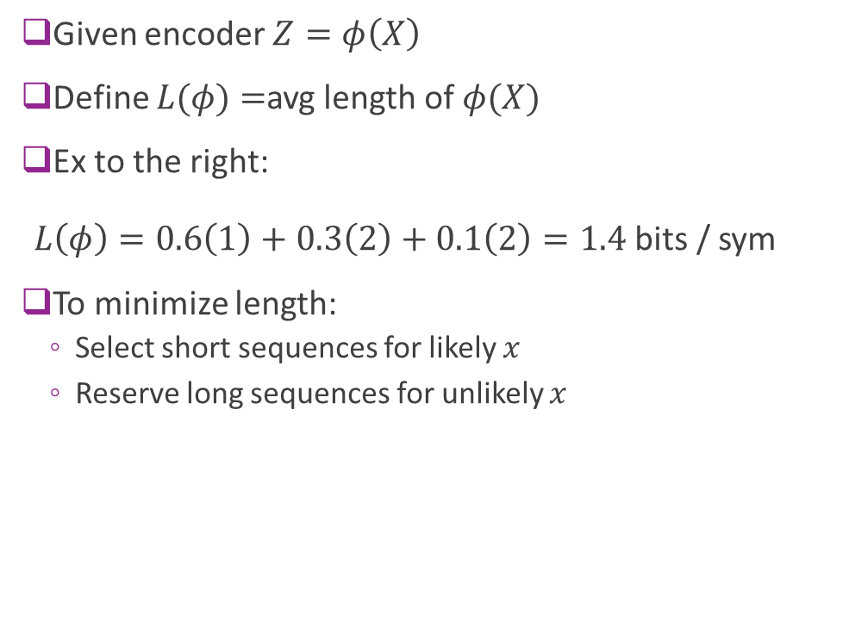
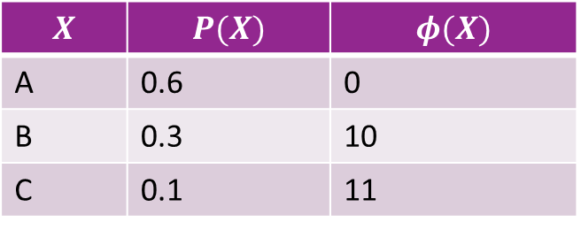
Length of an Encoder
Given encoder $Z=φ\left(X\right)$
Define $L(φ)$ $=$avg length of $φ(X)$
Ex to the right: $L\left(φ\right)=0.6\left(1\right)+0.3\left(2\right)+0.1\left(2\right)=1.4$ bits / sym
To minimize length:
Select short sequences for likely $x$
Reserve long sequences for unlikely $x$
Raw data $$X$$
$$φ\left(⋅\right)$$
Binary string $$Z$$
$$X$$ | $$P(X)$$ | $$φ(X)$$
A | 0.6 | 0
B | 0.3 | 10
C | 0.1 | 11

Slide 10
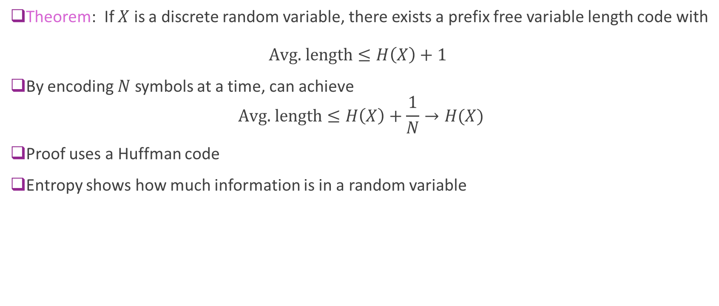
Compression and Entropy
Theorem: If $X$ is a discrete random variable, there exists a prefix free variable length code with $\text{Avg}\text{. }\text{length}≤H\left(X\right)+1$
By encoding $N$ symbols at a time, can achieve $\text{Avg}\text{. }\text{length}≤H\left(X\right)+\frac{1}{N}→H(X)$
Proof uses a Huffman code
Entropy shows how much information is in a random variable

Slide 11
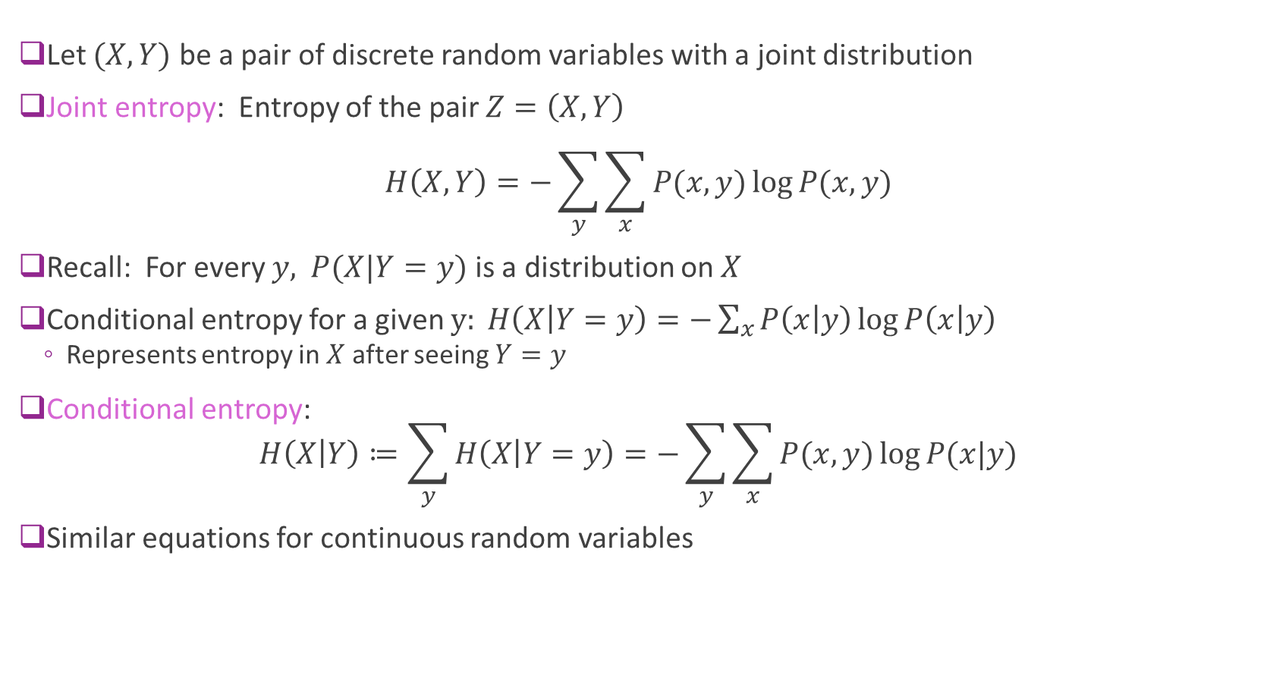
Joint and Conditional Entropy
Let $(X,Y)$ be a pair of discrete random variables with a joint distribution
Joint entropy: Entropy of the pair $Z=\left(X,Y\right)$ $H\left(X,Y\right)=−\sum_{y}{\sum_{x}{P(x,y)}\log{P(x,y)}}$
Recall: For every $y,$ $P(X|Y=y)$ is a distribution on $X$
Conditional entropy for a given $y: H\left(X | Y=y\right)=−\sum_{x}{P\left(x | y\right)}\log{P\left(x | y\right)}$
Represents entropy in $X$ after seeing $Y=y$
Conditional entropy: $H\left(X | Y\right)≔\sum_{y}{H\left(X | Y=y\right)}=−\sum_{y}{\sum_{x}{P(x,y)}\log{P(x|y)}}$
Similar equations for continuous random variables

Slide 12

Properties
Conditional: $H\left(X,Y\right)=H\left(X\right)+H\left(Y | X\right)=H\left(Y\right)+H(X|Y)$
Independence:
$H\left(X | Y\right)=H(X)$ if and only if $X$and $Y$ are independent
In this case, $H\left(X,Y\right)=H\left(X\right)+H\left(Y\right)$
For all $X,Y$: $H\left(X,Y\right)≤H\left(X\right)+H(Y)$

Slide 13
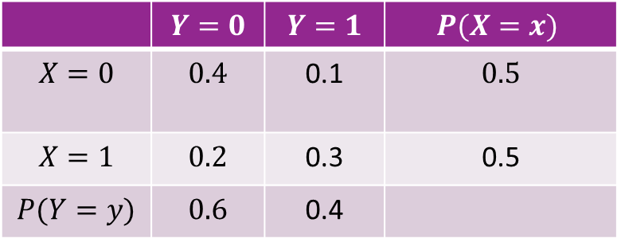
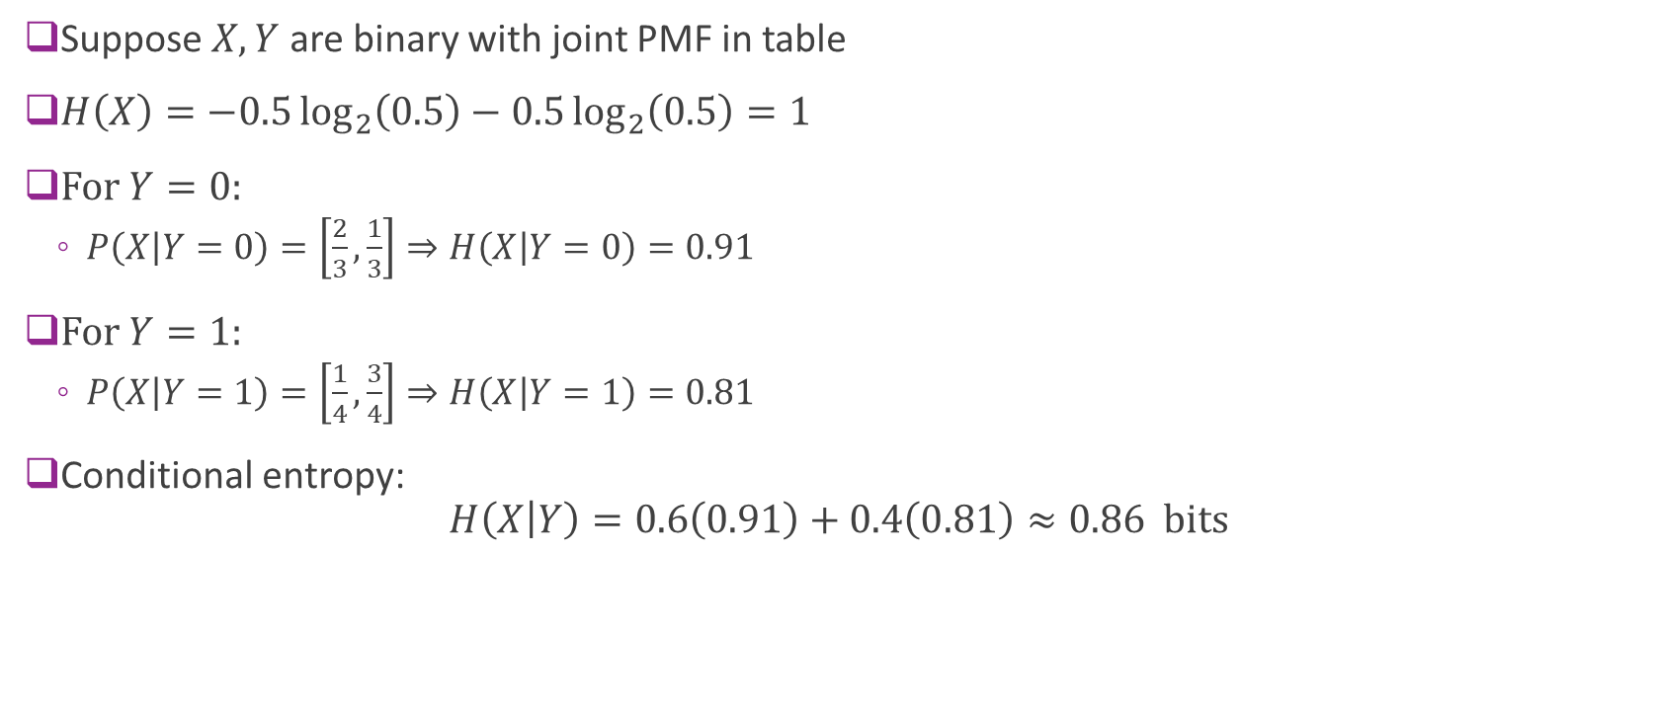
Example
Suppose $X,Y$ are binary with joint PMF in table
$H\left(X\right)=−0.5\log_{2}\left(0.5\right)−0.5\log_{2}\left(0.5\right)=1$
For $Y=0:$
$P\left(X | Y=0\right)=\left[\frac{2}{3},\frac{1}{3}\right]⇒H\left(X | Y=0\right)=0.91$
For $Y=1:$
$P\left(X | Y=1\right)=\left[\frac{1}{4},\frac{3}{4}\right]⇒H\left(X | Y=1\right)=0.81$
Conditional entropy: $H\left(X | Y\right)=0.6\left(0.91\right)+0.4\left(0.81\right)≈0.86 bits$
 | $$Y=0$$ | $$Y=1$$ | $$P(X=x)$$
$$X=0$$ | $$0.4$$ | 0.1 | $0.5$
$$X=1$$ | $$0.2$$ | 0.3 | 0.5
$$P(Y=y)$$ | $$0.6$$ | 0.4

Slide 14
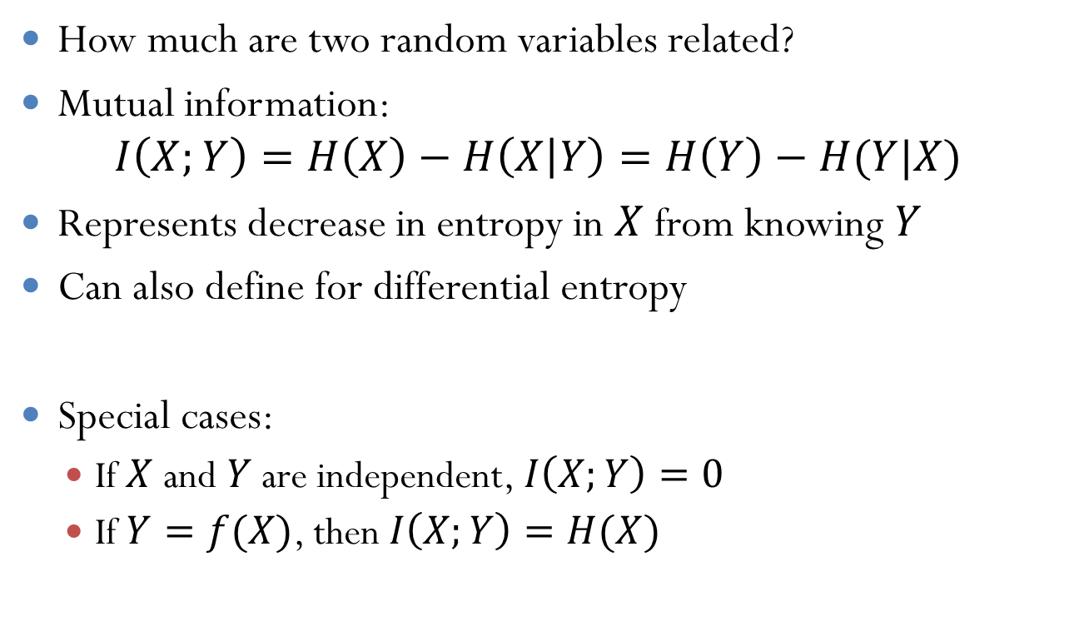
Mutual Information
How much are two random variables related?
Mutual information: $I\left(X;Y\right)=H\left(X\right)−H\left(X | Y\right)=H\left(Y\right)−H(Y|X)$
Represents decrease in entropy in $X$ from knowing $Y$
Can also define for differential entropy
Special cases:
If $X$ and $Y$ are independent, $I\left(X;Y\right)=0$
If $Y=f(X)$, then $I\left(X;Y\right)=H(X)$

Slide 15
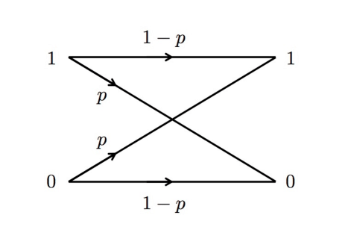
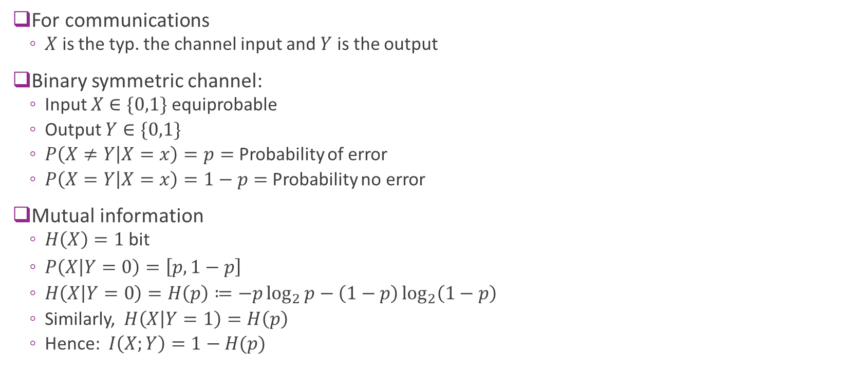


Example: BSC Channel
For communications
$X$ is the typ. the channel input and $Y$ is the output
Binary symmetric channel:
Input $X∈\{0,1\}$ equiprobable
Output $Y∈\{0,1\}$
$P\left(X≠Y | X=x\right)=p=$ Probability of error
$P\left(X=Y | X=x\right)=1−p=$ Probability no error
Mutual information
$H\left(X\right)=1$ bit
$P\left(X | Y=0\right)=\left[p,1−p\right]$
$H\left(X | Y=0\right)=H\left(p\right)≔−p\log_{2}{p}−\left(1−p\right)\log_{2}\left(1−p\right)$
Similarly, $H\left(X | Y=1\right)=H\left(p\right)$
Hence: $I\left(X;Y\right)=1−H(p)$
$$X$$
$$Y$$

Slide 16
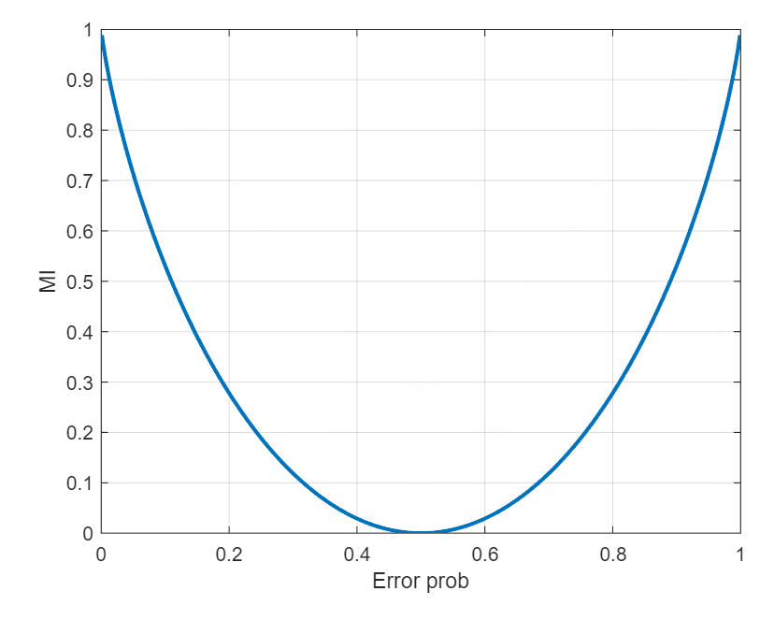
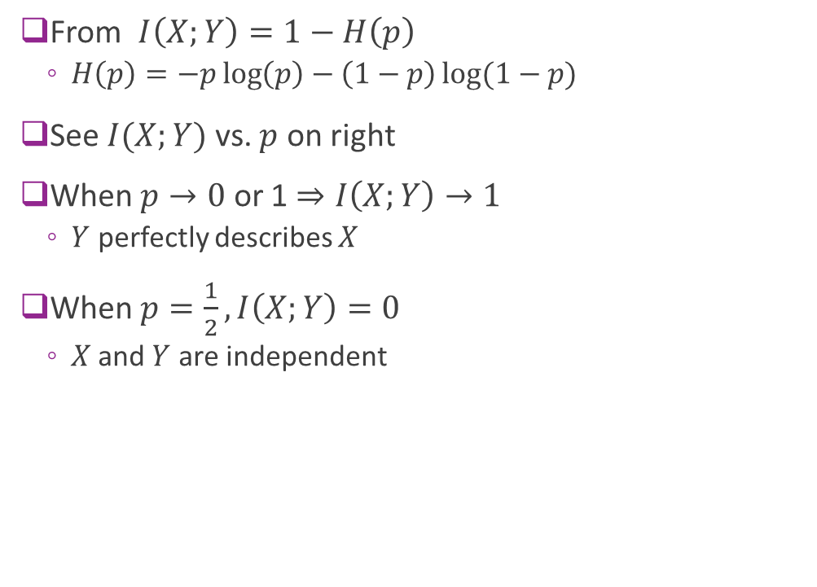
BSC Channel Illustrated
From $I\left(X;Y\right)=1−H\left(p\right)$
$H\left(p\right)=−p\log\left(p\right)−\left(1−p\right)\log{(1−p)}$
See $I(X;Y)$ vs. $p$ on right
When $p→0$ or 1 $⇒I\left(X;Y\right)→1$
$Y$ perfectly describes $X$
When $p=\frac{1}{2}, I\left(X;Y\right)=0$
$X$and $Y$ are independent

Slide 17
Outline
Information theory basics
Shannon capacity
Modeling capacity of practical systems
Constellation constrained capacity
Proof of the Shannon Theorem

Slide 18

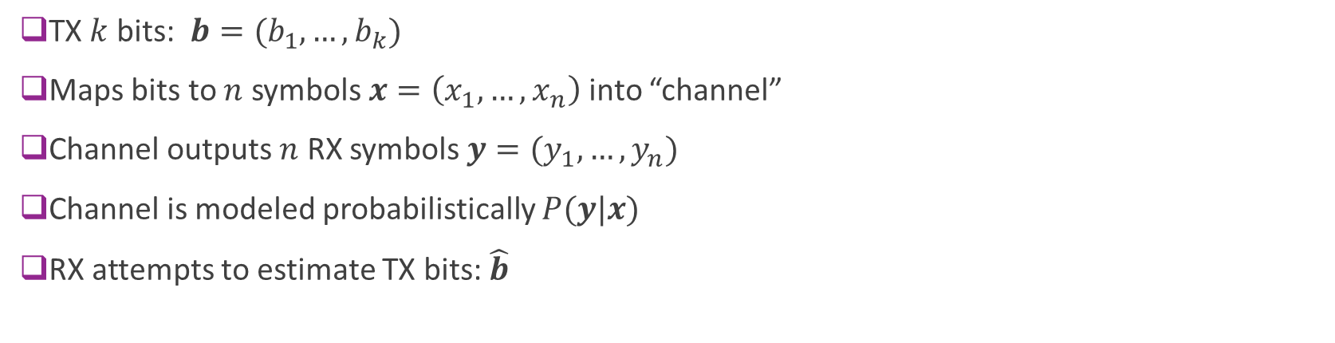



Abstract Communication System
Information bits
TX symbols
RX symbols
RX bits
$$b$$
$$x$$
$$y$$
$$\hat{b}$$
TX
Channel
RX
TX $k$ bits: $b=(b_{1},…,b_{k})$
Maps bits to $n$ symbols $x=\left(x_{1},…,x_{n}\right)$ into “channel”
Channel outputs $n$ RX symbols $y=(y_{1},…,y_{n})$
Channel is modeled probabilistically $P(y|x)$
RX attempts to estimate TX bits: $\hat{b}$

Slide 19




Practical System is an Example
$$b$$
$$x$$
$$y$$
$$\hat{b}$$
TX
Channel
RX
Coding
Symbol
mapping
RX filtering
Symbol
demod
Decoding
TX filtering
In the abstract model, the TX and RX can include typical block we have studied up to now
But they are not restricted to a particular structure

Slide 20
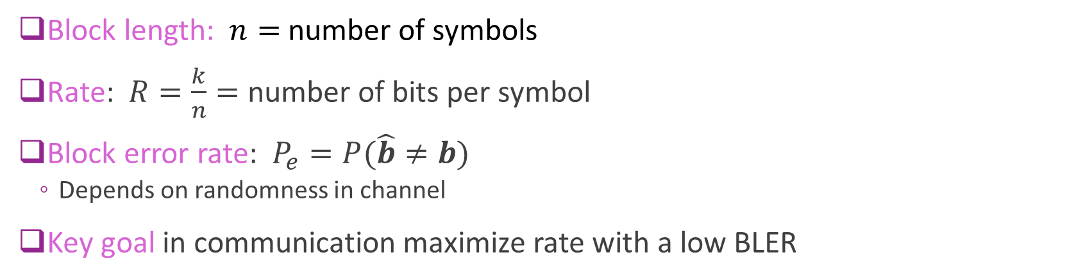
Key Parameters
Information bits
TX symbols
RX symbols
RX bits
$$b$$
$$x$$
$$y$$
$$\hat{b}$$
TX
Channel
RX
Block length: $n=$ number of symbols
Rate: $R=\frac{k}{n}=$ number of bits per symbol
Block error rate: $P_{e}=P(\hat{b}≠b)$
Depends on randomness in channel
Key goal in communication maximize rate with a low BLER

Slide 21
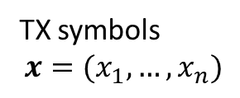
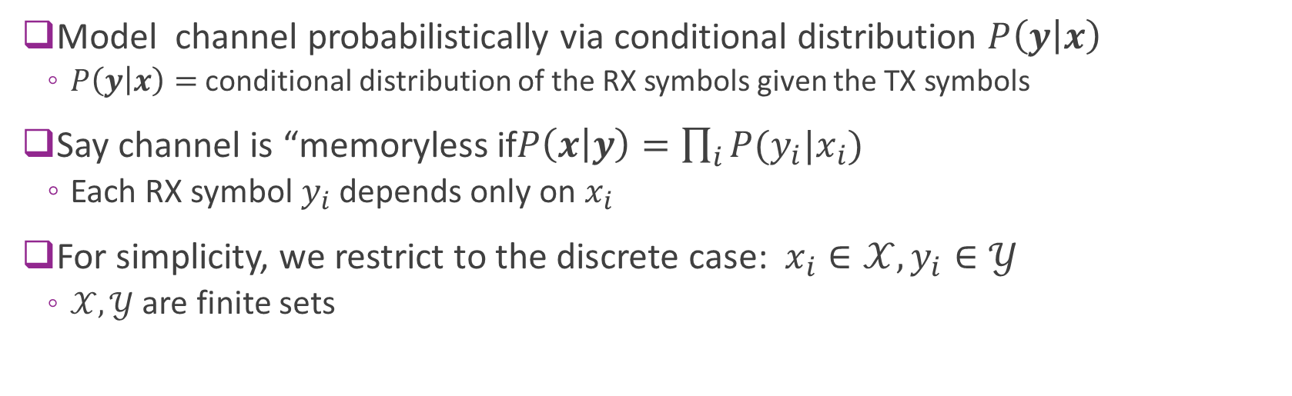
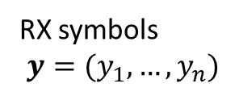
Discrete Memoryless Channel (DMC)
TX symbols $$x=(x_{1},…,x_{n})$$
RX symbols $$y=(y_{1},…,y_{n})$$
Channel
Model channel probabilistically via conditional distribution $P\left(y | x\right)$
$P\left(y | x\right)=$ conditional distribution of the RX symbols given the TX symbols
Say channel is “memoryless if$P\left(x | y\right)=\prod_{i}{P(y_{i}|x_{i})}$
Each RX symbol $y_{i}$ depends only on $x_{i}$
For simplicity, we restrict to the discrete case: $x_{i}∈𝒳, y_{i}∈𝒴$
$𝒳, 𝒴$ are finite sets

Slide 22
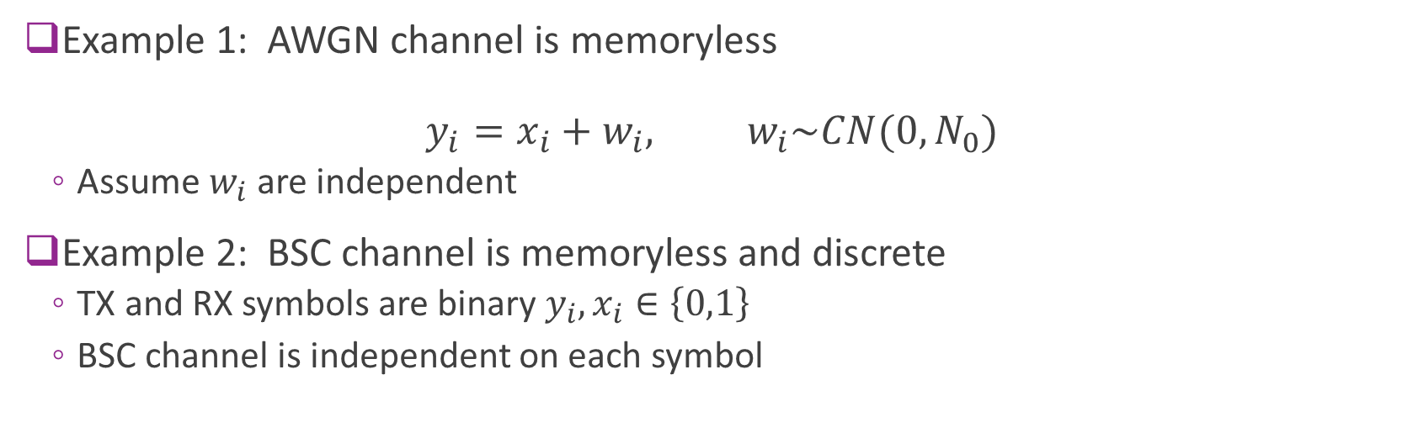
Example Channels
TX symbols $$x=(x_{1},…,x_{n})$$
RX symbols $$y=(y_{1},…,y_{n})$$
Channel
Example 1: AWGN channel is memoryless $y_{i}=x_{i}+w_{i}, w_{i}\sim CN(0,N_{0})$
Assume $w_{i}$ are independent
Example 2: BSC channel is memoryless and discrete
TX and RX symbols are binary $y_{i}, x_{i}∈\left\{0,1\right\}$
BSC channel is independent on each symbol

Slide 23

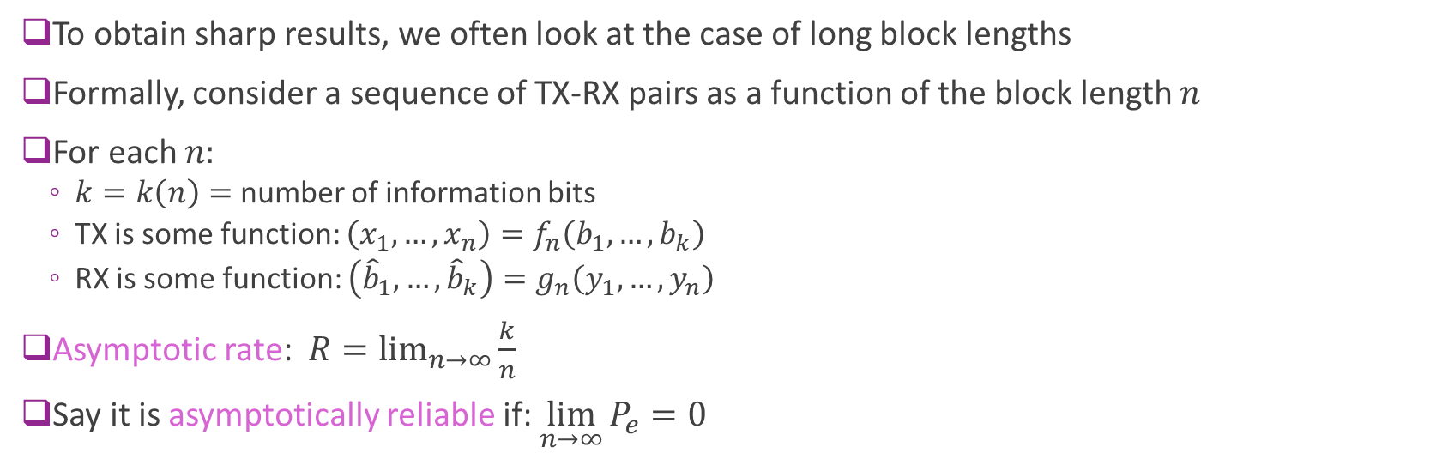



Asymptotic Rate and Reliability
$$b$$
$$x$$
$$y$$
$$\hat{b}$$
TX
Channel
RX
To obtain sharp results, we often look at the case of long block lengths
Formally, consider a sequence of TX-RX pairs as a function of the block length $n$
For each $n:$
$k=k\left(n\right)=$ number of information bits
TX is some function: $\left(x_{1},…,x_{n}\right)=f_{n}\left(b_{1},…,b_{k}\right)$
RX is some function: $\left({\hat{b}}_{1},…,{\hat{b}}_{k}\right)=g_{n}\left(y_{1},…,y_{n}\right)$
Asymptotic rate: $R=\lim_{n→∞}{\frac{k}{n}}$
Say it is asymptotically reliable if: $\lim_{n→∞}{P_{e}}=0$

Slide 24
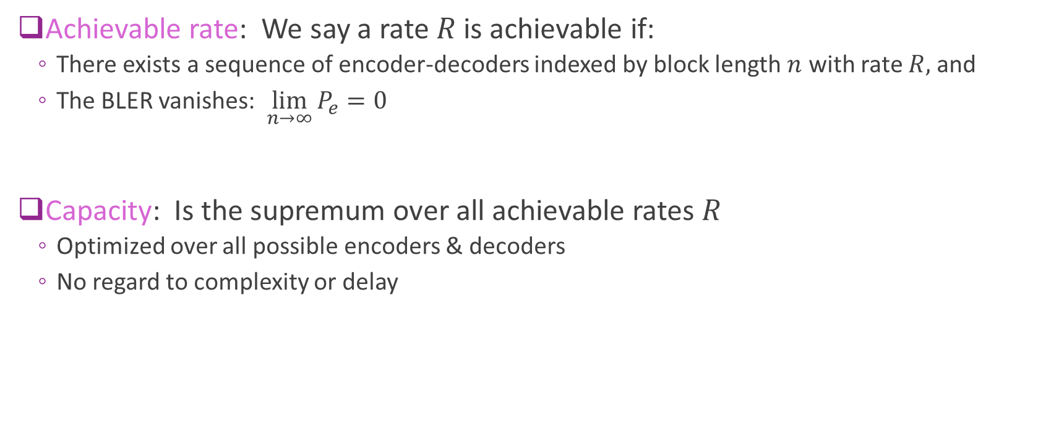
Achievable Rate and Capacity
Achievable rate: We say a rate $R$ is achievable if:
There exists a sequence of encoder-decoders indexed by block length $n$ with rate $R,$ and
The BLER vanishes: $\lim_{n→∞}{P_{e}}=0$
Capacity: Is the supremum over all achievable rates $R$
Optimized over all possible encoders & decoders
No regard to complexity or delay

Slide 25
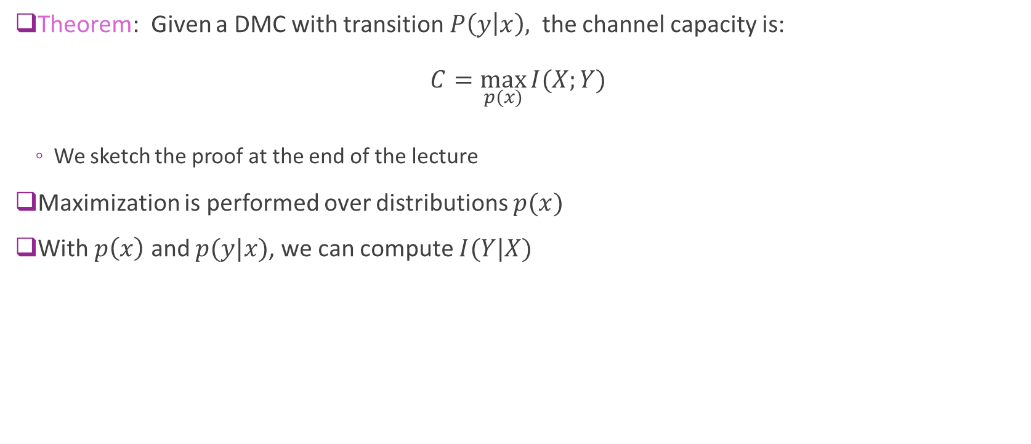
Shannon’s Capacity Theorem
Theorem: Given a DMC with transition $P\left(y | x\right),$ the channel capacity is: $C=\max_{p(x)}{I(X;Y)}$
We sketch the proof at the end of the lecture
Maximization is performed over distributions $p(x)$
With $p\left(x\right)$ and $p(y|x)$, we can compute $I(Y|X)$

Slide 26
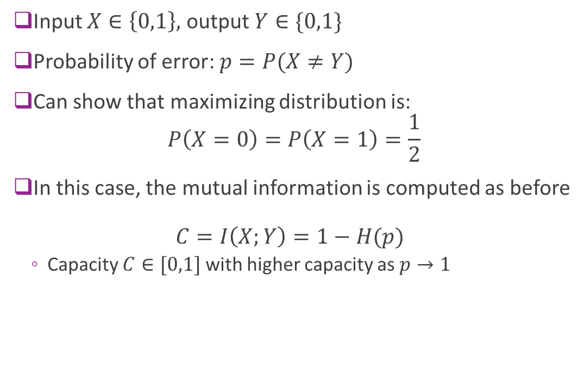
Example: BSC
Input $X∈\left\{0,1\right\},$ output $Y∈\{0,1\}$
Probability of error: $p=P(X≠Y)$
Can show that maximizing distribution is: $P\left(X=0\right)=P\left(X=1\right)=\frac{1}{2}$
In this case, the mutual information is computed as before $C=I\left(X;Y\right)=1−H(p)$
Capacity $C∈[0,1]$ with higher capacity as $p→1$

Slide 27
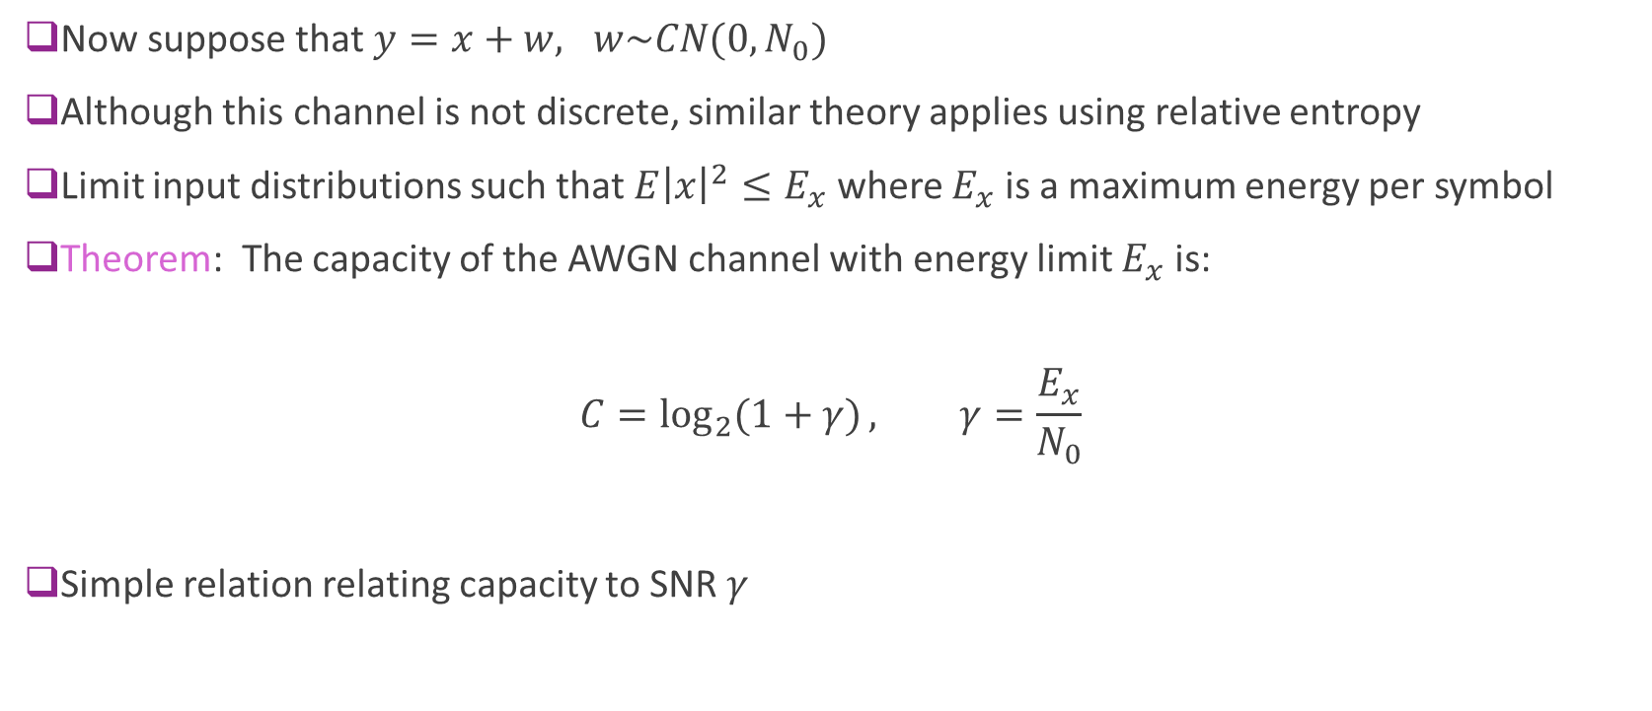
AWGN Channel Capacity
Now suppose that $y=x+w, w\sim CN(0,N_{0})$
Although this channel is not discrete, similar theory applies using relative entropy
Limit input distributions such that $E{\left|x\right|}^{2}≤E_{x}$ where $E_{x}$ is a maximum energy per symbol
Theorem: The capacity of the AWGN channel with energy limit $E_{x}$ is: $C=\log_{2}{(1+γ)}, γ=\frac{E_{x}}{N_{0}}$
Simple relation relating capacity to SNR $γ$

Slide 28
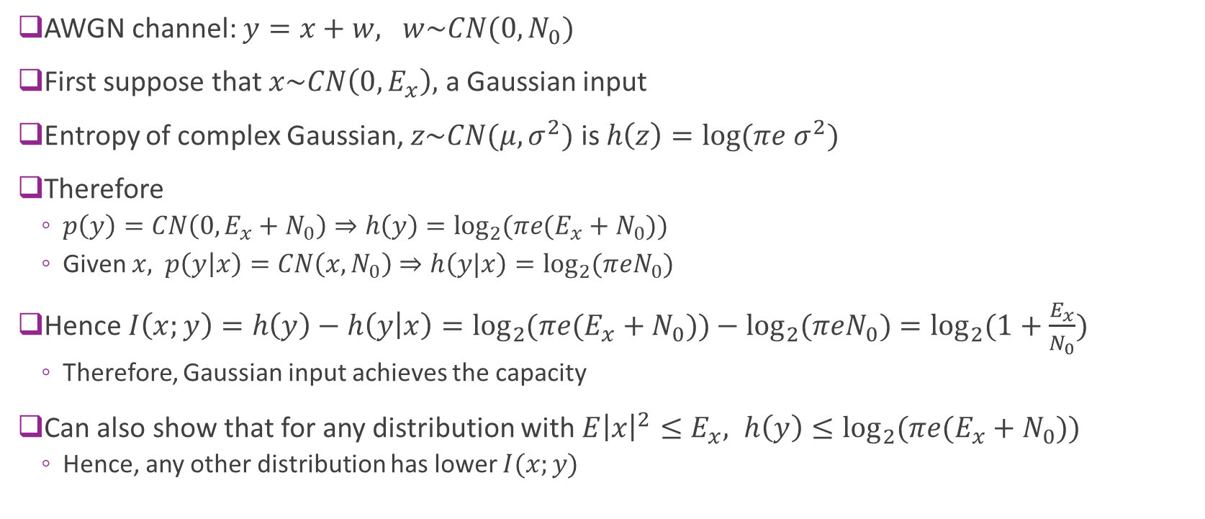
Proof of AWGN Channel Capacity
AWGN channel: $y=x+w, w\sim CN(0,N_{0})$
First suppose that $x\sim CN\left(0,E_{x}\right),$ a Gaussian input
Entropy of complex Gaussian, $z\sim CN(μ,σ^{2})$ is $h\left(z\right)=\log{(πe σ^{2})}$
Therefore
$p\left(y\right)=CN\left(0,E_{x}+N_{0}\right)⇒h\left(y\right)=\log_{2}{(πe(E_{x}+N_{0})})$
Given $x,$ $p\left(y | x\right)=CN\left(x, N_{0}\right)⇒h\left(y|x\right)=\log_{2}{(πeN_{0}})$
Hence $I\left(x;y\right)=h\left(y\right)−h\left(y | x\right)=\log_{2}{(πe(E_{x}+N_{0})})−\log_{2}{(πeN_{0}})=\log_{2}{(1+\frac{E_{x}}{N_{0}}})$
Therefore, Gaussian input achieves the capacity
Can also show that for any distribution with $E{\left|x\right|}^{2}≤E_{x}, h\left(y\right)≤\log_{2}{(πe(E_{x}+N_{0})})$
Hence, any other distribution has lower $I(x;y)$

Slide 29
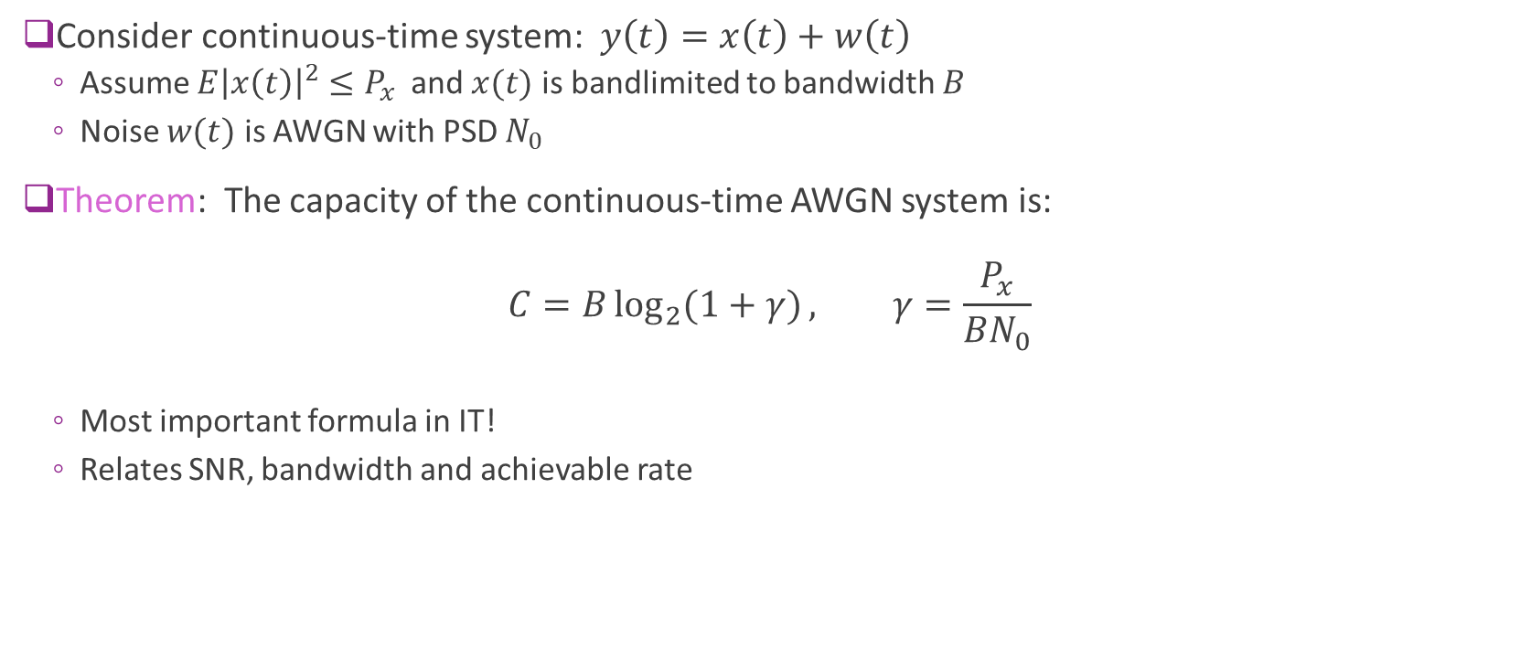
Continuous Time Capacity
Consider continuous-time system: $y\left(t\right)=x\left(t\right)+w\left(t\right)$
Assume $E{\left|x\left(t\right)\right|}^{2}≤P_{x}$ and $x(t)$ is bandlimited to bandwidth $B$
Noise $w(t)$ is AWGN with PSD $N_{0}$
Theorem: The capacity of the continuous-time AWGN system is: $C=B\log_{2}{(1+γ)}, γ=\frac{P_{x}}{BN_{0}}$
Most important formula in IT!
Relates SNR, bandwidth and achievable rate

Slide 30
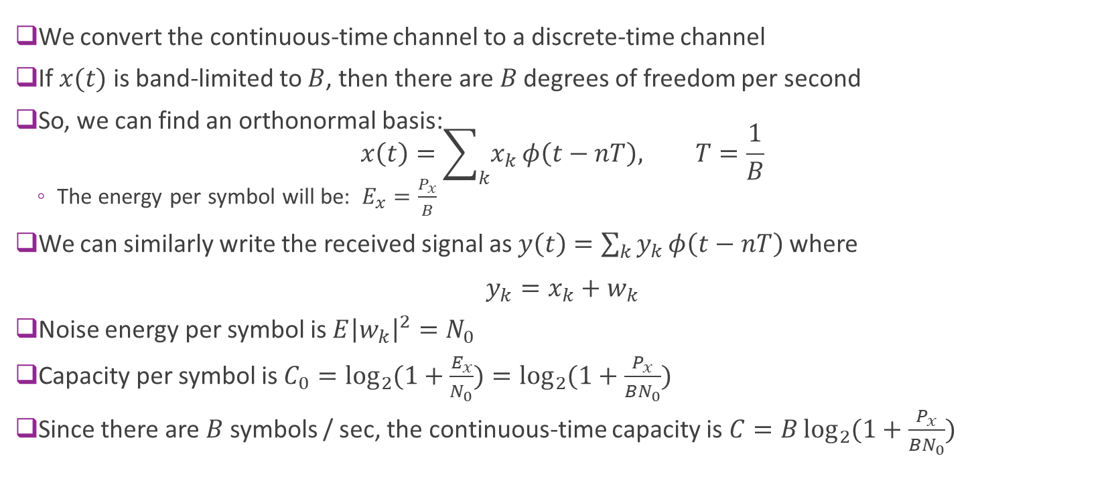
Proof of Continuous-Time Capacity
We convert the continuous-time channel to a discrete-time channel
If $x(t)$ is band-limited to $B$, then there are $B$ degrees of freedom per second
So, we can find an orthonormal basis: $x\left(t\right)=\sum_{k}{x_{k}}φ\left(t−nT\right), T=\frac{1}{B}$
The energy per symbol will be: $E_{x}=\frac{P_{x}}{B}$
We can similarly write the received signal as $y\left(t\right)=\sum_{k}{y_{k}}φ\left(t−nT\right)$ where $y_{k}=x_{k}+w_{k}$
Noise energy per symbol is $E{\left|w_{k}\right|}^{2}=N_{0}$
Capacity per symbol is $C_{0}=\log_{2}{(1+\frac{E_{x}}{N_{0}})}=\log_{2}{(1+\frac{P_{x}}{{BN}_{0}})}$
Since there are $B$ symbols / sec, the continuous-time capacity is $C=B\log_{2}{(1+\frac{P_{x}}{{BN}_{0}})}$

Slide 31
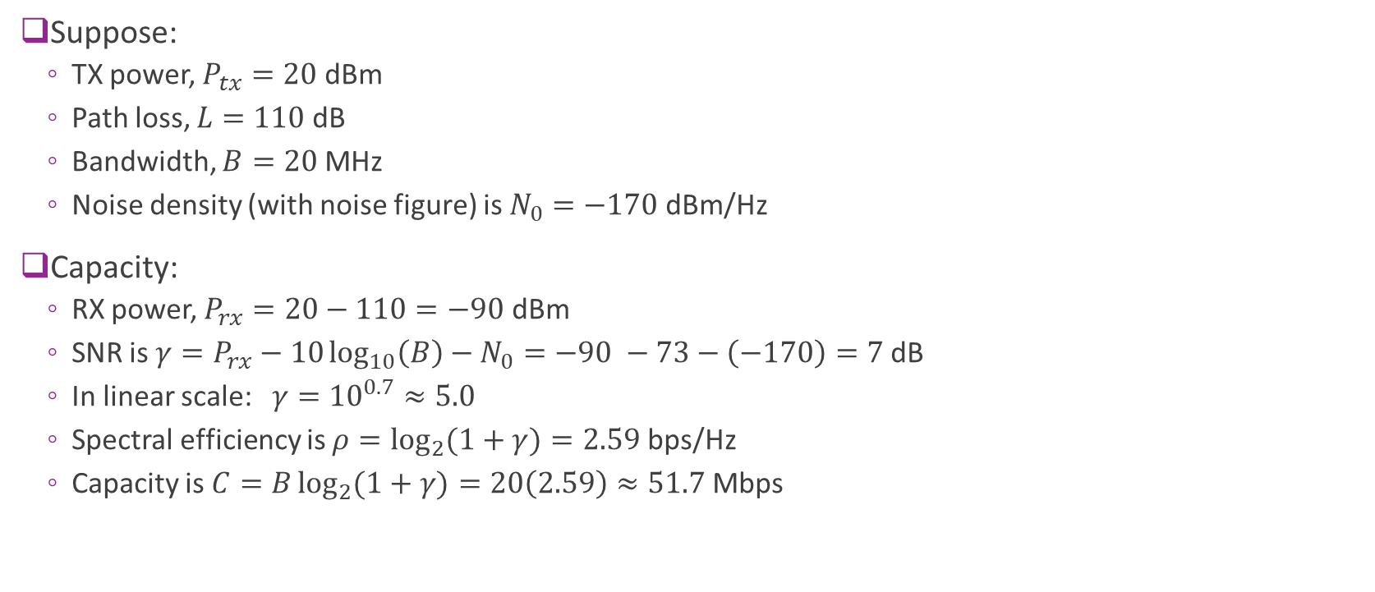
Example
Suppose:
TX power, $P_{tx}=20$ dBm
Path loss, $L=110$ dB
Bandwidth, $B=20$ MHz
Noise density (with noise figure) is $N_{0}=−170$dBm/Hz
Capacity:
RX power, $P_{rx}=20−110=−90$ dBm
SNR is $γ=P_{rx}−10\log_{10}\left(B\right)−N_{0}=−90 −73−\left(−170\right)=7$dB
In linear scale: $γ={10}^{0.7}≈5.0$
Spectral efficiency is $ρ=\log_{2}{(1+γ)}=2.59$ bps/Hz
Capacity is $C=B\log_{2}{(1+γ)}=20\left(2.59\right)≈51.7$ Mbps

Slide 32
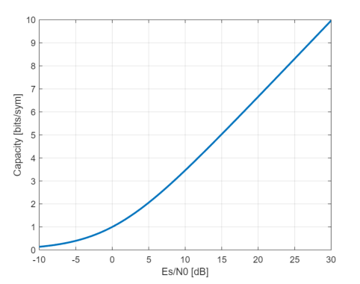
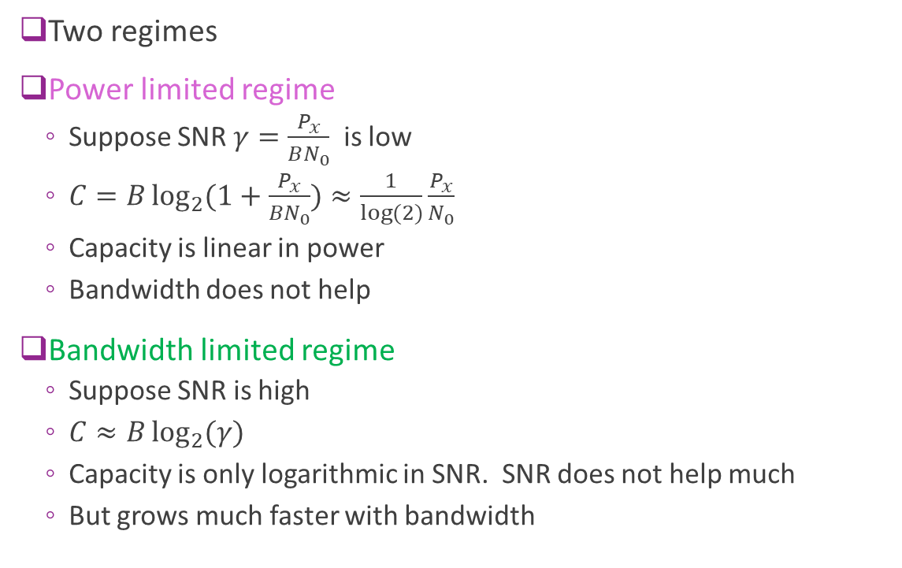
Regimes
Two regimes
Power limited regime
Suppose SNR $γ=\frac{P_{x}}{BN_{0}}$ is low
$C=B\log_{2}{(1+\frac{P_{x}}{BN_{0}})}≈\frac{1}{\log{(2)}}\frac{P_{x}}{N_{0}}$
Capacity is linear in power
Bandwidth does not help
Bandwidth limited regime
Suppose SNR is high
$C≈B\log_{2}{(γ)}$
Capacity is only logarithmic in SNR. SNR does not help much
But grows much faster with bandwidth

Slide 33
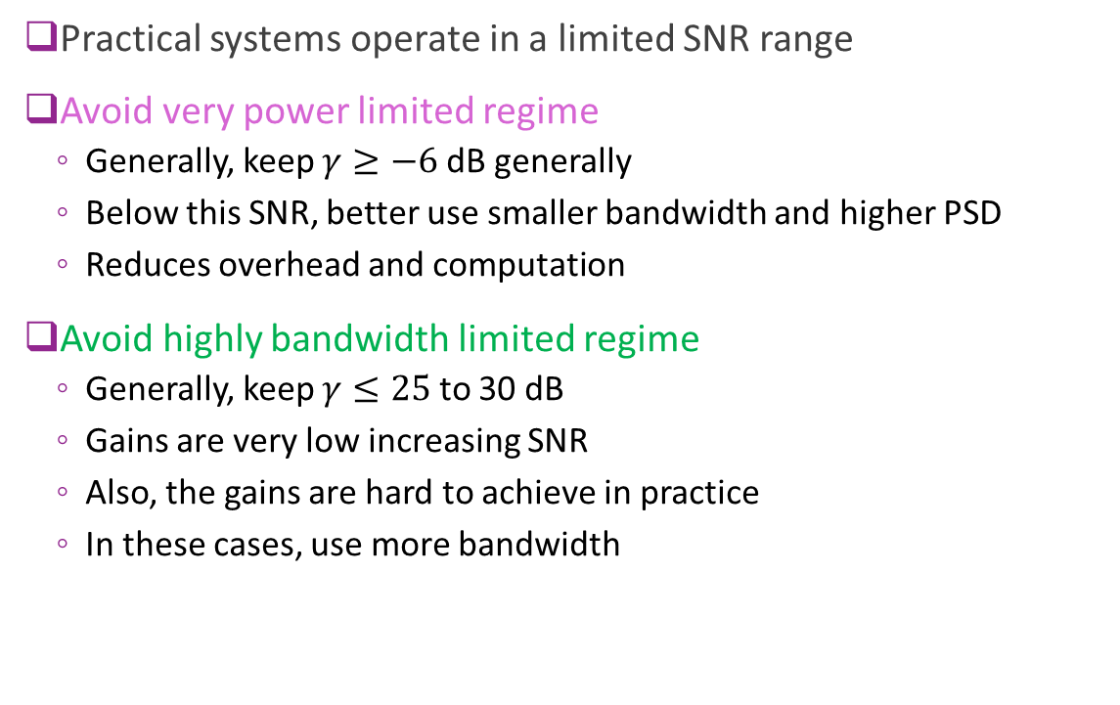
Practical Design Guidelines
Practical systems operate in a limited SNR range
Avoid very power limited regime
Generally, keep $γ≥−6$dB generally
Below this SNR, better use smaller bandwidth and higher PSD
Reduces overhead and computation
Avoid highly bandwidth limited regime
Generally, keep $γ≤25$ to 30 dB
Gains are very low increasing SNR
Also, the gains are hard to achieve in practice
In these cases, use more bandwidth

Slide 34

SNR Per Bit and Spectral Efficiency
Shannon formula: $C=B\log_{2}{(1+γ_{s})}, γ_{s}=\frac{P_{x}}{BN_{0}}$
Spectral efficiency: $ρ=\frac{C}{B}=\log_{2}{(1+γ_{s})}$
Units are bits per second / Hz
Represents rate / bandwidth
SNR per bit: $γ_{b}=\frac{P_{rx}}{N_{0}C}=\frac{γ_{s}}{ρ}$
Written as $γ_{b}=\frac{E_{b}}{N_{0}}$
Pronounced “Ebb-noh”

Slide 35
Outline
Information theory basics
Shannon capacity
Modeling capacity of practical systems
Constellation constrained capacity
Proof of the Shannon Theorem

Slide 36

Problems Achieving Shannon Capacity
Shannon’s capacity formula is impossible to exactly achieve in practice
Achieving the capacity requires generating a “random codebook”:
Codebook requires $M=2^{Rn}$ entries
Grows exponentially with block length $⇒$Prohibitive computation and memory
Also, $n→∞$ introduces infinite delay
How close can we get to Shannon capacity in practice?

Slide 37
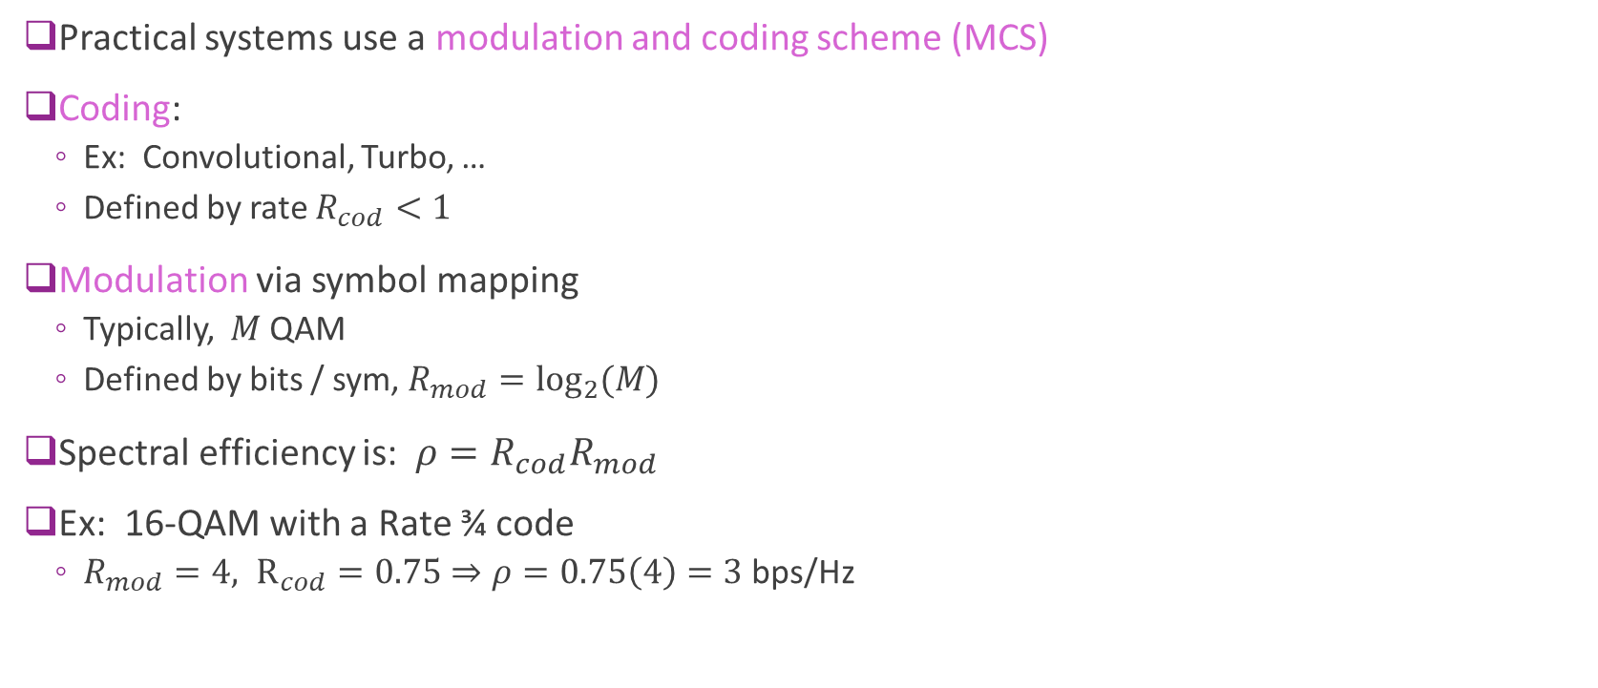
Modulation and Coding Schemes
Practical systems use a modulation and coding scheme (MCS)
Coding:
Ex: Convolutional, Turbo, …
Defined by rate $R_{cod}<1$
Modulation via symbol mapping
Typically, $M$ QAM
Defined by bits / sym, $R_{mod}=\log_{2}{(M)}$
Spectral efficiency is: $ρ=R_{cod}R_{mod}$
Ex: 16-QAM with a Rate ¾ code
$R_{mod}=4, R_{cod}=0.75⇒ρ=0.75\left(4\right)=3$ bps/Hz
Channel coding
Symbol mapping
Info bits
Coded bits

Slide 38
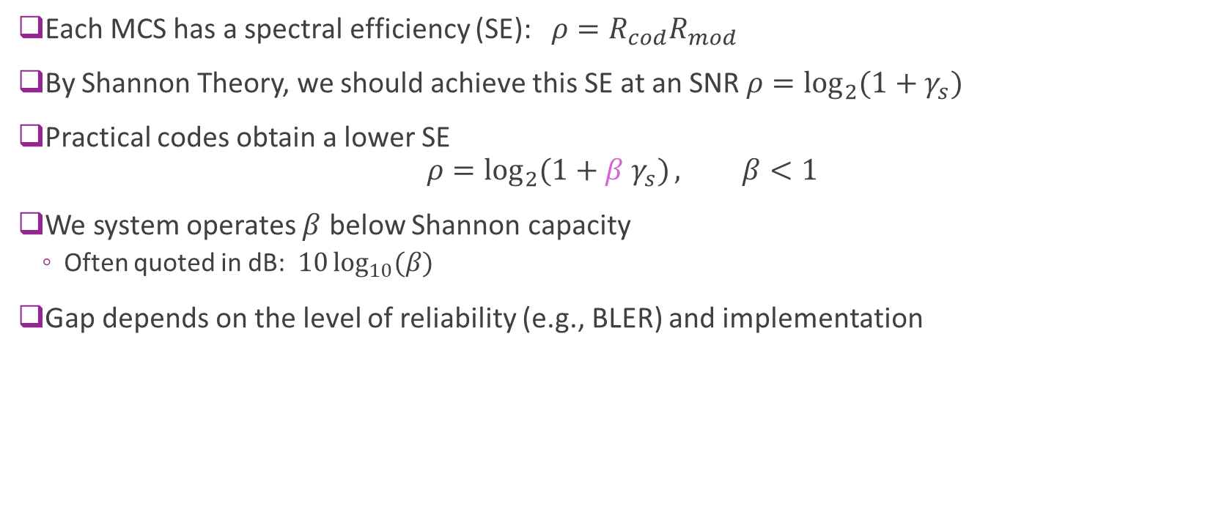
Measuring Gap to Shannon Capacity
Each MCS has a spectral efficiency (SE): $ρ=R_{cod}R_{mod}$
By Shannon Theory, we should achieve this SE at an SNR $ρ=\log_{2}{(1+γ_{s})}$
Practical codes obtain a lower SE $ρ=\log_{2}{(1+β γ_{s})}, β<1$
We system operates $β$ below Shannon capacity
Often quoted in dB: $10\log_{10}{(β)}$
Gap depends on the level of reliability (e.g., BLER) and implementation

Slide 39
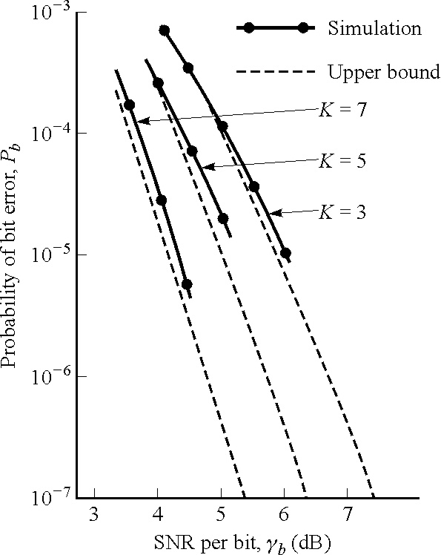
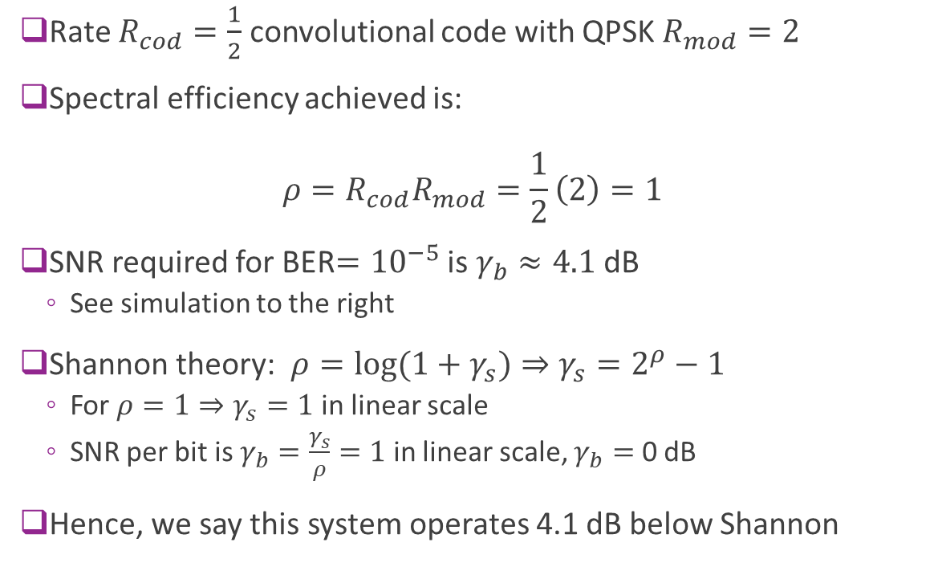
Example
Rate $R_{cod}=\frac{1}{2}$ convolutional code with QPSK $R_{mod}=2$
Spectral efficiency achieved is: $ρ=R_{cod}R_{mod}=\frac{1}{2}\left(2\right)=1$
SNR required for BER$={10}^{−5}$ is $γ_{b}≈4.1$ dB
See simulation to the right
Shannon theory: $ρ=\log{(1+γ_{s})}⇒γ_{s}=2^{ρ}−1$
For $ρ=1⇒γ_{s}=1$ in linear scale
SNR per bit is $γ_{b}=\frac{γ_{s}}{ρ}=1$ in linear scale, $γ_{b}=$ 0 dB
Hence, we say this system operates 4.1 dB below Shannon

Slide 40
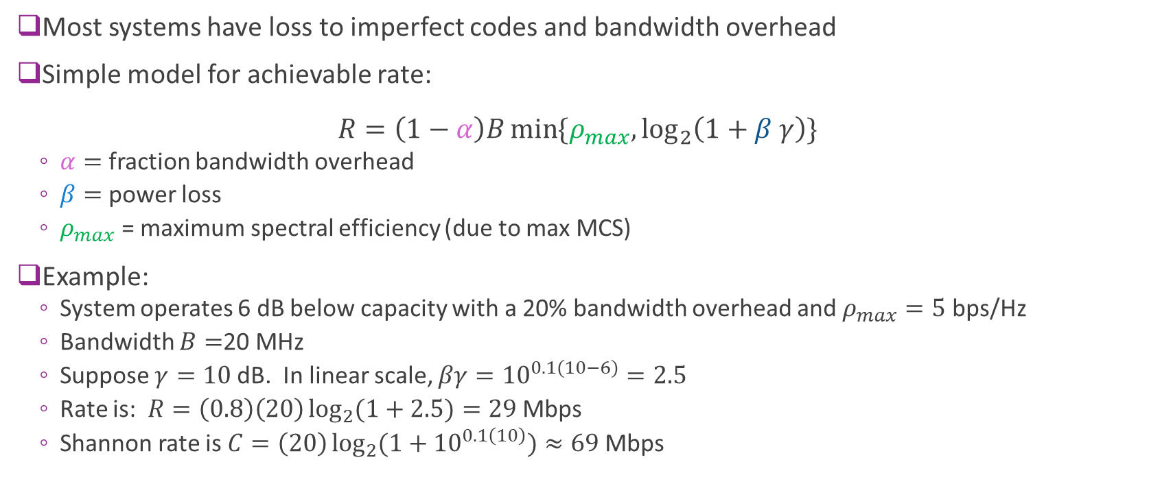
Capacity and Bandwidth Loss
Most systems have loss to imperfect codes and bandwidth overhead
Simple model for achievable rate: $R=\left(1−α\right)B\min{\{ρ_{max}, \log_{2}\left(1+β γ\right)\}}$
$α=$ fraction bandwidth overhead
$β=$ power loss
$ρ_{max}$ = maximum spectral efficiency (due to max MCS)
Example:
System operates 6 dB below capacity with a 20% bandwidth overhead and $ρ_{max}=5$ bps/Hz
Bandwidth $B=$20 MHz
Suppose $γ=10$dB. In linear scale, $βγ={10}^{0.1(10−6)}=2.5$
Rate is: $R=\left(0.8\right)\left(20\right)\log_{2}{(1+2.5)}=29$ Mbps
Shannon rate is $C=\left(20\right)\log_{2}{(1+{10}^{0.1\left(10\right)})}≈69$Mbps

Slide 41
Gaps to Shannon Theory for Early Codes
Shannon capacity formula and random codes, 1948.
Determines the capacity
But no practical code to achieve it.
Hamming (7,4) code, 1950
Reed-Solomon codes via polynomials over finite fields:
Invented in 1960 at MIT Lincoln Labs
Berlekamp-Massey decoding algorithm, 1969.
Used in Voyager program, 1977. CD players, 1982.
Convolutional codes.
Viterbi algorithm, 1969. Widely used in cellular systems. (Viterbi later invents CDMA and founds Qualcomm)
Typically, within 4-5 dB of capacity

Slide 42
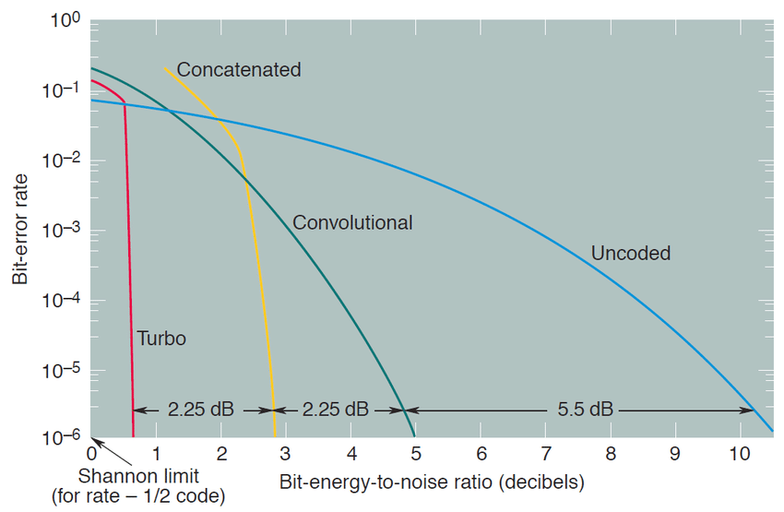
Improvements with Modern Codes
1990s: major breakthrough via graphical models
Turbo codes (next class)
Berrou, Glavieux, Thitimajshima, 1993.
Able to achieve capacity within a fraction of dB.
Adopted as standard in all cellular systems by the late 1990s.
LDPC codes
Similar iterative technique as turbo codes.
Re-discovered in 1996
Used in 5G today
Can provably hit Shannon capacity using graphs with spatial coupling, Richardson & Urbanke, 2012

Slide 43
Outline
Information theory basics
Shannon capacity
Modeling capacity of practical systems
Constellation-constrained capacity
Proof of the Shannon Theorem

Slide 44
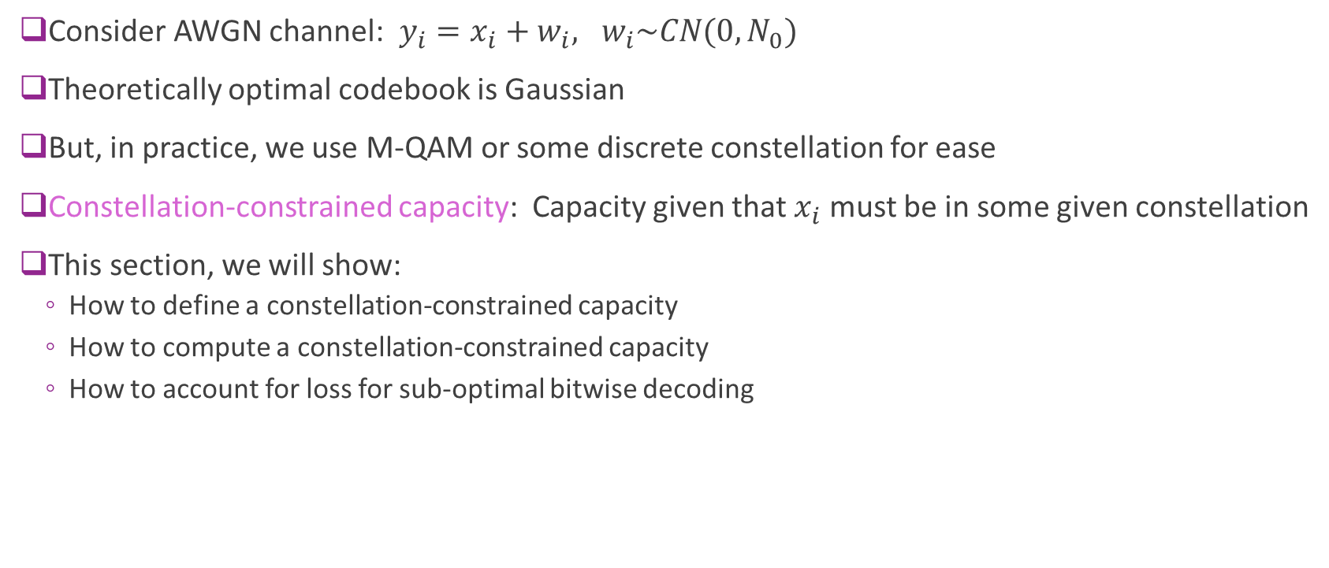
Loss from Finite Constellations
Consider AWGN channel: $y_{i}=x_{i}+w_{i}, w_{i}\sim CN(0,N_{0})$
Theoretically optimal codebook is Gaussian
But, in practice, we use M-QAM or some discrete constellation for ease
Constellation-constrained capacity: Capacity given that $x_{i}$ must be in some given constellation
This section, we will show:
How to define a constellation-constrained capacity
How to compute a constellation-constrained capacity
How to account for loss for sub-optimal bitwise decoding

Slide 45
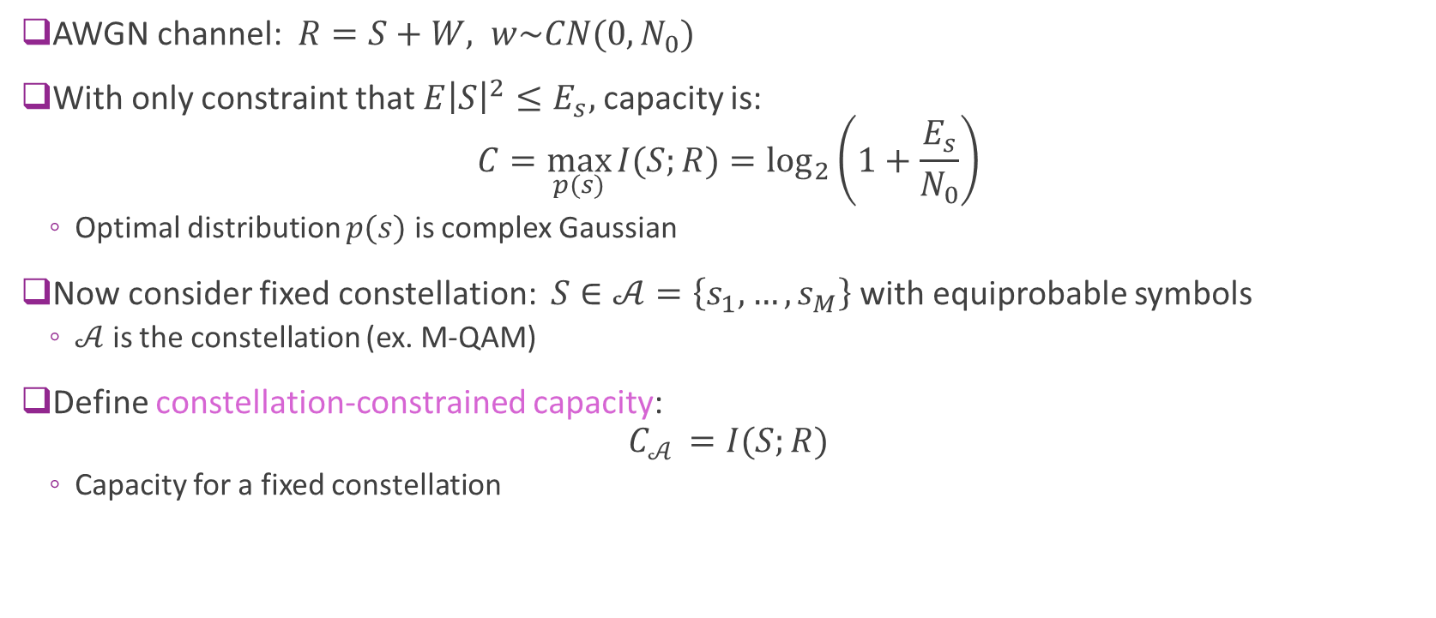
Capacity-Constrained Capacity Defined
AWGN channel: $R=S+W, w\sim CN(0,N_{0})$
With only constraint that $E{\left|S\right|}^{2}≤E_{s},$ capacity is: $C=\max_{p(s)}{I(S;R)}=\log_{2}\left(1+\frac{E_{s}}{N_{0}}\right)$
Optimal distribution $p(s)$ is complex Gaussian
Now consider fixed constellation: $S∈𝒜=\left\{s_{1},…,s_{M}\right\}$ with equiprobable symbols
$𝒜$ is the constellation (ex. M-QAM)
Define constellation-constrained capacity: $C_{𝒜 }=I(S;R)$
Capacity for a fixed constellation

Slide 46
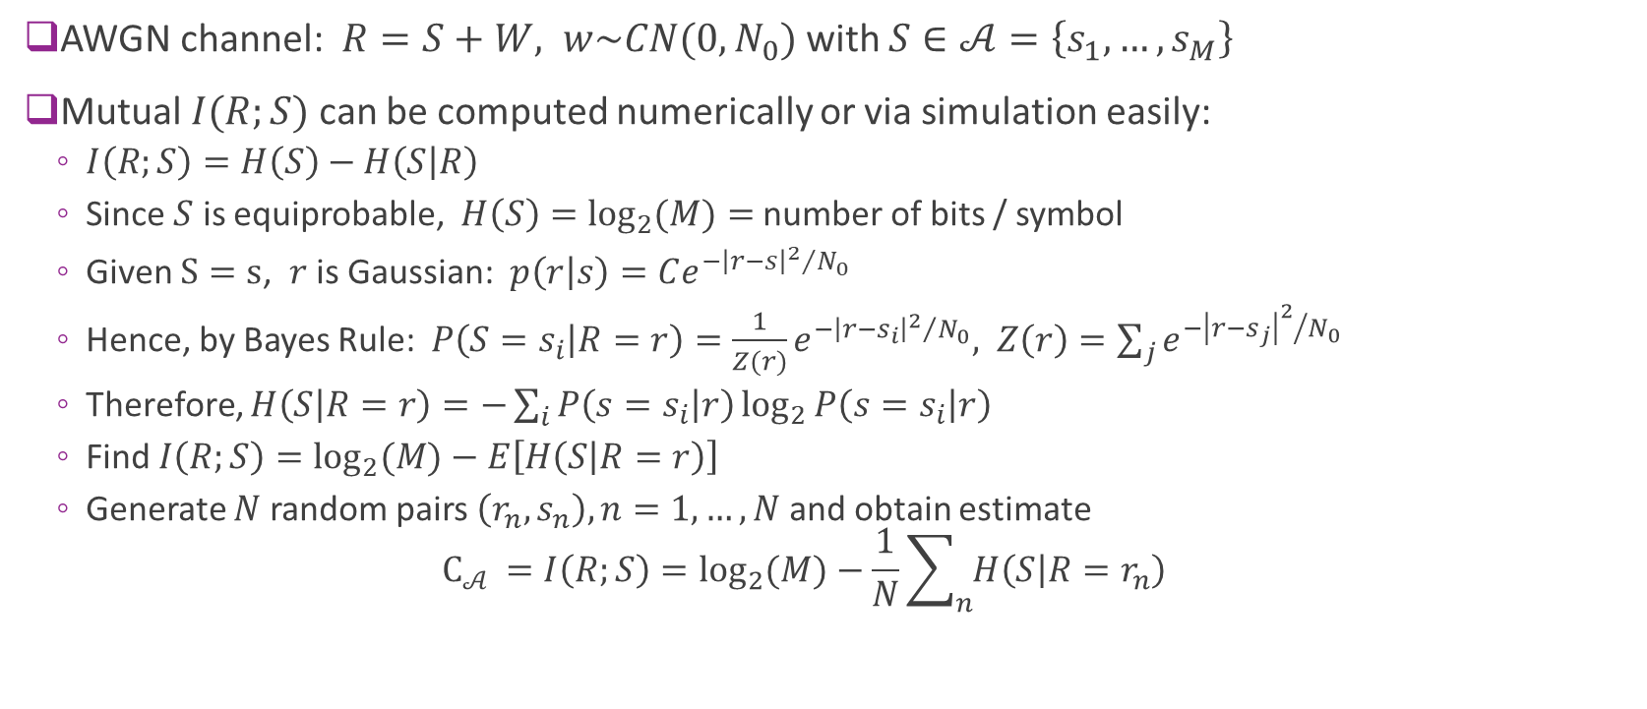
Computing Capacity-Constrained Constellation
AWGN channel: $R=S+W, w\sim CN(0,N_{0})$ with $S∈𝒜=\left\{s_{1},…,s_{M}\right\}$
Mutual $I(R;S)$ can be computed numerically or via simulation easily:
$I\left(R;S\right)=H\left(S\right)−H\left(S | R\right)$
Since $S$ is equiprobable, $H\left(S\right)=\log_{2}{(M)}=$ number of bits / symbol
Given $S=s$, $r$ is Gaussian: $p\left(r | s\right)=Ce^{−{{\left|r−s\right|}^{2}}/{N_{0}}}$
Hence, by Bayes Rule: $P\left(S=s_{i} | R=r\right)=\frac{1}{Z(r)}e^{−{{\left|r−s_{i}\right|}^{2}}/{N_{0}}}, Z\left(r\right)=\sum_{j}{e^{−{{\left|r−s_{j}\right|}^{2}}/{N_{0}}}}$
Therefore, $H\left(S | R=r\right)=−\sum_{i}{P\left(s=s_{i} | r\right)}\log_{2}{P\left(s=s_{i} | r\right)}$
Find $I\left(R;S\right)=\log_{2}{(M)}−E\left[H\left(S | R=r\right)\right]$
Generate $N$ random pairs $\left(r_{n},s_{n}\right), n=1,…,N$ and obtain estimate $C_{𝒜 }=I\left(R;S\right)=\log_{2}{(M)}−\frac{1}{N}\sum_{n}{H\left(S | R=r_{n}\right)}$

Slide 47
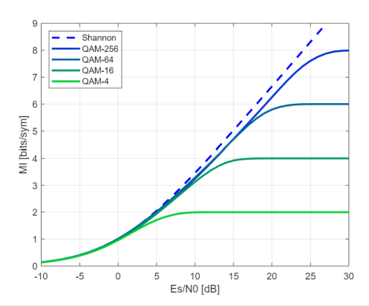

Constellation-Constrained Capacity
Key insights:
Capacity with $M−$QAM saturates
$C_{𝒜}≤\log_{2}{(M)}$
Hence, high SNR requires large $M$
Relative to Shannon Capacity
Minimal loss at low SNRs (< 2 dB)
Loss of 1-2 dB at high SNRs

Slide 48

Bitwise LLRs
AWGN channel: $r=s+w, s∈\{s_{1},…,s_{M}\}$
Up to now, we assume we decode each symbol
Requires we find a PMF $P\left(s=s_{m} | r\right), m=1,…,M$
Finding this PMF is computationally expensive since $M=2^{K}, K=$ number of bits / symbol
Also, most decoders requires probabilities on bits not symbols
Practical systems decode each bit
Suppose $s=φ(c_{1},…,c_{K})$ a mapping from $K$ bits to the symbol
We then compute the bitwise LLR: $z_{k}=\log{\frac{P(c_{k}=1|r)}{P(c_{k}=0|r)}}$
This method is computationally simpler.
But it is not optimal
What is the loss in capacity with bitwise LLRs?

Slide 49


Binary Cross Entropy
Let $b∈\left\{0,1\right\}:$ unknown binary variable
Let $z∈ℝ$ : Estimate of the LLR $z≈\log{\frac{P\left(b=1 | z\right)}{P(b=0|z)}}$
Define binary cross entropy $BCE\left(b,z\right)≔\frac{1}{\ln{(2)}}\left[\ln\left(1+e^{z}\right)−zb\right]$
Measure of error: Large when:
$b=0$ and $z$ large positive or
$b=1$ and $z$ large negative
Commonly used in training binary classifiers
See ML class

Slide 50





BCE Mutual Information Bound
$b_{1},b_{2},…,b_{K}$
$$s$$
$$r$$
$$z_{1},…,z_{K}$$
TX
Channel
RX
We derive a bound for a general binary input channel
TX: $K$ bit binary input $b=(b_{1},…,b_{K})$ bits and maps to a symbol vector $s$
RX: Obtains any output $r$and creates any vector $z=\left(z_{1},…,z_{K}\right)$
Values $z_{k}$ can be the LLRs or any approximation of the LLRs of the bits
Theorem: The mutual information is bounded as: $I\left(b;r\right)≥H\left(b\right)−\sum_{k=1}^{K}{E\left[BCE\left(b_{k},z_{k}\right)\right]} [bits]$
Proven at end of section

Slide 51

LLR Mutual Information Bound
$b_{1},b_{2},…,b_{K}$
$$s$$
$$r$$
$$z_{1},…,z_{K}$$
QAM mapping
Channel
LLRs
BCE bound can be used to find capacity with practical symbol demodulation
TX: Takes $b=\left(b_{1},…,b_{K}\right)$ bits and creates QAM symbol $s$ with energy $E_{s}=E{\left|s\right|}^{2}$
Channel is $r=s+w, w\sim CN\left(0,N_{0}\right)$
RX performs demodulation and creates LLRs $z=\left(z_{1},…,z_{K}\right)$

Slide 52

QAM Capacity with Bitwise LLRs
Can compute the bound easily
Generate $N$ bits $b_{1},…,b_{N}$ over $S$ symbols
Modulate to $s_{1},…, s_{P}$ symbols
Add noise and get $r_{1},…, r_{P}$ RX symbols
Compute $N$ LLRs $z_{1},…,z_{N}$
Compute MI: $I(b;r)≥\frac{1}{P}\sum_{i=1}^{N}{\left[1−BCE(b_{i},z_{i})\right]}$

Slide 53

Bitwise Capacity
Each modulation is optimal in a range
Select higher modulations at higher SNRs
At high SNRs:
Need to select high modulation
Relative to Shannon Capacity
Minimal loss at low SNRs (< 2 dB)
Loss of 1-2 dB at high SNRs

Slide 54

Bitwise vs Symbol-wise Decoding
Symbol-wise decoding
Bitwise decoding
Bitwise decoding has a small loss
But if correct constellation is chosen:
Loss is small
In most regimes, loss < 0.5 dB

Slide 55






ML Perspective: Learn a RX from Data
$$b=(b_{1}, …,b_{K})$$
$$s$$
$$r$$
$$z=g(r,θ)$$
TX
Channel
RX parameters $θ$
Many modern designs train the RX from data
Represent RX as a function $z=g(r,θ)$ where $θ$ represents parameters to train
Ex: $g(r,θ)$ is a neural network and $θ$ are the weights and biases
Can be useful when optimal receiver is difficult to derive or implement
Non-coherent channel (when the channel must be estimated)
Joint equalization and decoding
Non-linearities
Computational constraints
Many possibilities…

Slide 56

Training a RX
$$b=(b_{1}, …,b_{K})$$
$$s$$
$$r$$
$$z=g(r,θ)$$
TX
Channel
RX parameters $θ$
BCE bound permits a simple procedure to train
Generate samples $\left(b_{i},r_{i}\right), i=1,…,N$.
Each $b_{i}=\left(b_{i1},…,b_{iK}\right)=$ true bits transmitted
RX will generate outputs: $z_{i}=g\left(r_{i},θ\right)$ with outputs $z_{i}=(z_{i1},…,z_{iK})$
Adjust parameters $θ$ to minimize BCE loss: $J\left(θ\right)=\frac{1}{N}\sum_{i=1}^{N}{\sum_{k=1}^{K}{BCE(b_{ik},z_{ik})}}$
Then mutual information is bounded above by: $I\left(b;z\right)≥K−J(θ)$

Slide 57

BCE Bound Proof: Entropy Bound
To prove BCE bound, we need the following Lemma
Lemma: Suppose $X$ has some PMF $P(x)$ and $Q$ is any other distribution. Then $H\left(X\right)≤−\sum_{x}{P\left(x\right)\log{Q\left(x\right)}}$
Equality holds when $Q\left(x\right)=P(x)$
Also applies to conditional distributions. If $Q(x|y)$ is any conditional distribution: $H\left(X|Y\right)≤−\sum_{x}{P\left(x,y\right)\log{Q\left(x|y\right)}}$

Slide 58

BCE Bound Proof: Part of Lemma
Let $J\left(P,Q\right)≔−\sum_{x}{P\left(x\right)\log{Q\left(x\right)}}$
Find $Q(x)$ to minimize $J(P,Q)$ s.t. $∑Q\left(x\right)=1$
Lagrangian: $L=−\sum_{x}{P\left(x\right)\log{Q\left(x\right)}}+λ\sum{Q(x)}$
Take derivative: $\frac{∂L}{∂Q(x)}=−\frac{P\left(x\right)}{Q\left(x\right)}+λ=0⇒Q\left(x\right)=λP(x)$
Since $∑Q\left(x\right)=1⇒Q\left(x\right)=P(x)$
Hence the minimum is achieved at $Q\left(x\right)=P(x)$
Therefore, for all $Q(x)$: $J\left(P,Q\right)≥\min_{Q}{J\left(P,Q\right)}=J\left(P,P\right)=H(X)$

Slide 59

Proof BCE Bound
Let $P\left(b\right)=$ true distribution on bits $b=\left(b_{1},…,b_{K}\right)$
Given $z_{k}$ define the conditional binary distribution: $φ\left(b_{k}=1 | z_{k}\right)=\frac{e^{z_{k}}}{1+e^{z_{k}}}, φ\left(b_{k}=0 | z_{k}\right)=\frac{1}{1+e^{z_{k}}},$
Given $z$, define the distribution on the bits $b$ as $Q\left(b | r\right)=\prod_{k}{φ(b_{k}|z_{k})}$
The bits are conditionally independent
Can verify that $−\log{φ\left(b_{k} | z_{k}\right)}=\log\left(1+e^{z_{k}}\right)+b_{k}z_{k}=BCE(b_{k},z_{k})$
Also $\log{Q(b|r)}=\sum{\log{φ(b_{k}|z_{k})}}$
By Lemma: $H\left(b;r\right)≤$ $−\sum{E\left\{\log{φ\left(b_{k} | z_{k}\right)}\right\}}=\sum{E \left[BCE(b_{k},z_{k})\right]}$
Therefore: $I\left(b;r\right)=H\left(b\right)−H\left(b;r\right)≥H(b)−\sum{E \left[BCE(b_{k},z_{k})\right]}$

Slide 60
Outline
Information theory basics
Shannon capacity
Modeling capacity of practical systems
Constellation constrained capacity
Proof of the Shannon Theorem

Slide 61

Proof: Achievability
First, we show that any $R<C$ is achievable
Use a random codebook!
Find a $P(x)$ to maximize $I\left(X;Y\right)$ and select any $R<I\left(X;Y\right)$
For each $n,$ generate $M=2^{Rn}$ random messages or codewords:
$x_{m}=\left(x_{m1},…,x_{mn}\right), x_{mi}\sim P(x)$ are iid
Set of $x_{m}, m=1,…,M$ is called the message index
Encoder maps $Rn$ bits to a message index $m$ and transmits $x_{m}$
Each message $x_{m}$ is called a codeword
The set of messages is called the codebook: $𝒞=\{ x_{m}, m=1,…,M \}$

Slide 62

Joint Typicality
For large $n$, we know (via the law of large numbers)
${(1}/n)\log{P\left(x_{1},…,x_{n}\right)→−H(X)}$
${(1}/n)\log{P\left(y_{1},…,y_{n}\right)→−H(Y)}$
${(1}/n)\log{P\left(x_{1},y_{1},…,{x_{n},y}_{n}\right)→−H(X,Y)}$
Say a vector$\left(x^{n},y^{n}\right)$ is jointly typical if it satisfies the asymptotic values within some $ε>0$
Formally, we define the set $A_{ε}^{n}$ of length $n$ sequences $\left(x^{n},y^{n}\right)$such that:
$|{(1}/n)\log{P\left(x_{1},…,x_{n}\right)→−H\left(X\right)}|≤ε$
$|{(1}/n)\log{P\left(y_{1},…,y_{n}\right)→−H(Y)}|≤ε$
${|(1}/n)\log{P\left(x_{1},y_{1},…,{x_{n},y}_{n}\right)→−H(X,Y)|≤ε}$

Slide 63

Jointly Typical Decoder
Let $𝒞$ be the set of codewords
Given $y$receiver takes any $x∈𝒞$ from codebook such that $\left(x,y\right)∈A_{ε}^{n}$
That is, find $x∈𝒞$ such that $\left(x,y\right)$ is jointly typical
If no such $x$ exists, or there is more than one, declare error
To analyze, suppose we transmit a true sequence $x$ and receive $y$
We bound two errors:
Type 1 Error: The correct codeword, $\left(x,y\right)$, is not jointly typical
Type 2 Error: There is another codeword, $\left(x′,y\right)∈A_{ε}^{n}$ for some $x^{′}≠x$

Slide 64

Type 1 Error
We use the following asymptotic equipartition property (AEP)
AEP 1: Let $(x,y)=\{\left(x_{i},y_{i}\right), i=1,…,n\}$ where $\left(x_{i},y_{i}\right)\sim P(x,y)$ are i.i.d. Then $P\left(\left(x,y\right)∈A_{ε}^{n}\right)→1 as n→∞$
Let $x$ be the true transmitted codeword
Then $(x,y)$ has components $\left(x_{i},y_{i}\right)\sim P\left(x,y\right)$
Let $P_{1}$= Probability Type 1 error = Probability that $(x,y)$ is not jointly typical
By AEP 1, $P_{1}=1−P\left((x,y)∈A_{ε}^{n}\right)→0$

Slide 65

Type 2 Error
For this error, we use the following AEP property
AEP 2: Let $(x,y)=\{\left(x_{i},y_{i}\right), i=1,…,n\}$ where $\left(x_{i},y_{i}\right)\sim P\left(x\right)P(y)$ are i.i.d. Then : $P\left((x,y)∈A_{ε}^{n}\right)≤2^{−n(I\left(X;Y\right)−3ε)}$
In this case, for each $i, x_{i}^{n}$and $y_{i}^{n}$are drawn independent
Property shows with very high probability they will not be jointly typical

Slide 66

Type 2 Error Continued
For some $n$, let $x$ be the true transmitted codeword and $y$ the received symbols
Let $P_{2}$= probability that there exists a codeword $x^{′}≠x$ where $(x′,y)∈A_{ε}^{n}$
Since codewords are independent, $(x′,y)$ has components $\left(x_{i}^{′},y_{i}\right)\sim P\left(x\right)P(y)$
By AEP 2, $P\left((x′,y)∈A_{ε}^{n}\right)≤2^{−n(I\left(X;Y\right)−3ε)}$
Since there are $2^{nR}$ wrong codewords $x′$ by union bound: $P_{2}≤2^{nR}2^{−n\left(I\left(X;Y\right)−3ε\right)}=2^{n(R−I\left(X;Y\right)−3ε)}$
We know $R<I\left(X;Y\right)−3ε$ for some $ε$
Therefore, we can select $ε$ such that $\lim_{n→∞}{P_{2}}=0$

Slide 67

Converse Proof
Must show that for any rate $R>C$, $P_{e}$ is bounded away from zero
We will not cover this.
This is proved via Fano’s inequality
Take information theory class for more!

