Slide 1
Unit 6: Noise and Symbol Demodulation
EL-GY 6013: Digital communications
Prof. Sundeep rangan

Slide 2
Learning Objectives
Mathematical describe AWGN noise
Compute AWGN noise levels at passband, baseband and sample domain
Write the ML detector given likelihoods, compute error probabilities
Compute the ML detector for symbol detection
Compute BER and SER probabilities

Slide 3
This Unit
Channel coding
Symbol mapping
TX filter DAC
Upconversion
Info bits
Coded bits
IQ symbols
Analog baseband
RF
Passband
Channel
Sync
“Noise”
Channel decoding
Symbol demod
Equalization
RX filter and ADC
Down-conversion

Slide 4
Outline
Passband and baseband noise, signal to noise ratio
Noise in the discrete symbols
ML Detection
Symbol detection
Probability of error

Slide 5
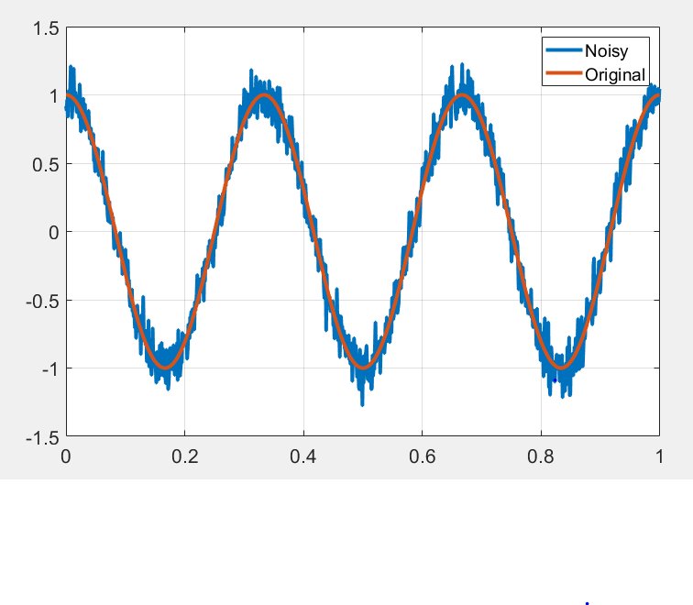
What is Noise?
Noise: Any unwanted component of the signal
Key challenge in communication:
Estimate the transmitted signal in the presence of noise

Slide 6
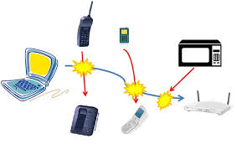
Types of “Noise”
Internal / thermal noise:
From imperfections in the receiver
Thermal noise: From random fluctuations of electrons
Other imperfections: Phase noise, quantization, channel estimation errors
External Interference
Signals from other sources
In-band: Transmitters in the same frequency Ex: Multiple devices in a cellular band
Out-of-band: From leakage out of carrier
Some texts do not consider “interference” as noise

Slide 7
Statistical Models for Noise
In communications, we model noise as a random process
Captures “uncertainty” in the value
This lecture:
Describe mathematical models for noise
Describe effect of noise on

Slide 8

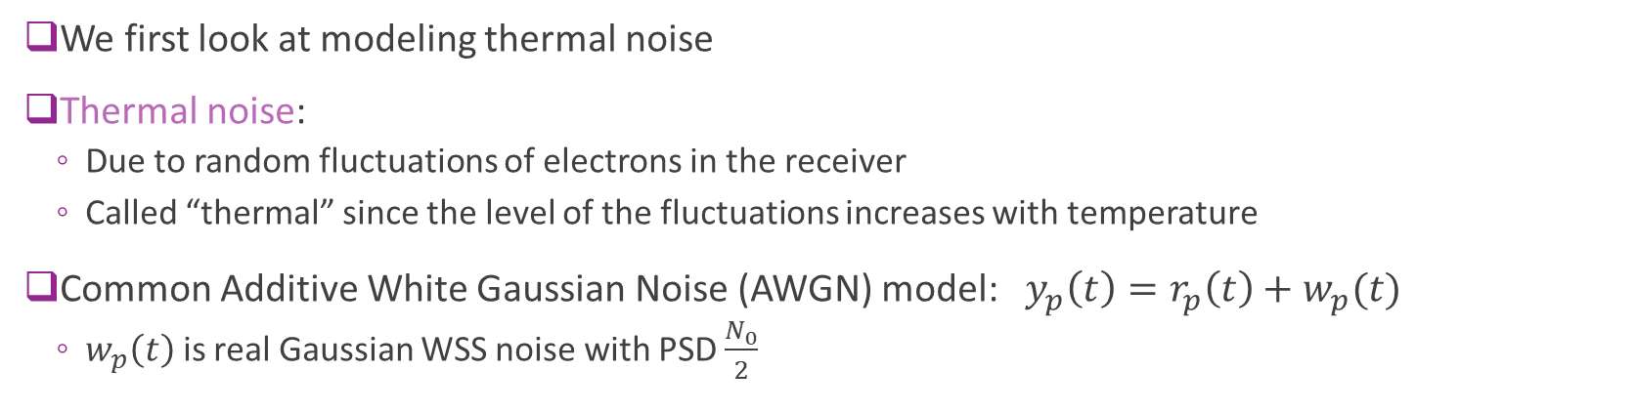





Additive Noise Model
AWGN
$$w_{p}(t)$$
$$u(t)$$
$$y(t)$$
$$u_{p}(t)$$
$$r_{p}(t)$$
$$y_{p}(t)$$
Upconversion
Channel
Down- conversion
We first look at modeling thermal noise
Thermal noise:
Due to random fluctuations of electrons in the receiver
Called “thermal” since the level of the fluctuations increases with temperature
Common Additive White Gaussian Noise (AWGN) model: $y_{p}\left(t\right)=r_{p}\left(t\right)+w_{p}(t)$
$w_{p}\left(t\right)$ is real Gaussian WSS noise with PSD $\frac{N_{0}}{2}$

Slide 9
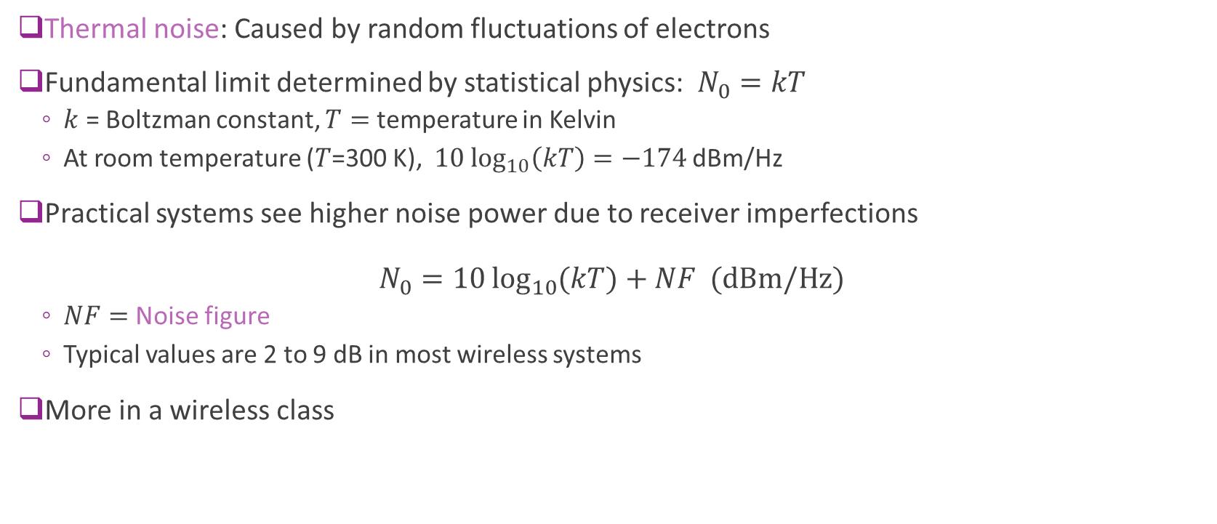
Thermal Noise
Thermal noise: Caused by random fluctuations of electrons
Fundamental limit determined by statistical physics: $N_{0}=kT$
$k$ = Boltzman constant, $T=$ temperature in Kelvin
At room temperature ($T$=300 K), $10 \log_{10}\left(kT\right)=−174$dBm/Hz
Practical systems see higher noise power due to receiver imperfections $N_{0}=10\log_{10}{(kT)}+NF \text{(}\text{dBm}\text{/}\text{Hz}\text{)}$
$NF=$Noise figure
Typical values are 2 to 9 dB in most wireless systems
More in a wireless class

Slide 10
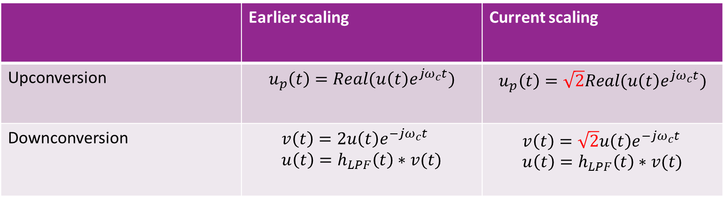
Scaling Up- and Down-Conversion
For noise modeling, it is convenient to use a different scaling convention
Modified scaling will keep powers in passband and baseband equal
Note: Proakis uses original scaling and has a factor of 2 in the conversion
 | Earlier scaling | Current scaling
Upconversion | $$u_{p}\left(t\right)=Real(u\left(t\right)e^{jω_{c}t})$$ | $$u_{p}\left(t\right)=\sqrt{2}Real(u\left(t\right)e^{jω_{c}t})$$
Downconversion | $$v\left(t\right)=2u\left(t\right)e^{−jω_{c}t} \\ u\left(t\right)=h_{LPF}\left(t\right)∗v(t)$$ | $$v\left(t\right)=\sqrt{2}u\left(t\right)e^{−jω_{c}t} \\ u\left(t\right)=h_{LPF}\left(t\right)∗v(t)$$

Slide 11
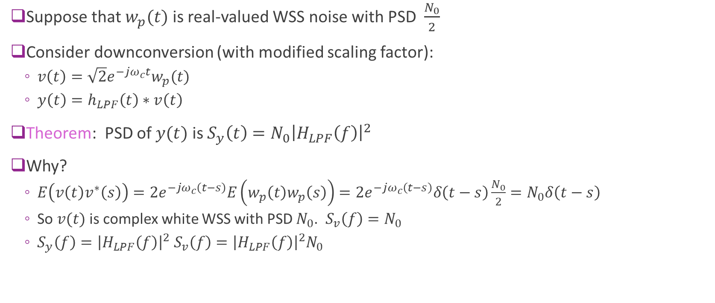
Downconverting Noise
Suppose that $w_{p}(t)$ is real-valued WSS noise with PSD $\frac{N_{0}}{2}$
Consider downconversion (with modified scaling factor):
$v\left(t\right)=\sqrt{2}e^{−jω_{c}t}w_{p}(t)$
$y\left(t\right)=h_{LPF}\left(t\right)∗v\left(t\right)$
Theorem: PSD of $y(t)$ is $S_{y}\left(t\right)=N_{0}{\left|H_{LPF}\left(f\right)\right|}^{2}$
Why?
$E\left(v\left(t\right)v^{∗}\left(s\right)\right)=2e^{−jω_{c}\left(t−s\right)}E\left(w_{p}\left(t\right)w_{p}\left(s\right)\right)=2e^{−jω_{c}\left(t−s\right)}δ\left(t−s\right)\frac{N_{0}}{2}=N_{0}δ\left(t−s\right)$
So $v(t)$ is complex white WSS with PSD $N_{0}$. $S_{v}\left(f\right)=N_{0}$
$S_{y}\left(f\right)={\left|H_{LPF}\left(f\right)\right|}^{2} S_{v}\left(f\right)={\left|H_{LPF}\left(f\right)\right|}^{2}N_{0}$

Slide 12

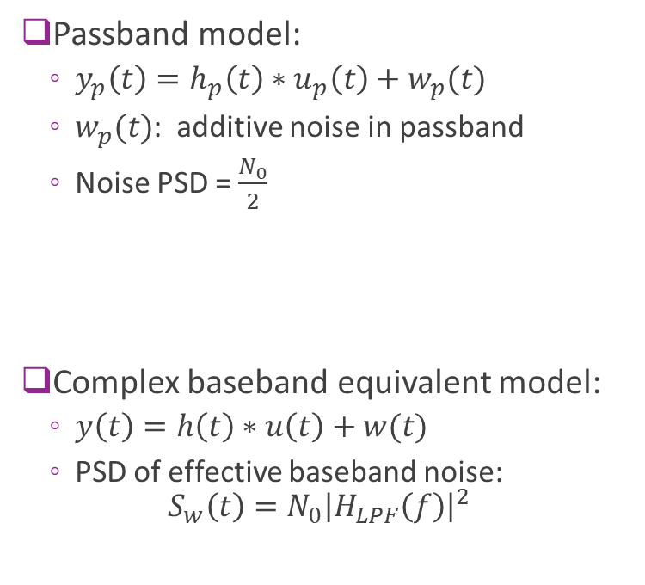







Equivalent Channel with Noise
$$w_{p}(t)$$
$$H_{p}(f)$$
Passband model:
$y_{p}\left(t\right)=h_{p}\left(t\right)∗u_{p}\left(t\right)+w_{p}(t)$
$w_{p}(t)$: additive noise in passband
Noise PSD = $\frac{N_{0}}{2}$
Complex baseband equivalent model:
$y\left(t\right)=h\left(t\right)∗u\left(t\right)+w(t)$
PSD of effective baseband noise: $S_{w}\left(t\right)=N_{0}{\left|H_{LPF}\left(f\right)\right|}^{2}$
$$u(t)$$
$$y(t)$$
Upconversion
Channel
Down- conversion
$$w(t)$$
$$H(f)$$
$$u(t)$$
$$y(t)$$
Channel

Slide 13





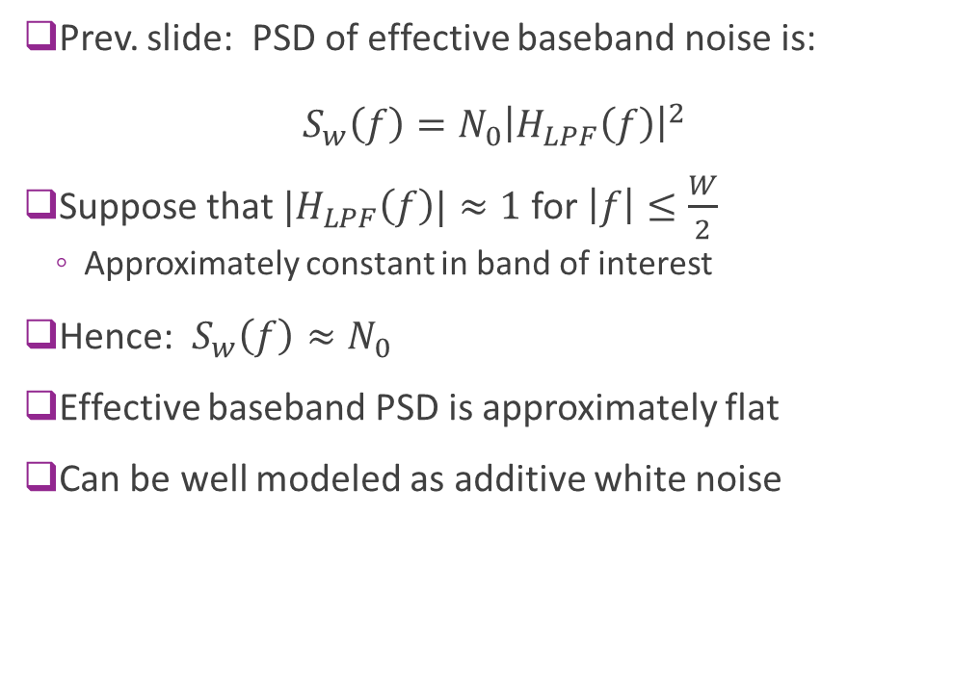
Effective Baseband Noise $≈$ White
Prev. slide: PSD of effective baseband noise is: $S_{w}\left(f\right)=N_{0}{\left|H_{LPF}\left(f\right)\right|}^{2}$
Suppose that $|H_{LPF}\left(f\right)|≈1$ for $\left|f\right|≤\frac{W}{2}$
Approximately constant in band of interest
Hence: $S_{w}\left(f\right)≈N_{0}$
Effective baseband PSD is approximately flat
Can be well modeled as additive white noise
$$w(t)$$
$$H(f)$$
$$u(t)$$
$$y(t)$$
Channel

Slide 14
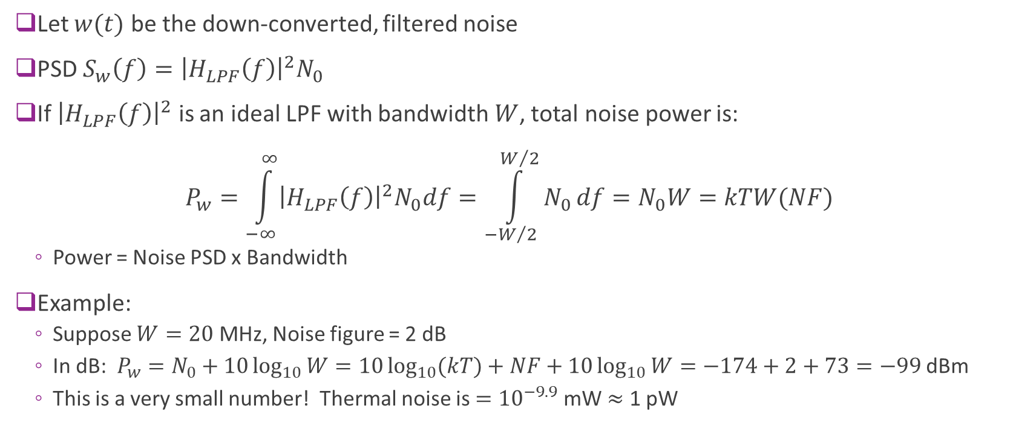
Thermal Noise and Bandwidth
Let $w(t)$ be the down-converted, filtered noise
PSD $S_{w}\left(f\right)={\left|H_{LPF}\left(f\right)\right|}^{2}N_{0}$
If ${\left|H_{LPF}\left(f\right)\right|}^{2}$ is an ideal LPF with bandwidth $W$, total noise power is: $P_{w}=\int_{−∞}^{∞}{{\left|H_{LPF}\left(f\right)\right|}^{2}N_{0}df}=\int_{{−W}/2}^{W/2}{N_{0}}df=N_{0}W=kTW(NF)$
Power = Noise PSD x Bandwidth
Example:
Suppose $W=20$ MHz, Noise figure = 2 dB
In dB: $P_{w}=N_{0}+10\log_{10}{W}=10\log_{10}{(kT)}+NF+10\log_{10}{W}=−174+2+73=−99$ dBm
This is a very small number! Thermal noise is $={10}^{−9.9}$mW $≈$ 1 pW

Slide 15

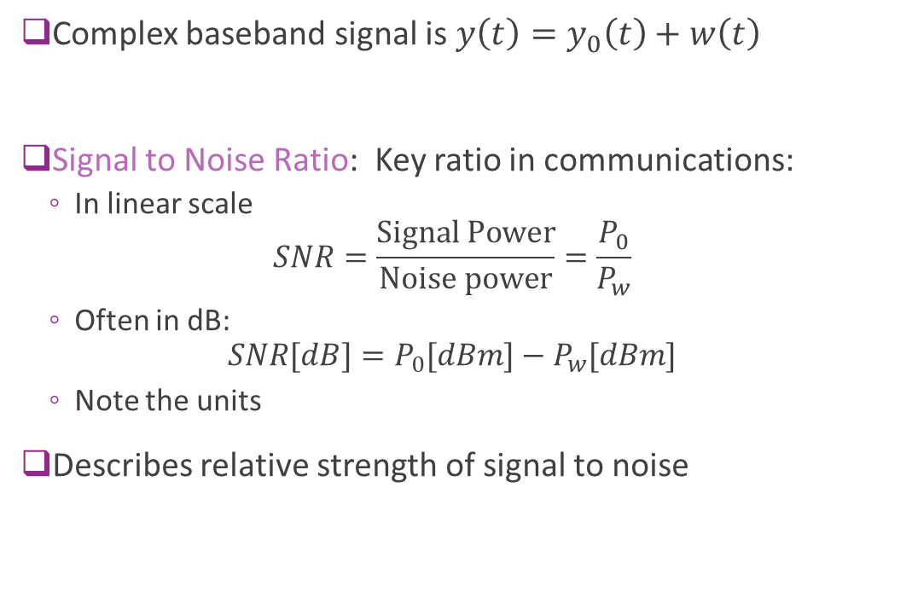




Signal To Noise Ratio
Complex baseband signal is $y\left(t\right)=y_{0}\left(t\right)+w\left(t\right)$
Signal to Noise Ratio: Key ratio in communications:
In linear scale $SNR=\frac{\text{Signal} \text{Power}}{\text{Noise} \text{power}}=\frac{P_{0}}{P_{w}}$
Often in dB: $SNR[dB]=P_{0}[dBm]−P_{w}[dBm]$
Note the units
Describes relative strength of signal to noise
$$w(t)$$
Noise
$$H(f)$$
$$u(t)$$
$$y(t)$$
$$y_{0}(t)$$
Channel
Desired signal

Slide 16
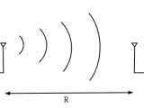
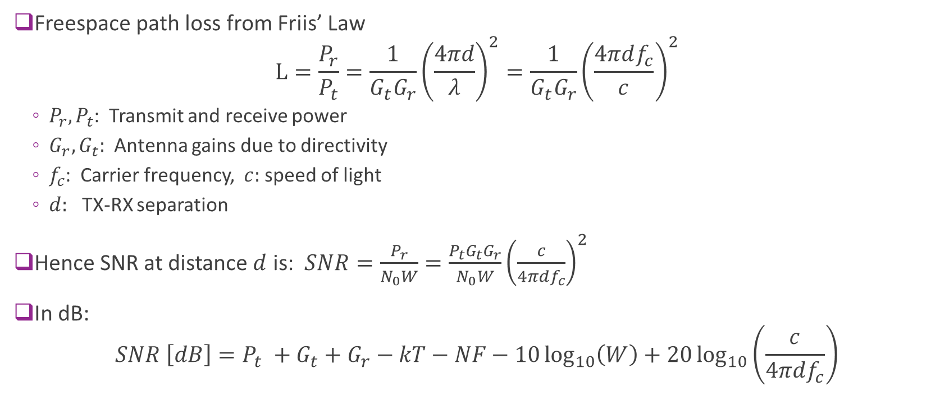
Example: SNR of a Wireless Signal
Freespace path loss from Friis’ Law
$P_{r},P_{t}$: Transmit and receive power
$G_{r},G_{t}:$ Antenna gains due to directivity
$f_{c}$: Carrier frequency, $c:$ speed of light
$d:$ TX-RX separation
Hence SNR at distance $d$ is: $SNR=\frac{P_{r}}{N_{0}W}=\frac{P_{t}G_{t}G_{r}}{N_{0}W}{\left(\frac{c}{4πdf_{c}}\right)}^{2}$
In dB: $SNR \left[dB\right]=P_{t} +G_{t}+G_{r}−kT−NF−10\log_{10}\left(W\right)+20\log_{10}\left(\frac{c}{4πdf_{c}}\right)$

Slide 17
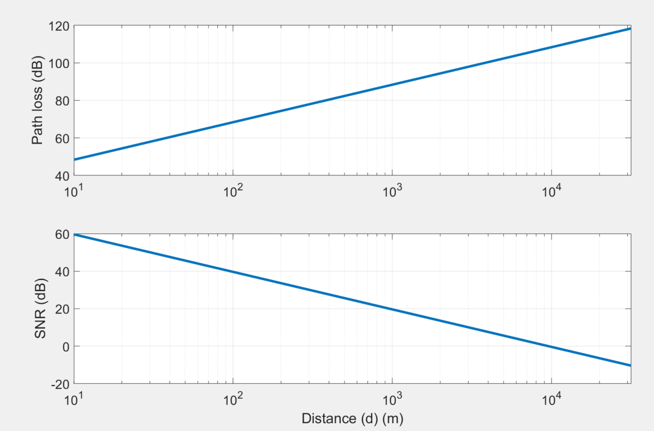

Free-Space SNR Visualized
Parameters:
$f_{c}=28$ GHz
NF = 6 dB
$G_{t}=21$ dBi, $G_{r}=12$dBi
$P_{t}=$30 dBm
$W$ = 1 GHz
SNR = 0 dB as far away as 10 km!

Slide 18
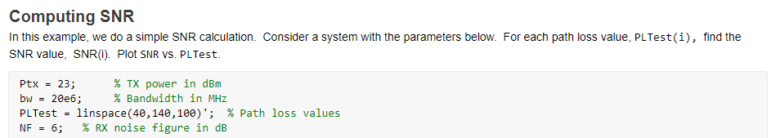
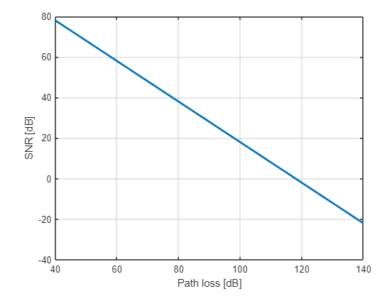
In Class Exercise

Slide 19
Outline
Passband and baseband noise, signal to noise ratio
Noise in the discrete symbols
ML Detection
Symbol detection
Probability of error

Slide 20

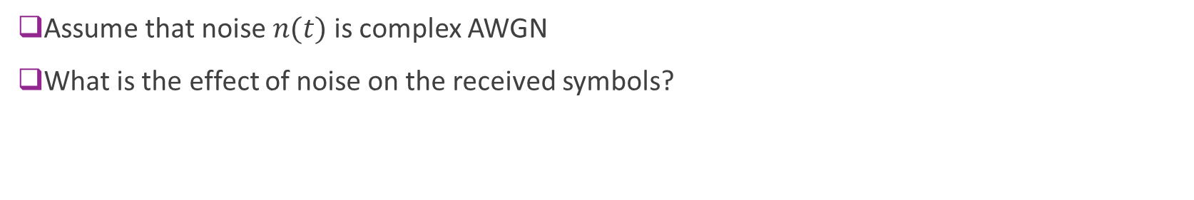







End-to-End System So Far
$$u_{δ}(t)$$
$$u(t)$$
$$s(t)$$
$$r(t)$$
$$v(t)$$
$$s[n]$$
$$r[n]$$
TX symbols
Ideal D/A
Channel
Ideal Sampling
RX symbols
TX filter
RX filter
$$n(t)$$
Assume that noise $n(t)$ is complex AWGN
What is the effect of noise on the received symbols?

Slide 21
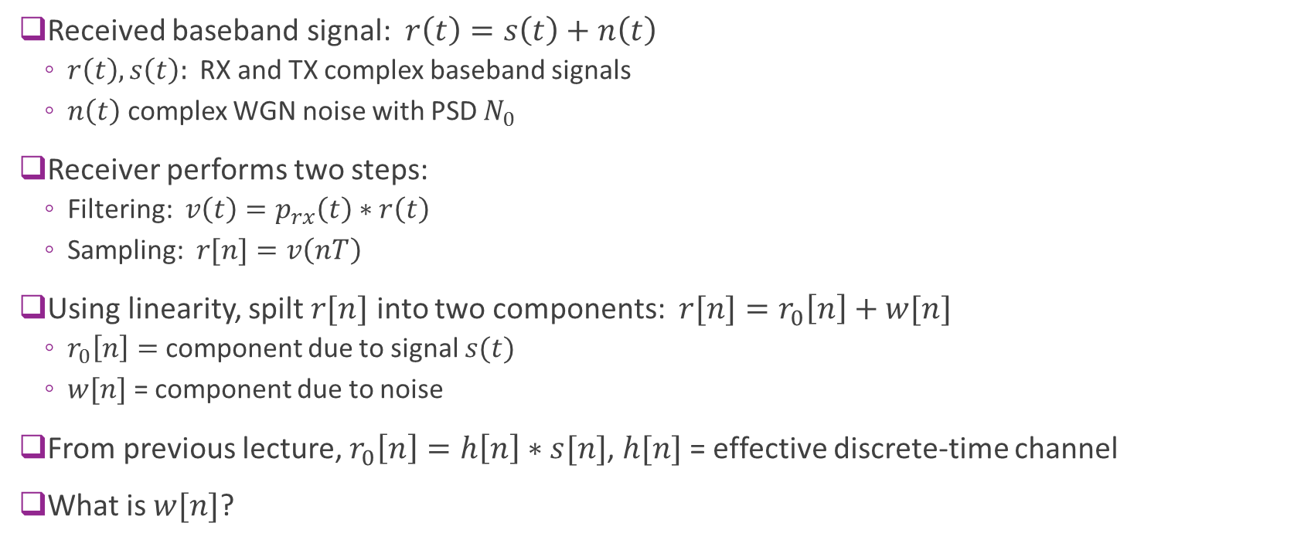
Signal and Noise Components
Received baseband signal: $r\left(t\right)=s\left(t\right)+n\left(t\right)$
$r\left(t\right), s\left(t\right):$ RX and TX complex baseband signals
$n\left(t\right)$ complex WGN noise with PSD $N_{0}$
Receiver performs two steps:
Filtering: $v\left(t\right)=p_{rx}\left(t\right)∗r\left(t\right)$
Sampling: $r[n]=v\left(nT\right)$
Using linearity, spilt $r[n]$ into two components: $r[n]=r_{0}\left[n\right]+w[n]$
$r_{0}\left[n\right]=$ component due to signal $s(t)$
$w[n]$ = component due to noise
From previous lecture, $r_{0}\left[n\right]=h\left[n\right]∗s[n]$, $h[n]$ = effective discrete-time channel
What is $w[n]$?

Slide 22
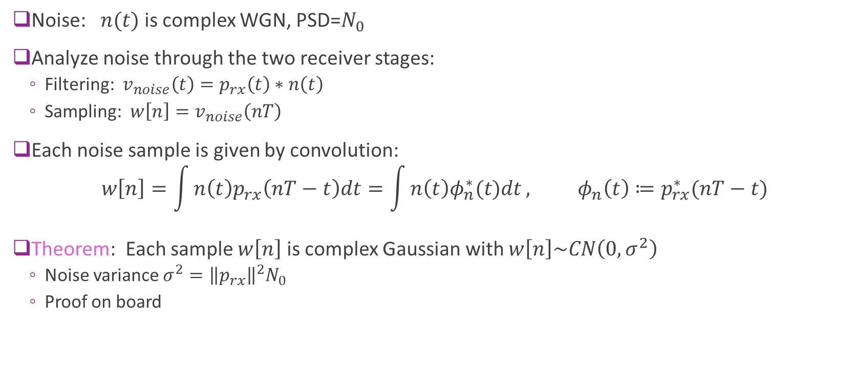
Noise Component
Noise: $n(t)$ is complex WGN, PSD=$N_{0}$
Analyze noise through the two receiver stages:
Filtering: $v_{noise}\left(t\right)=p_{rx}\left(t\right)∗n\left(t\right)$
Sampling: $w\left[n\right]=v_{noise}\left(nT\right)$
Each noise sample is given by convolution: $w\left[n\right]=\int{n\left(t\right)p_{rx}\left(nT−t\right)dt}=\int{n\left(t\right)φ_{n}^{∗}(t)dt}, φ_{n}\left(t\right)≔p_{rx}^{∗}(nT−t)$
Theorem: Each sample $w\left[n\right]$ is complex Gaussian with $w\left[n\right]\sim CN\left(0,σ^{2}\right)$
Noise variance $σ^{2}={\left\|p_{rx}\right\|}^{2}N_{0}$
Proof on board

Slide 23

Symbol Noise with Orthonormal RX Filtering
Suppose that $φ_{n}\left(t\right)≔p_{rx}^{∗}(nT−t)$ is an orthonormal basis
Theorem: Then $w\left[n\right]\sim CN(0,N_{0})$ and the noise samples are independent
Proof on board

Slide 24

Single Path Channel Model
Simple model
Orthonormal modulation: $φ_{n}\left(t\right)=p_{tx}(t−nT)$ is an orthonormal basis
Single path channel: $s\left(t\right)=hu(t−τ)$
Matched filter receiver: ${p_{rx}\left(t\right)=p}_{tx}^{∗}\left(−t\right)$
AWGN noise: $n(t)$ has PSD $N_{0}$
Equivalent discrete-time model:
$$r\left[n\right]=hs\left[n\right]+w\left[n\right]$$

Slide 25
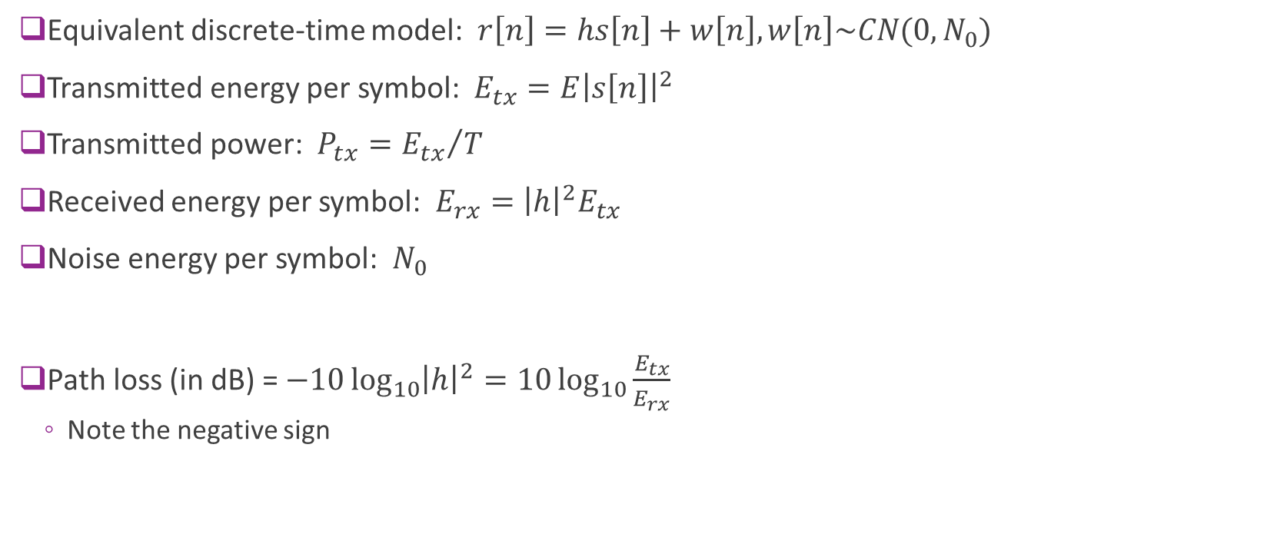
Power and Energy
Equivalent discrete-time model: $r\left[n\right]=hs\left[n\right]+w\left[n\right], w\left[n\right]\sim CN(0,N_{0})$
Transmitted energy per symbol: $E_{tx}=E{\left|s\left[n\right]\right|}^{2}$
Transmitted power: $P_{tx}={E_{tx}}/T$
Received energy per symbol: $E_{rx}={\left|h\right|}^{2}E_{tx}$
Noise energy per symbol: $N_{0}$
Path loss (in dB) = $−10\log_{10}{{\left|h\right|}^{2}}=10\log_{10}{\frac{E_{tx}}{E_{rx}}}$
Note the negative sign

Slide 26
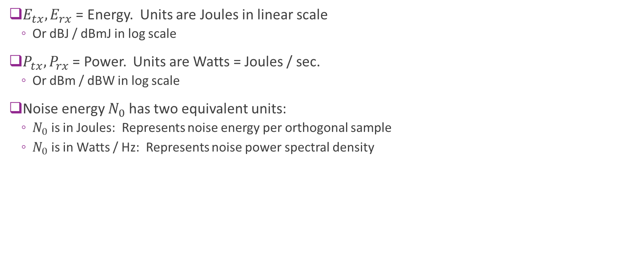
Units
$E_{tx},E_{rx}$ = Energy. Units are Joules in linear scale
Or dBJ / dBmJ in log scale
$P_{tx}, P_{rx}$ = Power. Units are Watts = Joules / sec.
Or dBm / dBW in log scale
Noise energy $N_{0}$ has two equivalent units:
$N_{0}$ is in Joules: Represents noise energy per orthogonal sample
$N_{0}$ is in Watts / Hz: Represents noise power spectral density

Slide 27
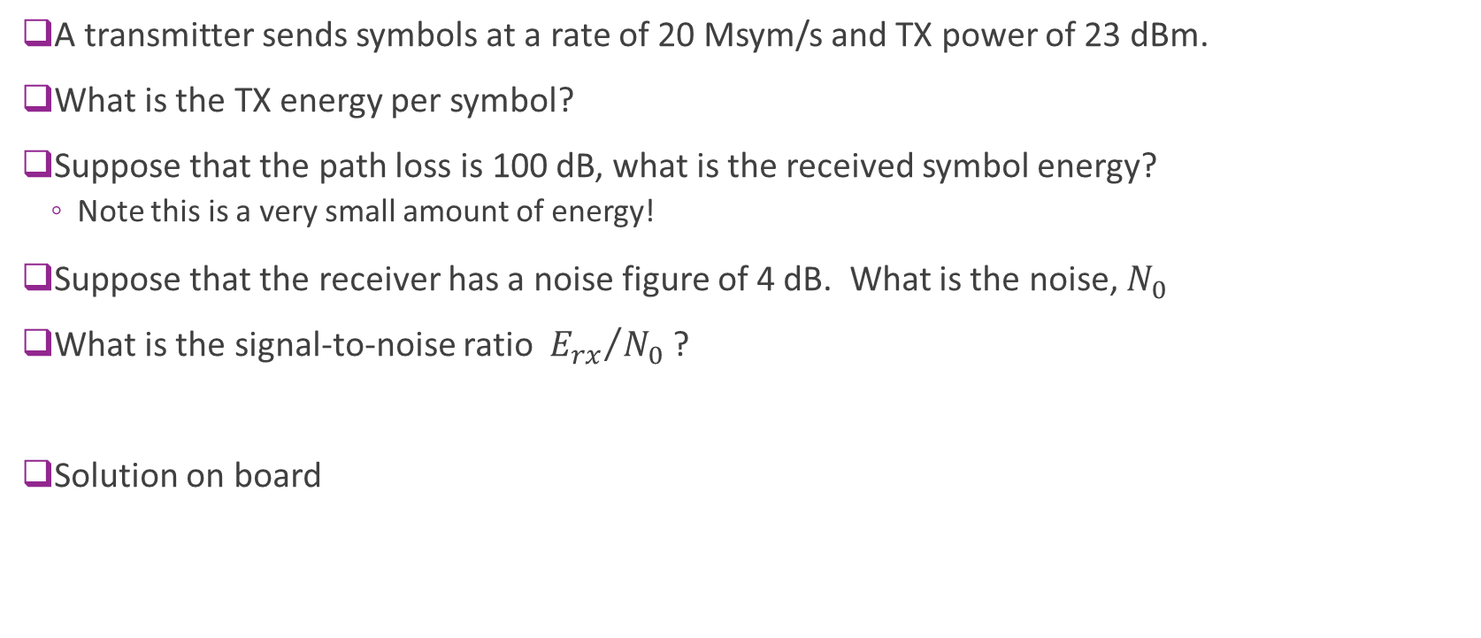
Sample Question
A transmitter sends symbols at a rate of 20 Msym/s and TX power of 23 dBm.
What is the TX energy per symbol?
Suppose that the path loss is 100 dB, what is the received symbol energy?
Note this is a very small amount of energy!
Suppose that the receiver has a noise figure of 4 dB. What is the noise, $N_{0}$
What is the signal-to-noise ratio ${E_{rx}}/{N_{0}}$ ?
Solution on board

Slide 28
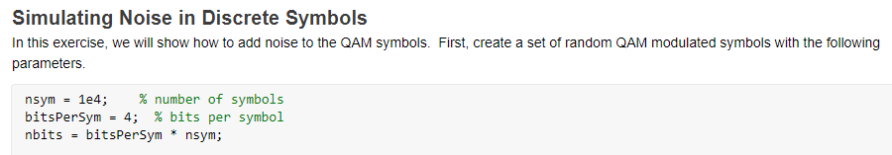
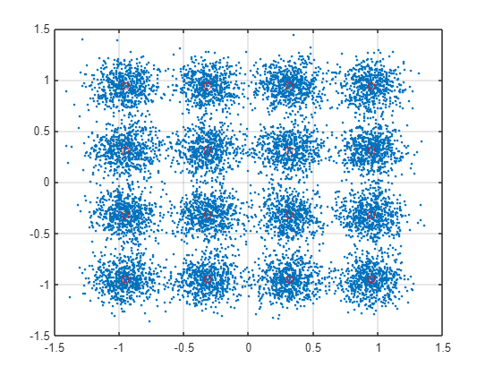
In Class Exercise

Slide 29
Outline
Passband and baseband noise, signal to noise ratio
Noise in the discrete symbols
ML Detection
Symbol detection
Probability of error

Slide 30
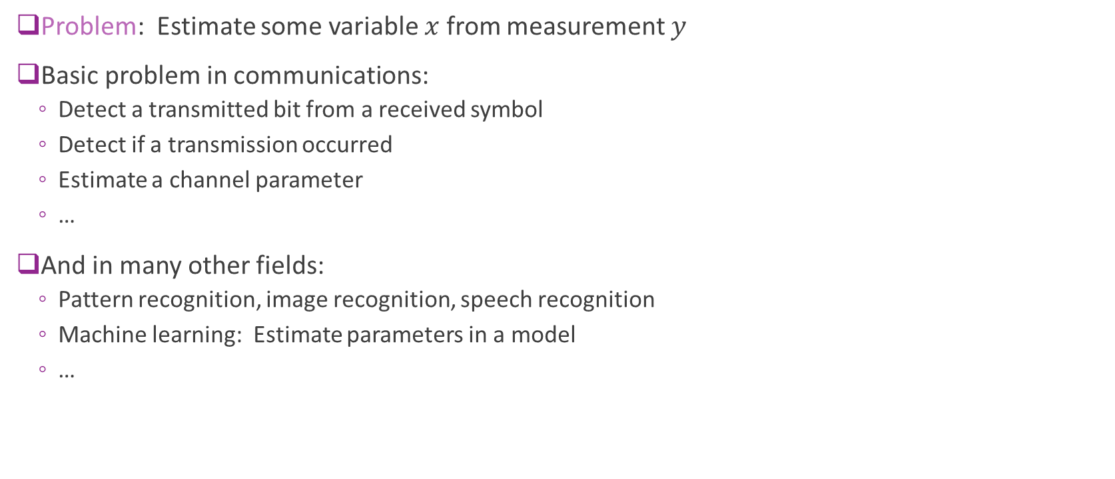
Detection Theory
Problem: Estimate some variable $x$ from measurement $y$
Basic problem in communications:
Detect a transmitted bit from a received symbol
Detect if a transmission occurred
Estimate a channel parameter
…
And in many other fields:
Pattern recognition, image recognition, speech recognition
Machine learning: Estimate parameters in a model
…

Slide 31
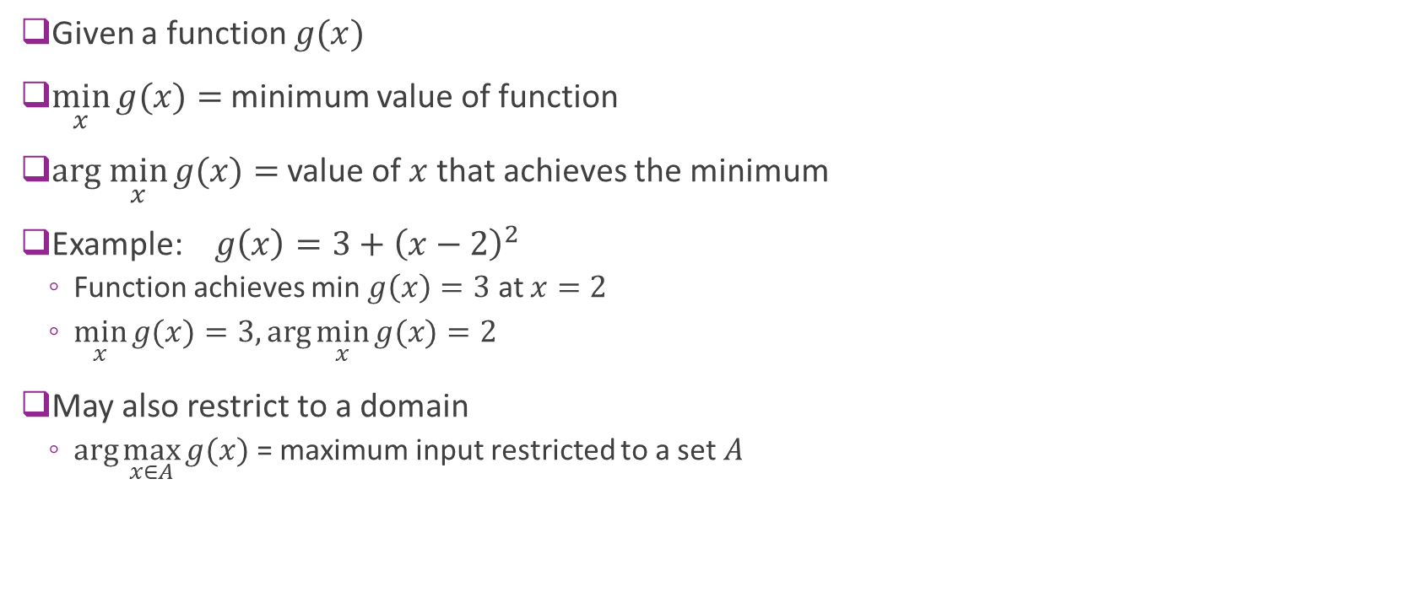



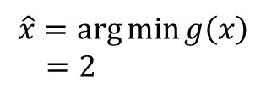
Min and Arg Min
Given a function $g(x)$
$\min_{x}{g(x)}=$ minimum value of function
$\text{arg} \min_{x}{g(x)}=$ value of $x$ that achieves the minimum
Example: $g\left(x\right)=3+{\left(x−2\right)}^{2}$
Function achieves min $g\left(x\right)=3$ at $x=2$
$\min_{x}{g(x)}=3, \arg{\min_{x}{g(x)}}=2$
May also restrict to a domain
$\arg{\max_{x∈A}{g(x)}}$ = maximum input restricted to a set $A$
$$g\left(x\right)=3+{\left(x−2\right)}^{2}$$
$$g(\hat{x})=3$$
$$x$$
$$\hat{x}=\arg{\min{g\left(x\right)}} \\ =2$$

Slide 32


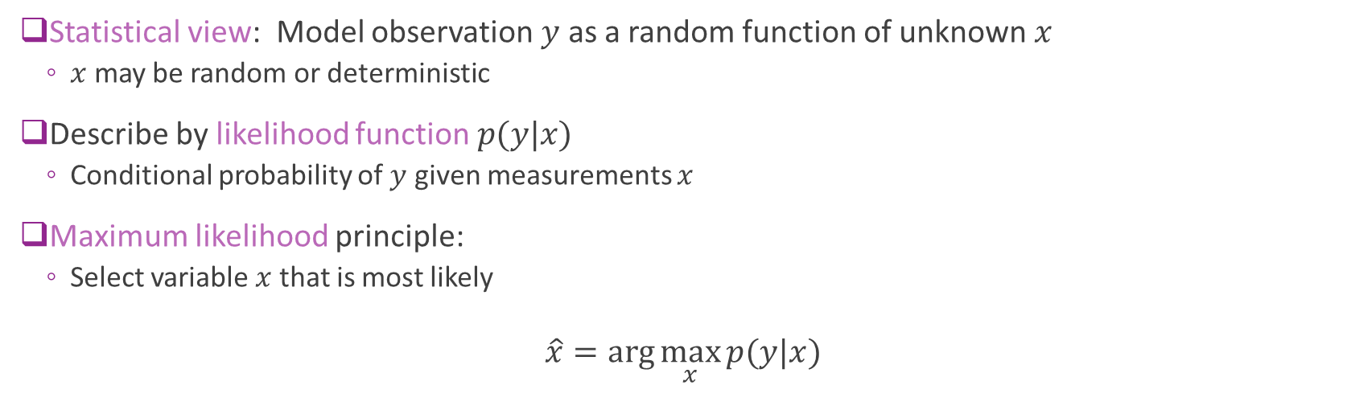


Maximum Likelihood Estimation
Unknown
$$x$$
$$p(y|x)$$
$$y$$
Observation
Statistical view: Model observation $y$ as a random function of unknown $x$
$x$ may be random or deterministic
Describe by likelihood function $p(y|x)$
Conditional probability of $y$ given measurements $x$
Maximum likelihood principle:
Select variable $x$ that is most likely
$$\hat{x}=\arg{\max_{x}{p(y|x)}}$$

Slide 33
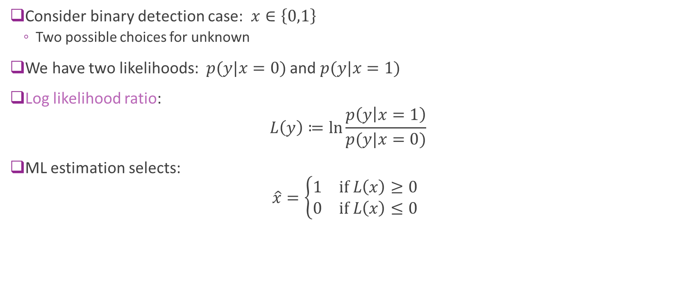
Likelihood Ratio
Consider binary detection case: $x∈\left\{0,1\right\}$
Two possible choices for unknown
We have two likelihoods: $p(y|x=0)$ and $p(y|x=1)$
Log likelihood ratio: $L\left(y\right)≔\ln{\frac{p\left(y | x=1\right)}{p(y|x=0)}}$
ML estimation selects: $\hat{x}=\left\{\begin{matrix}1 & \text{if} L\left(x\right)≥0 \\ 0 & \text{if} L\left(x\right)≤0\end{matrix}\right.$

Slide 34
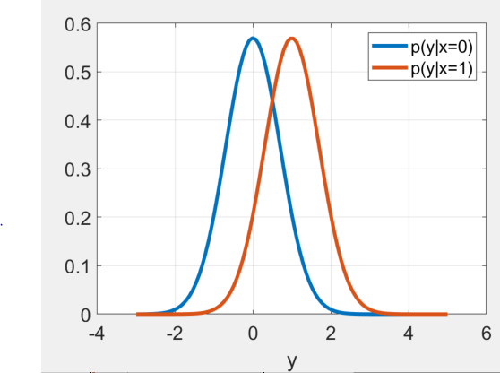
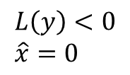
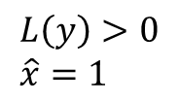

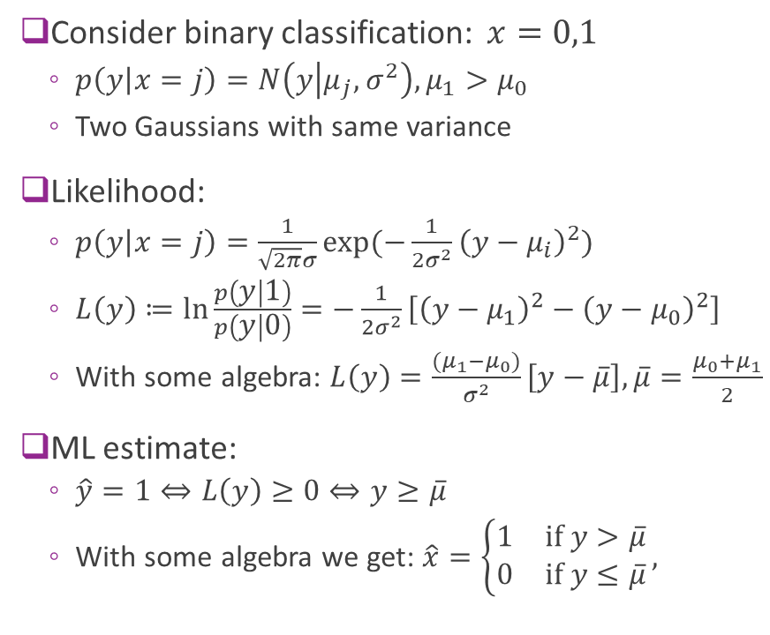
Example: Two Gaussians, Different Means
Consider binary classification: $x=0,1$
$p\left(y | x=j\right)=N\left(y | μ_{j},σ^{2}\right), μ_{1}>μ_{0}$
Two Gaussians with same variance
Likelihood:
$p\left(y | x=j\right)=\frac{1}{\sqrt{2π}σ}\exp{(−\frac{1}{2σ^{2}}{\left(y−μ_{i}\right)}^{2})}$
$L\left(y\right)≔\ln{\frac{p\left(y | 1\right)}{p\left(y | 0\right)}}=−\frac{1}{2σ^{2}}\left[{\left(y−μ_{1}\right)}^{2}−{\left(y−μ_{0}\right)}^{2}\right]$
With some algebra: $L\left(y\right)=\frac{(μ_{1}−μ_{0})}{σ^{2}}\left[y−\overline{μ}\right],\overline{μ}=\frac{μ_{0}+μ_{1}}{2}$
ML estimate:
$\hat{y}=1⇔L\left(y\right)≥0⇔y≥\overline{μ}$
With some algebra we get: $\hat{x}=\left\{\begin{matrix}1 & \text{if} y>\overline{μ} \\ 0 & \text{if} y≤\overline{μ}\end{matrix}\right.,$
$$L\left(y\right)<0 \\ \hat{x}=0$$
$$L\left(y\right)>0 \\ \hat{x}=1$$
$$\overline{μ}$$

Slide 35
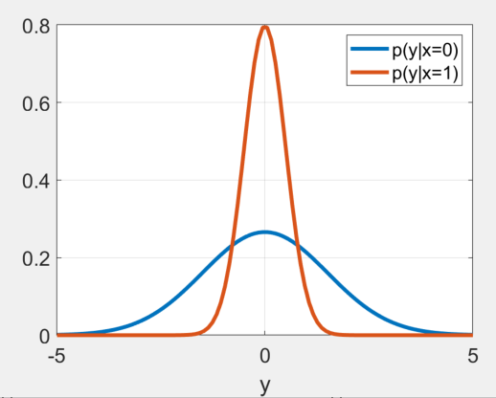




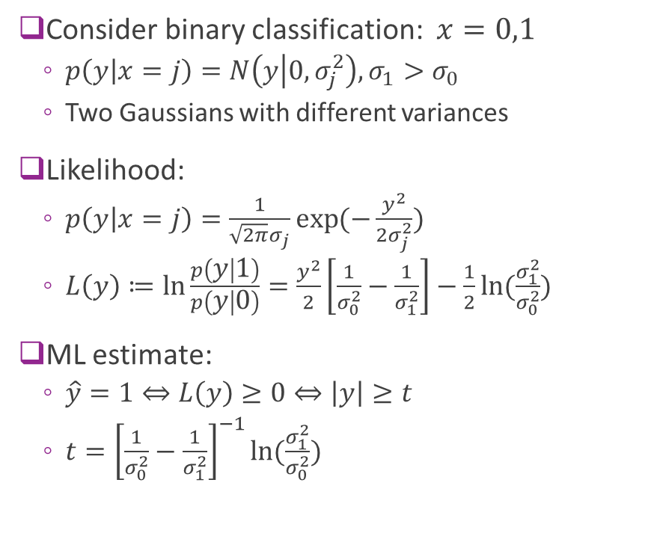

Example: Two Gaussians, Different Variances
Consider binary classification: $x=0,1$
$p\left(y | x=j\right)=N\left(y | 0,σ_{j}^{2}\right), σ_{1}>σ_{0}$
Two Gaussians with different variances
Likelihood:
$p\left(y | x=j\right)=\frac{1}{\sqrt{2π}σ_{j}}\exp{(−\frac{y^{2}}{2σ_{j}^{2}})}$
$L\left(y\right)≔\ln{\frac{p\left(y | 1\right)}{p\left(y | 0\right)}}=\frac{y^{2}}{2}\left[\frac{1}{σ_{0}^{2}}−\frac{1}{σ_{1}^{2}}\right]−\frac{1}{2}\ln{(\frac{σ_{1}^{2}}{σ_{0}^{2}})}$
ML estimate:
$\hat{y}=1⇔L\left(y\right)≥0⇔\left|y\right|≥t$
$t={\left[\frac{1}{σ_{0}^{2}}−\frac{1}{σ_{1}^{2}}\right]}^{−1}\ln{(\frac{σ_{1}^{2}}{σ_{0}^{2}})}$
$$−t$$
$$t$$
$$\hat{x}=0$$
$$\hat{x}=0$$
$$\hat{x}=1$$

Slide 36
Outline
Passband and baseband noise, signal to noise ratio
Noise in the discrete symbols
ML Detection
Symbol detection
Probability of error

Slide 37
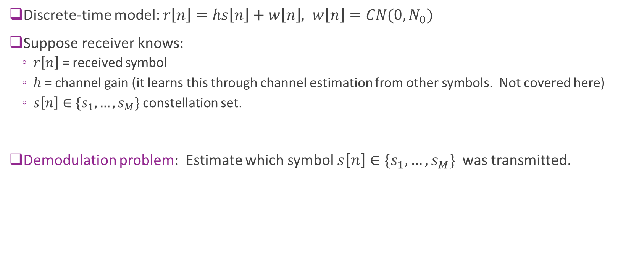
Demodulation
Discrete-time model: $r\left[n\right]=hs\left[n\right]+w\left[n\right], w\left[n\right]=CN(0,N_{0})$
Suppose receiver knows:
$r\left[n\right]$ = received symbol
$h$ = channel gain (it learns this through channel estimation from other symbols. Not covered here)
$s\left[n\right]∈\{s_{1},…,s_{M}\}$ constellation set.
Demodulation problem: Estimate which symbol $s\left[n\right]∈\{s_{1},…,s_{M}\}$ was transmitted.

Slide 38

ML Estimation for Symbol Demodulation
Demodulation problem: $r=hs+w, w \sim CN\left(0,N_{0}\right), s∈\{s_{1},…, s_{M}\}$
Drop the sample index $n$
Maximum likelihood estimation: $\hat{s}=\arg{\max_{{s=s}_{1},…s_{M}}{p(r|s=s_{m})}}$
Given $s$and $h$: $r\sim CN(hs, N_{0})$
Hence, $p\left(r | s\right)=\frac{1}{π N_{0}}\exp\left(−\frac{{\left|r−hs\right|}^{2}}{N_{0}}\right)$

Slide 39
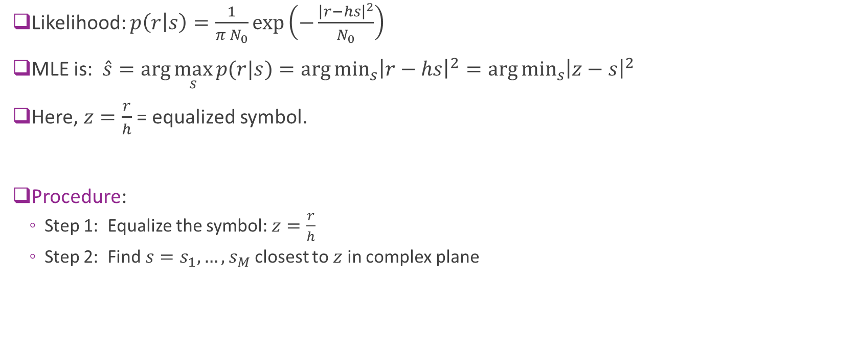
Nearest Symbol Detection
Likelihood: $p\left(r | s\right)=\frac{1}{π N_{0}}\exp\left(−\frac{{\left|r−hs\right|}^{2}}{N_{0}}\right)$
MLE is: $\hat{s}=\arg{\max_{s}{p(r|s)}}=\arg{\min_{s}{{\left|r−hs\right|}^{2}}}=\arg{\min_{s}{{\left|z−s\right|}^{2}}}$
Here, $z=\frac{r}{h}$ = equalized symbol.
Procedure:
Step 1: Equalize the symbol: $z=\frac{r}{h}$
Step 2: Find $s=s_{1},…,s_{M}$ closest to $z$ in complex plane

Slide 40
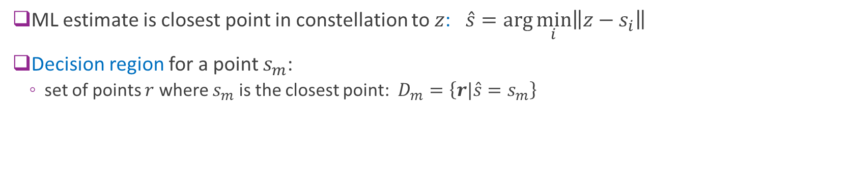
Decision Regions
s₂
s₁ (closest point)
Decision region for s₁
Example: Decision region in QPSK
r
s₃
s₄
ML estimate is closest point in constellation to $z$: $\hat{s}=\arg{\min_{i}\left\|z−s_{i}\right\|}$
Decision region for a point $s_{m}$:
set of points $r$ where $s_{m}$ is the closest point: $D_{m}=\left\{r|\hat{s}=s_{m}\right\}$

Slide 41
Sample Problems
Draw decision regions for:
QPSK
16-QAM
8-PSK
General constellations

Slide 42
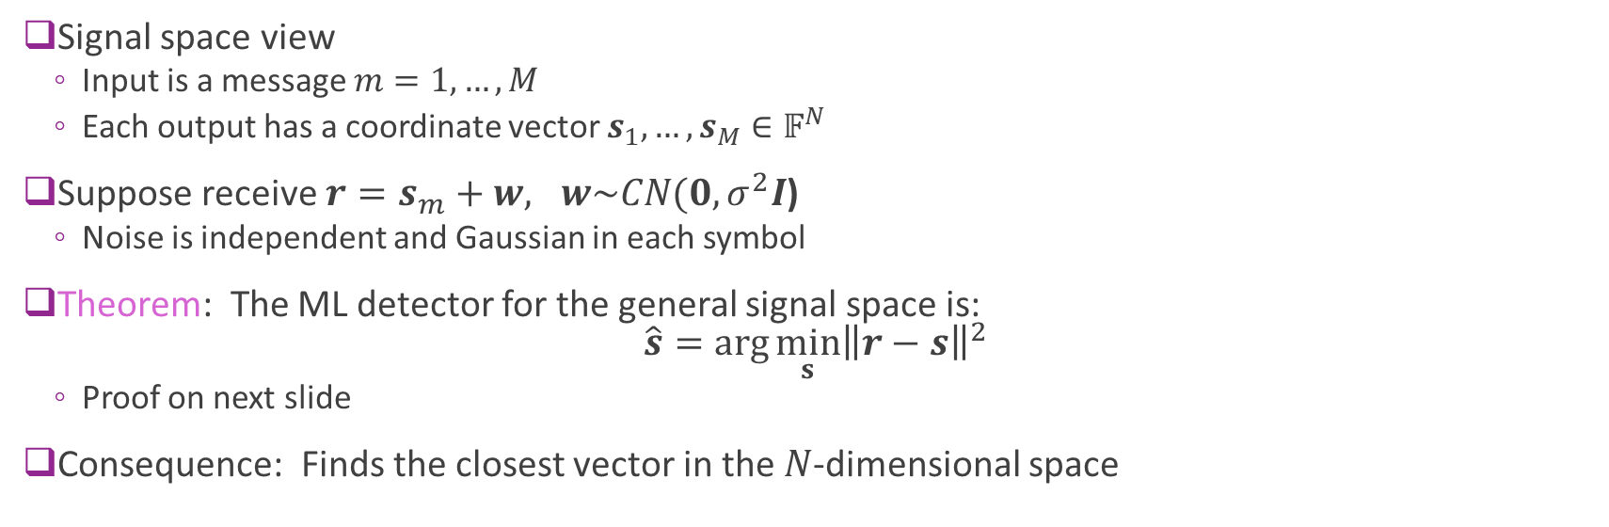
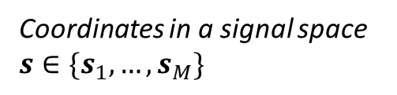
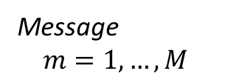
Detection in a General Signal Space
Message $$m=1,…,M$$
Coordinates in a signal space $s∈\{s_{1},…,s_{M}\}$
Signal space view
Input is a message $m=1,…,M$
Each output has a coordinate vector $s_{1},…,s_{M}∈𝔽^{N}$
Suppose receive $r=s_{m}+w, w\sim CN(0,σ^{2}I$)
Noise is independent and Gaussian in each symbol
Theorem: The ML detector for the general signal space is: $\hat{s}=\arg{\min_{s}{{\left\|r−s\right\|}^{2}}}$
Proof on next slide
Consequence: Finds the closest vector in the $N$-dimensional space

Slide 43
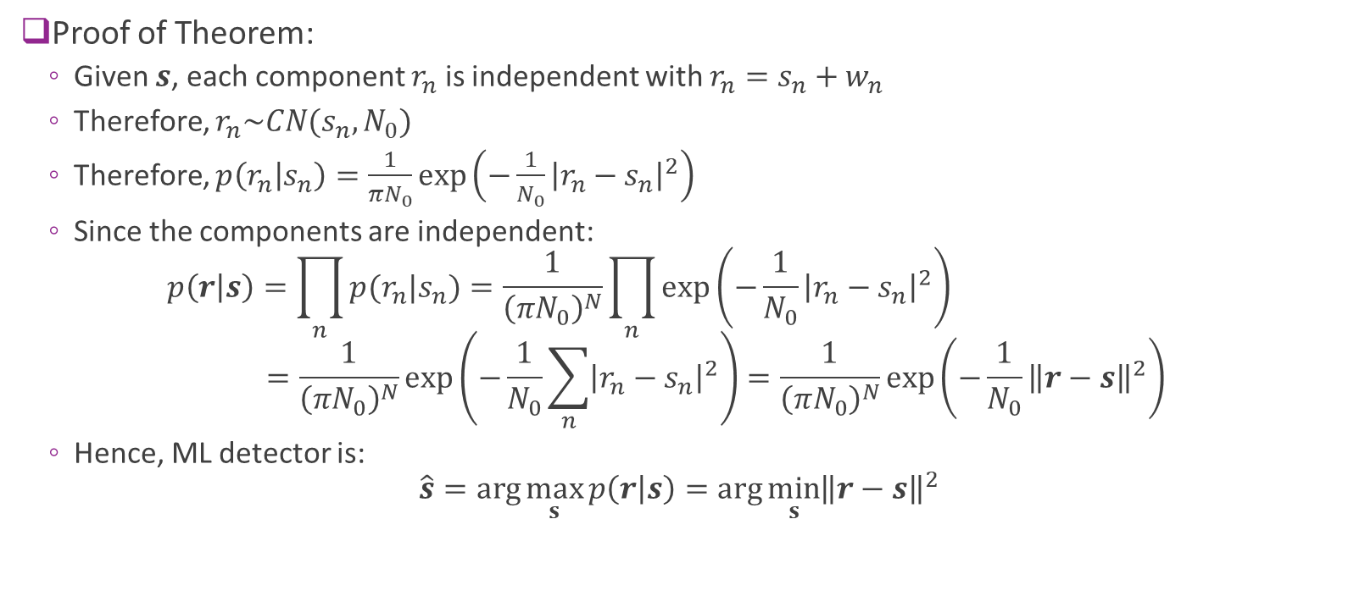
Detection in a General Signal Space
Proof of Theorem:
Given $s$, each component $r_{n}$ is independent with $r_{n}=s_{n}+w_{n}$
Therefore, $r_{n}\sim CN(s_{n},N_{0})$
Therefore, $p\left(r_{n} | s_{n}\right)=\frac{1}{πN_{0}}\exp\left(−\frac{1}{N_{0}}{\left|r_{n}−s_{n}\right|}^{2}\right)$
Since the components are independent: $p\left(r | s\right)=\prod_{n}{p(r_{n}|s_{n})}=\frac{1}{{\left(πN_{0}\right)}^{N}}\prod_{n}{\exp\left(−\frac{1}{N_{0}}{\left|r_{n}−s_{n}\right|}^{2}\right)}$ $=\frac{1}{{\left(πN_{0}\right)}^{N}}\exp\left(−\frac{1}{N_{0}}\sum_{n}{{\left|r_{n}−s_{n}\right|}^{2}}\right)=\frac{1}{{\left(πN_{0}\right)}^{N}}\exp\left(−\frac{1}{N_{0}}{\left\|r−s\right\|}^{2}\right)$
Hence, ML detector is: $\hat{s}=\arg{\max_{s}{p\left(r | s\right)}}=\arg{\min_{s}{{\left\|r−s\right\|}^{2}}}$

Slide 44
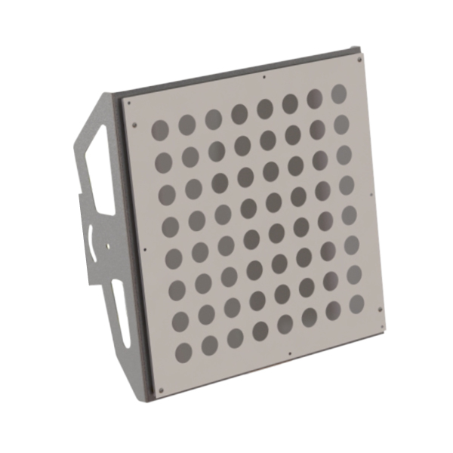
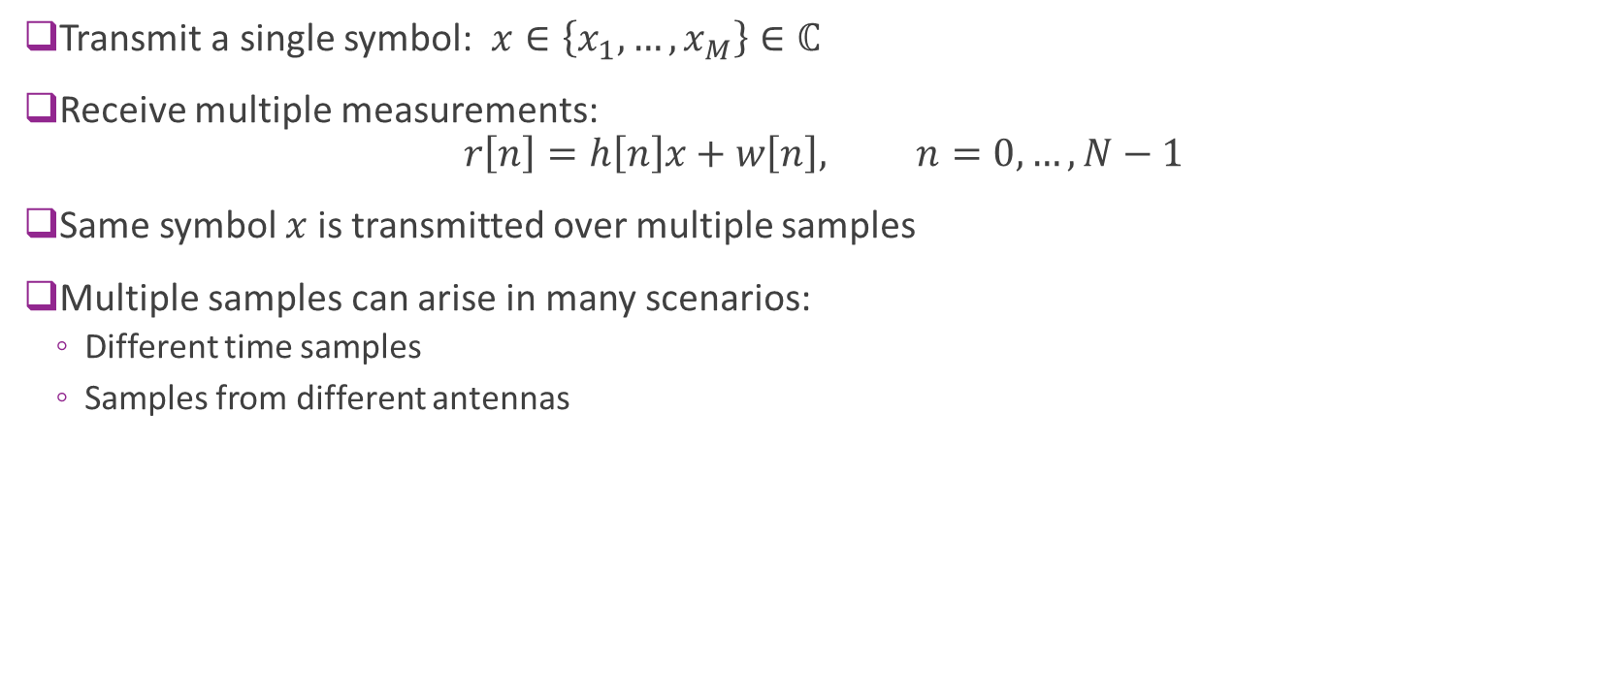
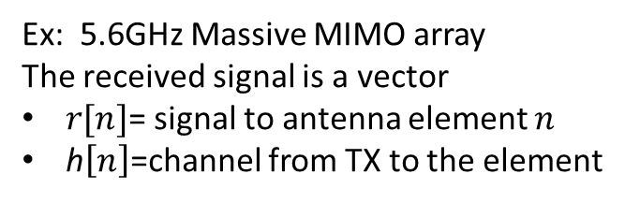
Example: Multiple Measurements
Transmit a single symbol: $x∈\left\{x_{1},…,x_{M}\right\}∈ℂ$
Receive multiple measurements: $r\left[n\right]=h\left[n\right]x+w\left[n\right], n=0,…,N−1$
Same symbol $x$ is transmitted over multiple samples
Multiple samples can arise in many scenarios:
Different time samples
Samples from different antennas
Ex: 5.6GHz Massive MIMO array
The received signal is a vector
$r[n]$= signal to antenna element $n$
h$\left[n\right]$=channel from TX to the element

Slide 45
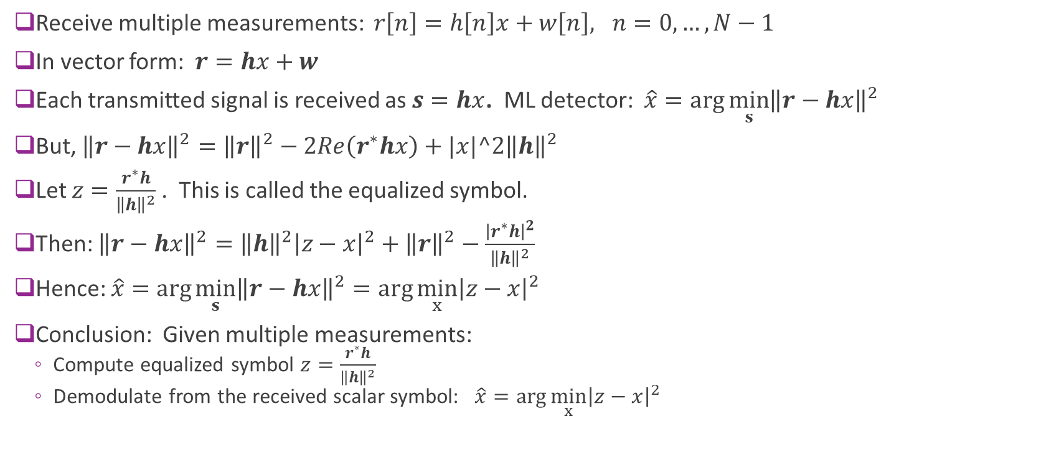
Example: Multiple Measurements
Receive multiple measurements: $r\left[n\right]=h\left[n\right]x+w\left[n\right], n=0,…,N−1$
In vector form: $r=hx+w$
Each transmitted signal is received as $s=hx$. ML detector: $\hat{x}=\arg{\min_{s}{{\left\|r−hx\right\|}^{2}}}$
But, ${\left\|r−hx\right\|}^{2}={\left\|r\right\|}^{2}−2Re\left(r^{∗}hx\right)+|x|^2{\left\|h\right\|}^{2}$
Let $z=\frac{r^{∗}h}{{\left\|h\right\|}^{2}}$ . This is called the equalized symbol.
Then: ${\left\|r−hx\right\|}^{2}={\left\|h\right\|}^{2}{\left|z−x\right|}^{2}+{\left\|r\right\|}^{2}−\frac{{\left|r^{∗}h\right|}^{2}}{{\left\|h\right\|}^{2}}$
Hence: $\hat{x}=\arg{\min_{s}{{\left\|r−hx\right\|}^{2}}}=\arg{\min_{x}{{\left|z−x\right|}^{2}}}$
Conclusion: Given multiple measurements:
Compute equalized symbol $z=\frac{r^{∗}h}{{\left\|h\right\|}^{2}}$
Demodulate from the received scalar symbol: $\hat{x}=\arg{\min_{x}{{\left|z−x\right|}^{2}}}$

Slide 46
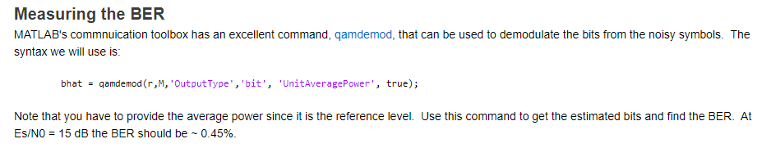

In Class Exercise

Slide 47
Outline
Passband and baseband noise, signal to noise ratio
Noise in the discrete symbols
ML Detection
Symbol detection
Probability of error

Slide 48

Symbol Error Probability
Want to compute symbol error rate $SER=P(m≠\hat{m})$
Assume all constellation points equally likely
Average SER: $SER=\frac{1}{M}\sum_{m=1}^{M}{P(\hat{s}≠s_{m}|s=s_{m})}$ $=\frac{1}{M}\sum_{m=1}^{M}{P(z ∉D_{m}|s=s_{m})}$
z
No error
z in correct decision region
w
s_{m}
w
Error
z not in correct decision region
z
s_{m}

Slide 49

Signal to Noise Ratio
Discrete-symbol model (no channel gain): $r=s+w, w\sim CN\left(0,N_{0}\right), s=s_{1},…,s_{M}$
Received symbol energy: $E_{s}=\frac{1}{M}\sum_{m=1}^{M}{{\left|s_{m}\right|}^{2}}$
Signal to noise ratio: $γ_{s}=\frac{E_{s}}{N_{0}}$
Sometimes called SNR per symbol
When there is a channel gain, $r=hs+w$. Replace $E_{s}$ with ${\left|h\right|}^{2}E_{s}$

Slide 50



SER for BPSK
BPSK constellation: $s=±\sqrt{E_{s}}$
AWGN channel: $r=s_{i}+n, n\sim CN(0,N_{0})$
SER: By symmetry $SER=P(\hat{m}=2|m=1)$
Will show on board: $SER=Q\left(\sqrt{2γ_{s}}\right)$
$γ_{s}={E_{s}}/{N_{0}}$ symbol SNR
Also, for BPSK: $γ_{b}={E_{b}}/{N_{0}}=γ_{s}$
$$s_{2}=−\sqrt{E_{s}}$$
$$s_{1}=\sqrt{E_{s}}$$
r
w

Slide 51

SER for QPSK
QPSK or 4-QAM
2 bits / symbol
Smaller dmin
SER for QPSK (will show on board) $SER=1−{\left(1−Q\left(\sqrt{γ_{s}}\right)\right)}^{2}=2Q\left(\sqrt{γ_{s}}\right)−Q^{2}\left(\sqrt{γ_{s}}\right)$
Look at SNR per bit
High SNR asymptotic
Compare to BPSK
Decision region for s₀₀
10
00
11
01

Slide 52
More Calculations
If you are interested, Proakis “Digital Communications” derives error rates for many constellation types:
M-PSK, M-QAM, DQPSK, …
Provides exact formulae and various bounds

Slide 53

SER for Various Modulation Schemes
Some observations:
QPSK has roughly same BER as BPSK for same Eb/N0
Note that SNR is shown in figure asEs/N0 not Eb/N0
M= QAM requires roughly 6 dB per bit above M=4
M-PSK is significantly less efficient that M-QAM

Slide 54


In Class Exercise

