Slide 1
Course Admin
EL-GY 6013: Digital Communications
Prof. Sundeep rangan

Slide 2
People and Time
Professor: Sundeep Rangan, srangan@nyu.edu
370 Jay St, 9.104
Office Hours: Thursdays, 2-4 pm
TA: Ruth Gebremedhin
Office Hours: TBD
Ask for all questions regarding homeworks and labs
Location: Rogers Hall 204
Tuesdays, 5 to 7:30pm

Slide 3
Pre-requisites
EL6303 Graduate probability
May also be taken as co-requisite
Chapters 1-7 and chapter 9 from Papoullis, Pillai
This class is offered this semester
Undergraduate signals & systems:
Fourier transforms, filters, sampling, bandwidth
We will review stochastic processes only very briefly.

Slide 4
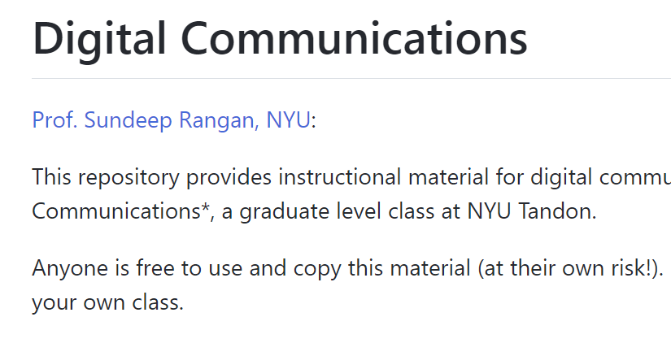
Github Site
All material is open-source on github
Contains:
Lecture notes
Problems
MATLAB demos
MATLAB problems
Solutions are given in class
https://github.com/sdrangan/digitalcomm

Slide 5
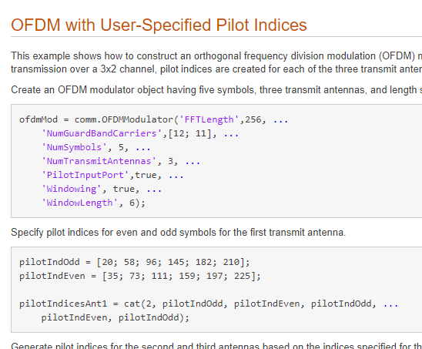
MATLAB
All labs will be in MATLAB
Download the latest MATLAB with Communications Toolbox
NYU students can get this for free:
https://www.mathworks.com/academia/tah-portal/new-york-university-618777.html
Make sure you get latest version
Communications Toolbox
Very powerful set of tools for simulating communications systems
Building blocks for all common parts
Channels, modulators, demod, coding, decoding, …
Can integrate with Simulink
Can even export to HDL for synthesis

Slide 6
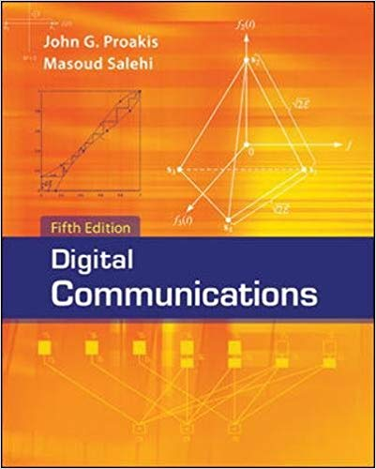
Text
Proakis, Salehi, “Digital Communications”
Fifth edition
Good points:
Very comprehensive. Widely-used
Lots of problems
But, extremely abstract
I will try to make it more concrete
It is OK if you have an older version
TA will post the questions when we use problems from the book

Slide 7
Class will Follow This Diagram
Channel coding
Symbol mapping
TX filter DAC
Upconversion
Info bits
Coded bits
IQ symbols
Analog baseband
RF
Passband
Channel
Sync
Channel decoding
Symbol demod
Equalization
RX filter and ADC
Down-conversion

Slide 8
Tentative Schedule
Week | Date | Unit | Topic
1 | 9/6/2022 | 1 | Introduction. Passband modulation
2 | 9/13/2022 | 2 | Symbol mapping, TX filtering
3 | 9/20/2022 | 3 | Receive filtering
4 | 9/27/2022 | 4 | Signal space theory
5 | 10/4/2022 | 5 | Random process review
6 | 10/11/2022 | 6 | Symbol demodulation
7 | 10/18/2022 |  | Midterm review
8 | 10/25/2022 |  | Midterm
9 | 11/1/2022 | 7 | Synchronization, matched filtering
10 | 11/8/2022 | 8 | Equalization
11 | 11/15/2022 | 9 | Linear codes
12 | 11/22/2022 |  | Thanksgiving week. No class
13 | 11/29/2022 | 10 | Convolutional and turbo codes
14 | 12/6/2022 | 11 | Information theory
15 | 12/13/2022 |  | Final exam

Slide 9
Grading
Grading:
40% homework, labs, 30% midterm, 30% final
Homework and labs:
Written problems
MATLAB exercises
Software-Defined Radio (SDR) labs (see next slide)
Exams: Midterm and final are take home
~24 hours to complete
Will ask questions on written and MATLAB component

Slide 10
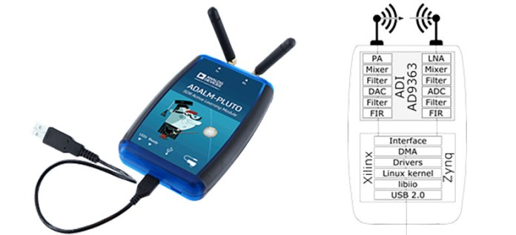


Software-Defined Radio (SDR) Labs
Based on ADALM-Pluto devices
Simple, but powerful
Low cost
Used in non-real-time mode
TX and RX signals over the air
Analyze offline in MATLAB
You will learn to implement:
Implement up and down-conversion
Measure SNR, PSD
Synchronization
Timing and frequency correction
Basic OFDM-based communication link

Slide 11
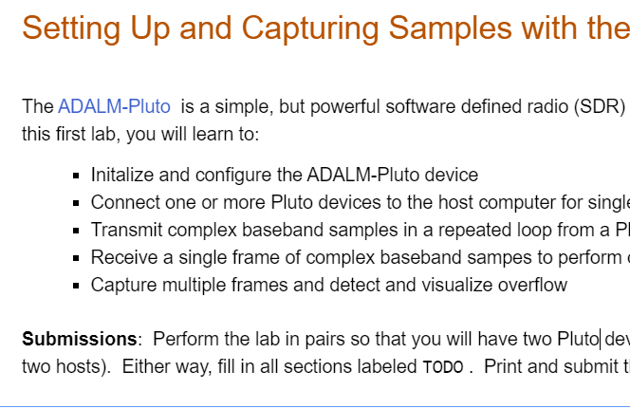
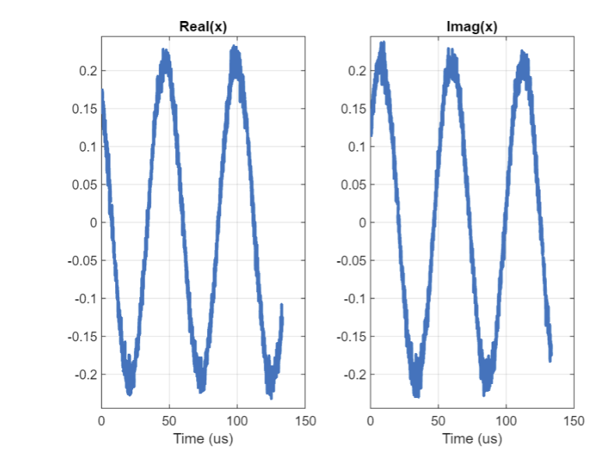
SDR Github Site
SDR labs are on a second github site
Contains:
Instructions for setting up the labs
MATLAB code skeletons
Some slides
Still in progress
Will be completed over the course of the semester
https://github.com/sdrangan/sdrlab

Slide 12
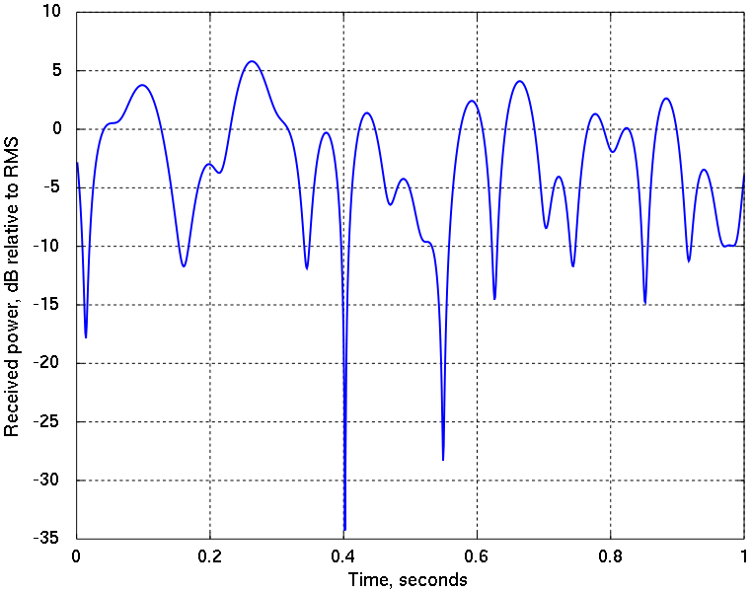
What is Digital Communications?
Transmission of digital data through a channel
Digital data
011000101…
Analog waveform
Digital data
011000101…
Transmitter
Channel
Receiver

Slide 13
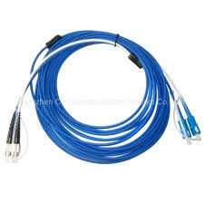
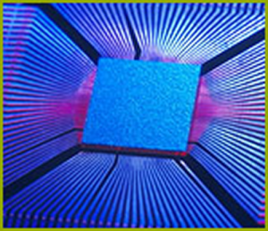
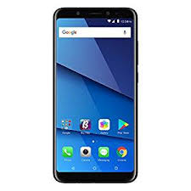
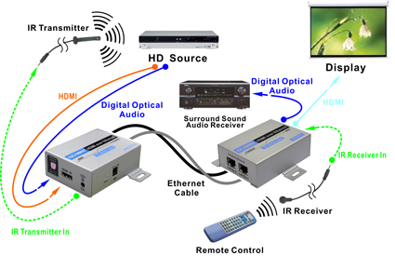
Digital Communications is Everywhere!
Systems vary with
Scales
Data rates
Channel media,
Ranges, …

Slide 14
What do Communications Theorists Do?
Try to make communication:
Reliable,
Fast,
Cheap, …
Basic tools in this class:
Look at point-to-point links.
Model transmission and reception as a statistical estimation problem.
Develop mathematical methods for good communication

Slide 15
Course Learning Objectives
Mathematically describe the components of a basic communication link
Mixing, filtering, symbol modulation, synchronization, equalization, channel coding, …
Simulate the system
Implement simple systems on software defined radios
Mathematical analyze the performance of the system
Model impairments in the channel and devices
Measure the performance such as bit error rate, power, …
Optimize the parameters of the design to maximize various performance metric
Account for constraints such as power, complexity, …

Slide 16
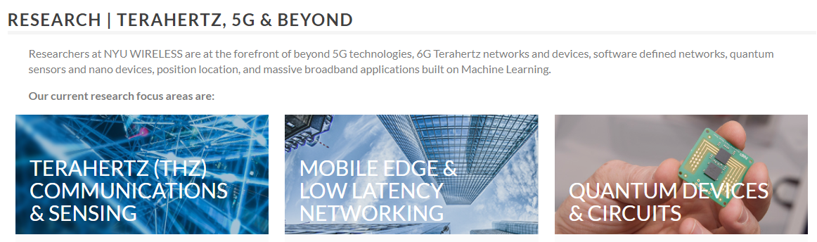
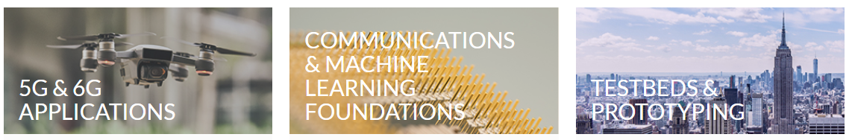
Research at NYU WIRELESS

