Slide 1
Unit 8: Equalization
EL-GY 6013: Digital communications
Prof. Sundeep rangan

Slide 2
Learning Objectives
Describe the synchronization mechanisms in common commercial standards
Formulate binary decision tasks as hypothesis testing problems
Compute the LRT detector for a hypothesis testing problem
Compute error probabilities and optimize the threshold
Formulate signal detection as a hypothesis test
Describe and analyze the matched filter detector
Analyze various non-idealities including clock offset, auto-correlation and multi-path
Simulate the MF detector for real systems

Slide 3
This Unit
Channel coding
Symbol mapping
TX filter DAC
Upconversion
Info bits
Coded bits
IQ symbols
Analog baseband
RF
Passband
Channel
Sync
“Noise”
Channel decoding
Symbol demod
Equalization
RX filter and ADC
Down-conversion

Slide 4
Outline
What is Equalization?
Time-Domain Equalization for Single Carrier Systems
OFDM
OFDM Channel Estimation

Slide 5
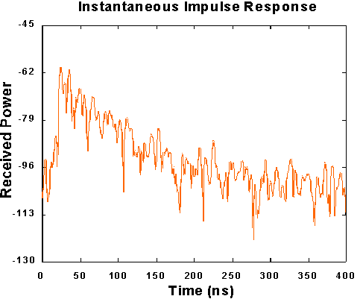
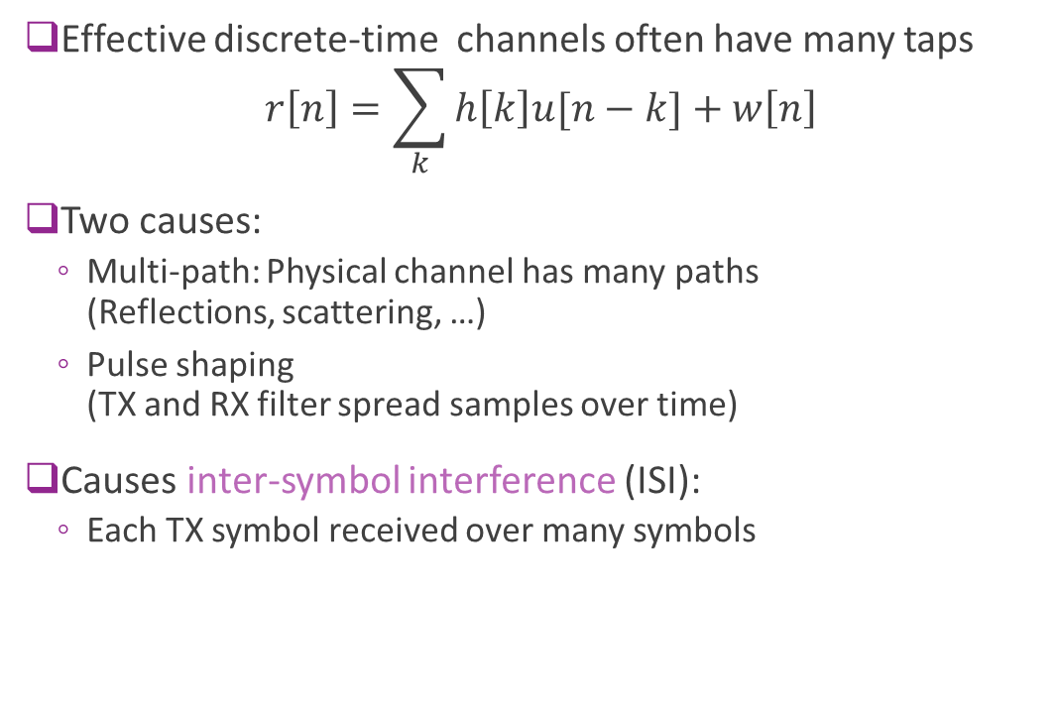
Multi-Path and ISI
Effective discrete-time channels often have many taps $r\left[n\right]=\sum_{k}{h\left[k\right]u[n−k]}+w\left[n\right]$
Two causes:
Multi-path: Physical channel has many paths (Reflections, scattering, …)
Pulse shaping (TX and RX filter spread samples over time)
Causes inter-symbol interference (ISI):
Each TX symbol received over many symbols
Multi-path indoor channel measured at UC Berkeley

Slide 6
Equalization
Equalization: Any method to overcome ISI
This lecture we look at two main methods
Time-domain equalization
Used in single carrier systems
Frequency-domain equalization
Used in OFDM systems

Slide 7


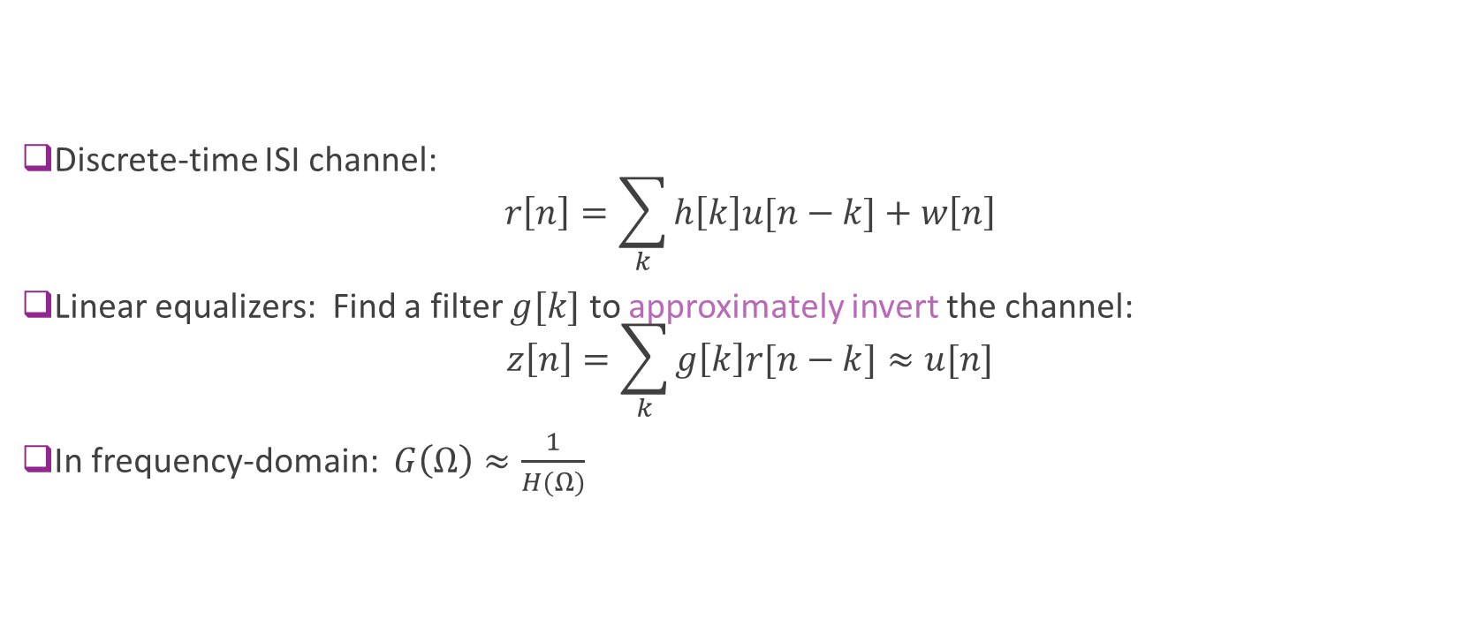



Linear Equalization
$$r[n]$$
$$u[n]$$
h$[n]$
g$[n]$
$$z\left[n\right]≈u[n]$$
ISI channel
Equalization
Discrete-time ISI channel: $r\left[n\right]=\sum_{k}{h\left[k\right]u[n−k]}+w\left[n\right]$
Linear equalizers: Find a filter $g[k]$ to approximately invert the channel: $z\left[n\right]=\sum_{k}{g\left[k\right]r[n−k]}≈u[n]$
In frequency-domain: $G\left(Ω\right)≈\frac{1}{H(Ω)}$

Slide 8

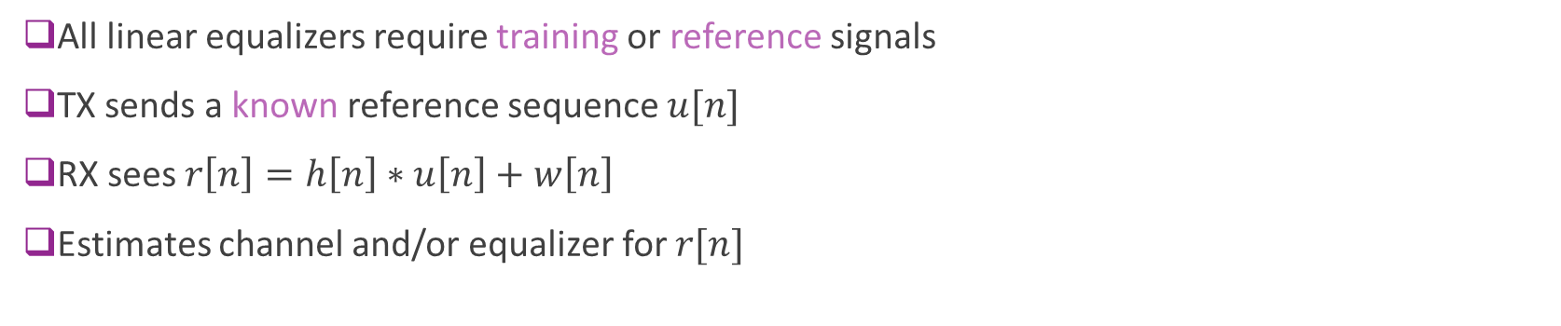
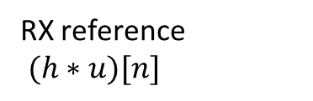
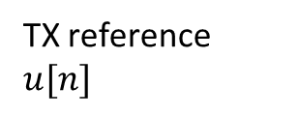

Training Symbols
TX reference $u[n]$
RX reference $(h∗u)[n]$
h$[n]$
$$g[n]$$
ISI channel
Equalizer estimator
All linear equalizers require training or reference signals
TX sends a known reference sequence $u[n]$
RX sees $r\left[n\right]=h\left[n\right]∗u\left[n\right]+w\left[n\right]$
Estimates channel and/or equalizer for $r[n]$

Slide 9
Outline
What is Equalization?
Time-Domain Equalization for Single Carrier Systems
OFDM
OFDM Channel Estimation

Slide 10
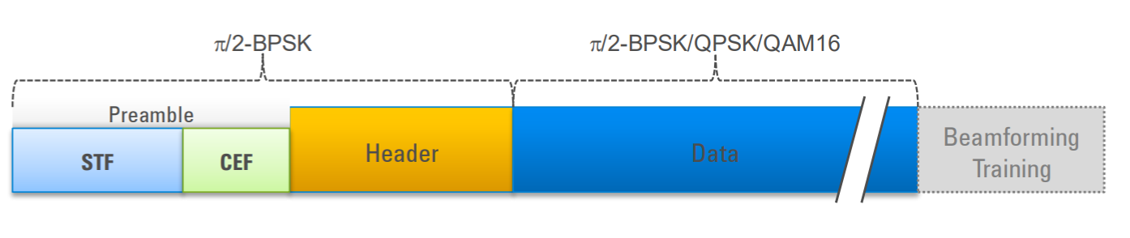
802.11 ad Preamble for 60 GHz WiFi
Apply equalizer
STF: Short training field
AGC, detection of packet
coarse estimate of timing
Process as previous lecture
CEF: Channel estimation field
Train equalizer

Slide 11
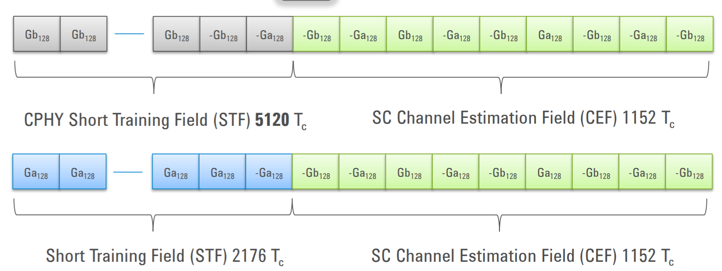
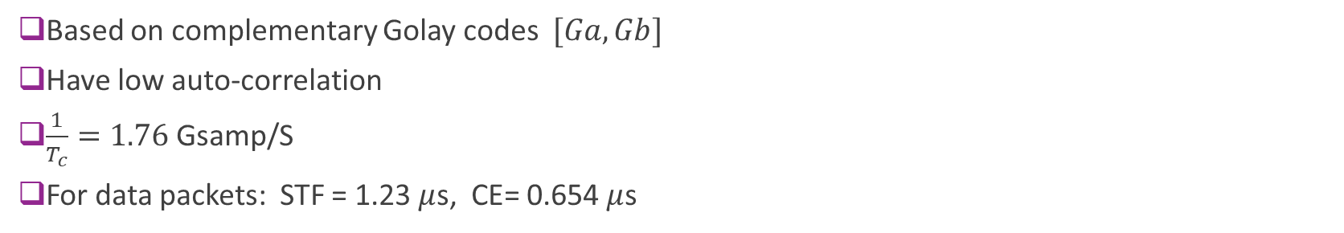
802.11ad Preamble Details
Control packets
Longer STF.
Need to be decoded by all stations. No directional gain
Data packets
Shorter STF
Based on complementary Golay codes $[Ga, Gb]$
Have low auto-correlation
$\frac{1}{T_{c}}=1.76$Gsamp/S
For data packets: STF = 1.23 $μ$s, CE= 0.654 $μ$s

Slide 12
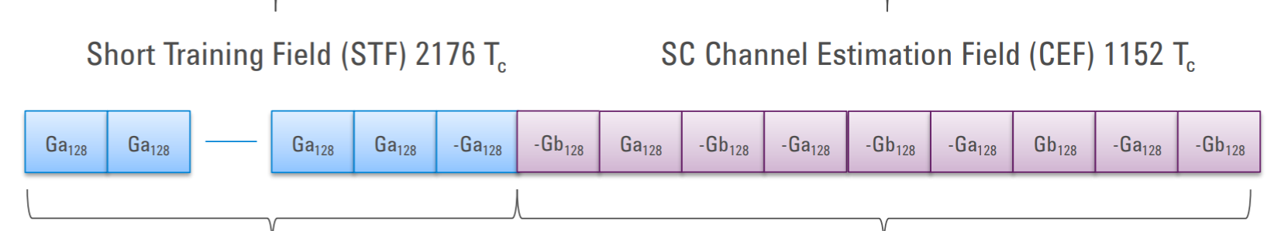
STF Detection
MF detector: Correlate with STF
Gives good performance but expensive
Simpler delay detector

Slide 13
Estimation from the CEF
Known sequence
Linear estimation problem

Slide 14
Linear Estimation
Linear estimation
Matrix form
Least squares solution

Slide 15
Outline
What is Equalization?
Time-Domain Equalization for Single Carrier Systems
OFDM
OFDM Channel Estimation

Slide 16
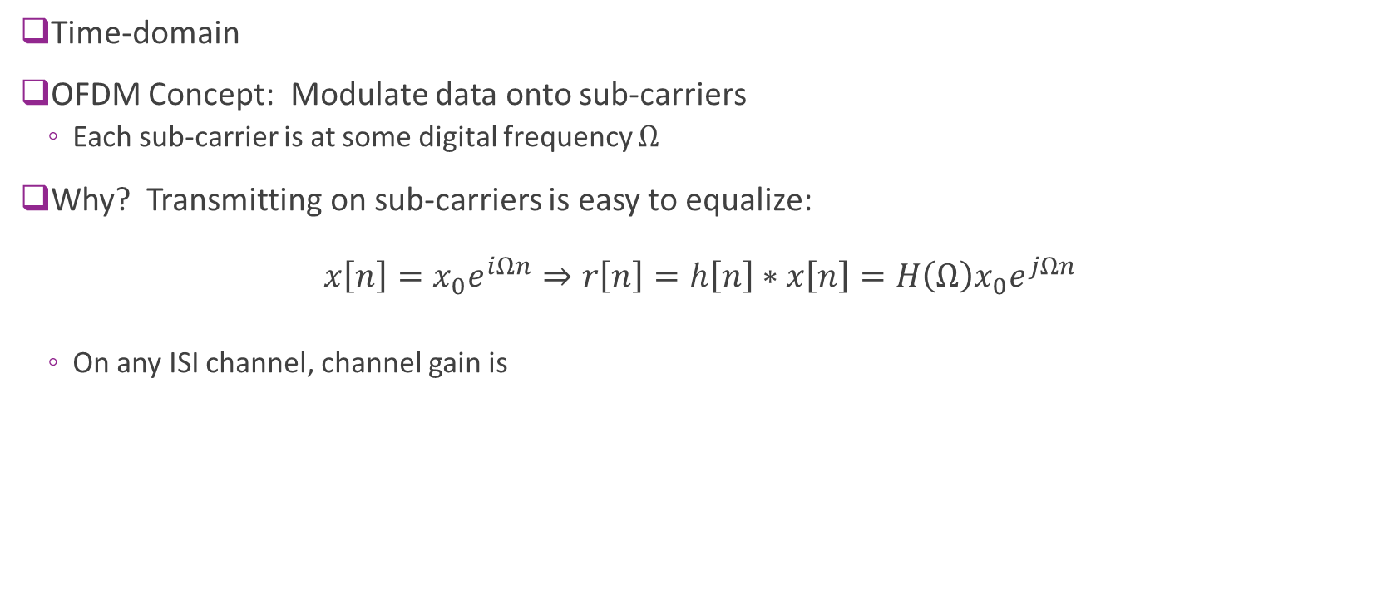
OFDM
Time-domain
OFDM Concept: Modulate data onto sub-carriers
Each sub-carrier is at some digital frequency $Ω$
Why? Transmitting on sub-carriers is easy to equalize:
On any ISI channel, channel gain is

Slide 17


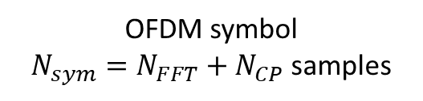

OFDM Symbol Structure in Time-Domain
Time is divided into OFDM symbols
Each symbol divided into samples
$\frac{1}{T}$= sample rate
Each symbol has:
FFT period, $N_{FFT}$ samples
CP period, $N_{CP}$ samples
$N_{FFT}$ = number samples in FFT period
$N_{CP}$ = number samples in cyclic prefix
$N_{sym}=N_{FFT}+N_{CP}=$ samples per symbol
$T_{sym}=TN_{sym}=$symbol period
OFDM symbol
$N_{sym}=N_{FFT}+N_{CP}$ samples
Cyclic prefix
$$N_{CP}$$
FFT period
$$N_{FFT}$$

Slide 18
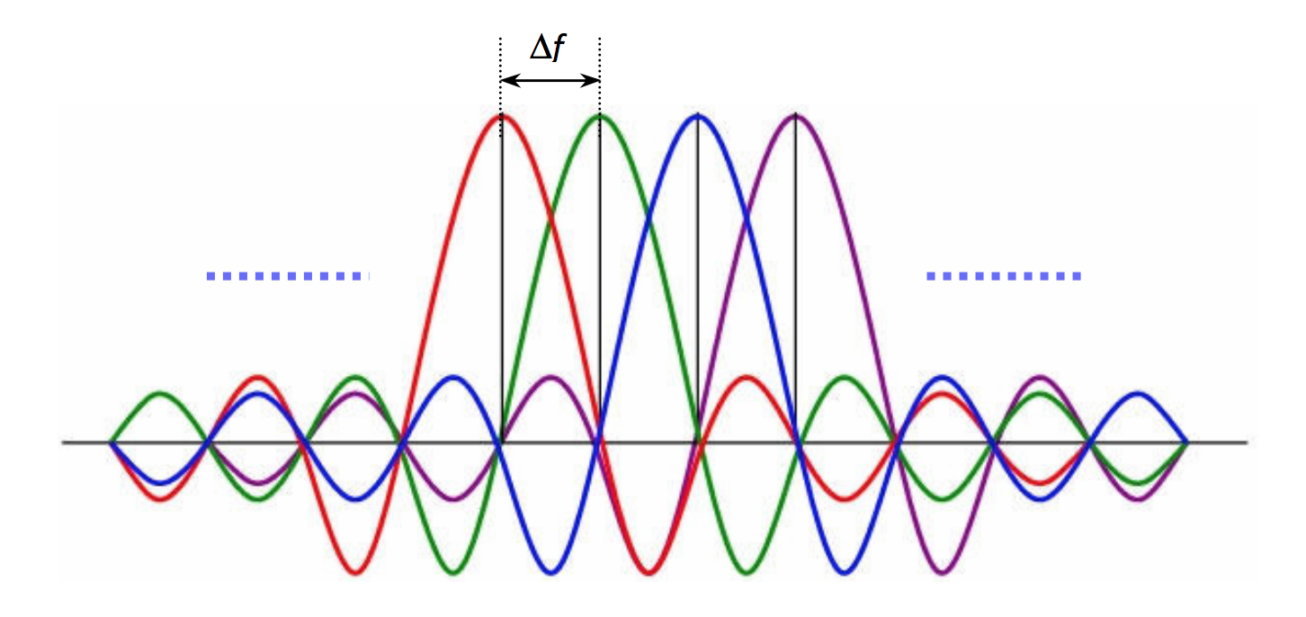
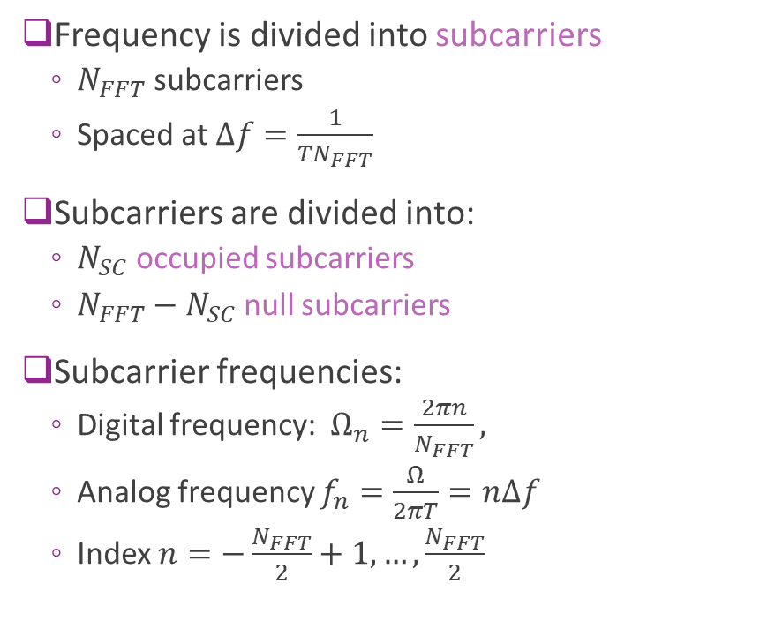
OFDM in Frequency Domain
Frequency is divided into subcarriers
$N_{FFT}$ subcarriers
Spaced at $Δf=\frac{1}{TN_{FFT}}$
Subcarriers are divided into:
$N_{SC}$ occupied subcarriers
$N_{FFT}−N_{SC}$ null subcarriers
Subcarrier frequencies:
Digital frequency: $Ω_{n}=\frac{2πn}{N_{FFT}},$
Analog frequency $f_{n}=\frac{Ω}{2πT}=nΔf$
Index $n=−\frac{N_{FFT}}{2}+1,…,\frac{N_{FFT}}{2}$

Slide 19
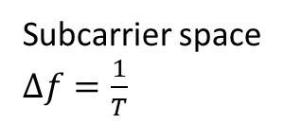
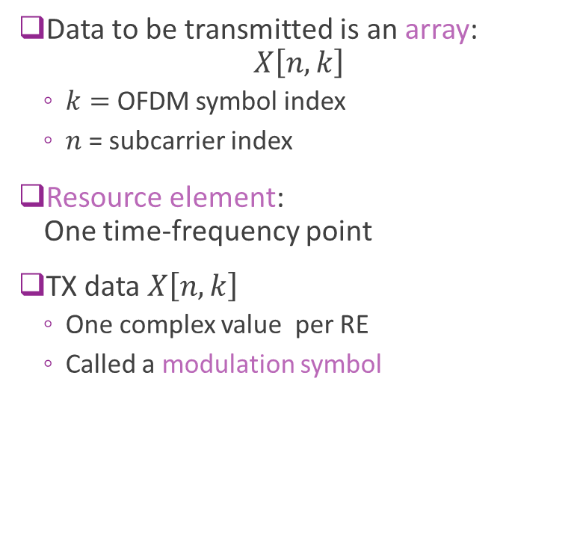
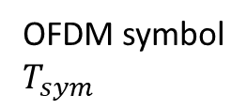
OFDM Time-Frequency Grid
Data to be transmitted is an array: $X\left[n,k\right]$
$k=$ OFDM symbol index
$n$ = subcarrier index
Resource element: One time-frequency point
TX data $X\left[n,k\right]$
One complex value per RE
Called a modulation symbol
Subcarrier space $Δf=\frac{1}{T}$
OFDM symbol $T_{sym}$

Slide 20





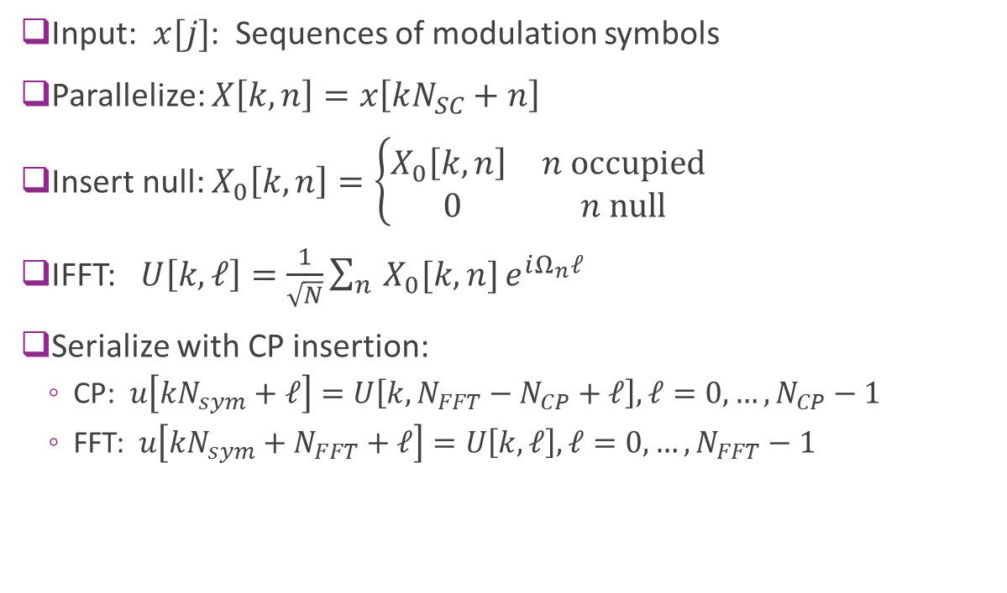






OFDM TX Modulation
Modulation of $L$ OFDM symbols
Input: $x[j]$: Sequences of modulation symbols
Parallelize: $X\left[k,n\right]=x\left[kN_{SC}+n\right]$
Insert null: $X_{0}\left[k,n\right]=\left\{\begin{matrix}X_{0}\left[k,n\right] & n \text{occupied} \\ 0 & n \text{null}\end{matrix}\right.$
IFFT: $U\left[k,ℓ\right]=\frac{1}{\sqrt{N}}\sum_{n}{X_{0}[k,n]}e^{iΩ_{n}ℓ}$
Serialize with CP insertion:
CP: $u\left[kN_{sym}+ℓ\right]=U\left[k,N_{FFT}−N_{CP}+ℓ\right], ℓ=0,…,N_{CP}−1$
FFT: $u\left[kN_{sym}+N_{FFT}+ℓ\right]=U\left[k, ℓ\right], ℓ=0,…,N_{FFT}−1$
$$x[j]$$
$$N_{SC}L$$
$$X[n,k]$$
$$N_{sc}×L$$
$$X_{0}[n,k]$$
$$N_{FFT}×L$$
$$U[k,ℓ]$$
$$N_{FFT}×L$$
$$u[j]$$
$$N_{sym}L$$

Slide 21
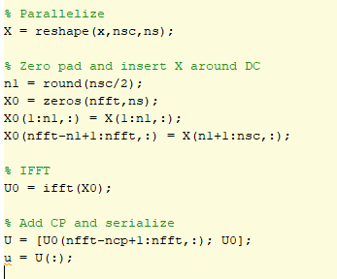

OFDM TX Modulation in MATLAB
Manually performing the operations
Using MATLAB’s built-in function
This is preferable and easier

Slide 22

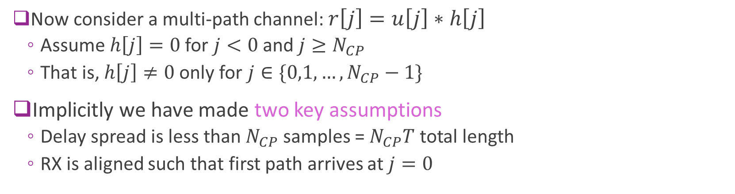

Multipath Channel
Multipath channel
RX OFDM symbol $r[j]$
TX OFDM symbol $u[j]$
Now consider a multi-path channel: $r\left[j\right]=u\left[j\right]∗h\left[j\right]$
Assume $h\left[j\right]=0$ for $j<0$ and $j≥N_{CP}$
That is, $h\left[j\right]≠0$ only for $j∈\{0,1,…,N_{CP}−1\}$
Implicitly we have made two key assumptions
Delay spread is less than $N_{CP}$ samples = $N_{CP}T$ total length
RX is aligned such that first path arrives at $j=0$

Slide 23



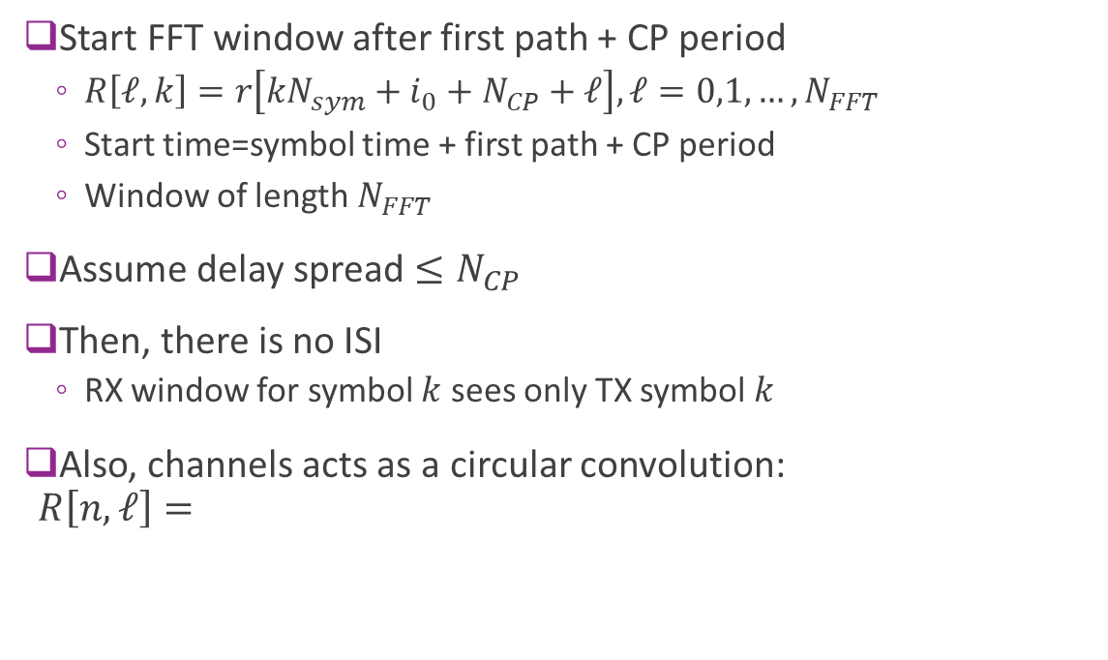





OFDM Receiver
$$U[n,ℓ]$$
Start FFT window after first path + CP period
$R\left[ℓ,k\right]=r\left[kN_{sym}+i_{0}+N_{CP}+ℓ\right], ℓ=0,1,…,N_{FFT}$
Start time=symbol time + first path + CP period
Window of length $N_{FFT}$
Assume delay spread $≤N_{CP}$
Then, there is no ISI
RX window for symbol $k$ sees only TX symbol $k$
Also, channels acts as a circular convolution: $R\left[n,ℓ\right]=$
TX OFDM
$$N_{CP}$$
$$N_{FFT}$$
Delay for first arrival
$$i_{0}$$
$$N_{CP}$$
RX
$R[n,k$]
$$kN_{sym}$$
$$kN_{sym}+i_{0}$$
TX symbol start

Slide 24
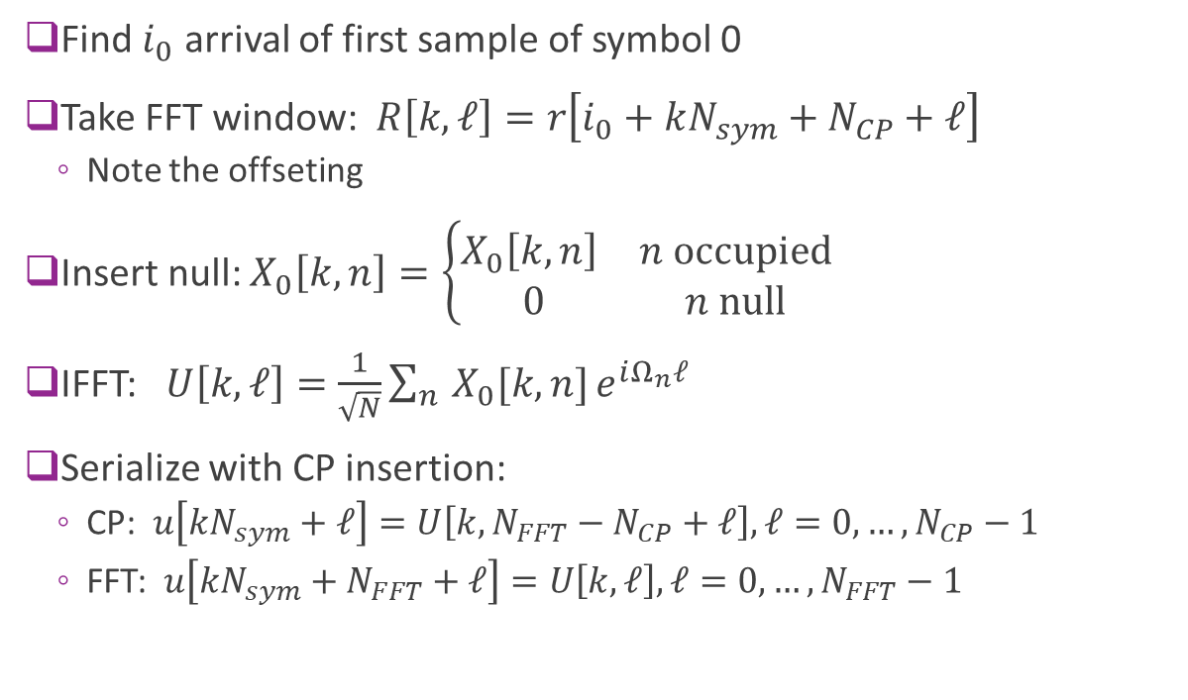
OFDM RX DeModulation
Modulation of $L$ OFDM symbols
Find $i_{0}$ arrival of first sample of symbol 0
Take FFT window: $R\left[k,ℓ\right]=r\left[i_{0}+kN_{sym}+N_{CP}+ℓ\right]$
Note the offseting
Insert null: $X_{0}\left[k,n\right]=\left\{\begin{matrix}X_{0}\left[k,n\right] & n \text{occupied} \\ 0 & n \text{null}\end{matrix}\right.$
IFFT: $U\left[k,ℓ\right]=\frac{1}{\sqrt{N}}\sum_{n}{X_{0}[k,n]}e^{iΩ_{n}ℓ}$
Serialize with CP insertion:
CP: $u\left[kN_{sym}+ℓ\right]=U\left[k,N_{FFT}−N_{CP}+ℓ\right], ℓ=0,…,N_{CP}−1$
FFT: $u\left[kN_{sym}+N_{FFT}+ℓ\right]=U\left[k, ℓ\right], ℓ=0,…,N_{FFT}−1$
$$x[j]$$
$$N_{SC}L$$
$$X[n,k]$$
$$N_{sc}×L$$
$$X_{0}[n,k]$$
$$N_{FFT}×L$$
$$U[k,ℓ]$$
$$N_{FFT}×L$$
$$u[j]$$
$$N_{sym}L$$

Slide 25

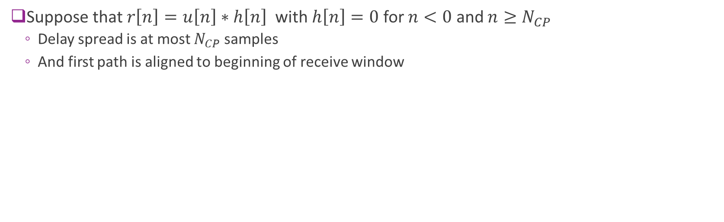


OFDM Over a Multi-Path Channel
Suppose that $r\left[n\right]=u\left[n\right]∗h\left[n\right]$ with $h\left[n\right]=0$ for $n<0$ and $n≥N_{CP}$
Delay spread is at most $N_{CP}$ samples
And first path is aligned to beginning of receive window
TX $u[n]$
RX $r\left[n\right]$
Delayed versions of $u[n]$

Slide 26
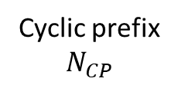
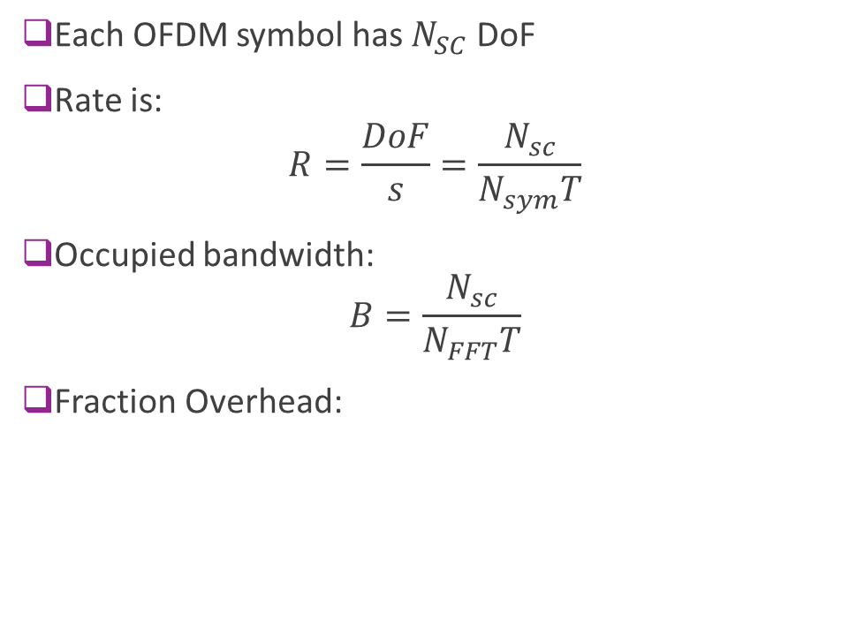
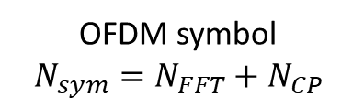
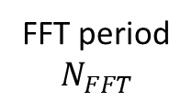
Degrees of Freedom, Overhead
Each OFDM symbol has $N_{SC}$ DoF
Rate is:
$$R=\frac{DoF}{s}=\frac{N_{sc}}{N_{sym}T}$$
Occupied bandwidth: $B=\frac{N_{sc}}{N_{FFT}T}$
Fraction Overhead:
OFDM symbol
$$N_{sym}=N_{FFT}+N_{CP}$$
Cyclic prefix
$$N_{CP}$$
FFT period
$$N_{FFT}$$

Slide 27
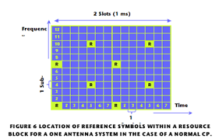
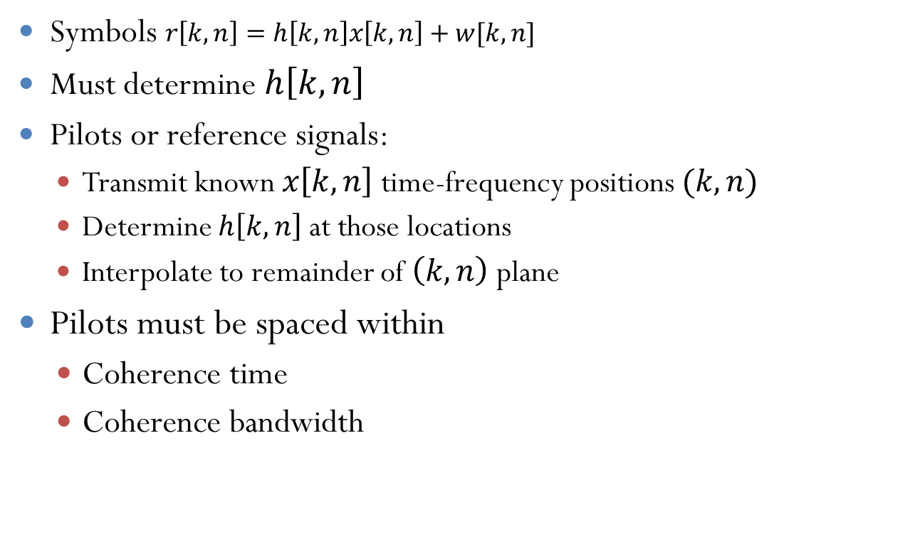
OFDM Channel Estimation
Symbols $r\left[k,n\right]=h\left[k,n\right]x\left[k,n\right]+w[k,n]$
Must determine $h\left[k,n\right]$
Pilots or reference signals:
Transmit known $x\left[k,n\right]$ time-frequency positions $(k,n)$
Determine $h\left[k,n\right]$ at those locations
Interpolate to remainder of $\left(k,n\right)$ plane
Pilots must be spaced within
Coherence time
Coherence bandwidth
LTE reference symbols
(for antenna port 1)

Slide 28
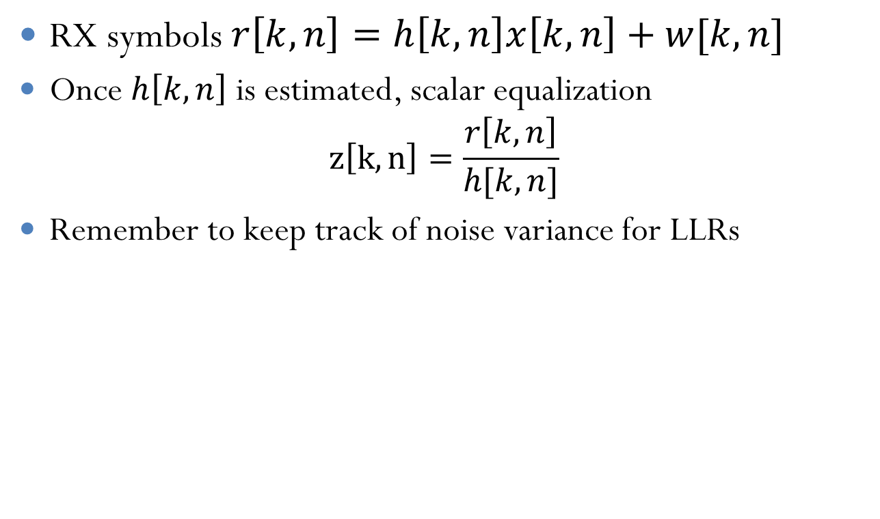
OFDM Demodulation
RX symbols $r\left[k,n\right]=h\left[k,n\right]x\left[k,n\right]+w[k,n]$
Once $h\left[k,n\right]$ is estimated, scalar equalization $z\left[k,n\right]=\frac{r\left[k,n\right]}{h[k,n]}$
Remember to keep track of noise variance for LLRs

Slide 29
History of OFDM
First proposed by Chang, Bell Labs,1966
Many applications:
Early digital TV, LER, Paris 1988
ETSI Digital Audio Broadcast, 1995
ETSI Digital Video Broadcast, DVB-T, 1997
DSL, 1998
Wireless LANs:
802.11a, 1999 and 802.11g, 2002
802.11n, 2004
Fourth Generation Cellular standards
Flash-OFDM, 2001
WiMax, 2004
LTE, adopted OFDM in 2005

Slide 30
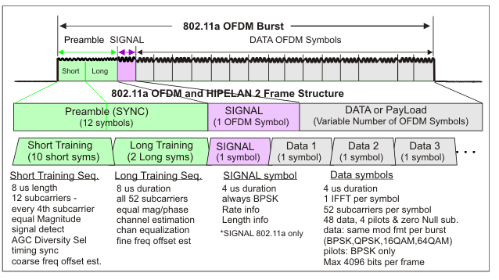
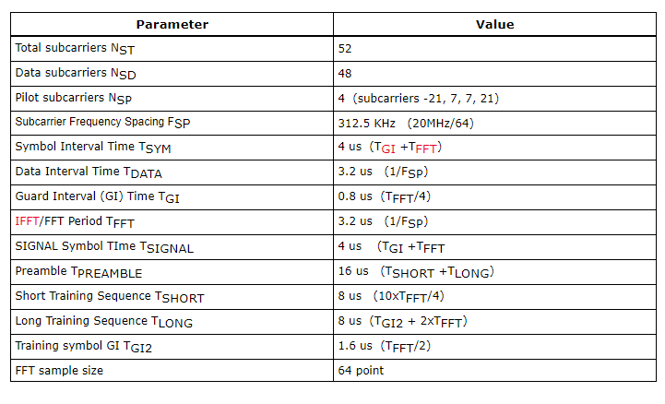
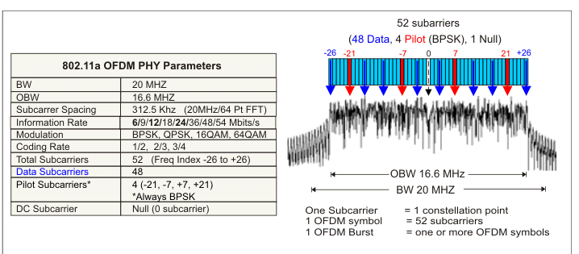
Ex: 802.11a/g OFDM
STF: For detection, AGC
2 OFDM symbols for initial channel estimate
4 pilots in remainder of symbols for tracking

Slide 31
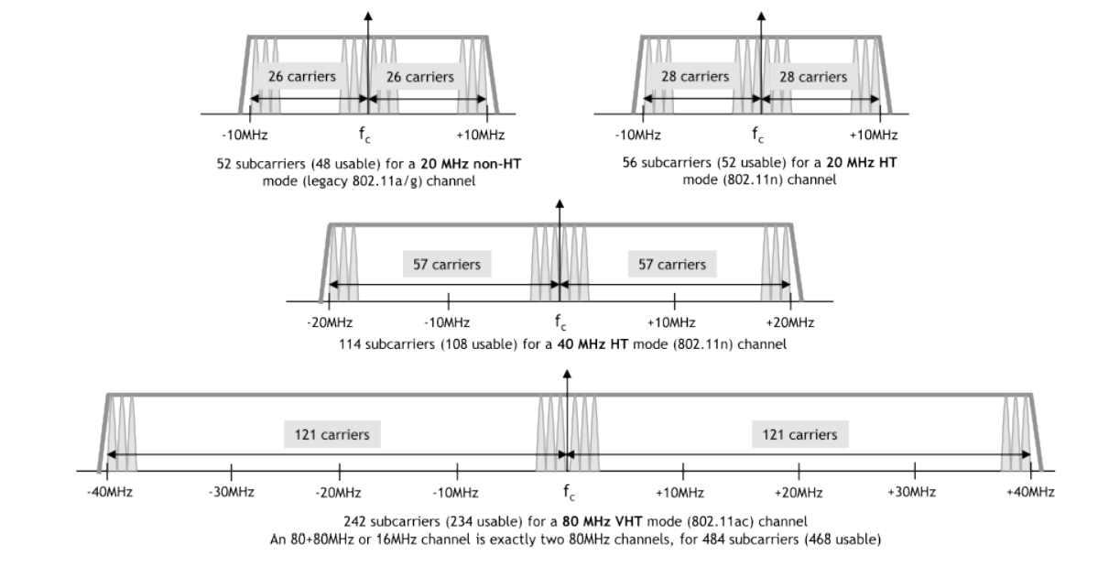
High Throughput 802.11n and 802.11ac
Increase bandwidth by using more subcarriers
Subcarrier spacing and CP length are identical

Slide 32
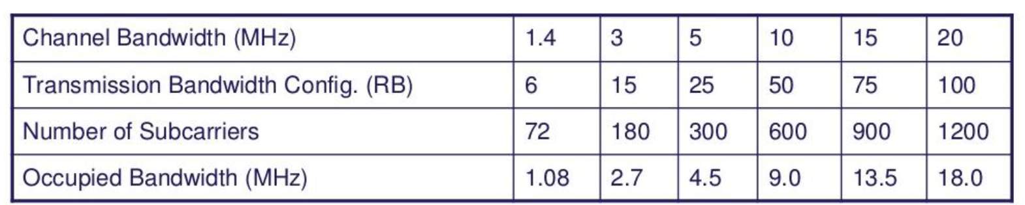
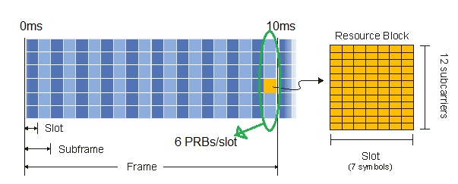
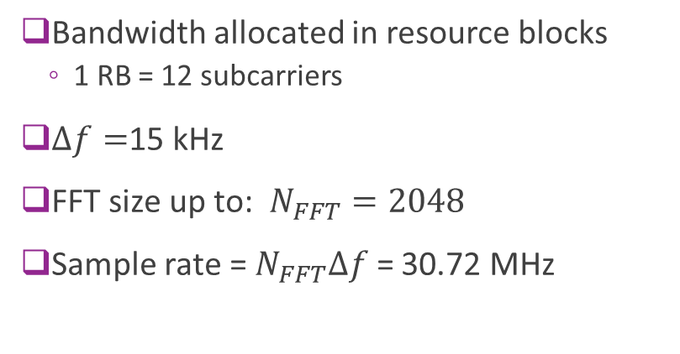
4G LTE
Bandwidth allocated in resource blocks
1 RB = 12 subcarriers
$Δf=$15 kHz
FFT size up to: $N_{FFT}=2048$
Sample rate = $N_{FFT}Δf$ = 30.72 MHz

Slide 33
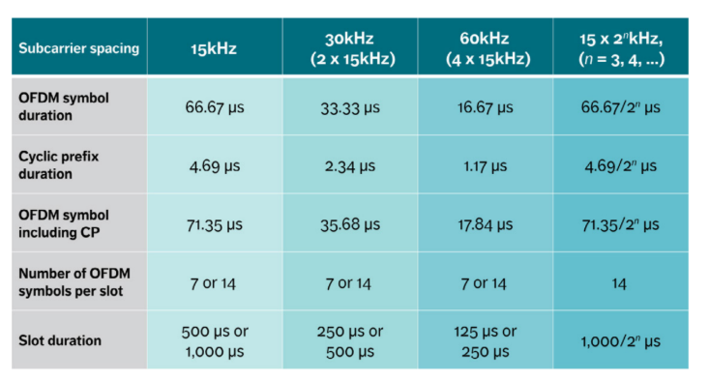
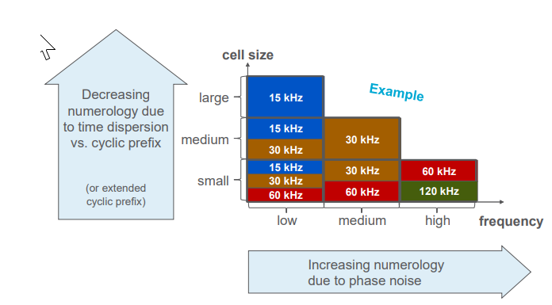
5G NR OFDM
Flexible numerology
Supports different cell sizes and latency / granularity

Slide 34
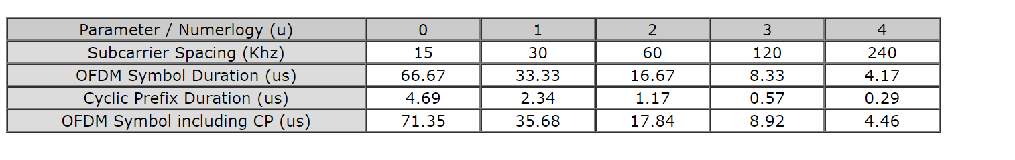
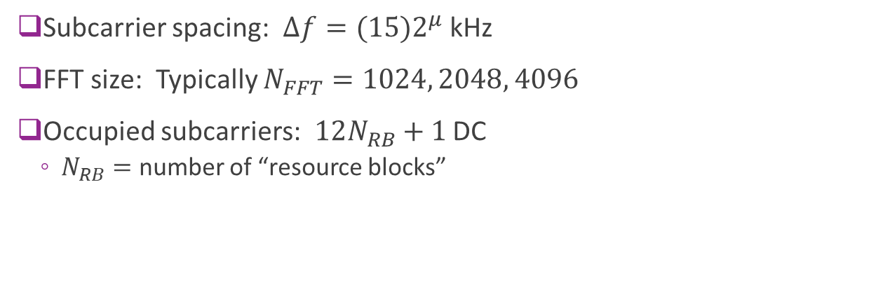
5G NR OFDM Details
Subcarrier spacing: $Δf=(15)2^{μ}$ kHz
FFT size: Typically $N_{FFT}=1024, 2048, 4096$
Occupied subcarriers: $12N_{RB}+1$ DC
$N_{RB}=$ number of “resource blocks”

Slide 35
Outline
What is Equalization?
Time-Domain Equalization for Single Carrier Systems
OFDM
OFDM Channel Estimation

Slide 36

OFDM Channel Estimation Problem
Receive: $r\left[n,k\right]=h\left[n,k\right]u\left[n,k\right]+w\left[n,k\right]$
Know

Slide 37
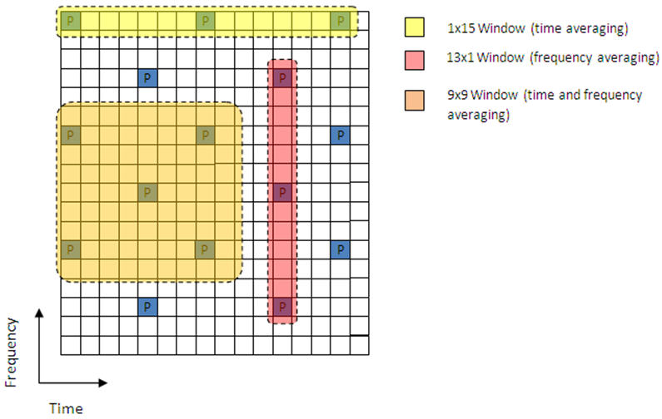
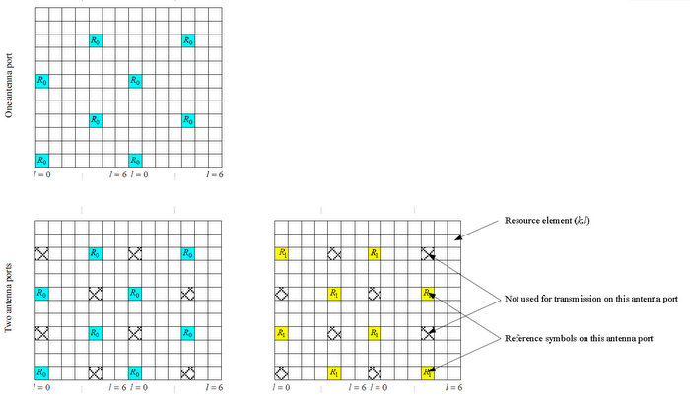
Ex: LTE Pilots
Can average in time or frequency
Pilots (Cell Reference signals) in one RB

