Slide 1
Unit 8: Equalization
EL-GY 6013: Digital communications
Prof. Sundeep rangan

Slide 2
Learning Objectives
Describe the equalization problem
Implement and simulate a OFDM transmitter and receiver
Describe an OFDM channel
Implement a simple OFDM channel estimator via smoothing
Implement the symbol equalization
Simulate an end-to-end OFDM system

Slide 3
This Unit
Channel coding
Symbol mapping
TX filter DAC
Upconversion
Info bits
Coded bits
IQ symbols
Analog baseband
RF
Passband
Channel
Sync
“Noise”
Channel decoding
Symbol demod
Equalization
RX filter and ADC
Down-conversion

Slide 4
Outline
What is Equalization?
Time-Domain Equalization for Single Carrier Systems
OFDM
OFDM Channel Estimation, a preview…

Slide 5
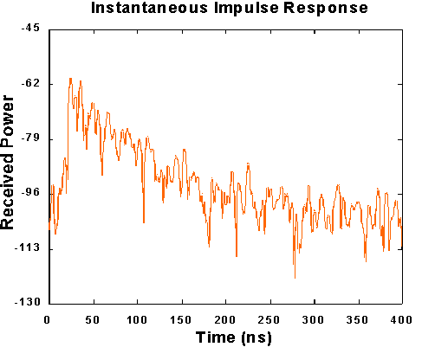
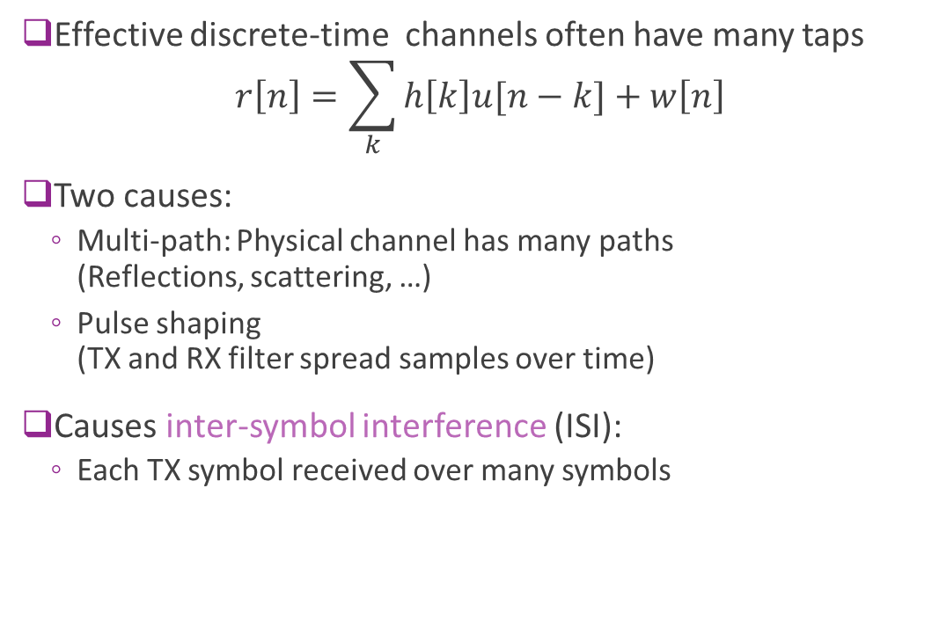
Multi-Path and ISI
Effective discrete-time channels often have many taps $r\left[n\right]=\sum_{k}{h\left[k\right]u[n−k]}+w\left[n\right]$
Two causes:
Multi-path: Physical channel has many paths (Reflections, scattering, …)
Pulse shaping (TX and RX filter spread samples over time)
Causes inter-symbol interference (ISI):
Each TX symbol received over many symbols
Multi-path indoor channel measured at UC Berkeley

Slide 6
Equalization
Equalization: Any method to overcome ISI
This lecture we look at two main methods
Time-domain equalization
Used in single carrier systems
Frequency-domain equalization
Used in OFDM systems

Slide 7


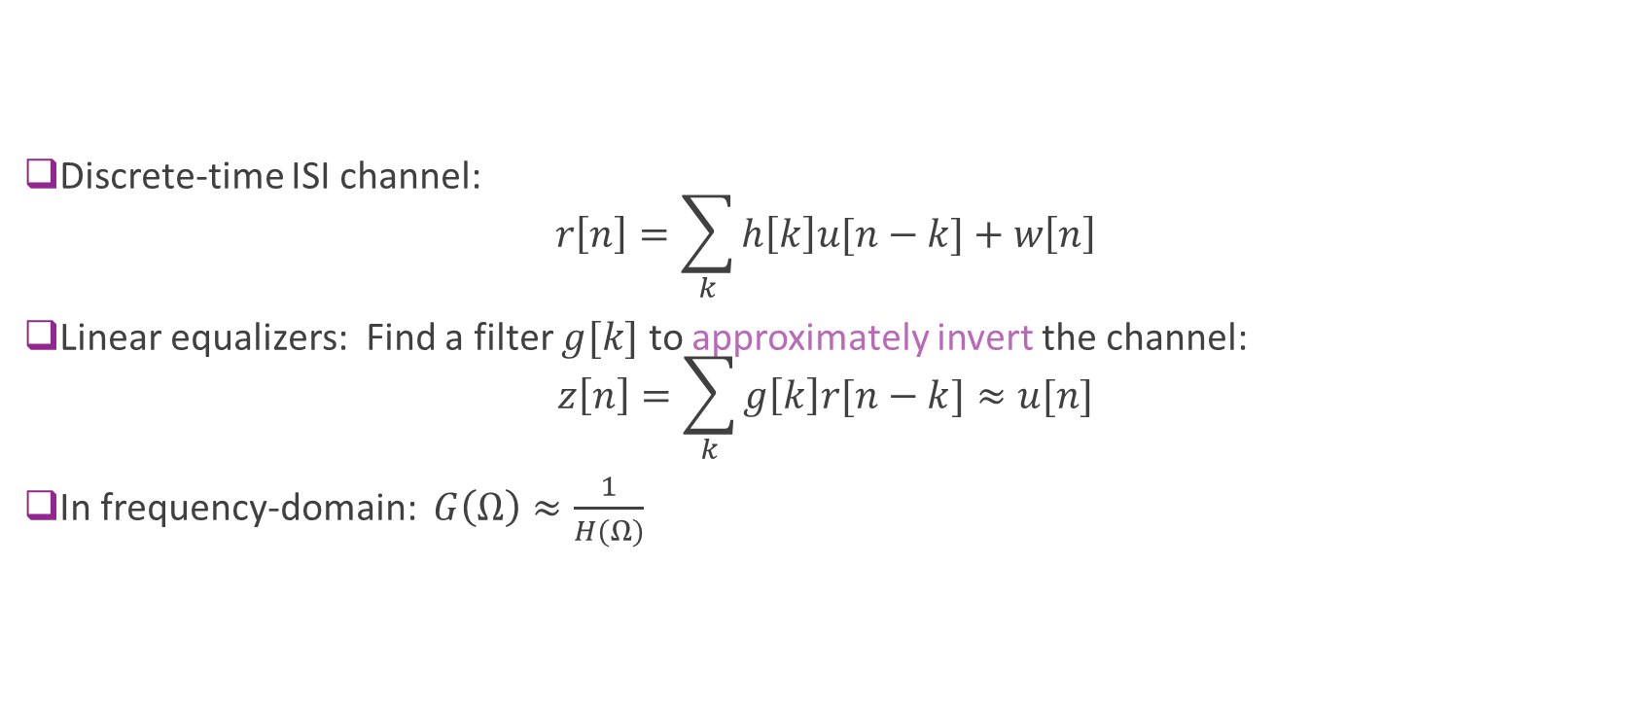



Linear Equalization
$$r[n]$$
$$u[n]$$
h$[n]$
g$[n]$
$$z\left[n\right]≈u[n]$$
ISI channel
Equalization
Discrete-time ISI channel: $r\left[n\right]=\sum_{k}{h\left[k\right]u[n−k]}+w\left[n\right]$
Linear equalizers: Find a filter $g[k]$ to approximately invert the channel: $z\left[n\right]=\sum_{k}{g\left[k\right]r[n−k]}≈u[n]$
In frequency-domain: $G\left(Ω\right)≈\frac{1}{H(Ω)}$

Slide 8

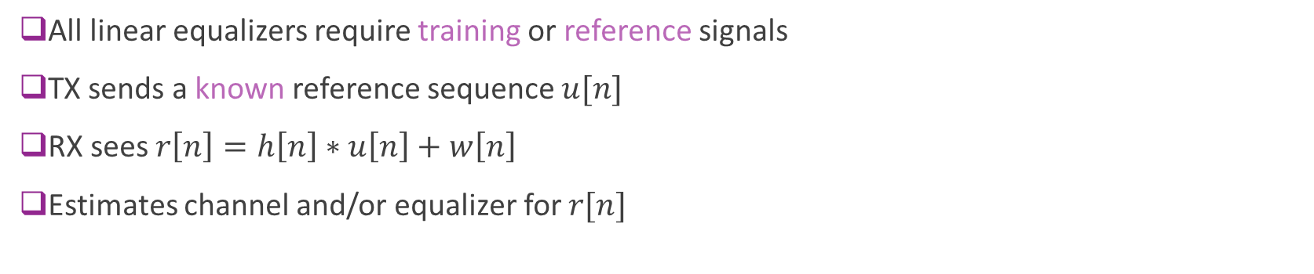
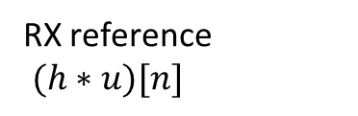
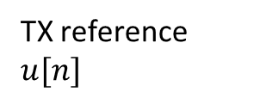

Training Symbols
TX reference $u[n]$
RX reference $(h∗u)[n]$
h$[n]$
$$g[n]$$
ISI channel
Equalizer estimator
All linear equalizers require training or reference signals
TX sends a known reference sequence $u[n]$
RX sees $r\left[n\right]=h\left[n\right]∗u\left[n\right]+w\left[n\right]$
Estimates channel and/or equalizer for $r[n]$

Slide 9
Outline
What is Equalization?
Time-Domain Equalization for Single Carrier Systems
OFDM
OFDM Channel Estimation, a preview…

Slide 10
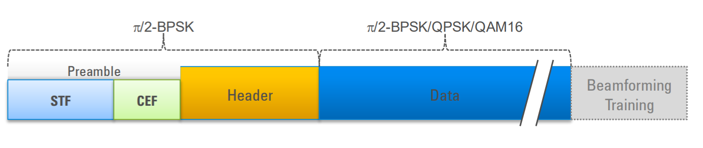
802.11 ad Preamble for 60 GHz WiFi
Apply equalizer
STF: Short training field
AGC, detection of packet
coarse estimate of timing
Process as previous lecture
CEF: Channel estimation field
Train equalizer

Slide 11
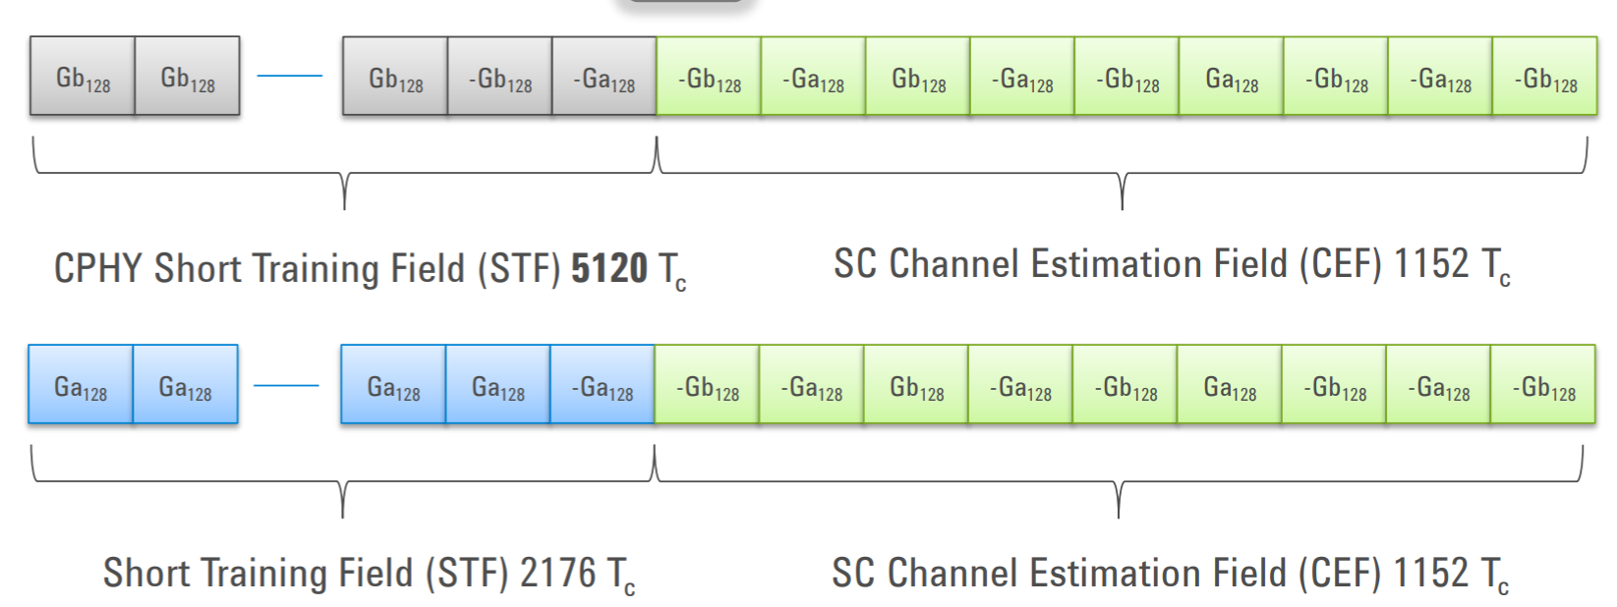
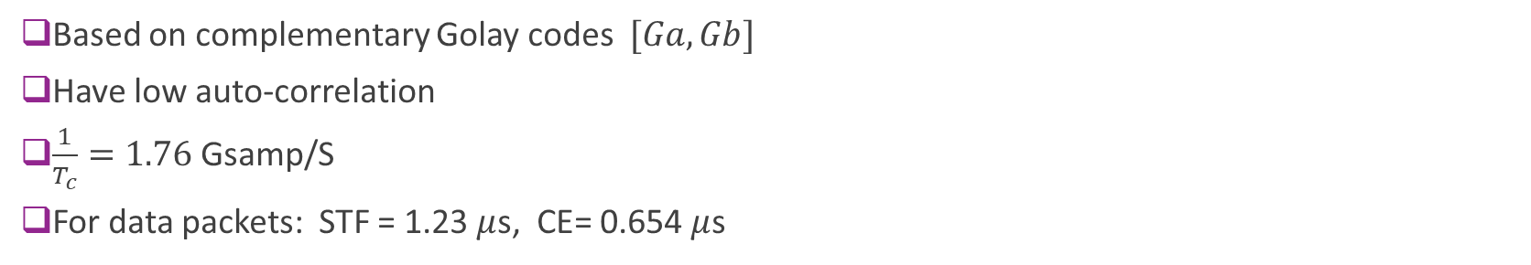
802.11ad Preamble Details
Control packets
Longer STF.
Need to be decoded by all stations. No directional gain
Data packets
Shorter STF
Based on complementary Golay codes $[Ga, Gb]$
Have low auto-correlation
$\frac{1}{T_{c}}=1.76$Gsamp/S
For data packets: STF = 1.23 $μ$s, CE= 0.654 $μ$s

Slide 12
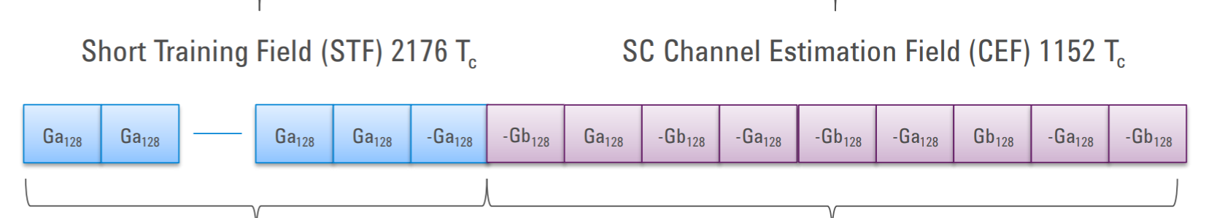
STF Detection
MF detector: Correlate with STF
Gives good performance but expensive
Simpler delay detector

Slide 13
Estimation from the CEF
Known sequence
Linear estimation problem

Slide 14
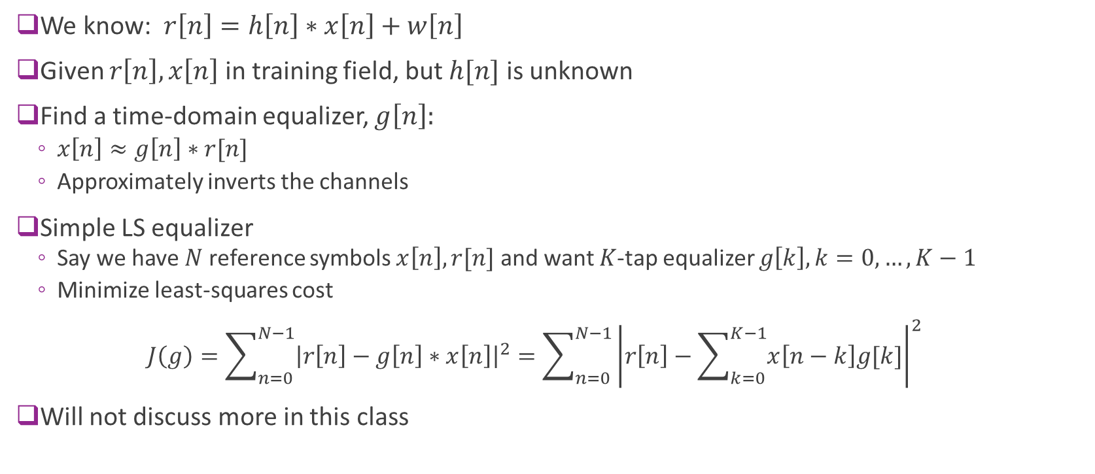
Linear Estimation
We know: $r\left[n\right]=h\left[n\right]∗x\left[n\right]+w\left[n\right]$
Given $r\left[n\right],x\left[n\right]$ in training field, but $h[n]$ is unknown
Find a time-domain equalizer, $g\left[n\right]:$
$x\left[n\right]≈g\left[n\right]∗r[n]$
Approximately inverts the channels
Simple LS equalizer
Say we have $N$ reference symbols $x\left[n\right], r[n]$ and want $K$-tap equalizer $g\left[k\right], k=0,…,K−1$
Minimize least-squares cost $J\left(g\right)=\sum_{n=0}^{N−1}{{\left|r\left[n\right]−g\left[n\right]∗x\left[n\right]\right|}^{2}}=\sum_{n=0}^{N−1}{{\left|r\left[n\right]−\sum_{k=0}^{K−1}{x\left[n−k\right]g[k]}\right|}^{2}}$
Will not discuss more in this class

Slide 15
Outline
What is Equalization?
Time-Domain Equalization for Single Carrier Systems
OFDM
OFDM Channel Estimation, a preview…

Slide 16

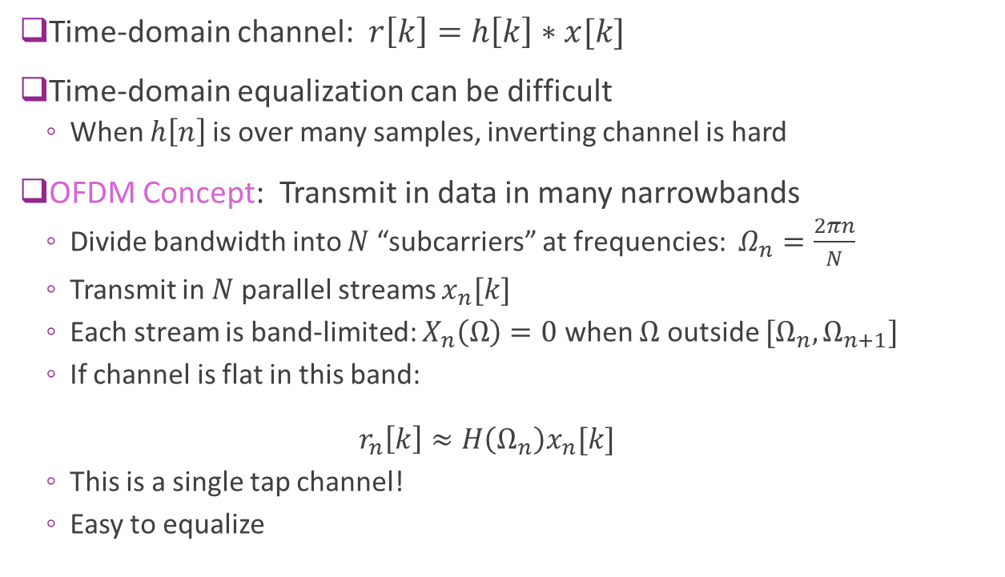


OFDM
Time-domain channel: $r\left[k\right]=h\left[k\right]∗x[k]$
Time-domain equalization can be difficult
When $h\left[n\right]$is over many samples, inverting channel is hard
OFDM Concept: Transmit in data in many narrowbands
Divide bandwidth into $N$ “subcarriers” at frequencies: $Ω_{n}=\frac{2πn}{N}$
Transmit in $N$ parallel streams $x_{n}[k]$
Each stream is band-limited: $X_{n}\left(Ω\right)=0$ when $Ω$ outside $[Ω_{n},Ω_{n+1}]$
If channel is flat in this band: $r_{n}\left[k\right]≈H\left(Ω_{n}\right)x_{n}[k]$
This is a single tap channel!
Easy to equalize
$$H(Ω)$$
$$\frac{2π}{N}$$
$$Ω$$

Slide 17
History of OFDM
First proposed by Chang, Bell Labs,1966
Early applications in digital broadcast and DSL (for home Internet)
Early digital TV, LER, Paris 1988
ETSI Digital Audio Broadcast, 1995, ETSI Digital Video Broadcast, DVB-T, 1997, DSL, 1998
Wireless LANs:
802.11a, 1999 and 802.11g, 2002
802.11n, 2004 and many future standards (but not 802.11ad)
Cellular standards
Early cellular standards Flash-OFDM, 2001 and WiMax, 2004
LTE, adopted OFDM in 2005
5G NR

Slide 18


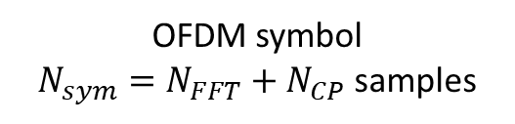

OFDM Symbol Structure in Time-Domain
Time is divided into OFDM symbols
Each symbol divided into samples
$\frac{1}{T}$= sample rate
Each symbol has:
FFT period, $N_{FFT}$ samples
CP period, $N_{CP}$ samples
$N_{FFT}$ = number samples in FFT period
$N_{CP}$ = number samples in cyclic prefix
$N_{sym}=N_{FFT}+N_{CP}=$ samples per symbol
$T_{sym}=TN_{sym}=$symbol period
OFDM symbol
$N_{sym}=N_{FFT}+N_{CP}$ samples
Cyclic prefix
$$N_{CP}$$
FFT period
$$N_{FFT}$$

Slide 19
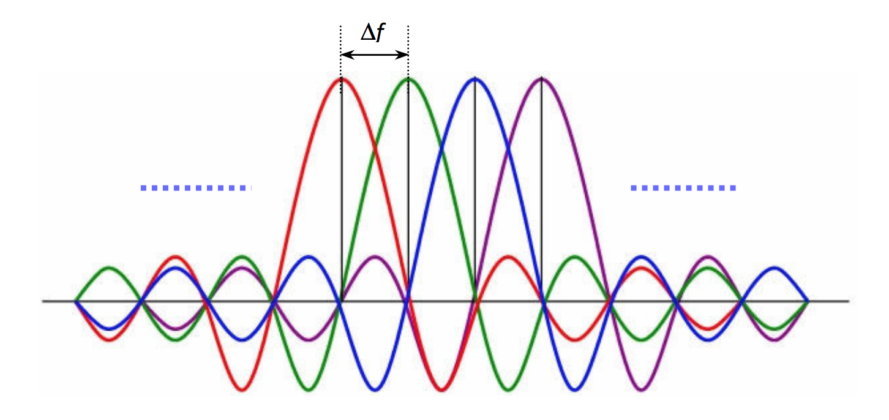
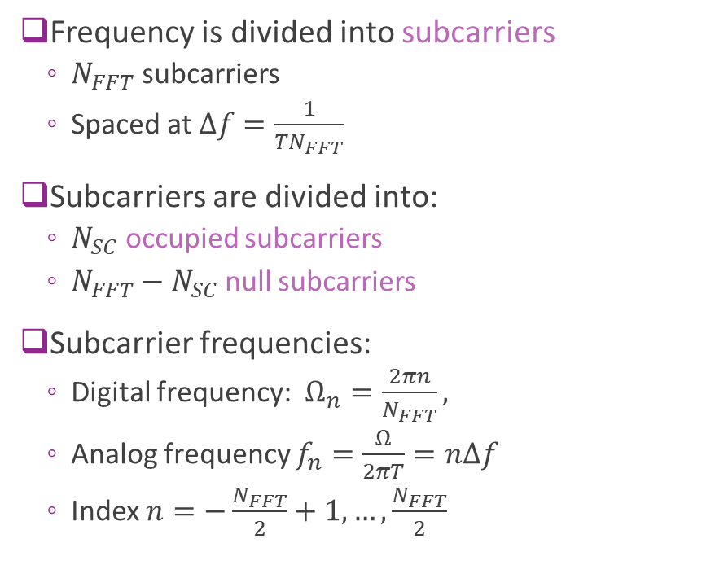
OFDM in Frequency Domain
Frequency is divided into subcarriers
$N_{FFT}$ subcarriers
Spaced at $Δf=\frac{1}{TN_{FFT}}$
Subcarriers are divided into:
$N_{SC}$ occupied subcarriers
$N_{FFT}−N_{SC}$ null subcarriers
Subcarrier frequencies:
Digital frequency: $Ω_{n}=\frac{2πn}{N_{FFT}},$
Analog frequency $f_{n}=\frac{Ω}{2πT}=nΔf$
Index $n=−\frac{N_{FFT}}{2}+1,…,\frac{N_{FFT}}{2}$

Slide 20
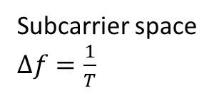
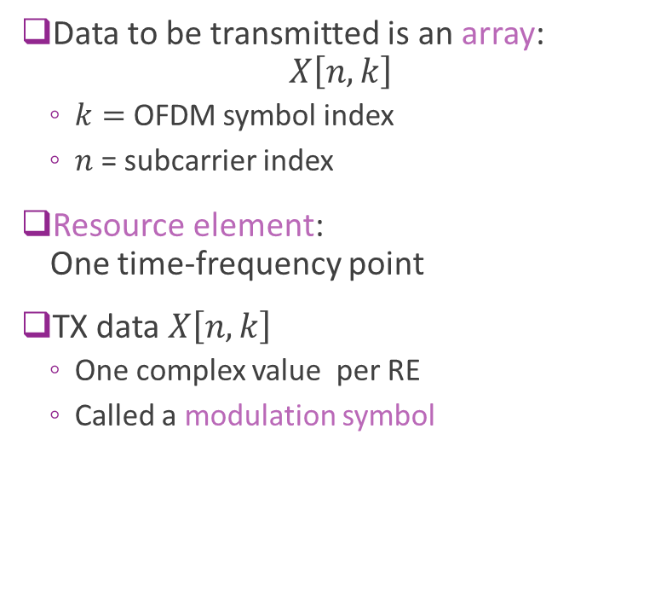
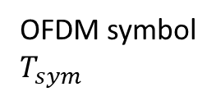
OFDM Time-Frequency Grid
Data to be transmitted is an array: $X\left[n,k\right]$
$k=$ OFDM symbol index
$n$ = subcarrier index
Resource element: One time-frequency point
TX data $X\left[n,k\right]$
One complex value per RE
Called a modulation symbol
Subcarrier space $Δf=\frac{1}{T}$
OFDM symbol $T_{sym}$

Slide 21





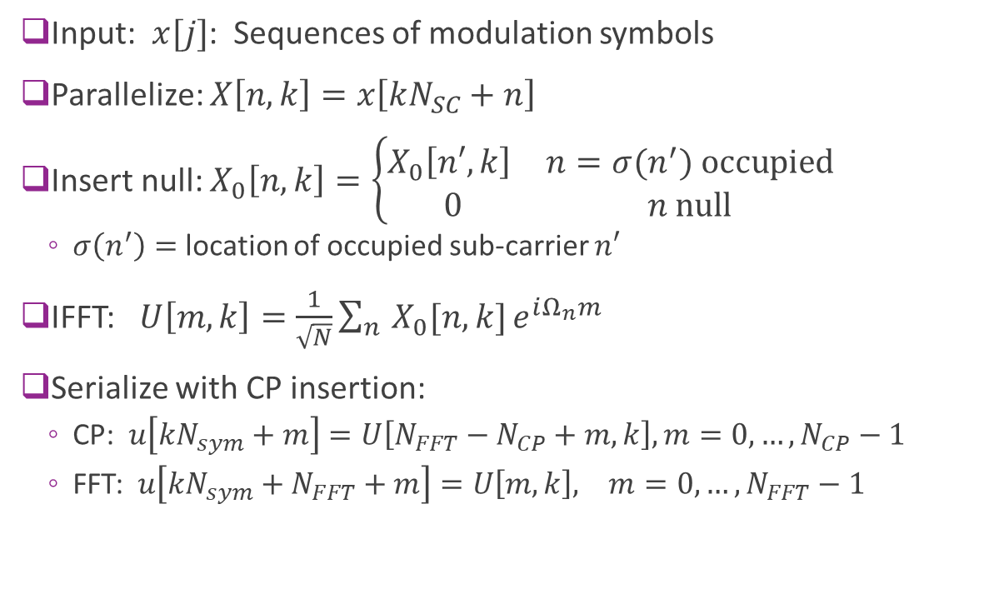






OFDM TX Modulation
Modulation of $L$ OFDM symbols
Input: $x[j]$: Sequences of modulation symbols
Parallelize: $X\left[n,k\right]=x\left[kN_{SC}+n\right]$
Insert null: $X_{0}\left[n,k\right]=\left\{\begin{matrix}X_{0}\left[n′,k\right] & n=σ(n^{′}) \text{occupied} \\ 0 & n \text{null}\end{matrix}\right.$
$σ\left(n^{′}\right)=$ location of occupied sub-carrier $n′$
IFFT: $U\left[m,k\right]=\frac{1}{\sqrt{N}}\sum_{n}{X_{0}[n,k]}e^{iΩ_{n}m}$
Serialize with CP insertion:
CP: $u\left[kN_{sym}+m\right]=U\left[N_{FFT}−N_{CP}+m,k\right], m=0,…,N_{CP}−1$
FFT: $u\left[kN_{sym}+N_{FFT}+m\right]=U\left[m,k\right], m=0,…,N_{FFT}−1$
$$x[j]$$
$$N_{SC}L$$
$$X[n,k]$$
$$N_{sc}×L$$
$$X_{0}[n,k]$$
$$N_{FFT}×L$$
$$U[m,ℓ]$$
$$N_{FFT}×L$$
$$u[j]$$
$$N_{sym}L$$

Slide 22
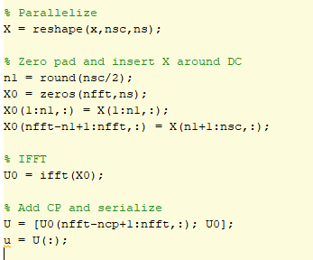

OFDM TX Modulation in MATLAB
Manually performing the operations
Using MATLAB’s built-in function
This is preferable and easier

Slide 23

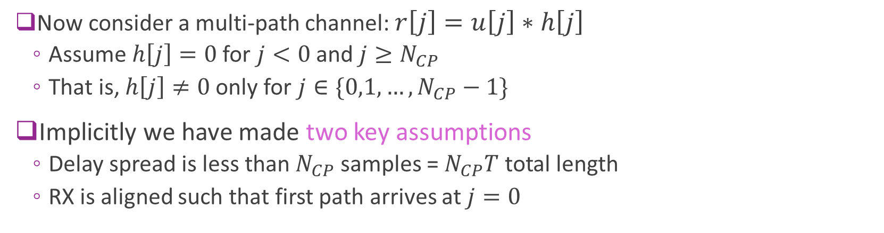

Multipath Channel
Multipath channel
RX OFDM symbol $r[j]$
TX OFDM symbol $u[j]$
Now consider a multi-path channel: $r\left[j\right]=u\left[j\right]∗h\left[j\right]$
Assume $h\left[j\right]=0$ for $j<0$ and $j≥N_{CP}$
That is, $h\left[j\right]≠0$ only for $j∈\{0,1,…,N_{CP}−1\}$
Implicitly we have made two key assumptions
Delay spread is less than $N_{CP}$ samples = $N_{CP}T$ total length
RX is aligned such that first path arrives at $j=0$

Slide 24



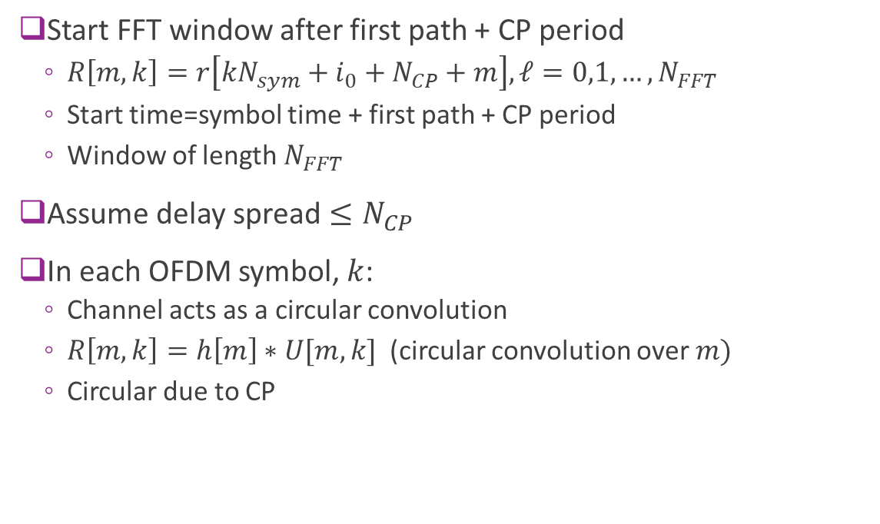




Circular Convolution
$$U[m,k]$$
Start FFT window after first path + CP period
$R\left[m,k\right]=r\left[kN_{sym}+i_{0}+N_{CP}+m\right], ℓ=0,1,…,N_{FFT}$
Start time=symbol time + first path + CP period
Window of length $N_{FFT}$
Assume delay spread $≤N_{CP}$
In each OFDM symbol, $k$:
Channel acts as a circular convolution
$R\left[m,k\right]=h\left[m\right]∗U[m,k]$ (circular convolution over $m)$
Circular due to CP
TX OFDM
$$N_{CP}$$
Delay for first arrival
$$i_{0}$$
$$N_{CP}$$
RX
$R[n,k$]
$$kN_{sym}$$
$$kN_{sym}+i_{0}$$
TX symbol start

Slide 25

Frequency Domain
$$U[m,k]$$
Up to now:
In each OFDM symbol, $k$:
Channel acts as a circular convolution
$R\left[m,k\right]=h\left[m\right]∗U[m,k]$ (circular convolution over $m)$
Circular due to CP
TX OFDM
$$N_{CP}$$
Delay for first arrival
$$i_{0}$$
$$N_{CP}$$
RX
$R[n,k$]
$$kN_{sym}$$
$$kN_{sym}+i_{0}$$
TX symbol start

Slide 26

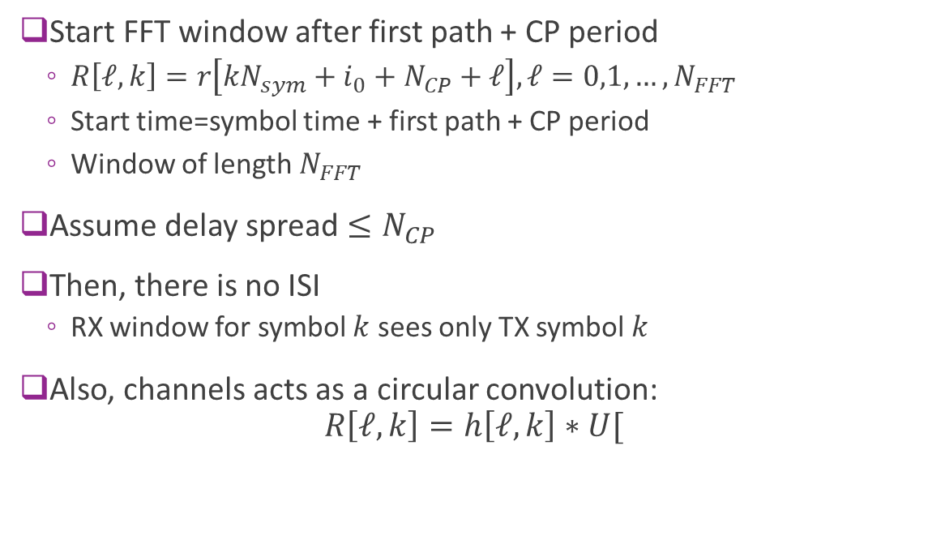

OFDM Receiver
$$U[n,ℓ]$$
Start FFT window after first path + CP period
$R\left[ℓ,k\right]=r\left[kN_{sym}+i_{0}+N_{CP}+ℓ\right], ℓ=0,1,…,N_{FFT}$
Start time=symbol time + first path + CP period
Window of length $N_{FFT}$
Assume delay spread $≤N_{CP}$
Then, there is no ISI
RX window for symbol $k$ sees only TX symbol $k$
Also, channels acts as a circular convolution: $R\left[ℓ,k\right]=h\left[ℓ,k\right]∗U[$
TX OFDM
$$N_{CP}$$
$$N_{FFT}$$
Delay for first arrival
$$i_{0}$$
$$N_{CP}$$
RX
$R[n,k$]
$$kN_{sym}$$
$$kN_{sym}+i_{0}$$
TX symbol start

Slide 27





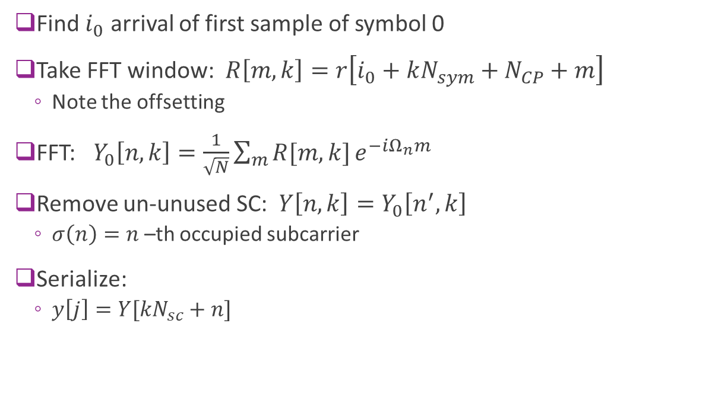





OFDM RX DeModulation
DeMod of $L$ OFDM symbols
Find $i_{0}$ arrival of first sample of symbol 0
Take FFT window: $R\left[m,k\right]=r\left[i_{0}+kN_{sym}+N_{CP}+m\right]$
Note the offsetting
FFT: $Y_{0}\left[n,k\right]=\frac{1}{\sqrt{N}}\sum_{m}{R[m,k]}e^{−iΩ_{n}m}$
Remove un-unused SC: $Y\left[n,k\right]=Y_{0}\left[n^{′},k\right]$
$σ\left(n\right)=n$ –th occupied subcarrier
Serialize:
$y\left[j\right]=Y[kN_{sc}+n]$
$$r[j]$$
$$N_{sym}L$$
$$R[m,k]$$
$$N_{FFT}×L$$
$$Y_{0}[n,k]$$
$$N_{FFT}×L$$
$$N_{sc}×L$$
$$Y[k,ℓ]$$
$$N_{SC}L$$
$$y[j]$$

Slide 28

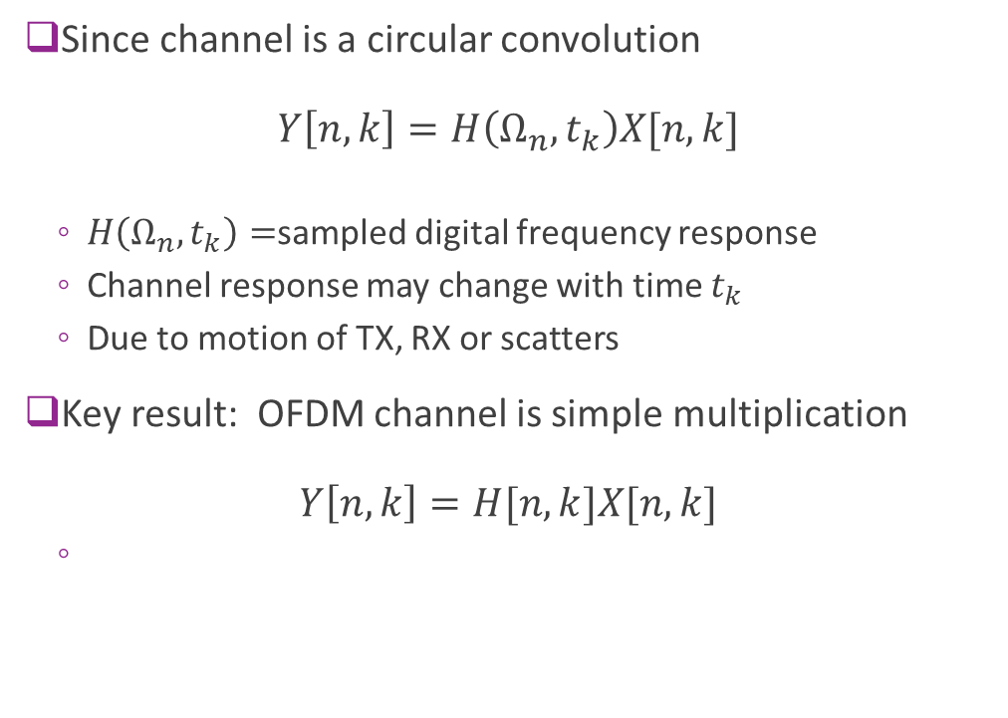



OFDM Channel as Multiplication
Since channel is a circular convolution $Y\left[n,k\right]=H\left(Ω_{n},t_{k}\right)X[n,k]$
$H\left(Ω_{n},t_{k}\right)=$sampled digital frequency response
Channel response may change with time $t_{k}$
Due to motion of TX, RX or scatters
Key result: OFDM channel is simple multiplication $Y\left[n,k\right]=H[n,k]X[n,k]$
$$X[n,k]$$
Zero pad & IFFT
$$U[m,k]$$
Circular convolution
$$R[m,k]$$
FFT & extract occupied sub-carriers
RX symbols
Channel
TX symbols
$$Y[k,ℓ]$$

Slide 29
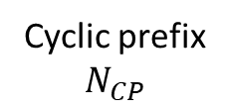
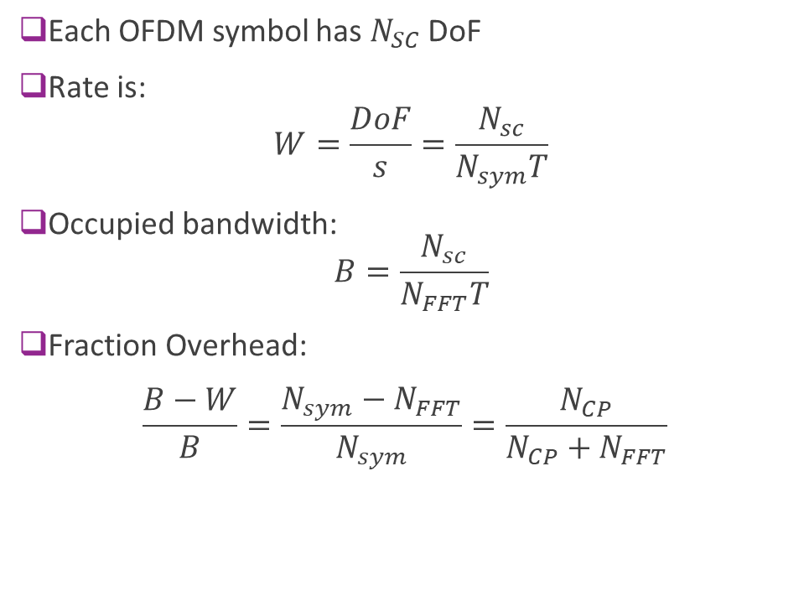
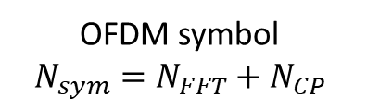
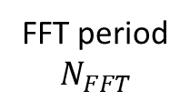
Degrees of Freedom and Overhead
Each OFDM symbol has $N_{SC}$ DoF
Rate is:
$$W=\frac{DoF}{s}=\frac{N_{sc}}{N_{sym}T}$$
Occupied bandwidth: $B=\frac{N_{sc}}{N_{FFT}T}$
Fraction Overhead: $\frac{B−W}{B}=\frac{N_{sym}−N_{FFT}}{N_{sym}}=\frac{N_{CP}}{N_{CP}+N_{FFT}}$
OFDM symbol
$$N_{sym}=N_{FFT}+N_{CP}$$
Cyclic prefix
$$N_{CP}$$
FFT period
$$N_{FFT}$$

Slide 30
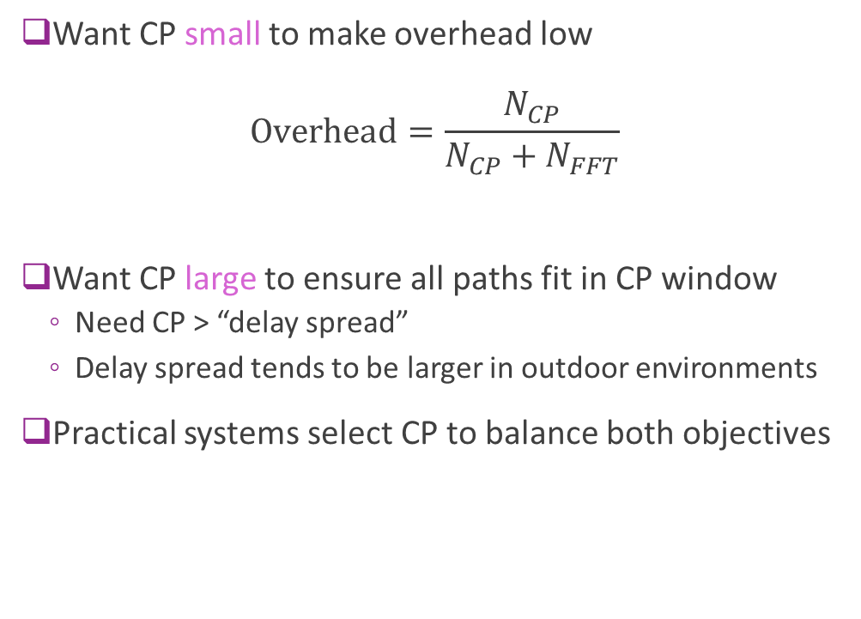
CP Selection
Want CP small to make overhead low $Overhead=\frac{N_{CP}}{N_{CP}+N_{FFT}}$
Want CP large to ensure all paths fit in CP window
Need CP > “delay spread”
Delay spread tends to be larger in outdoor environments
Practical systems select CP to balance both objectives
OFDM symbol
$$N_{sym}=N_{FFT}+N_{CP}$$
Cyclic prefix
$$N_{CP}$$
FFT period
$$N_{FFT}$$

Slide 31
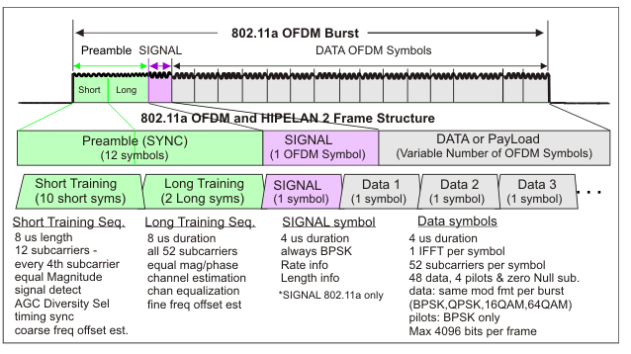
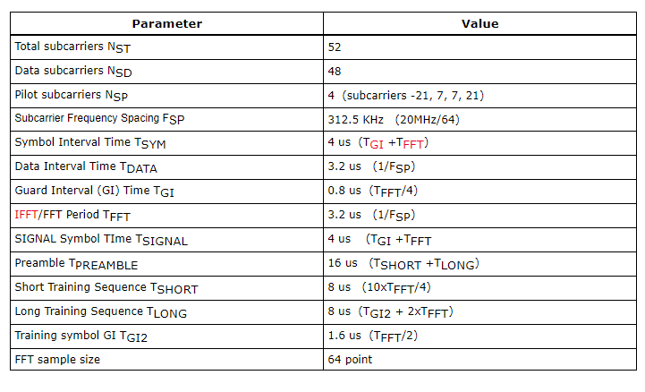
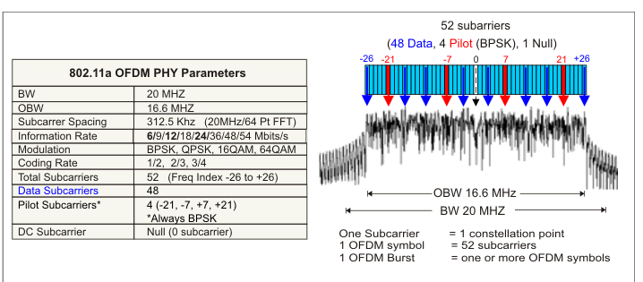
Ex: 802.11a/g OFDM
STF: For detection, AGC
2 OFDM symbols for initial channel estimate
4 pilots in remainder of symbols for tracking

Slide 32
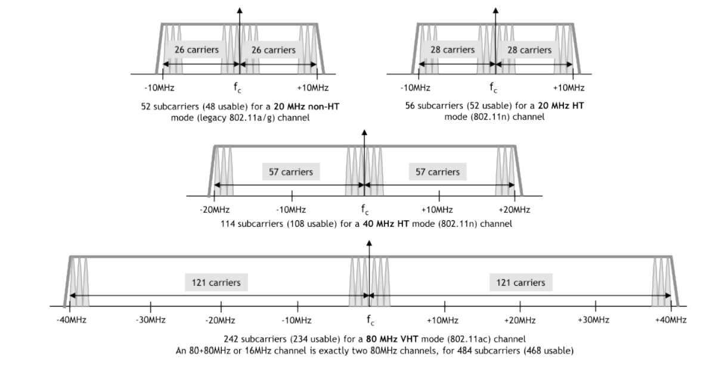
High Throughput 802.11n and 802.11ac
Increase bandwidth by using more subcarriers
Subcarrier spacing and CP length are identical

Slide 33
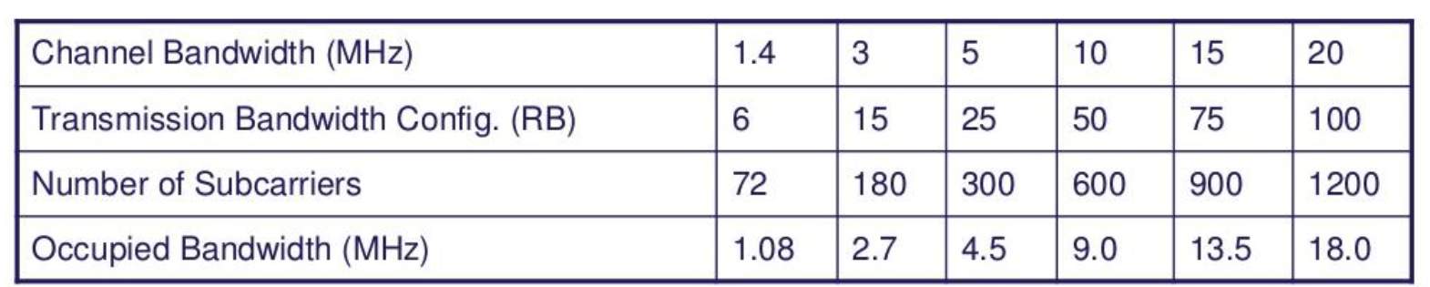
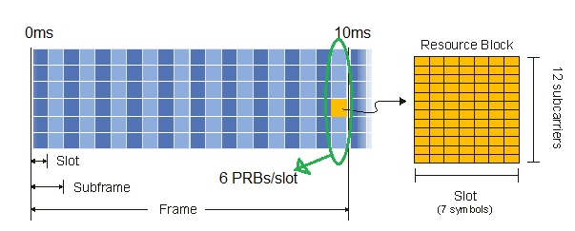
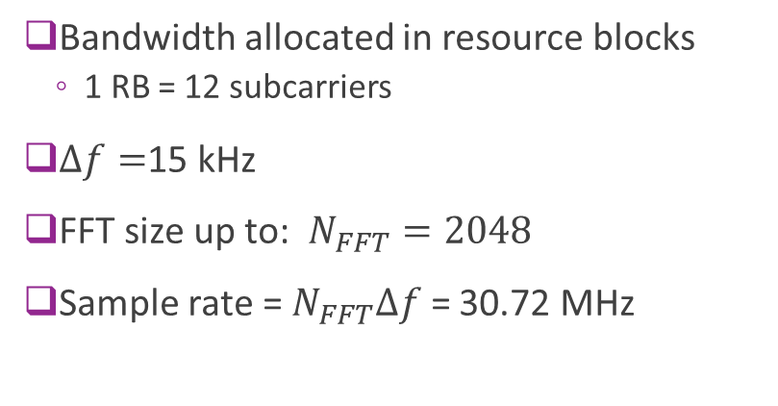
4G LTE
Bandwidth allocated in resource blocks
1 RB = 12 subcarriers
$Δf=$15 kHz
FFT size up to: $N_{FFT}=2048$
Sample rate = $N_{FFT}Δf$ = 30.72 MHz

Slide 34
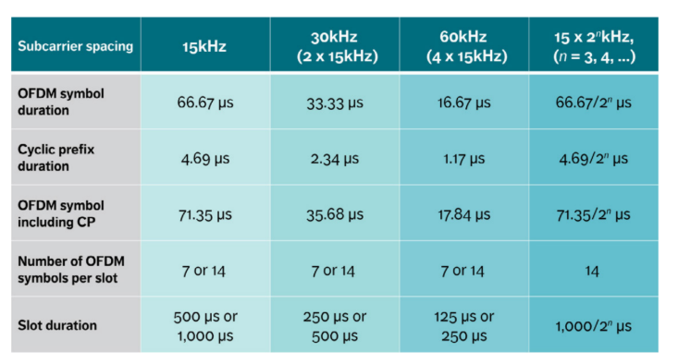
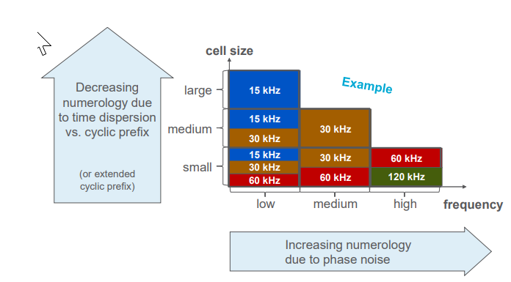
5G NR OFDM
Flexible numerology
Supports different cell sizes and latency / granularity

Slide 35
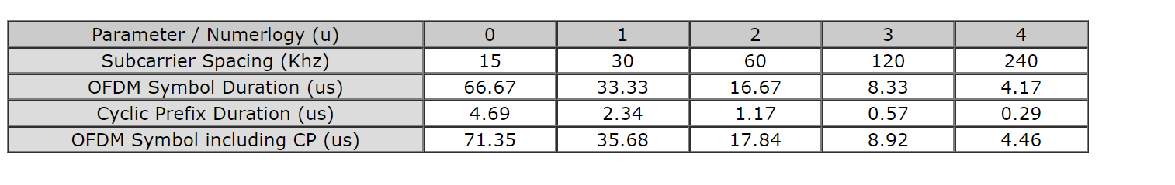
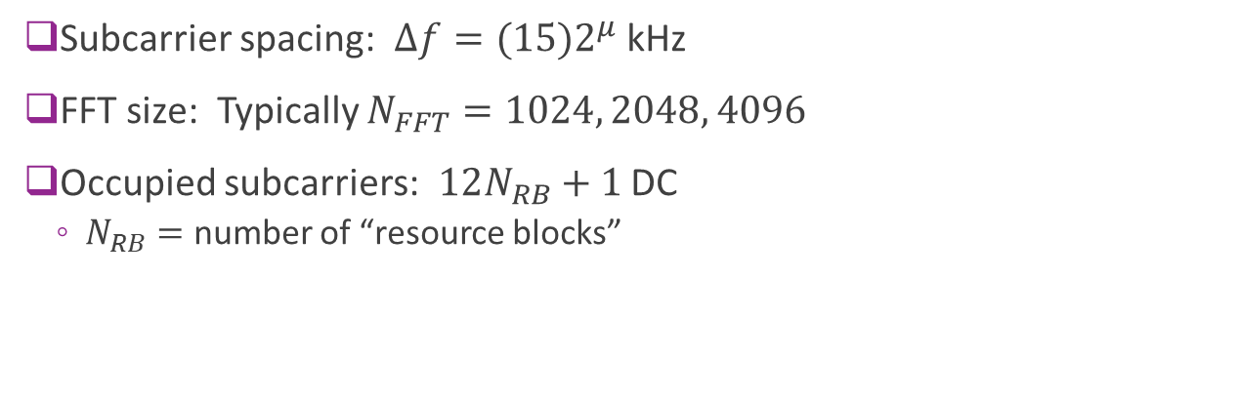
5G NR OFDM Details
Subcarrier spacing: $Δf=(15)2^{μ}$ kHz
FFT size: Typically $N_{FFT}=1024, 2048, 4096$
Occupied subcarriers: $12N_{RB}+1$ DC
$N_{RB}=$ number of “resource blocks”

Slide 36
Outline
What is Equalization?
Time-Domain Equalization for Single Carrier Systems
OFDM
OFDM Channel Estimation, a preview…

Slide 37
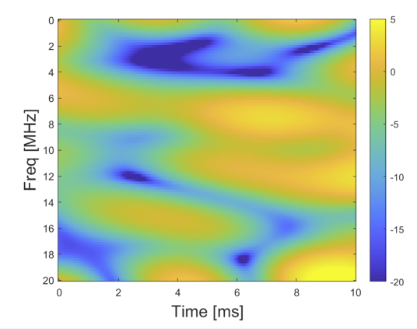
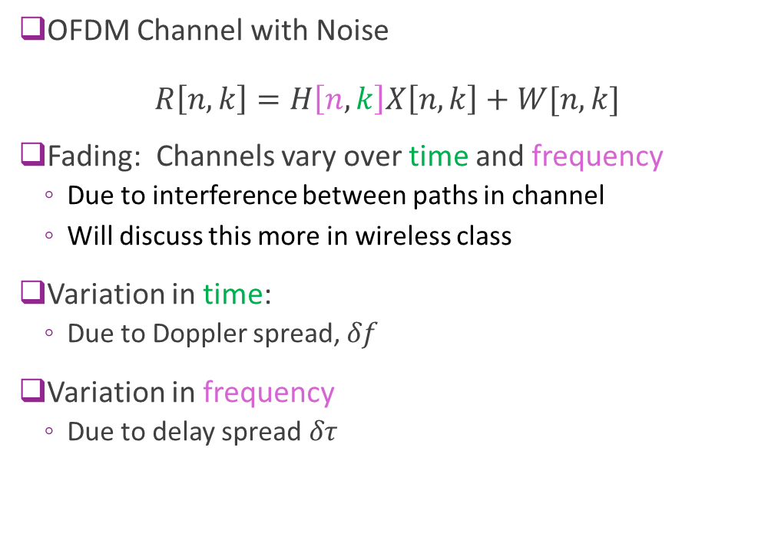
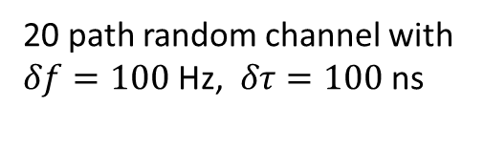
OFDM Channel Variations
OFDM Channel with Noise $R\left[n,k\right]=H\left[n,k\right]X\left[n,k\right]+W[n,k]$
Fading: Channels vary over time and frequency
Due to interference between paths in channel
Will discuss this more in wireless class
Variation in time:
Due to Doppler spread, $δf$
Variation in frequency
Due to delay spread$δτ$
SNR [dB]
20 path random channel with $δf=100$ Hz, $δτ=100$ ns

Slide 38
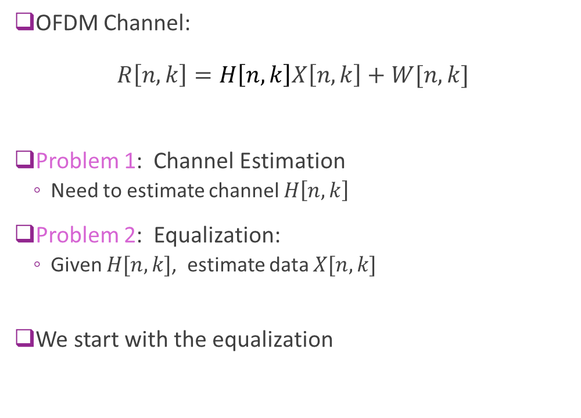
Problems with Time-Varying Channels
OFDM Channel: $R\left[n,k\right]=H\left[n,k\right]X\left[n,k\right]+W[n,k]$
Problem 1: Channel Estimation
Need to estimate channel $H\left[n,k\right]$
Problem 2: Equalization:
Given $H[n,k]$, estimate data $X[n,k]$
We start with the equalization
SNR [dB]
20 path random channel with $δf=100$ Hz, $δτ=100$ ns

Slide 39


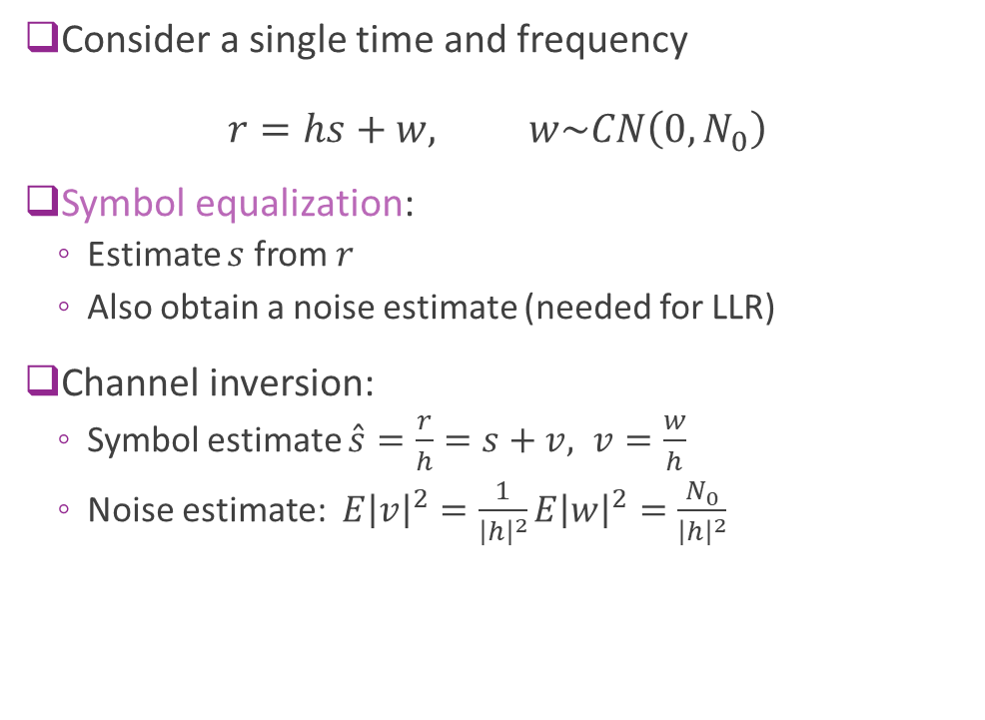



Symbol Equalization via Inversion
Consider a single time and frequency $r=hs+w, w\sim CN\left(0,N_{0}\right)$
Symbol equalization:
Estimate $s$ from $r$
Also obtain a noise estimate (needed for LLR)
Channel inversion:
Symbol estimate $\hat{s}=\frac{r}{h}=s+v, v=\frac{w}{h}$
Noise estimate: $E{\left|v\right|}^{2}=\frac{1}{{\left|h\right|}^{2}}E{\left|w\right|}^{2}=\frac{N_{0}}{{\left|h\right|}^{2}}$
$$w$$
$$s$$
$$h$$
$$r$$
Symbol Equalization
$$\hat{s}$$
+

Slide 40

MMSE Symbol Equalization
Received noisy symbol: $r=hs+w, w\sim CN\left(0,N_{0}\right)$
MMSE estimation:
Use linear estimate $\hat{s}=αr$
Select $α$ to minimize $E{\left|s−\hat{s}\right|}^{2}=E{\left|s−αr\right|}^{2}$
Resulting estimate (shown with simple algebra):
Estimate: $\hat{s}=αr, α=\frac{E_{s}h^{∗}}{{\left|h\right|}^{2}E_{s}+N_{0}}$
Noise variance: $E{\left|s−\hat{s}\right|}^{2}=\frac{E_{s}N_{0}}{{\left|h\right|}^{2}E_{s}+N_{0}}$
Provides lower noise estimate than channel inversion
$$w$$
$$s$$
$$h$$
$$r$$
Symbol Equalization
$$\hat{s}$$
+

Slide 41





Estimation Reference Symbols
TX reference $x[n,k]$
RX reference $h\left[n,k\right]x[n,k]$
h$[n,k]$
$$g[n,k]$$
Fading channel
Equalizer estimator
Equalizers require training or reference signals
TX sends a known reference sequence $x[n,k]$ on some locations $(k,n)$
RX sees $r\left[n,k\right]=h\left[n,k\right]x\left[n,k\right]+w\left[n,k\right]$
Estimates channel $h[n,k]$ and/or equalizer $g[n,k]$ for $r[n,k]$

Slide 42



Ex: 5G NR RS
OFDM Channel $R\left[n,k\right]=H\left[n,k\right]X\left[n,k\right]+W[n,k]$
5G NR Demodulation Reference Signals
Called DM-RS
Transmitted in downlink with data (PDCSH)
Very configurable in terms of over-head
Basic channel estimation idea
Transmit know $X[n,k]$ on DM-RS.
Estimate ${\hat{H}}_{0}\left[n,k\right]≈{R\left[n,k\right]}/{X\left[n,k\right]}$ on DM-RS symbols
Interpolate to data symbols

Slide 43

Example: 802.11 Channel Estimation
STF: Short training field
AGC, detect packet, approximate timing
LTF: Long training field
Estimate channel
Pilots in data
Modify estimate to tracking time variations
For 802.11, most variations are CFO

Slide 44


Ex: LTE Pilots
Can average in time or frequency
Pilots (Cell Reference signals) in one RB

Slide 45



Estimating Channel in a Single Symbol
First consider estimation in one symbol
True channel is $h[n]$
$n=$ sub-carrier index
RX: $r\left[n\right]=h\left[n\right]x\left[n\right]+w\left[n\right]$
DM-RS $x[n]$ known
Example to right:
10 MHz bandwidth
200 ns delay spread
10 dB SNR on DM-RS
Subcarrier

Slide 46


Raw Channel Estimate
Channel: $r\left[n\right]=h\left[n\right]x\left[n\right]+w\left[n\right]$
On DM-RS positions, $x[n]$ is known
Raw channel estimate: ${\hat{h}}_{0}\left[n\right]=\frac{r\left[n\right]}{x[n]}$
Can be computed in every DM-RS position
We see estimate is noisy

Slide 47

Smoothing the Estimate
Raw channel estimates are:
Noisy
Only available on DM-RS locations
Often smooth the estimate
Fit over all locations
Many options
Linear interpolation, splines
Parametric

Slide 48
Lab and Beyond
Lab 6: You will:
Build a simple smoothing estimate for an 802.11-like packet
Measure SNR
In wireless class, you will learn a lot more:
Fading and physical mechanisms for channel variation
Kernel smoothing estimators
Analysis of the estimators
Bias-variance tradeoff

