Slide 1
Unit 10: Convolutional Codes
EL-GY 6013: Digital communications
Prof. Sundeep rangan

Slide 2
Learning Objectives
Encode data using a convolutional code for given a generator polynomial
Compute the rate of the code including tail bits
Represent the code via a trellis diagram and finite state machine
Compute the branch metrics of a code for a memoryless channel
Decode the code via the Viterbi algorithm

Slide 3
Graduate vs. Undergraduate
Unit 9 on basic codes is skipped for the graduate students
However, a few of the Unit 9 slides are included here for completeness
Grad students who would like a review are encouraged to look at Unit 9

Slide 4
This Unit
Channel coding
Symbol mapping
TX filter DAC
Upconversion
Info bits
Coded bits
IQ symbols
Analog baseband
RF
Passband
Channel
Sync
“Noise”
Channel decoding
Symbol demod
Equalization
RX filter and ADC
Down-conversion

Slide 5
Outline
Convolutional codes: encoding and representations
Tree, trellis and state diagrams
Decoding with branch metrics
Viterbi decoding

Slide 6
Convolutional Codes History
Generates a stream of coded bits from uncoded bits
Block codes form by terminating the stream
Output stream created by binary FIR filters
Developed originally by Elias (1955)
Key challenge was decoders. Much study in 1960s.
Practical, optimal decoders developed by Viterbi,1967.
Can perform within 2-3 dB of Shannon limit.
Instrumental in Pioneer Space program (along with RS codes)
Most widely-used code in industry today: WiFi, cellular
In the mid 1990s, longer block length cellular codes were replaced with Turbo codes,
But, these use convolutional codes as basis

Slide 7
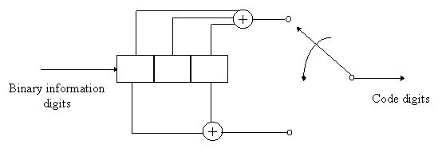

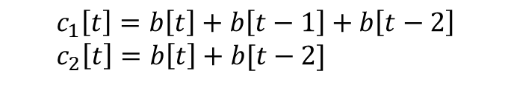
Convolutional Codes
Encode data through parallel binary (usu. FIR) filters
Example convolutional code:
Rate = ½ (two output bits ($c_{1}\left[t\right],c_{2}[t]$) for each input bit b[t].
Constraint length K=3 (size of shift register)
c₁[t]
b[t]
z⁻¹
z⁻¹
z⁻¹
$$c_{1}\left[t\right]=b\left[t\right]+b\left[t−1\right]+b\left[t−2\right] \\ c_{2}\left[t\right]=b\left[t\right]+b[t−2]$$
c₂[t]

Slide 8
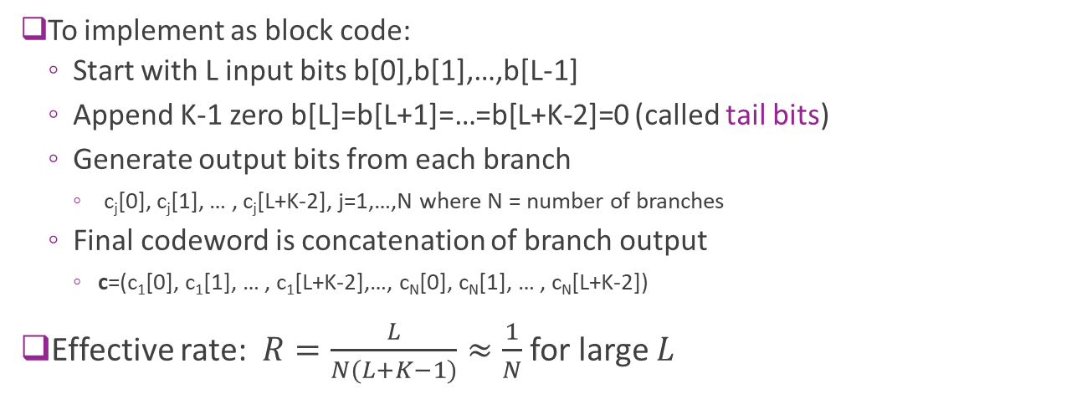
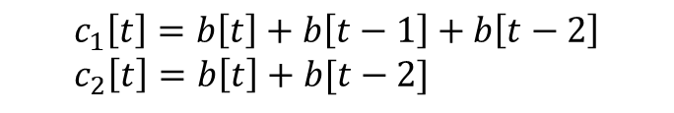
Convolutional Codes Block Implementation
c₁[t]
b[t]
$$c_{1}\left[t\right]=b\left[t\right]+b\left[t−1\right]+b\left[t−2\right] \\ c_{2}\left[t\right]=b\left[t\right]+b[t−2]$$
z⁻¹
z⁻¹
z⁻¹
c₂[t]
To implement as block code:
Start with L input bits b[0],b[1],…,b[L-1]
Append K-1 zero b[L]=b[L+1]=…=b[L+K-2]=0 (called tail bits)
Generate output bits from each branch
c_{j}[0], c_{j}[1], … , c_{j}[L+K-2], j=1,…,N where N = number of branches
Final codeword is concatenation of branch output
c=(c₁[0], c₁[1], … , c₁[L+K-2],…, c_{N}[0], c_{N}[1], … , c_{N}[L+K-2])
Effective rate: $R=\frac{L}{N(L+K−1)}≈\frac{1}{N}$ for large $L$

Slide 9
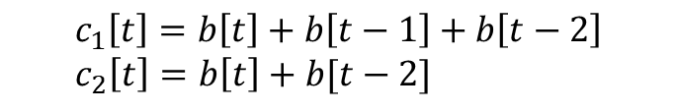
Convolutional Codes Encoding Example
Encode message b = [1 0 1]
Branch outputs c1=[11011] c2=[11001]
Final output c=[11,10,00,10,11] (interleaved)
Rate = 3/10
$$c_{1}\left[t\right]=b\left[t\right]+b\left[t−1\right]+b\left[t−2\right] \\ c_{2}\left[t\right]=b\left[t\right]+b[t−2]$$
t | b[t] | c1[t] | c2[t]
0 | 1 | 1 | 1
1 | 0 | 1 | 0
2 | 1 | 0 | 0
3 | 0 | 1 | 0
4 | 0 | 1 | 1
c₁[t]
b[t]
z⁻¹
z⁻¹
z⁻¹
Tail bits
c₂[t]

Slide 10
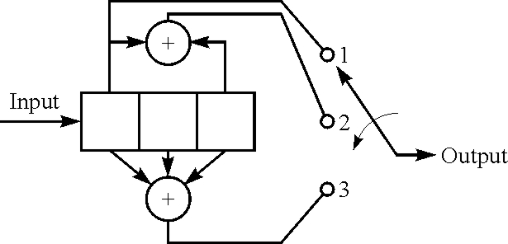
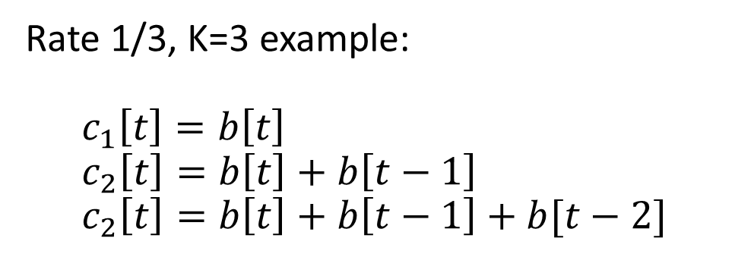
Generator Polynomials: Binary Form
Rate 1/3, K=3 example: $$c_{1}\left[t\right]=b\left[t\right] \\ c_{2}\left[t\right]=b\left[t\right]+b\left[t−1\right] \\ c_{2}\left[t\right]=b\left[t\right]+b\left[t−1\right]+b[t−2]$$
Code polynomials: Binary vector of filter coefficients

Slide 11
Generator Polynomials: Octal Form
For large constraint lengths (large K), binary form is inefficient
Engineers often use octal form
Base 8, each digit 0…7
Each digit represents three bits
Example:
Binary
Octal

Slide 12
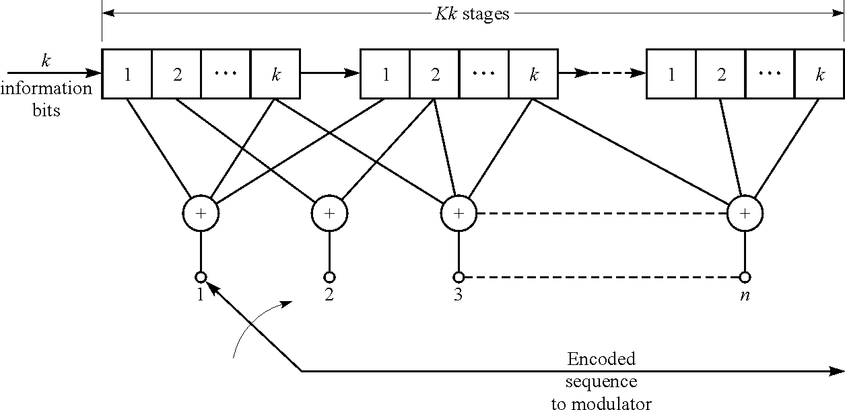
Multiple Inputs
Examples up to now are R=1/n
Can extend to rate R=k/n
Add k bits at a time

Slide 13
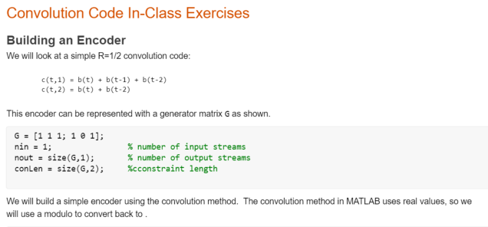
In-Class Exercise

Slide 14
Outline
Convolutional codes: encoding and representations
Tree, trellis and state diagrams
Decoding with branch metrics
Viterbi decoding

Slide 15
Convolutional Codes as State Machines
Convolutional codes have memory
Stored in contents of shift registers
Each input bit changes memory contents
Output bits are a function of memory and input
Three common ways to represent evolution of the memory:
Tree diagram
Trellis diagram
State diagram

Slide 16

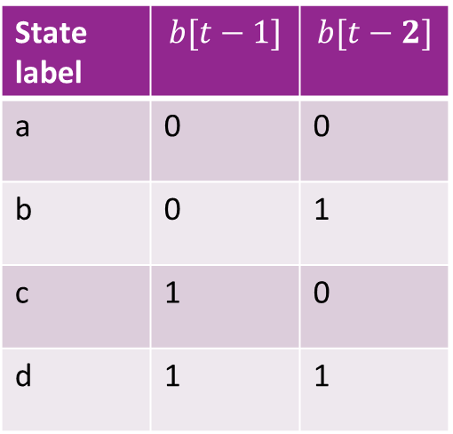
Encoder States
State of the encoder determined by contents of shift register: $x\left[t\right]=(b\left[t−1\right],…,b\left[t−K\right])$
Only need to look at most recent K-1 bits not including the current bit
Last bit will be shifted out
There are $2^{K−1}$ states
State label | $$b[t−1]$$ | $$b[t−2]$$
a | 0 | 0
b | 0 | 1
c | 1 | 0
d | 1 | 1
b[t-1] b[t-2]

Slide 17
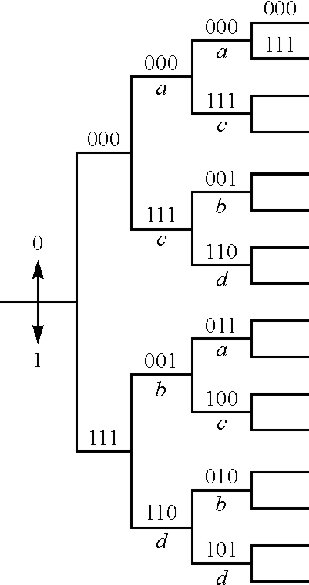
Tree Diagram
Two branches for each input bit 0 or 1.
Branches labeled by output bits (n bits)
Difficult to use since branches infinitely grow

Slide 18
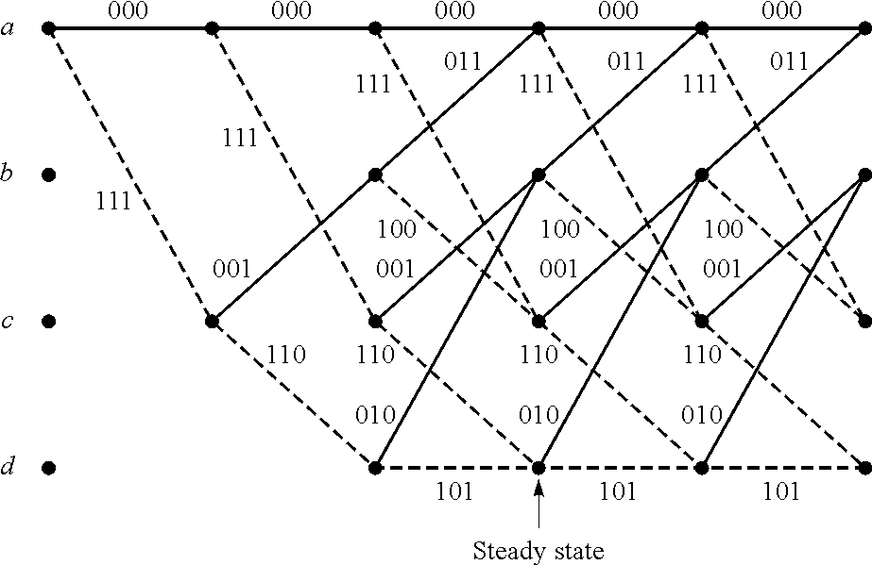
Trellis Diagram
Show trajectory through the states
Solid lines: paths with b[t]=0, Dash lines: b[t]=1
Labels are the outputs along each path

Slide 19
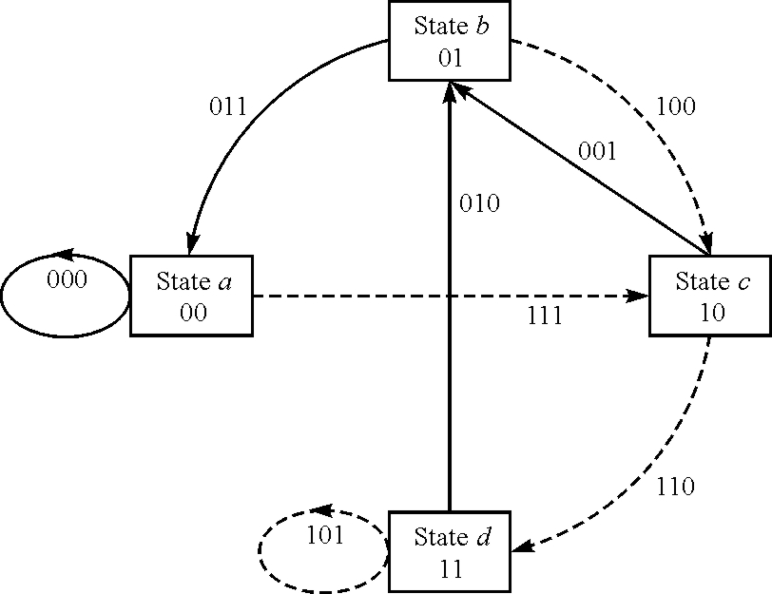
State Diagram
One node per state
Solid lines:
Transitions with b[t]=0
Dashed lines:
Transitions with b[t]=1
Labels indicate outputs on each state

Slide 20

State Machine Functional Description
Finite state machine:
$x[t]$: Sequence of states, $x\left[t\right]∈\{0,…,2^{K−1}−1\}$
$b[t]$: Input sequence
$c[t]$: Output sequence
Iterative generating sequence: $x\left[t+1\right]=f\left(x\left[t\right], b\left[t\right]\right)$ $c\left[t\right]=h(x\left[t\right], b\left[t\right])$
Initial condition: $x[0]$
State function
Output function

Slide 21
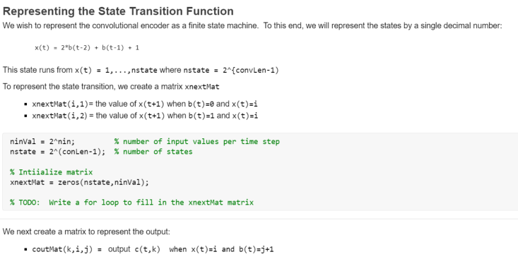
In-Class Exercise

Slide 22
Outline
Convolutional codes: encoding and representations
Tree, trellis and state diagrams
Decoding with branch metrics
Viterbi decoding

Slide 23
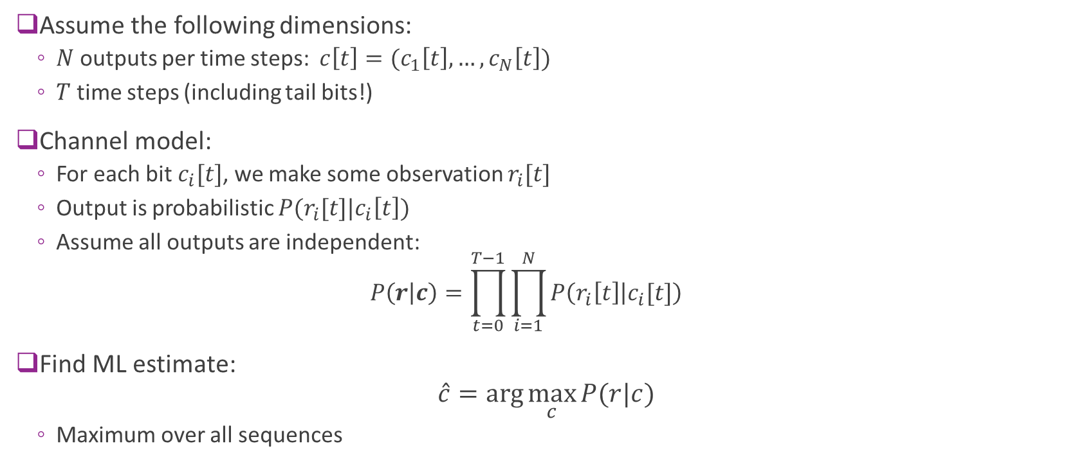
ML Estimation
Assume the following dimensions:
$N$ outputs per time steps: $c\left[t\right]=(c_{1}\left[t\right],…,c_{N}\left[t\right])$
$T$ time steps (including tail bits!)
Channel model:
For each bit $c_{i}[t]$, we make some observation $r_{i}[t]$
Output is probabilistic $P(r_{i}[t]|c_{i}\left[t\right])$
Assume all outputs are independent: $P\left(r | c\right)=\prod_{t=0}^{T−1}{\prod_{i=1}^{N}{P\left(r_{i}\left[t\right] | c_{i}[t]\right)}}$
Find ML estimate: $\hat{c}=\arg{\max_{c}{P(r|c)}}$
Maximum over all sequences

Slide 24
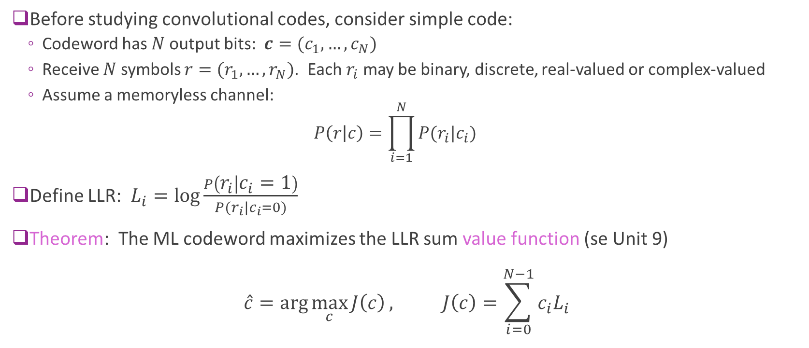
LLR Review
Before studying convolutional codes, consider simple code:
Codeword has $N$output bits: $c=(c_{1},…,c_{N})$
Receive $N$ symbols $r=(r_{1},…,r_{N})$. Each $r_{i}$ may be binary, discrete, real-valued or complex-valued
Assume a memoryless channel: $P\left(r | c\right)=\prod_{i=1}^{N}{P(r_{i}|c_{i})}$
Define LLR: $L_{i}=\log{\frac{P\left(r_{i} | c_{i}=1\right)}{P(r_{i}|c_{i}=0)}}$
Theorem: The ML codeword maximizes the LLR sum value function (se Unit 9) $\hat{c}=\arg{\max_{c}{J\left(c\right)}}, J\left(c\right)=\sum_{i=0}^{N−1}{c_{i}L_{i}}$

Slide 25
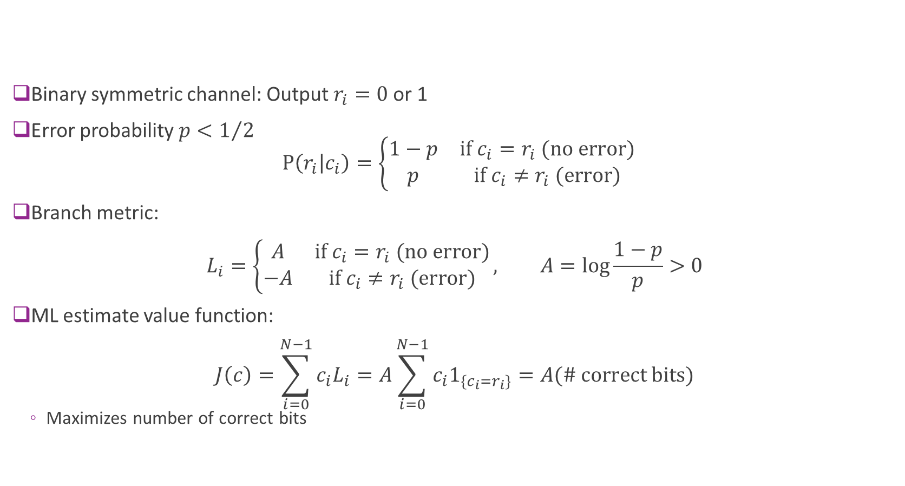
Example 1: Binary Symmetric Channel
Binary symmetric channel: Output $r_{i}=0$ or 1
Error probability $p<1/2$ $P\left(r_{i} | c_{i}\right)=\left\{\begin{matrix}1−p & \text{if} c_{i}=r_{i} \text{(}\text{no} \text{error}\text{)} \\ p & \text{if} c_{i}≠r_{i} \text{(}\text{error}\text{)}\end{matrix}\right.$
Branch metric: $L_{i}=\left\{\begin{matrix}A & \text{if} c_{i}=r_{i} \text{(}\text{no} \text{error}\text{)} \\ −A & \text{if} c_{i}≠r_{i} \text{(}\text{error}\text{)}\end{matrix}\right., A=\log{\frac{1−p}{p}}>0$
ML estimate value function: $J\left(c\right)=\sum_{i=0}^{N−1}{c_{i}L_{i}}=A\sum_{i=0}^{N−1}{c_{i}1_{\{c_{i}=r_{i}\}}}=A(\# \text{correct} \text{bits})$
Maximizes number of correct bits

Slide 26
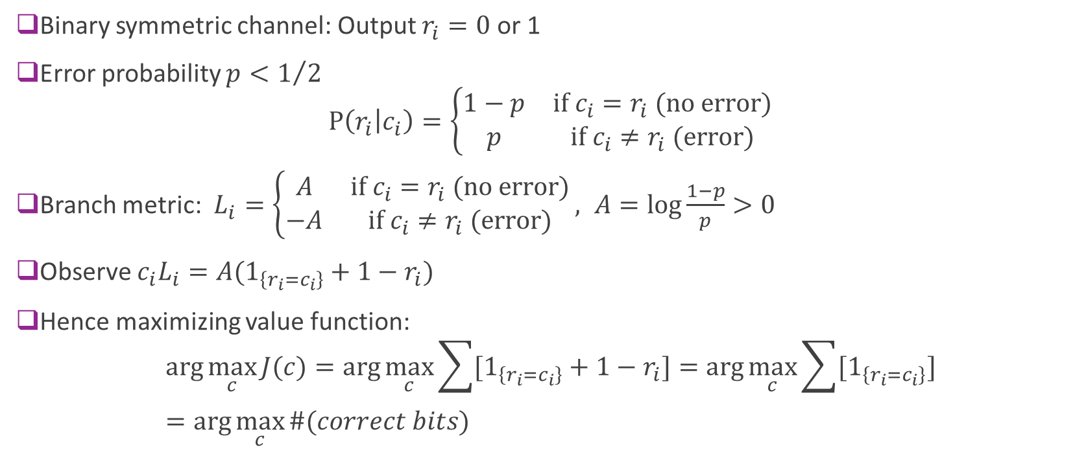
Example 1: Binary Symmetric Channel
Binary symmetric channel: Output $r_{i}=0$ or 1
Error probability $p<1/2$ $P\left(r_{i} | c_{i}\right)=\left\{\begin{matrix}1−p & \text{if} c_{i}=r_{i} \text{(}\text{no} \text{error}\text{)} \\ p & \text{if} c_{i}≠r_{i} \text{(}\text{error}\text{)}\end{matrix}\right.$
Branch metric: $L_{i}=\left\{\begin{matrix}A & \text{if} c_{i}=r_{i} \text{(}\text{no} \text{error}\text{)} \\ −A & \text{if} c_{i}≠r_{i} \text{(}\text{error}\text{)}\end{matrix}\right., A=\log{\frac{1−p}{p}}>0$
Observe $c_{i}L_{i}=A(1_{\left\{r_{i}=c_{i}\right\}}+1−r_{i})$
Hence maximizing value function: $\arg{\max_{c}{J(c)}}=\arg{\max_{c}{\sum{[1_{\left\{r_{i}=c_{i}\right\}}+1−r_{i}]}}}=\arg{\max_{c}{\sum{[1_{\left\{r_{i}=c_{i}\right\}}]}}}$ $=\arg{\max_{c}{\#(correct bits)}}$

Slide 27
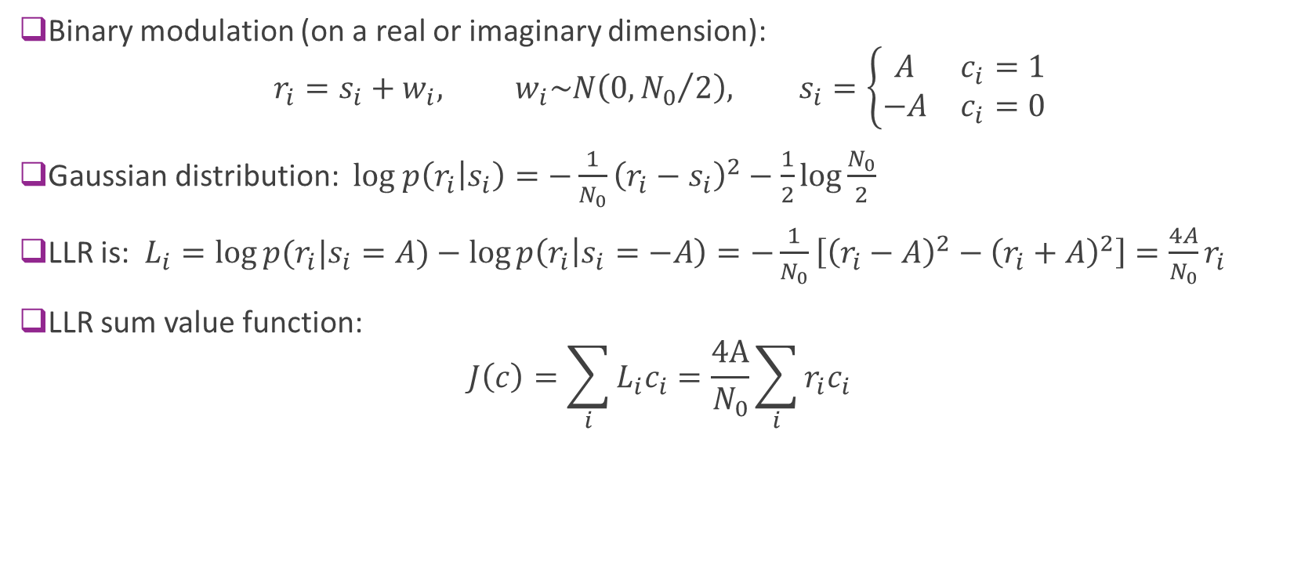
Example 2: QPSK Channel
Binary modulation (on a real or imaginary dimension): $r_{i}=s_{i}+w_{i}, w_{i}\sim N\left(0,{N_{0}}/2\right), s_{i}=\left\{\begin{matrix}A & c_{i}=1 \\ −A & c_{i}=0\end{matrix}\right.$
Gaussian distribution: $log p\left(r_{i} | s_{i}\right)=−\frac{1}{N_{0}}{\left(r_{i}−s_{i}\right)}^{2}−\frac{1}{2}\log{\frac{N_{0}}{2}}$
LLR is: $L_{i}=\log{p(r_{i}|s_{i}=A)}−\log{p\left(r_{i} | s_{i}=−A\right)}=−\frac{1}{N_{0}}\left[{\left(r_{i}−A\right)}^{2}−{\left(r_{i}+A\right)}^{2}\right]=\frac{4A}{N_{0}}r_{i}$
LLR sum value function: $J\left(c\right)=\sum_{i}{L_{i}c_{i}}=\frac{4A}{N_{0}}\sum_{i}{r_{i}c_{i}}$

Slide 28
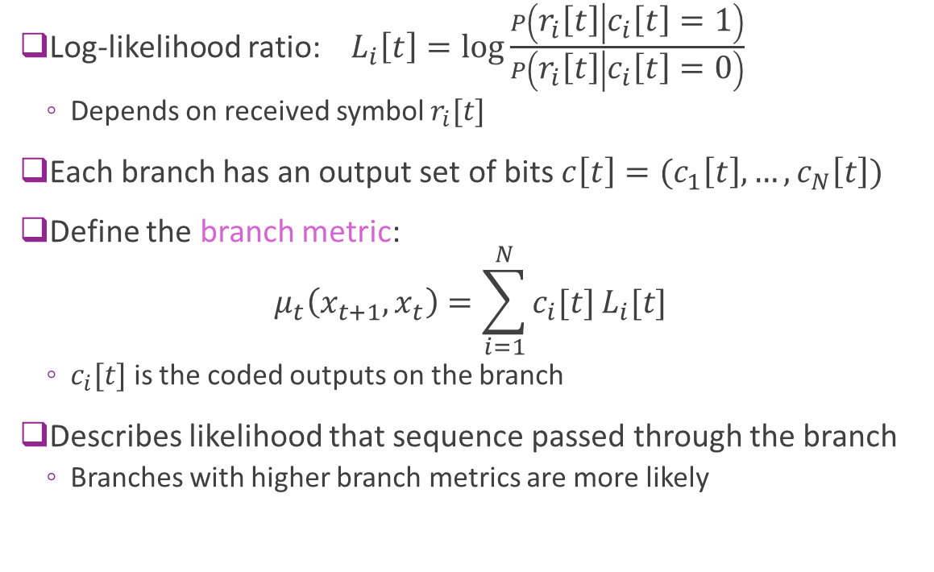
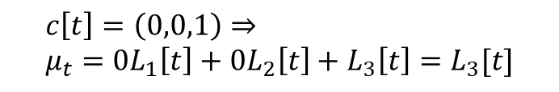
Branch Metric
Log-likelihood ratio: $L_{i}\left[t\right]=\log{\frac{P\left(r_{i}\left[t\right] | c_{i}\left[t\right]=1\right)}{P\left(r_{i}\left[t\right] | c_{i}\left[t\right]=0\right)}}$
Depends on received symbol $r_{i}[t]$
Each branch has an output set of bits $c\left[t\right]=(c_{1}\left[t\right],…,c_{N}\left[t\right])$
Define the branch metric: $μ_{t}\left(x_{t+1},x_{t}\right)=\sum_{i=1}^{N}{c_{i}[t]}L_{i}[t]$
$c_{i}[t]$ is the coded outputs on the branch
Describes likelihood that sequence passed through the branch
Branches with higher branch metrics are more likely
$$c\left[t\right]=\left(0,0,1\right)⇒ \\ μ_{t}=0L_{1}\left[t\right]+0L_{2}\left[t\right]+L_{3}\left[t\right]=L_{3}[t]$$

Slide 29
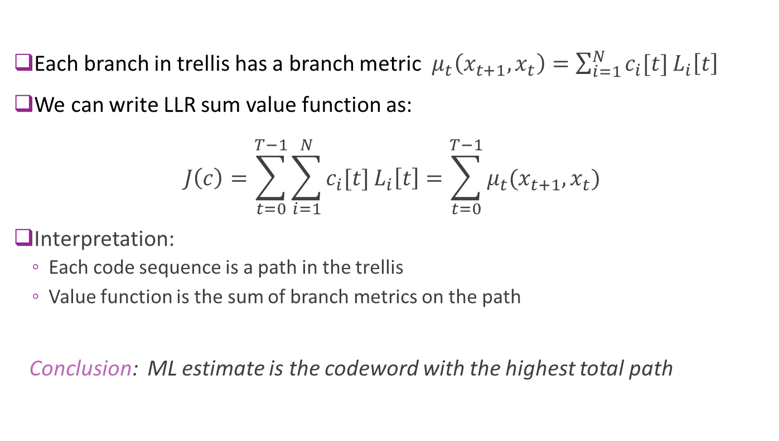
Branch Metric Maximization
Each branch in trellis has a branch metric $μ_{t}\left(x_{t+1},x_{t}\right)=\sum_{i=1}^{N}{c_{i}[t]}L_{i}\left[t\right]$
We can write LLR sum value function as: $J\left(c\right)=\sum_{t=0}^{T−1}{\sum_{i=1}^{N}{c_{i}[t]}L_{i}\left[t\right]}=\sum_{t=0}^{T−1}{μ_{t}(x_{t+1},x_{t})}$
Interpretation:
Each code sequence is a path in the trellis
Value function is the sum of branch metrics on the path
Conclusion: ML estimate is the codeword with the highest total path

Slide 30








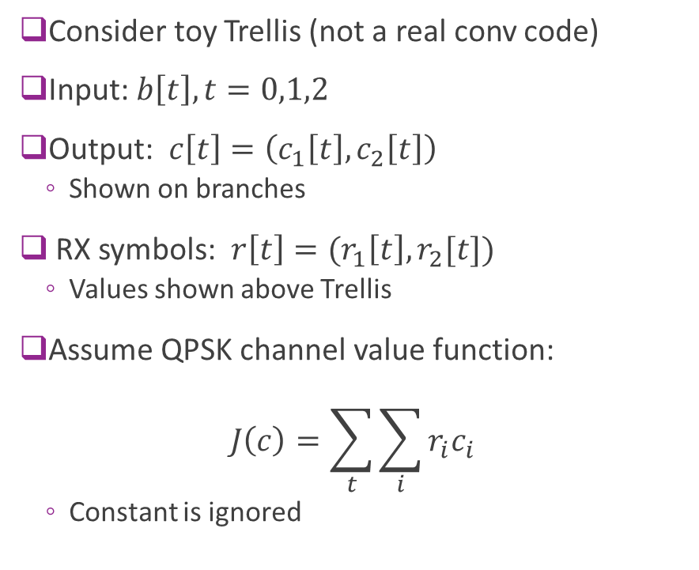












Example
Consider toy Trellis (not a real conv code)
Input: $b\left[t\right], t=0,1,2$
Output: $c\left[t\right]=\left(c_{1}\left[t\right],c_{2}\left[t\right]\right)$
Shown on branches
RX symbols: $r\left[t\right]=(r_{1}\left[t\right],r_{2}[t])$
Values shown above Trellis
Assume QPSK channel value function: $J\left(c\right)=\sum_{t}{\sum_{i}{r_{i}c_{i}}}$
Constant is ignored
$$b\left[t\right]=1$$
$$b\left[t\right]=0$$
$r[t]$:
$$(0.8,−0.2)$$
$$(1.3,0.1)$$
$$(−0.6, −0.2)$$
$$00$$
$$00$$
$$00$$
$$10$$
$$10$$
$$11$$
$$11$$
$$11$$
$$01$$
$$01$$
$$t=0$$
$$1$$
$$2$$
$$3$$

Slide 31











Step 1: Compute Branch Metrics
For QPSK channel, branch metric is
$$μ_{t}\left(x_{t+1},x_{t}\right)=\sum_{i}{r_{i}\left[t\right]c_{i}[t]}$$
On each branch we have labeled:
(Output Bits, branch)$=(c\left[t\right],μ_{t})$
$$b\left[t\right]=1$$
$$b\left[t\right]=0$$
$r[t]$:
$$(0.8,−0.2)$$
$$(1.3,0.1)$$
$$(−0.6, −0.2)$$
$$00, 0$$
$$00, 0$$
$$00, 0$$
$$10, 1.3$$
$$10, −0.6$$
$$11, 0.6$$
$$11, 1.2$$
$$11, 0.8$$
$$01, 0.1$$
$$01, −0.2$$
$$t=0$$
$$1$$
$$2$$
$$3$$

Slide 32

Step 2: Find the Maximizing Path
For this simple Trellis, we can do this manually
Path is shown with red nodes
Solution:
Coded sequence: (11), (10), (00)
Bits: (1,1,0)
$$b\left[t\right]=1$$
$$b\left[t\right]=0$$
$r[t]$:
$$(0.8,−0.2)$$
$$(1.3,0.1)$$
$$(−0.6, −0.2)$$
$$00, 0$$
$$00, 0$$
$$00, 0$$
$$10, 1.3$$
$$10, −0.6$$
$$11, 0.6$$
$$11, 1.2$$
$$11, −0.8$$
$$01, 0.1$$
$$01, −0.2$$
$$t=0$$
$$1$$
$$2$$
$$3$$

Slide 33
Outline
Convolutional codes: encoding and representations
Tree, trellis and state diagrams
Decoding with branch metrics
Viterbi decoding

Slide 34


















Viterbi Algorithm by Example
Iterative solution for finding maximum path in a graph
Key idea: Find the max path one time step at a time
We will illustrate by example: Shown are the branch metrics
$$−0.8$$
$$−0.6$$
$$−0.5$$
$$0.1$$
$$0.3$$
$$1.5$$
$$0.5$$
$$0.3$$
$$−0.3$$
$$1.2$$
$$0.2$$
$$−1.3$$
$$2.1$$
$$−1$$
$$−3$$
$$−1.1$$
$$0.3$$
$$−2$$

Slide 35


Ex: Time 1
Find total value to get to each node at time 1
We call these the partial value functions up to time 1
Remember best path to get to node (indicated with green line)
$$−0.8$$
$$−0.8$$
$$−0.6$$
$$−0.5$$
$$0.1$$
$$0.3$$
$$1.5$$
$$0.5$$
$$0.3$$
$$−0.3$$
$$1.2$$
$$0.2$$
$$−1.3$$
$$1.2$$
$$2.1$$
$$−1$$
$$−3$$
$$−1.1$$
$$0.3$$
$$−2$$

Slide 36





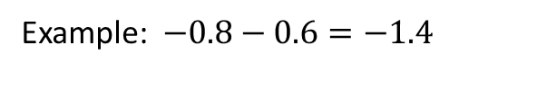
Ex: Time 2
Add value from Time 1 + branch
Example: $−0.8−0.6=−1.4$
$$−0.8$$
$$−0.8$$
$$−0.6$$
$$−1.4$$
$$−0.5$$
$$0.1$$
$$0.3$$
$$1.5$$
$$0.7$$
$$0.3$$
$$0.5$$
$$−0.3$$
$$1.2$$
$$0.2$$
$$−1.3$$
$$1.2$$
$$−0.5$$
$$2.1$$
$$−1$$
$$0.3$$
$$−3$$
$$−1.1$$
$$0.3$$
$$1.5$$
$$−2$$

Slide 37




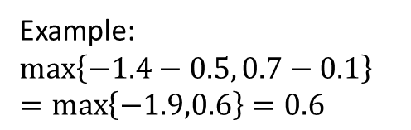

Ex: Time 3
Add value from Time 2 + branch
Take route with maximum value (shown in green)
Example: $\max\left\{−1.4−0.5, 0.7−0.1\right\}$ $=\max\left\{−1.9,0.6\right\}=0.6$
$$−0.8$$
$$−0.8$$
$$−0.6$$
$$−1.4$$
$$0.6$$
$$−0.5$$
$$0.1$$
$$0.3$$
$$−0.1$$
$$1.5$$
$$0.7$$
$$0.3$$
$$2.4$$
$$0.5$$
$$−0.3$$
$$1.2$$
$$0.2$$
$$−1.3$$
$$1.2$$
$$−0.5$$
$$2.1$$
$$−1$$
$$0.3$$
$$0.9$$
$$−3$$
$$−1.1$$
$$0.3$$
$$1.5$$
$$−2$$
$$−0.5$$

Slide 38


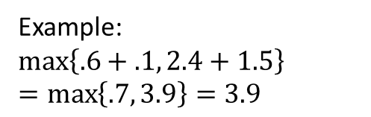
Ex: Time 4
Add value from Time 3 + branch
Take route with maximum value (shown in green)
Example: $\max\left\{.6+.1, 2.4+1.5\right\}$ $=\max\left\{.7, 3.9\right\}=3.9$
$$−1.4$$
$$0.6$$
$$3.9$$
$$−0.8$$
$$−0.8$$
$$−0.6$$
$$−0.5$$
$$0.1$$
$$0.3$$
$$−0.1$$
$$1.5$$
$$0.7$$
$$0.3$$
$$2.4$$
$$0.5$$
$$−0.3$$
$$1.2$$
$$0.2$$
$$−1.3$$
$$−0.4$$
$$1.2$$
$$−0.5$$
$$2.1$$
$$−1$$
$$0.3$$
$$0.9$$
$$−3$$
$$−1.1$$
$$0.3$$
$$1.5$$
$$−2$$
$$−0.5$$

Slide 39
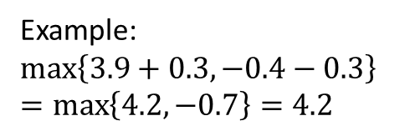

Ex: Time 5
Add value from Time 4 + branch
Take route with maximum value (shown in green)
$$−1.4$$
$$0.6$$
$$3.9$$
$$−0.8$$
$$−0.8$$
$$−0.6$$
$$−0.5$$
$$0.1$$
$$0.3$$
$$4.2$$
$$−0.1$$
$$1.5$$
$$0.7$$
$$0.3$$
$$2.4$$
$$0.5$$
$$−0.3$$
$$1.2$$
$$0.2$$
$$−1.3$$
$$−0.4$$
$$1.2$$
$$−0.5$$
$$2.1$$
$$−1$$
Example: $\max\left\{3.9+0.3, −0.4−0.3\right\}$ $=\max\left\{4.2, −0.7\right\}=4.2$
$$0.3$$
$$0.9$$
$$−3$$
$$−1.1$$
$$0.3$$
$$1.5$$
$$−2$$
$$−0.5$$

Slide 40
Ex: Trace back path
Trace back maximum path. Shown in red
$$−1.4$$
$$0.6$$
$$3.9$$
$$−0.8$$
$$−0.8$$
$$−0.6$$
$$−0.5$$
$$0.1$$
$$0.3$$
$$4.2$$
$$−0.1$$
$$1.5$$
$$0.7$$
$$0.3$$
$$2.4$$
$$0.5$$
$$−0.3$$
$$1.2$$
$$0.2$$
$$−1.3$$
$$−0.4$$
$$1.2$$
$$−0.5$$
$$2.1$$
$$−1$$
$$0.3$$
$$0.9$$
$$−3$$
$$−1.1$$
$$0.3$$
$$1.5$$
$$−2$$
$$−0.5$$

Slide 41

Ex: Read off bits
Read off the bits from the maximum path
ML input bits = $(0,1,0,0,0)$

Slide 42
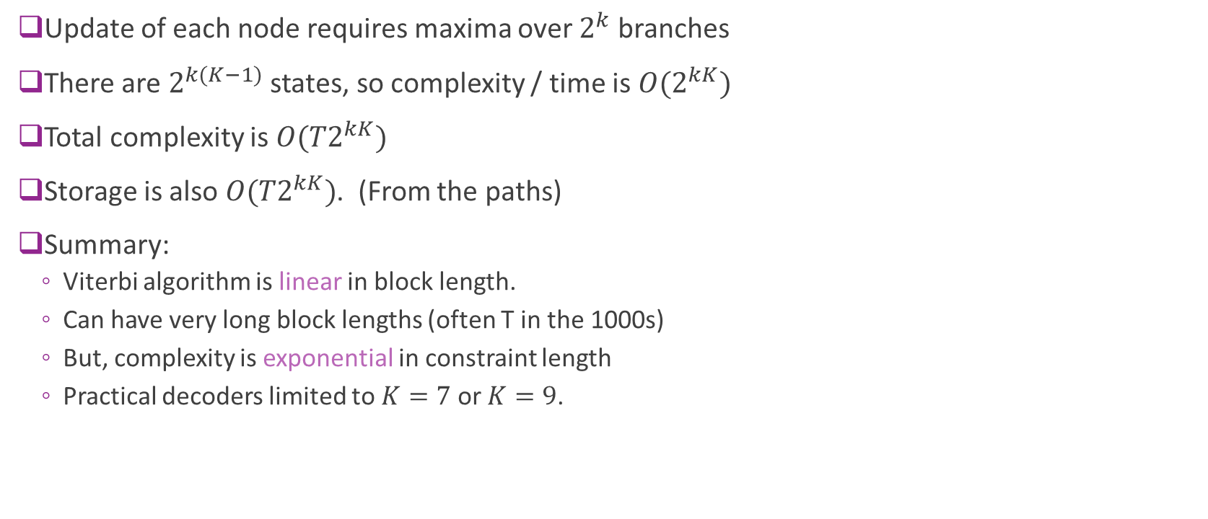
Complexity
Update of each node requires maxima over $2^{k}$ branches
There are $2^{k(K−1)}$ states, so complexity / time is ${O(2}^{kK})$
Total complexity is ${O(T2}^{kK})$
Storage is also ${O(T2}^{kK})$. (From the paths)
Summary:
Viterbi algorithm is linear in block length.
Can have very long block lengths (often T in the 1000s)
But, complexity is exponential in constraint length
Practical decoders limited to $K=7$or $K=9$.

Slide 43
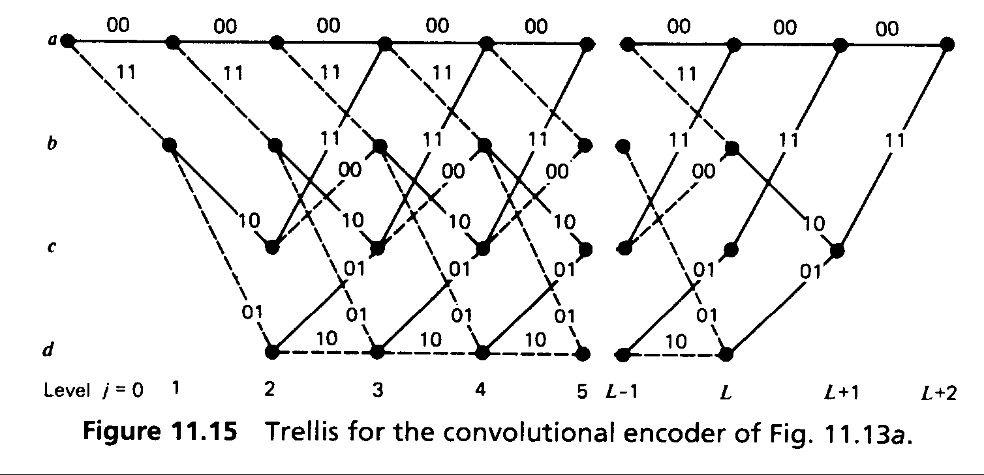
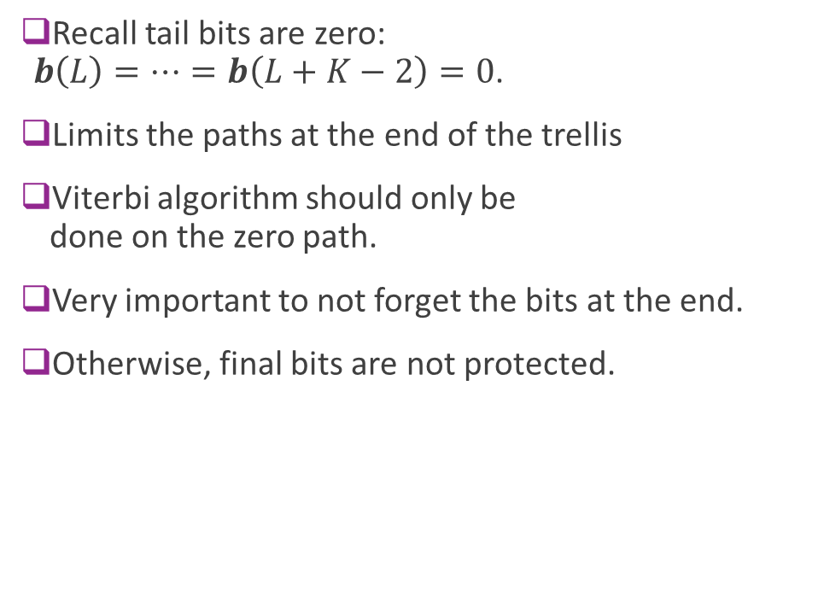
Terminating the Trellis
Recall tail bits are zero: $b\left(L\right)=…=b\left(L+K−2\right)=0$.
Limits the paths at the end of the trellis
Viterbi algorithm should only be done on the zero path.
Very important to not forget the bits at the end.
Otherwise, final bits are not protected.
During tail bits only paths with zero bit inputs.

Slide 44
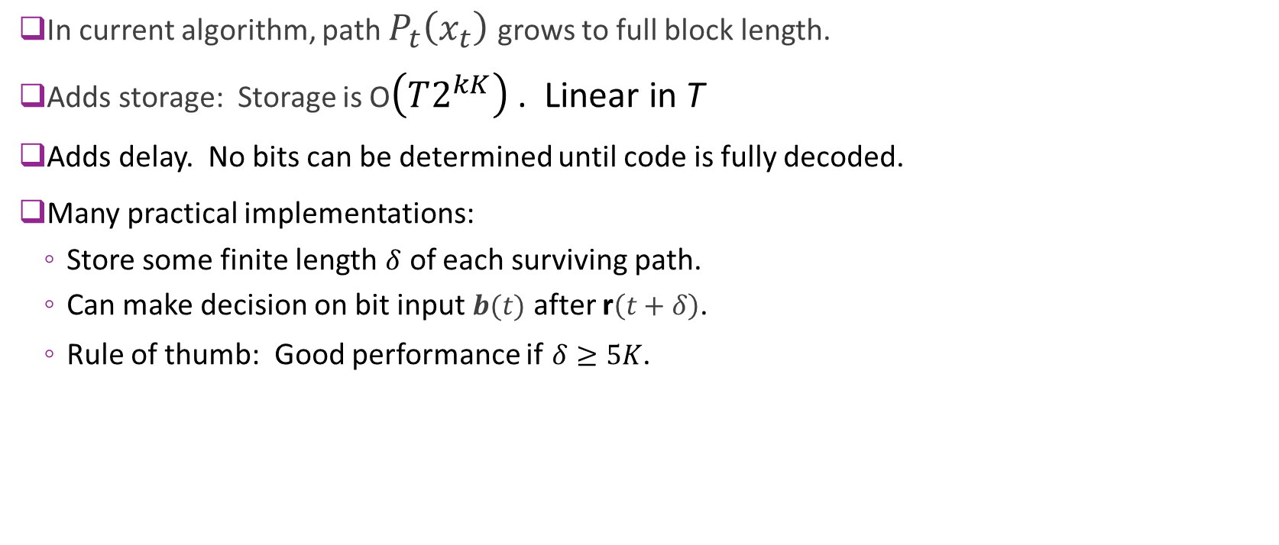
Pruning the Path Memory
In current algorithm, path $P_{t}\left(x_{t}\right)$ grows to full block length.
Adds storage: Storage is O$\left(T2^{kK}\right)$ . Linear in T
Adds delay. No bits can be determined until code is fully decoded.
Many practical implementations:
Store some finite length $δ$ of each surviving path.
Can make decision on bit input $b(t)$ after r$\left(t+δ\right)$.
Rule of thumb: Good performance if $δ≥5K$.

Slide 45
Rate Matching Convolutional Codes
Convolutional codes have limited rates, usu. ½ or 1/3.
Obtain other rates through
Puncturing: Remove coded bits to increase rate
Repetition: Repeat coded bits to decrease rate
Puncture / repeat pattern is important (see Proakis)
Try to spread out modified bits
For punctured bits, set corresponding LLRs to zero
Viterbi decoder just ignores those bits
For repeated bits, add the corresponding LLRs
Viterbi decoder will increase confidence on that branch

Slide 46

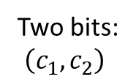

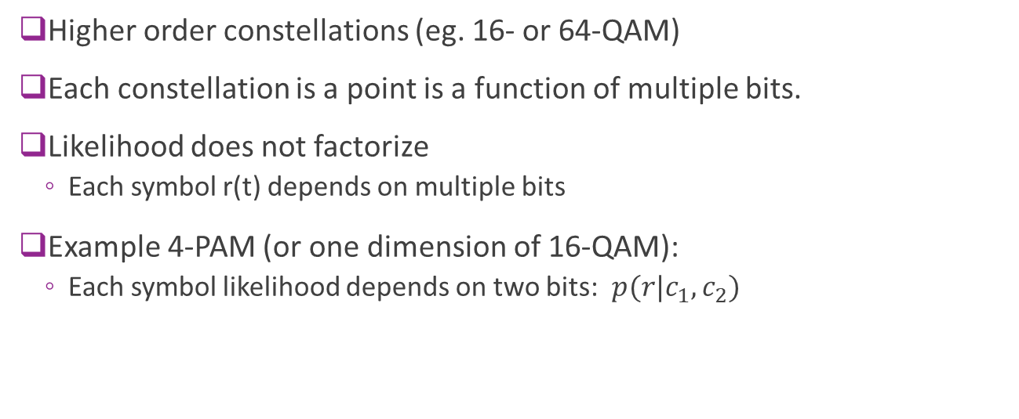



High Order Constellations
Higher order constellations (eg. 16- or 64-QAM)
Each constellation is a point is a function of multiple bits.
Likelihood does not factorize
Each symbol r(t) depends on multiple bits
Example 4-PAM (or one dimension of 16-QAM):
Each symbol likelihood depends on two bits: $p(r|c_{1},c_{2})$
$s_{00}$
$$s_{10}$$
$$s_{11}$$
$s_{01}$
$r=s+n$
Two bits: $\left(c_{1},c_{2}\right)$

Slide 47

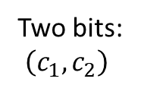

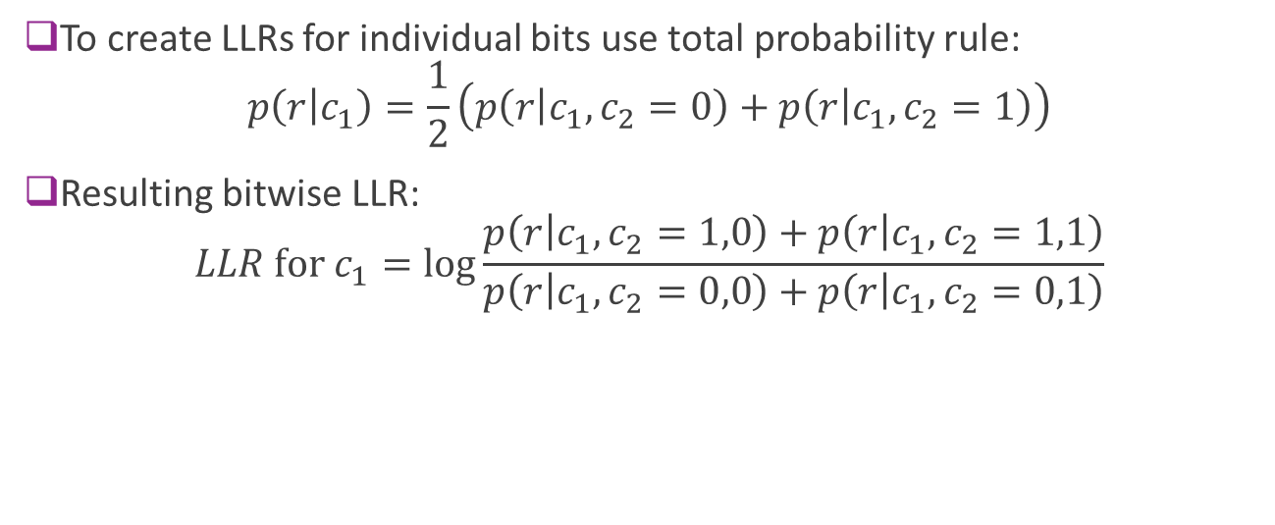



High Order Constellations
$s_{00}$
$$s_{10}$$
$$s_{11}$$
$s_{01}$
$r=s+n$
Two bits: $\left(c_{1},c_{2}\right)$
To create LLRs for individual bits use total probability rule: $p\left(r | c_{1}\right)=\frac{1}{2}\left(p\left(r | c_{1},c_{2}=0\right)+p\left(r | c_{1},c_{2}=1\right)\right)$
Resulting bitwise LLR: $LLR \text{for} c_{1}=\log{\frac{p\left(r | c_{1},c_{2}=1,0\right)+p\left(r | c_{1},c_{2}=1,1\right)}{p\left(r | c_{1},c_{2}=0,0\right)+p\left(r | c_{1},c_{2}=0,1\right)}}$

Slide 48
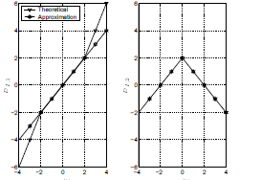


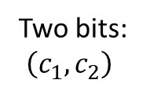



High Order Constellations
$s_{00}$
$$s_{10}$$
$$s_{11}$$
$s_{01}$
$r=s+n$
Two bits: $\left(c_{1},c_{2}\right)$
LLR for c2 LLR for c1
LLRs can have irregular shapes
Not simple linear function as in BPSK / QPSK case
Often use approximations
More info: Caire, Taricco and Biglieri, “Bit-Interleaved Coded Modulation," 1998.

Slide 49
Convolutional Codes in WiFi
802.11 uses R=1/2 K=7 code.
Length adjusted to packet size
Higher rates (R=2/3 and ¾) achieved through puncturing
Enables decoding as data arrives for ACK fast turnaround
Preamble
Data symbols
Turnaround time (<= SIFS = 10us)
Channel est / sync
Viterbi decoding
Check CRC & form ACK
ACK

Slide 50
Convolutional Codes in LTE
Convolutional codes in LTE used for:
Control channels (payload typ 20-40 bits +CRC), and
Short (< 128 bit) data frames
Larger payloads encoded with turbo codes (discussed later)
Uses rate=1/3 base convolutional code with K=7.
Higher rates achieved via puncturing
Control channels use a sophisticated technique called tail biting to reduce loss on the tail bits

Slide 51
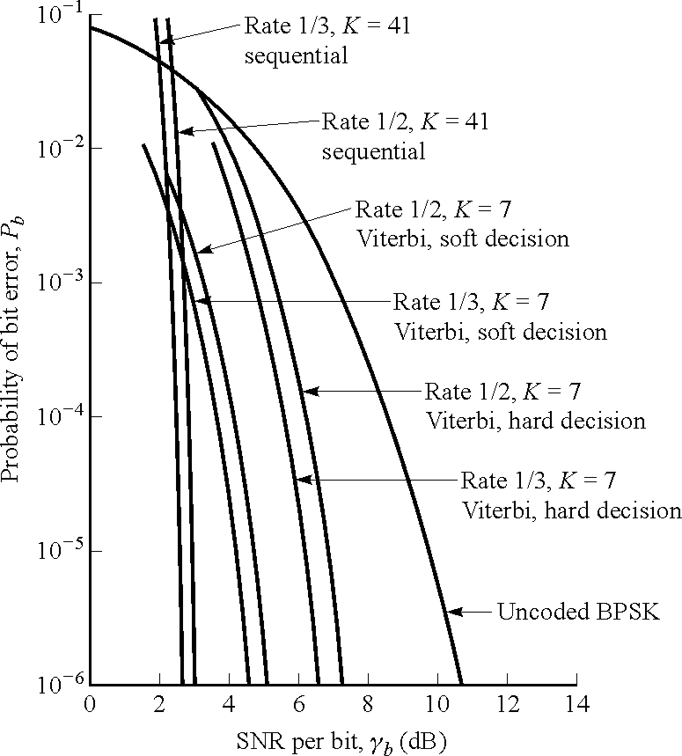
Decoding Performance
Hard decision loses approximately 1.5 to 2 dB
Constraint length K=7 is sufficient for very sharp error performance

Slide 52
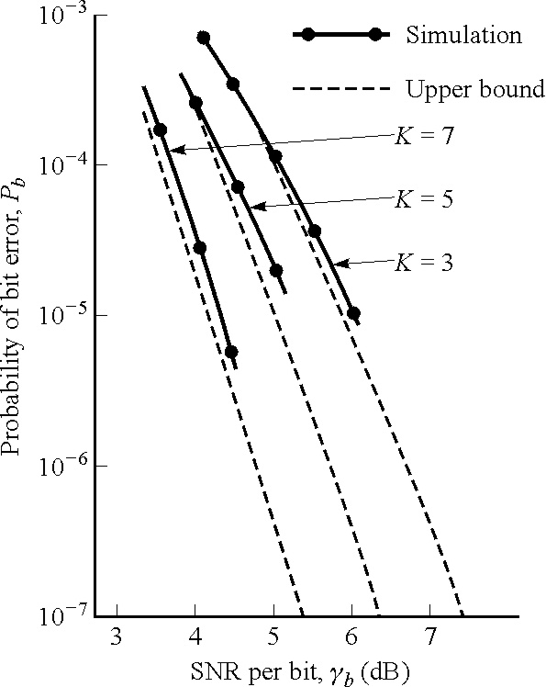
Different Constraint Lengths
Approximate 1 dB improvement between K=3, 5 and 7
Higher constraint lengths become computationally intractable
Recall decoding complexity is exponential in K

Slide 53
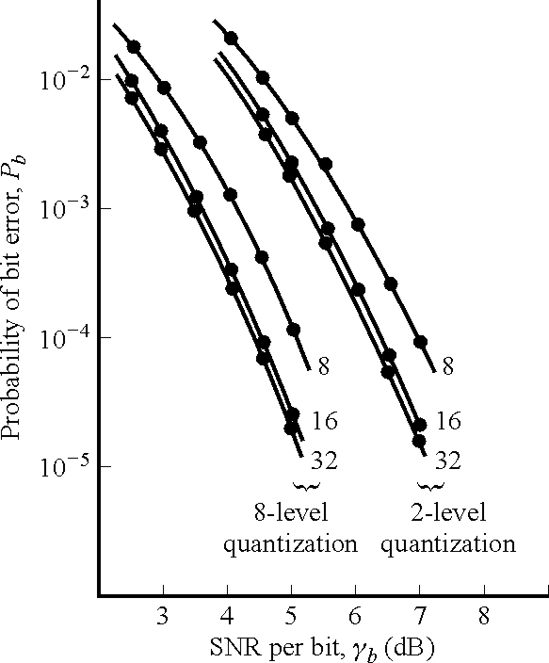
LLR Quantization
Minimal gains after 16 bit quantization of branch metrics
Recall HD is equivalent to 1 bit quantization
Most commercial implementations use 6-bit LLRs

Slide 54
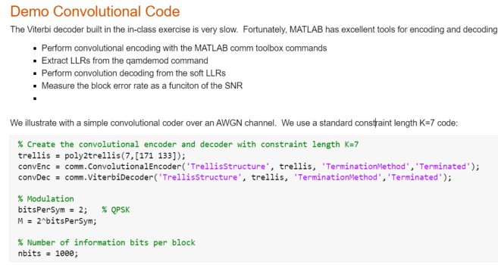
MATLAB Convolution Tools
MATLAB comm toolbox
General convolution encoders & decoders
Efficient implementation
Excellent for testing
See demo

Slide 55
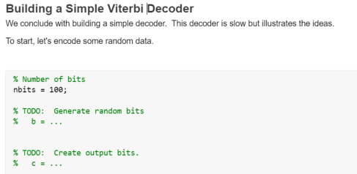
In-Class Exercise

