Slide 1
Power window control System
Team 14

Slide 2
Team 14
Abdelrahman Elhawary 19P5295
Ahmed Ossama Ahmed 19P9956
Ziad Mohamed Nasr 19P2061
Alaa Mohamed Galal 19P4206
Jannah Ayman 19P1728

Slide 3
Project Description

Slide 4
Power window system using TIVA C as the controller
Our system focuses on handling the Automatic and Manual modes of the of the window.
Our system detects the jamming of the window and lowers itself.
2 For the Driver’s Up and Down
2 for the Passenger’s Up and Down
Lock Button to Disable Passengers’ buttons
2 Limit switches per window
Each button is connected with a pin for interrupt.

Slide 5
State Diagram

Slide 6
(d_up || (pass_up && !pass_lock))
Motor
UP
Motor DOWN
(d_dwn|| (pass_dwn && !pass_lock))
Iimit_up || pressTime > 1000ms
Iimit_dwn || pressTime > 1000ms
jammed
(d_up || (pass_up && !pass_lock)) && limit_up == 0
(d_dwn || (pass_dwn && !pass_lock)) && limit_dwn == 0
Motor
DOWN
Motor OFF
Wait 0.5 seconds

Slide 7
Circuits Topologies

Slide 8
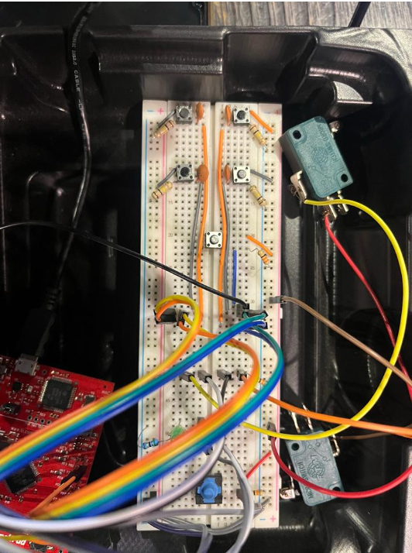
Driver up
Driver down
Emergency Jam button
4. Passenger up
5. Upper Limit Switch
6. Passenger down
7. Passenger lock
8. Down Limit Switch

Slide 9
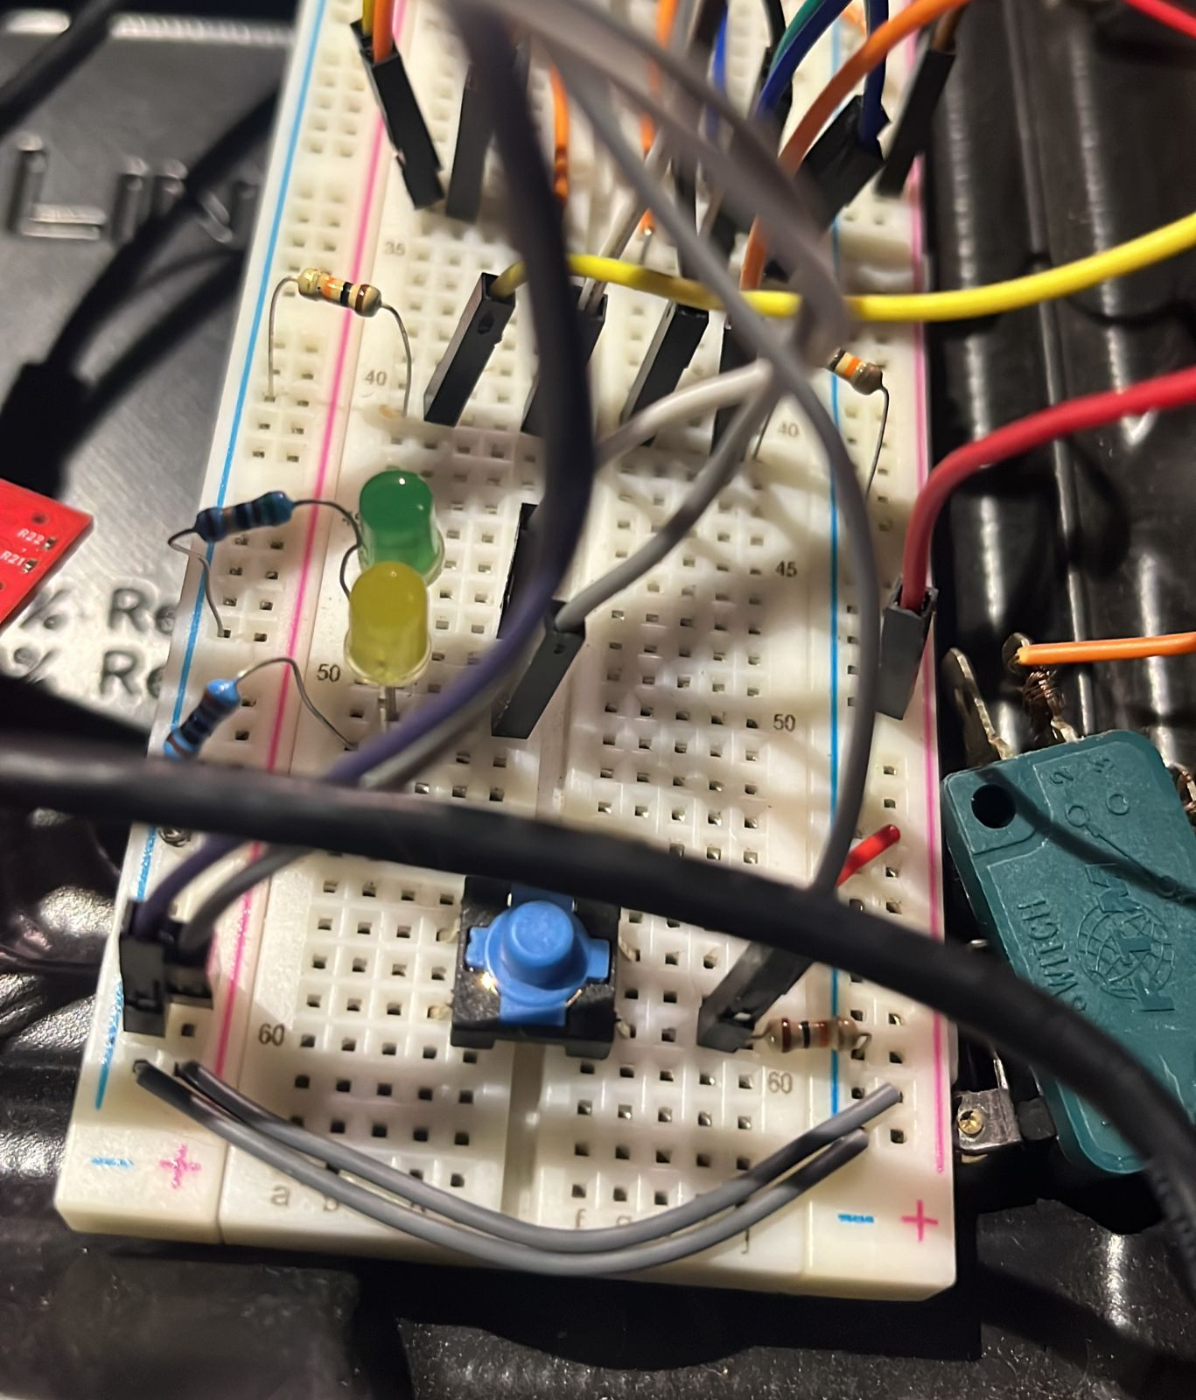
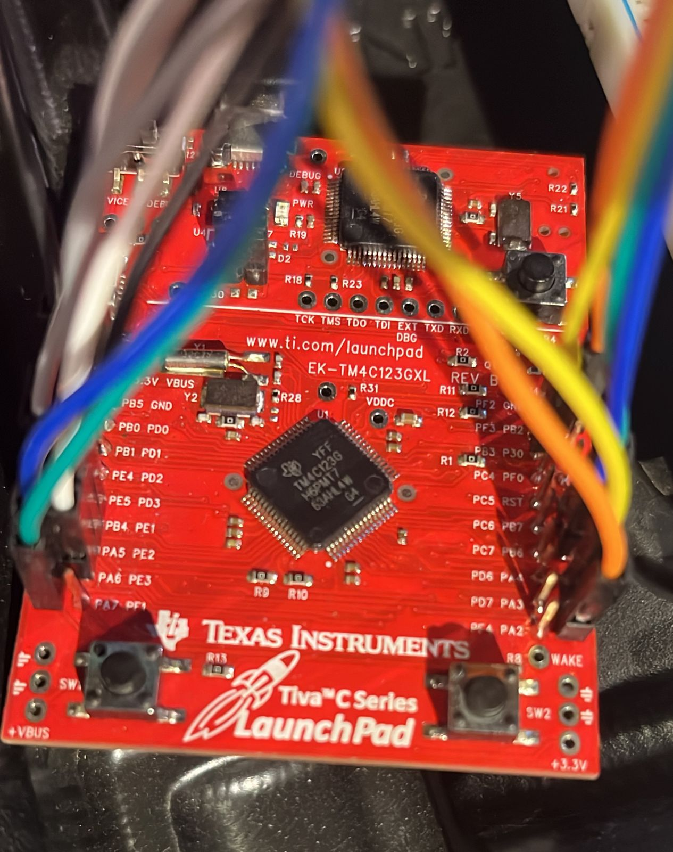
Up indicator
Down Indicator
Port A: Detecting Falling Edges
Port B: Detecting Rising Edges
Port E: Switches and Motor

Slide 10
Edge Cases

Slide 11
Handling of all the tests and corner cases
If the up limit switch is pressed , you can’t go up again until going down
If the down limit switch is pressed , you can’t go down again until going up
The jamming mode can’t be interrupted until it finishes, done using mutex lock
The jamming mode entered only in case of up mode only.
If two reversing buttons are pressed, the last one works.
If driver or passenger manually down and the passenger or driver pressed the automatic before the former letting go of the button, the automatic mode will be chosen even letting go of the former release the button

