Slide 1
Project Name : Bike Rent App
Course Teacher : Md. Ashiqur Rahman
Course Name : Mobile Application Development
Section : A
Name : Ahmed Raihan Alif
Id : 011191133

Slide 2
Project Idea
This project is designed so as to be used is renting bikes to customers.It is an online system through which customers can view bikes,register and book for bike.

Slide 3
Project Features :
1.Post for Rent by renters.
2.View Request by customers.
3.View Bike Categories.
4.Apply for Rent.
5.Authentication

Slide 4
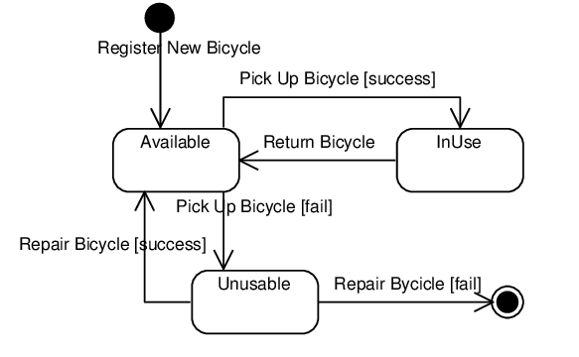
User Interaction Diagram

Slide 5


