Slide 1
Skill Tutor
Submitted by
011191037 – Siful Islam Ahad
011191133 – Ahmed Raihan Alif
011191137 – Samia Ahmed Mim
011191173 – Mahfujur Rahman
Faculty
Md. Mohaiminul Islam
Lecturer, United International University

Slide 2
Project Idea
Learner can learn skill from experts
Experts can show their skill details by their personal profile
Learner can choose their expert for their prefarable skills and will have to pay
Experts will teach learners by their chosen skill and earn money
Admin can get payment from learners for each experts they hire

Slide 3
Motivation Behind This Project
To make easy to earn money for skilled people
Find the best tutor for the skill hunter
To make comfortable to learn skill from the experts with flexible time,proper personal guideline,heavy resource with daily or weekly task

Slide 4

Benchmark
Features
TuitionBD
Tutor Sheba
Up work
Freelancer.com
Skill Tutor
Login & Sign-up
Search
Skill post & price
Filter
Learning Fees
Subscription
CV maker & upload
Project show case
Privacy & Security
Quick Response
Maintenance

Slide 5
Strength & Weakness
Users can easily see all the jobs and applied for the jobs. But in our system there is no e learning system which is a weakness point from our side.
Interview scheduling is our unique feature as we can see in other systems there is not present this feature so this can be unique feature for our project.

Slide 6
Project Scope
As we know everyone need jobs also company want best employee so everyday thousand of job post is posted in job sites and many got jobs from this sites.
From our existing system we can see 2000+ company and 4000+ jobs are available.
So system owner can earn huge amount of money from employer’s post which is brought by them.

Slide 7
Feature List
Skill post and price
Admin can set price for post
Employers can post
Job apply
Job seekers can apply for job
Category
Different types of categories for job search
CV
Cv make
Cv upload
Cv download

Slide 8
Feature List
Search
Can search for different types jobs
Email
Can apply through email if there is option for email apply
Payment
Admin can get payment for post that is brought by employers
Interview schedule
Employers can set a time date schedule for interview

Slide 9

Tools

Slide 10
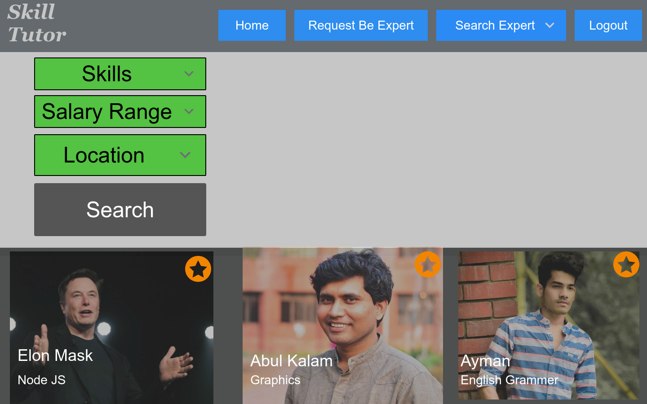
Project Demo

