Slide 1
TOMORROW · DAY 1
HOW THE MARKET
MEASURES ITSELF.
Every market needs a scoreboard. In Egypt, that's EGX30 — the 30 largest, most liquid companies listed on the exchange.
Every strategy you build this internship gets judged against this number.
THIS INTERNSHIP, WE'RE TRYING TO BEAT IT.
THIS WEEK'S FOCUS
01
Before any model or strategy — the right inputs. True of every data science problem, not just this one.
Feature engineering, first.
02
An algorithm looks for two things.
When to get in. When to get out. Everything else serves those two questions.
03
Risk management and diversification. A strategy that wins once on lucky data isn't reliable — that distinction matters all internship.
Reliable is not the same as profitable-looking.
1 / 2

Slide 2
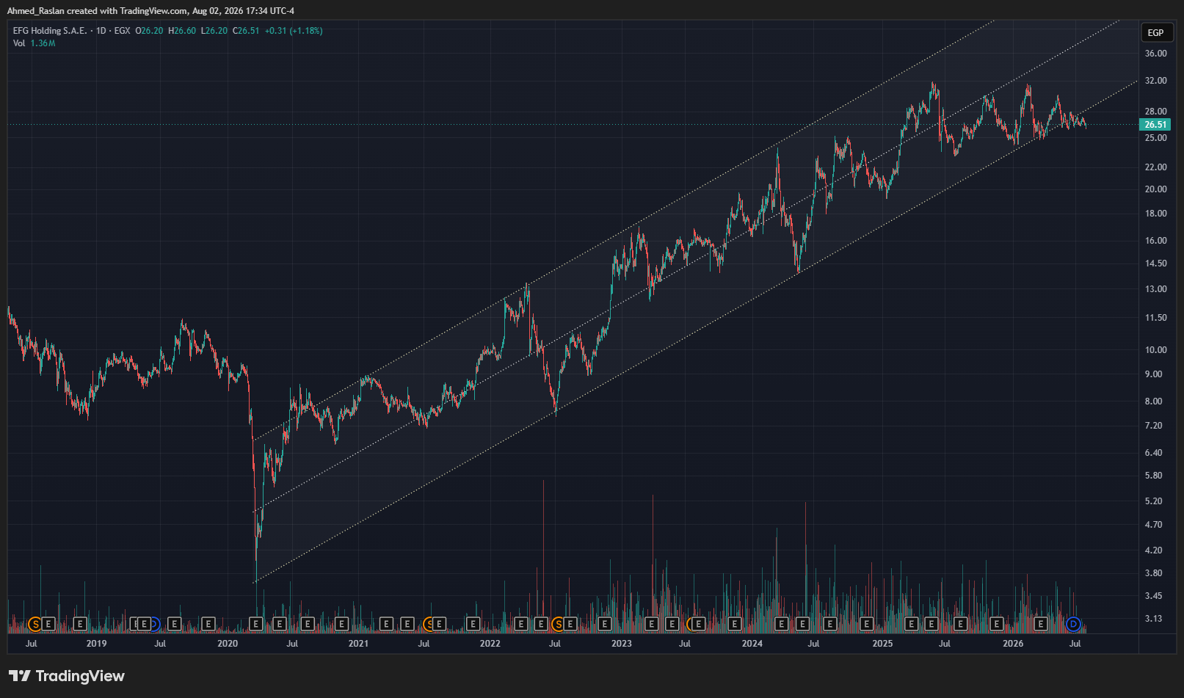
TOMORROW · DAY 1
Access to market: EFG Hermes ONE
GET SET UP.
THEN GO BUILD.
ENVIRONMENT
TradingView.com — charts, indicators, drawings
VS Code walkthrough: Debug, Source Control, Extensions
Open week1/01-setup-and-data, run the first notebook
Use debug mode — step inside every function
Read: learn/01-stock-market, learn/02-algo-trading
Notebooks 1 & 2, plus their extensions. Then, on your own: implement MACD. Read the real definition first — link below — then build it.

