Slide 1
CS-419 DEEP LEARNING · FINAL PROJECT
Credit Card Fraud Detection
An Experimental Study: Supervised MLP vs Unsupervised Autoencoder
Ahmed Raza
BSCS 2k23 · Section 13D / 13E · Spring 2026
github.com/AhmedRaza33/dl-project

Slide 2
WHY FRAUD DETECTION
The Problem
Credit-card fraud causes billions of dollars in losses each year.
Key feature of the problem:
• Extreme class imbalance — fraud is < 0.2 % of all transactions.
• Accuracy is meaningless — predicting "never fraud" already scores 99.83 %.
• Mistakes are asymmetric: missed fraud is the costly error.
Two questions this project answers:
1. Which DL technique helps the most on this data?
2. Is a supervised classifier (MLP) really better than an unsupervised anomaly detector (Autoencoder)?
By the numbers
284 807
transactions
30
features (V1..V28, Time, Amount)
492
fraud cases
0.172 %
positive rate
Ahmed Raza · CS-419 Deep Learning · Credit Card Fraud Detection
2 / 10

Slide 3
METHODOLOGY
Two Models, Same Test Set
Supervised MLP
Deep Autoencoder
Binary classifier
Unsupervised anomaly detector
• 30 → 64 → 32 → 16 → 1 (sigmoid)
• 30 → 28 → 20 → 12 → 7 → 12 → 20 → 28 → 30
• Binary cross-entropy loss
• Trained on normals only (MSE)
• Sees fraud labels during training
• Never sees fraud during training
• Decision = predicted probability
• Decision = reconstruction error
• ≈ 5 k parameters
• ≈ 4 k parameters
Both evaluated on the same stratified 70 / 15 / 15 split (seed=42) — every reported number is directly comparable.
Ahmed Raza · CS-419 Deep Learning · Credit Card Fraud Detection
3 / 10

Slide 4
ADDITIVE SWEEP
Experimental Study — 7 MLP Variants
Variant | What it adds | F1 | ROC-AUC | PR-AUC
1_baseline | SGD, ReLU, no tricks | 0.794 | 0.9593 | 0.6998
2_adam ★ | Swap SGD → Adam | 0.815 | 0.9791 | 0.8329
3_classweights | + class weights | 0.759 | 0.9750 | 0.6552
4_batchnorm | + BatchNormalization | 0.767 | 0.9651 | 0.6448
5_dropout_l2 | + Dropout(0.3) + L2(1e-4) | 0.789 | 0.9577 | 0.6671
6_leakyrelu | ReLU → LeakyReLU(0.1) | 0.775 | 0.9615 | 0.6600
7_best | + He init + LR scheduler | 0.794 | 0.9701 | 0.6658
Winner
2_adam ★
F1 0.815
PR-AUC 0.833
ROC-AUC 0.979
Plain Adam on the baseline arch.
Adding BN / Dropout / L2 / class-weights hurts.
Switching SGD → Adam alone delivers +0.13 PR-AUC. Further regularisation removes signal — the model is already low-variance.
Ahmed Raza · CS-419 Deep Learning · Credit Card Fraud Detection
4 / 10

Slide 5
WHY
Key Insight: simpler is better here
Data : parameters ratio
Implications
• Adam dominates SGD — adaptive LRs converge to a strictly better optimum on the PCA-decorrelated loss surface.
• Dropout & L2 hurt — the model has plenty of capacity headroom; suppressing it removes signal.
• Class weights help ROC-AUC, but the F1 gain disappears once we tune the threshold.
• LeakyReLU + He init matter most in the subtractive ablation: removing them costs −0.056 F1.
199 364 / 5 057 ≈ 39 : 1
examples per parameter — already low-variance
Ahmed Raza · CS-419 Deep Learning · Credit Card Fraud Detection
5 / 10

Slide 6
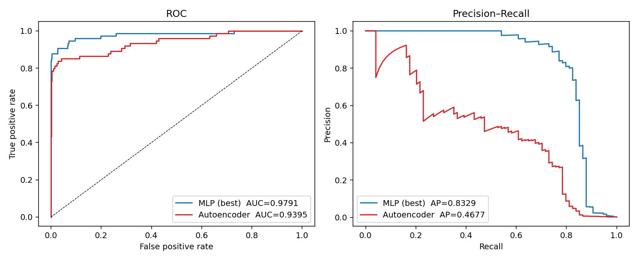
COMPARATIVE ANALYSIS
Head-to-Head: MLP vs Autoencoder
Metric | MLP (best) | Autoencoder | Δ
Precision | 0.902 | 0.413 | +0.488
Recall | 0.743 | 0.676 | +0.068
F1 | 0.815 | 0.513 | +0.302
ROC-AUC | 0.9791 | 0.9395 | +0.0396
PR-AUC | 0.8329 | 0.4677 | +0.3652
Params | 4,609 | 4,085 | —
Train time | 7.9 s | 96.8 s | —
ROC (left) and Precision–Recall (right) on the shared test set.
Same 42 722-sample test set. Same F1-tuned threshold rule.
Ahmed Raza · CS-419 Deep Learning · Credit Card Fraud Detection
6 / 10

Slide 7
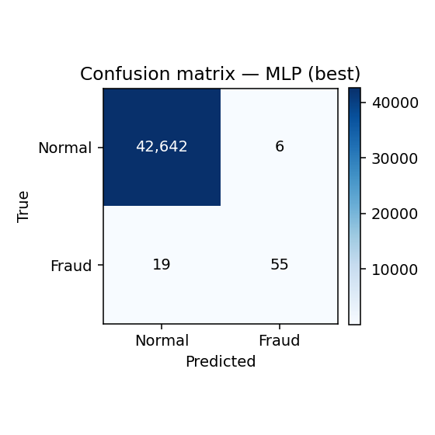

ERROR ANALYSIS
Where each model errs
MLP — FP=6, FN=19, TP=55
Autoencoder — FP=71, FN=24, TP=50
• MLP makes only 6 false positives on 42,648 legitimate transactions (0.0141% FPR) and misses 19/74 frauds.
• Autoencoder catches 50 frauds at the cost of 71 false alarms — 12× more noise for the operations team.
• In production we'd ensemble: MLP as primary, AE as drift sensor + fallback for novel fraud types.
Ahmed Raza · CS-419 Deep Learning · Credit Card Fraud Detection
7 / 10

Slide 8
WHAT CARRIES THE MODEL?
Ablation Study (subtractive)
Removed component | ΔF1 | ΔROC-AUC | ΔPR-AUC
LeakyReLU | -0.0556 | -0.0250 | -0.0516
Class weights | -0.0221 | -0.0713 | -0.0755
He init | -0.0190 | -0.0086 | -0.0058
BatchNorm | -0.0137 | -0.0324 | -0.0415
Dropout(0.3) | +0.0055 | -0.0073 | +0.0032
L2(1e-4) | +0.0082 | -0.0002 | -0.0030
Reading the table
Removing LeakyReLU hurts F1 the most (−0.056).
Removing class weights hurts ROC-AUC the most (−0.071).
Removing Dropout and L2 gives positive Δ — they were over-regularising.
Bottom line:
Optimiser > activation/init > BatchNorm > class weights ≫ Dropout/L2
Ahmed Raza · CS-419 Deep Learning · Credit Card Fraud Detection
8 / 10

Slide 9
LESSONS LEARNED
Biggest challenges faced
Extreme class imbalance (0.17 %)
Forced us off accuracy and on to PR-AUC. Every threshold tweak had outsized impact on the confusion matrix.
Fair model comparison
Realised the AE was trained on a different normals split than the MLP's test set — risked train/test leakage. Fixed by retraining the AE on the same train split before comparing.
Threshold instability
Adding class weights shifts the entire probability calibration — every variant needed its own threshold re-tuning before metrics were comparable.
Counter-intuitive regularisation
Default DL instinct says "add Dropout + L2". The ablation showed they were hurting; this only became visible after running the subtractive study.
Ahmed Raza · CS-419 Deep Learning · Credit Card Fraud Detection
9 / 10

Slide 10
FUTURE WORK
What we'd improve with more time
Gradient-boosted trees baseline
Focal loss
XGBoost / LightGBM are historically very competitive on tabular data. We need to know how much deep learning is actually buying us over a strong classical baseline.
Replace BCE with focal loss to directly down-weight easy negatives — known to help under extreme class imbalance.
MLP + Autoencoder ensemble
Probability calibration
Stack the MLP probability and AE reconstruction error in a logistic meta-learner. The AE's ranking is complementary at the high-recall tail.
Add Platt scaling / isotonic regression on the validation set so probabilities are usable in cost-sensitive downstream decisions.
Bootstrap confidence intervals
Only 74 frauds in the test set — every CM cell has high variance. Report 95 % CIs on F1 before any deployment claim.
Ahmed Raza · CS-419 Deep Learning · Credit Card Fraud Detection
10 / 10

Slide 11
SUMMARY
Key takeaways
• Best supervised MLP: F1 = 0.815, ROC-AUC = 0.9791, PR-AUC = 0.8329
Plain Adam-trained baseline beats every more-regularised variant.
• Supervised MLP > Autoencoder by +0.36 F1, +0.34 PR-AUC on the same test set.
But the AE is still valuable as a drift sensor and as a fallback for novel fraud types.
• Optimiser choice was the single biggest design decision.
Adam over SGD added +0.13 PR-AUC; nothing else moved the needle as much.
• Heavy regularisation hurts when data : params is high.
With ~39 examples per parameter, Dropout / L2 removed signal we couldn't spare.
• Methodology matters as much as architecture.
Retraining the AE on the shared split was the difference between a fair comparison and a leaky one.
Ahmed Raza · CS-419 Deep Learning · Credit Card Fraud Detection
10 / 10

Slide 12
Thank you
Questions?
Ahmed Raza · CS-419 Deep Learning · Spring 2026
github.com/AhmedRaza33/dl-project

