Slide 1

East West University
Course: CSE-207
Instructor-Md. Manowarul Islam
Topic: Rat in a Maze
Presented by: Shamil Bin Hossain Noor (2021-2-60-102) Redown Ahmed (2022-1-60-159) Abdul Mumeet Pathan (2022-1-60-267) Tasnuva Tasnim Nova (2022-1-60-266)

Slide 2

INTRODUCTION
A "rat in a maze" is a classic metaphorical scenario often used in various contexts, including computer science, psychology, and decision-making studies. It refers to a simple yet illustrative problem where a hypothetical rat is placed within a maze and must navigate through it to reach a specific goal or exit point.

Slide 3
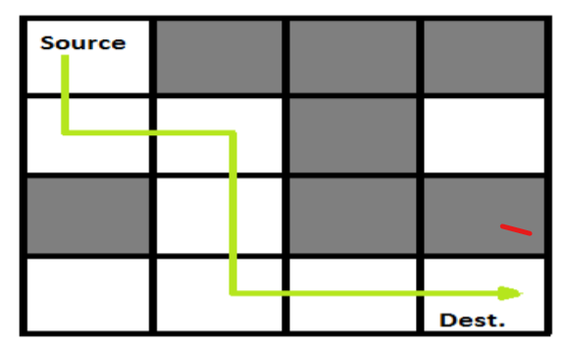
About Question
A rat starts from source and has to reach destination.
A Maze is given as N*N binary matrix

Slide 4
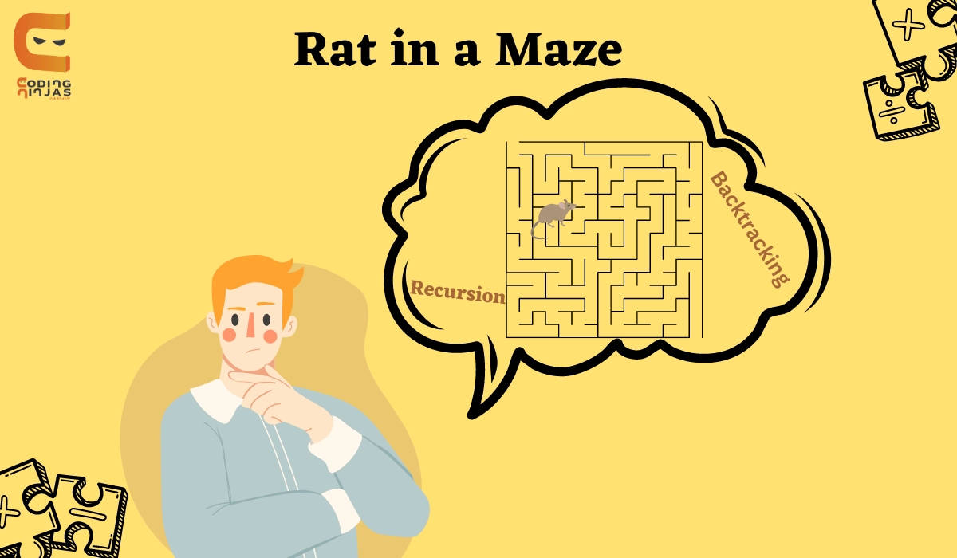
Purpose
A rat-in-a-maze project in Computer Science and Engineering serves diverse purposes, including algorithm development, education, research, and skill development, with its specific objectives shaping its overarching goal.

Slide 5
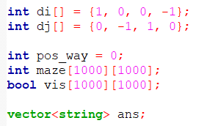
Short Overview Before We Dive in
it includes necessary header files: <bits/stdc++.h> and <windows.h>.
The prelude outlines a code snippet featuring header files, directional arrays, path tracking, maze representation, visited cell markers, path storage, and a recursive 'solve' function for maze exploration using backtracking.

Slide 6
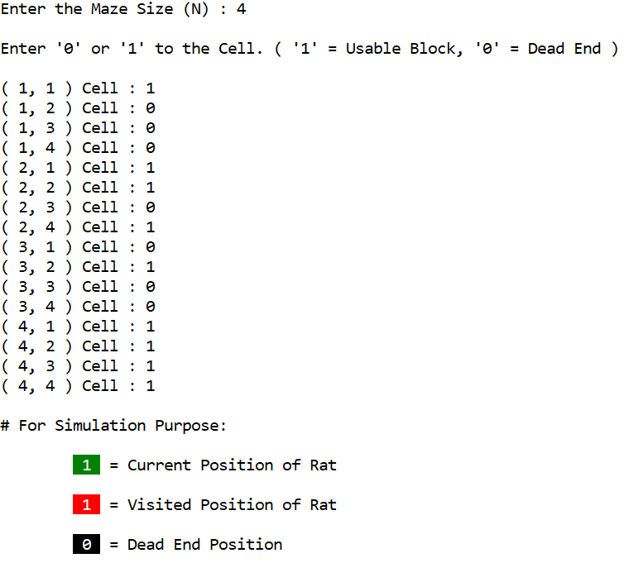
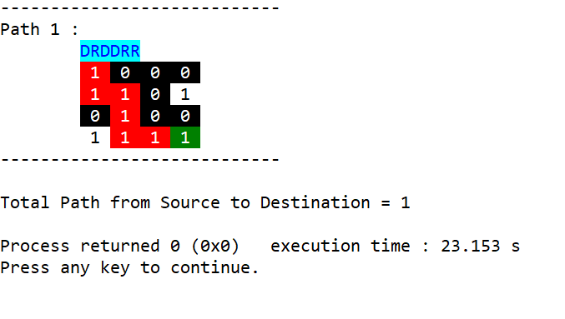
Describing Code a. Input Output

Slide 7
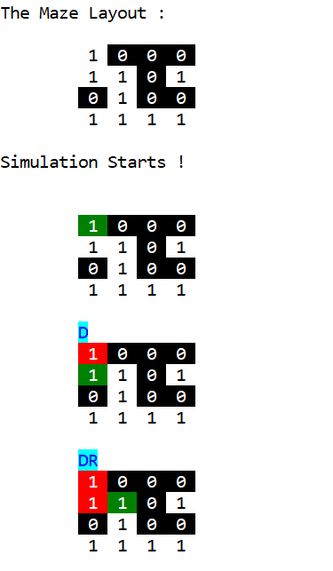
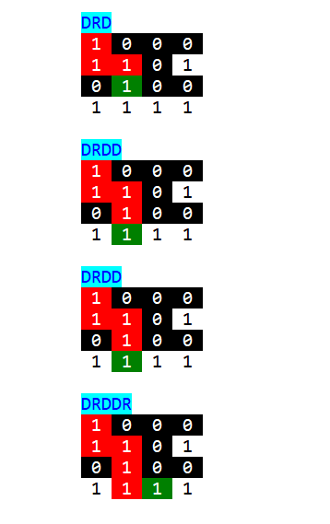
Visualization

Slide 8


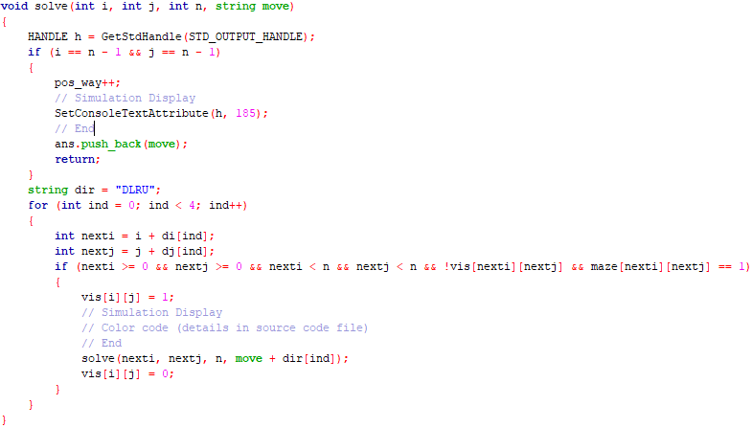
Solve Function

Slide 9
Conclusion
Our exploration of maze-solving and visualization underscored the importance of algorithms across diverse fields. We delved into a sophisticated C++ program for maze solving and visualization, fostering creativity and problem-solving abilities with real-world relevance.

Slide 10
Thank You

