Slide 1
Welcome to my Presentation
Project Title: Construction of a Microcontroller-Based Protection System for Voltage and Frequency Fluctuation
Presenting by: Ahmed Rijvee
ID: 1810874144
Batch-2
Session: 2017-18

Slide 2
Goal of this project
To develop a protection system using microcontroller technology to safeguard against voltage fluctuations and frequency deviations.
Based on:
Real time monitoring
Anomaly detection
Immediate response

Slide 3
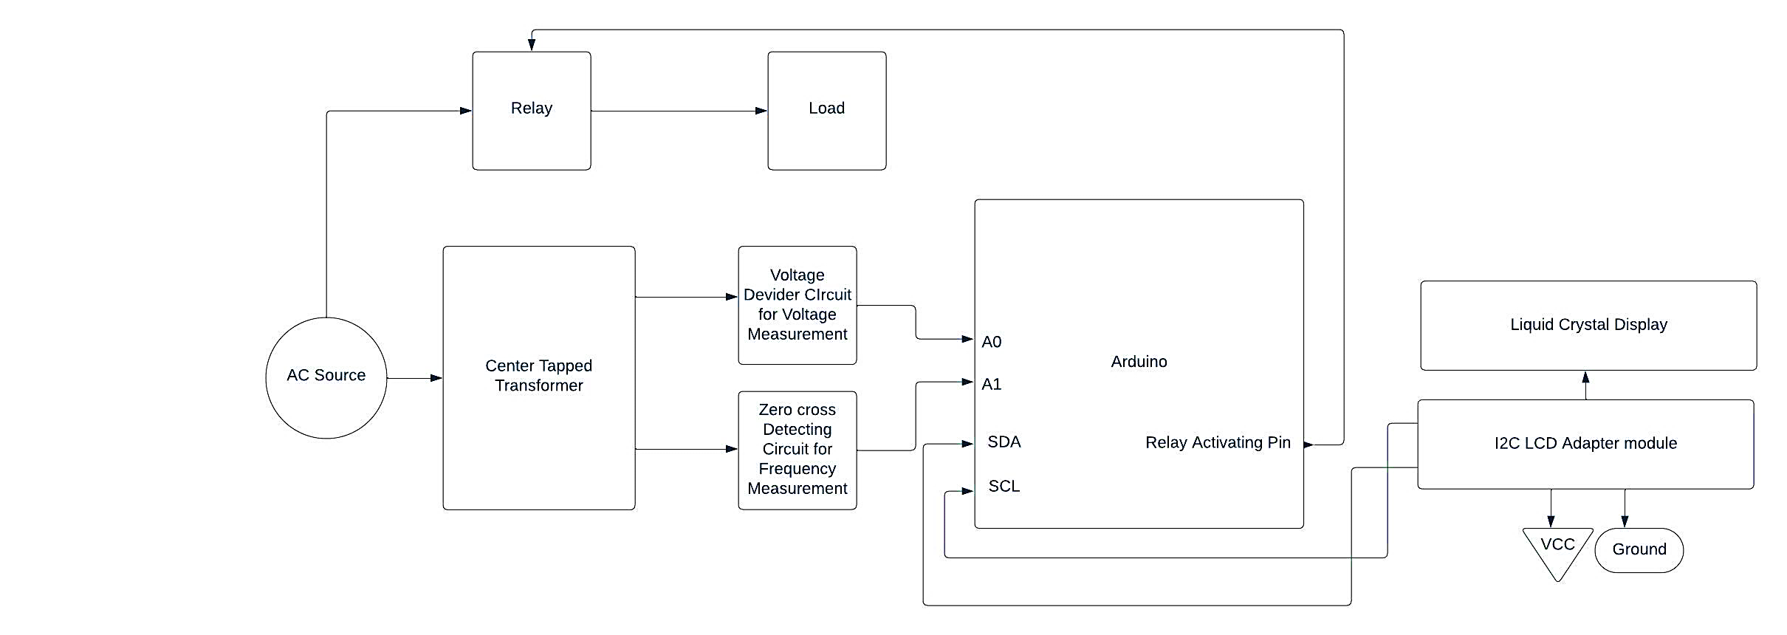
Schematic Diagram

Slide 4
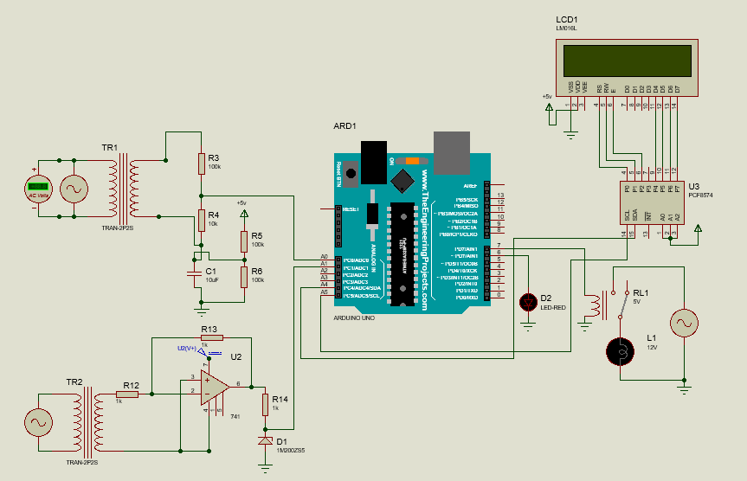
Circuit Diagram

Slide 5
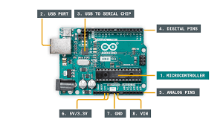
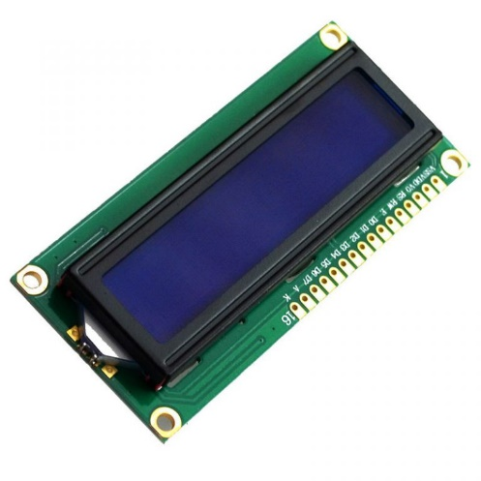
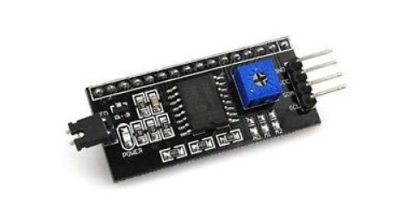
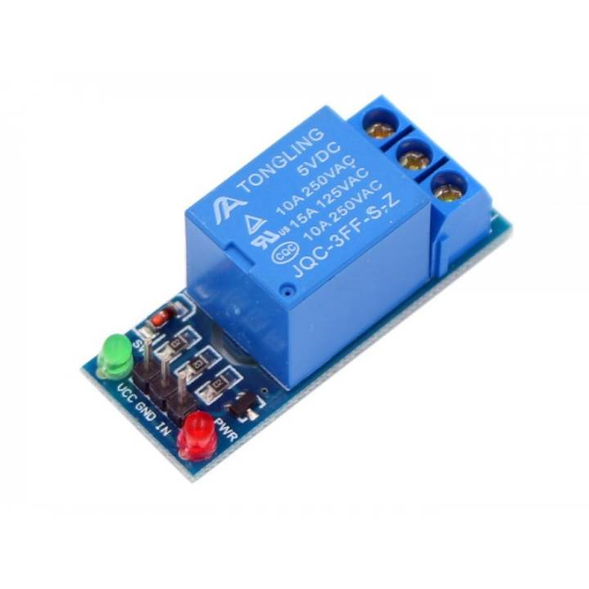
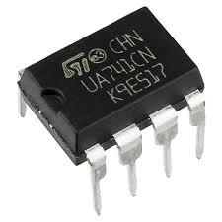
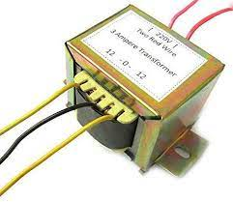
Components used in this project
I2C Adapter Module
Arduino UNO
16 x 2 LCD
5V DC Relay
741 Op-amp
Center tapped stepdown
transformer

Slide 6
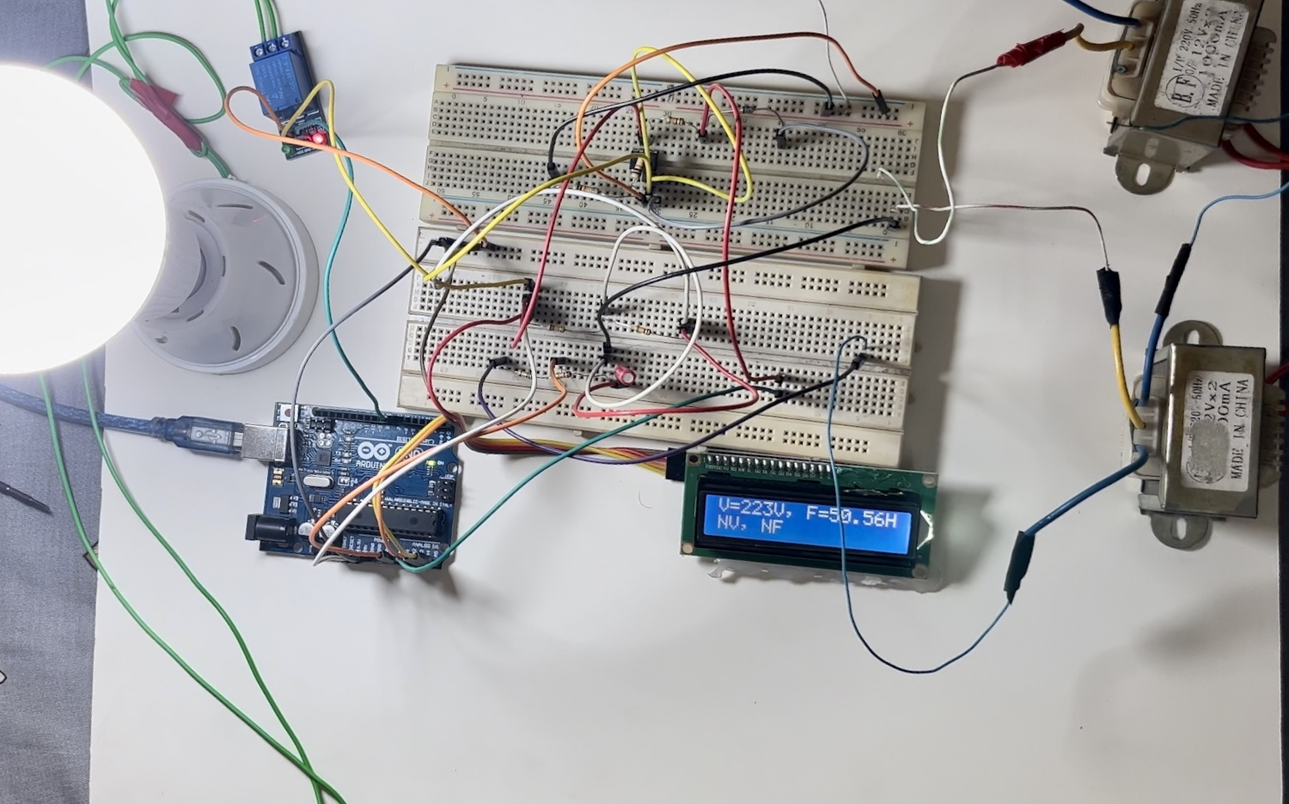
Implementation and Condition
Conditions:
Normal voltage, 200V ≤ NV ≤ 240V
Under Voltage, UV < 200V
Over Voltage, OV > 240V
Normal frequency, 49Hz ≤ NF ≤ 51.5Hz
Under frequency, UF < 49Hz
Over frequency, OV > 51.5Hz
Hardware Implementation

Slide 7
Limitations
Initially, two transformers were used to handle the loading effect.
When a high voltage supply is used, the rating of the transformer is subject to change.
A slight tolerance is showing due to variations in component uniformity.

Slide 8
Future enhancement
Allowing the system to send alerts to remote monitoring stations or trigger automated shutdown procedures.
The system could benefit from predictive algorithms that anticipate voltage and frequency anomalies based on historical data, enabling even more proactive protection strategies.

Slide 9
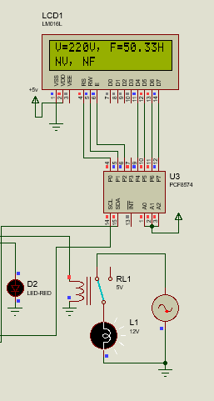
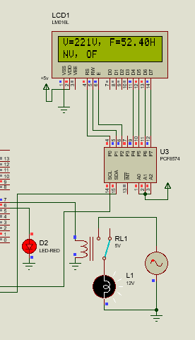
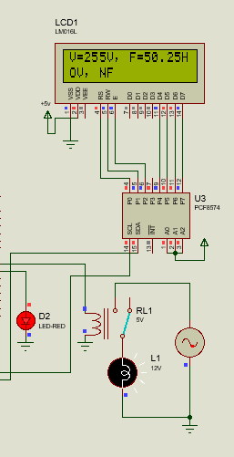
Conclusion
Load operating at
NV, NF condition
Load disconnected at
NV, OF condition
Load disconnected at
OV, NF condition

Slide 10
Thanks for Your Kind Attention

