Slide 1
EDA Project
MTA Advertisement
Name : Ahmed Alonaizi

Slide 2
Overview:
The advertising sales department of public transport companies is considered one of the most important sources of income, It contributes to achieving profits through advertisements inside stations and transportation.

Slide 3

What do we need?
Over a three-month period of data we will find:
1- Top 5 most visited stations throughout the week
2- How many views are expected for the advertisement in the most visited stations?
3- What is the best time to advertise?

Slide 4
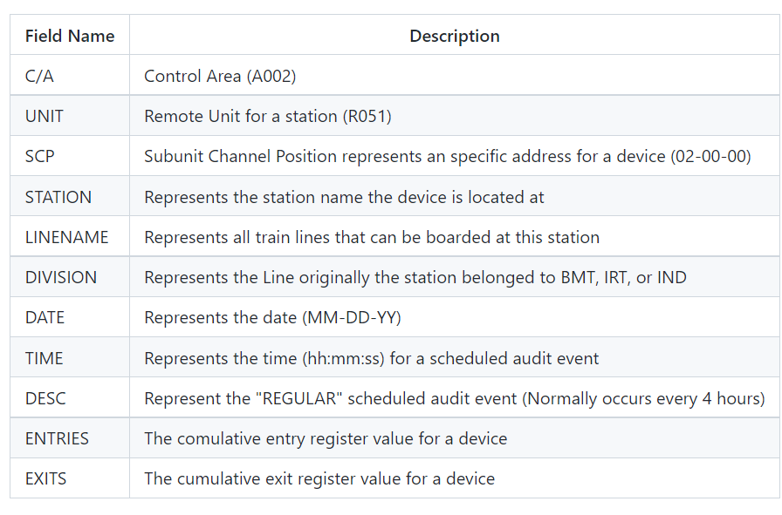
Data Description: The period from 06/26/2021 to 10/01/2021 (three months)

Slide 5
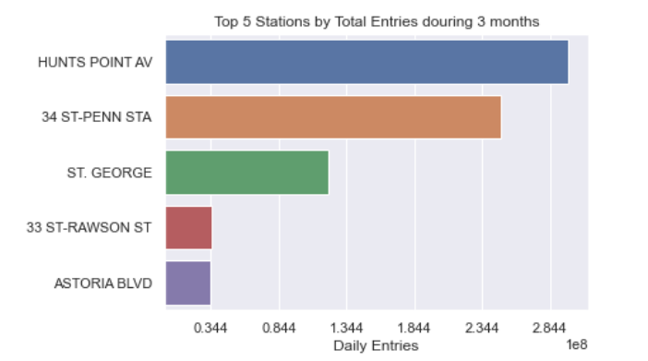
Top 5 most visited stations throughout the week

Slide 6
Let’s Take two random Station
let's choose
1- ST. GEORGE station
2- 33 ST-RAWSON ST station
To Answer our Question/need

Slide 7
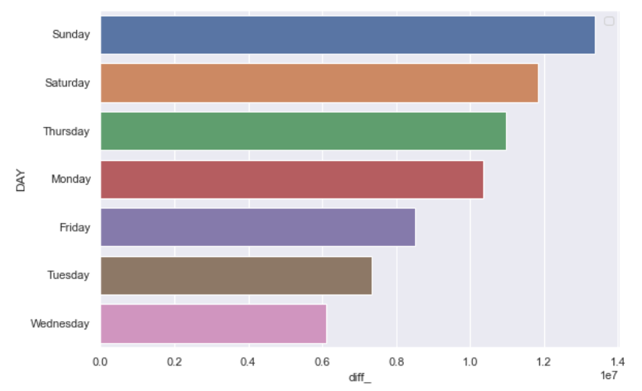
Finding the busiest day
(ST. GEORGE) station

Slide 8
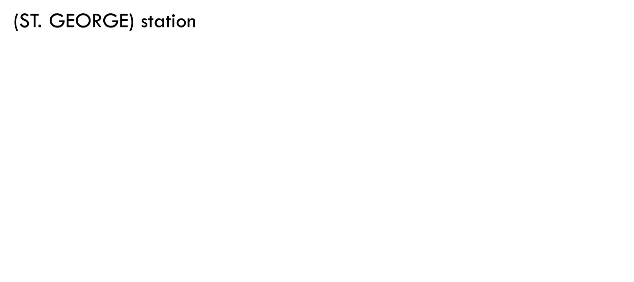
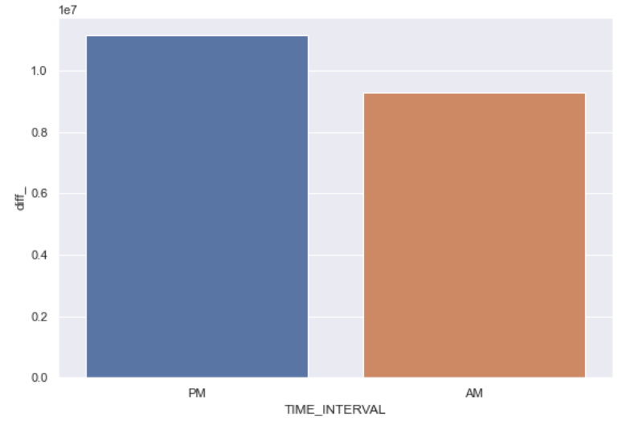
Finding the busiest time interval

Slide 9
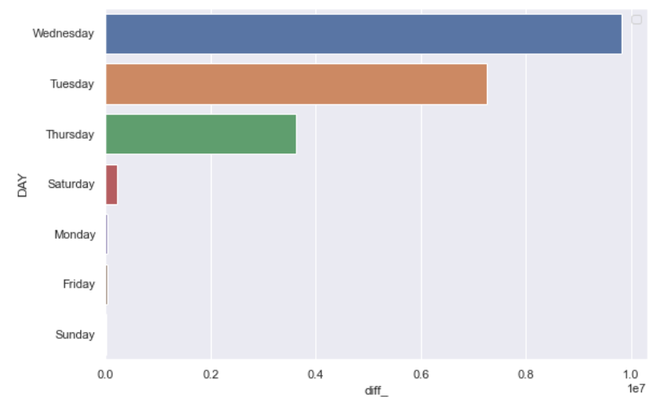
Finding the busiest day
(33 ST-RAWSON ST) station

Slide 10
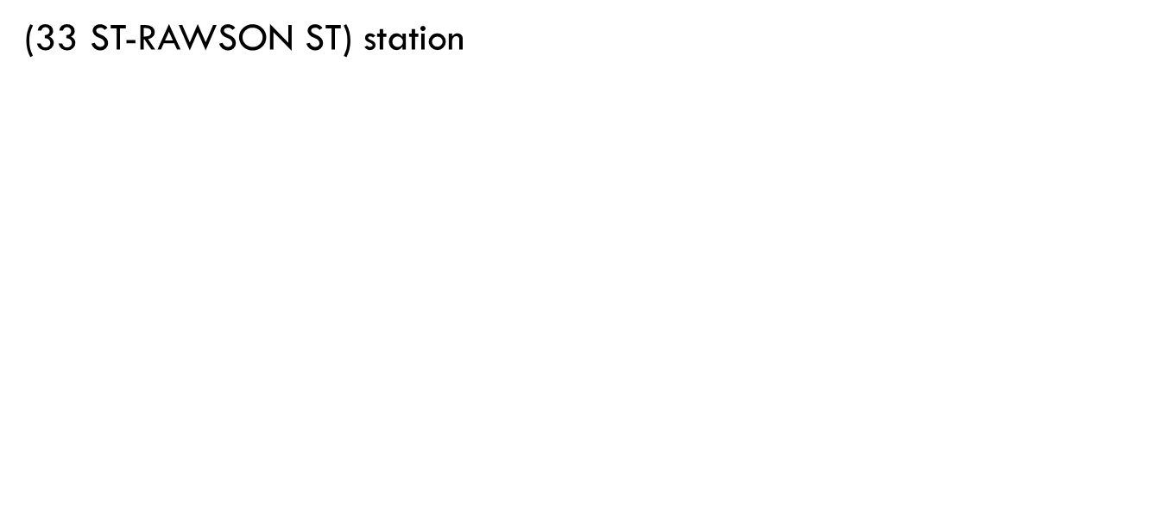
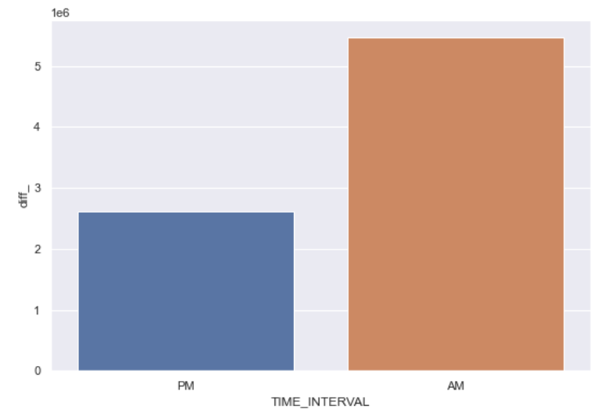
Finding the busiest time interval

Slide 11
Comparison
33 ST-RAWSON ST | ST. GEORGE | BEST TIME
Wednesday Tuesday Thursday | Saturday Sunday Thursday Monday | Expected highest views of ads in the following days
AM | PM | Expected highest views of ads in the following Interval

Slide 12
conclusion
After taking advantage of the available dataset of MTA stations The directors of the advertising department can set the appropriate price for the advertisement according to the number of expected views for each station. The higher the number of expected views, therefore the higher the value of the ads.

Slide 13
Thank your for listening

