Slide 1
Non-Preemptive Scheduler
Application
HAL
MCAL

Slide 2
Non-Preemptive Scheduler
Application
HAL
GPIO
GPTM
SYSTICK
ADC
PWM

Slide 3
Non-Preemptive Scheduler
Application
Temperature Sensor
LCD
Motors
LDR
Ultrasonic
GPIO
GPTM
SYSTICK
ADC
PWM

Slide 4
Non-Preemptive Scheduler
Application
Non-Preemptive Scheduler
Temperature Sensor
LCD
Motors
LDR
Ultrasonic
GPIO
GPTM
SYSTICK
ADC
PWM

Slide 5
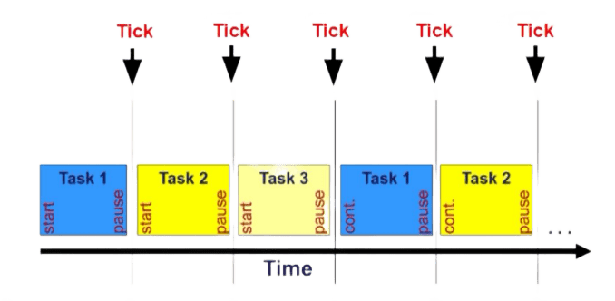
Non-Preemptive Scheduler
Scheduler Features
Uses the SysTick timer for scheduling.

Slide 6
Non-Preemptive Scheduler
RAM
Scheduler Features
Uses the SysTick timer for scheduling.
Task Control Block (TCB) for each task.
Heap
TCB 1
Pointer to Task
Free Area
Stack
Periodicity
Task 1
TCB 2
Task 2
Pointer to Task
.data
Periodicity
.bss

Slide 7
Non-Preemptive Scheduler
Scheduler Features
Uses the SysTick timer for scheduling.
Task Control Block (TCB) for each task.
Support for Multiple Tasks.
Pseudo Code
int main(void) {
Initialize and setup the hardware.
Create different tasks using create_task(task, ms_periodicity).
Start the scheduler using tasks_scheduler().
while (1); }

Slide 8
Non-Preemptive Scheduler
Application
Non-Preemptive Scheduler
Temperature Sensor
LCD
Motors
LDR
Ultrasonic
GPIO
GPTM
SYSTICK
ADC
PWM

Slide 9
Preemptive Scheduler
Application
RTOS
Temperature Sensor
LCD
Motors
LDR
Ultrasonic
GPIO
GPTM
SYSTICK
ADC
PWM

Slide 10
Preemptive Scheduler
SWC 1
SWC 2
SWC 3
SWC 4
RTOS
Temperature Sensor
LCD
Motors
LDR
Ultrasonic
GPIO
GPTM
SYSTICK
ADC
PWM

Slide 11
Preemptive Scheduler
SWC 1
SWC 2
SWC 3
SWC 4
Ultrasonic Read
Ultrasonic Update
Modules Init
LCD Print
LDR Read
LDR Update
Switch Check
TS Read
TS Update

Slide 12
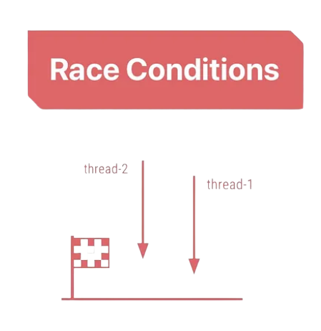
Task Synchronization
Our Simple Scheduler
Global Variables
Challenges
Data Corruption
Race Conditions
Task 1
Task 2

Slide 13
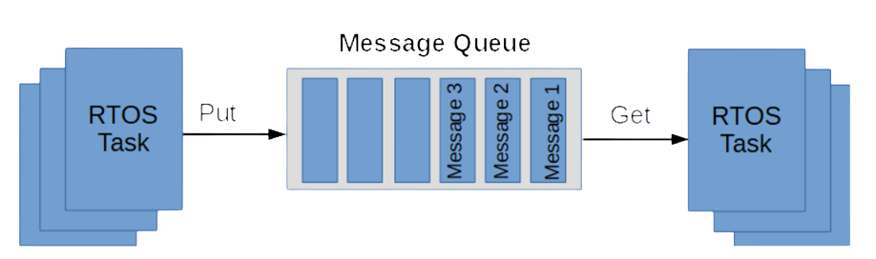
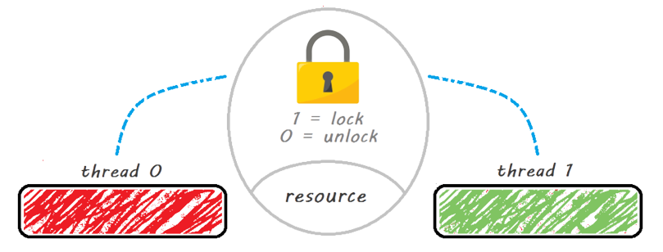
Task Synchronization
RTOS Scheduler
Queues
Semaphores
Advantages
Improved Task Isolation
Data Integrity
Task 1
Task 2

Slide 14
Preemptive Scheduler
System is on for 60 seconds
System is off
Switch pressed
Switch not pressed
Ultrasonic Read
Queue 1
Ultrasonic Update
Queue 3
Switch Check
LDR Read
Queue 2
LDR Update
Queue 4
LCD Print
Modules Init
Turn off the system
TS Read
TS Update
Queue 5

Slide 15
Preemptive Scheduler
Unbalanced BCET and WCET
Task Execution Fluctuations
Poor Determinism
Task | BCET | WCET | Deadline | Periodicity | Priority
Ultrasonic Read | 1 ms | 4 ms | 25 ms | 25 ms | 6
Ultrasonic Update | 1 ms | 1 ms | 25 ms | 25 ms | 5
LDR Read | 1 ms | 1 ms | 50 ms | 50 ms | 4
LDR Update | 1 ms | 1 ms | 50 ms | 50 ms | 3
TS Read | 1 ms | 1 ms | 50 ms | 50 ms | 2
LCD Print | 62 ms | 77 ms | 200 ms | 200 ms | 1

Slide 16
Preemptive Scheduler
Balancing the System with the Time Sandwich Method
Used in Ultrasonic Read and LCD Print tasks for system balance.
increase BCET while maintaining task functionality.
Improved Predictability.
Sandwich ( 4 ms )
Ultrasonic Read
Sandwich ( 77 ms )
LCD Print

Slide 17
Preemptive Scheduler
Task | BCET | WCET | Deadline | Periodicity | Priority
Ultrasonic Read | 4 ms | 4 ms | 25 ms | 25 ms | 6
Ultrasonic Update | 1 ms | 1 ms | 25 ms | 25 ms | 5
LDR Read | 1 ms | 1 ms | 50 ms | 50 ms | 4
LDR Update | 1 ms | 1 ms | 50 ms | 50 ms | 3
TS Read | 1 ms | 1 ms | 50 ms | 50 ms | 2
LCD Print | 77 ms | 77 ms | 200 ms | 200 ms | 1

Slide 18
Preemptive Scheduler
System Schedulability Check
Ensure that the real-time system is schedulable.
Guarantee that all tasks meet their deadlines.
Task | WCET | Deadline | Periodicity | Priority
Ultrasonic Read | 4 ms | 25 ms | 25 ms | 6
Ultrasonic Update | 1 ms | 25 ms | 25 ms | 5
LDR Read | 1 ms | 50 ms | 50 ms | 4
LDR Update | 1 ms | 50 ms | 50 ms | 3
TS Read | 1 ms | 50 ms | 50 ms | 2
LCD Print | 77 ms | 200 ms | 200 ms | 1

Slide 19
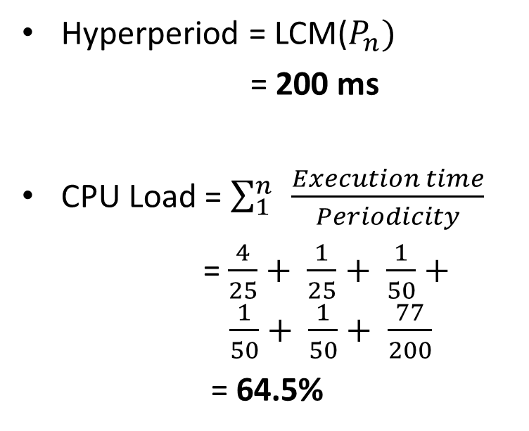
Preemptive Scheduler
Task | WCET | Deadline | Periodicity | Priority
Ultrasonic Read | 4 ms | 25 ms | 25 ms | 6
Ultrasonic Update | 1 ms | 25 ms | 25 ms | 5
LDR Read | 1 ms | 50 ms | 50 ms | 4
LDR Update | 1 ms | 50 ms | 50 ms | 3
TS Read | 1 ms | 50 ms | 50 ms | 2
LCD Print | 77 ms | 200 ms | 200 ms | 1
Hyperperiod = LCM($P_{n})$
= 200 ms
CPU Load = $\sum_{1}^{n}{ }\frac{Execution time}{Periodicity}$
= $\frac{4}{25}+ \frac{1}{25}+ \frac{1}{50}+ \frac{1}{50}+ \frac{1}{50}+ \frac{77}{200}$
= 64.5%

Slide 20
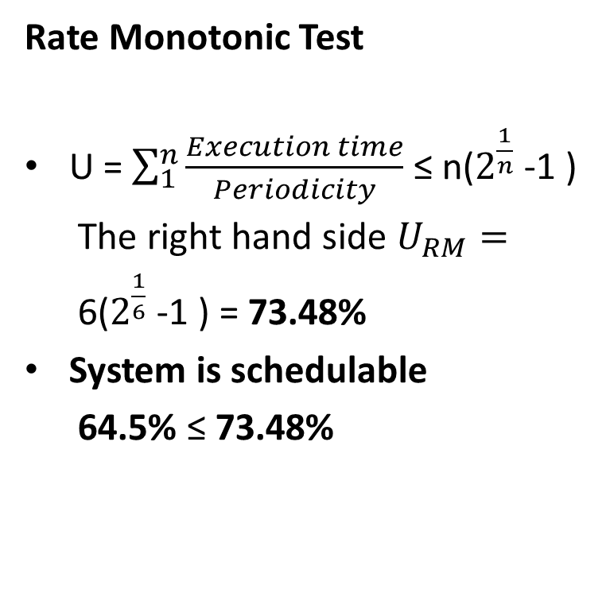
Preemptive Scheduler
Rate Monotonic Test
U = $\sum_{1}^{n}{\frac{Execution time}{Periodicity}}$ ≤ n($2^{\frac{1}{n}}$-1 )
The right hand side $U_{RM}=$
6($2^{\frac{1}{6}}$-1 ) = 73.48%
System is schedulable
64.5% ≤ 73.48%
Task | WCET | Deadline | Periodicity | Priority
Ultrasonic Read | 4 ms | 25 ms | 25 ms | 6
Ultrasonic Update | 1 ms | 25 ms | 25 ms | 5
LDR Read | 1 ms | 50 ms | 50 ms | 4
LDR Update | 1 ms | 50 ms | 50 ms | 3
TS Read | 1 ms | 50 ms | 50 ms | 2
LCD Print | 77 ms | 200 ms | 200 ms | 1

Slide 21
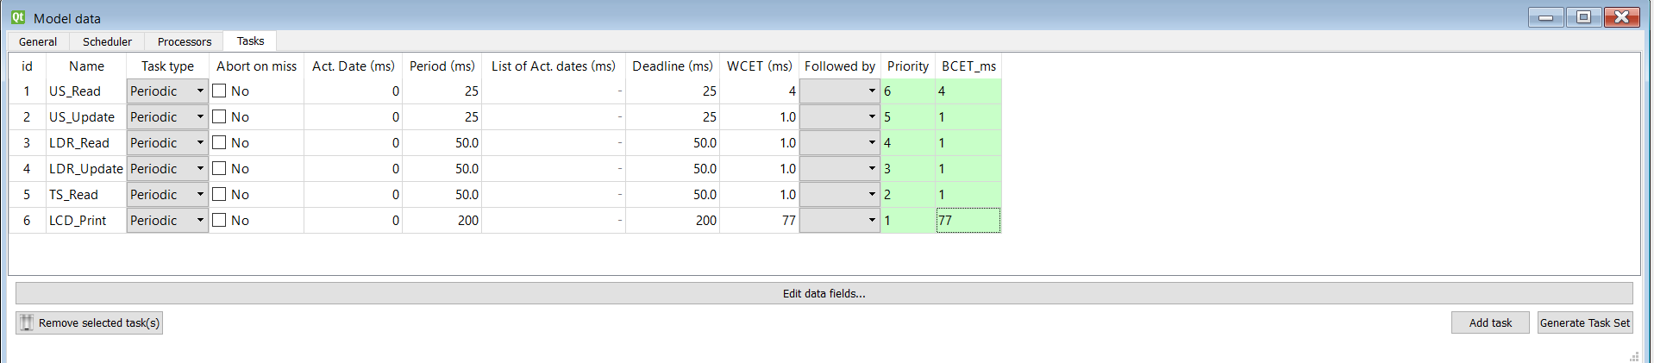
Preemptive Scheduler
Simulate Scheduling Offline Using Simso Simulator
Create Tasks

Slide 22
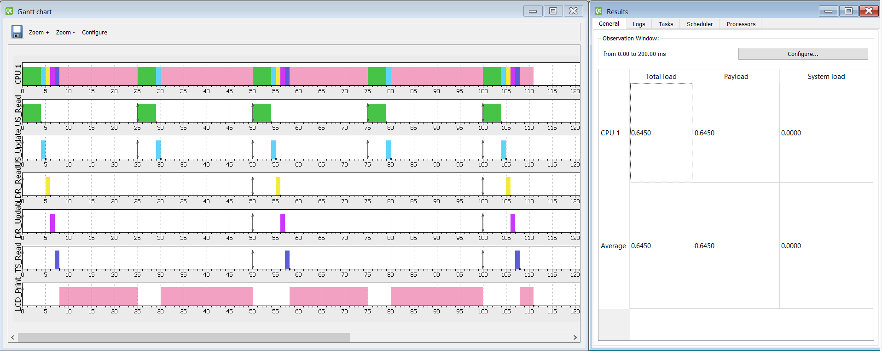
Preemptive Scheduler
Simulate Scheduling Offline Using Simso Simulator
Generating Timeline and Statistics
The simulation verifies the same CPU Load 64.5%

