Slide 1
TSKS14 Multiple Antenna Communications
Lecture 1, 2020
Emil Björnson

Slide 2
Three main benefits of multiple antenna communications
Beamforming gain
Spatial diversity
Spatial multiplexing
The course will cover all of them:
First historical perspective
Then the theory behind them

Slide 3
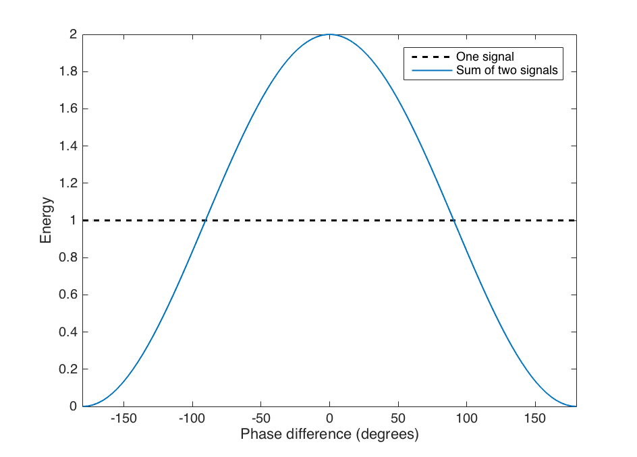
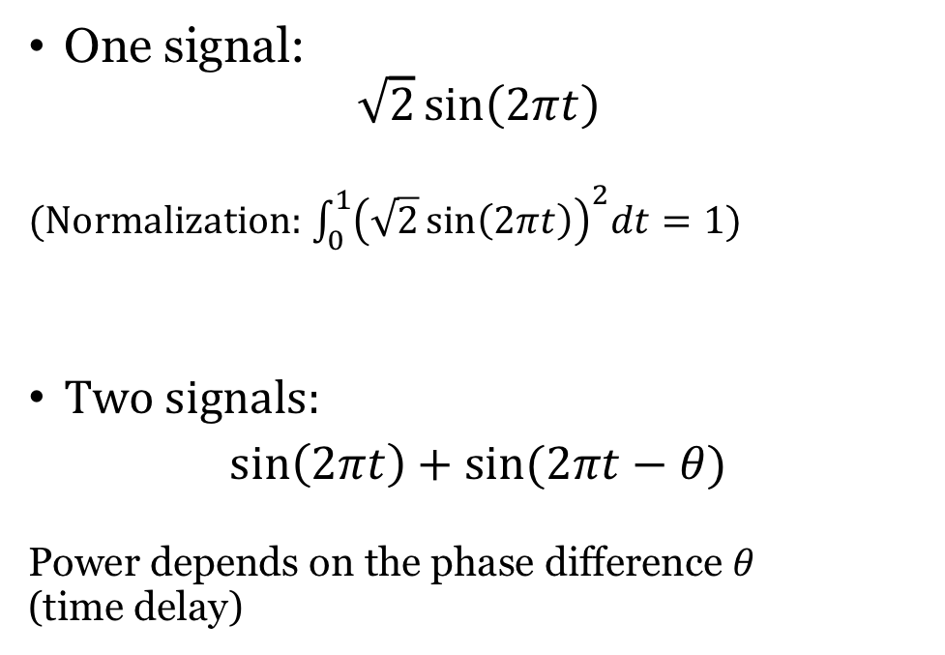
Constructive and destructive interference
One signal:
$$\sqrt{2}\sin\left(2πt\right)$$
(Normalization: $\int_{0}^{1}{{\left(\sqrt{2}\sin\left(2πt\right)\right)}^{2}dt=1)}$
Two signals:
$$\sin\left(2πt\right)+sin⁡(2πt−θ)$$
Power depends on the phase difference $θ$
(time delay)

Slide 4
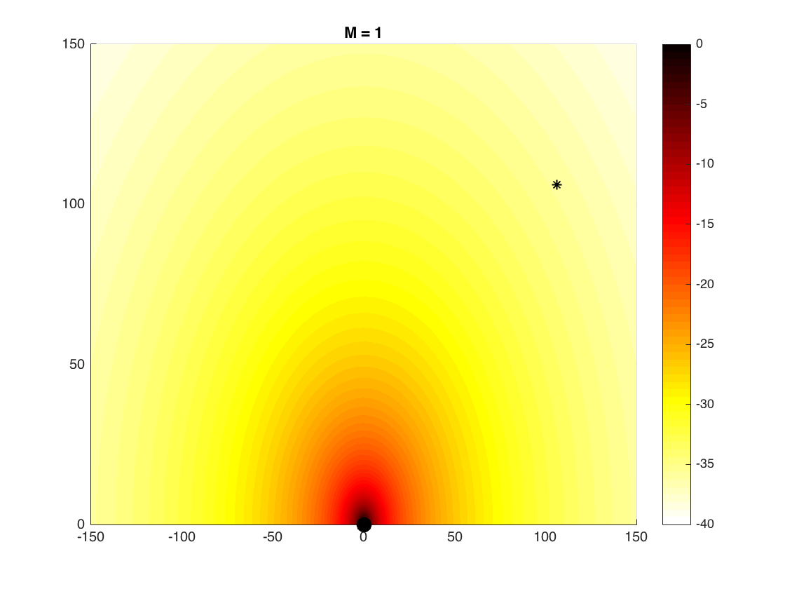
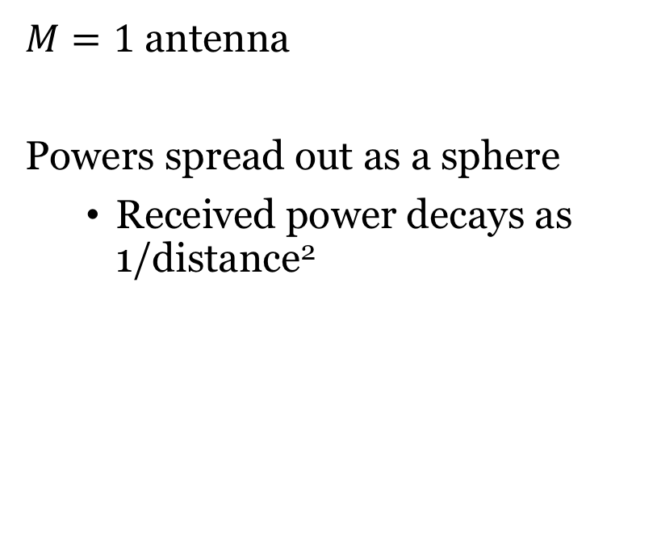
Omni-directional radiation
$M=1$ antenna
Powers spread out as a sphere
Received power decays as 1/distance²

Slide 5
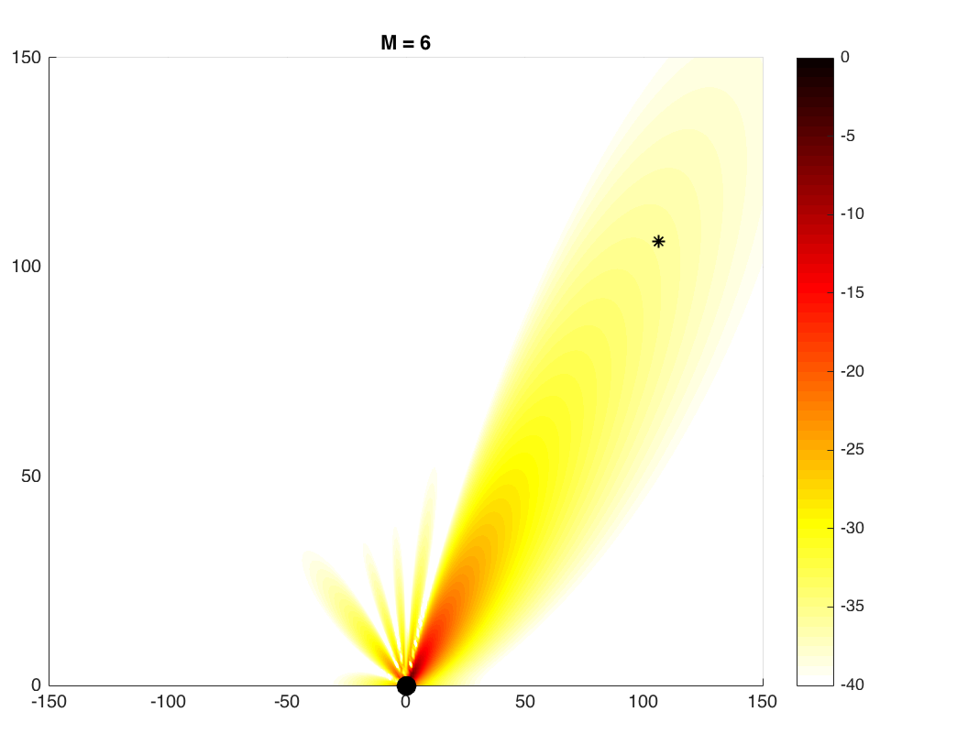
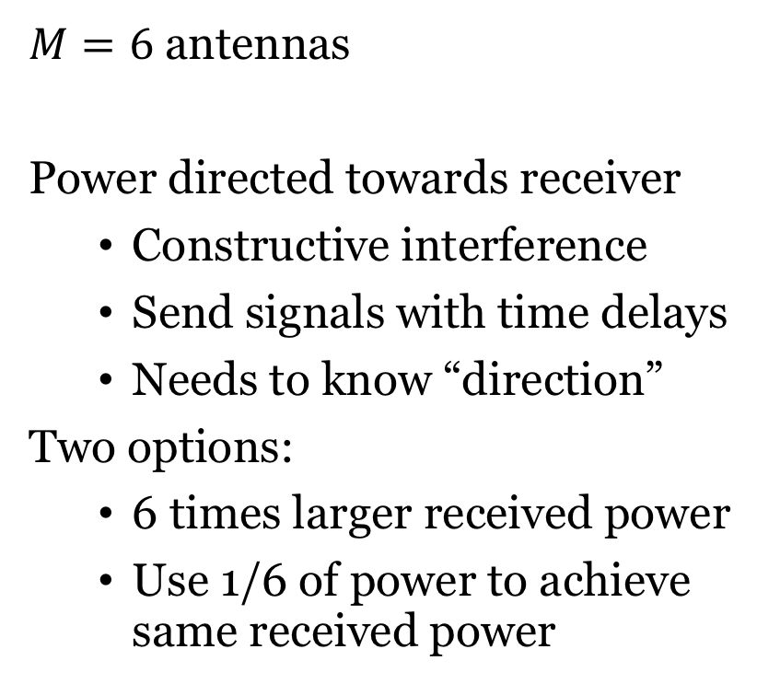
Directive radiation – Beamforming gain
$M=6$ antennas
Power directed towards receiver
Constructive interference
Send signals with time delays
Needs to know “direction”
Two options:
6 times larger received power
Use 1/6 of power to achieve same received power
Beamforming

Slide 6
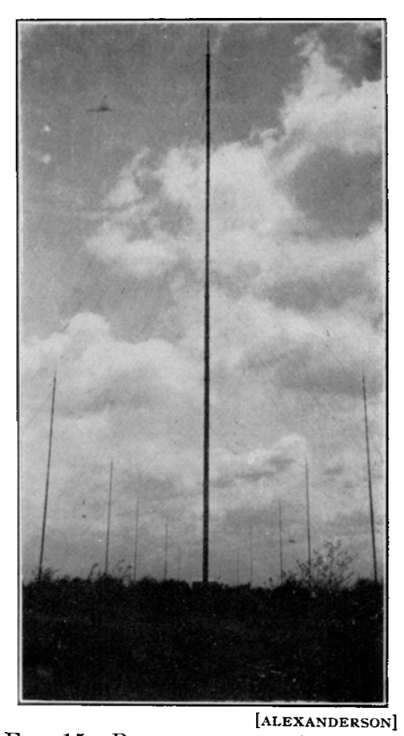
History: Beamforming
Directional communication
E.F.W. Alexanderson, ”Transatlantic Radio Communication”, Trans. AIEE, 1919.
Directive radiation pattern
Constructive/destructive interference patterns
Energy savings or better performance
Called beamforming gain

Slide 7

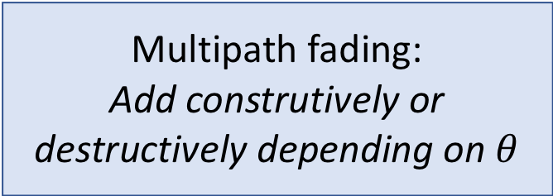

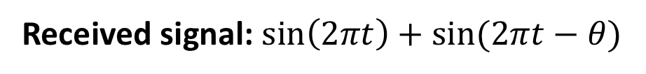
Multipath Propagation
$$sin⁡(2πt−θ)$$
Transmitter
$$\sin\left(2πt\right)$$
Receiver
Multipath fading:
Add construtively or destructively depending on $θ$
Received signal: $\sin\left(2πt\right)+sin⁡(2πt−θ)$

Slide 8
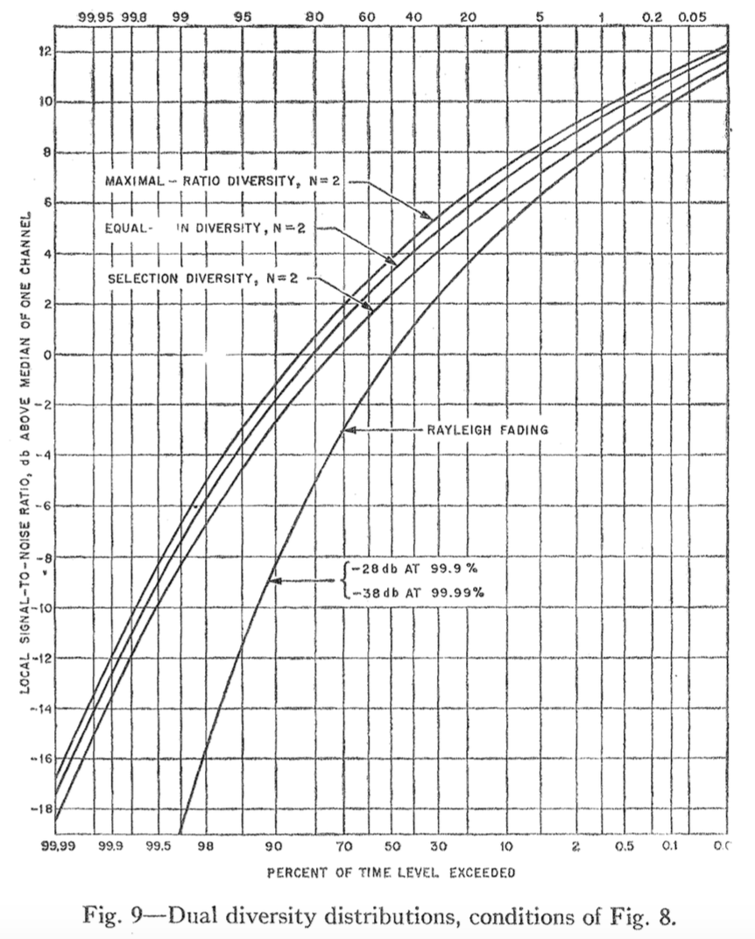
History: Spatial diversity
Diversity combining
D.G. Brennan, “Linear diversity combining techniques,” Proc. IRE, 1959
Protect against fading/noise
Multiple antennas with independent observations
Small risk that multiple observations are all bad
Improve reliability
Called diversity gain

Slide 9
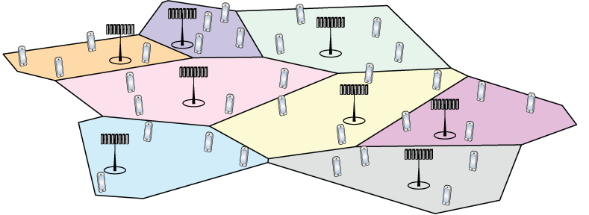
Cellular networks
Designed for mobile telephone systems
Bullington, K. (1953). “Frequency economy in mobile radio bands”. The Bell System Technical Journal.
Schulte, H. J. and W. A. Cornell (1960). “Multi-area mobile telephone system”. IEEE Trans. Veh. Technol.
Reuse of spectrum in space:
Densify as usage increases
Control interference by fractional spectrum reuse, power control

Slide 10
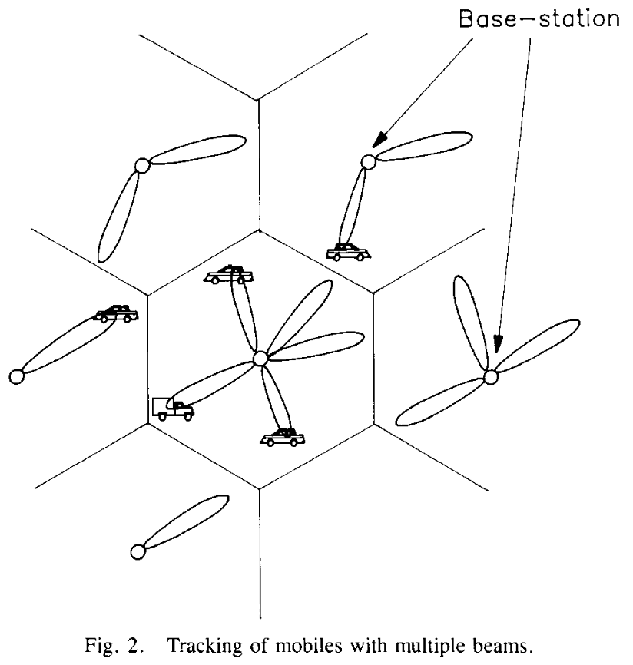
History: Space division multiple access (SDMA)
Multiple user communication
S. C. Swales et al., “The Performance Enhancement of Multibeam Adaptive Base-Station Antennas for Cellular Land Mobile Radio Systems” Trans. on Vehicular Technology, 1990.
Spatial multiplexing of users
Serve multiple users on same time and frequency
Handle more users per base station
Exists in 4G/5G and Wi-Fi
Called multiplexing gain

Slide 11
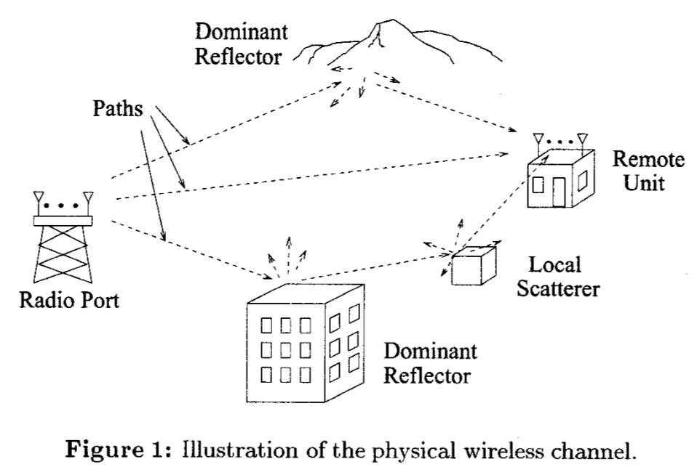
History: Point-to-point multi-antenna links
Point-to-point multiple-input multiple-output (MIMO)
G. G. Raleigh and J. M. Cioffi, “Spatio-temporal coding for wireless communications,” Globecom 1996.
Multiple streams per user
Increase capacity (bit/s) per user
Requires multiple paths
Exists in 4G/5G and Wi-Fi
Also called multiplexing gain

Slide 12
Outline of the course
Lecture 1:
History of multiple antenna communications
Channel capacity for single-antenna channels
Basic multi–antenna channels (Lecture 2)
Diversity and ergodic capacity (Lecture 3)
Point-to-point MIMO (Lecture 4)
Multi-user MIMO (Lectures 5-12)
Capacity bounds, Channel estimation, Power control, etc.
Based on lecture note document:
“Introduction to Multiple Antenna Communications”
Based on the book
“Fundamentals of Massive MIMO”

Slide 13

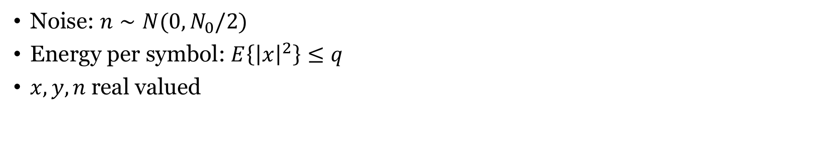


Example: Additive White Gaussian Noise (AWGN) Channel
$$n$$
$$x$$
+
$$y=x+n$$
Noise: $n∼N(0,N_{0}/2)$
Energy per symbol: $E\left\{{\left|x\right|}^{2}\right\}≤q$
$x,y,n$real valued

Slide 14
How to measure performance?
Data packet:
Characterized by
How many symbols the packet contains
How many information bits these symbols represent (determined by the modulation and coding scheme)
Probability of incorrect decoding at the receiver
Information symbols

Slide 15

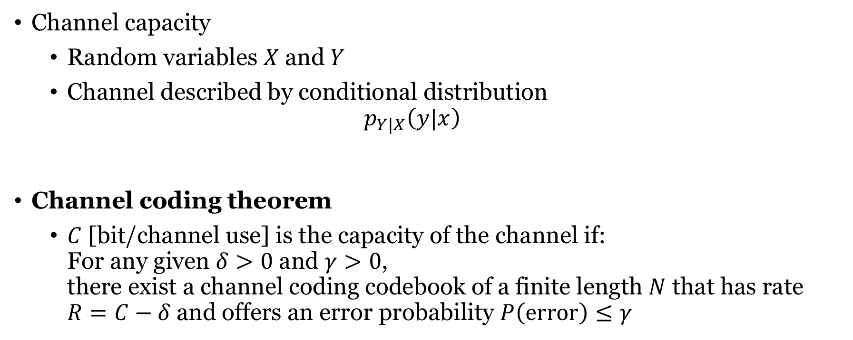


Channel capacity
Channel capacity
Random variables $X$ and $Y$
Channel described by conditional distribution
$$p_{Y|X}\left(y|x\right)$$
Channel coding theorem
$C$ [bit/channel use] is the capacity of the channel if: For any given $δ>0$ and $γ>0$, there exist a channel coding codebook of a finite length $N$ that has rate $R=C−δ$and offers an error probability $P\left(error\right)≤γ$
$$x$$
$$Channel$$
$$y$$

Slide 16



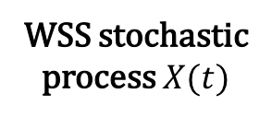

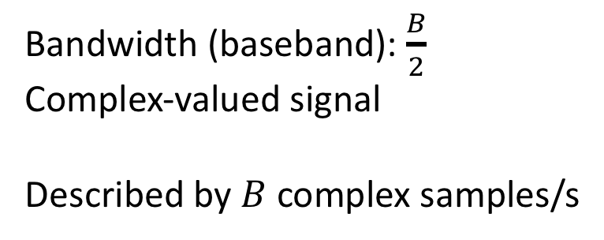
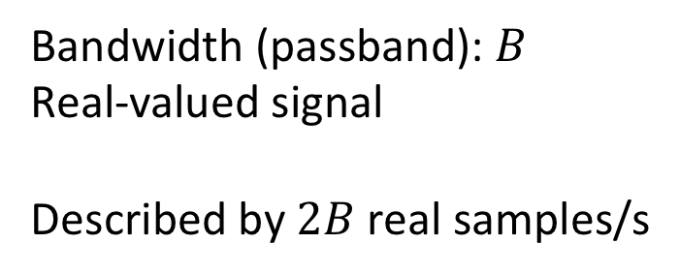


Passband and baseband signals
Bandwidth: Distance from smallest to largest frequency
$$f$$
$$f$$
$$f_{c}−\frac{B}{2}$$
$$f_{c}$$
$$f_{c}+\frac{B}{2}$$
$$−\frac{B}{2}$$
0
$$+\frac{B}{2}$$
Bandwidth (passband): $B$
Real-valued signal
Described by $2B$ real samples/s
Bandwidth (baseband): $\frac{B}{2}$
Complex-valued signal
Described by $B$ complex samples/s
These samples are used to convey information

Slide 17
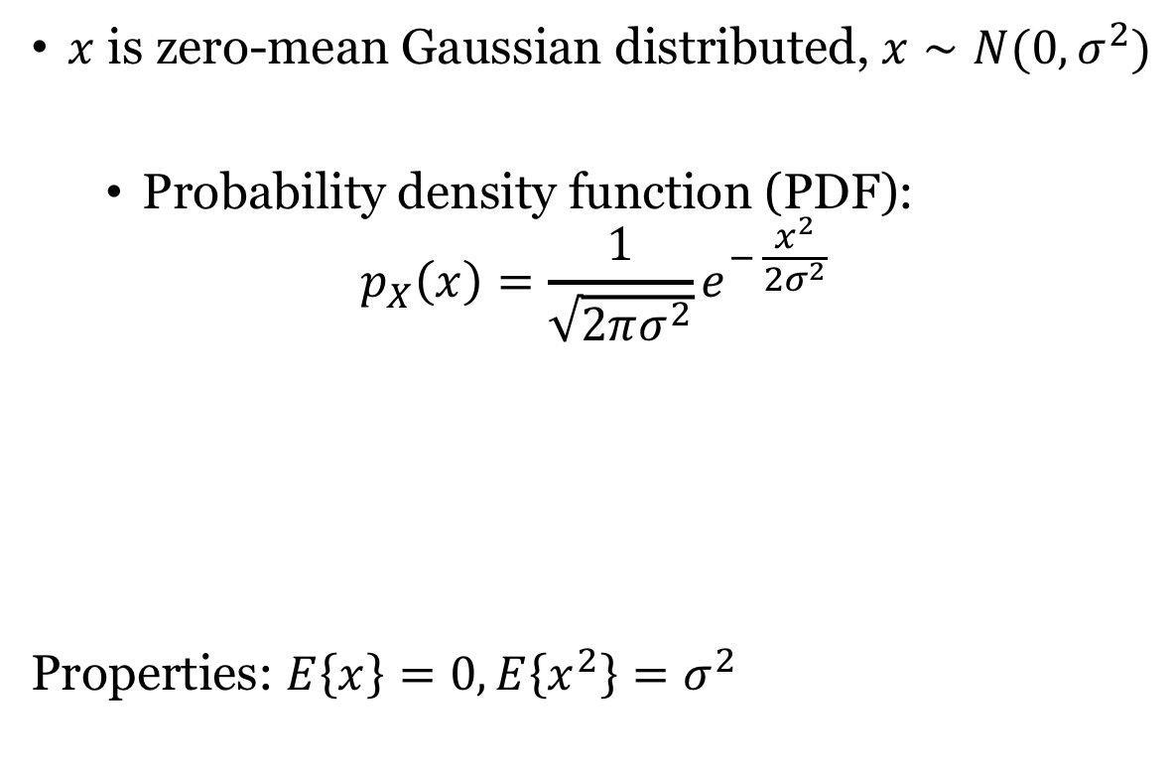
Gaussian Distribution
$x$ is zero-mean Gaussian distributed, $x∼N(0,σ^{2})$
Probability density function (PDF):
$$p_{X}\left(x\right)=\frac{1}{\sqrt{2πσ^{2}}}e^{− \frac{x^{2}}{2σ^{2}}}$$
Properties: $E\left\{x\right\}=0,E\left\{x^{2}\right\}=σ^{2}$

Slide 18
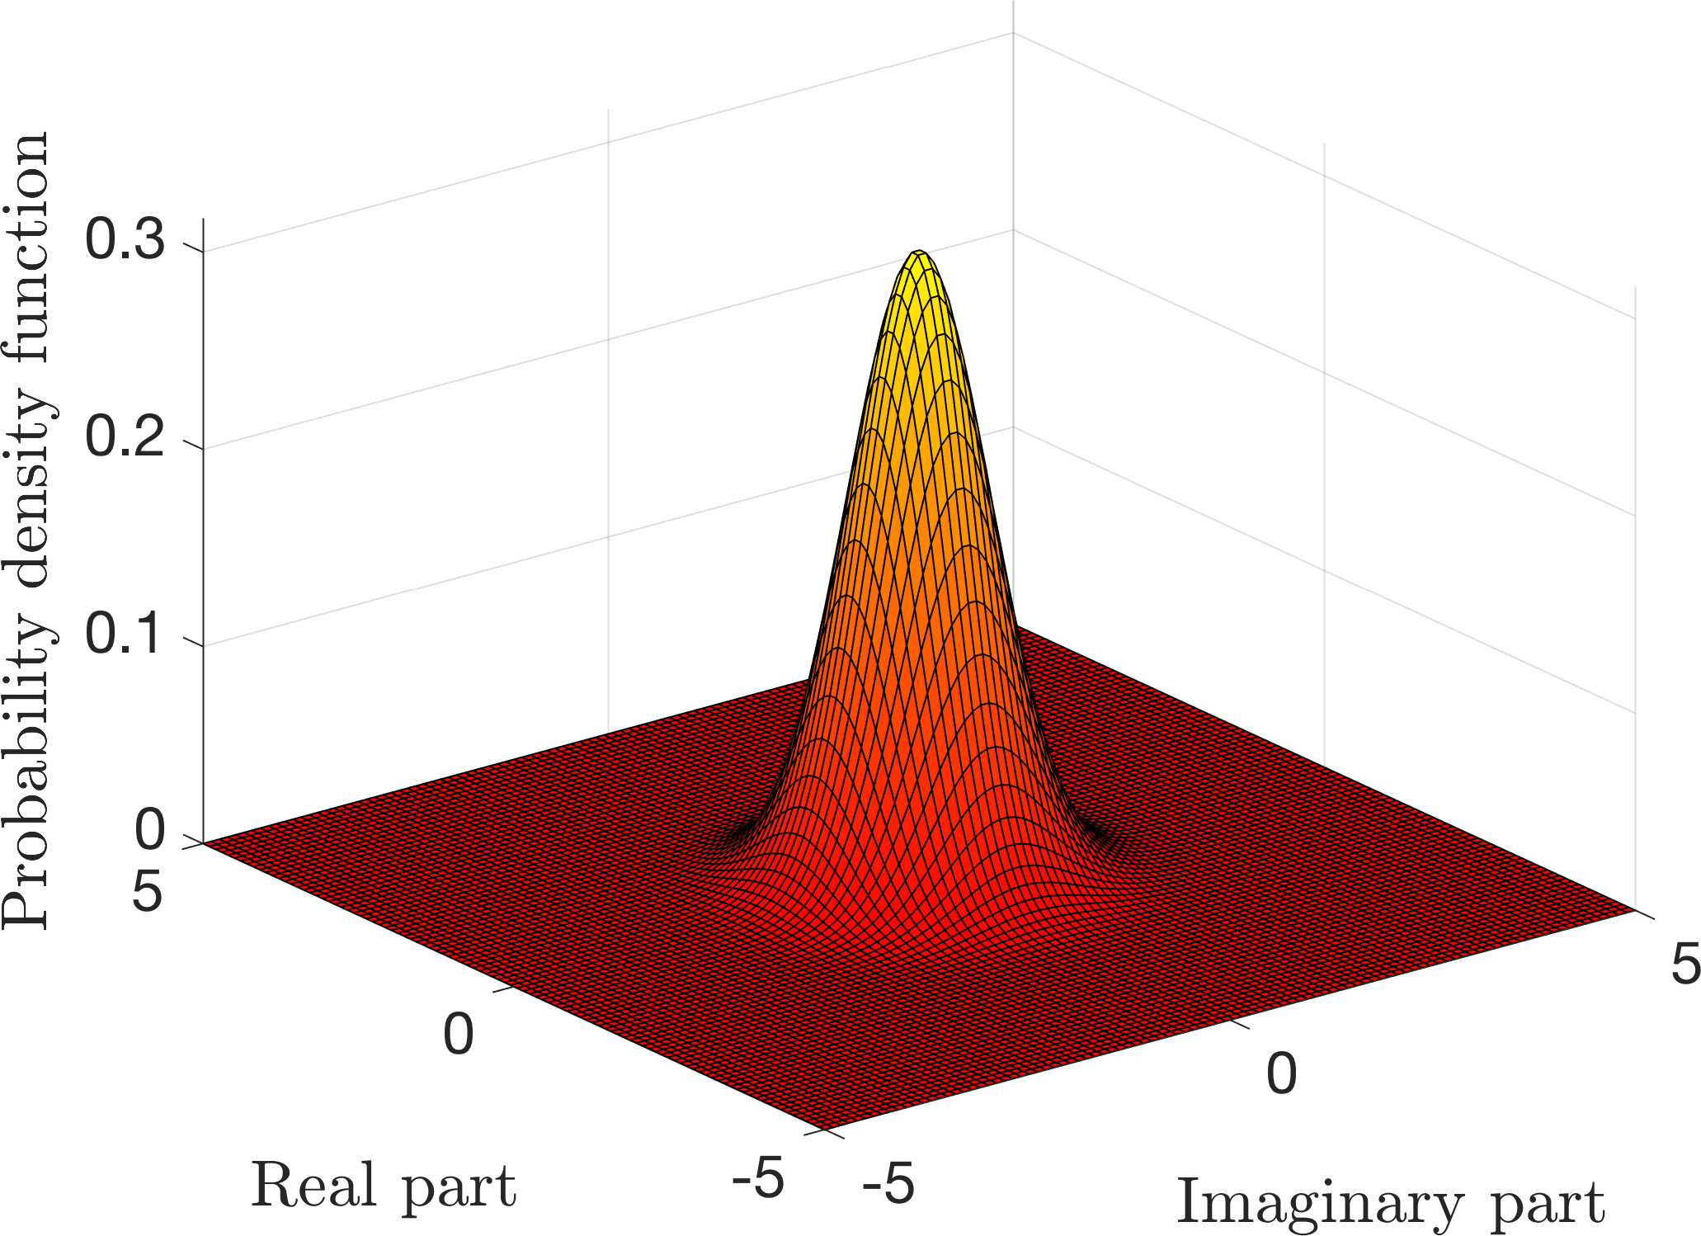
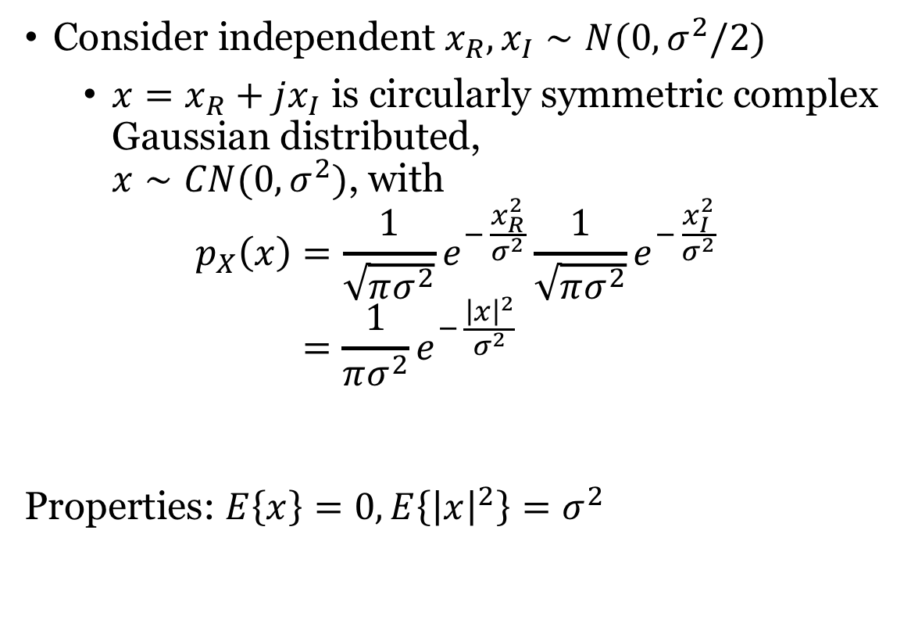
Complex Gaussian Distribution
Consider independent $x_{R},x_{I}∼N(0,σ^{2}/2)$
$x=x_{R}+jx_{I}$ is circularly symmetric complex Gaussian distributed, $x∼CN(0,σ^{2})$, with
$$p_{X}\left(x\right)=\frac{1}{\sqrt{πσ^{2}}}e^{− \frac{x_{R}^{2}}{σ^{2}}}\frac{1}{\sqrt{πσ^{2}}}e^{− \frac{x_{I}^{2}}{σ^{2}}}$$
$$=\frac{1}{πσ^{2}}e^{− \frac{{\left|x\right|}^{2}}{σ^{2}}}$$
Properties: $E\left\{x\right\}=0,E\left\{{\left|x\right|}^{2}\right\}=σ^{2}$

Slide 19

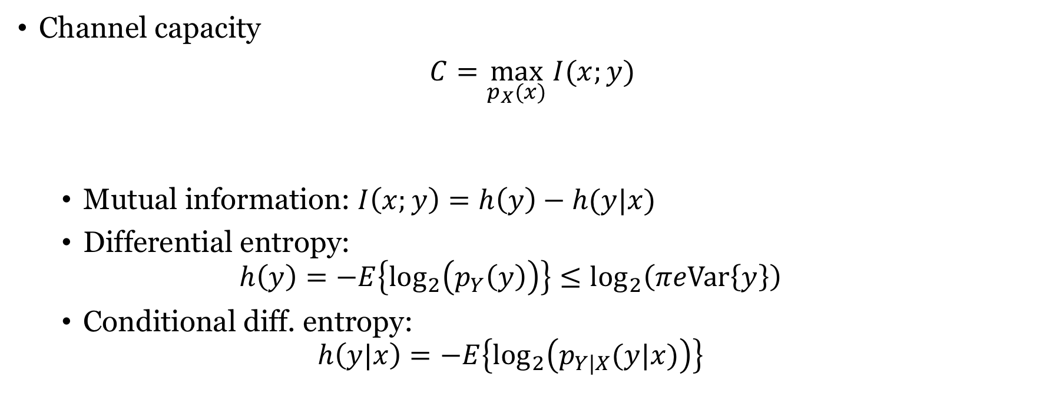
Capacity and mutual information
Channel capacity
$C=\max_{p_{X}(x)} I(x;y)$
Mutual information: $I\left(x;y\right)=h\left(y\right)−h(y|x)$
Differential entropy: $h\left(y\right)=−E\left\{\log_{2}\left(p_{Y}\left(y\right)\right)\right\}≤\log_{2}\left(πeVar\left\{y\right\}\right)$
Conditional diff. entropy: $h\left(y|x\right)=−E\left\{\log_{2}\left(p_{Y|X}(y|x)\right)\right\}$
$$x$$
$$Channel$$
$$y$$
Equality if
Complex Gaussian

Slide 20
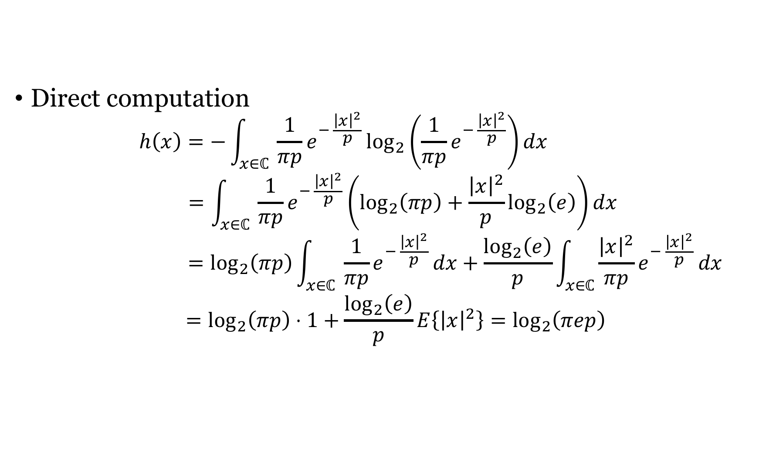
Differential entropy $h\left(x\right)$of $x∼CN(0,p)$
Direct computation
$$h\left(x\right)=−\int_{x∈ℂ}{ \frac{1}{πp}e^{− \frac{{\left|x\right|}^{2}}{p}}\log_{2}\left(\frac{1}{πp}e^{− \frac{{\left|x\right|}^{2}}{p}}\right)}dx$$
$$=\int_{x∈ℂ}{ \frac{1}{πp}e^{− \frac{{\left|x\right|}^{2}}{p}}\left(\log_{2}\left(πp\right)+\frac{{\left|x\right|}^{2}}{p}\log_{2}\left(e\right)\right)}dx$$
$$=\log_{2}\left(πp\right)\int_{x∈ℂ}{ \frac{1}{πp}e^{− \frac{{\left|x\right|}^{2}}{p}}}dx+\frac{\log_{2}\left(e\right)}{p}\int_{x∈ℂ}{\frac{{\left|x\right|}^{2}}{πp}e^{− \frac{{\left|x\right|}^{2}}{p}}}dx$$
$$=\log_{2}\left(πp\right)⋅1+\frac{\log_{2}\left(e\right)}{p}E\left\{{\left|x\right|}^{2}\right\}=\log_{2}\left(πep\right)$$

Slide 21

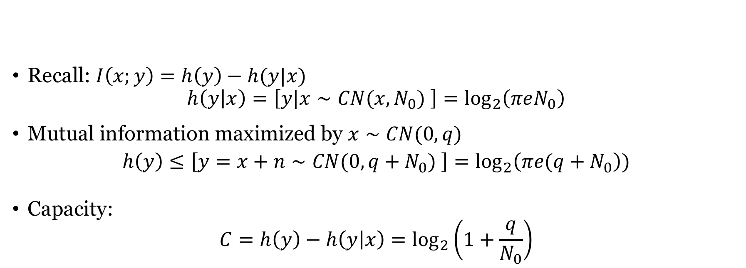


Capacity of complex AWGN channel
$$n∼CN(0,N_{0})$$
Recall: $I\left(x;y\right)=h\left(y\right)−h(y|x)$
$$h\left(y | x\right)=\left[y|x∼CN(x,N_{0}) \right]=\log_{2}\left(πeN_{0}\right)$$
Mutual information maximized by $x∼CN(0,q)$
$$h\left(y\right)≤\left[y=x+n∼CN(0,q+N_{0}) \right]=\log_{2}\left(πe(q+N_{0}\right))$$
Capacity:
$$C=h\left(y\right)−h\left(y | x\right)=\log_{2}\left(1+\frac{q}{N_{0}}\right)$$
$$x$$
+
$$y=x+n$$

Slide 22
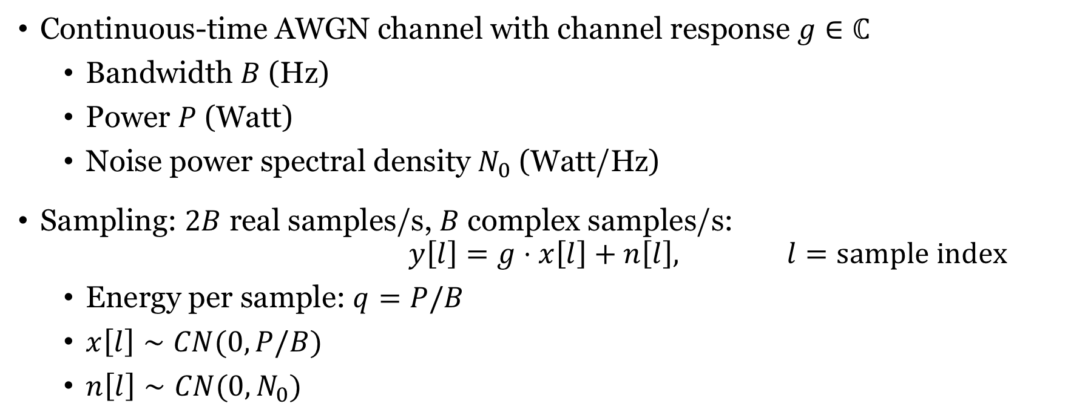
Point-to-point scalar channel
Continuous-time AWGN channel with channel response $g∈ℂ$
Bandwidth $B$ (Hz)
Power $P$ (Watt)
Noise power spectral density $N_{0}$ (Watt/Hz)
Sampling: $2B$ real samples/s, $B$ complex samples/s:
$$y\left[l\right]=g⋅x\left[l\right]+n\left[l\right], l=sample index$$
Energy per sample: $q=P/B$
$x\left[l\right]∼CN(0,P/B)$
$n\left[l\right]∼CN(0,N_{0})$
Complex Gaussian signals are capacity achieving

Slide 23
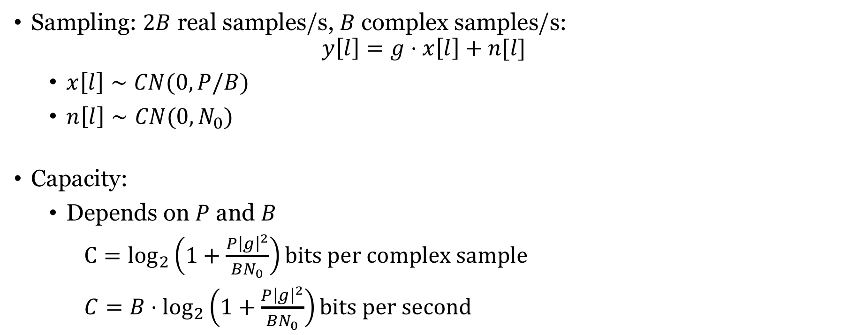
Point-to-point scalar channel: Capacity
Sampling: $2B$ real samples/s, $B$ complex samples/s:
$$y\left[l\right]=g⋅x\left[l\right]+n[l]$$
$x\left[l\right]∼CN(0,P/B)$
$n\left[l\right]∼CN(0,N_{0})$
Capacity:
Depends on $P$ and $B$
${C=log}_{2}\left(1+\frac{P{\left|g\right|}^{2}}{BN_{0}}\right)bits per complex sample$
$C=B⋅\log_{2}\left(1+\frac{P{\left|g\right|}^{2}}{BN_{0}}\right)bits per second$

Slide 24

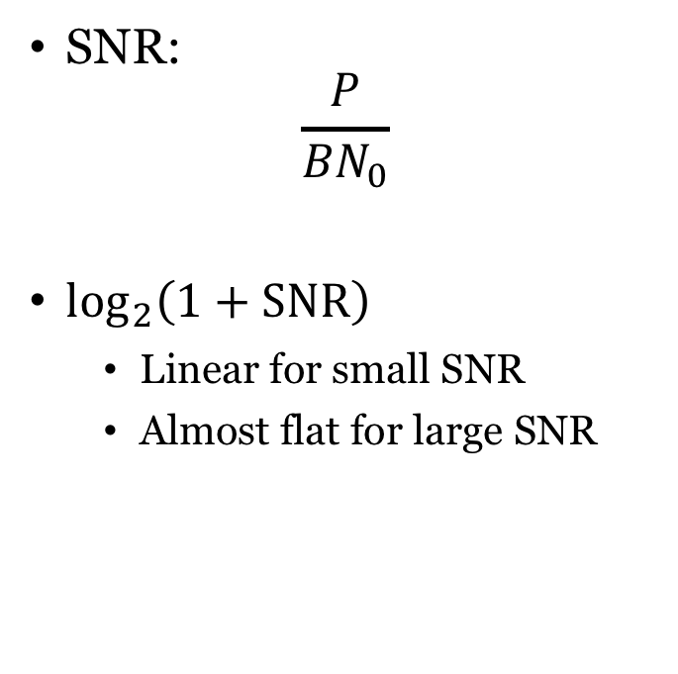
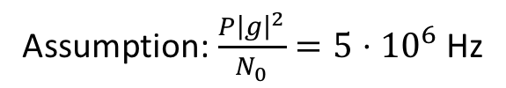
Capacity behaviors
$$\frac{P}{N_{0}}\log_{2}\left(e\right)$$
SNR:
$$\frac{P}{{BN}_{0}}$$
$\log_{2}\left(1+SNR\right)$
Linear for small SNR
Almost flat for large SNR
Power limited region
Bandwidth
limited
region
Assumption: $\frac{P{\left|g\right|}^{2}}{N_{0}}=5⋅{10}^{6}$ Hz

Slide 25
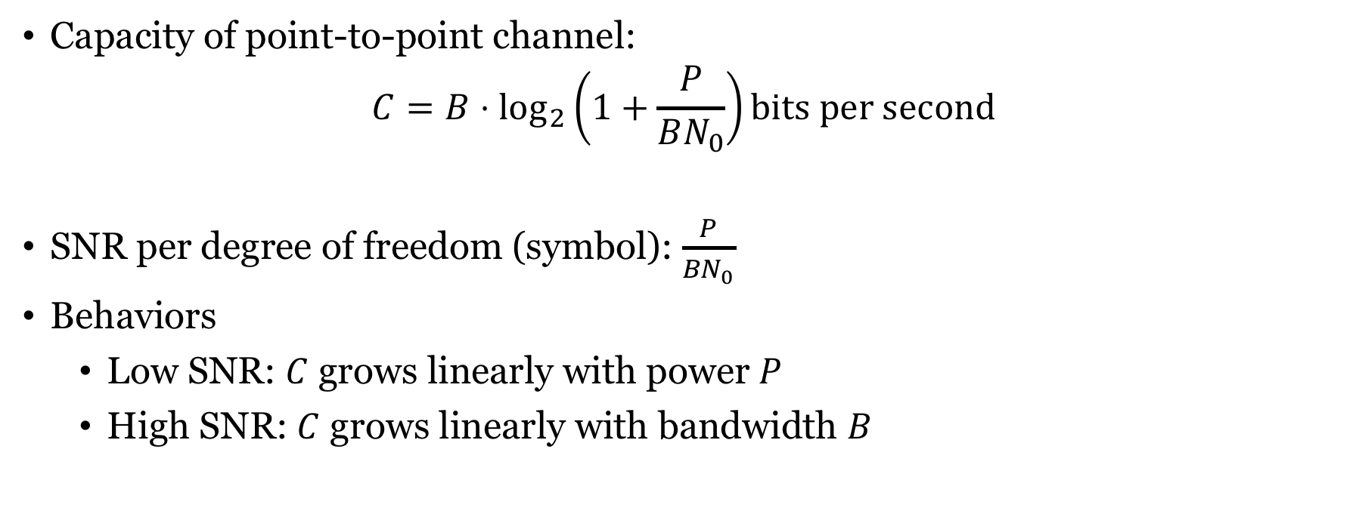
Summary
Capacity of point-to-point channel:
$$C=B⋅\log_{2}\left(1+\frac{P}{BN_{0}}\right)bits per second$$
SNR per degree of freedom (symbol): $\frac{P}{{BN}_{0}}$
Behaviors
Low SNR: $C$ grows linearly with power $P$
High SNR: $C$ grows linearly with bandwidth $B$

Slide 26
End of Lecture 1
TSKS14 Multiple Antenna Communications

