Slide 1
TSKS14 Multiple Antenna Communications
Lecture 11, 2020
Emil Björnson

Slide 2
Outline of this lecture
Power control
Purpose and operating points
Structure of the SINR
Max-min fairness power control
Uplink
Downlink
Simulation example

Slide 3
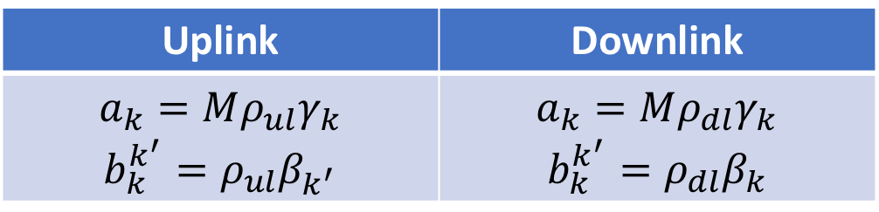

Single-cell effective SINRs
Capacity lower bound for user $k$
$$\log_{2}\left(1+{SINR}_{k}\right)$$
where the “effective” SINR is
$${SINR}_{k}=\frac{a_{k}η_{k}}{1+\sum_{k^{′}=1}^{K}{b_{k}^{k^{′}}η_{k^{′}}}}$$
With MR:
Uplink | Downlink
$$a_{k}=Mρ_{ul}γ_{k}$$ $$b_{k}^{k^{′}}=ρ_{ul}β_{k^{′}}$$ | $$a_{k}=Mρ_{dl}γ_{k}$$ $$b_{k}^{k^{′}}=ρ_{dl}β_{k}$$
Same structure with other methods than MR

Slide 4
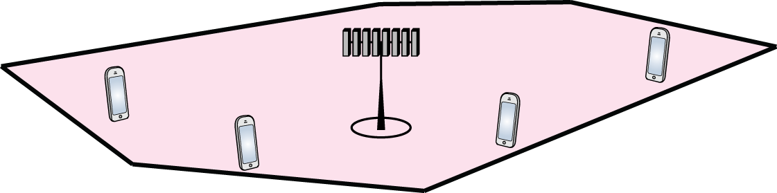

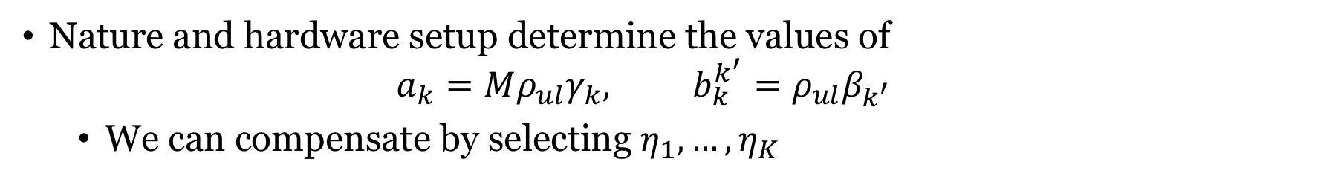



Different channel conditions
$−97$dB
$−120$dB
$−94$ dB
$−65$dB
Nature and hardware setup determine the values of
$$a_{k}=Mρ_{ul}γ_{k}, b_{k}^{k^{′}}=ρ_{ul}β_{k^{′}}$$
We can compensate by selecting $η_{1},…,η_{K}$

Slide 5
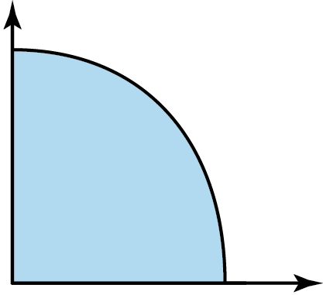



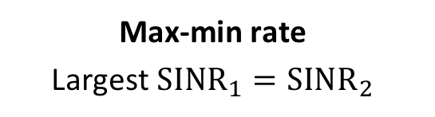
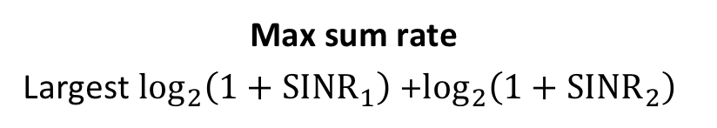
Power control
Effective SINRs depend on $η_{1},…,η_{K}$
Can be selected to achieve different operating points
Max sum rate
Largest $\log_{2}\left(1+SINR_{1}\right)$+$\log_{2}\left(1+SINR_{2}\right)$
$$\log_{2}\left(1+SINR_{2}\right)$$
Max-min rate
Largest ${SINR}_{1}={SINR}_{2}$
Rate region
$$\log_{2}\left(1+SINR_{1}\right)$$

Slide 6
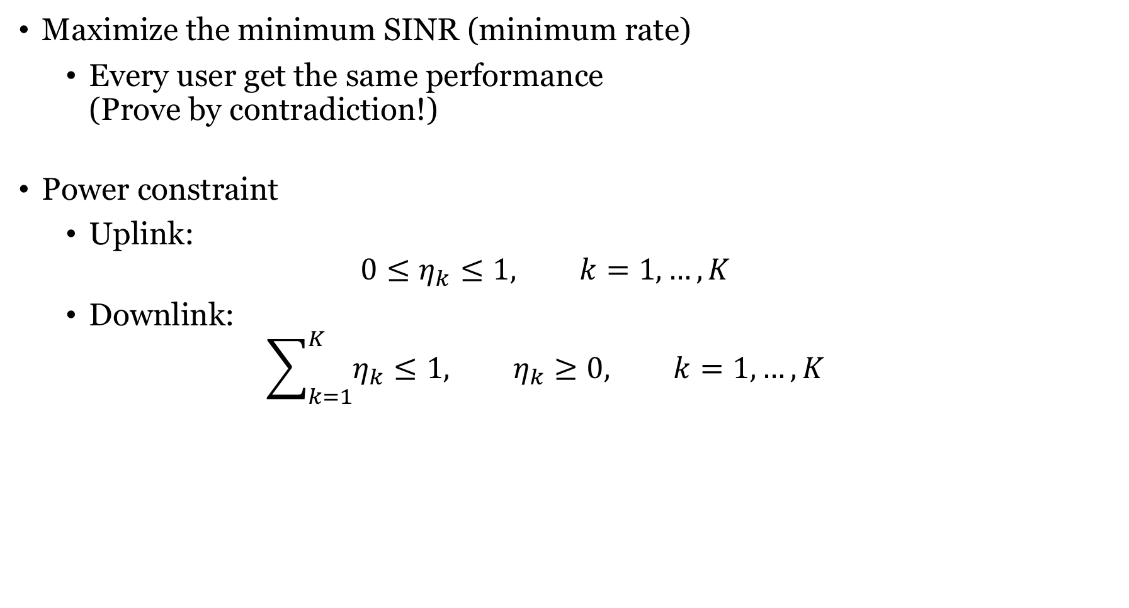
Max-min fairness power control
Maximize the minimum SINR (minimum rate)
Every user get the same performance (Prove by contradiction!)
Power constraint
Uplink:
$$0≤η_{k}≤1, k=1,…,K$$
Downlink:
$$\sum_{k=1}^{K}{η_{k}}≤1, η_{k}≥0, k=1,…,K$$

Slide 7
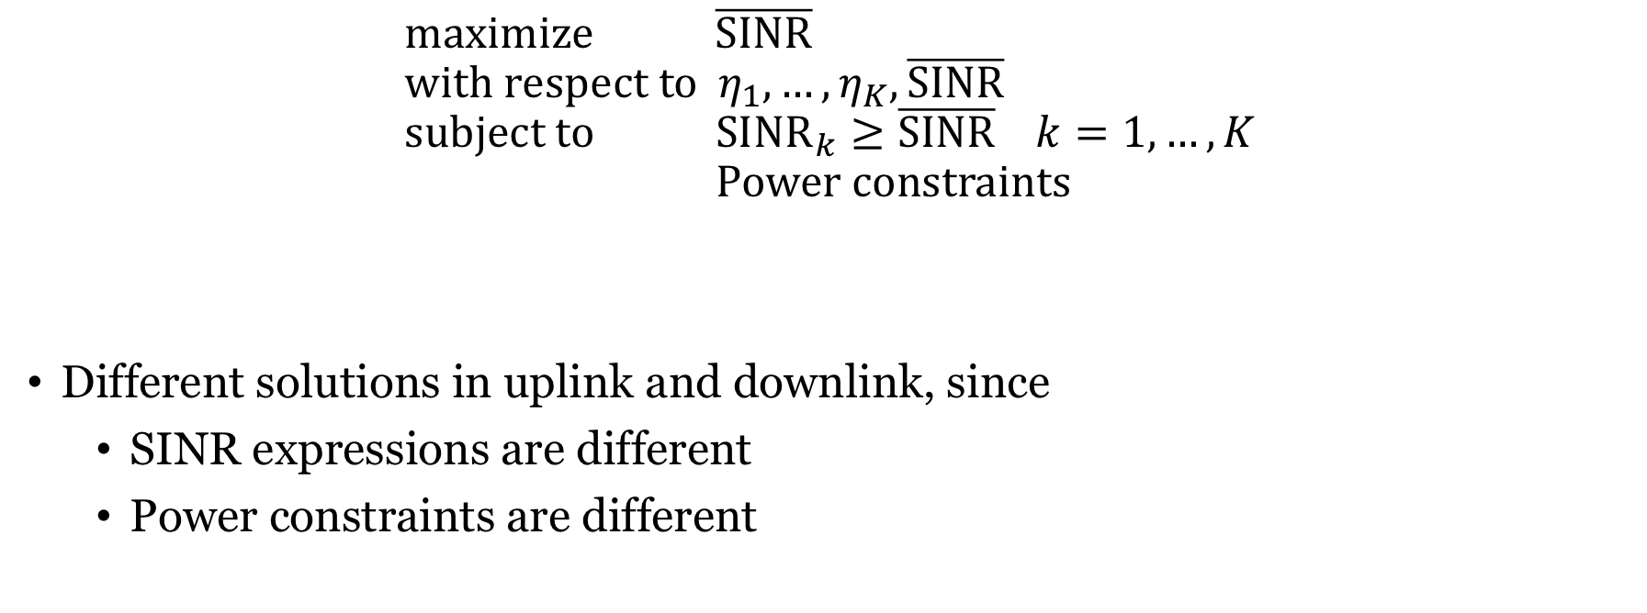
Formulation as an optimization problem
$$maximize \overline{SINR} \\ with respect to { η}_{1},…,η_{K},\overline{SINR} \\ subject to SINR_{k}≥\overline{SINR} k=1,…,K \\ Power constraints$$
Different solutions in uplink and downlink, since
SINR expressions are different
Power constraints are different

Slide 8
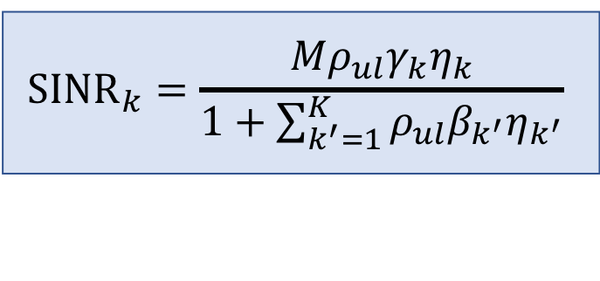

Uplink max-min fairness with MR
$${SINR}_{k}=\frac{Mρ_{ul}γ_{k}η_{k}}{1+\sum_{k^{′}=1}^{K}{ρ_{ul}β_{k^{′}}η_{k^{′}}}}$$
Optimal power-control coefficients:
$$η_{k}=\frac{\min_{k^{′}}{γ_{k^{′}}}}{γ_{k}}$$
Max-min SINR:
$$\overline{SINR}=\frac{Mρ_{ul}}{\frac{1}{\min_{k^{′}}{γ_{k^{′}}}}+ρ_{ul}\sum_{k=1}^{K}{\frac{β_{k}}{γ_{k}}}}$$

Slide 9
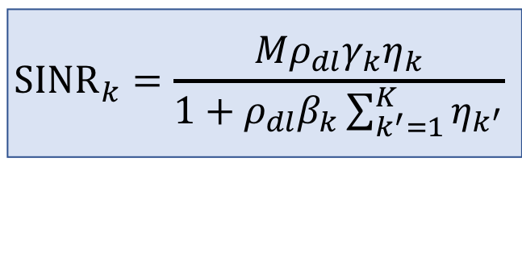
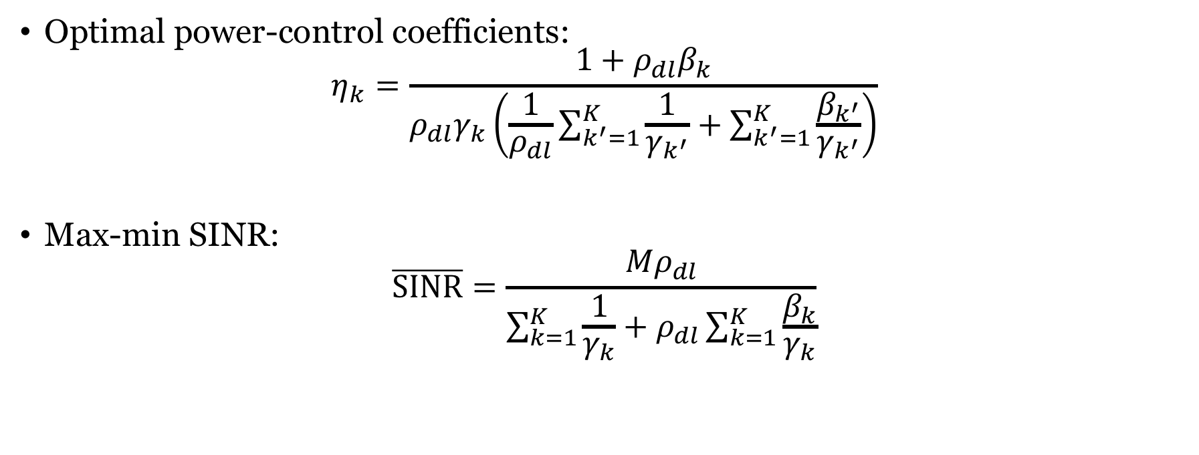
Downlink max-min fairness with MR
$${SINR}_{k}=\frac{Mρ_{dl}γ_{k}η_{k}}{1+ρ_{dl}β_{k}\sum_{k^{′}=1}^{K}{η_{k^{′}}}}$$
Optimal power-control coefficients:
$$η_{k}=\frac{1+ρ_{dl}β_{k}}{ρ_{dl}γ_{k}\left(\frac{1}{ρ_{dl}}\sum_{k^{′}=1}^{K}{\frac{1}{γ_{k^{′}}}}+\sum_{k^{′}=1}^{K}{\frac{β_{k^{′}}}{γ_{k^{′}}}}\right)}$$
Max-min SINR:
$$\overline{SINR}=\frac{Mρ_{dl}}{\sum_{k=1}^{K}{\frac{1}{γ_{k}}}+ρ_{dl}\sum_{k=1}^{K}{\frac{β_{k}}{γ_{k}}}}$$

Slide 10
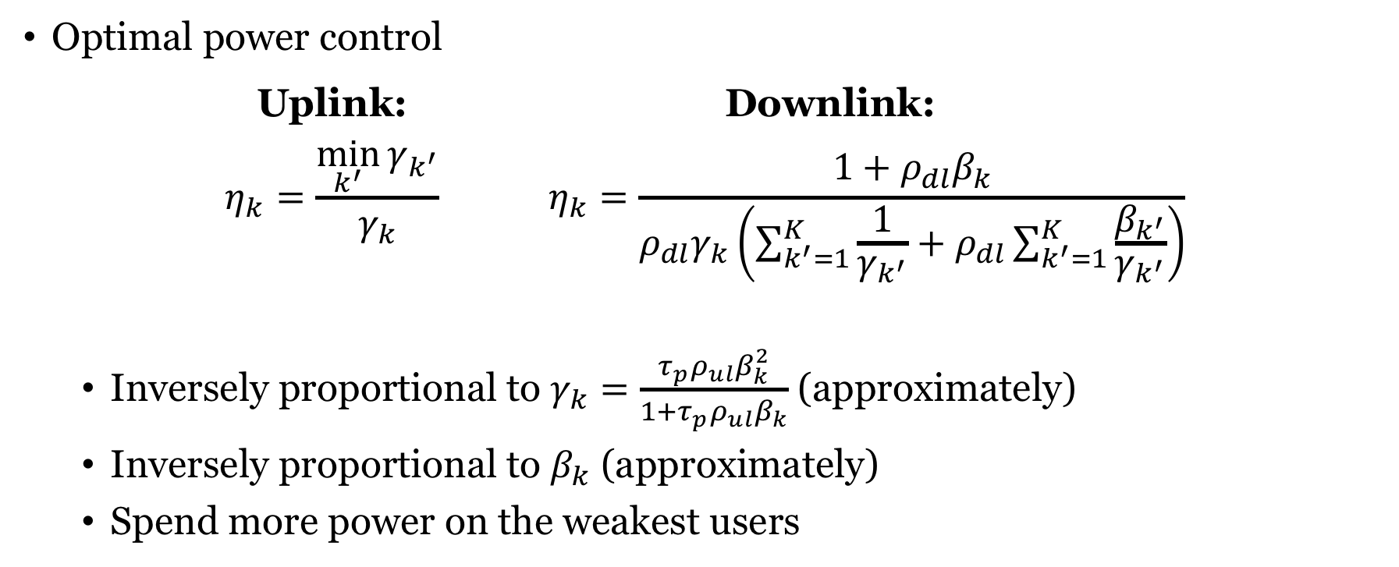
Insights from max-min power control
Optimal power control
Uplink: Downlink:
$$η_{k}=\frac{\min_{k^{′}}{γ_{k^{′}}}}{γ_{k}} η_{k}=\frac{1+ρ_{dl}β_{k}}{ρ_{dl}γ_{k}\left(\sum_{k^{′}=1}^{K}{\frac{1}{γ_{k^{′}}}}+ρ_{dl}\sum_{k^{′}=1}^{K}{\frac{β_{k^{′}}}{γ_{k^{′}}}}\right)}$$
Inversely proportional to $γ_{k}=\frac{τ_{p}ρ_{ul}β_{k}^{2}}{1+τ_{p}ρ_{ul}β_{k}}$ (approximately)
Inversely proportional to $β_{k}$ (approximately)
Spend more power on the weakest users

Slide 11
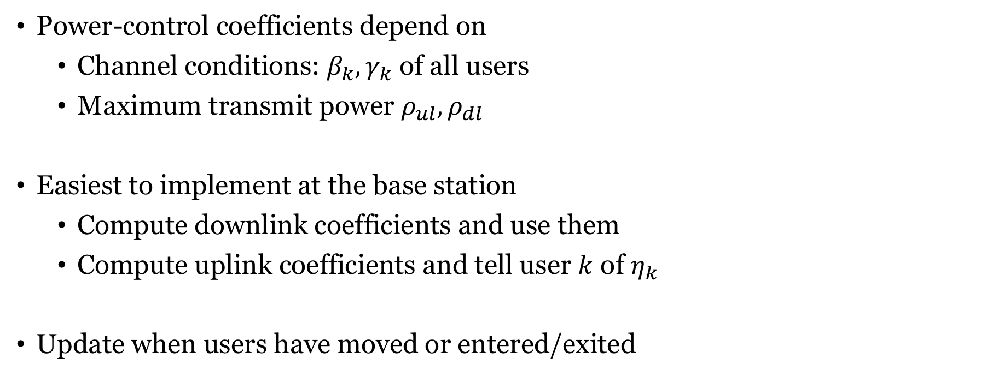
Who performs the optimization?
Power-control coefficients depend on
Channel conditions: $β_{k},γ_{k}$ of all users
Maximum transmit power $ρ_{ul},ρ_{dl}$
Easiest to implement at the base station
Compute downlink coefficients and use them
Compute uplink coefficients and tell user $k$ of $η_{k}$
Update when users have moved or entered/exited

Slide 12

Simulation example: Urban deployment
Single-cell setup
Circular cell with radius 500 m
Base station: $M=100$antennas
$K=10$ uniformly users
Important properties
Independent Rayleigh fading
No inter-cell interference
Carrier frequency: 2 GHz
Bandwidth 20 MHz
500 m

Slide 13
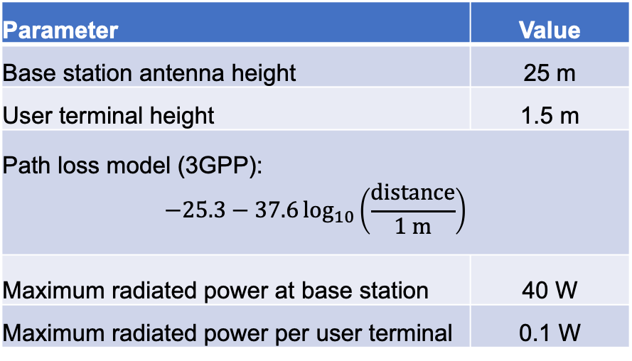
Some parameter values
Parameter | Value
Base station antenna gain | 0 dBi
User terminal antenna gain | 0 dBi
Base station receiver noise figure | 7 dB
Terminal receiver noise figure | 7 dB
Nominal noise temperature | 300 K
Coherence time | 1 ms
Coherence bandwidth | 200 kHz
Parameter | Value
Base station antenna height | 25 m
User terminal height | 1.5 m
Path loss model (3GPP): $$−25.3−37.6\log_{10}\left(\frac{distance}{1 m}\right)$$
Maximum radiated power at base station | 40 W
Maximum radiated power per user terminal | 0.1 W
1 ms x 200 kHz = 200 samples per coherence interval
10 for pilots, 63 for uplink (33%), 127 for downlink (67%)

Slide 14

Uplink signal-to-noise ratio (SNR)
Users at different locations
Cell edge
Cell center
Simulation methodology
Drop $K$ users in the cell
Compute $β_{k}$ and $γ_{k}$
Compute power control $η_{k}$
Compute data rates
500 m

Slide 15
Case study: Uplink with power control

Slide 16
Case study: Downlink with power control
Equal power
Equal power

Slide 17
Summary
User performance depends on transmit powers
Power control must be actively done
Max-min fairness power control
Give everyone the same rate, maximize the common value
Power control coefficients can be computed in closed form
Insight from simulation
Uplink is particularly affected by power control

Slide 18
End of Lecture 11
TSKS14 Multiple Antenna Communications

Slide 19
Case study: Fixed broadband access
Deliver high data rates to homes
7.5 homes/km²
3000 homes within radius 11.3 km
Downlink: 20 Mb/s, Uplink: 10 Mb/s
Deploy a “large” base station in center
No inter-cell interference
Carrier frequency: 800 MHz
Bandwidth 20 MHz
11.3 km

Slide 20
Case study: Some parameters
Parameter | Value
Base station antenna gain | 0 dBi
Terminal antenna gain | 6 dBi
Base station receiver noise figure | 9 dB
Terminal receiver noise figure | 9 dB
Nominal noise temperature | 300 K
Terminal mobility | Stationary
Coherence time | 50 ms
Coherence bandwidth | 300 kHz
Parameter | Value
Shadow fading standard deviation | 8 dB
Shadow fading diversity | best of two
Path loss model | Hata
Base station antenna height | 32 m
Terminal antenna height | 5 m
Total radiated power per base station | 10 W
Radiated power per terminal | 1 W
50 ms x 300 kHz = 15000 samples per coherence interval
3000 for pilots, 4000 for uplink, 8000 for downlink

Slide 21
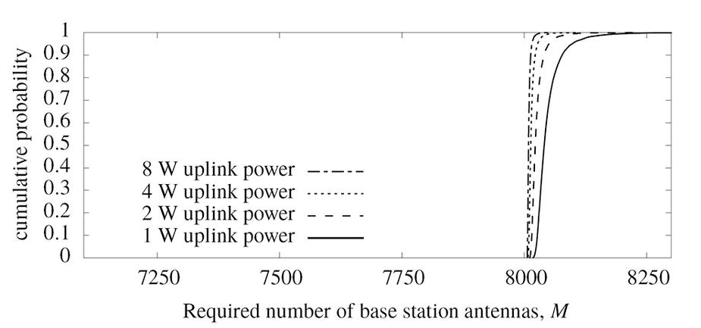
Case study: Uplink with power control
Figure 6.1 from Fundamentals of Massive MIMO

Slide 22
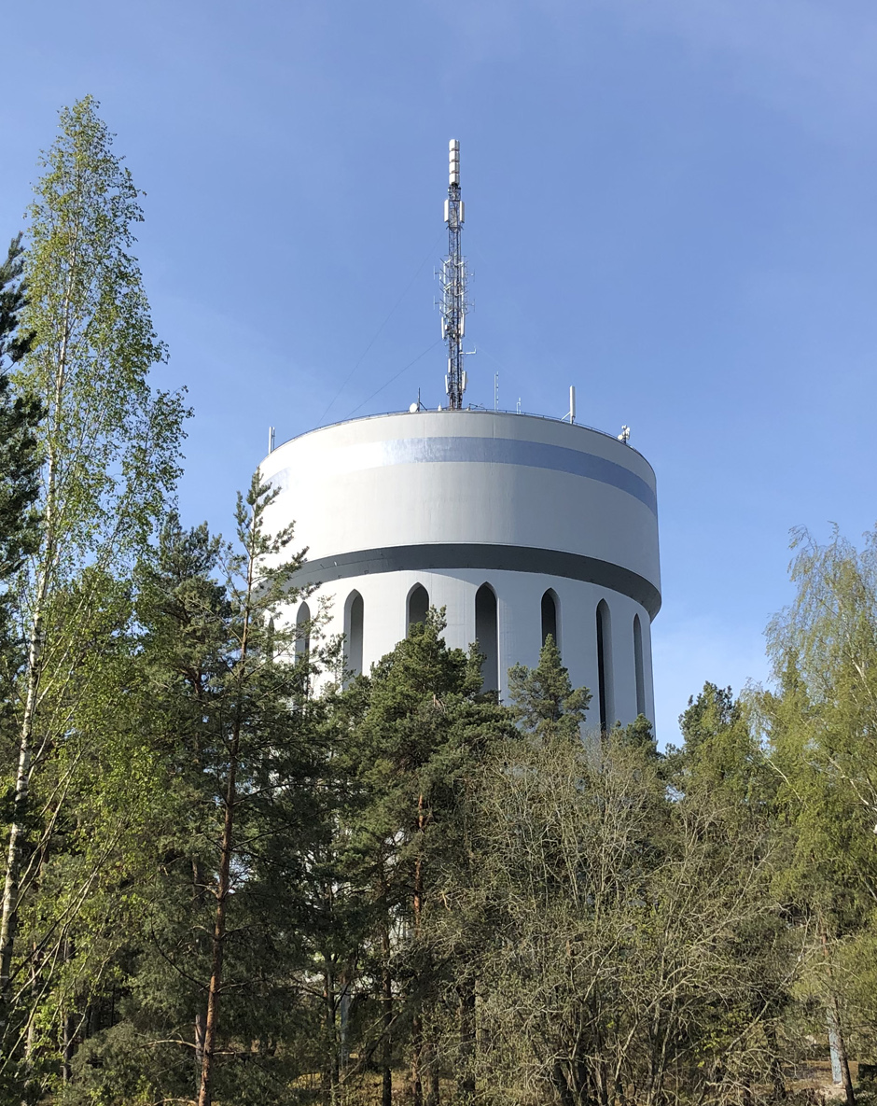
Deploying thousands of antennas
Linköping Water Tower:
Deploy antennas on a cylinder

Slide 23
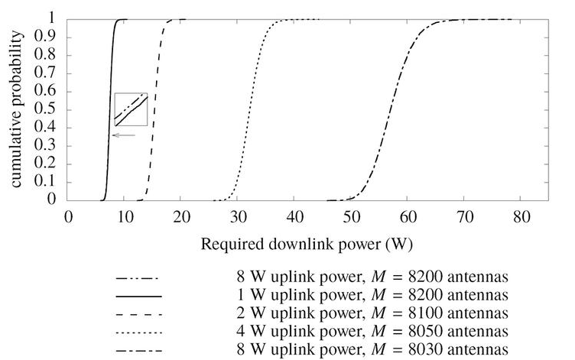
Case study: Downlink with power control
Figure 6.2 from Fundamentals of Massive MIMO

Slide 24
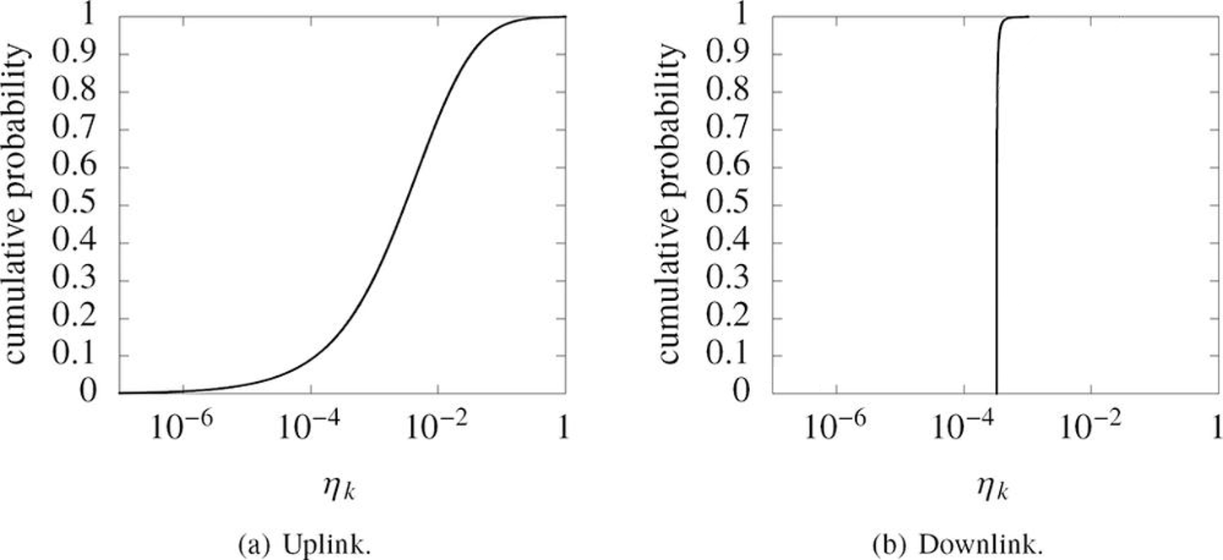
Case study: Power control coefficients
Figure 6.3 from Fundamentals of Massive MIMO

