Slide 1
TSKS14 Multiple Antenna Communications
Lecture 2, 2020
Emil Björnson

Slide 2
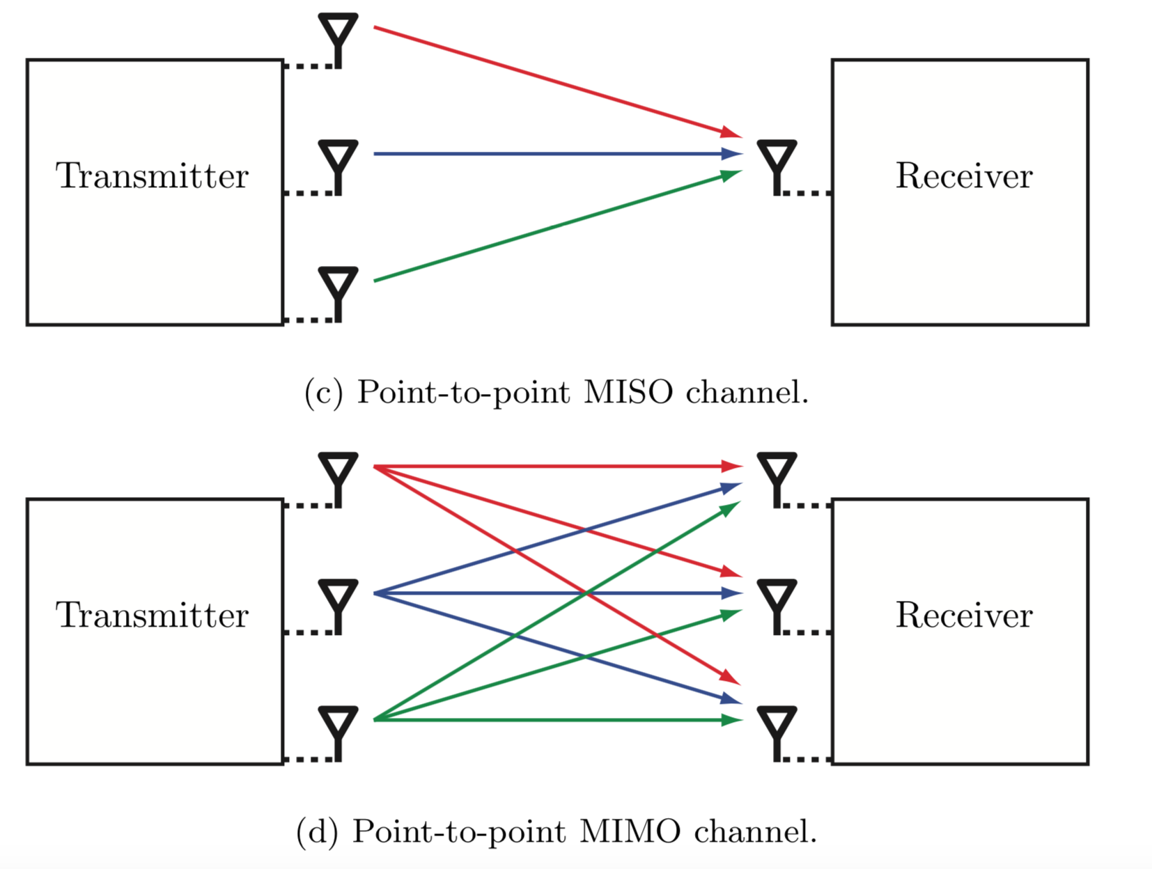
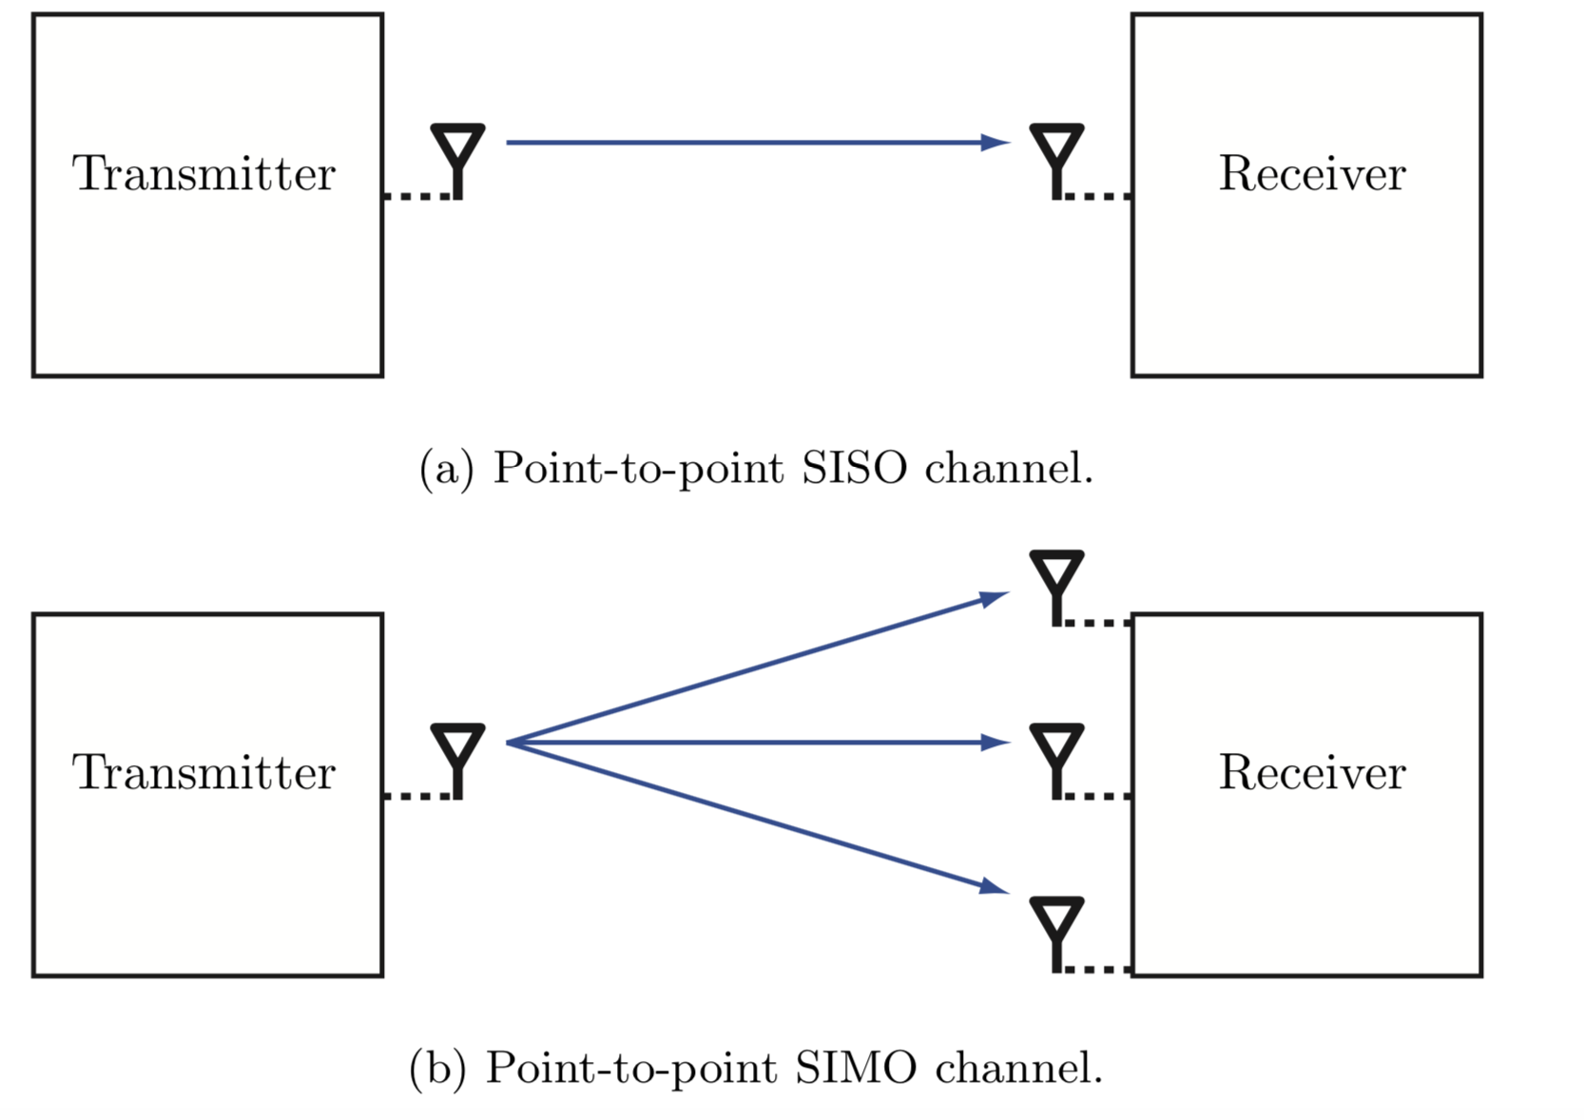
Taxonomy: Point-to-point channels
Single-input single-output (SISO)
Single-input multiple-output (SIMO)
Multiple-input single-output (MISO)
Multiple-input multiple-output (MIMO)

Slide 3
Outline of this lecture
Recap of SISO channel capacity
Capacity of SIMO and MISO channels
Channel models for line-of-sight channels
Beamwidth with uniform linear arrays

Slide 4

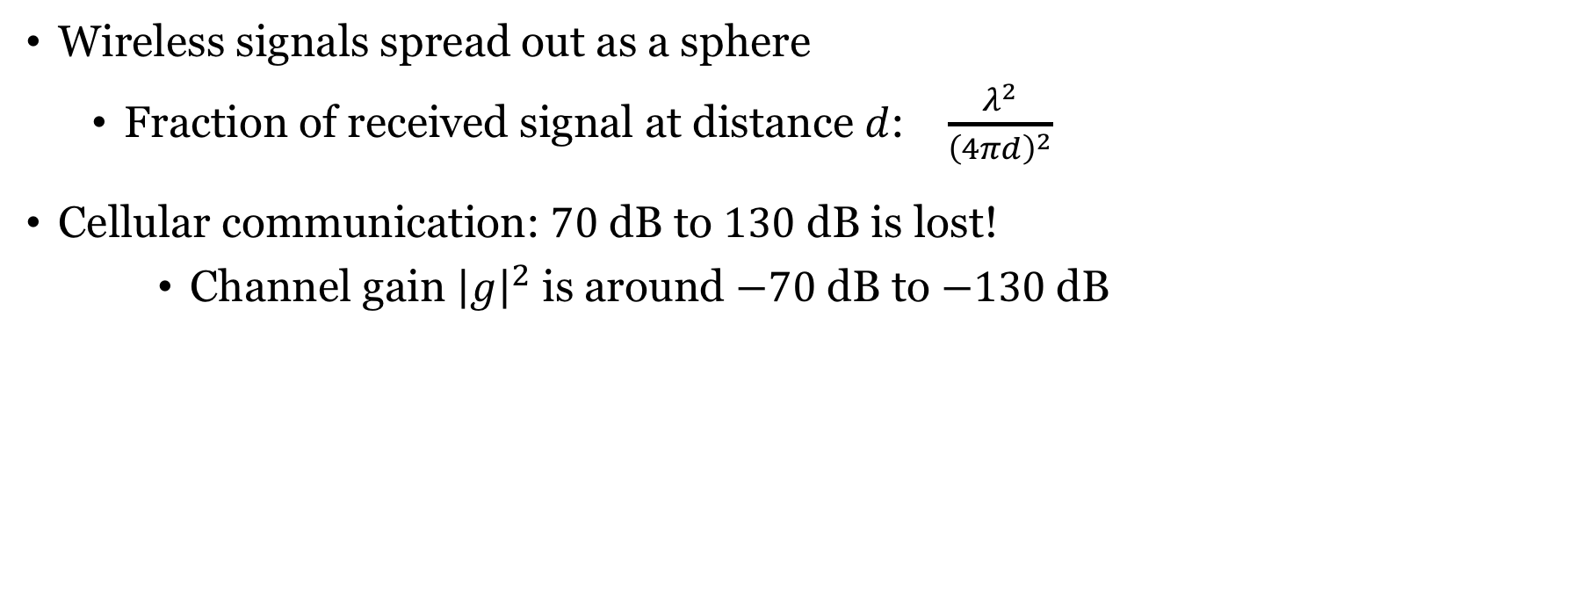



Not all transmit power is received
Wireless signals spread out as a sphere
Fraction of received signal at distance $d$: $\frac{λ^{2}}{{\left(4πd\right)}^{2}}$
Cellular communication: $70$ dB to $130$ dB is lost!
Channel gain ${\left|g\right|}^{2}$ is around $−70$ dB to $−130$dB
Also known as pathloss
$$n[l]$$
$$x[l]$$
$$g$$
+
$$y\left[l\right]=g⋅x\left[l\right]+n[l]$$
Channel response

Slide 5
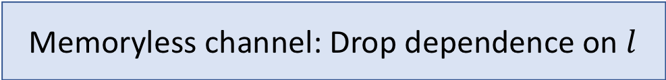
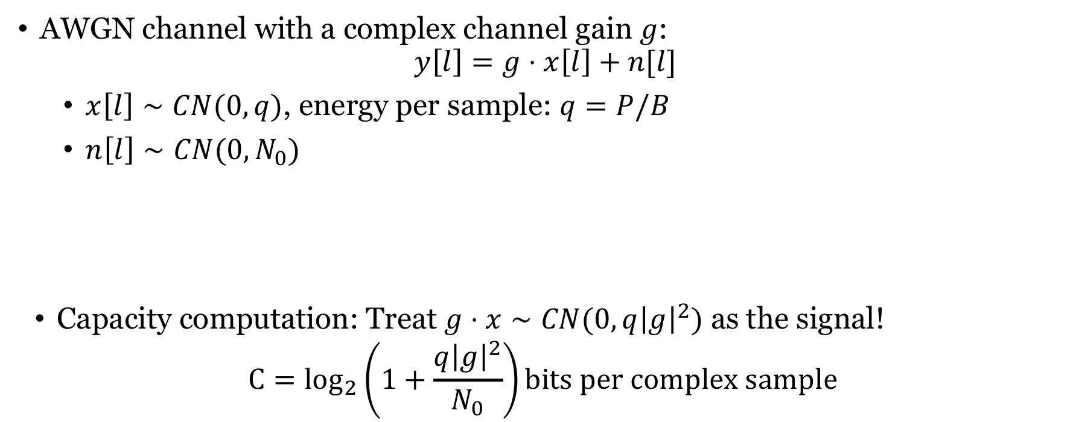
Capacity of memoryless SISO channel
AWGN channel with a complex channel gain $g$:
$$y\left[l\right]=g⋅x\left[l\right]+n[l]$$
$x\left[l\right]∼CN(0,q)$, energy per sample: $q=P/B$
$n\left[l\right]∼CN(0,N_{0})$
Capacity computation: Treat $g⋅x∼CN(0,q{\left|g\right|}^{2})$ as the signal!
$${C=log}_{2}\left(1+\frac{q{\left|g\right|}^{2}}{N_{0}}\right)bits per complex sample$$
Memoryless channel: Drop dependence on $l$
How can we increase the SNR?
Received SNR

Slide 6
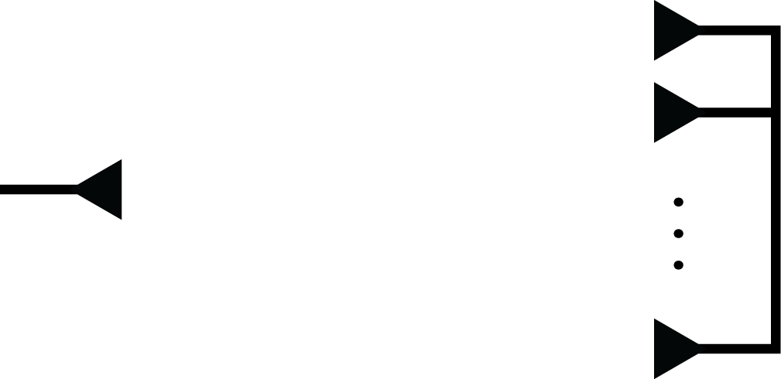




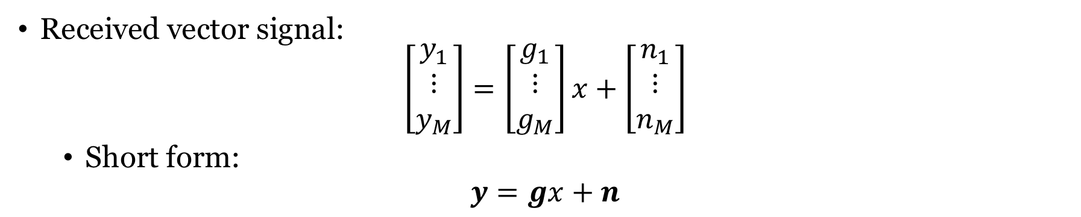







Single-input multiple-output (SIMO) channel
$$n_{1}$$
$$y_{1}$$
+
$$y_{2}$$
$$g_{1}$$
$$x$$
$$g_{2}$$
+
Noise: $n_{m}∼CN(0,N_{0})$
$$g_{M}$$
$$n_{2}$$
+
$$y_{M}$$
$$n_{M}$$
Received vector signal:
$$\left[\begin{matrix}y_{1} \\ ⋮ \\ y_{M}\end{matrix}\right]=\left[\begin{matrix}g_{1} \\ ⋮ \\ g_{M}\end{matrix}\right]x+\left[\begin{matrix}n_{1} \\ ⋮ \\ n_{M}\end{matrix}\right]$$
Short form:
$$y=gx+n$$

Slide 7
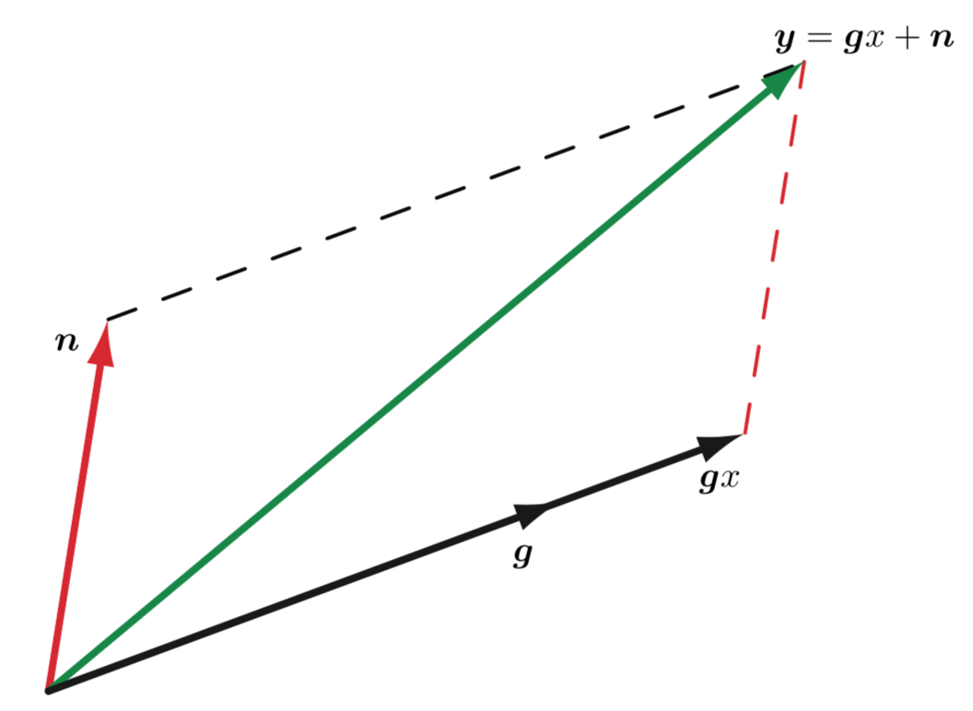

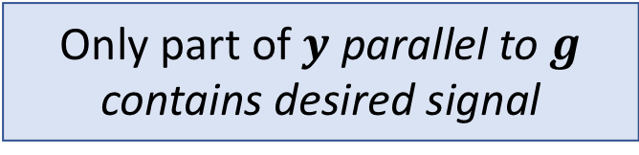
Geometry of received signal
Received vector $y$ is summation of
Desired signal $gx$
Noise vector $n$
Want to turn $y$ into an estimate of $x$
Only part of $y$ parallel to $g$ contains desired signal

Slide 8
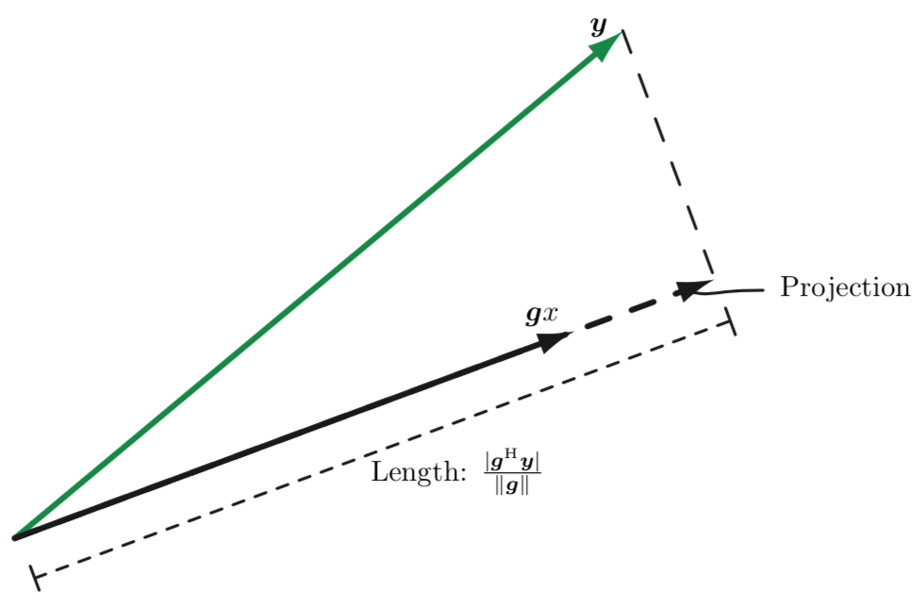
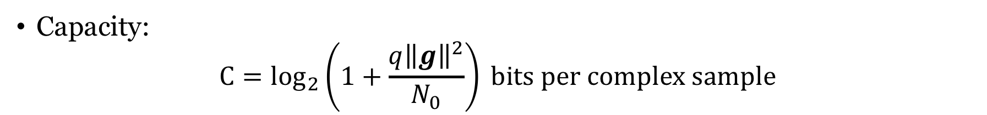
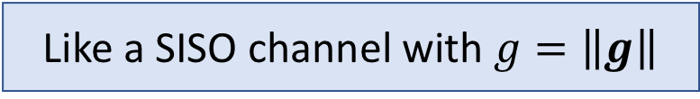
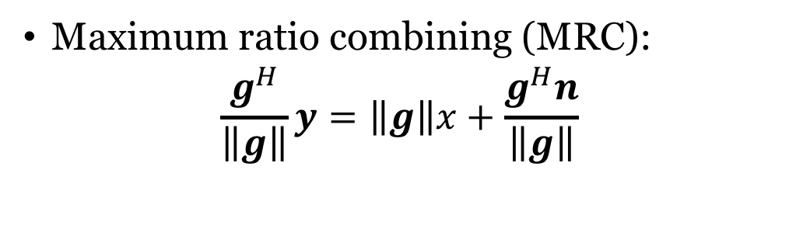
Capacity of SIMO channel
Maximum ratio combining (MRC):
$$\frac{g^{H}}{\left\|g\right\|}y=\left\|g\right\|x+\frac{g^{H}n}{\left\|g\right\|}$$
Combining vector
Scalar
Like a SISO channel with $g=\left\|g\right\|$
Capacity:
$${C=log}_{2}\left(1+\frac{q{\left\|g\right\|}^{2}}{N_{0}}\right) bits per complex sample$$

Slide 9





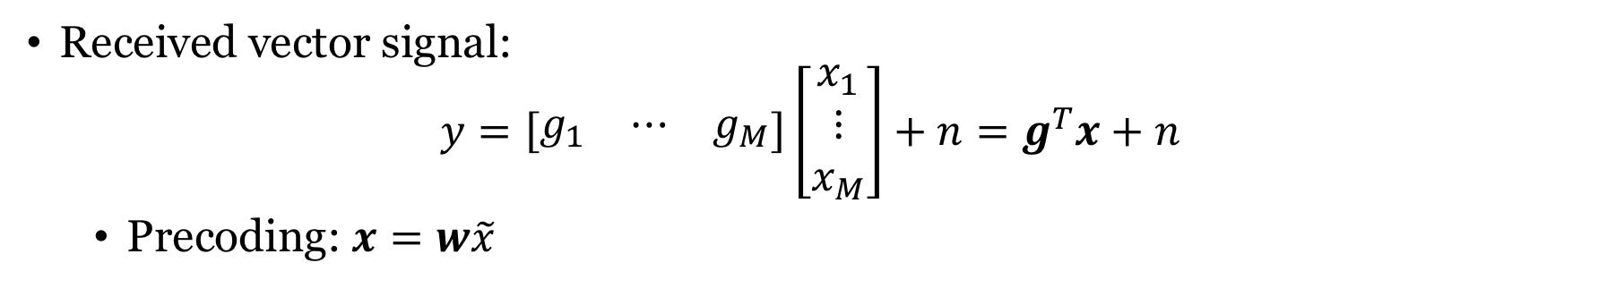




Multiple-input single-output (MISO) channel
$$x_{1}$$
$$g_{1}$$
$n$ $∼CN(0,N_{0})$
$$x_{2}$$
$$g_{2}$$
$$y$$
+
$$x_{M}$$
$$g_{M}$$
Received vector signal:
$$y=\left[\begin{matrix}g_{1} & ⋯ & g_{M}\end{matrix}\right]\left[\begin{matrix}x_{1} \\ ⋮ \\ x_{M}\end{matrix}\right]+n=g^{T}x+n$$
Precoding: $x=w\tilde{x}$
Information signal: $\tilde{x}∼CN(0,q)$
Unit-norm
precoding vector

Slide 10
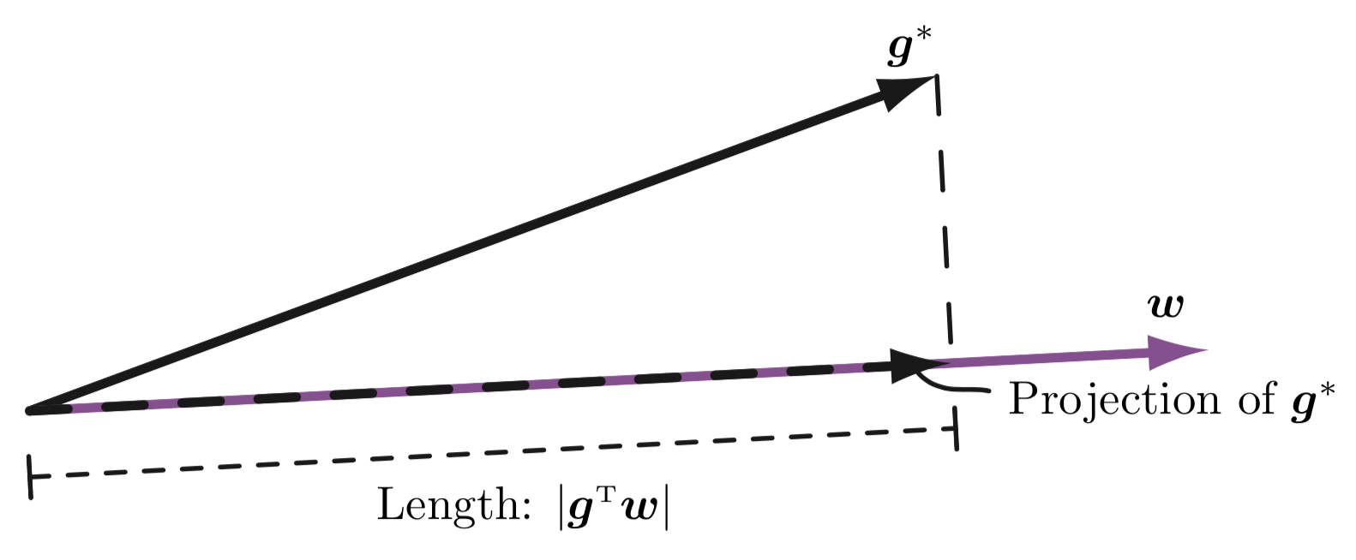
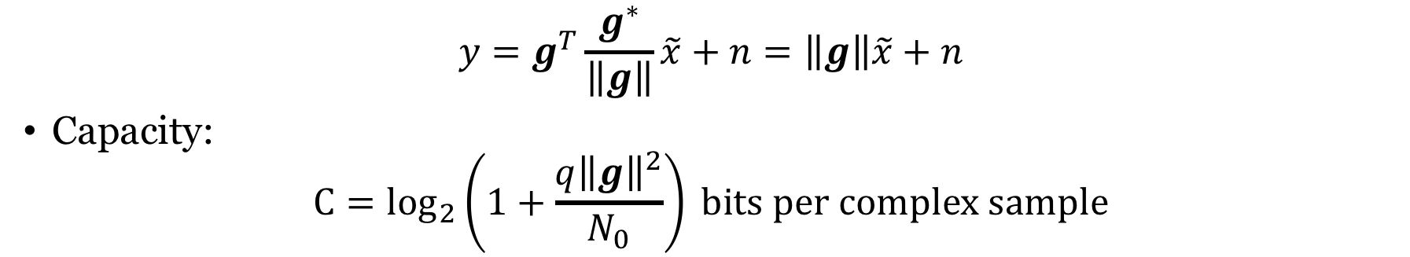
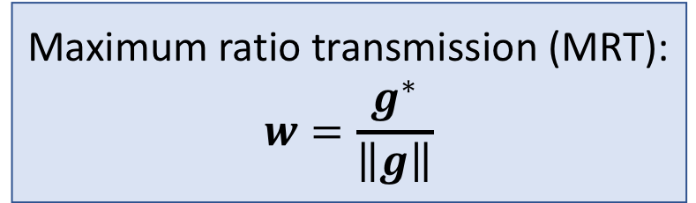
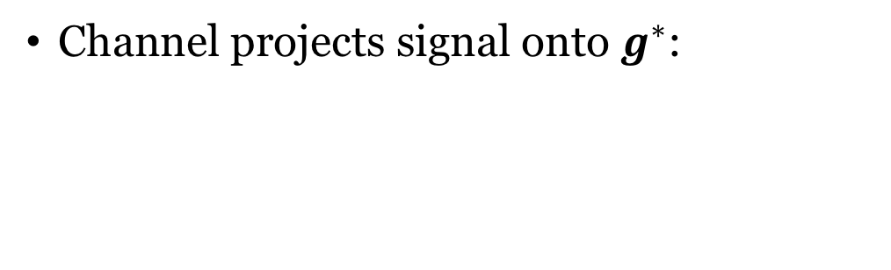
Geometry of received signal
Channel projects signal onto $g^{∗}$:
Maximum ratio transmission (MRT):
$$w=\frac{g^{∗}}{\left\|g\right\|}$$
$$y=g^{T}\frac{g^{∗}}{\left\|g\right\|}\tilde{x}+n=\left\|g\right\|\tilde{x}+n$$
Capacity:
$${C=log}_{2}\left(1+\frac{q{\left\|g\right\|}^{2}}{N_{0}}\right) bits per complex sample$$

Slide 11
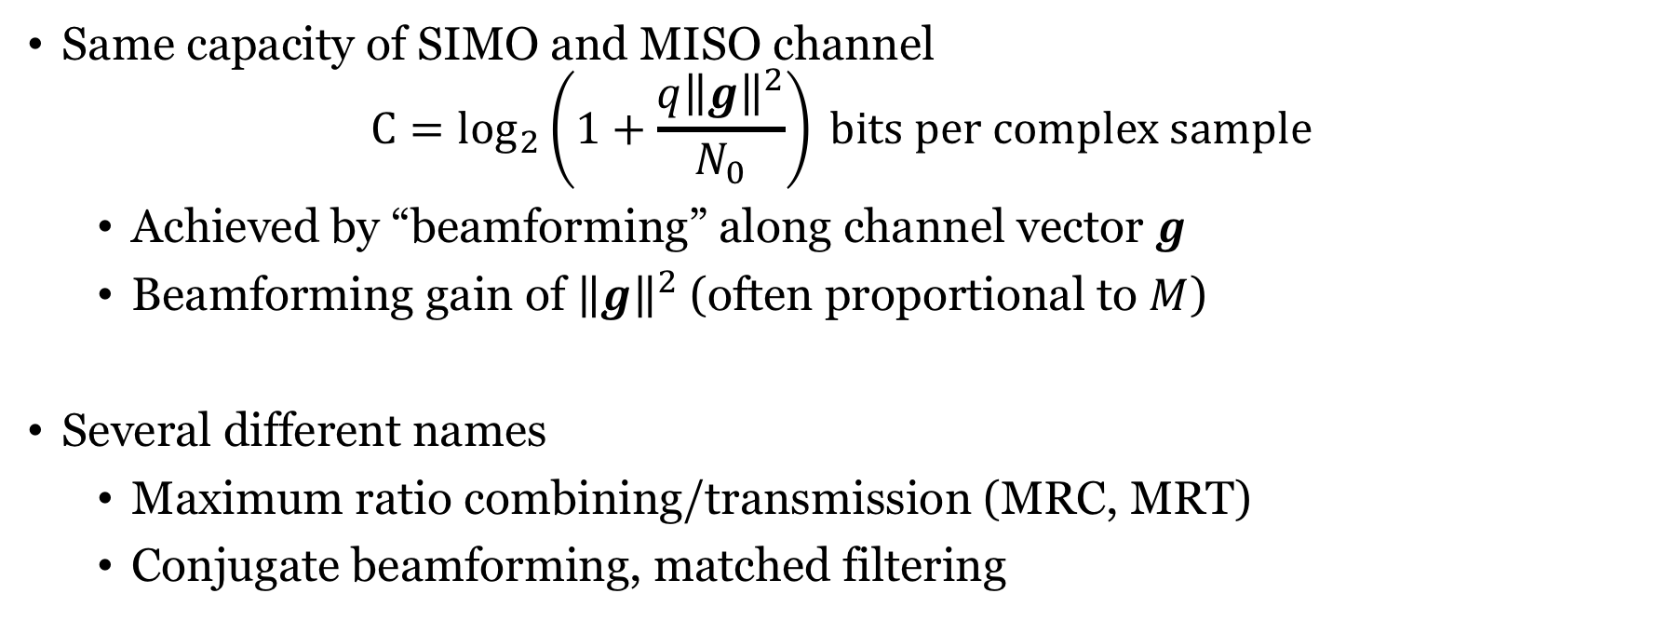
Receive and transmit beamforming
Same capacity of SIMO and MISO channel
$${C=log}_{2}\left(1+\frac{q{\left\|g\right\|}^{2}}{N_{0}}\right) bits per complex sample$$
Achieved by “beamforming” along channel vector $g$
Beamforming gain of ${\left\|g\right\|}^{2}$ (often proportional to $M$)
Several different names
Maximum ratio combining/transmission (MRC, MRT)
Conjugate beamforming, matched filtering

Slide 12
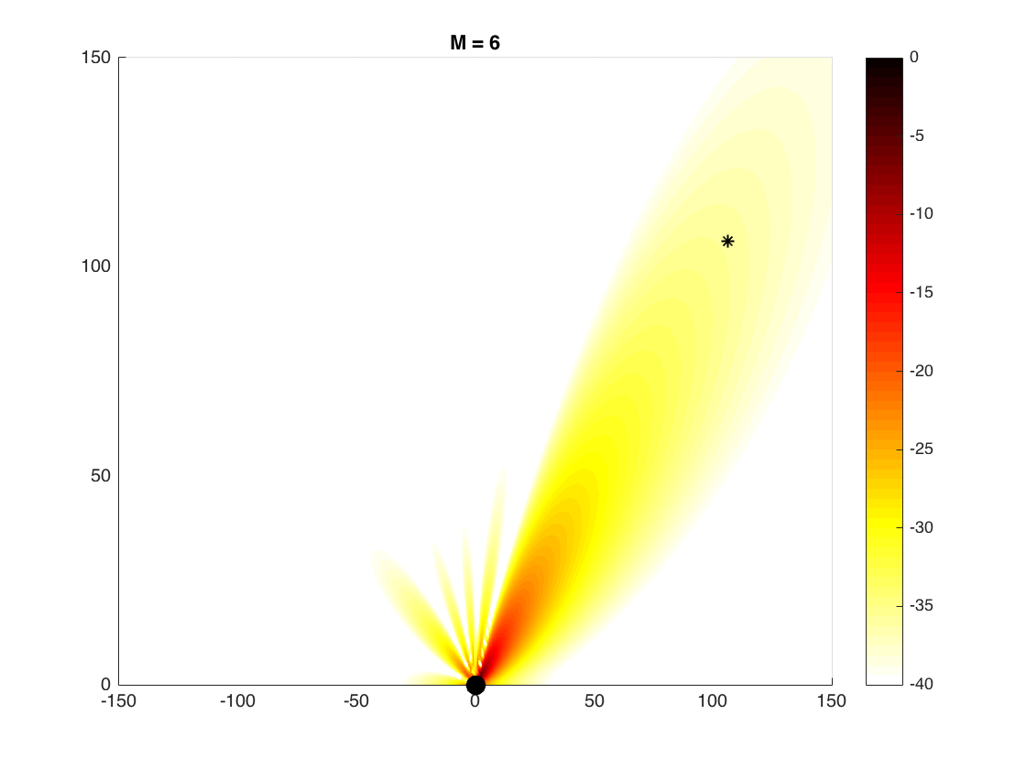

Transmit beamforming
Directivity $→$ Beamforming gain
Other names:
Array gain
Power gain

Slide 13
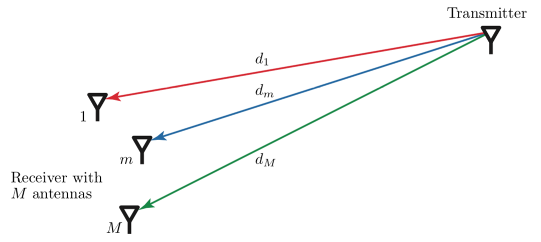
Free-space line-of-sight commmunication
Direct path between transmitter and receiver
No other paths
We will derive a channel model

Slide 14
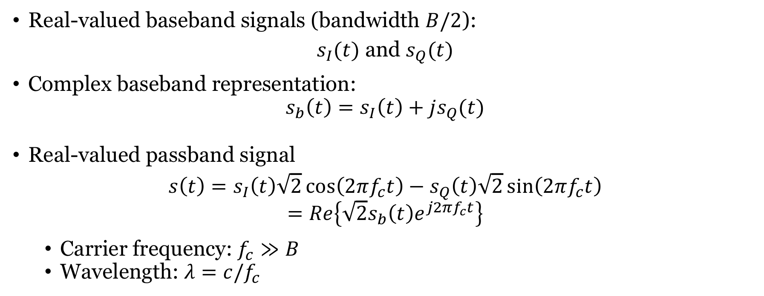
Complex baseband representation
Real-valued baseband signals (bandwidth $B/2$):
$s_{I}(t)$ and $s_{Q}(t)$
Complex baseband representation:
$$s_{b}\left(t\right)=s_{I}\left(t\right)+js_{Q}(t)$$
Real-valued passband signal
$$s\left(t\right)=s_{I}\left(t\right)\sqrt{2}\cos\left(2πf_{c}t\right)−s_{Q}\left(t\right)\sqrt{2}\sin\left(2πf_{c}t\right)$$
$$=Re\left\{\sqrt{2}s_{b}\left(t\right)e^{j2πf_{c}t}\right\}$$
Carrier frequency: $f_{c}≫B$
Wavelength: $λ=c/f_{c}$

Slide 15



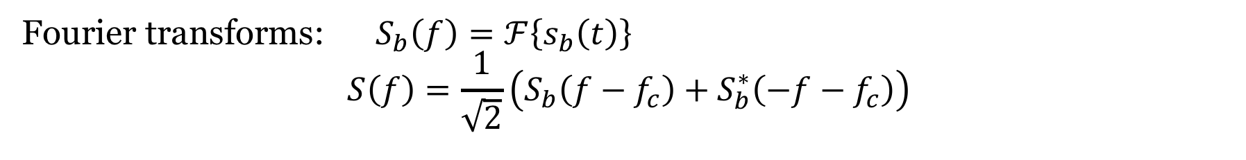




Complex baseband representation (2)
Fourier transforms: $S_{b}\left(f\right)=ℱ\left\{s_{b}\left(t\right)\right\}$
$$S\left(f\right)=\frac{1}{\sqrt{2}}\left(S_{b}\left(f−f_{c}\right)+S_{b}^{∗}\left(−f−f_{c}\right)\right)$$
$$S_{b}\left(f\right)$$
$$B/2$$
$$0$$
$$S\left(f\right)$$
$$B$$
$$−f_{c}$$
$$+f_{c}$$

Slide 16
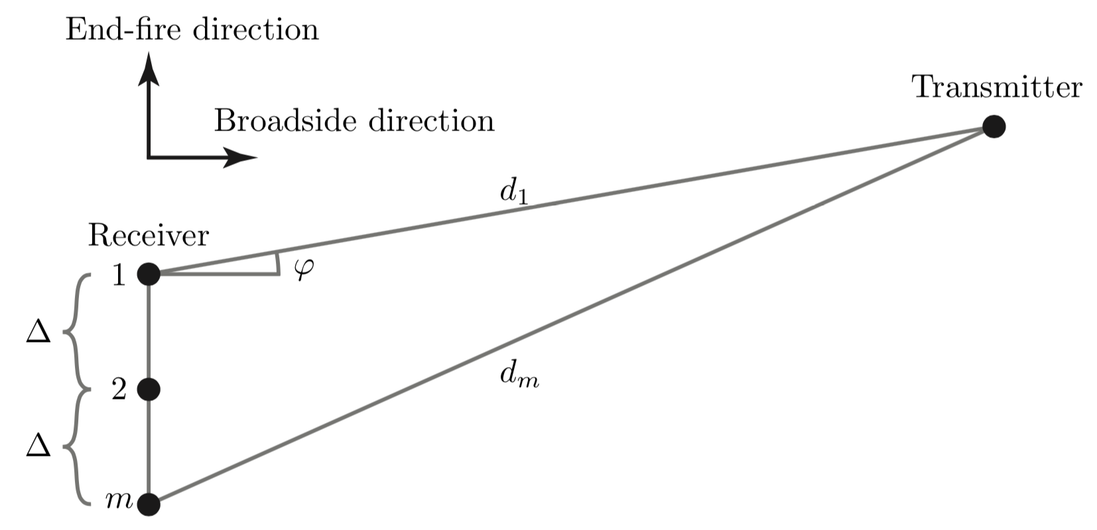
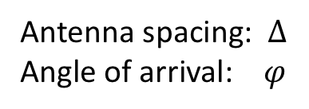
Uniform linear array (ULA)
Antenna spacing: $Δ$
Angle of arrival: $φ$

Slide 17
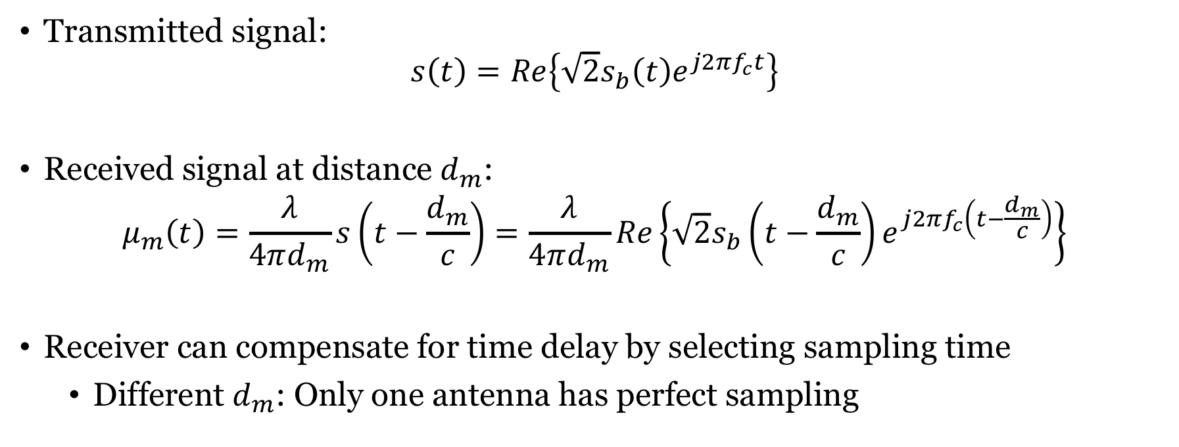
Impact of channel in complex baseband
Transmitted signal:
$$s\left(t\right)=Re\left\{\sqrt{2}s_{b}\left(t\right)e^{j2πf_{c}t}\right\}$$
Received signal at distance $d_{m}$:
$$μ_{m}\left(t\right)=\frac{λ}{4πd_{m}}s\left(t−\frac{d_{m}}{c}\right)=\frac{λ}{4πd_{m}}Re\left\{\sqrt{2}s_{b}\left(t−\frac{d_{m}}{c}\right)e^{j2πf_{c}\left(t−\frac{d_{m}}{c}\right)}\right\}$$
Receiver can compensate for time delay by selecting sampling time
Different $d_{m}$: Only one antenna has perfect sampling

Slide 18
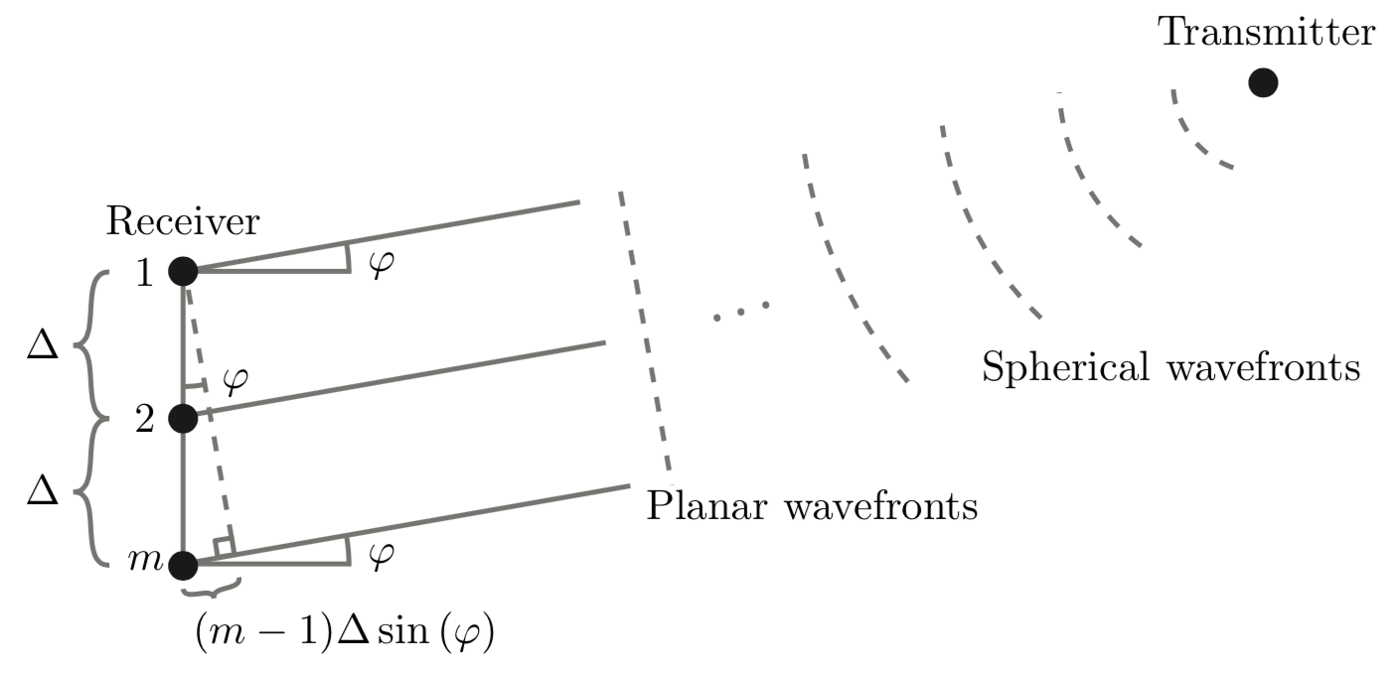


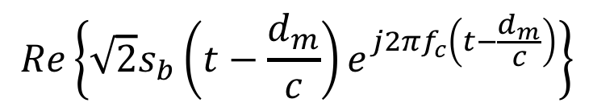

Far-field approximation
Distances $d_{1},…,d_{M}$ approximately the same
Approximately same channel gain:
$$\frac{λ^{2}}{{\left(4πd_{m}\right)}^{2}}≈\frac{λ^{2}}{{\left(4πd\right)}^{2}}$$
$$Re\left\{\sqrt{2}s_{b}\left(t−\frac{d_{m}}{c}\right)e^{j2πf_{c}\left(t−\frac{d_{m}}{c}\right)}\right\}$$
Sample at $t=\frac{d_{1}}{c}=\frac{d}{c}$

Slide 19
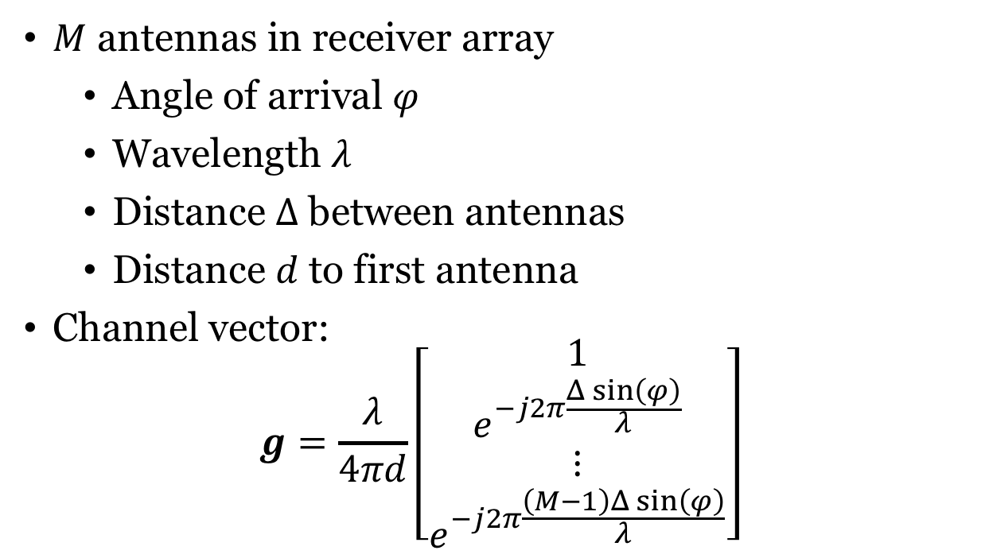
ULA channel model
$M$ antennas in receiver array
Angle of arrival $φ$
Wavelength $λ$
Distance $Δ$ between antennas
Distance $d$ to first antenna
Channel vector:
$$g=\frac{λ}{4πd}\left[\begin{matrix}\begin{matrix}1 \\ e^{−j2π\frac{Δ\sin\left(φ\right)}{λ}}\end{matrix} \\ \begin{matrix}⋮ \\ e^{−j2π\frac{\left(M−1\right)Δ\sin\left(φ\right)}{λ}}\end{matrix}\end{matrix}\right]$$
Applies to both SIMO and MISO channels

Slide 20
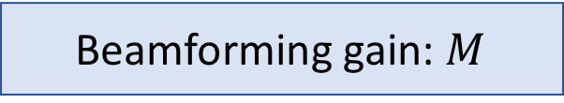

Channel capacity with line-of-sight channel
Recall:
$${C=log}_{2}\left(1+\frac{q{\left\|g\right\|}^{2}}{N_{0}}\right) bits per complex sample$$
We have ${\left\|g\right\|}^{2}=βM$ where $β=\frac{λ^{2}}{{\left(4πd\right)}^{2}}$:
$${C=log}_{2}\left(1+\frac{qβM}{N_{0}}\right)$$
Beamforming gain: $M$

Slide 21
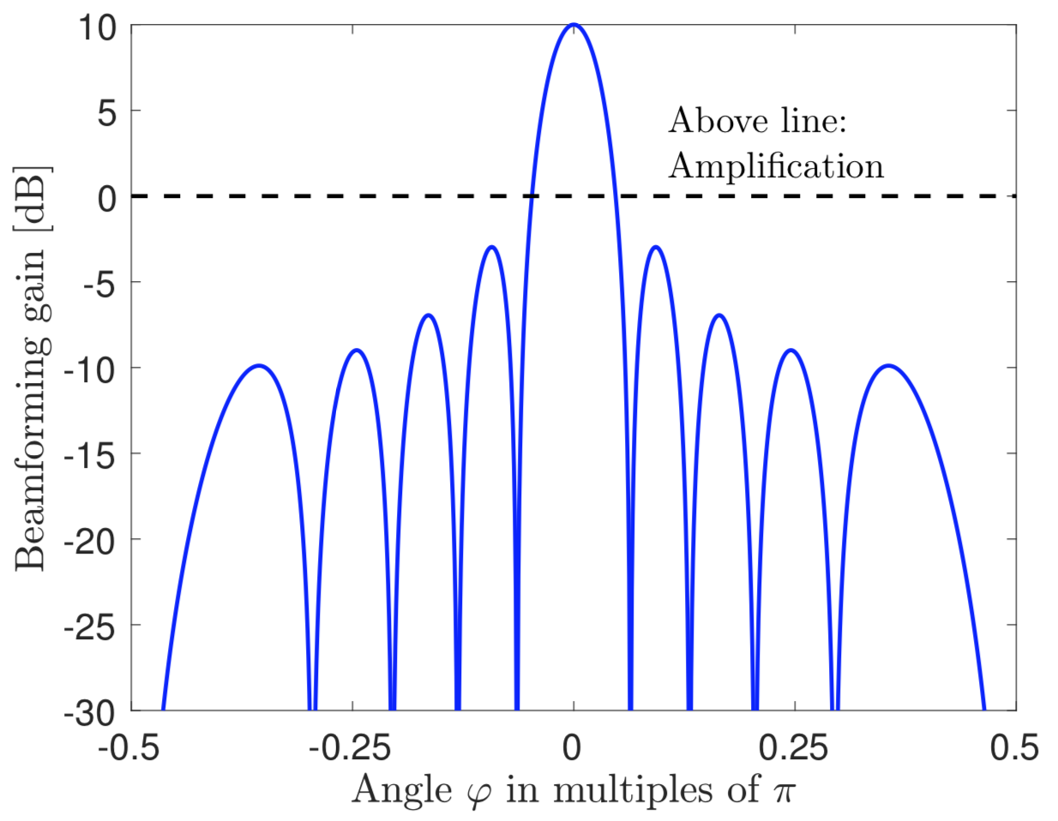
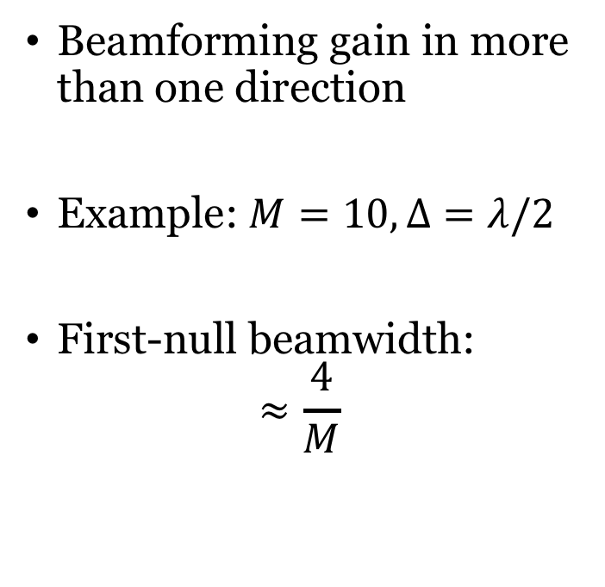
Beamwidth
Beamforming gain in more than one direction
Example: $M=10, Δ=λ/2$
First-null beamwidth:
$$≈\frac{4}{M}$$
More antennas:
Narrower beams

Slide 22
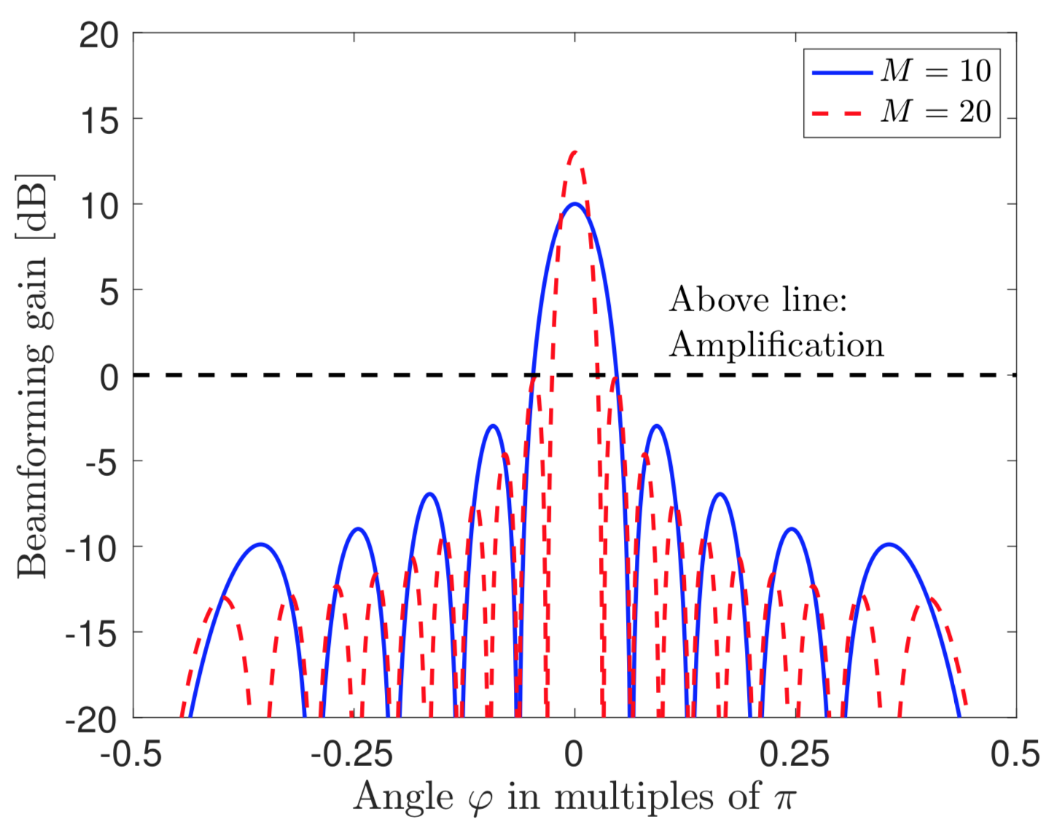
Two benefits of beamforming
Beamforming gain
Stronger signal at desired location
Narrower beam
Less interference at undesired locations

Slide 23
End of Lecture 2
TSKS14 Multiple Antenna Communications

